Slide 1
Empowering Content Authors in Maintaining Accessible Web-Based Content

Slide 2
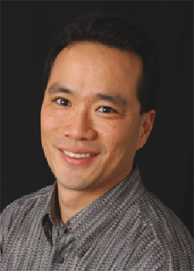
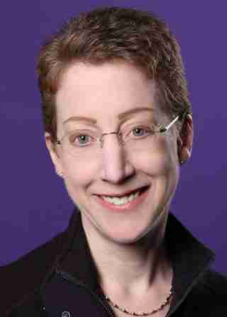
Who is Converge Accessibility?
Jeff Singleton
Ken Nakata
Laura Ruby

Slide 3
Our Services
Web Site Reviews
Mobile Apps
Hardware & Software
Accessibility Complaints
ADA, Accessibility, & Procurement Policies

Slide 4
Our Topic Today
“Maintaining Day-to-Day Accessibility in a CMS”

Slide 5
Are You a Content Author?
How many of you are responsible for creating, adding, or updating website content?
What is your role regarding accessible content?
What do you hope to gain from this presentation?

Slide 6
Content Management Systems (CMS)

Slide 7
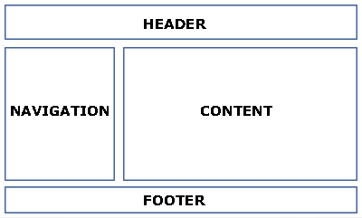
What Makes a CMS?

Slide 8
CMS Header

Slide 9
CMS Navigation

Slide 10
CMS Footer

Slide 11
CMS Content

Slide 12
Content Author's Area of Responsibility

Slide 13
Where’s the Love?

Slide 14
The Solution – Part 1
Know what the CMS allows for content.

Slide 15
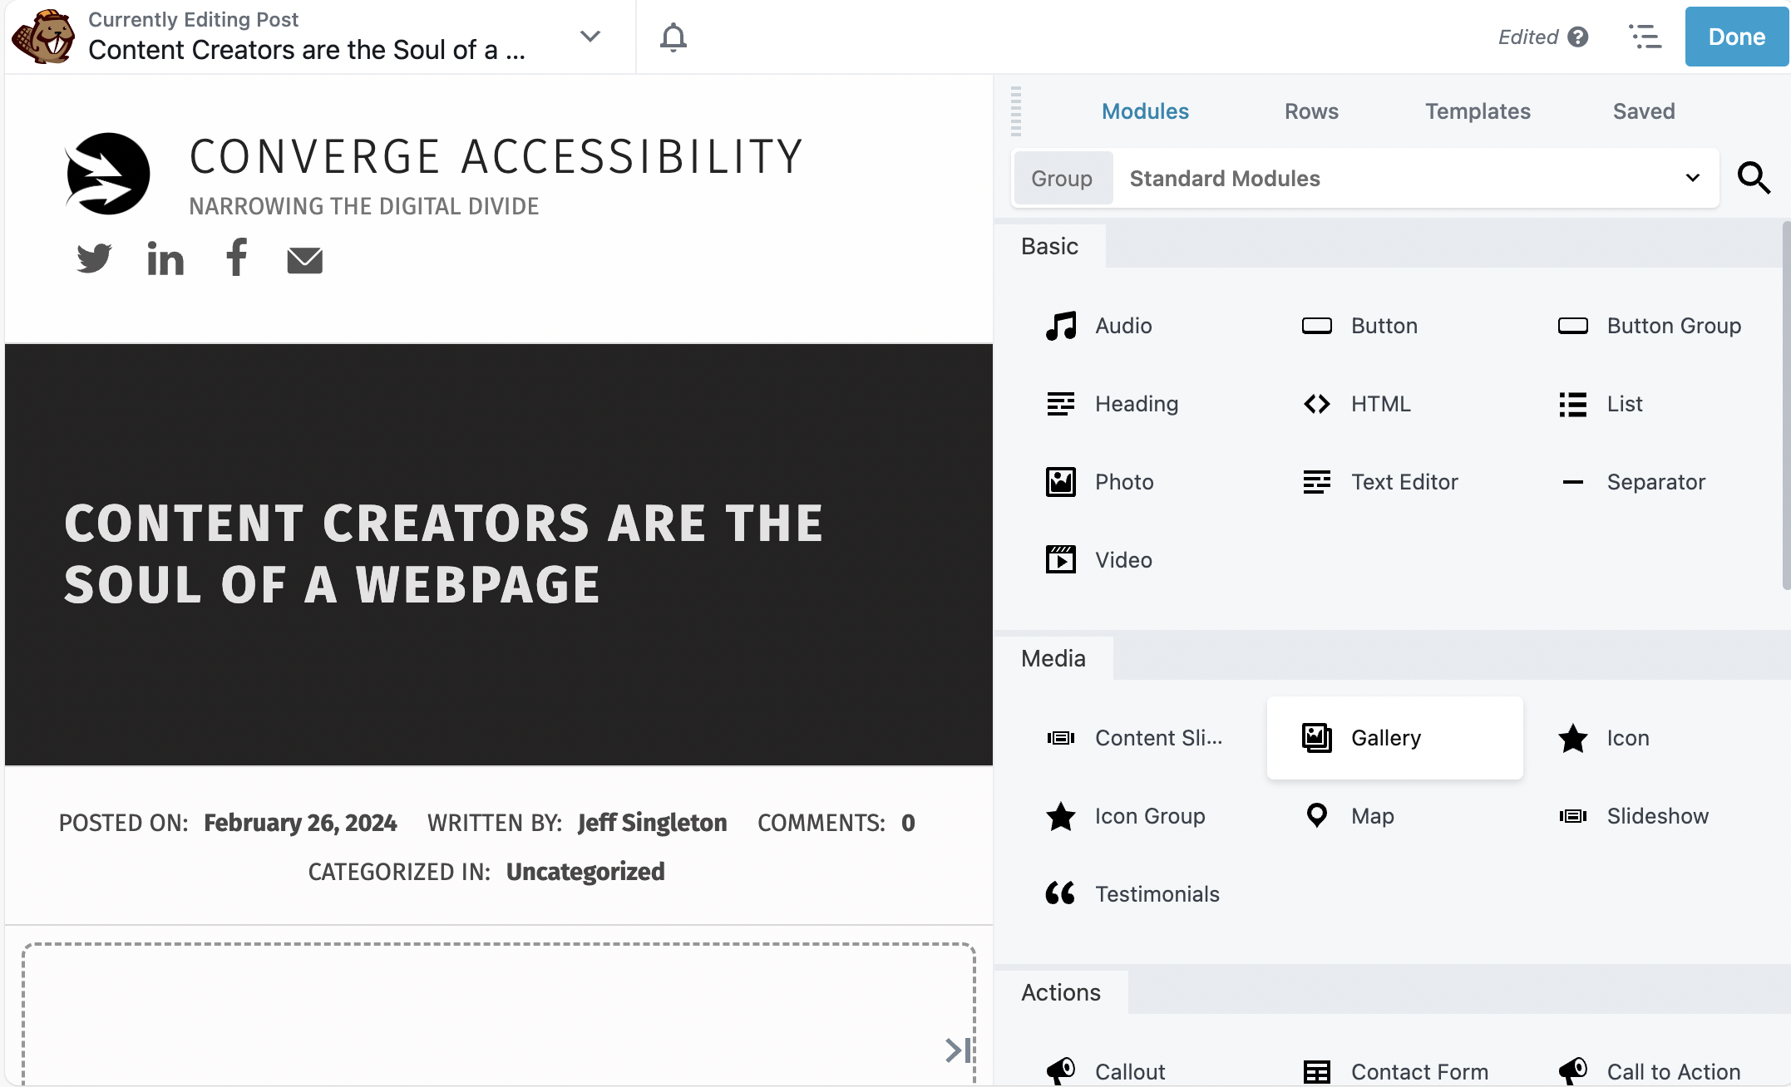
WordPress Beaver Builder Example

Slide 16
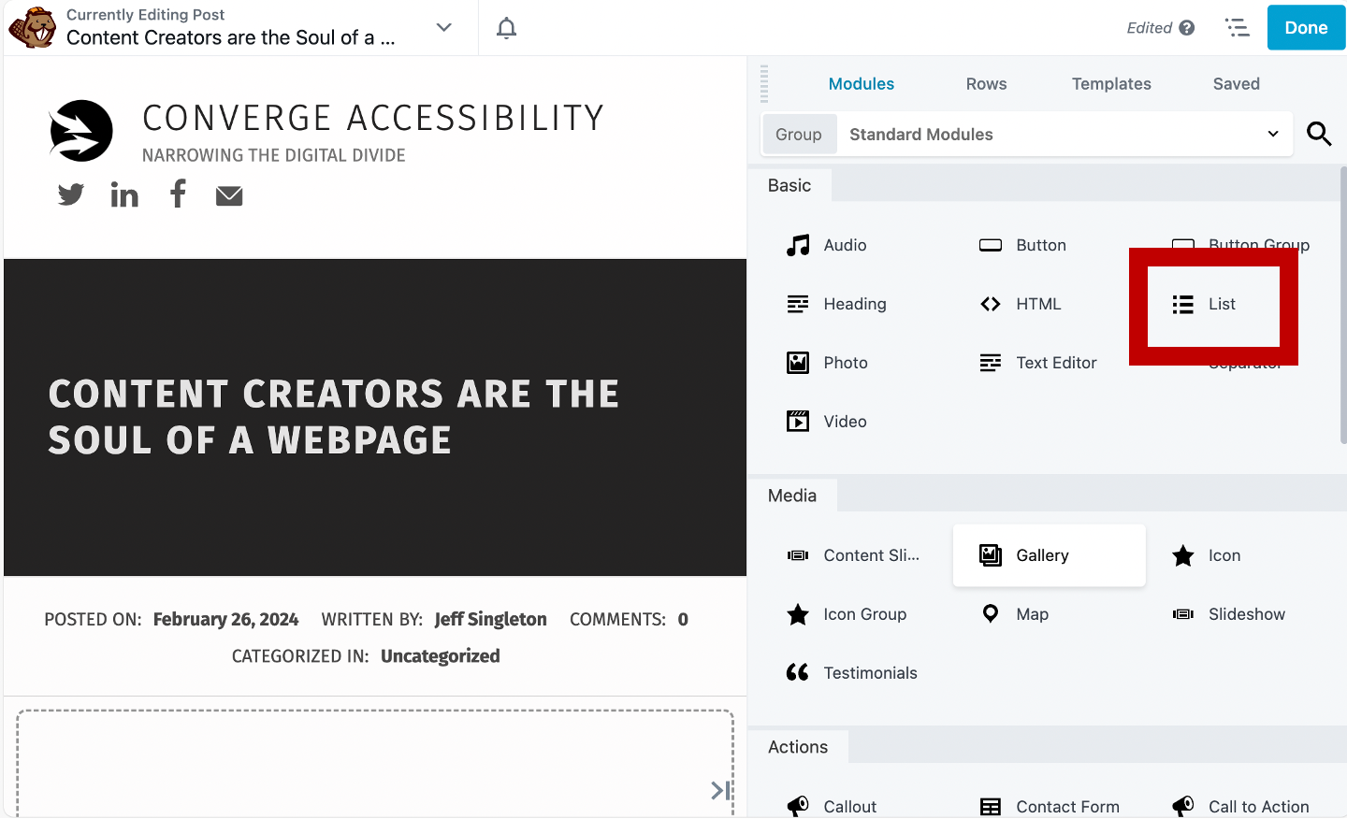
WordPress Beaver Builder (List Module)

Slide 17
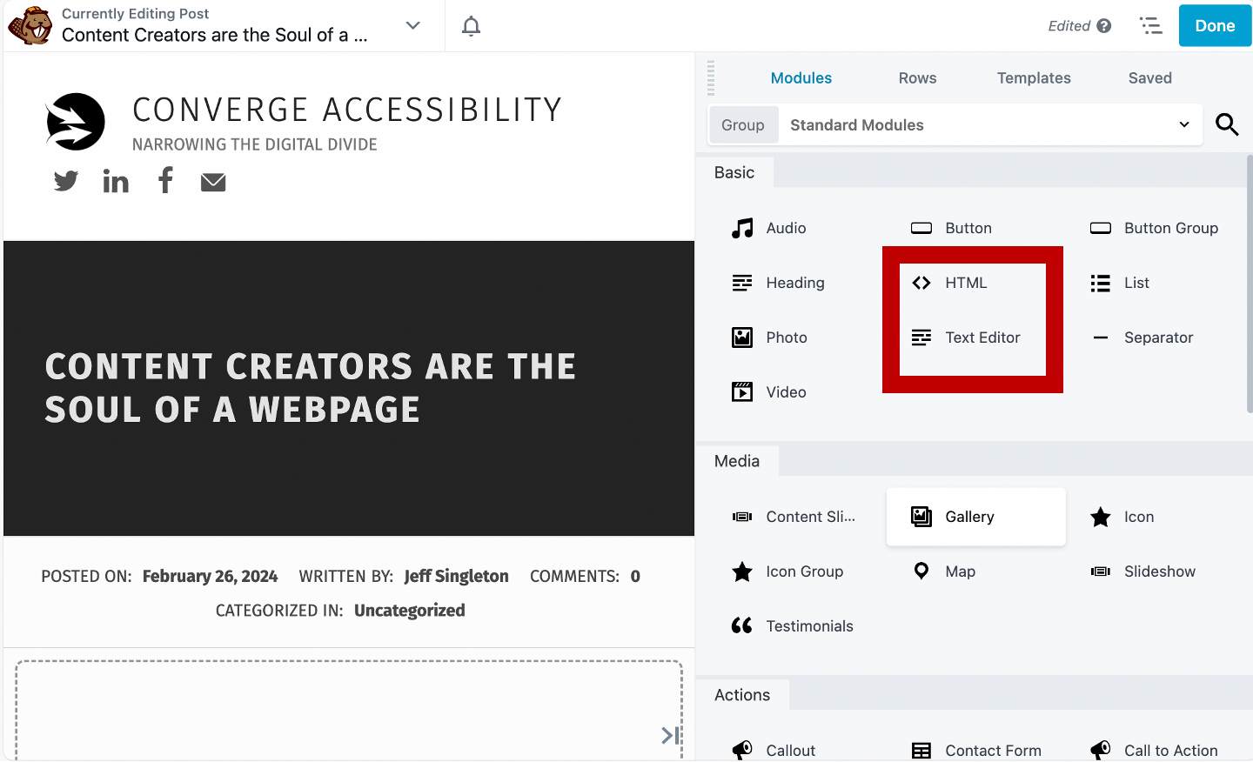
WordPress Beaver Builder (HTML & Text)

Slide 18
The Solution – Part 2
Headings
Tables (Data and Layout)
Alternative Text (for Images)
Contrast
Lists (Bulleted or Numbered)
Link Text

Slide 19
DEMO!!!

Slide 20
Thank You!
Jeff Singleton
jeffrey.singleton@convergeaccessibility.com
Questions?

