Slide 1
Collaboration, not Contention

Slide 2
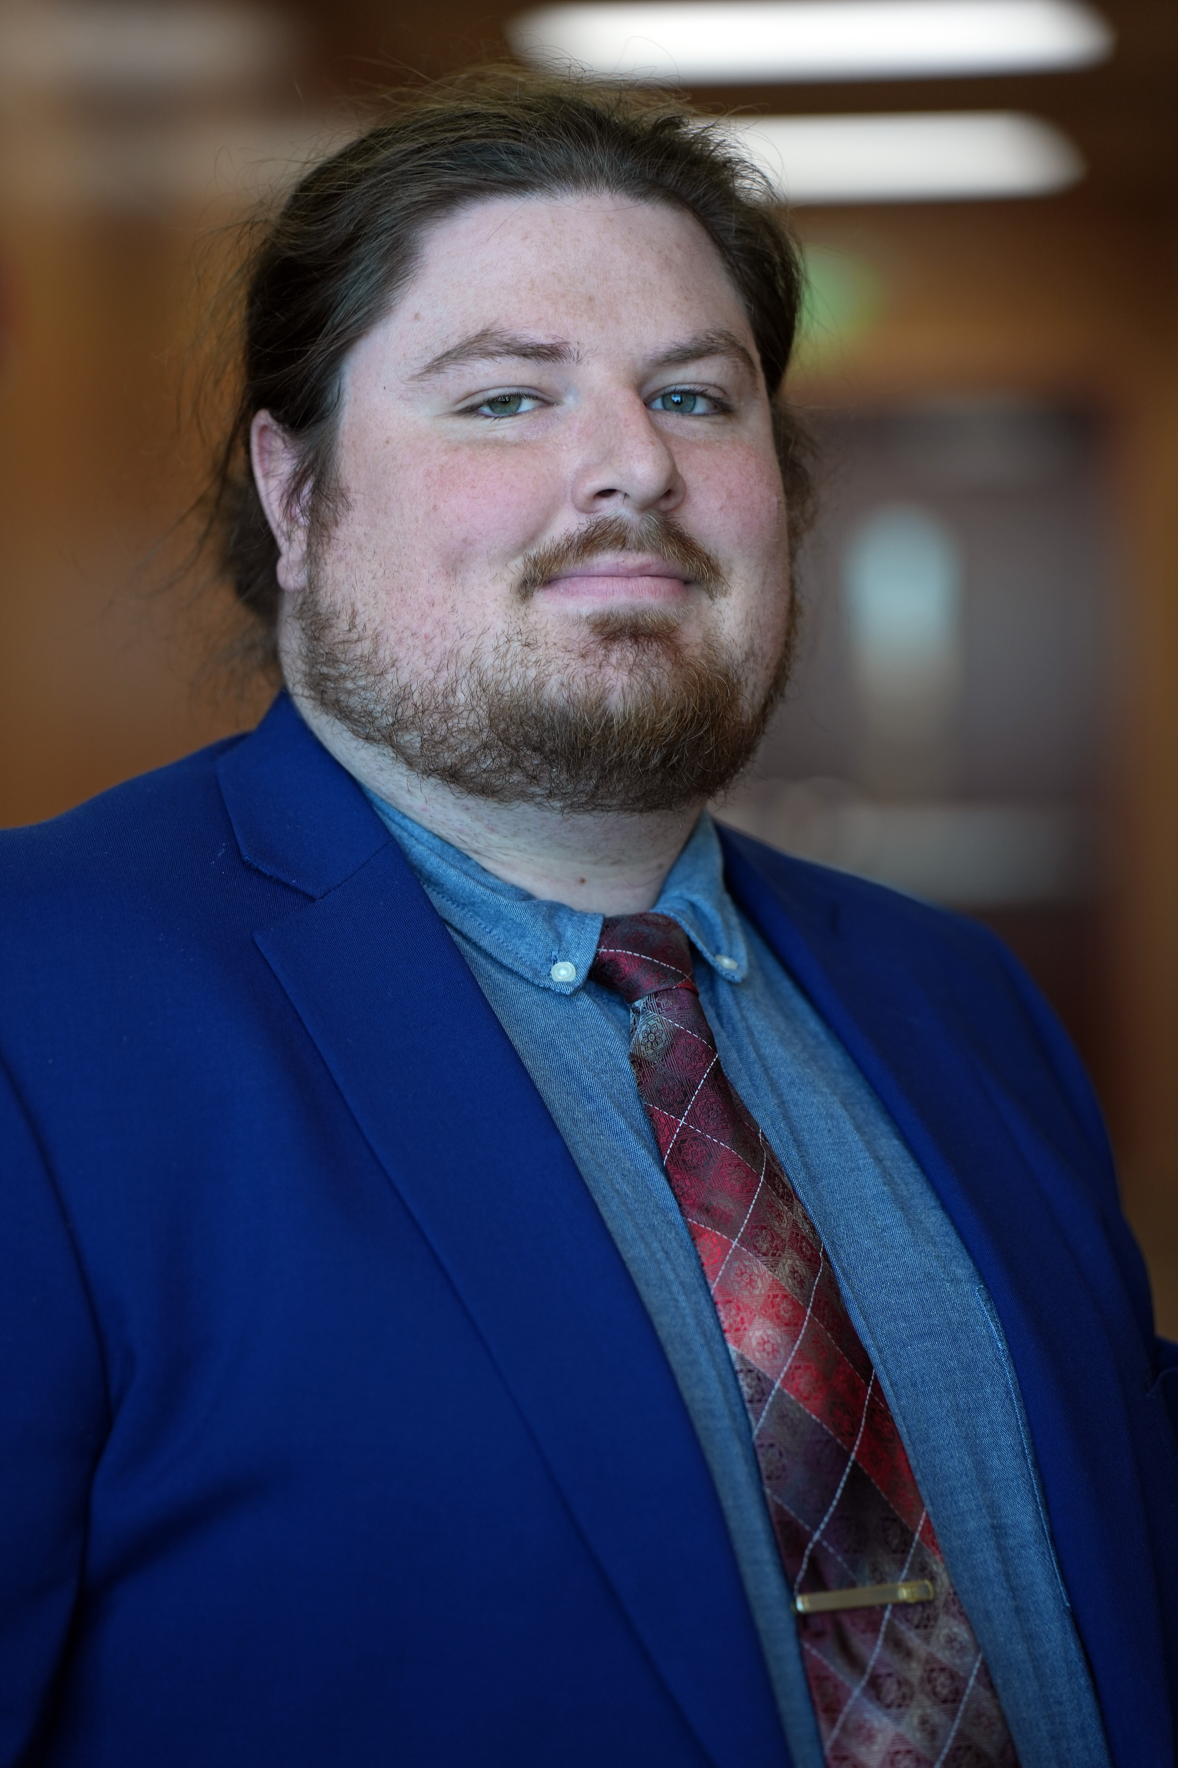
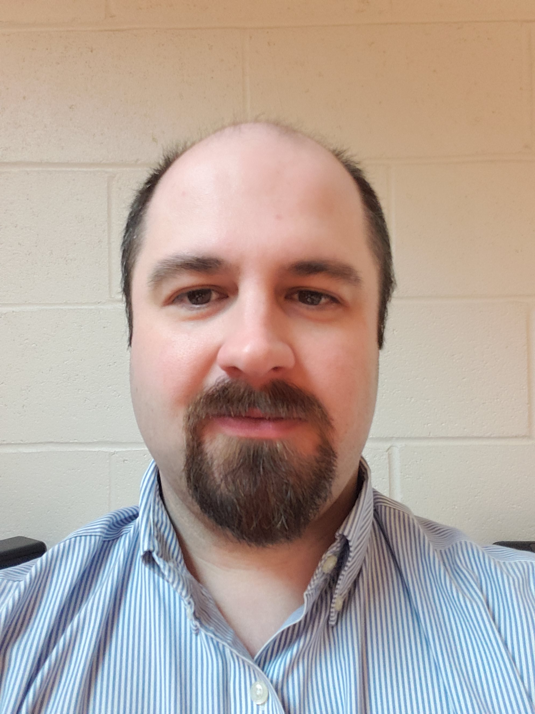
Introductions
Kennedy Zimnik
Access Technology Specialist, National Federation of the Blind
6 years at the NFB
Experience with tactile graphic creation and design
A current Subject Matter Expert for the NFB
Stephen Polacek
Director of IT Accessibility Policy & Programs, MDOD – MDTAP
Certified Trusted Tester
Received 3 months of blindness independence skills training
A Current Subject Matter Expert for State of Maryland

Slide 3
About the National federation of the Blind
The National Federation of the Blind knows that blindness is not the characteristic that defines you or your future. Every day we raise the expectations of blind people, because low expectations create obstacles between blind people and our dreams. You can live the life you want; blindness is not what holds you back.
•Founded in 1940 - Oldest and largest organization of blind people
•Affiliates in each state, DC, and Puerto Rico
•Special interest divisions (e.g. computer science)
•Provides a vehicle for collective action by the blind
•Drives innovation through the practical experience of the blind

Slide 4
MDOD and NFB relationship
Maryland Department of Disabilities (MDOD) and the National Federation of the Blind (NFB) started the Nonvisual Accessibility Initiative (NVAI) in 2018
Center of Excellence in Nonvisual Accessibility (CENA) is the NFB's access tech department

Slide 5
MDOD and NFB relationship
Cont.
Programs under NVAI
Access to Education Technology and Strategies
Access to Employment-Related Tools and Services
Accessibility Boutiques and Half Day Seminars
Integration of Smart Technologies for Accessible Cities
Accessibility Inclusion Fellowship Program
CENA provides monthly reports to MDOD

Slide 6
Access to Education
Create an accessible environment for students
Materials
Documents
Videos
LMS accessibility
Teaching strategies
Not relying on visual language
Clearly defined instructions
Providing alternate modes of information
Maryland Equivalent Access Requirements for Students with Disabilities (§ 7-910)
Four training modules
Intro to digital accessibility, How to read a VPAT, Accessibility testing principals, Accessibility testing demonstrations
MD Open-Source Textbook (MOST) Supporting Digital Accessibility for Learning conference

Slide 7
Access to Employment
70% of blind adults are unemployed (from 2016)
Accessibility in all aspects of employment
Job search + application process
Interview techniques for both applicant and employer
Self-advocacy as an employee
MD DOL training
Boutiques and trainings
Job seeking websites
In-depth look at LinkedIn
How to work from home as a blind person
Myth busting employment panel

Slide 8
Accessibility Boutiques and seminars
One of the biggest programs under NVAI
Monthly 90 min boutiques on a wide variety of accessibility topics
Intro to accessibility, web testing, PDF creation, accessibility in the classroom
Quarterly four-hour seminars on large accessibility topics
Using Collaborative tools and meeting platforms, Accessible device showcase, Artificial Intelligence (AI) and accessibility
Average of 130 participants from all over the country
Free for anybody, questions and discussion
NFB.org/CENA

Slide 9
Accessible Smart cities
Tools and tech that allow blind people to live, work, and play in their environments
Orientation and Mobility
Mobile applications
Public transportation
Accessible train stations
Spin to be seen
Relationship with MDOT (MD department of transportation)
Kiosks
Freedom scientific kiosk
DMV kiosk at national center

Slide 10
Accessibility Inclusion fellowship
Work with university and community college professors to make their courses accessible
Wide variety of subjects
Biology, Statistics, Sociology
Nonvisual teaching techniques
Teaching students to incorporate accessibility in the materials they produce
In-person presentations from CENA
Class of four fellows per school year

Slide 11
Getting Started

Slide 12
Starting Projects
Access to Education: Host a staff development days and request training on lived experience
Access to Employment: Request user testing to get feedback on new tools or apps
Accessibility Seminars: Invite guest speakers to classes and events
Smart Cities: Develop accessible campus maps and AT in classrooms
Accessibility Fellowship: Build internships or host summits

Slide 13
Include Those With Disabilities

Slide 14
CENA – ITAI Evaluations
ITAI provides accessibility evaluations to other state agencies
NFB CENA receives complaints or notifications from members, reviews, and passes them along
ITAI tracks remediation progress and sends updates to CENA to inform constituents of expected updates
CENA helps explain blind and low vision needs to vendors (lived experience)

Slide 15
MDTAP’s Connections
AT Tech Act Program
Other state's AT programs
Centers for Independent Living
MDTAP Advisory Council
NFB Executive
Veteran Advocate
Constituent with a disability
Policy directors at MTAP will work with other organizations on policy and bills
Disability Rights Maryland – Plain Language Initiative
Maryland Developmental Disabilities Council – Inclusive Playgrounds
Assisting agency and advocate communications
Department of Transportation – NFB of Maryland – feedback on apps

Slide 16
Benefits of Participation
Agencies
Advocates
Get actionable feedback
Organize better communication with constituents
Earn trust
Talk to those with the same goals
Feel like they are getting results
Don't need lawsuits to accomplish something

Slide 17
University Events

Slide 18
Collaborative Events
Maryland Open-Source Textbook (MOST) conference
Smart Cities Summit
Train the Trainers
Digital Equity Summit
Inclusive Publishing Conference
Teachers of Tomorrow
Maryland Initiative for Digital Accessibility (MIDA)

Slide 19
Future efforts
Teachers of Tomorrow with access tech focus
Transformative seminar for K-12 teachers
Introduction to digital accessibility in the classroom
Blindness skills, Orientation and Mobility (O&M)
Continued collaboration with the University System of MD (USM)
Teams from past events come share successes
Employment and career fair
Invite employers from around MD
Employer panel
Accessibility education

Slide 20
References and Contact
Kennedy Zimnik
Email: kzimnik@nfb.org
Phone: 410-659-9314 ext. 2235
Website NFB.org/CENA
Stephen Polacek
Email: stephen.polacek@maryland.gov
Phone: 410-554-9481
Website: mdod.maryland.gov or mdtap.org

