Slide 1
Our Journey to Creating an Accessible Procurement Process
Jen Bethmann, Web Accessibility Coordinator, Technology Solutions
Tammie Keney, Director of Student Access and Accommodation Services
Stacy Brown, Associate Director of Purchases

Slide 2
How We Started
Connects made between departments
WEB/Technology Solutions
Purchasing
Student Access Accommodation Services (SAAS)
General Council
ADA coordinator/ Office of Equal Opportunity and Access (OEOA)
Getting buy in from direct leadership

Slide 3
Current Procurement Process
Multiple laws in the state of Illinois
Note the accessibility statement in contracts
Historically certification state law “any tech has to comply with IITAA” but in 2022 procurement relief law regulated the procurement process under 50,0000. Changed law, no longer applicable for smaller contracts, rewrote
Accessibility Review Process
Ultimately who takes on the risk?
Requesting Department – acknowledge/accept risk, accommodation plan
Campus-wide – Accessibility Review Committee, Provost

Slide 4
Who is on the review committee?
Technology Solutions
Chief Information Officer
IT Business office
Web Accessibility Coordinator
Student Access and Accommodation Services
Office of Equal Opportunity and Access
Legal/General Counsel
Purchasing
Faculty Research
Academic Affairs and Provost
President’s Cabinet

Slide 5
Addendum Language
Technology Accessibility: This applies to information technology contracts and is otherwise not applicable. Vendor certifies that information technology, including electronic information, software, systems and equipment (including websites and mobile applications), developed or provided under this contract comply with the applicable requirements of the Illinois Information Technology Accessibility Act Standards as published at (www.dhs.state.il.us/iitaa) 30 ILCS 587. Illinois' IITAA accessibility standards exactly match the United States' Section 508 Standards and the World Wide Web Consortium's Web Content Accessibility Guidelines (WCAG) 2.0 Level AA. In the event that an accessibility assessment conducted or obtained by Vendor reveals an issue of non-compliance, Vendor will endeavor to correct the issue.
Notes:
The state requires that technology contracts include this language, but recent law changes made it no longer required for small dollar contracts, so we incorporated it elsewhere.

Slide 6
Accessibility Review
Internet Search
Find Voluntary Product Accessibility Template (VPAT), if not provided
Vendor’s information
Accessibility related
Keyboard shortcuts
Public information
Other universities
Customer reviews
VPAT
Who wrote the VPAT?
How detailed is the report?
Manual Reviews
Who is using product?
How many people are using it?
Notes:
Content of Accessibility Notes: Accessibility Notes – [Product Name]
Review Date(s):
Requested by (First Last, email):
Department:
Reviewer(s):
Jen Bethmann (jbbeth1@ilstu.edu)
Vendor:
URL:
Previous Reviews
Previous Review Date(s):
Initial Questions
Product Description:
Who will use this product?
☐ Students ☐ Faculty ☐ Staff ☐ Campus-wide/public ☐ Lab School
This software request for:
☐ Course/Instructional ☐ Research ☐ Something Else
How many people will see/use this product?
Is this product used primarily on:
☐ Desktop ☐ Mobile
Particular features used? Major tasks required for use?
This technology is:
☐ Required ☐ Optional ☐ Unknown
Special Instructions
Internet Search
Searched terms “Product Name” + “accessibility.”

Slide 7
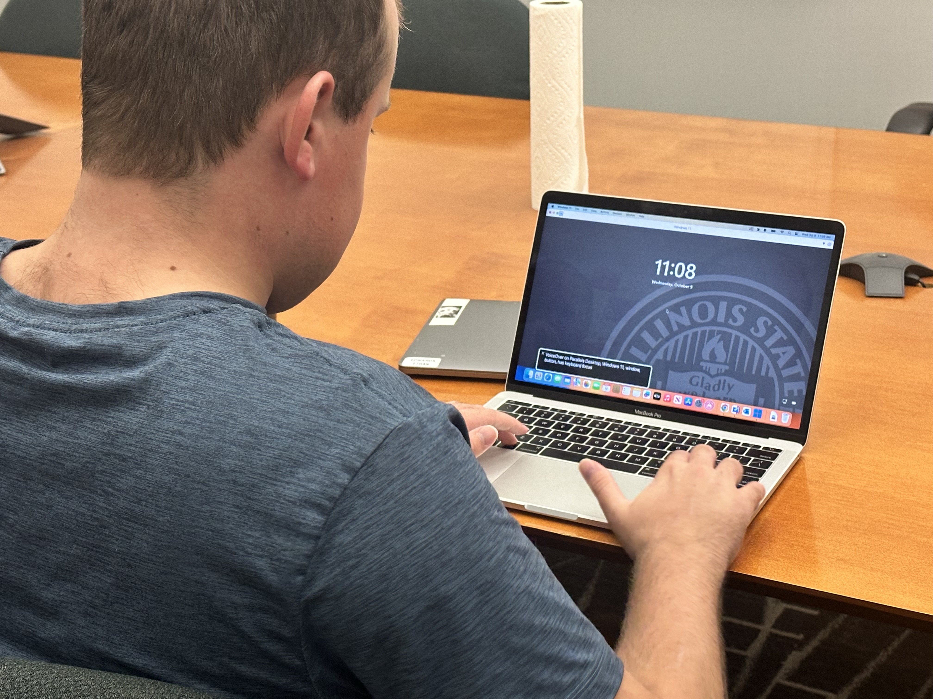
Manual Reviews
What?
Page structure
Headings
Lists
Tables
Forms
Color contrast
Navigating the product using only a keyboard (no mouse)
Using common assistive technologies, like screen readers
Screen magnification
Alt text for images
Captioning and transcripts for videos, podcasts, and audio content
Can main tasks be done independently?
Notes:
Photo by Jen Bethmann

Slide 8
Changes to the RPF Process
ISU utilizes a seven tab specifications workbook for all software RFPs
We added a specific accessibility tab to the template to ask consistent accessibility questions
The template also requires vendor provide a VPAT for review with their proposal
Notes:
Had an existing process addressing functional, technical, data security, business continuity, service level agreement, and implementation/training. This used an excel workbook which we then added an accessibility component to.

Slide 9
Improvements
Allows us to request specific tasks in the demo to see them in action
Allows us to request potential corrections in the Best and Final Offer
Helps address accessibility issues early for large-scale procurements
Notes:
Identify risks and encourage work with vendor to mitigate.

Slide 10
OCR Resolution Example
Wording taken directly from a resolution agreement. The University will engage in the following activities to ensure its programs, services, and activities communicated or facilitated online are accessible to people with disabilities:
Adopt an accessibility standard within 30 days
Provide notice of how to report within 30 days
Conduct an audit within 120 days.
Engage in remediation and amend barriers within six months.
Develop a plan to maintain accessible features within one year

Slide 11
Lessons Learned
Procurement is difficult!
Frustration of faculty/staff with changes
Lack of transparency
Lack of understanding
Audience is important.
Universal design in a non-universal world.
Risk management.
Some software cannot be accommodated
Improve the human experience while using technology for everyone.
Best technology in industry, shouldn’t it be accessible too. Keep asking the question.

Slide 12
Planning for the Future
Update Accessibility Policy
Work to meet WCAG 2.1 (per ADA law update)
Educate the campus community
Continue to Refine the Process
Notes:
Help.ilstu.edu/accessibility
Making sure people understand why
A live process constantly evolving.
Open communication

Slide 13
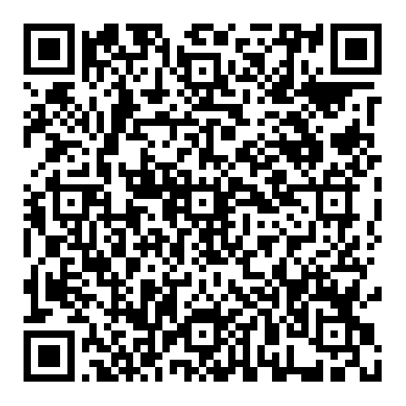
Questions?
Additional Resources
https://help.illinoisstate.edu/accessibility/ website-and-digital/additional- accessibility-resources

Slide 14
End Slide

