Slide 1
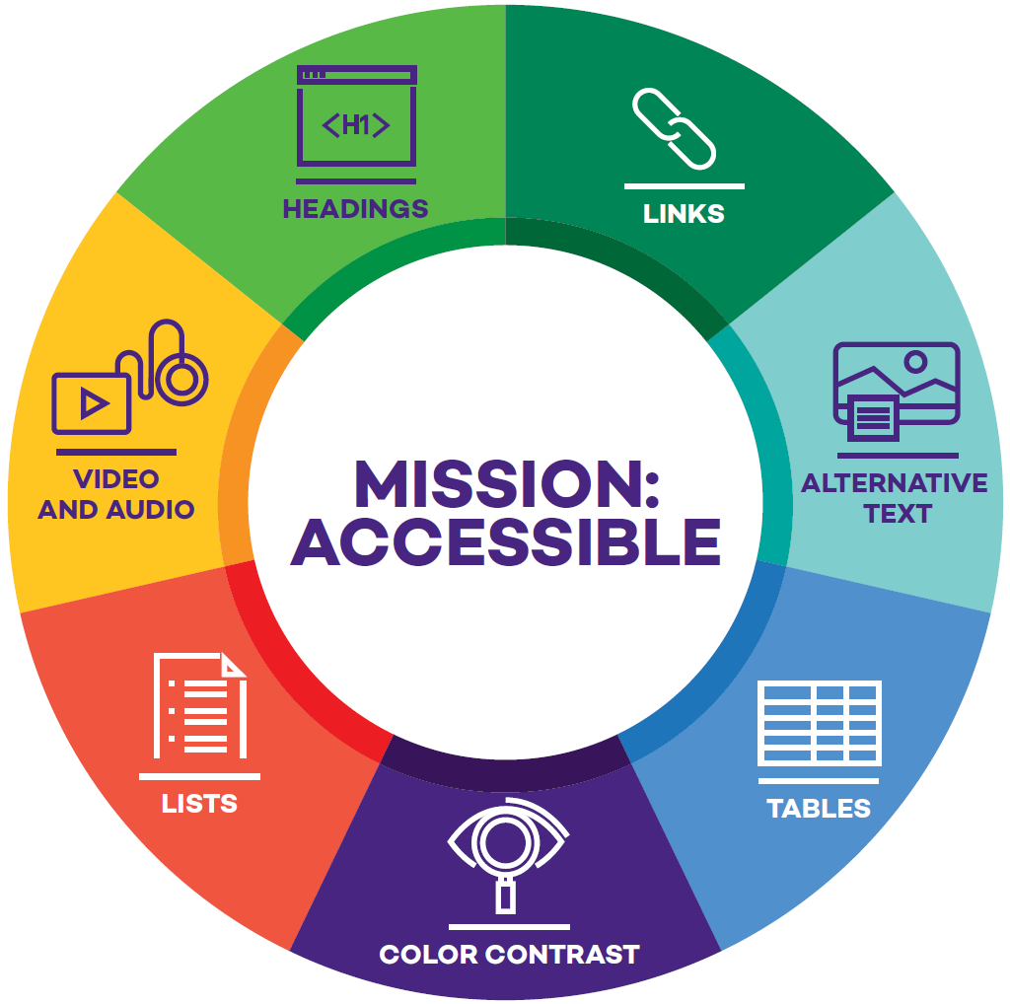
Developing and Sustaining an Effective Campus-Wide Accessible Course Development Program – The Northwestern Model
Jim Stachowiak
Accessible Technology
Strategy and Operations Lead
Northwestern University

Slide 2
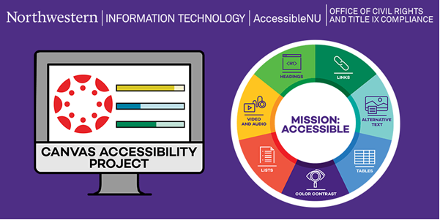
1

Slide 3
Approach
Start with Canvas content
Focus on easy, high impact issues
Don’t overwhelm
Educate
Make it easy

Slide 4
Seven Core Accessibility Skills
Headings
Links
Alternative Text
Color Contrast
Lists
Tables
Video and Audio

Slide 5
Visual Brand
Developed by NUIT Communications
Reminder of the seven core skills
Used in messaging
Used on laptop stickers
Helped make the project feel official

Slide 6
Create and Cultivate Partnerships

Slide 7
Involve Stakeholders & Supporters
Developed the CAP Brains Trust
Informal advisory board
Meets when there’s ideas
Offers feedback
Increases reach
Add new members consistently
Brains Trust Representative
Weinberg
Medill
Engineering
Chemistry
Medical School
Law
Orthotics and Prosthetics
Theatre

Slide 8
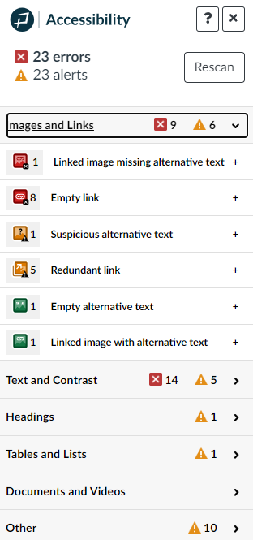
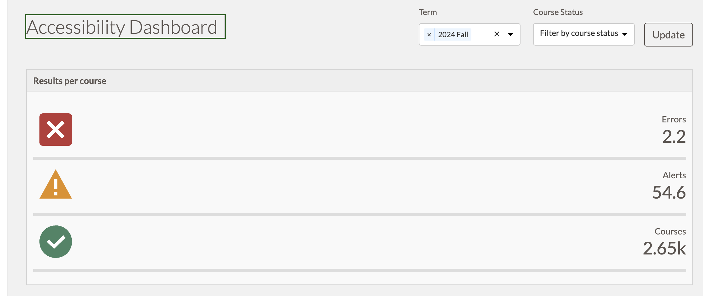
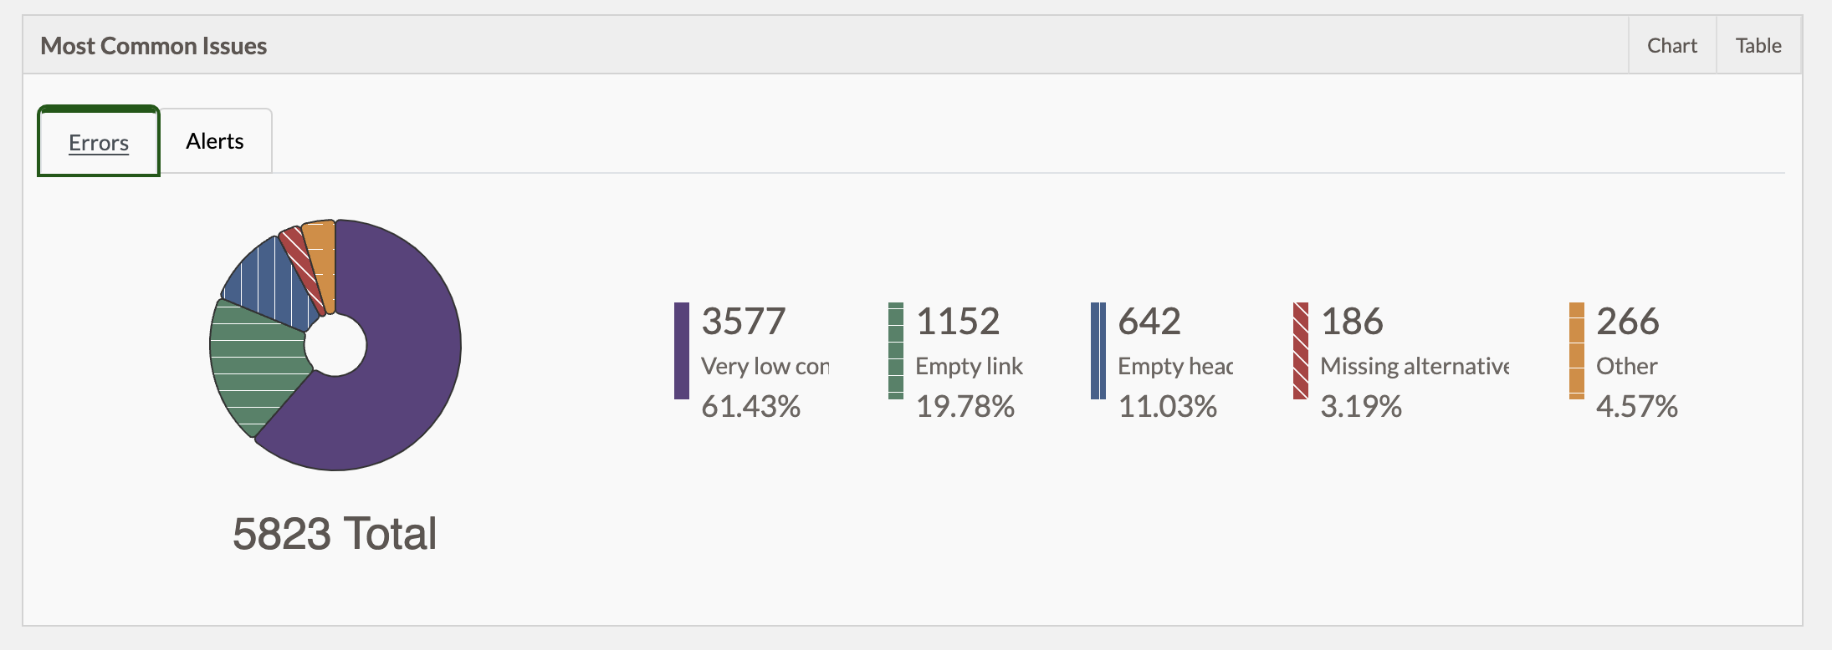
Pope Tech Accessibility Guide

Slide 9
Support
Trained TLT Staff
3 took the U of Illinois certificate course
4 trained via WebAIM training
Staff used for consultations and individual work in group sessions
WebAIM Trainings
5 offered so far
Open to all staff and faculty
Aimed at Canvas support
100+ have currently participated

Slide 10
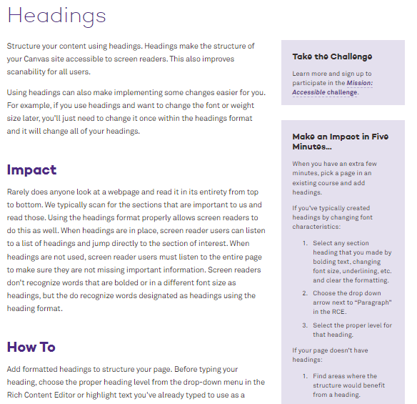
Seven Core Skills Website
Impact
How To
Things to Avoid
Going Forward
Make an Impact in Five Minutes
www.northwestern.edu/accessibility/digital-accessibility/seven-core-skills/

Slide 11
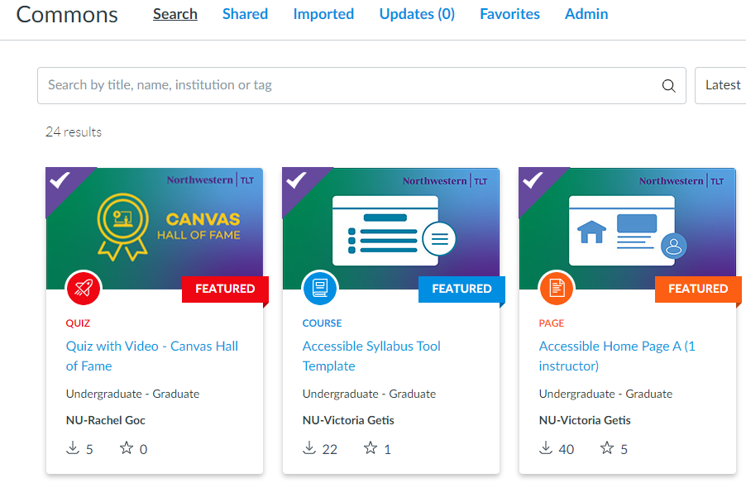
Templates
Developed several accessible course templates
Full course
Syllabus page
Assignment
Template with explanations
Made available via Canvas Commons
Created school specific templates

Slide 12
Phase I: Self Identification (April 2023 – April 2024)

Slide 13
Phase I: Key Strategies
Mass Communication
Individual Tracking and Follow Up
Recognition

Slide 14
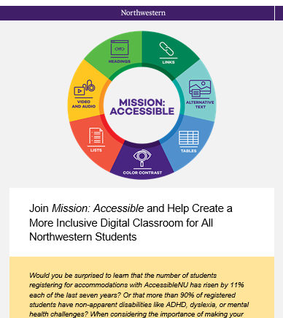
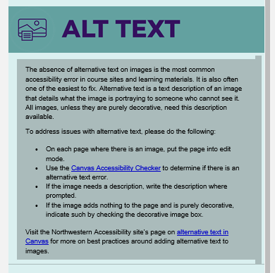

Slide 15
Tracking
Instructor signs up their class for the challenge
Every two weeks they receive an email with a link asking them to update their progress
When all seven skills are addressed, their site is reviewed and approved or sent back to fix errors

Slide 16
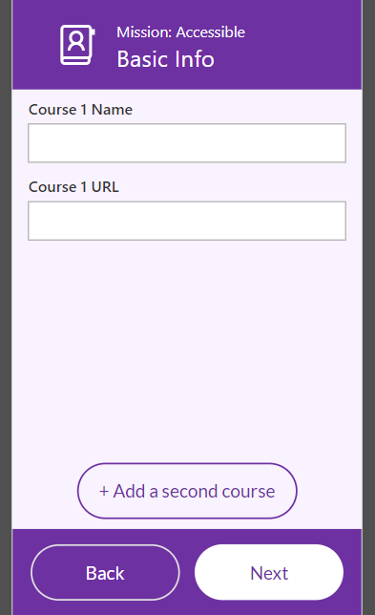
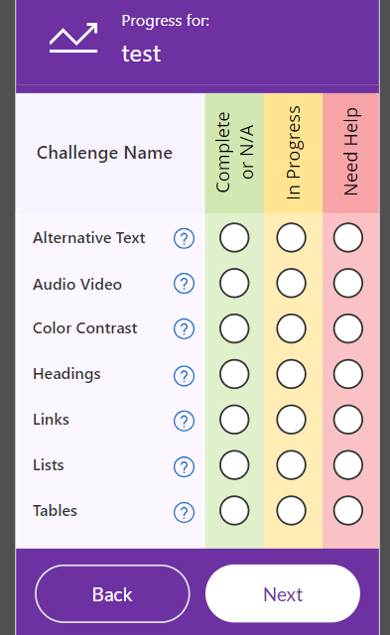
Tracking - PowerApp
Instructor enters courses they are working on
Instructor enters progress
Reminder emails are automatically sent
Project staff supports and verifies

Slide 17
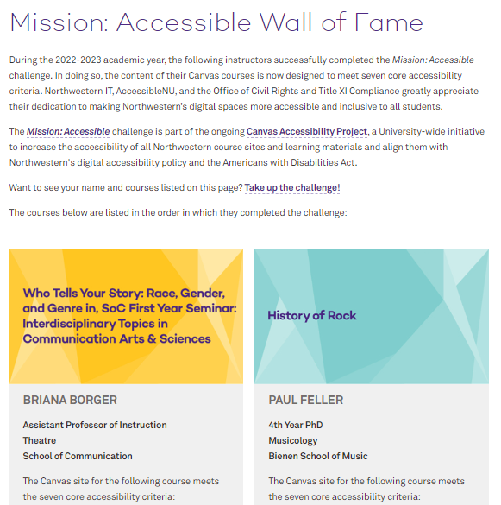
Wall of Fame

Slide 18
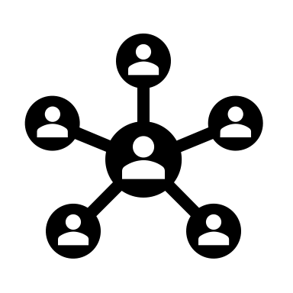
Mission: Accessible Stats
112 instructors completed the challenge
12 of 12 Northwestern schools were represented in the challenge
205 classes successfully completed the challenge

Slide 19
Phase II: Working with Units (December 2023 – Present)

Slide 20
Phase II: Key Strategies
Outreach Directly Associate Dean
Individual Unit Workshop and Support
Data Tracking and Usage
Document Remediation

Slide 21
Medill School of Journalism Partnership
Goal
Work with Medill associate deans, instructors, and librarians to make Medill a model school for digital accessibility in the learning environment.
Winter 2024
Spring 2024
Results
Identify 10 classes with most issues
Invite instructors to in-person workshop (with food) to learn and address issues
Follow up with individual consultations
Present project at Medill faculty meetings
Identify instructors who did not teach in the Winter and invite to Medill specific workshop
Follow up with Winter instructors
Begin remediating documents for courses that passed M:A
Hosted a celebration for removing errors
There were 0 accessibility errors in Medill classes in Spring 2024 (alerts were also reduced)
There were 0 accessibility errors in Medill classes in Fall 2024
Significant sustainable learning occurred
New accessibility evangelists developed

Slide 22
Medill Spring 2024 Scan

Slide 23
Spring 2024 - Present
Data
Medill Success

Slide 24
Partner Units
Communication Sciences and Disorders
Legal Reasoning
Law School
Foreign Languages
Spanish
IEMS
Engineering
Orthotics and Prosthetics
Global Health

Slide 25
Future Partners
History
Theatre
Weinberg Deans Office
Computer Science
Math
Chemistry
Radio, Television, and Film

Slide 26
Document Remediation
Complete the work on your Canvas course
Remove unused documents from your course
Work with your librarian to find links through NU Library database when possible
Document Accessibility Specialists take docs from course and remediate
Docs are replaced under same name
Instructors are given folder with remediated docs
Hired 2 Document Accessibility Specialists
in March 2024
Over 40 classes have had
documents completely remediated

Slide 27
Phase III: Main Offenders (September 2024 – Present)

Slide 28
Phase III: Key Strategies
Outreach Directly to Classes with High Numbers of Specific Issues
Work with High Enrollment Classes
Data Tracking and Usage
Document Remediation

Slide 29
Main Offenders Emails
Process
Identified top 10 courses with specific issues
Emailed instructors directly with brief video on how to address the identified issue
Results
50% ignored the email
25% got better
Staff typically made the corrections
25% got worse
Only a few confrontational responses
Some positive responses, but no action

Slide 30
Next Steps
High Enrollment Classes
Identified top 100 enrollment classes for Winter and Spring
Direct outreach on issues
Offer to address documents
Pope Tech Reminder
Working on a message to pop up to use Pope Tech every time a page is saved
Day of Action
Considering a group effort to reduce Canvas issues around Global Accessibility Awareness Day

Slide 31
Results

Slide 32
Mission: Accessible’s Impact
Error | Fall 2023 | Fall 2024 | Percent Improvement
Color Contrast | 16869 | 3981 | 76.5%
Suspicious Link Text | 6491 | 3162 | 52.3%
No or suspicious alt text | 25610 | 9920 | 61.3%
Possible Lists | 5490 | 3397 | 39.2%
Missing Headings | 84270 | 51540 | 39%
Layout Table | 18573 | 5351 | 72.2%

Slide 33
Accessibility Errors Per Course

Slide 34
Most Common Errors

Slide 35
Most Common Errors

Slide 36
Most Common Alerts

Slide 37
Most Common Alerts

Slide 38
Errors Per Course - Schools

Slide 39
Errors Per Course - Schools

Slide 40
Errors by School

Slide 41
Errors by School

Slide 42
Errors by School

Slide 43
Lessons Learned
1. Make it easy as easy as possible.
2. Partnerships are key. Start with like-minded people and build.
3. Data opens doors, shows success, helps build support.
4. Associate Deans are key.
5. Mass communication has its limitations.
5. Celebrate success

Slide 44
Questions? Email: james.stachowiak@northwestern.edu

