Slide 1
Just in Time! Assistive Technology Tools for Organization, Time Management, and Stress Reduction
Rachel Gramig, MS, OTR/L, CEAS, CBIS she.her.hers - Rachel.Gramig@colostate.edu
Michelle Brodsky, MEd, MOT, OTR/L she.her.hers - Michelle.Brodsky@colostate.edu
ATRC Website: https://www.chhs.colostate.edu/atrc/

Slide 2
Agenda:
Introduction
ATRC Process
Time Management
Organization
Stress Reduction
Questions

Slide 3
The Assistive Technology Resource Center at Colorado State University
Provides services to students and employees
Housed within the Department of Occupational Therapy
Works closely with other campus inclusion programs
Serves around 600 students/year
4 OT's on staff providing services
Research
Common Diagnoses that we see:
ADHD
Anxiety/Depression
Autism
TBI
POTS
PTSD
Learning Disabilities
Neurological Disorders
Orthopedic Conditions
Low Vision

Slide 4
ATRC's Process of Gathering Information
Initial interview/Occupational Profile
Build upon referral from SDC
Inquire about 5 areas of school
Inquire about student's support system
Provide resources, training and software/hardware as applicable

Slide 5
Time Management and Organization
ATRC Survey: 1,642 participants
967 (59%) rated 10/10 importance for TMO in Higher Education

Slide 6
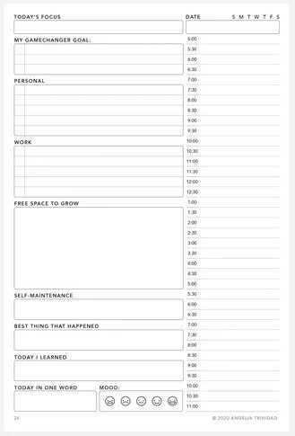
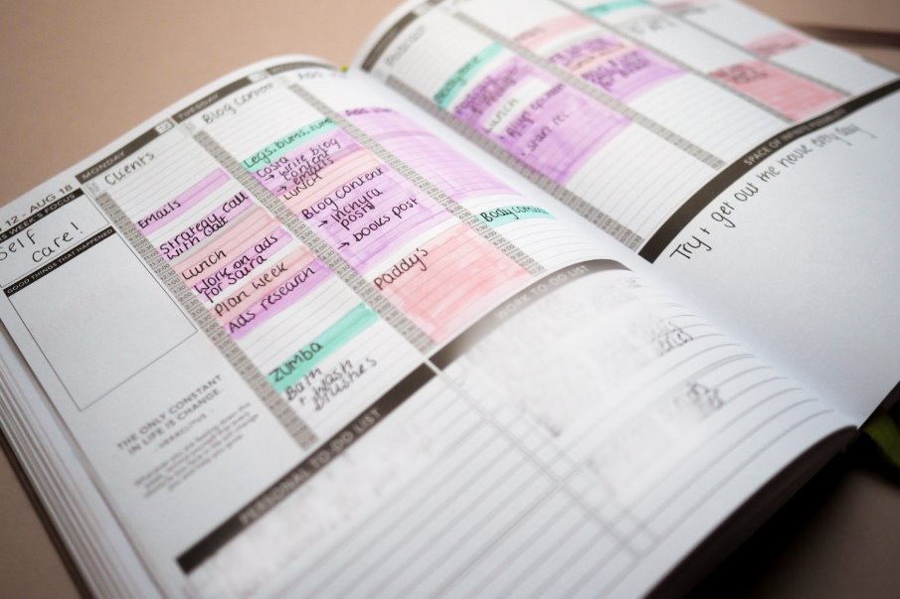
Low Tech Options
Planners
Checklists
Sticky Notes
Whiteboards
Wall Calendars
Passion Planners

Slide 7
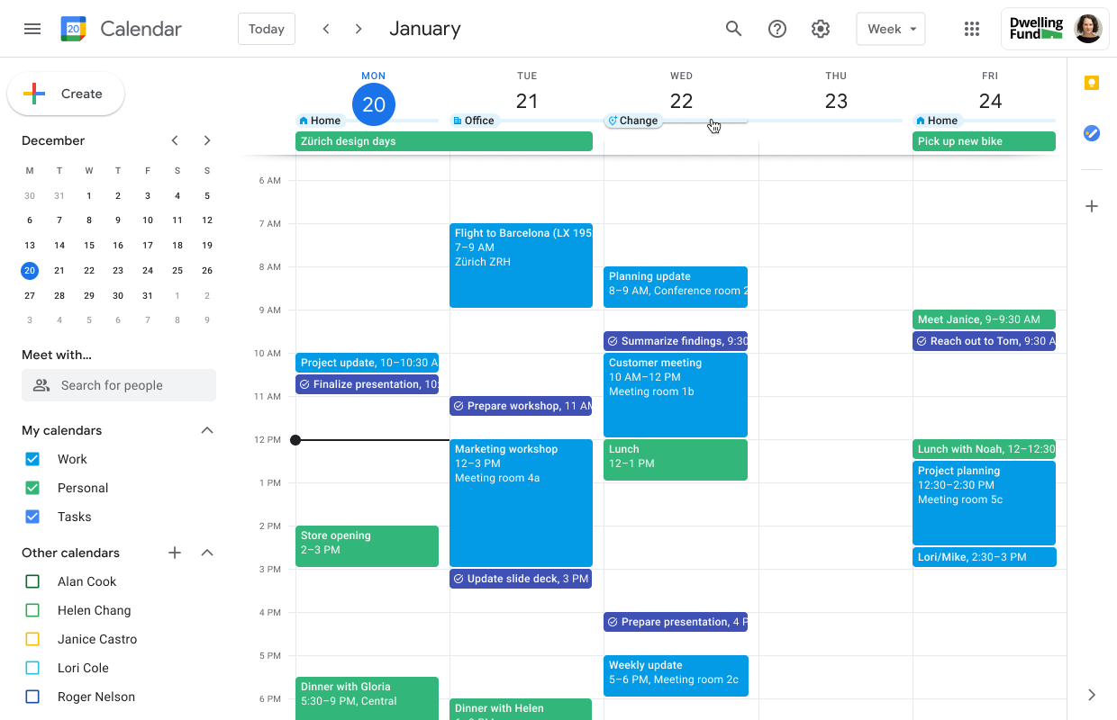
Digital Calendars
Outlook
Google
Apple (iCal)
LMS (Canvas Calendar)
Useful Features
Recurring Events
Color Coding
Notifications and alerts
Syncing LMS with personal calendars

Slide 8
LMS Organization
Web Extensions
Tasks for Canvas
Better Canvas
Canvas To-Do

Slide 9
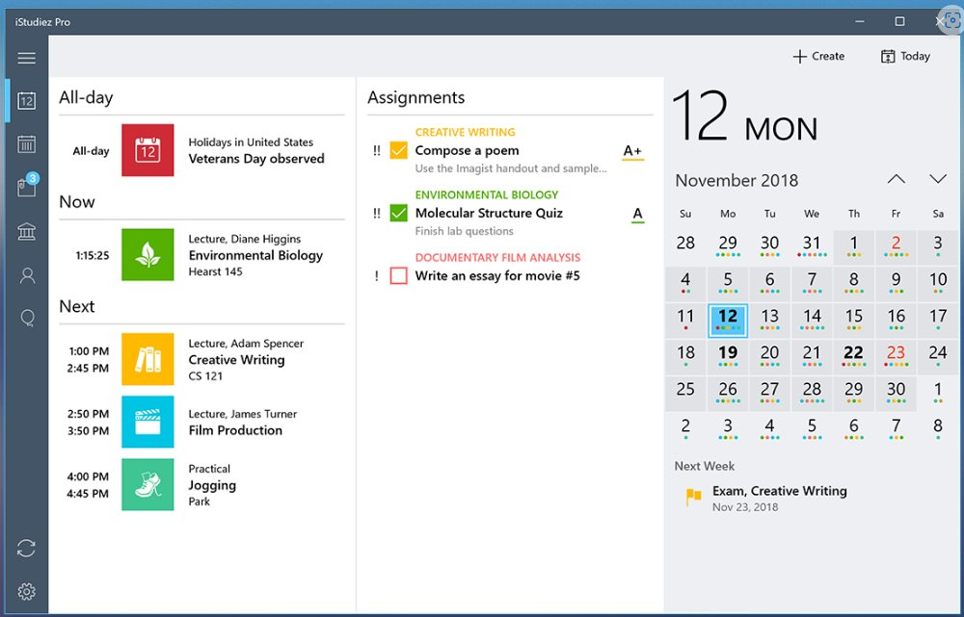
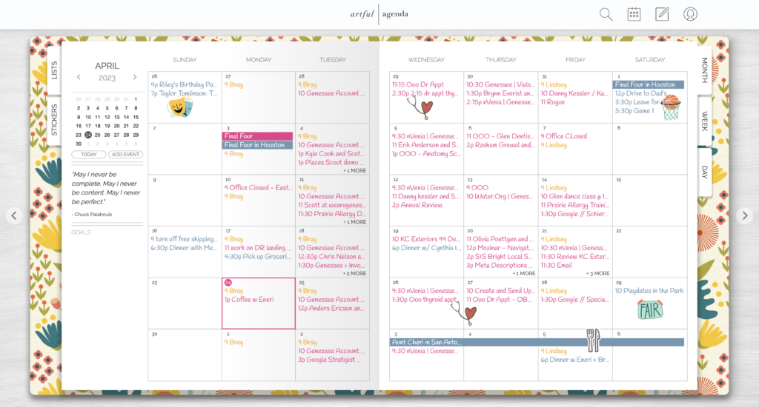
Digital School Planners
My Study Life
IStudiez
Artful Agenda
Structured.app

Slide 10
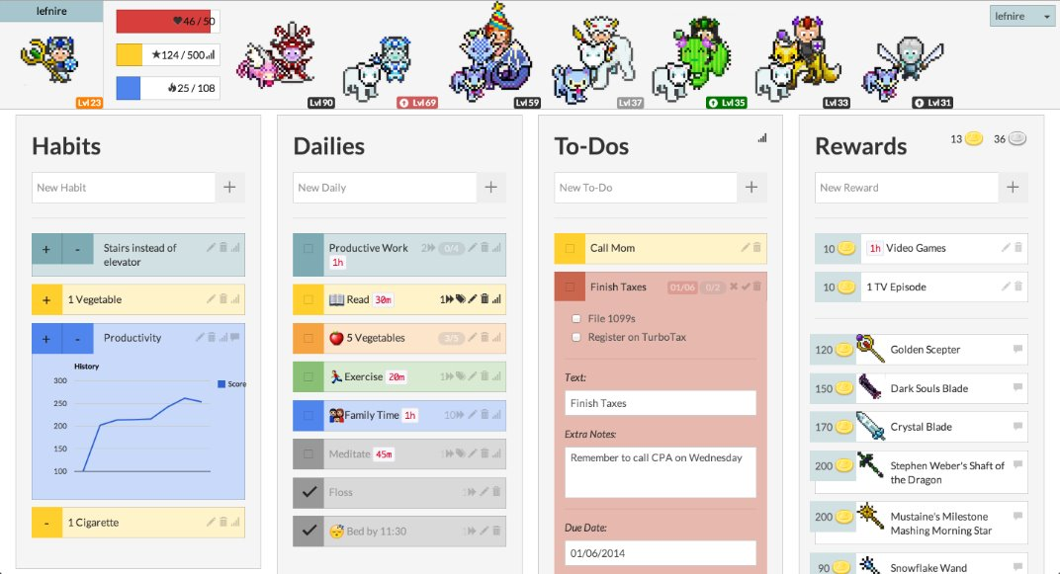
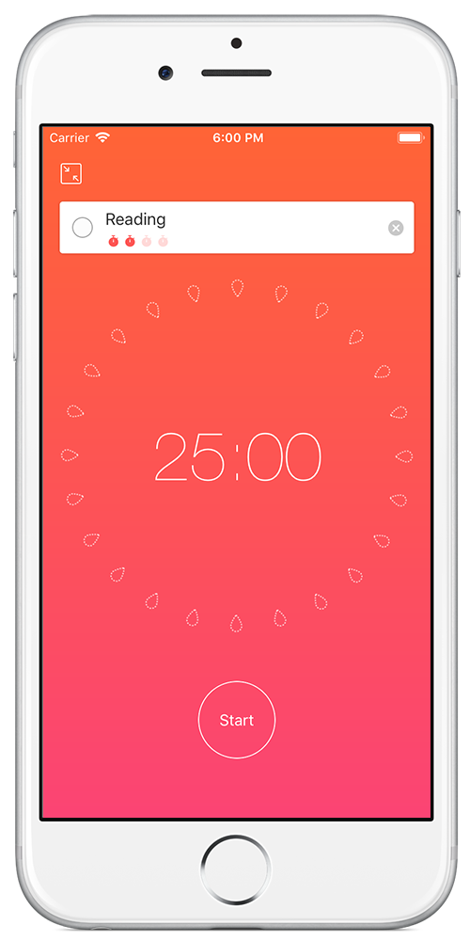
Pomodoro and Habit Tracking Apps
Focus To-Do
Be Focused
Forest
Habitica
Study Bunny
Finch Care
Notes:
Focus To-Do: Task Manager, Focus Timer, Track Progress, Planning
Be Focused: Focus Timer, Task manager, track progress
Forest: Gamified Focus Application
Habitica: Gamified Task and habit management with rewards
Study Bunny: Focus Timer, Time Management
Finch Care: Gamification for Task management, self-care habits, goal setting, and reflections

Slide 11
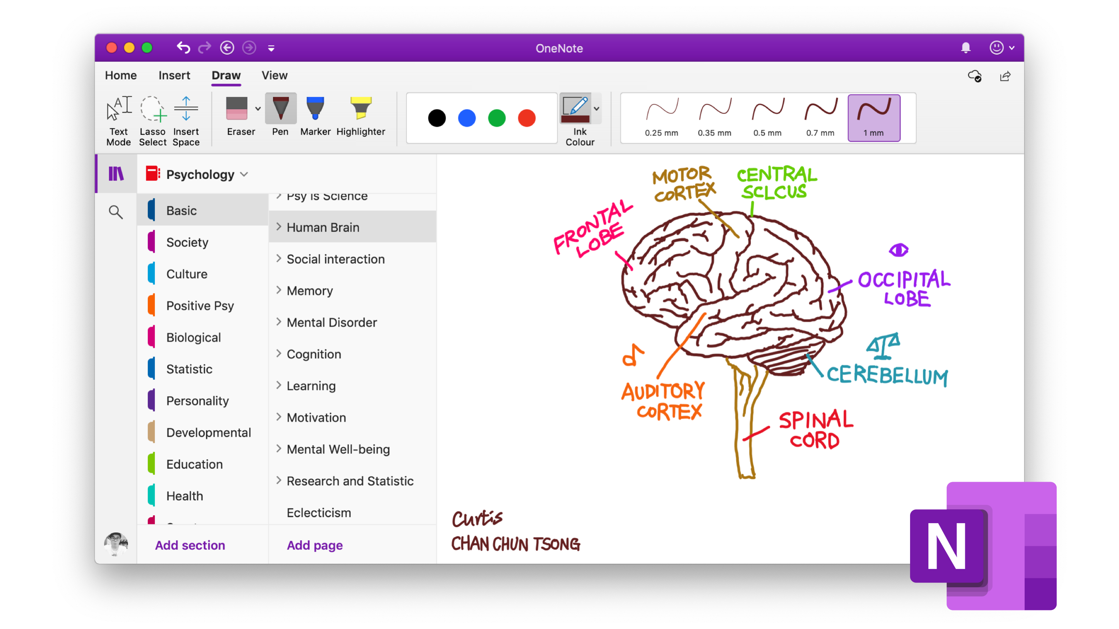
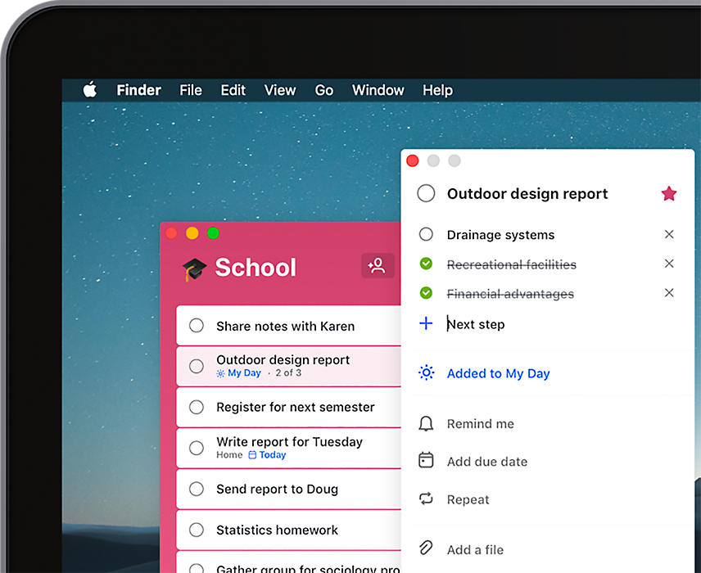
To-Do Lists and Notes
Microsoft To-Do
Google Keep and Tasks
Built-In Sticky Notes
OneNote, Notability
Many other note-taking apps with organizational features
Glean
Natural Reader
ReadSpeaker (UD)
Useful Features:
Adding due dates and reminders
Prioritizing
Creating Lists

Slide 12
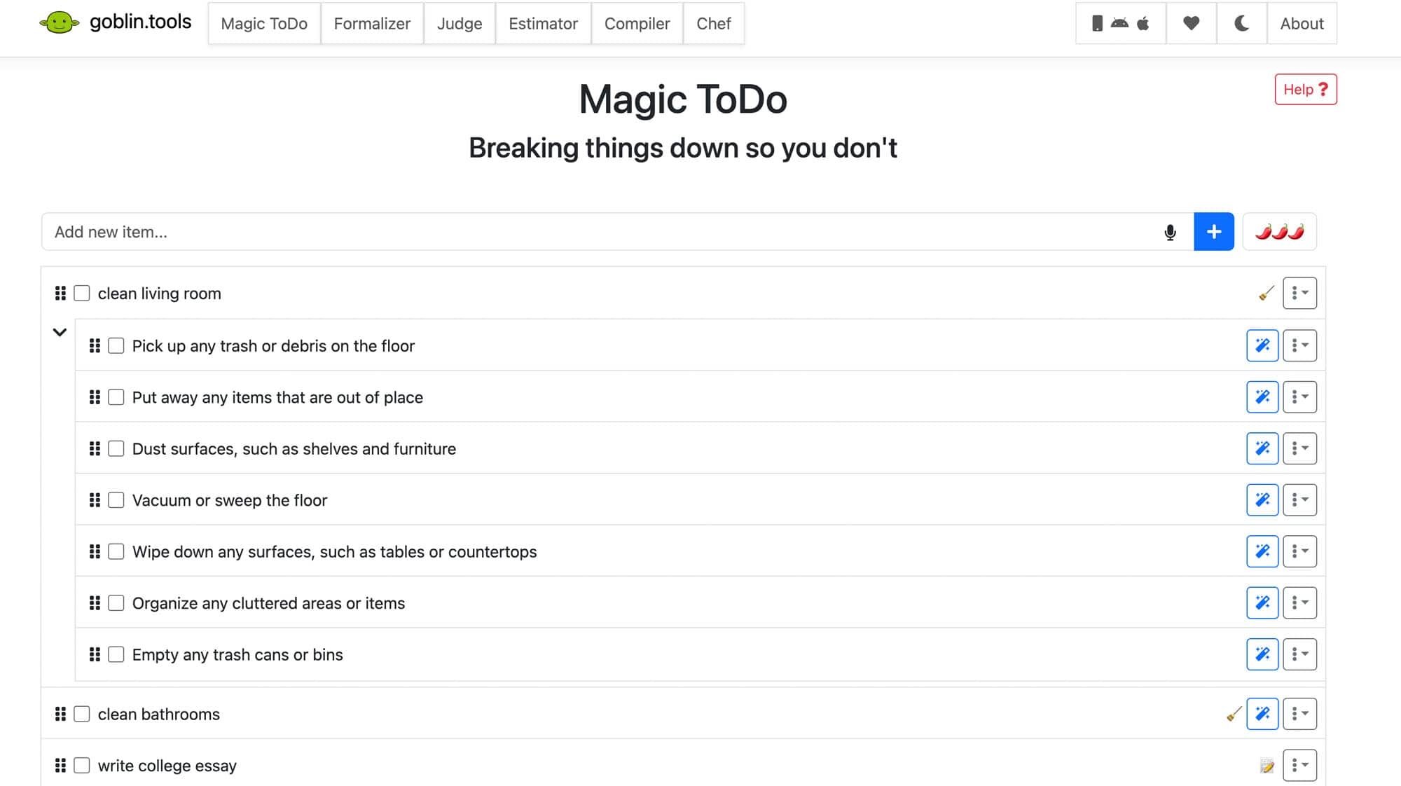
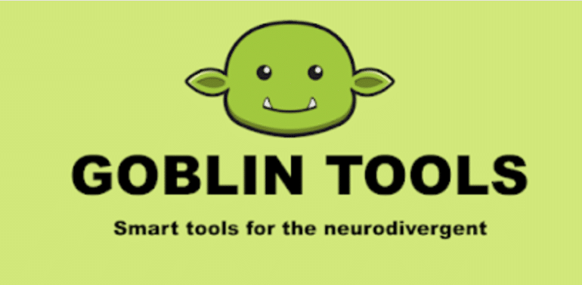
AI and Time Management
Goblin Tools
Breaking down tasks
Prediction of how long task will take
E-mail summaries, tone of text/statements
Prioritizing Tasks
Magic ToDo - GoblinTools

Slide 13
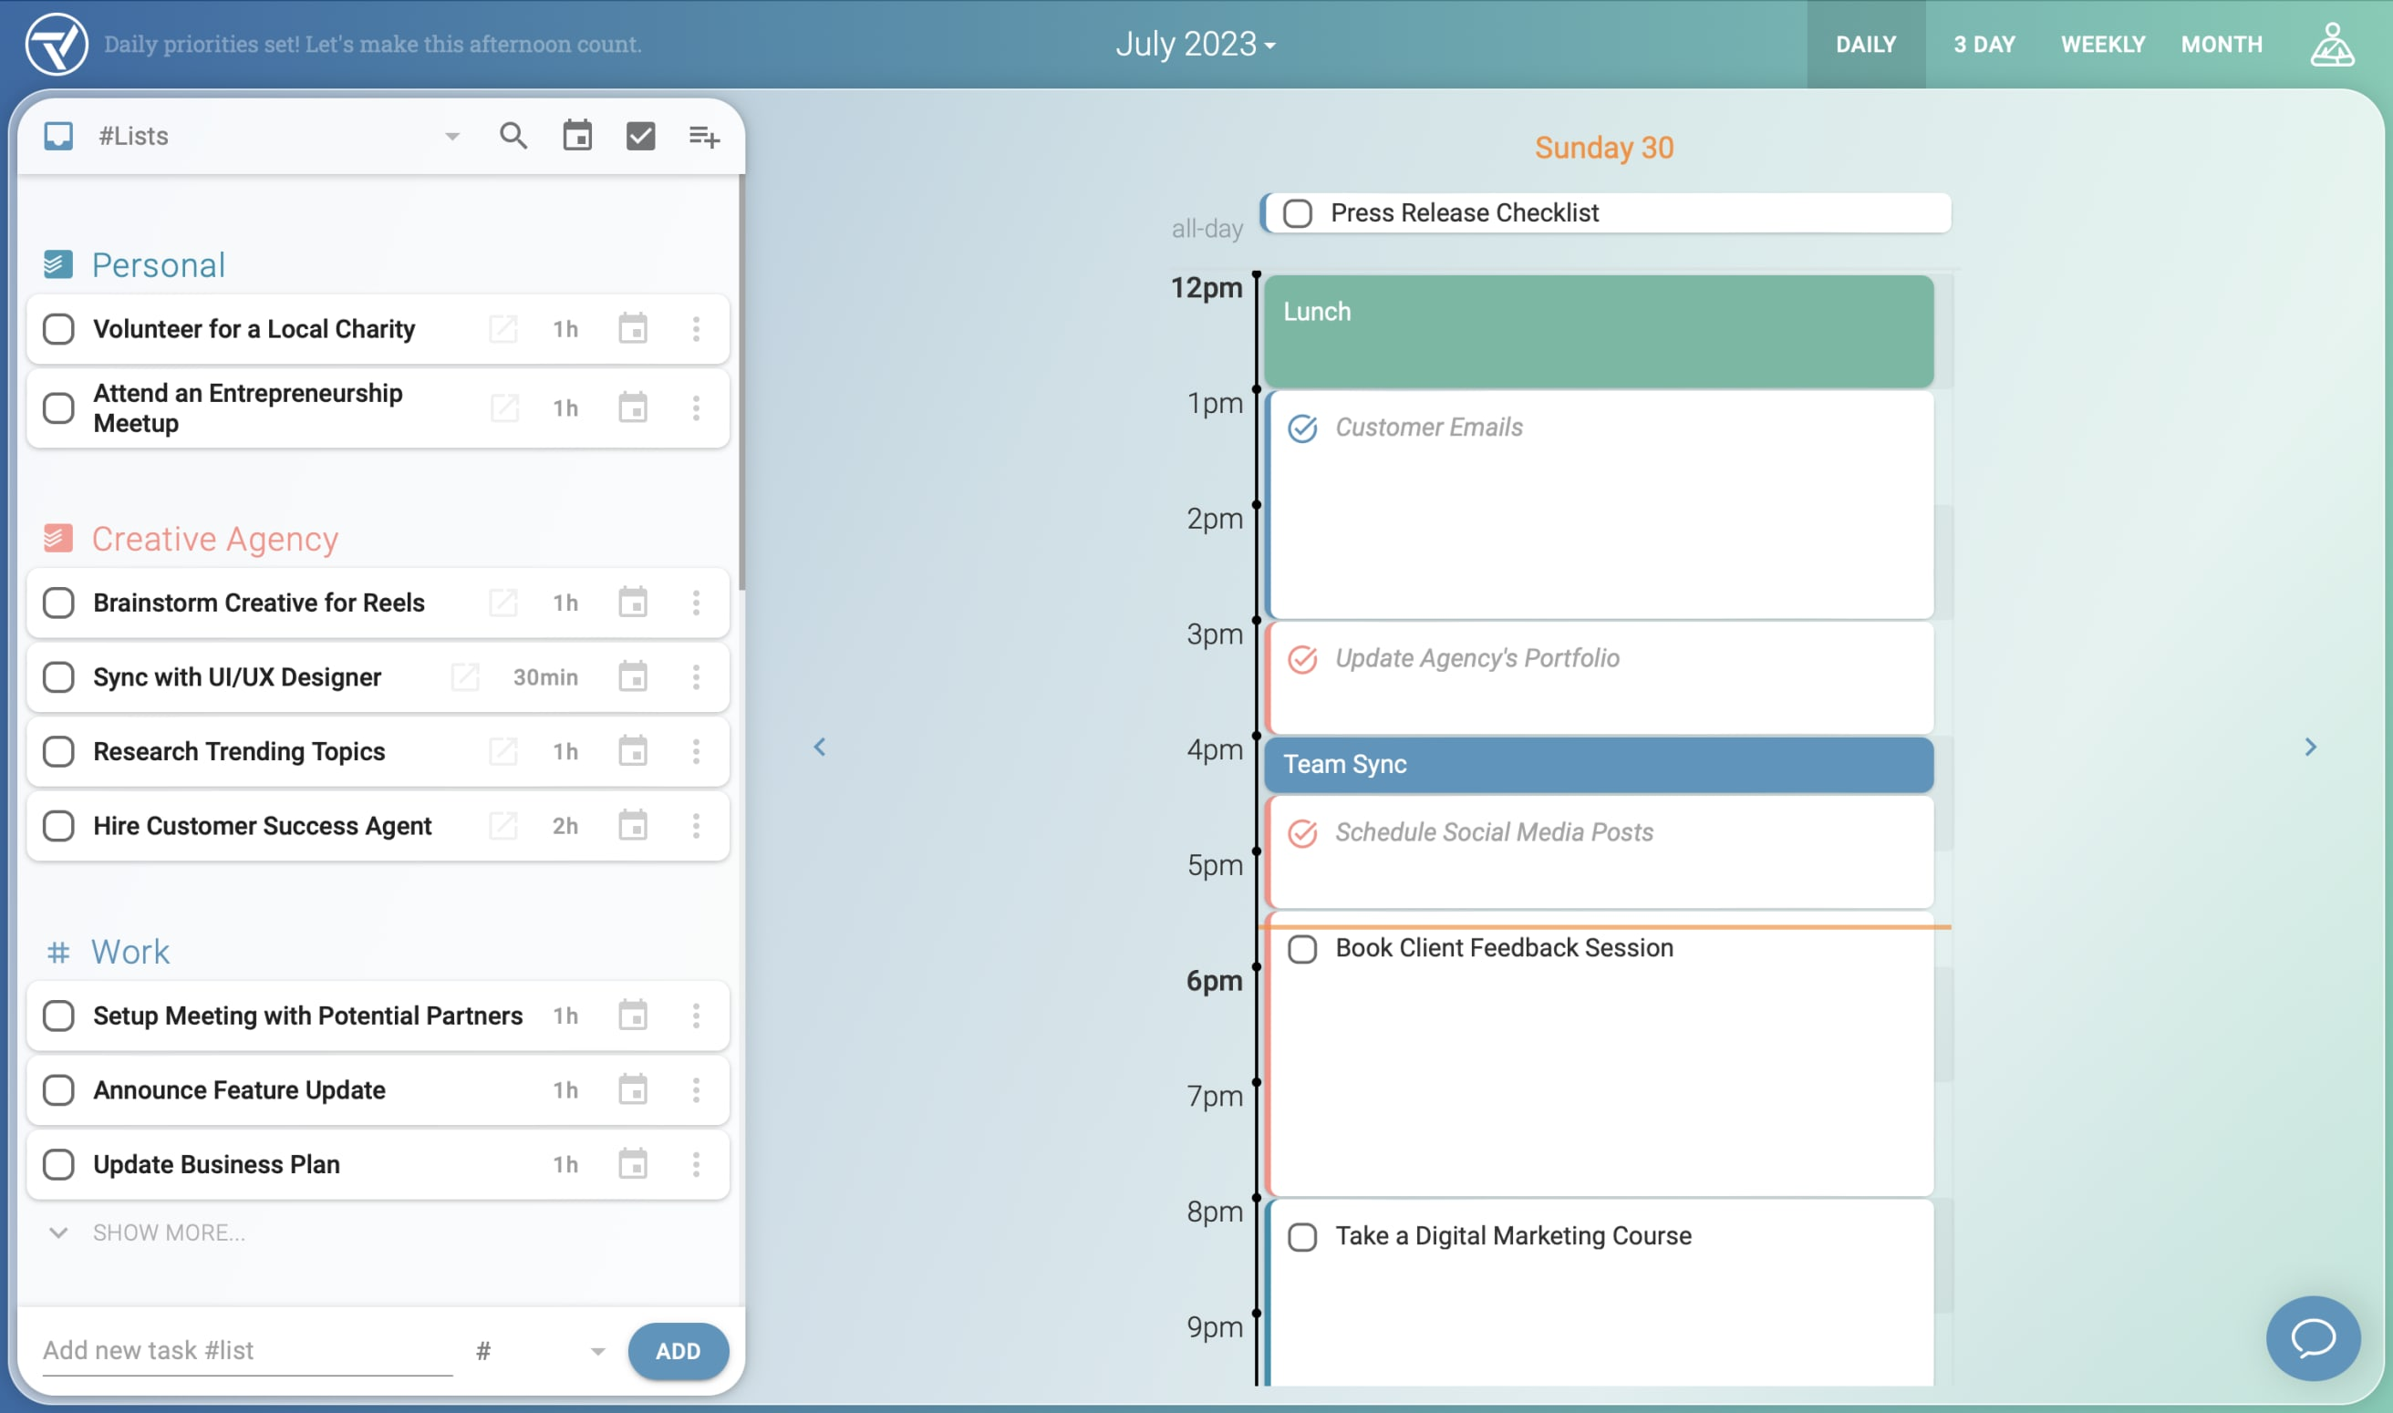
AI and Time Management
ToDoist
Motion
Trevor AI
Syncs with other calendars (Google, iCal, Outlook, etc)
Lists
Prioritizing
Alerts and reminders

Slide 14
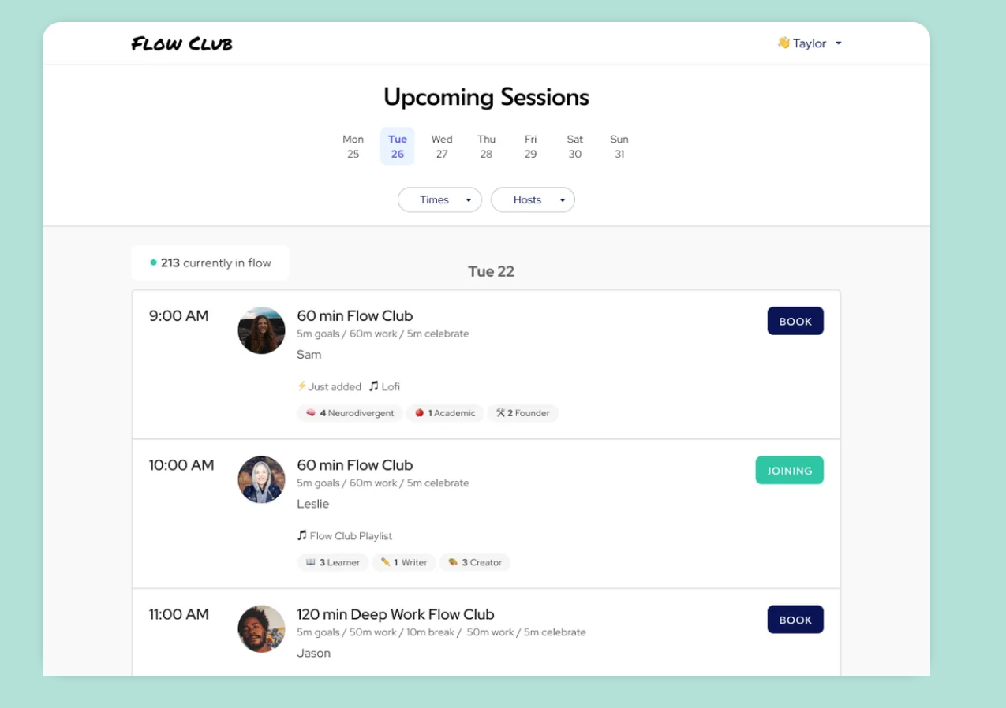
Body Doubling for Focus and Co-Working
Deepwrk
Cofocus
FlowClub
Cave Day
Think Divergent

Slide 15
Case Study: Elliot
First year student
Work Study job on campus
Full courseload
ADHD
Anxiety/Depression
Strengths
Loves helping others in their work study job
Strong writing skills
Loves Math courses
Very comfortable with use of tech
Barriers: ​
Missing due dates​
Disorganized with notes in class​
"Zone's out" during lectures and when studying​
Too many calendars (Outlook for school, iCal for personal, Canvas calendar for classes)​
Often doesn't get assignments done because can't predict how long they need for assignments

Slide 16
Case Study: Elliot
Glean for note taking and organization, recording lectures, studying with use of focus timer
Goblin Tools for breaking down tasks and estimating amount of time for each task
Syncing Canvas and Outlook calendars with iCal so that all events and due dates are on the same calendar platform
Added "Tasks for Canvas" web extension for task manager, alerts for due dates and tracking progress/completion

Slide 17
Time Management=Self-care
Try the Game

Slide 18
Stress Reduction
Calm App
Let's breathe together

Slide 19
Survey Says...
Two in five students say their mental health is impacting their ability to focus, learn and perform academically “a great deal,” and one in 10 students rate their mental health as “poor.”
Inside Higher Ed’s 2024 Student Voice survey of 5,025 undergraduates, conducted by Generation Lab in May
Notes:
https://www.insidehighered.com/news/student-success/health-wellness/2024/08/19/experts-weigh-college-student-mental-health -crisis#:~:text=Recent%20data%20from%20Inside%20Higher,for%20administrators%20and%20learners%20alike.

Slide 20
Four in 10 college students have recently considered withdrawing from college. The number-one reason why? “Emotional stress.”
Emotional stress was cited by 69 percent of bachelor’s degree students and 55 percent of community college students.
When asked what emotional stress means to them, many students told researchers that coursework can be overwhelming, especially in combination with jobs or caregiving duties. Some mentioned depression and anxiety, or concerns about paying for college.
Emotional Stress
“Stressed Out and Stopping Out: The Mental Health Crisis in Higher Education report produced by Gallup and the Lumina Foundation.​ More than 90,000 students across 133 U.S. campuses participated in the survey.​ ​
Notes:
https://www.nea.org/nea-today/all-news-articles/mental-health-crisis-college-campuses#:~:text=Specifically%2C%20White%20college%20students%20are,33%20percent%20of%20Latino%20students
“Stressed Out and Stopping Out: The Mental Health Crisis in Higher Education report produced by Gallup and the Lumina Foundation. More than 90,000 students across 133 U.S. campuses participated in the survey.

Slide 21
Personal Mental Health Reasons
The second biggest reason was “personal mental health reasons,” (59 and 44 percent of bachelor’s- and associate’s-degree seekers, respectively)​.
​

Slide 22
Students at Colorado State University
2023-2024 Academic Year
ATRC saw 587 Clients
45% had a mental health or psychiatric disorder diagnosis

Slide 23
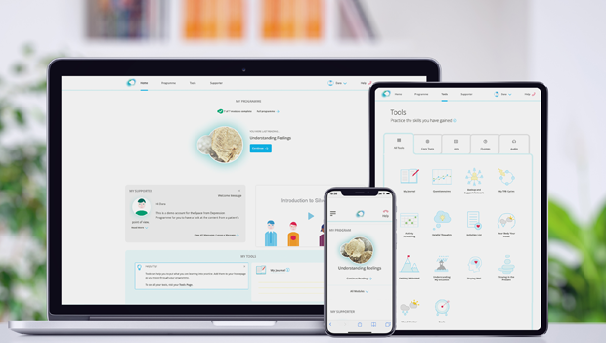
Learn more (video)
SilverCloud
Notes:
2 min video

Slide 24
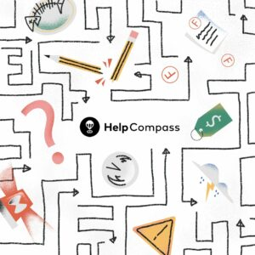
Help Compass
HelpCompass is an anonymous crisis navigation tool that helps you connect to the right help in moments of need. Life gets hard. Finding help should be easy.
Learn more (video)

Slide 25
NOD
Learn more (video)

Slide 26
Apps to support mental health
sleep, stress, anxiety, mindfulness ​
Calm
Breethe
Headspace
Insight Timer
DownDog
Unwinding Anxiety​
Smiling Mind​
The Shine App​
Aura Health
Breathe

Slide 27
Other AT that may reduce stress
Notetaking apps that record, provide transcripts
Reading AT for comprehension
AT for test taking

Slide 28
Case Study: Sam
Non traditional student
Single Parent
Veteran
TBI
PTSD
Insomnia
Strengths
Life experience
Multi-lingual
Family support
Tech savvy
Barriers
Difficulty with reading comprehension and tracking
Hard time making friends
Struggles to balance school and home life
Panic attacks during class

Slide 29
Case Study: Sam
Silvercloud for mental health resources
NOD to help make social connections
Calm for regulation during panic attacks
DownDog to exercise at home with their daughter
Natural Reader to support reading comprehension with audio and highlighting

Slide 30
Questions?

