Slide 1
Practical Strategies to Get the Word Out, Build Awareness and Grow Usage of Your AT Tools
Accessing Higher Ground 2024
November 13th, 2024

Slide 2
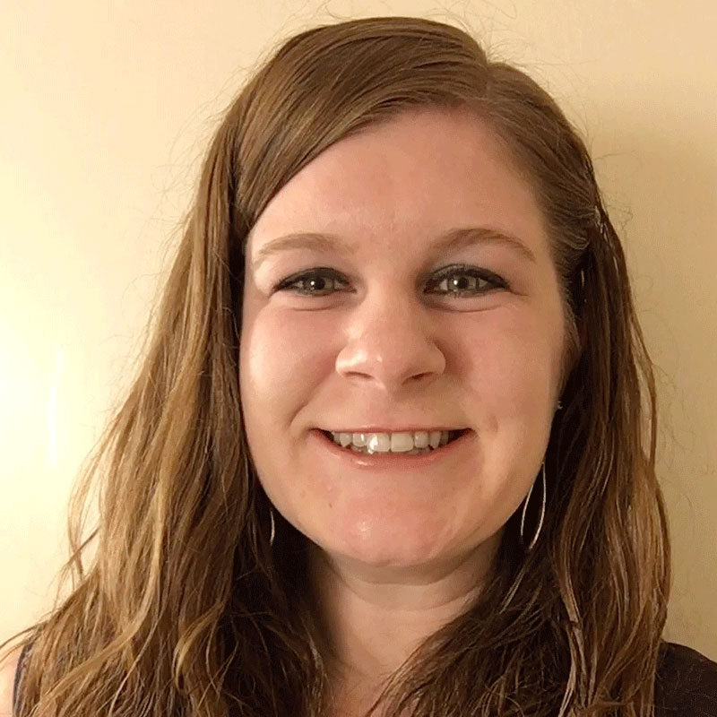
Hello There!
Rachel Kruzel, ATP
Higher Education Specialist
Texthelp
Email: r.kruzel@texthelp.com
Phone: 651-245-3128

Slide 3
Today’s Agenda
Vision
Incentives
Action Plan
Skills
Resources

Slide 4
Campuswide Adoption of AT Tools

Slide 5
Rationale for adoption
Belief in the (bigger) impact it can make - inclusion
In office or campuswide
Evolution of our mindset and evolution of support
Students with disabilities connected to our offices versus the wider student population - statistics
Collaboration and all students are “our students”

Slide 6
Realities of adoption
Budgets, funding
Funding is availability; advocacy is necessary
Competing priorities
Time, expertise, personnel
Justification - data, use, impact, scope of reach
Embrace the “why” of adoption and support it can provide

Slide 7
Data Driven Decision Making
Data driven decision making is essential and a non-negotiable
When you have the info, you can make better decisions
Academic Return on Investment (AROI)
Funding is availability; advocacy is necessary
Understanding baseline levels of use, goal setting, active implementation strategies, accountability

Slide 8
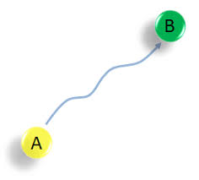
But how do we get from adoption to successful implementation?

Slide 9
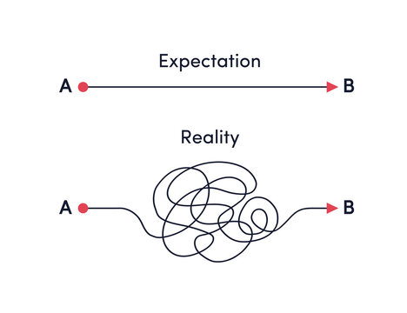
Expectations versus Reality

Slide 10
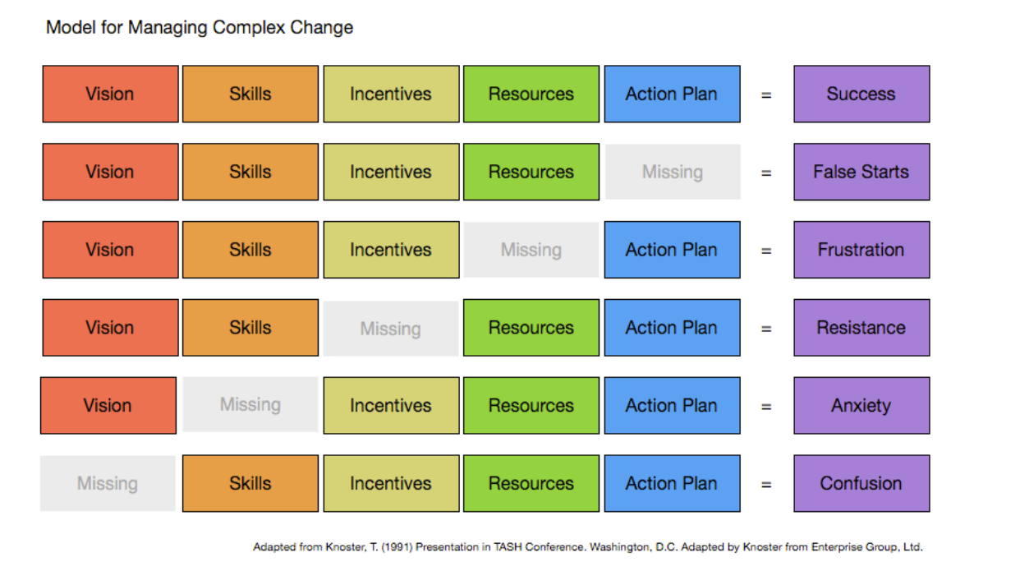
Model for Managing Complex Change

Slide 11
The Vision

Slide 12
The Vision - What’s Your Why?
Purpose, reason, goal, impact you are striving to achieve
People need to know why this was adopted
What is the impact it could and will have?
Need to effectively communicate this to those impacted
Campus, students, stakeholders, faculty, etc.

Slide 13
But also…
The availability of the resource/assistive technology tool
What is it?
Who’s it for?
Where can I get it?
How do I use it? (Skills & Resources)

Slide 14
Common institutional priorities
Diversity, Equity, and Inclusion
Digital Accessibility
Retention, Student Success, Graduation Rates
Financial sustainability
UDL
Mental Health/Well-being
Enrollment
Sustainability
Assessment

Slide 15
Awareness Building: Vision
Website or landing page
Flyers or digital boards
Email campaigns - student access vs. staff/faculty
Professional Development Days
Videos
Key milestone - orientations, first year experience/seminar
Tabling
Blogs/newspaper

Slide 16
Self-Reflection: Vision
What were the reasons you chose to adopt this assistive technology tool? What’s your why?
What goals or outcomes are you hoping to achieve through this adoption for campus or with the intended users?
What methods have worked to effectively share access to the tool with key campus groups?

Slide 17
Pair & Share: Vision
Have certain channels of communication worked better for certain groups versus others?
In sharing your vision or access to this tool, what methods or channels have worked best for the different campus groups: stakeholders, faculty, fellow staff, students?

Slide 18
Skills

Slide 19
Skills: Two Parts
Learned skills to make the technology function
How do I use it?
But also skills of the professionals who:
Can help you implement this tool
Can support the work of skilling the users on campus with the tool

Slide 20
Importance of collaboration
“Alone we can do so little; together we can do so much.”
Helen Keller

Slide 21
Key partnerships
Instructional Design/Academic Technology
Retention, Student Success & Student Support
Library and/or Tutoring Center
Student Government/Student Leadership
Marketing
Intentionality of connection is key

Slide 22
Other key offices
TRiO
Veterans Support
Athletics
International Students
Academic Advising
First Year Programming
Academic Probation
Cultural Support Offices
McNair Scholars
English Department
Education Department
Human Resources

Slide 23
Academic Toolbox

Slide 24
You’re Not Alone
Cross functional teams/working groups are key
Different positions bring different ideas, assets, skills
Social capital
Upskilling those who are helping drive this effort alongside you
3-5 people to work alongside you and “own this”

Slide 25
Self-Reflection: Skills
Who is helping you with this implementation? Who can you bring into a cross functional group to share the efforts around implementation? What skills do these people bring?
What will you need to upskill people helping to roll out this assistive technology? Does it differ if it is an end user or someone supporting this piece of assistive technology? If so, what does the end user need to gain skills?

Slide 26
Pair & Share: Skills
What strategies and actions have been useful on your campus to help build skills around a particular piece of assistive technology?
Have there been colleagues who have been central to this work? What skills did they bring to support these efforts?

Slide 27
Incentives

Slide 28
Why should I care? (user)
User:
What impact (positive or negative) does it have on me?
What is the effort needed to see the impact or start using this too?
Who says so? Peers? Influencers?

Slide 29
Why should I care? (faculty/staff)
Faculty and staff:
Why are campus resources invested in this?
What will this do to help students?
What will this do to help our campus?
What’s required of me? Time, attention, training, awareness?

Slide 30
The Six Principles of Persuasion
Reciprocity - return favors, payback
Scarcity - innovation and short supply to get buy-in
Liking - the more you’re liked, the more you’ll persuade
Authority - influencers, titles, leaders are followed
Social Proof - what are your peers doing? competition?
Commitment/Consistency - alignment of beliefs and values

Slide 31
Awareness Building: Incentives
Who - influencers, peers, leadership
Testimonials
Video with student use
Student made videos (self or through a course)
Written testimonials
Quotes

Slide 32
Awareness Building: Incentives cont.
Survey results
Workshops led by students
Peer-to-peer
Word of mouth
Tabling
Talk to end users (skills and empowerment)

Slide 33
Self-Reflection: Incentives
Do you feel your campus understands the reason behind the technology adoption and the impact it can make to campus and the users?
Which areas/personas on campus understand the impact this tool can have on campus or users? Which areas require additional communication to understand the impact?

Slide 34
Pair and Share: Incentives
What strategies have successfully helped to convey the impact these tools can have on the users on your campus?
Are there others on your campuses who can be a champion and help spread the story of the impact this tool can have?

Slide 35
Resources

Slide 36
Resources as a support
Resources are a key way to support users
Users, preferences, identities impact the type and format our resources that are most impactful
Live versus asynchronous
Print versus video versus training/modeling

Slide 37
Abandonment
Without understanding the use and being well resourced, users are more likely to abandon a piece of AT
Once abandoned, it’s harder to get them to use the next piece of AT in the future
Success the first time is key

Slide 38
Awareness Building: Resources
In-house versus vendor/supplier created resources
Videos - length and purpose (feature based or modeling)
Training guides or how tos
Training sessions
Professionals/staff or supplier
Student employees/peer mentorship

Slide 39
Awareness Building: Resources cont.
Website with resources/repository
Flyers or 1 Pagers
posted or sent out
Who can you partner with to build resources or spread the word?
ID, student project, marketing and communication

Slide 40
Self-Reflection: Resources
What specific resources, assets or training do you need to help support and sustain this roll out and awareness building?
Are there people on your campus who can help to create or collate resources in collaboration with you or your team? Who are these people and what help can they provide?

Slide 41
Pair and Share: Resources
What types of resources have resonated the most with users on your campus? What methods did you use to create these resources or support their impact?
If there is a low-hanging fruit or a quick and easy win for a type of resource to implement to maximize the impact, what would you suggest to others tackling this now?

Slide 42
Action Plan

Slide 43
Self-Reflection: Action Plan
What are three to five actionable items or steps you can take to help build awareness and use?
What resources are needed? Who needs to be involved? When do you want each of these items completed by?
Resource: Ways to Get the Word Out on Campus About Texthelp Tools

Slide 44
Questions & Discussion

Slide 45
Let’s Connect!
Rachel Kruzel, ATP
Higher Education Specialist
Texthelp
Email: r.kruzel@texthelp.com
Phone: 651-245-3128

