Slide 1
Infusing Innovation into Texthelp Tools: Improvements and Exciting Updates
Rachel Kruzel, ATP
AHG 2024

Slide 2
Hello There!
Rachel Kruzel, ATP
Higher Education Specialist
Texthelp
Email: r.kruzel@texthelp.com
Phone: 651-245-3128

Slide 3
Today’s Agenda
Our Students & Learner Preparedness
Digital Transformation
Artificial Intelligence
Learner-Centered Adoption
Data & Analytics

Slide 4
Our Students & Learner Preparedness

Slide 5
Reality of our Campus Populations
Who are our current students today?
Increase in variability
Graduation rates, learning loss¹, literacy levels
Tech focused world they grew up in + digital literacy levels
What barriers are student still facing despite the work being done on campus?

Slide 6
Students of today
Students with disabilities
Connected and not connected with DS
Un and underdiagnosed students
Finances, stigma, documentation, disclosure, awareness of disability or resources, lack of connection
Struggling learners, academic preparedness, skill preparedness, executive functioning, literacy, variability

Slide 7
Depth and breath of student access
Students with disabilities
Undiagnosed, underdiagnosed or lack of connection with DS
Neurodiversity
Mental Health
Veterans
Academic preparedness & students of today entering our institutions
Dual enrollment and returning learners
Online & hybrid learning
International and multilingual learners

Slide 8
Disclosure in Higher Ed
37%
70%
of higher education students with a disability reported it to their institution.
70%
of higher education students with a mental health condition do not register for accommodations.
37%
Mental Health America. (2020.). 2020 disability and Campus Mental Health Report. 2020 Disability And Campus Mental Health Report. Retrieved from: https://mhanational.org/get-involved/2020-disability-and-campus-mental-health-report
National Center for Education Statistics. (2022, April 26). A Majority of College Students with Disabilities Do Not Inform School, New NCES Data Show. Retrieved from: https://nces.ed.gov/whatsnew/press_releases/4_26_2022.asp

Slide 9
Disability and Neurodiversity
Students with disabilities, those who identify as neurodiverse and those who have a mental health condition make up a large part of college and university populations
19.4%
11-30%
>60%
of college students reports having a disability.¹
Number of college students who identify as neurodiverse.²
of college students meet the criteria for least one mental health condition.³

Slide 10
Weis, R., Waters, E.A. Evidence-Based Accommodations for Postsecondary Students with Disabilities: Beware the Base Rate Fallacy. Psychol. Inj. and Law 16, 213–226 (2023). https://doi.org/10.1007/s12207-023-09471-7
“A large, diverse sample of undergraduates with and without disabilities rated their academic functioning across multiple domains… Overall, 95.5% of students with disabilities an 90.0% of students without disabilities reported at least one substantial limitation in academic functioning.”

Slide 11
Academic Preparedness:
Reading
 | Reading too slowly | Understanding what I read | Need to re-read to get the main point
Students without disabilities | 11.1% | 16.1% | 33.1%
Students with disabilities | 17.7% | 25.9% | 43.6%

Slide 12
Academic Preparedness:
Notetaking
 | Taking organized notes that make sense | Taking good notes that prepare me for tests | Listening to a lecture/taking notes at the same time
Students without disabilities | 11.3% | 13.1% | 15.6%
Students with disabilities | 24.2% | 25.6% | 32.2%

Slide 13
Academic Preparedness:
Overall
 | More effort on academic tasks than others to perform well | More time on academic tasks than others to perform well | Any academic limitation
Students without disabilities | 16.6% | 17.5% | 90.0%
Students with disabilities | 31.6% | 34.5% | 95.5%

Slide 14
In the Headlines

Slide 15
Article Links
Slate: The Loss of Things I Took for Granted
The Atlantic: The Elite College Students Who Can’t Read Books
Inside Higher Ed: How Much Do Students Really Read?
The Chronicle: Is This the End of Reading?
College Matters Podcast: Is Reading Over for Gen Z Students?
The Chronicle of Higher Education: Declarations of Dependence - The Many reasons students can't, or won't, work on their own.

Slide 16
Read&Write
Help students understand, engage and express themselves
Read&Write is a literacy support tool that offers help with everyday tasks like reading text out loud, understanding unfamiliar words, researching assignments and proofing written work.

Slide 17
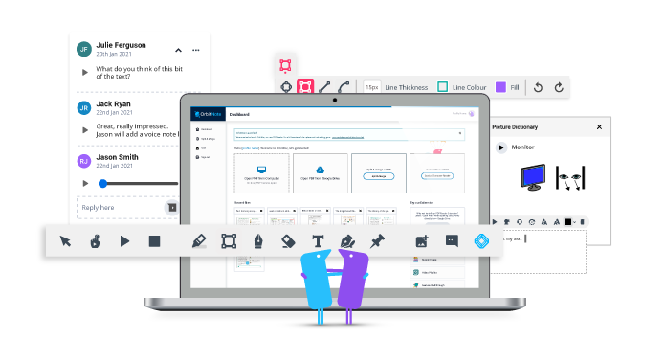
OrbitNote
Create, convert, connect:
Take your documents to the next level
OrbitNote allows you to transform and interact with documents in a completely different way. Create an accessible, dynamic and collaborative space that works for everyone.

Slide 18
Equatio
Make math Digital
Equatio allows you to create equations, formulas, and more, digitally. Helping to make math and STEM classes more accessible and engaging for every student.

Slide 19
Let’s Take a Peek - Learner Preparedness

Slide 20
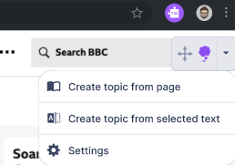
Custom topics
Translation writing support
What’s next
Create your own topics from a website or selected text, to see more subject-specific words in your prediction list.
Type or speak a word in your first or preferred language, and have it translated to English.

Slide 21
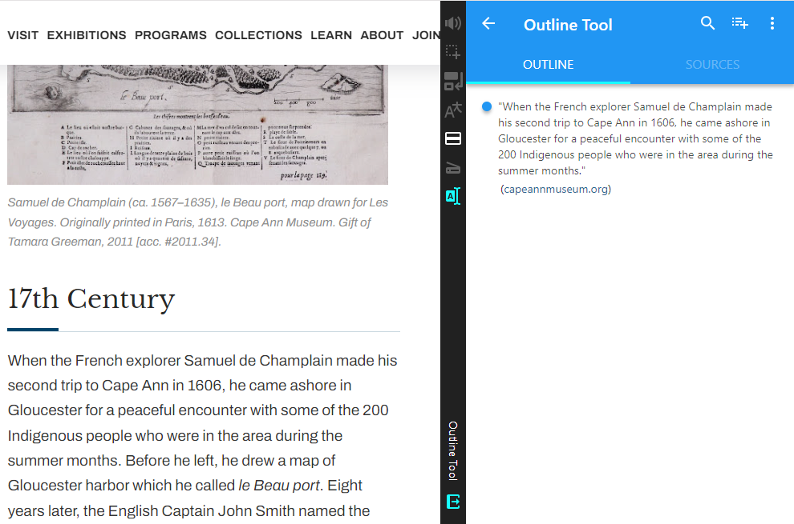
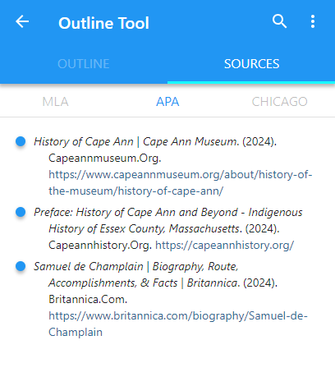
Outline Tool
Citation Generator
What’s next
Create your own Outline with quotes from multiple resources into a single outline
Automatically save citation information and provide citation support for MLA - APA - Chicago.
Note: screenshots from current Snap&Read tool and not representative of future design in Read&Write

Slide 22
Learner-Centered Adoption

Slide 23
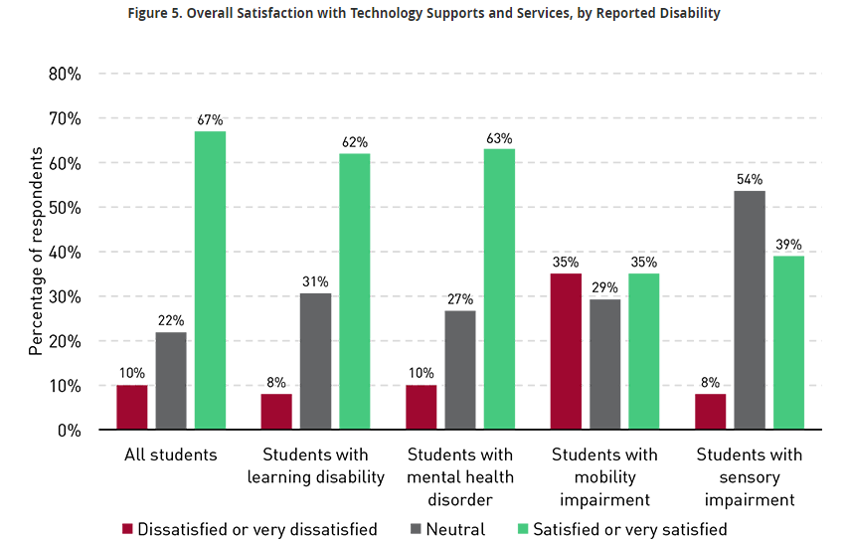
Satisfaction with Technology
“Advancements in technology have opened up opportunities for individuals who may have previously faced barriers to education, although they still aren't equal to the experiences of students without disabilities…”
From EDUCAUSE: Educational Technology Research in Higher Education: New Considerations and Evolving Goals - Information, Tools, and Access at All Levels

Slide 24
Students at the center
Why we are in our roles
Students have opinions, want to be involved
Articles coming out about students having voice and choice and understanding of “why” things are happening
Focus groups, surveys, feedback channels
What have students used before - tools and platforms?

Slide 25
Let’s Take a Peek - Learner-Centered Adoption

Slide 26
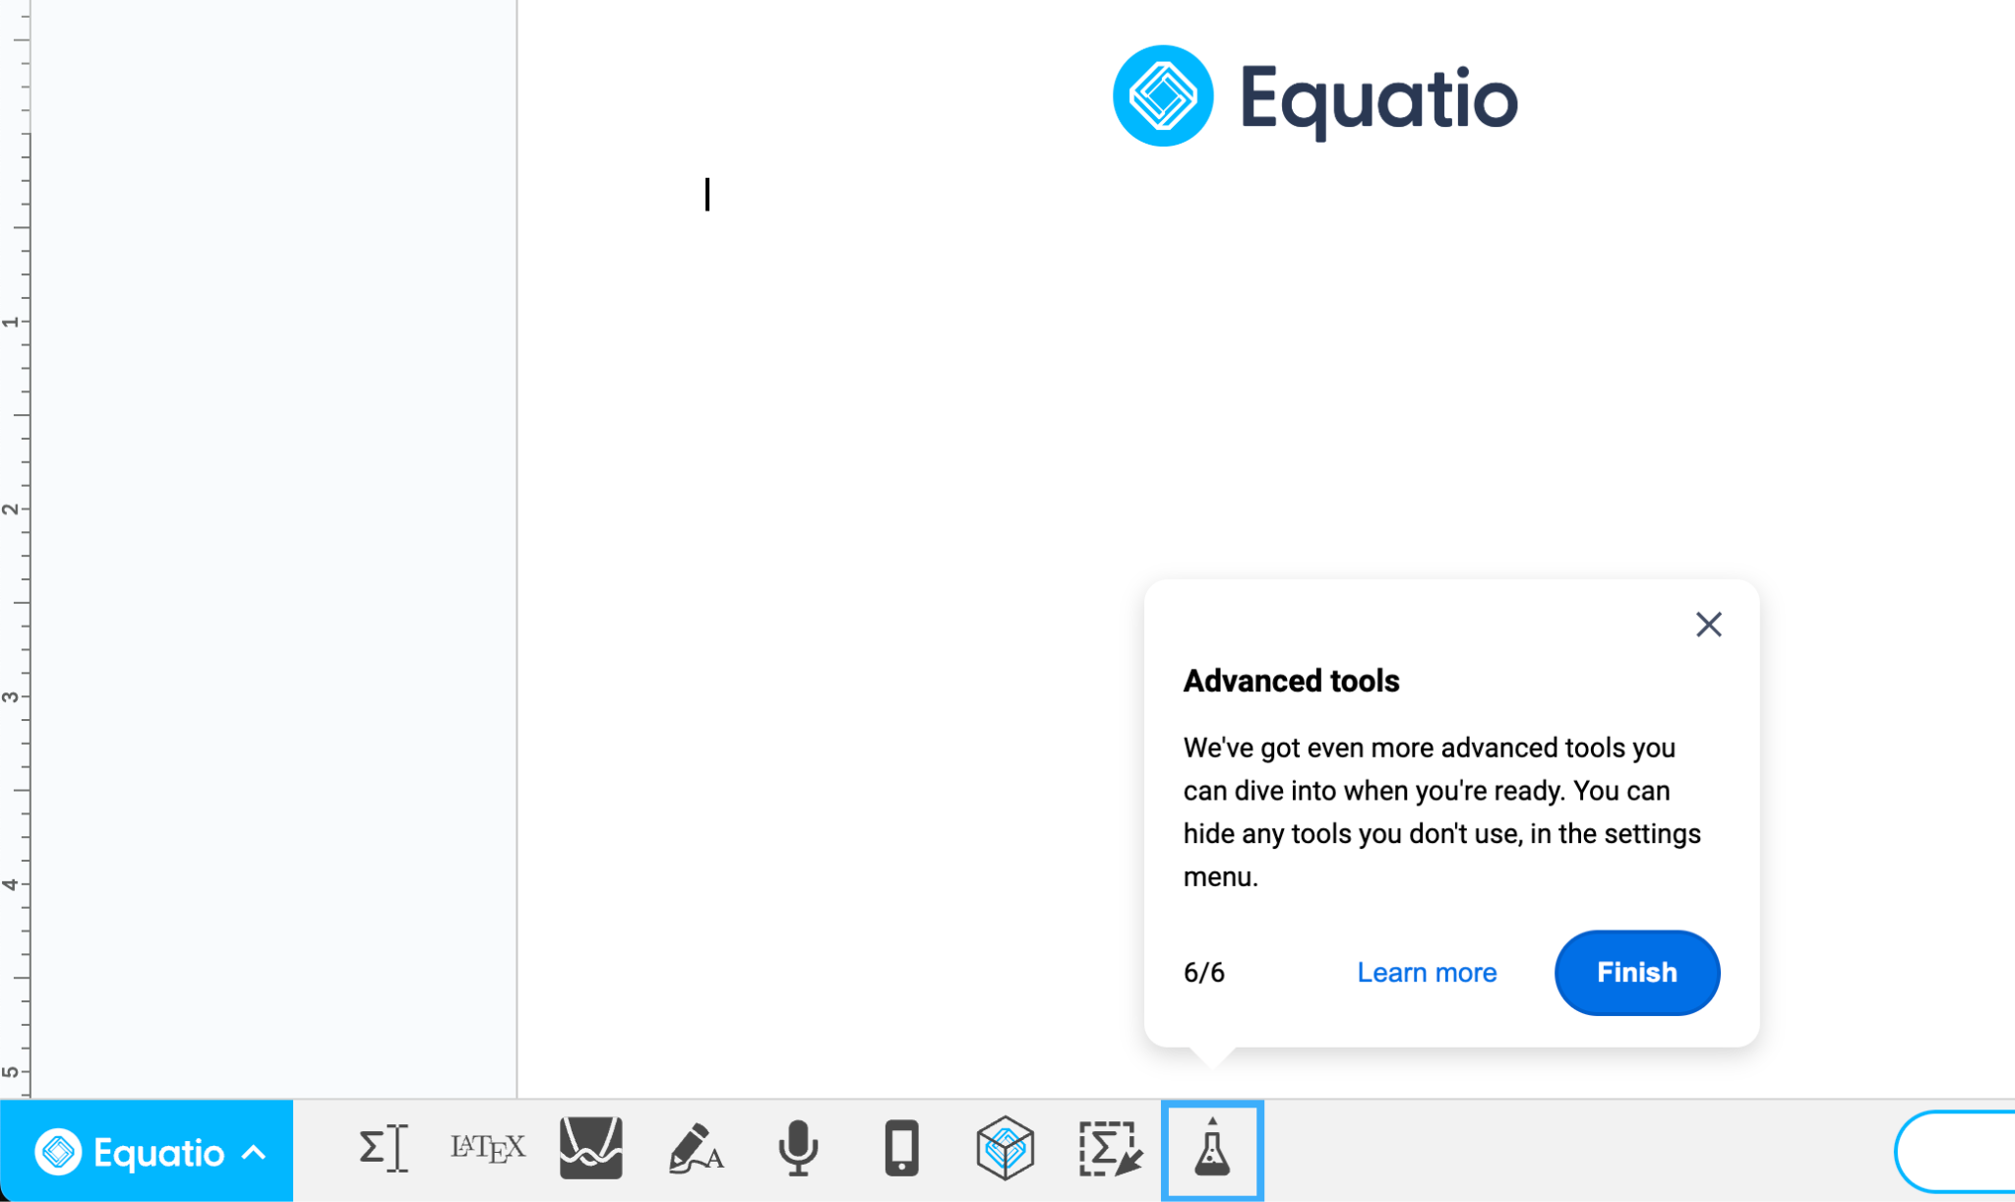
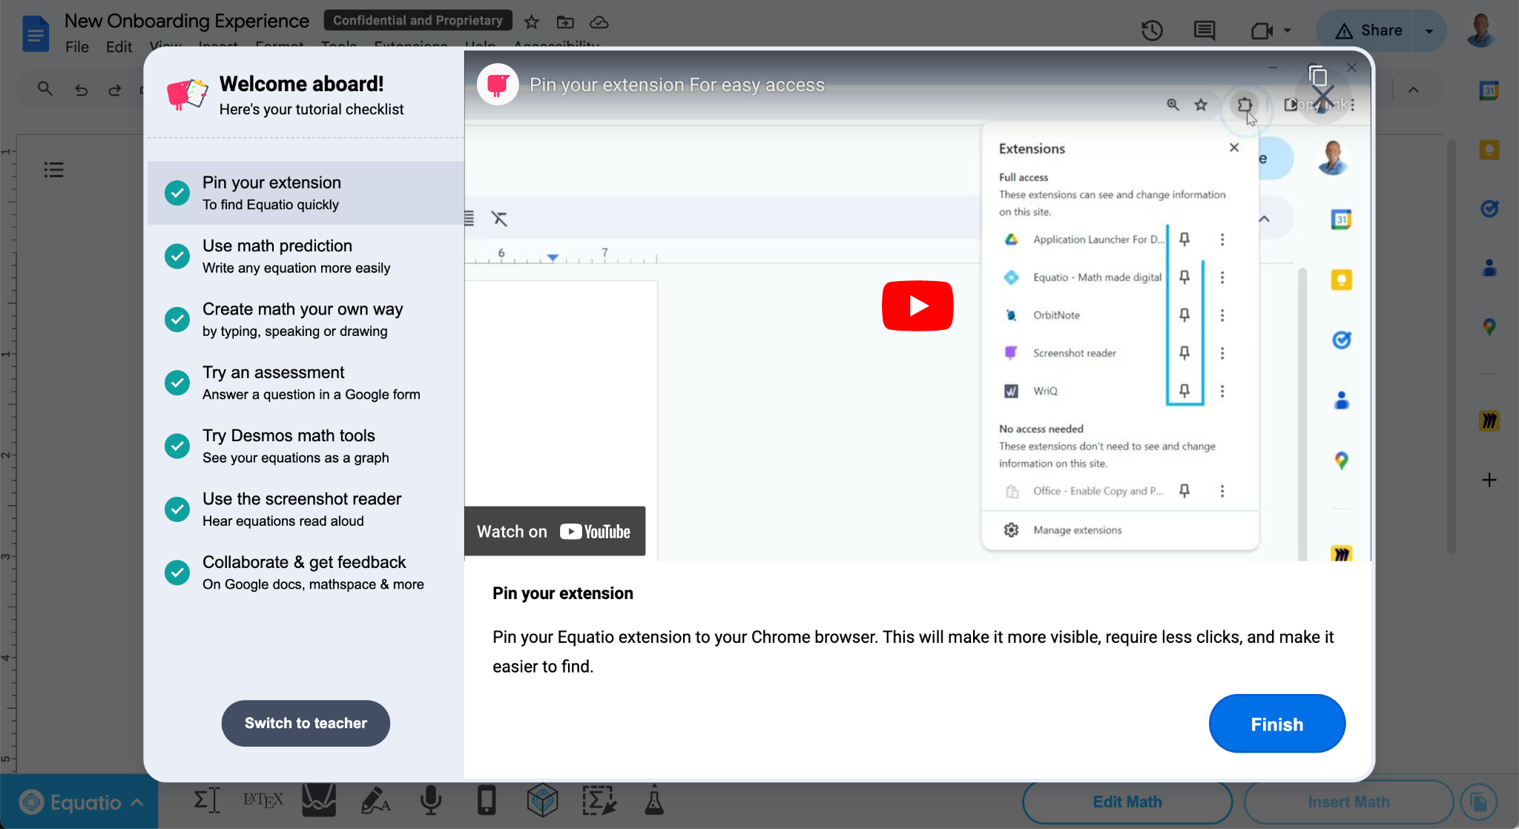
The New Experience Contains 2 Ways In Which A Learner Can Use The Product
Product Tour
Video Tutorials/w Checklist
The New Equatio Onboarding Experience
The New Equatio Onboarding Experience

Slide 27
Digital Transformation

Slide 28
What’s Digital Transformation
“Digital transformation in higher education is the strategic use of digital technologies to improve the educational experience and how institutions operate. It involves a comprehensive approach that changes how institutions deliver value to students and staff, and requires a strategic approach across multiple departments, faculties, and campuses.”

Slide 29
What’s Digital Transformation Numbers
“About two out of three CTOs said the digital transformation of their institution is essential (23 percent) or a high priority (39 percent).” - From Inside Higher Ed article
“Regarding their institution’s priority areas for digital transformation efforts, many CTOs (81 percent) cited student success.”- From Inside Higher Ed article

Slide 30
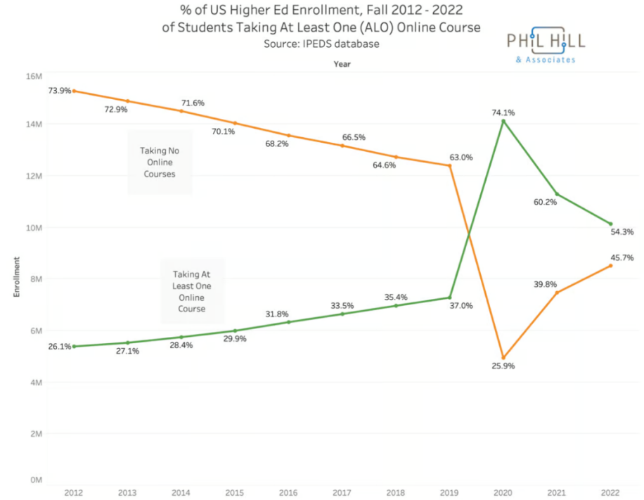
Online Learning
54%
of college students took one or more of their classes online in fall 2022
SOURCE: Proof Points: Most college kids are taking at least one class online, even long after campuses reopened

Slide 31
Evolution of education online
Enrollment of one or more online classes has increased since 2012
“Institutions should plan for 75% of overall enrollment to be online and 25% in-person in the next 10 years as online continues to expand rapidly.” - From 10 trends to watch in distance learning from American Association of Community Colleges
Student preference, flexibility, mental health, loneliness epidemic

Slide 32
Let’s Take a Peek - Digital Transformation

Slide 33
Platform integrations
Google Chrome Extension
Microsoft Edge Extension
Windows Desktop
Mac Desktop
Android Tablet
iPad & iPhone

Slide 34
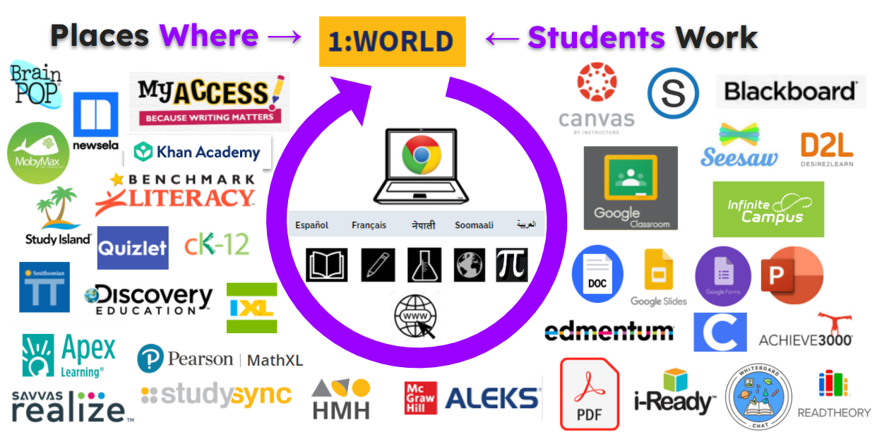
Integration in education is key
For education to truly be inclusive and equitable, tools should be available for all learners in all environments, no matter the place or assignment given.

Slide 35
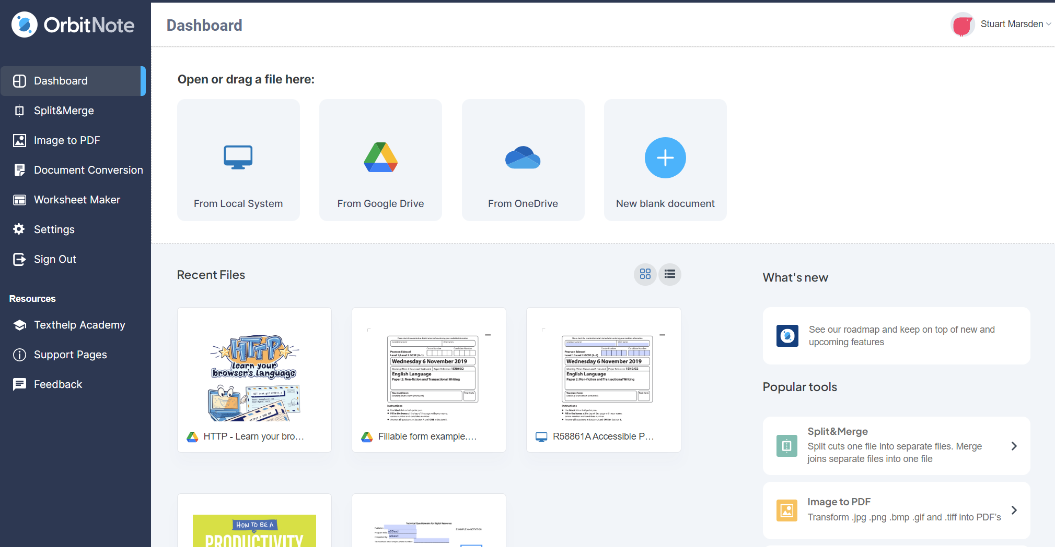
OrbitNote Refresh Dashboard

Slide 36
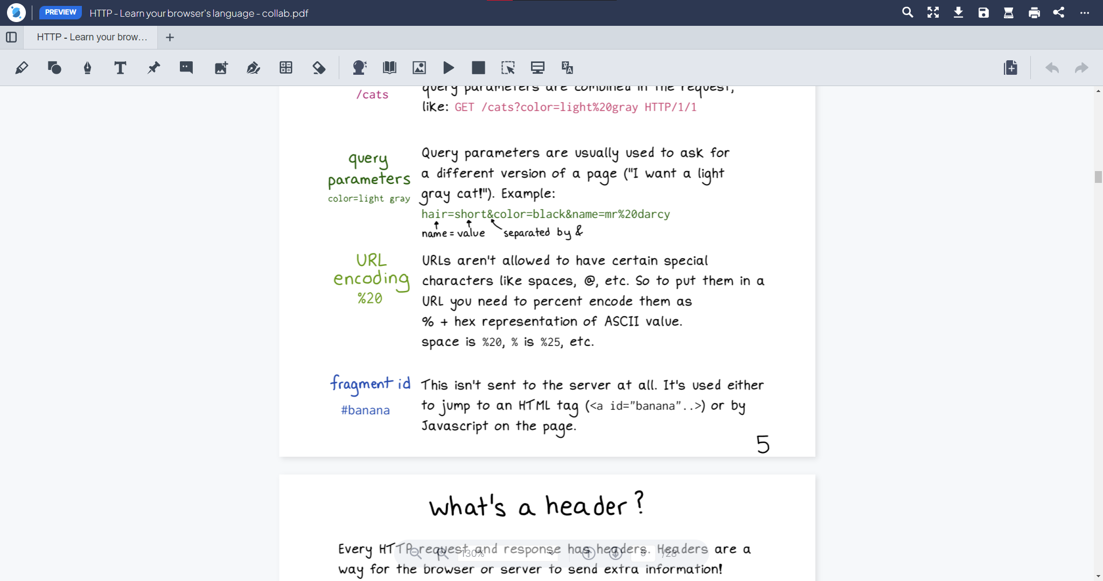
OrbitNote Refresh Interface

Slide 37
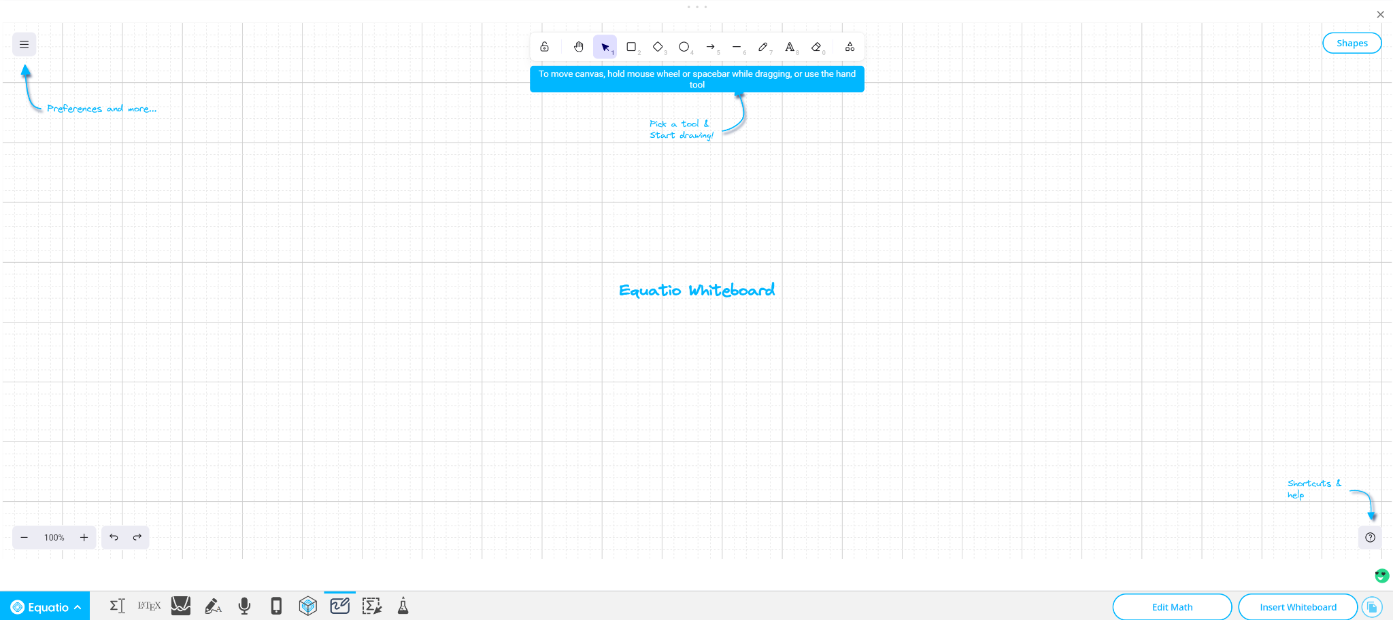
New Input Method!
Whiteboard Tool

Slide 38
Data and Analytics

Slide 39
Show me the data!
Data driven decision making is essential
Academic Return on Investment (AROI)
Understanding baseline levels of use, goal setting, active implementation strategies, accountability

Slide 40
Let’s Take a Peek - Data & Analytics

Slide 41
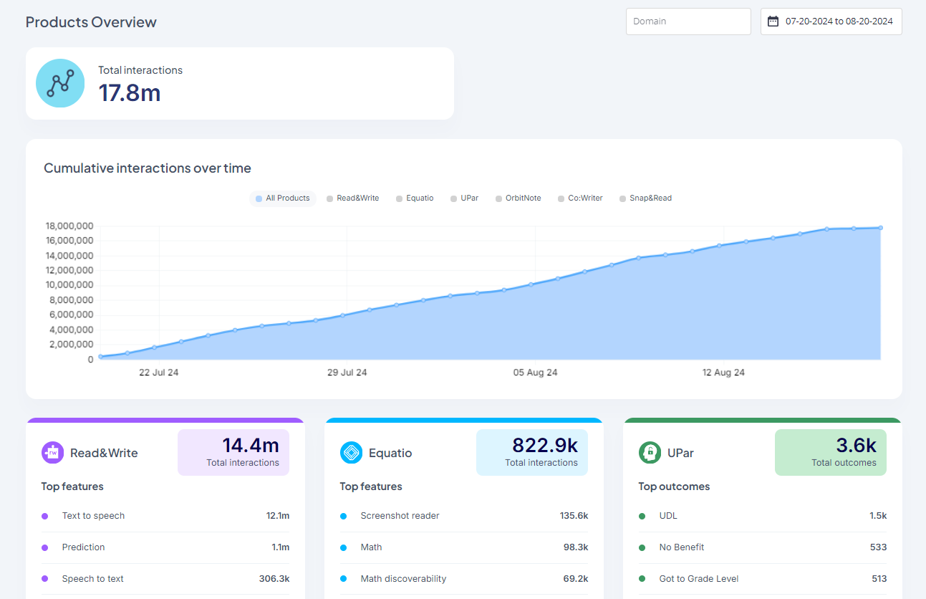
What is the Data Dashboard?
The Data Dashboard is an overview of data engagement trends for all your Texthelp products
What you can see in your data dashboard:
Total interactions
An interaction is any meaningful way that a user interacts with the procut - clicks, inserts, and other actions.
Engagement trends based on date range with default set to 1 month from current date
Access: datadashboard.texthelp.com - reach out to be added

Slide 42
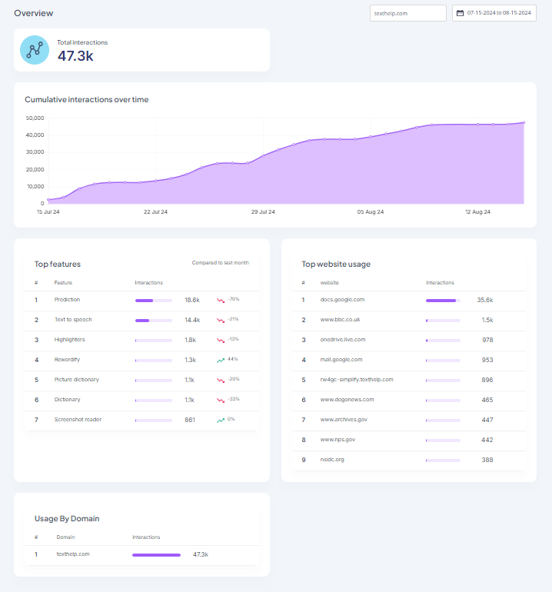
Data Dashboard Product Page
For each product:
Each product page provides a high level look at total usage, as well as more detailed insights into top features used and top websites for certain products.
The available data includes:
Total number of interactions across the domain
Cumulative usage over time
Top features used and % change compared to the previous time period
Top websites where the tools are used (where available)
Usage broken down by domain

Slide 43
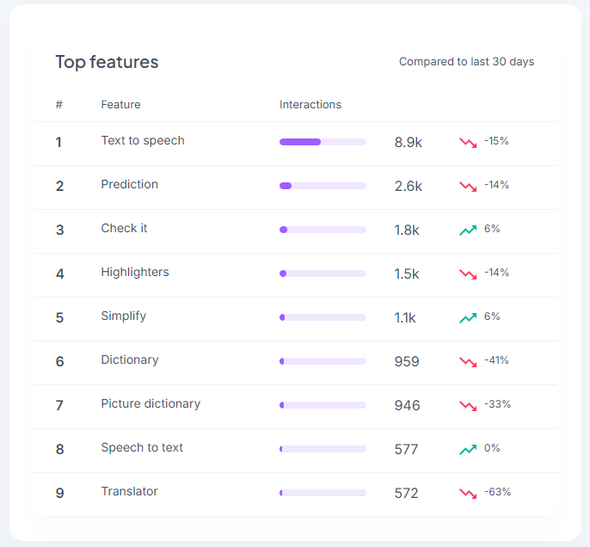
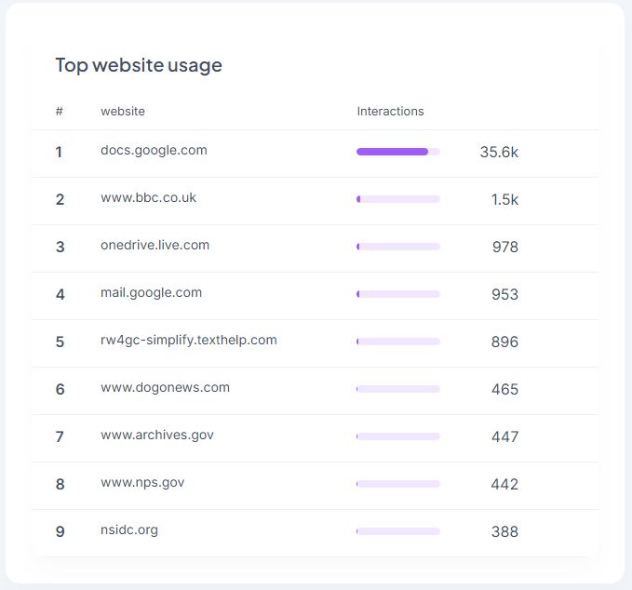
Data Dashboard Top Website
Top Features & Top Websites
Number of interactions
% of increase or decrease as compared to date range

Slide 44
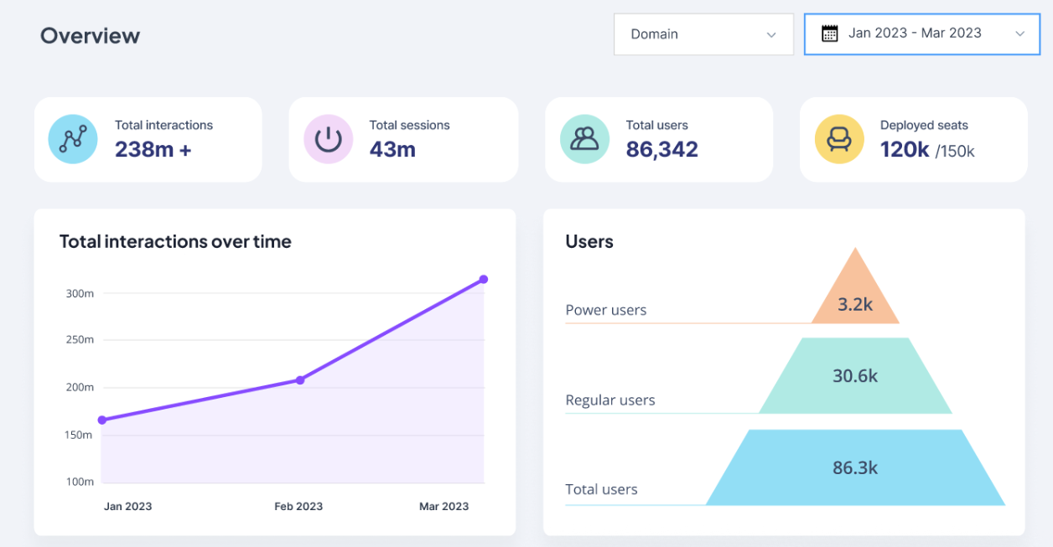
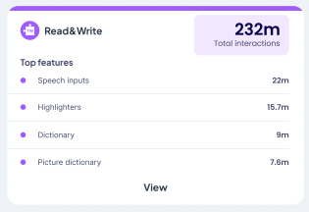
Data Dashboard Roadmap
The Data Dashboard has an exciting roadmap.
This includes things like…
User analysis - breakdown of data like deployed seats, total users, and active users
Desktop usage statistics
Turning features on and off (certain LMSs and sign in methods)

Slide 45
Artificial Intelligence

Slide 46
Artificial Intelligence Sentiments
Tech - embracing AI, imbedding in our institutions
Students - actively using
Faculty
Disability Resources & Staff

Slide 47
Artificial Intelligence Numbers
“...9 percent of chief technology officers believe higher education is prepared to handle the new technology’s rise.”
“The CTO survey found that the most popular applications of AI after chat bots included enhancements of cybersecurity (35 percent), predictive analytics for student performance and trends (27 percent), research and data analysis (24 percent), and learning management systems (20 percent).”
From: Most Campus Tech Leaders Say Higher Ed Is Unprepared for AI’s Rise

Slide 48
Let’s Take a Peek - AI

Slide 49
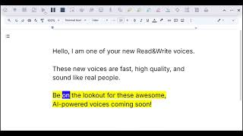
New Voices (finally!)
What’s next
Introducing new, AI-powered text to speech voices made by ElevenLabs.
These will be premium voices added to Read&Write for Google Chrome first, and more products to follow.

Slide 50
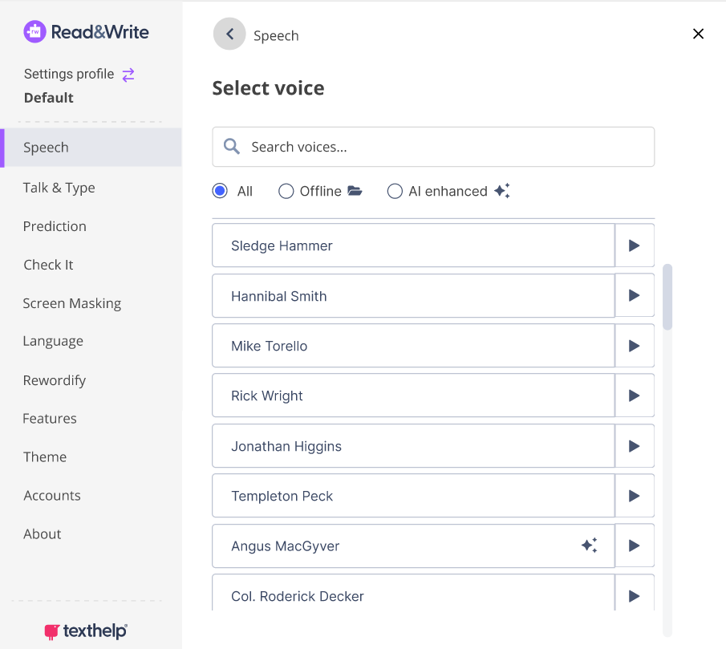
New and improved voice list
What’s next
The new voice list will make it easier for students to find the voice that works best for them.
This includes new filtering options, and the ability to preview what the voices sound like.

Slide 51
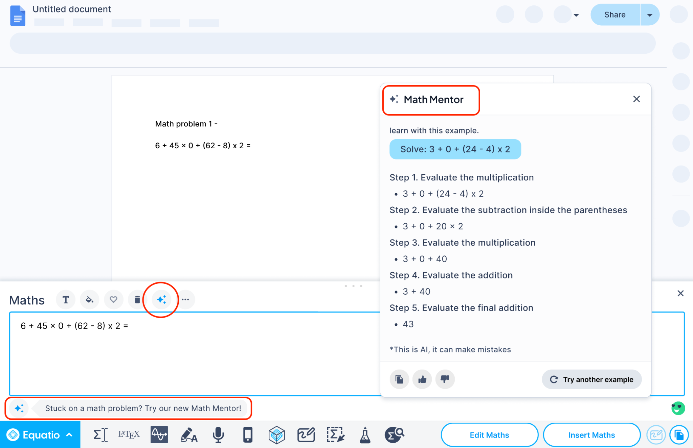
Equatio Math Mentor
What’s next
Academic integrity considerations - does not give answer to problem
Embedded in the tool for ease of use and access
Ability to turn on and off for assessment

Slide 52
Questions & Discussion

Slide 53
Let’s Connect!
Rachel Kruzel, ATP
Higher Education Specialist
Texthelp
Email: r.kruzel@texthelp.com
Phone: 651-245-3128

