Slide 1
Confronting and Addressing Barriers:
UDL, AT Myths and Biases
Accessing Higher Ground 2024

Slide 2
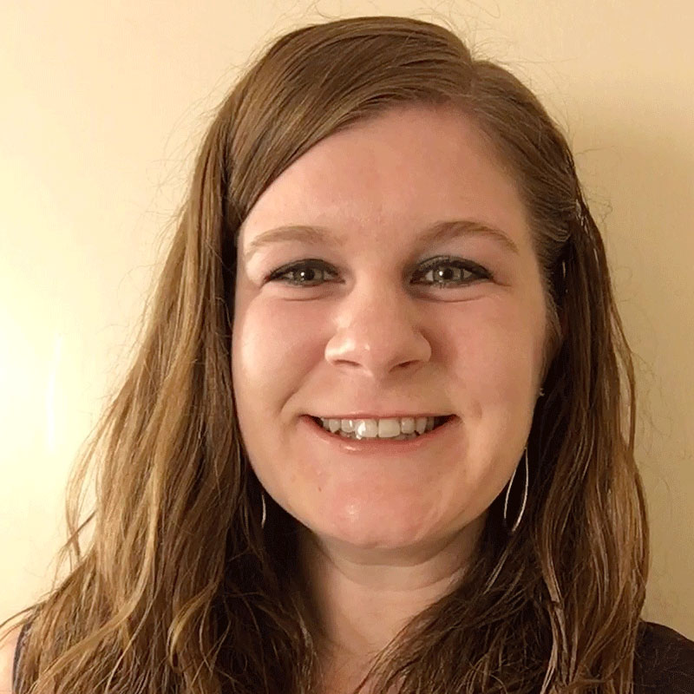
Hello There!
Rachel Kruzel, ATP
Higher Education Specialist
Texthelp
Email: r.kruzel@texthelp.com
Phone: 651-245-3128

Slide 3
Today’s Agenda
Our College Students Today
Awareness Building
Questions and Discussion
Campuswide adoption of AT tools
Building Partnerships

Slide 4
Focuses of Colleges Today

Slide 5
Disclosure in college
37%
70%
of higher education students with a disability reported it to their institution.
70%
of higher education students with a mental health condition do not register for accommodations.
37%
National Center for Education Statistics. (2022, April 26). A Majority of College Students with Disabilities Do Not Inform School, New NCES Data Show. Retrieved from: https://nces.ed.gov/whatsnew/press_releases/4_26_2022.asp
Mental Health America. (2020.). 2020 disability and Campus Mental Health Report. 2020 Disability And Campus Mental Health Report. Retrieved from: https://mhanational.org/get-involved/2020-disability-and-campus-mental-health-report

Slide 6

Disability and Neurodiversity
Students with disabilities, those who identify as neurodiverse and those who have a mental health condition make up a large part of college and university populations
19.4%
11-30%
>60%
of college students reports having a disability.¹
Number of college students who identify as neurodiverse.²
of college students meet the criteria for least one mental health condition.³

Slide 7

Weis, R., Waters, E.A. Evidence-Based Accommodations for Postsecondary Students with Disabilities: Beware the Base Rate Fallacy. Psychol. Inj. and Law 16, 213–226 (2023). https://doi.org/10.1007/s12207-023-09471-7
“A large, diverse sample of undergraduates with and without disabilities rated their academic functioning across multiple domains… Overall, 95.5% of students with disabilities an 90.0% of students without disabilities reported at least one substantial limitation in academic functioning.”

Slide 8
Depth and breath of student access
Students with disabilities
Undiagnosed, underdiagnosed or lack of connection with DS
Neurodiversity
Mental Health
Academic preparedness & students of today entering our institutions
Dual enrollment and returning learners
Online & hybrid learning

Slide 9

Inclusion is everywhere

Slide 10
AT & UDL Myths & Biases

Slide 11
Universal Design for Learning Guidelines 3.0
Universal Design for Learning Guidelines 3.0
  Updated and released on July 30th
  “...to address critical barriers rooted in bosses and systems of exclusion.” and “...the Guidelines as a tool to guide the design of learning environments that more fully honor and value every learner.”
Assistive technology - method of UDL for for wider access and support (4.2)

Slide 12
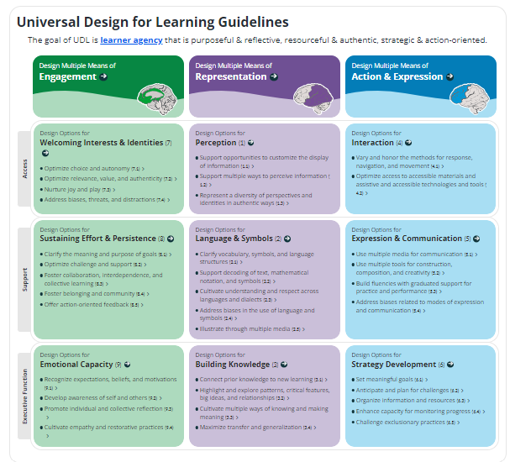
Universal Design for Learning Guidelines 3.0 website
Changes from Guidelines Version 2.2 to Guidelines Version 3.0

Slide 13
Reflection:
Do I believe in any of these myths or biases?
Do colleagues I work with in my office believe in any of these myths or biases?
Are there faculty I work with that believe in any of these myths or biases?
Are there senior leaders I work with that believe in any of these myths or biases?

Slide 14

Disclaimer

Slide 15
The “What” of AT

Slide 16
What Myth 1 Statement
Assistive technology gives learners a leg up.

Slide 17
What Myth 1 Insight
Assistive technology gives learners a leg up.
Assistive technology provides equal access. Some features built into assistive technology might provide additional supports above and beyond the impact of a disability. But these features can benefit a wider population of students on campus and/or address other challenges students face around executive functioning, incomplete development of study skills or academic core competencies.

Slide 18
What Myth 2 Statement
Assistive technology lowers a learner's motivation because it does the work for them.

Slide 19
What Myth 2 Insight
Assistive technology lowers a learner's motivation because it does the work for them.
Studies show that having access to assistive technology actually motivates learners to do the work as they can reach the curriculum and show what they know. This one of the UDL Guidelines.
From Myths and Facts Surrounding Assistive Technology Devices and Services

Slide 20
What Myth 3 Statement
Assistive technology is always electronic and is high tech.

Slide 21
What Myth 3 Insight
Assistive technology is always electronic and is high tech.
Assistive technology is on a continuum from low to high tech. Sometimes the best assistive technology for a learner is the lowest tech, such as planner, highlighters or Post-It notes.

Slide 22
What Myth 4 Statement
The programs we’ve used in our office (on campus) historically are good enough for our students.

Slide 23
What Myth 4 Insight
The programs we’ve used in our office historically are good enough for our students.
Periodically, we should review the assistive technology available to ensure we are providing the tool that best support learners, their needs and the environments they are working within. Having students as part of this process is key through surveys for feedback on current tools, future tool needs and/or as selection committee members.

Slide 24
What Myth 5 Statement
The assistive technology programs I recommend to students are the ones I am most comfortable with.

Slide 25
What Myth 5 Insight
The assistive technology programs I recommend to students are the ones I am most comfortable with.
Students are coming to our campuses having used types of tools and technology in stark contrast to what we have used historically. To truly meet our learners where they are at, we need to adapt and lead with tools and platforms that they are comfortable with and have used before.

Slide 26
The “Who” of AT

Slide 27
Who Myth 1 Statement
Assistive technology should only be given to students who identify with my office as having a disability.

Slide 28
Who Myth 1 Insight
Assistive technology should only be given to students who identify with my office as having a disability.
Most recent statistics show that approximately 2/3rds of students with disabilities do not disclose to the disability resources office. Nearly 70% of students with mental health conditions do not disclose. These students likely would benefit from AT. Universally provided tools can help bridge this gap in access.

Slide 29
Who Myth 2 Statement
Only certain disabilities should be considered or provided access to assistive technology.

Slide 30
Who Myth 2 Insight
Only certain disabilities should be considered or provided access to assistive technology.
Every disability should be considered for assistive technology. Based on the impact of the disability, the question “would a piece of assistive technology support a learner and/or create equal access” should be asked.

Slide 31
Who Myth 3 Statement
Only low incidence disabilities can benefit from AT.

Slide 32
Who Myth 3 Insight
Only low incidence disabilities can benefit from AT.
All disabilities can benefit from assistive technology, with many providing equal access. Text-to-speech, speech-to-text, notetaking, organizational tools to support executive functioning all traditionally support students with high incidence disabilities.

Slide 33
Who Myth 4 Statement
If my students aren’t asking for assistive technology, they don’t want or need it.

Slide 34
Who Myth 4 Insight
If my students aren’t asking for assistive technology, they don’t want or need it.
Just because a student doesn’t ask, doesn’t mean they don’t need or require assistive technology. For most high incidence students, their first exposure to or awareness of assistive technology is when they reach a college or university. Some studies say 90% of students are first exposed to AT in college.

Slide 35
Who Myth 5 Statement
Students who need or want assistive technology have used it or are aware of it prior to coming to college.

Slide 36
Who Myth 5 Insight
Students who need or want assistive technology have used it or are aware of it prior to coming to college.
The majority of students have not used nor are they aware of AT prior to coming to college. With a rise in number of districts providing AT universally to all students, the number of students who have used or have been exposed to tools like text-to-speech prior to college is increasing.

Slide 37
Who Myth 6 Statement
If a student’s documentation doesn’t say they need assistive technology as a recommendation, then they won’t benefit from having it.

Slide 38
Who Myth 6 Insight
If a student’s documentation doesn’t say they need assistive technology as a recommendation, then they won’t benefit from having it.
While some documentation calls out AT that can be a benefit, professionals should consider if assistive technology would be an appropriate accommodation to provide equal access.

Slide 39
Text-to-speech/literacy support

Slide 40
TTS/Literacy Myth 1 Statement
Assistive technology for reading support is only for students with a specific learning disability.

Slide 41
TTS/Literacy Myth 1 Insight
Assistive technology for reading support is only for students with a specific learning disability.
Text-to-speech is beneficial for any disability which impacts a student’s ability to concentrate, attend, comprehend, engage, or decode. It can also lower the cognitive load for learner. This includes mental health condition and medication side effects.

Slide 42
TTS/Literacy Myth 2 Statement
A disability which impacts a student’s ability to read, won’t impact their ability to write.

Slide 43
TTS/Literacy Myth 2 Insight
A disability which impacts a student’s ability to read, won’t impact their ability to write.
Reading and writing have a unique interplay. You use reading skills when you write, such as when editing and proofreading your content, determining complete sentences or run on sentences, grammar and/or spelling errors, flow, paragraph structure and descriptive language and details.

Slide 44
TTS/Literacy Myth 3 Statement
Assistive technology to support reading, such as a text-to-speech tool is only needed when a student is reading an exam or formative assessment.

Slide 45
TTS/Literacy Myth 3 Insight
Assistive technology to support reading, such as a text-to-speech tool is only needed when a student is reading an exam or formative assessment.
A disability which impacts reading knows no boundaries. The includes reading an exam, reading a book, reading an article, reading an LMS or reading a website, just to name a few.

Slide 46
TTS/Literacy Myth 4 Statement
Accessible course content for access with a text-to-speech tool only applies to textbooks and printed materials, not LMS content or other digital materials.

Slide 47
TTS/Literacy Myth 4 Insight
Accessible course content for access with a text-to-speech tool only applies to textbooks and printed materials, not LMS content or other digital materials.
Course content includes all materials a student engages with. Many people focus on just what was historically print materials due to their capacity or knowledge of AT functionality. Finding tools that interface with the varied platforms for integrated access is key for equal access for learners.

Slide 48
Financing

Slide 49
Financing Myth 1 Statement
My office budget is limited. I can’t/don’t have to/are unable to provide assistive technology to my learners.

Slide 50
Financing Myth 1 Insight
My office budget is limited. I can’t/don’t have to/are unable to provide assistive technology to my learners.
Continued and ongoing advocacy efforts for budgets and funding are key to sustain the efforts of your office and to provide access to students. Tying your initiatives to wider campus priorities is one strategy to help get senior leaders on board.

Slide 51
Financing Myth 2 Statement
Free or low cost assistive technology tools works fine for my learners.

Slide 52
Financing Myth 2 Insight
Free or low cost assistive technology tools works fine for my learners.
While free and low cost assistive technology tools are budget friendly, they are often limited in their scope, features, capacity, development and sustainability. Many times, it takes multiple tools to get students the access that can be found in a single tool. Using multiple tools increases the complexity and cognitive load for learners.

Slide 53
Financing Myth 3 Statement
Using multiple apps or extensions to give students the access they need for assistive technology is just fine.

Slide 54
Financing Myth 3 Insight
Using multiple apps or extensions to give students the access they need for assistive technology is just fine.
The more tools a student is responsible for using and knowing how to use, the more cognitive load it takes to engage with course content. Having multiple tools for equal access is creating barriers for learners, not removing them.

Slide 55
Financing Myth 4 Statement
I’m providing the accommodation/equal access even though the student is using multiple tools.

Slide 56
Financing Myth 4 Insight
I’m providing the accommodation/equal access even though the student is using multiple tools.
Typically, multiple tools which attempt to address the same barrier instead increase the cognitive load for learners. This can cause frustration and ultimately abandonment of their assistive technology tools.

Slide 57
Financing Myth 5 Statement
If a student likes an assistive technology tool enough, they can purchase it on their own for access.

Slide 58
Financing Myth 5 Insight
If a student likes an assistive technology tool enough, they can purchase it on their own for access.
If the tool is determined to be an effective accommodation for the learner, then the student should not be self-funding access to a device, software or assistive technology tool.

Slide 59
Training & Implementation

Slide 60
Training & Implementation Myth 1 Statement
Providing the AT tool to a student is enough. They can figure out how to use it on their own without training or support from me.

Slide 61
Training & Implementation Myth 1 Insight
Providing the AT tool to a student is enough. They can figure out how to use it on their own without training or support from me.
Providing the tool is only part of access. Students will require some level of training or support from you, your office or campus as it relates to these tools. It is campus’ responsibility to find the support and resources for students.

Slide 62
Training & Implementation Myth 2 Statement
Students have grown up in the digital age. They can figure out how to use this assistive technology on their own.

Slide 63
Training & Implementation Myth 2 Insight
Students have grown up in the digital age. They can figure out how to use this assistive technology on their own.
Despite growing up in the digital age, students are technologically savvy with mobile devices and tools they are used to using. Tools or devices which differ from this can be a challenge for students to learn.

Slide 64
Training & Implementation Myth 3 Statement
I have limited capacity to help with training and support on assistive technology. Providing the tools to students is enough.

Slide 65
Training & Implementation Myth 3 Insight
I have limited capacity to help with training and support on assistive technology. Providing the tools to students is enough.
Advocating for resources and supports, which also creatively finding solutions is key in supporting learners with assistive technology onboarding and training.

Slide 66
Training & Implementation Myth 4 Statement
Supporting a learner with AT takes a lot of time and effort.

Slide 67
Training & Implementation Myth 4 Insight
Supporting a learner with AT takes a lot of time and effort.
While some AT tools are complex and require copious amounts of training, for the majority of students, the AT tools they will use require little time to learn. This can be in less than 15 minutes. For students with more complex needs, partnering with outside agencies or consultants can be key in providing the appropriate amount and type of training a student needs to effectively use a tool.

Slide 68
Training & Implementation Myth 5 Statement
I have to coordinate, fund, vet, implement and train assistive technology (universal technology/ edtech) own my own.

Slide 69
Training & Implementation Myth 5 Insight
I have to coordinate, fund, vet, implement and train assistive technology (universal technology/ edtech) own my own.
You are part of a wider campus ecosystem. Collaborate with your colleagues to help fund and implement these tools. Student support offices and technology teams on campus are some of your best AT assets. Collating resources is key to share with students to support training efforts.

Slide 70
Communication & Collaboration

Slide 71
Why myths and biases?
Human experience
Culture
Categorization
Misinformation/misinformed/misunderstanding/lack of information
Confirmation bias

Slide 72
Changing mindsets
Empathic listening
Growth mindset vs. fixed mindset
Education around cognitive biases
  Foster open-mindedness and critical thinking
New or updated information
  Evidence-based information

Slide 73
The Six Principles of Persuasion
Reciprocity - return favors, payback
Scarcity - innovation and short supply to get buy-in
Liking - the more you’re liked, the more you’ll persuade
Authority - influencers, titles, leaders are followed
Social Proof - what are your peers doing? competition?
Commitment/Consistency - alignment of beliefs and values

Slide 74
The Yes Ladder
Getting to the final yes is like a ladder - one step at a time
Steps (from The Scientifically Proven Method For Getting People to Say Yes)
  What is your big ask?
  Work backwards
  Play your first ‘yes’
  Encourages trust

Slide 75
Key partnerships
Instructional Design
Retention, Student Success & Student Support
CEO & CIO (Experience and Innovation)
Faculty?
Intentionality of connection is key

Slide 76
Letting It Happen versus Making It Happen
When actively working on implementation, using research backed strategies, you can expect up to an 80% outcome of what you’re seeking in three years.
If you don’t use implementation science strategies, you will only see 14% of the desired outcomes and it can take you up to 17 years to get to your desired outcomes.
This is why things start, stop, and fizzle out and why we don’t get lasting impact.

Slide 77
Action Planning

Slide 78
Actions for Campus
Refer to the last two pages of the document
  Which myth(s) or biases do you want to address and with whom?
  What actions steps are needed to help change view or people’s mindsets of this myth or bias? What is the messaging?
  What resources and/or support are needed?

Slide 79
Questions & Discussion

Slide 80
Let’s stay connected!
Rachel Kruzel, ATP
Higher Education Specialist
Texthelp
Email: r.kruzel@texthelp.com
Phone: 651-245-3128

