Slide 1
New Department of Justice Title II Web Accessibility Regulation
Ken Nakata
Converge Accessibility LLC

Slide 2
Who Am I?
Ken Nakata
Principal, Converge Accessibility LLC
12 years as a Trial Attorney with the U.S. Department of Justice
Helped shape the government’s policies for the Americans with Disabilities Act and Section 508 of the Rehabilitation Act
Work with several attorneys across the country facing web accessibility lawsuits.
Help cities, counties, and local governments to comply with web accessibility laws and regulations and integrate with existing accessibility programs.

Slide 3
Agenda
Web accessibility before the new regulation
DOJ’s new title II regulation, limitations, and impact
Implications for private sector
Impact on education
Threats to the new regulation post-Chevron

Slide 4
Web Accessibility Before New Regulations
Part of “effective communication” and subpart E. 28 C.F.R. § 35.160 et seq.
Martin v. MARTA, 225 F. Supp. 2d 1362 (N.D. Ga. 2002).
Later DOJ Project Civic Access (PCA) settlements required WCAG conformance.
Technical assistance on ADA.gov

Slide 5
New Title II Web Accessibility Regulations
New subpart H requires WCAG 2.1 A/AA conformance. 28 C.F.R. § 35.200 et seq.
Required by April 24, 2026 (50K or larger) or April 24, 2027.
Includes usual limitations of undue burden, fundamental alteration (and direct threat)
Includes WCAG’s allowance for conforming alternate versions.

Slide 6
New Limitations in Regulations
Controversial exceptions for:
Archived web content,
Preexisting conventional electronic documents,
Content posted by a third-party,
Individualized, password-protected documents, and
Preexisting social media posts

Slide 7
Implications for Private Sector
Title III regulations for web accessibility highly unlikely due to Congressional Review Act.
Also, Title III is ambiguous about whether websites are “places of public accommodation” (and will create issues post-Chevron).
Section 504 regulations (e.g. new HHS regulations)
State laws (e.g. California SB 1486)

Slide 8
Impact on Education
No impact on private sector education (unless Ed comes out with a 504 web access rule)
Clear directive towards WCAG 2.1 A/AA for public sector education
Unclear how limitations will affect OCR’s position

Slide 9
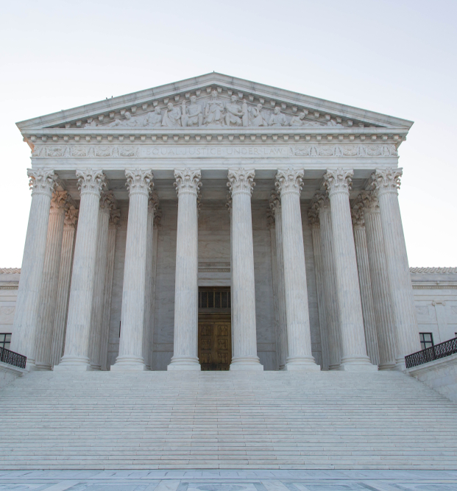
Threats to DOJ Web Accessibility Regulation Post-Chevron
Loper Bright Enterprises v. Raimondo (U.S. 2024).
Title II likely safe as Congress expressly delegated rulemaking to DOJ … but didn’t tell them to create standards for website.
Title III has big ”gap” and “ambiguity” about coverage of private sector so even more vulnerable.

Slide 10
Lessons from Colorado
Create a Digital Accessibility Plan that includes basic Title II duties.
Develop tools that IT and procurement departments can use to allocate resources and meet needs (e.g. risk matrices, RACI diagrams, procurement flowcharts, IT asset accessibility scorecards).
Start soon and stay nimble for easier, faster solutions
Stay tuned for upcoming workshops from Converge that include tools that have worked with Colorado counties and municipalities.

Slide 11
Digital Accessibility Plan
Major Areas of Focus
Existing Technologies
New Technologies and Procurement
Electronic Documents and PDFs
Training
Prerequisites
Organizational buy-in and support
IT control of digital assets
Process
Messaging, communications plan, FAQ to secure buy-in
Understanding of how accessibility compliance is critical-– just like privacy and security

Slide 12
IT Process Tools
Common Tools
Risk matrices
RACI diagrams
Procurement flowcharts
Digital accessibility asset scorecards
Goal is program access and not perfect WCAG compliance
Copy tools from others and make them your own

Slide 13
Start Fast and Be Nimble
New assessment solutions (e.g. Allyant ProcureEnsure) and PDF solutions (e.g. CommonLook, Crawford, and Continual Engine) are making this much cheaper and far easier.
Start fast before they get overwhelmed and you need pricier solutions and delays.
Keep an accessibility partner who is technology-agnostic and process-oriented.

Slide 14
Shameless Plug
We have won most of the recent Colorado RFPs because of our legal and policy expertise-- and because we are strictly neutral between solution providers.
We specialize in empowering accessibility teams by creating communications plans and overall strategy that focuses on meeting accessibility laws and regulations.
Stay tuned for upcoming workshops in early 2025 that includes the tools for doing this yourself-- or contact us.

Slide 15
Thank You!!
Ken Nakata
ken.nakata@convergeaccessibility.com
www.convergeaccessibility.com

