Slide 1
Leveraging LaTeX: Using LaTeX to Craft Accessible Math in Digital Documents
Notes:
https://go.iu.edu/4Rgb
https://brichwin.pages.iu.edu/math-a11y/ahg2023/leveraging_latex.html

Slide 2
Presenters:
Brian Richwine, CPACC
Senior Accessibility Strategist – Learning Tech.
UITS Assistive Technology and Accessibility Centers
brichwin@iu.edu
https://go.iu.edu/4Rgb

Slide 3
Who’s Here? Let’s learn a bit about each other!
Share your name
Your role in education or accessibility
Your experience with LaTeX and/or digital math
One thing you’re hoping to get from this workshop
Tex
Notes:
Welcome, everyone! Before we dive into the world of LaTeX and accessible math, let's get to know each other. Please take a moment to introduce yourself. Share your name, your role in education or accessibility, and your experience with LaTeX—whether you're a newcomer or a seasoned user. Also, let us know one thing you're hoping to take away from today's workshop. This will help us tailor the session to your needs and create networking opportunities.

Slide 4
What is TeX?
Created by Donald Knuth in the late 1970s.
A typesetting system focusing on precise control over document layout.
Users write plain text files and use markup commands to define the structure.
Highly programmable and extensible.
Primarily concerned with the accurate typesetting of mathematical formulas and text.

Slide 5
What is LaTeX?
Developed by Leslie Lamport in the early 1980s.
A set of macros built on top of TeX to simplify the typesetting process.
Provides predefined professional layouts, making document preparation easier.
Focuses on content structure, automating many of the typesetting details.
More user-friendly, with commands for high-level structural elements like chapters, sections, tables, etc.

Slide 6
What are LaTeX’s strengths?
Ideal for scientific and academic documentation
Specializes in producing complex mathematical formulas and precise formatting with minimal effort
Uses plain text and markup commands for structure and formatting
Focuses on logical rather than visual content design
Produces professional, high-quality documents
Notes:
LaTeX is a typesetting system widely used for scientific documents, academic papers, and any material that includes complex mathematical formulas or precise formatting. It excels in producing well-structured and high-quality documents, particularly those containing equations, by using markup tagging conventions to define the general structure of a document, to format text, and to add citations and cross-references. Unlike typical word processors, LaTeX users define the content's structure logically rather than visually, resulting in professional-looking documents with minimal effort regarding layout and formatting.

Slide 7
Sample LaTeX document
Notes:
https://guides.nyu.edu/LaTeX/sample-document

Slide 8
Compiled result of the sample LaTeX document
Notes:
https://guides.nyu.edu/LaTeX/sample-document

Slide 9
What is a LaTeX math expression?
Here is an example of a LaTeX math expression (text):
\[ \int_{-\infty}^{\infty} e^{-x^2} dx = \sqrt{\pi} \]
Which, when rendered visually becomes:
$$\int_{−∞}^{∞}{e^{−x^{2}}dx}=\sqrt{π}$$
Notes:
A LaTeX math expression is a way to write complex mathematical formulas using a special coding language, which when processed, creates neatly formatted and publication-quality mathematical notation.

Slide 10
How does LaTeX become accessible math in digital documents?
That’s what we’ll see today – How LaTeX becomes:
MathML (HTML, EPUBs, etc.)
MathType objects (in Word)
Microsoft Equations / Office Math objects (OMath in Word)

Slide 11
How does LaTeX become braille?
The must reliable route is LaTeX math converted into either:
MathType objects in Word
Microsoft Equations in Word
And then, run that Word file through the Duxbury Braille Translator

Slide 12
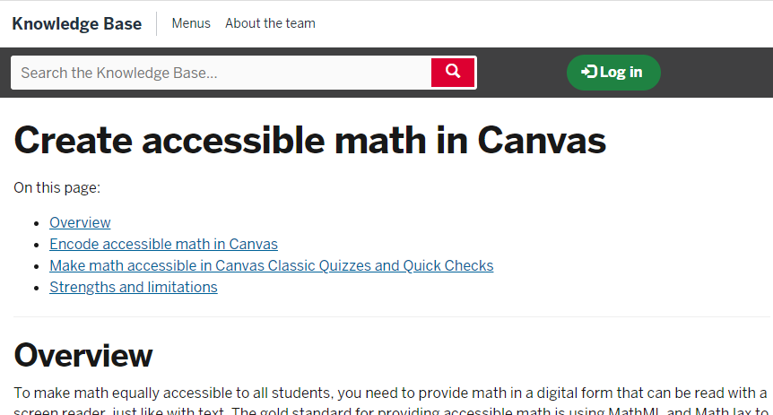
We Started Promoting Digital Math in Courses
Create accessible math in Canvas knowledge base article
LaTeX for Canvas on “Canvas Commons”
Notes:
https://lor.instructure.com/resources/4b4ade4b500c429a96cba0322125a3bf?shared

Slide 13
Build and Collect References!

Slide 14
Where can LaTeX be used?
Unless an individual prefers getting mathematical expressions in raw / plain text LaTeX markup, we need to convert it to MathML (or Office Math)
That means using:
MathType in Word
MathJax in HTML contexts (web pages, rich content editors (RCEs), EPUBs, etc.)
Microsoft Equations in Word (only)

Slide 15
Authoring and Conversion Tool Demos
MathType
Equatio
MathPix:
MathPix Snipping
MathPix Snip
Office Equations
Canvas RCE
Pandoc
Notes:
https://www.overleaf.com/latex/templates/sample-math-exam/ktpvpwmchyvq

Slide 16
Leverage Pandoc to Convert .html to Word
Pandoc is a free Swiss army knife command line tool that can convert between many document formats.
It’s useful for taking “MathPage” .htm / .html files created by MathType and converting into Word documents with Office Math
Here are two command lines that seem to work for this:
pandoc -s --mathml -t docx -o "test2.docx" MathTypeEquations.htm
pandoc -s -o "test.docx" -t html5 -t docx MathTypeEquations.htm
Notes:
pandoc -s --mathml -t docx -o "test2.docx" MathTypeEquations.htm
pandoc -s -o "test.docx" -t html5 -t docx MathTypeEquations.htm

Slide 17
Examples of Incorrect LaTeX (1/3)
Can you spot the error in how the wave number has been represented?
What is wrong with the way it was marked up?

Slide 18
Example of Incorrect LaTeX (2/3)
Can you spot the errors in this sentence?
How do you think this will read aloud?

Slide 19
Example of Incorrect LaTeX (2/3)
Can you spot the likely error in this expression?
How do you think this will read aloud?
Notes:
\[ P(\text{Dice1} = 1 \ and \text{ Dice2} = 1) = \frac{1}{6} \times \frac{1}{6} \]

Slide 20
Example of Incorrect LaTeX (3/3)
Can you determine which trig function is correct?
How do you think this will read aloud?
Notes:
[\sin(\Theta)\textit{ vs. }sin(\Theta)\]

Slide 21
We Started Promoting Digital Math in Courses
Create accessible math in Canvas knowledge base article
LaTeX for Canvas on “Canvas Commons”
Notes:
https://lor.instructure.com/resources/4b4ade4b500c429a96cba0322125a3bf?shared

Slide 22
Give faculty the Ah-ha! moment
Many faculty thought there is no way a student could access math in a web page or document
Use the demos to show them it can work
As a bonus they learn how to check their own creations!
Now they have control on when they make their content again.

Slide 23
Considerations for Hiring Editors / Designers
Get to know faculty and staff in schools where LaTeX is used
Ask faculty for recommendations
Give candidates a clear expectation of the work they will be doing
Have a writing/editing exercise as part of the interview
This is detailed work! Ask about how they maintain focus to attention to detail.

Slide 24
DAISY Webinars on Accessible Math
The DAISY Consortium produces many great online Webinars.
Their Creating and Reading Accessible Math Webinar covers using tools to produce accessible Word, HTML, and EPUB output.
https://daisy.org/news-events/articles/creating-reading-accessible-math-w/

Slide 25
Thank You! Feel free to contact me:
Brian Richwine, CPACC
Senior Accessibility Strategist – Learning Tech.
UITS Assistive Technology and Accessibility Centers
brichwin@iu.edu
https://go.iu.edu/4Rgb

