Slide 1
What Fit and Flopped: Reflections of Accessibility Initiatives
Steven Kolberg, MA
Senior Coordinator, Accessibility and LMS Administration
Office of Information Technology
Florida SouthWestern State College
Kevin Price, MSW
Assistant Director of Accessible Technology
Student Accessibility Services
University of Central Florida

Slide 2
Key Points
Limited stakeholder buy-in can hinder accessibility initiatives.
Ongoing networking and education are vital for accessibility knowledge.
Keep brainstorming until you find the right initiative for your organization's needs.

Slide 3
Agenda
Steven’s Initiatives that Fit & Flopped
Kevin’s Initiatives that Fit & Flopped
Collaboration Time to Share Your Initiatives

Slide 4
Steven’s Initiatives that Fit & Flopped
Weekly Accessibility Tips included within Student and Faculty/Staff email blasts.
Professional Development:
Weekly “Accessibility Tech Tuesday” training sessions.
New Faculty/Adjunct Seminars.
Individualized 1-hour training sessions.
Online Design Certification (DEV101) – Universal Design and Access.
Student training workshop opportunities.
Visible accessibility scanning within the LMS.
Providing Accessibility Goals for Unit Planning.
Impact campaigns

Slide 5
Steven, What Flopped?
Weekly “Accessibility Tech Tuesday” training sessions.
Weekly Accessibility Tips included within Student and Faculty/Staff email blasts.
Student training workshop opportunities.
Individualized 1-hour professional development training sessions.
Impact campaign.

Slide 6
Steven, So, What Fit?
There is no magic solution, each initiative has strengths and weaknesses.
Professional Development:
New Faculty/Adjunct Seminars
Online Design Certification (DEV101) – Universal Design and Access
Visible accessibility scanning results within the LMS.
Providing Accessibility Goals for Unit Planning.

Slide 7
Kevin’s Initiatives that Fit & Flopped
Policy Implementation
Training of Accessibility
Administrative Support
Hiring Accessibility Evangelist
Providing Tools on Accessibility

Slide 8
Kevin, So, What Fit?
Policy with clear mandates, Consequences, Timelines, and ongoing committee to support. Updating policy on a regular basis.
Leadership actively engaged with process and supporting time used towards accessibility.
Outreach with the needs of audience in mind.
Providing resources when infrastructure including training/policy is ready.
Use standard tools for accessibility with existing software.
Online trainings that can be accessed at user's convenience.
Making sure accessibility language is in the procurement process.
Recognizing the accessibility champions and providing continuous support for them.

Slide 9
Kevin, What flopped?
Trainings had low attendance due to audience understanding and needs.
Lack of involvement in policy implementation by a key stakeholder.
No clear policy baselines to document a goal was completed.
Not factoring in turnover of employees and training of new employees.
Lack of consequences for non-compliance.
No plan for change as accessibility standards change and new technologies are implemented.
Taking vendor's word regarding VPAT Accessibility.

Slide 10
Each Initiative is a Learning Lesson
There are never true failures, creativity is essential.

Slide 11
Fitting Factors
Strong endorsement from senior leadership.
Effective change management and succession planning.
Adequate promotion and funding.
Advocates for technology adoption.
Integration of accessibility into job descriptions for talent acquisition.
Availability of resources to provide training/tools
Recognition of accessibility as an ongoing commitment.
Impact on institutional culture.

Slide 12
Flopping Factors
No Plan of Action
Not Highly Prioritized
Unrealistic Expectations
Low Technology Skills
Turnover
Decentralized Systems
The “Lack ofs…”
Lack of Funding
Lack of Communication
Lack of Support
Lack of Faculty or Staff Buy-in
Lack of Interest or Appeal
Lack of Consequence

Slide 13
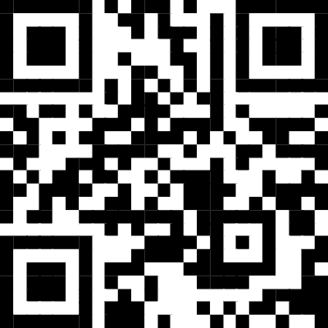
Let’s Collaborate!
Please take the next 10 minutes to team up with a partner or two. Put together a quick list of some successful accessibility initiatives for your institutions.
https://tinyurl.com/fitorflop

Slide 14
Thank You!
Steven Kolberg, MA Senior Coordinator, Accessibility and LMS Administration Office of Information Technology Florida SouthWestern State College.
Email: sbianco@fsw.edu
Kevin Price, MSW Assistant Director of Accessible Technology Student Accessibility Services University of Central Florida.
Email: kevin.price@ucf.edu

