Slide 1
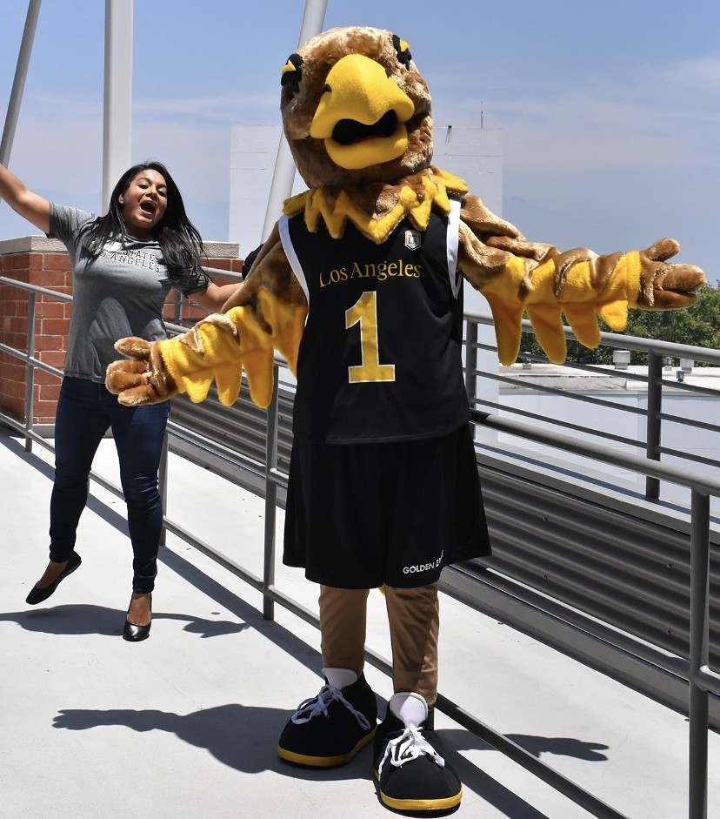
Tactical Use of the Vendor Accessibility Process: From High-Impact to Demo Leon McNaught, Cal State LA lmcnaug@calstatela.edu Sue Cullen, Tech for All scullen@tfaconsulting.com Accessing Higher Ground 2023
Notes:
Photo of Cal State LA mascot, Eddie the Golden Eagle

Slide 2
Agenda
Brief intro to CSU ATI Capability Maturity Model (CMM)
Vendor Accessibility Requirements
Leverage limited resources for maximum impact within the procurement process
Understanding the importance of the User Flow and how this relates to a Vendor accessibility demo and/or ACR testing methodologies
Tactical use of product vendor accessibility demo when you have:
No time, short on staff, and demanding needs.
No documentation or poor documentation.
Leadership wanting to buy the product now.
Side note: You’re asked to make all this work and avoid lawsuits

Slide 3
CSU ATI Capability Maturity Model (CMM)
WEB
6 goals
38 Success Indicators
INSTRUCTIONAL MATERIALS
7 Goals
32 Success Indicators
PROCUREMENT
5 Goals
22 Success Indicators

Slide 4
CSU ATI Procurement Priority
Procurement Processes
Equally Effective Alternate Access Plans
Training & Outreach
Experience/Implementation
ATI Procurement Plan
Procurement Priority
5 Goals
22 Success Indicators

Slide 5
ATI CMM Success Indicator Status Levels
Not Started
Initiated
Defined
Established
Managed
Optimizing
Notes:
Established box bigger animatation

Slide 6
CSU ATI CMM: Working Towards “Established”
Success Indicator | Status Level | Procedures | Documentation | Resources
1.4 Develop a process to determine the level/complexity of 508 evaluation required for new procurements and/or renewals. | Established | The campus has a standard practice. Procedures are consistent and formal. | Documentation is complete and fully reflects the standard practice. Process documentation is stored in a campus electronic location and process has been communicated to the campus. ATI Annual Report Evidence Column Include link to documentation or location of process document on internal drive | Resources have been both identified and allocated. ATI tasks have been added to campus job descriptions. New positions have been created as needed. Budget allocated for ATI processes ATI Annual Report Evidence Column Include job titles associated with the indicator Include budget allocations or other resources associated with the indicator

Slide 7
ATI Procurement: Five Global Goals
Procurement Processes
The campus has procurement processes that follow Section 508 requirements for all acquired Information and Communication Technology (ICT) products and/or services.
Equally Effective Alternate Access Plans
Equally Effective Alternate Access Plans are created for ICT products that are not fully Section 508 compliant.
Training & Outreach
Training and outreach programs are in place for all ICT procurement stakeholders (e.g., buyers, purchase requestors, vendors, etc.)

Slide 8
ATI Procurement: Five Global Goals Con’t.
Experience/Implementation
Campuses have sufficient experience and expertise in completing ICT procurements.
ATI Procurement Plan
Annually review and update the ATI Procurement Plan.

Slide 9
How and when to Leverage the Vendor Accessibility Demo

Slide 10
Begin with High-Impact ICT Acquisitions
Product Use and Impact
Type of users
Is it required?
How/where will it be accessed?
High Probability Low Impact
High Probability High Impact
Low Probability Low Impact
Low Probability High Impact

Slide 11
Additional Vendor Red Flags that Call for a Demo
Zero ACR
Poor quality ACR
Requiring Non-Disclosure Agreements (NDAs)
Fee to review of ACR comments

Slide 12
Reframing the Demo as the Critical Review
Gather Info
Collect pre-purchase information
Determine Impact/Review
Assign priority
Critical Review
Obtain Accessibility Roadmap
Purchase
Accessibility Conformance Report (ACR)
Determine the type of review
Accessibility Statement
Prepare EEAAP(s), if required
Ensure accessibility documents are in order
Add contract language if applicable
Parallel processes
Notes:
Think about this somemore

Slide 13
Vendor Demo Parameters
Follow user flow completing core functions
Operate via keyboard only
Demonstrate a well-defined keyboard visual focus
Raise the text size to 200%
Point out any suspected low color contrast
Screen reader navigation
Accessibility statement
Demonstrate how an end-user gets accessibility help

Slide 14
Prepare in Advance for Best Outcomes
Prepare to document the process
Provide demo parameters to the vendor in advance
Vendor must understand they are expected to navigate the product with screen-reader and keyboard only navigation
Specifically, ask for someone from the vendor who can run a screen reader
Tag-team: have two team members, one to guide the demo and someone to take notes and screen capture

Slide 15
Your demo prep
Be ready to summarize findings
Take screenshots or better yet record meeting
Be ready to share your notes or findings
Office Disability Services – to plan accommodations
Creating Equally Effective Alternative Access Plan (EEAAP)
Help the product requester and leadership understand the impact to users

Slide 16
Be Deliberate with Roles and Expectations
Emphasize:
How the demo can be derailed:
Vendor runs the demo with a focus on user flow and completing core functions
Represents meaningful use of a screen reader, not just tabbing though the page. Or using a mouse when they get stuck.
Keyboard only operations must be high lighted
If a sales pitch
No screen reader expertise
The appropriate stakeholders aren’t invited
Navigation is done via the mouse
Don’t be afraid to halt the meeting and reconvene once expectations are aligned

Slide 17
Vendor Prep for Demo
https://www.calstatela.edu/accessibility/vendor-requirements
VPAT Title page: Name and product version(s), date, contact information, and evaluation methods used
Table 1: Success Criteria, Level A
Table 2: Success Criteria, Level AA
Chapter 3: Functional Performance Criteria (FPC)
Chapter 5: Software
Chapter 6: Support Documentation and Services

Slide 18
During the Demo
Maintain a spirit of collaboration: this can be stressful for the vendor
Represent the user and guide the vendor to perform core functions
Encourage the vendor to record any barriers that are discovered in order to make remediations

Slide 19
Choose representative sample of core functionality & features
Examples
Menus
Forms
Error messaging
Login
Headings
Link navigation
Color Contrast
Interactive elements
Are these functions build on a shared code base? If so, you know the product will behave more consistently. Good or Bad

Slide 20
Demo facilitation 1 of 3
Start with keyboard navigation
Watch for logical flow
Sequential order? Reasonable number of keystrokes?
Don’t be afraid to ask what exact key combo are being used.
Are there any unique keyboard combinations particular to this product?
It is a good time to ask where a user can get Help via a menu or via an Accessibility Statement preferably within the product
Visual focus
Do you know where the active cursor is on the screen?
Is the visual focus sharp enough to draw your attention?
Color contrast
Ask them to view the page in high contrast mode.
Can you still see all the page elements?

Slide 21
Demo facilitation 2 of 3
Magnification
When enlarged to 200%
Check that features/functions are visualble and functional
Screen reader navigation
Ask that they tell you what they are about to do before they do it.
That way you know what to listen for
You may not understand all the feedback from the screen reader audio but you may get a sense of it
It is best if someone on your team who is observing knows how to use a screen reader
Don’t be afraid to ask that it be slowed down so you can hear it

Slide 22
Demo facilitation 3 of 3
Captioning and audio description
Are they present and accurate?
Are they appropriately displayed?
Cognitive diversity
As you observe the demo ask yourself:
Overall does the product have a consistent navigation?
Is it visually overwhelming?
Do you feel like you didn’t get the special decoder ring for the product?

Slide 23
Creating Equally Effective Alternate Access Plans (EEAAPs) from the Demo
Optional component of our ServiceNow ICT Purchase Request form
State present barriers in the products – negative user impact
Id name or department responsible to facilitate alternative access
Emphasis on equally effective
EEAAPs are reviewed at the time of product renewal

Slide 24
Resources
California State University, Accessible Technology Initiative
[https://ati.calstate.edu/]
Cal State LA Accessible Procurement
[https://www.calstatela.edu/accessibility/acquiring-accessible-ict]
https://www.calstatela.edu/accessibility/vendor-requirements
Tech For All (TFA) Consulting
[https://www.tfaconsulting.com/]

Slide 25
Tactical Use of Product Vendor Accessibility Process: From High-Impact to Demo.
Leon McNaught
Director of Digital Accessibility
Cal State LA
lmcnaug@calstatela.edu
1-323-343-2750
Sue Cullen
Director of Universal Design & ICT Accessibility
Tech for All
scullen@tfaconsulting.com
1-818-632-3525
Thank you for attending. Please cite the California State University (CSU) Accessible Technology Initiative (ATI) Capability Maturity Model if you’ll present on aspects of this approach.

