Slide 1
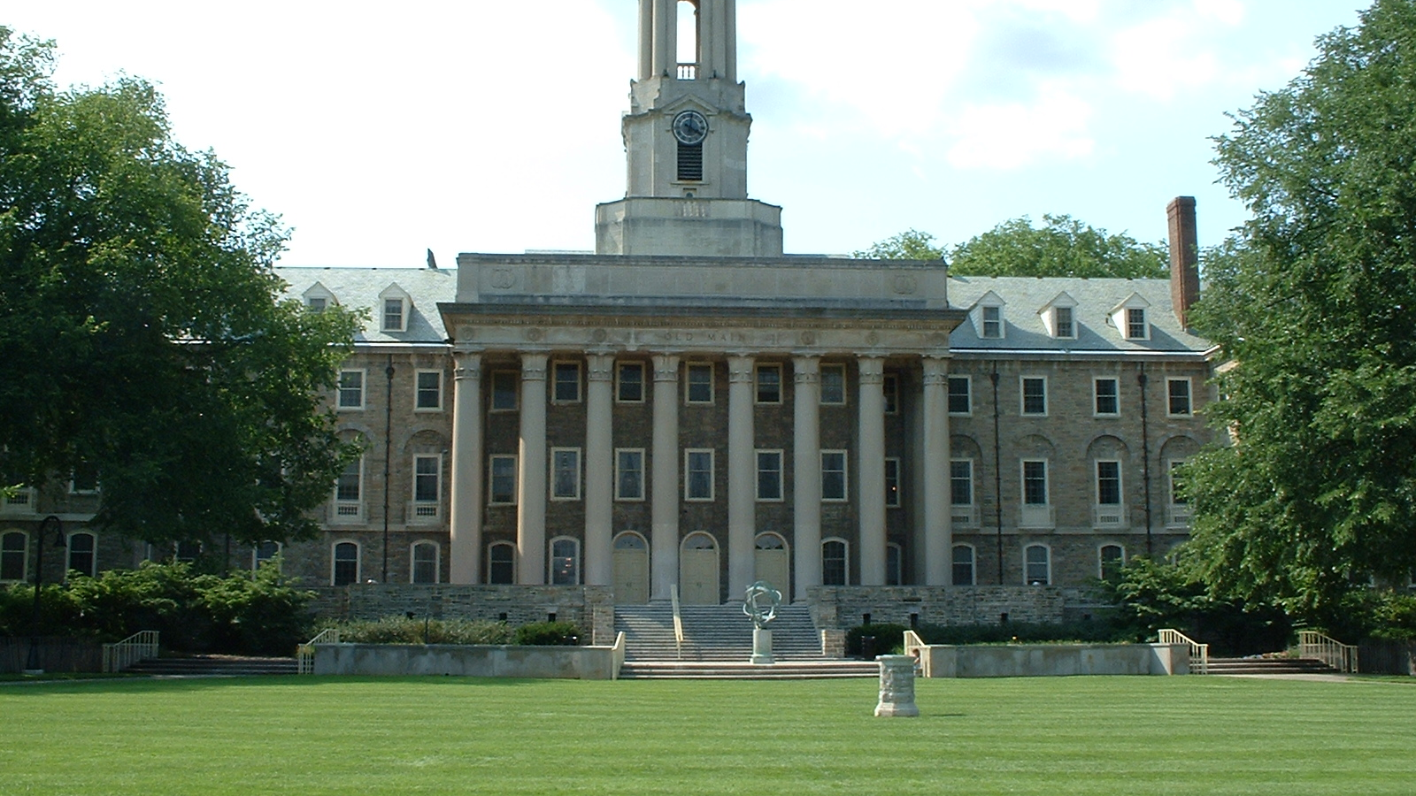
Holistic Accessibility Across Penn State University
Part 2
Binky Lush
University Libraries
Philip Voorhees
IT Accessibility
Notes:
B
Good afternoon!
My name is Binky Lush and I am here with Philip Voorhees to talk with you about how we are working towards strategic and holistic accessibility across all of Penn State University. I presented a couple of years ago here when this intitiative was just getting started. We're here with an update on how things are going...
My background…
Manager of dicovery, access and web services in the libraries
I manage the web team and the software development team (catalog, inst repository, etdas) supporting university research and open access
Focus on Accessible design and development
Libraries has a strong culture of accessibility
Intro Philip
In this talk we'll provide you with some context and accessibility history at PSU, Where we are and where we hope to go from here.

Slide 2
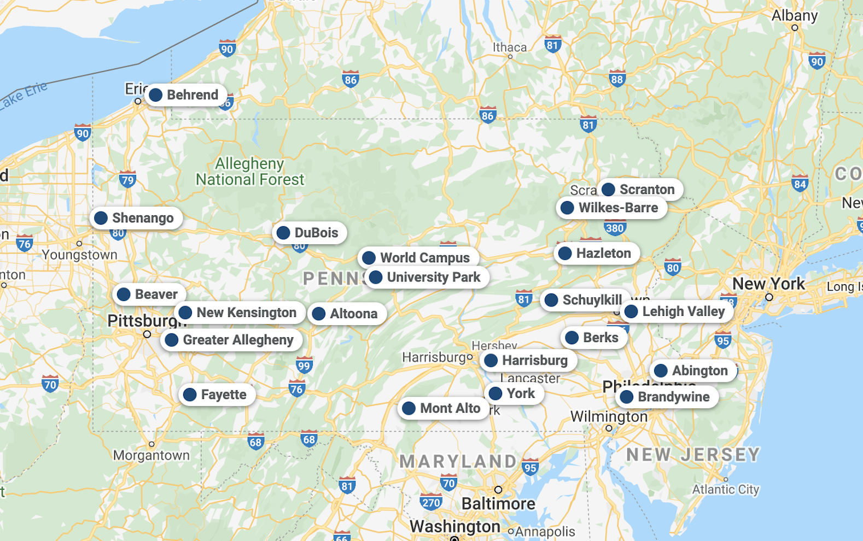
Penn State University
Notes:
B
Penn State facts
88,000 students – current enrollment
23 physical campuses plus World Campus
2 law schools
2 medical schools
21,000 employees
It’s a HUGE place
in a lot of ways accessibility has happened very separately at the campus level
At University Park (Main campus) and world campus we work really closely together)
without a University-wide centralized effort, accessibility is a challenge!

Slide 3
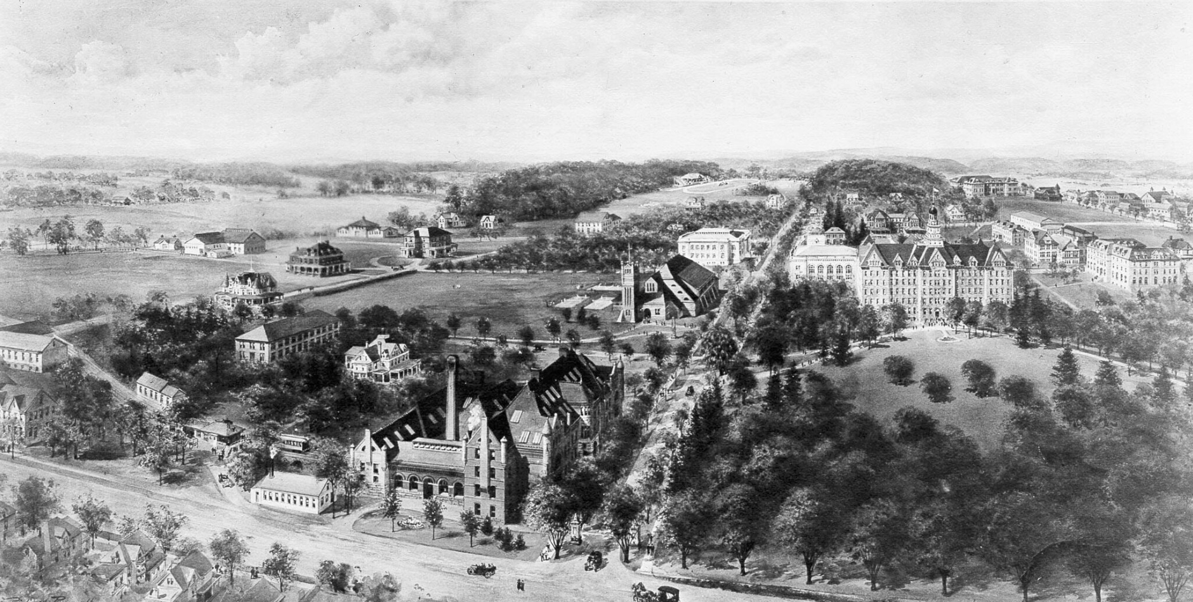
History of Accessibility
Notes:
B
Here's some ancient accessibility history at penn state
Penn State has always had a long term commitment to accessibility
Like other institutions in the early days, there was a small but mighty and very vocal accessibility community
There were disparate pockets of great accessibility work being done
Historically, no centralized effort though
varied support from the administration

Slide 4
accessibility groups across psu
SDR Exam (Upark)
Affirmative Action Office
Accessibility Users Group (AUG)
Student Disability Resources
Access Services (University Libraries)
World Campus Accessibility Personas Team
Diversability Month Committee
University Access Committee
Tactile Team
Libraries Accessibility Student Advisory Group (LASAG)
World Campus Accessibility Process Team
Campus Disability Coordinators
Web Liaisons
PSU Accessibility (Yammer Group)
Libraries Accessibility Community of Advocacy (ACOA)
World Campus Accessibility Team
Group to propose President's Commission on Disability Inclusion
ATI Committee
Notes:
B
In 2019, some of us tried to get a better sense of who was doing what from an accessibility standpoint – and started by inventorying the groups that we knew who were focusing on accessibility at psu –
We counted over 25, and we knew that we were missing a number of them!
They were all doing great work
scattered with limited individual resources
not always aware of other accessibility efforts

Slide 5
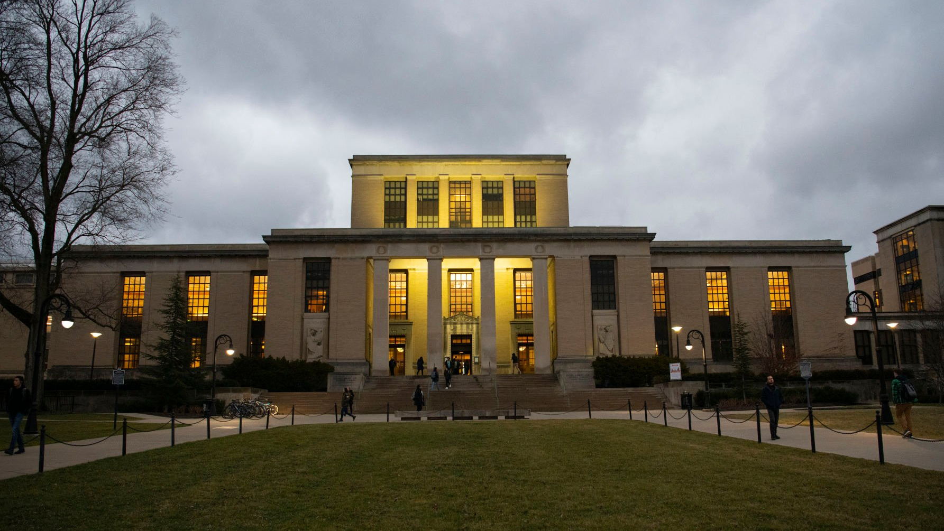
Meanwhile, back at the libraries
Notes:
B
Meanwhile back at the Libraries…
Adaptive technology dept
Assistive technologies
Alternative media for students
Quiet study space
This area was funded by It Accessibility, Student Disability resources and the Libraries
In the Libraries, we had some turnover and leadership changes in our Adaptive Technologies Department
In an effort to make some strategic decisions, the libraries brought in an organizational consultant
As she began the discussions, it became evident that the scope was much more broad
What started as some decision making around a single department in the Libraries grew into a two year long investigation of the entire accessibility landscape at Penn State
Asking the questions…
What does the accessibility leadership look like
Where are the pockets doing accessibility work
What needs are we serving
Where are the gaps?
Why are we working at cross purposes?
Where are the duplicative efforts

Slide 6
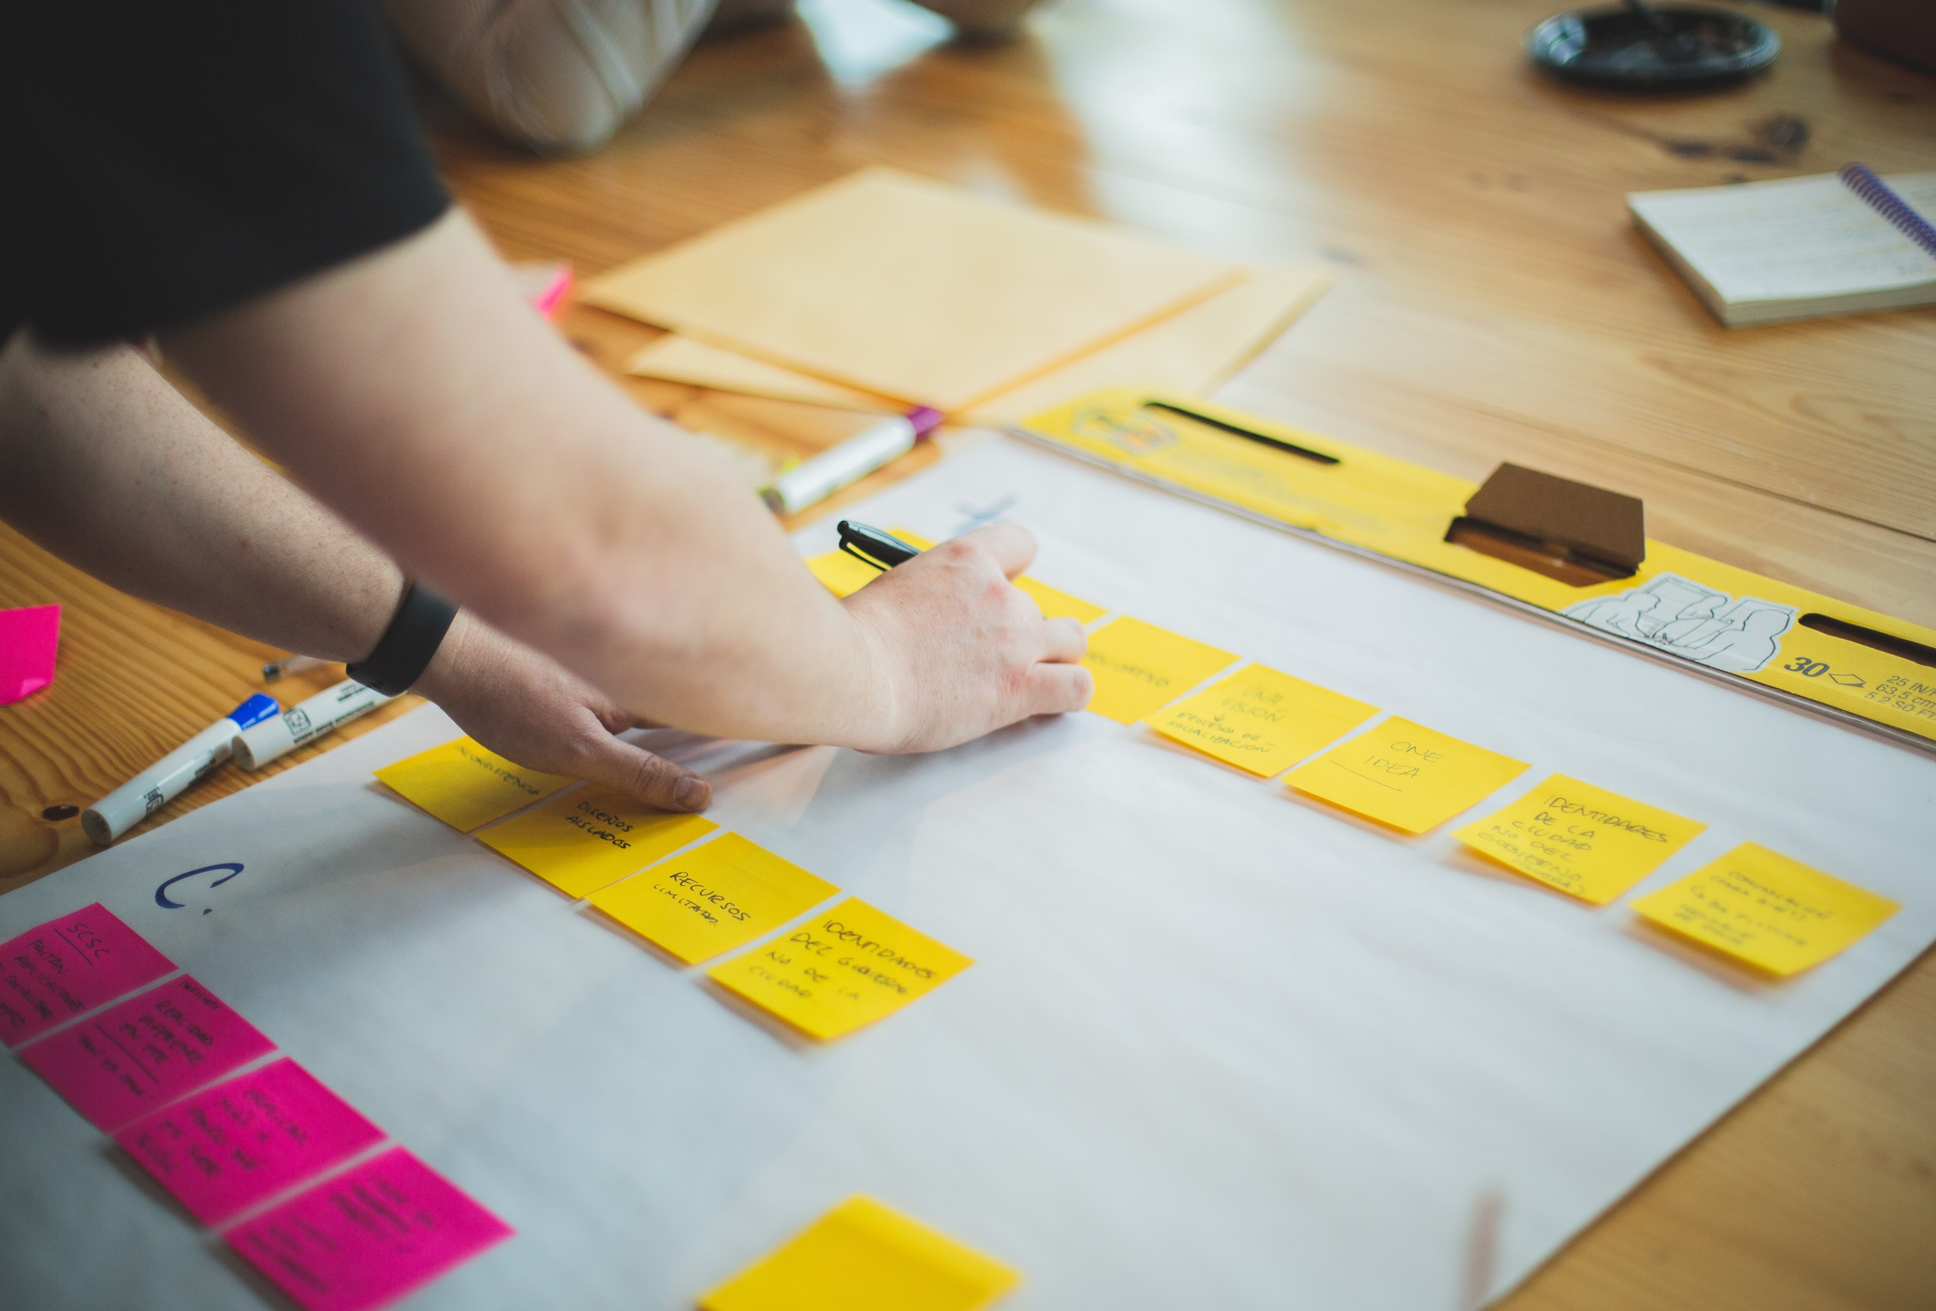
The consulting/investigative process
Notes:
B
We gathered representatives from all of the groups we could across campus
All of the offices
All of the stakeholders
All of the committees
All of the Communities of practice
From Administrators to hands on practitioners
We met every few months
One on one meetings
Sticky note exercises
Group discussions
Facilitated conversations
Our consultant worked on this for 2 years and came back with her report.

Slide 7

A Strategic Vision
Notes:
B
It was evident from this exercise that what was really needed was far more than a reorg of the way our department worked
We needed a meeting of the minds of the accessibility leadership across the university
We needed a cohesive vision, strategy, and plan
And we needed support for this work at the highest level.
This wasn’t only about siloed accessibility efforts – web accessibility in IT, faculty support in the colleges, procurement and purchasing, accommodations here, alternate media there
It was about the entire thing – a full on holistic accessibility plan, vision and strategy for the university

Slide 8
The Approach
Strong Leadership
Living document
Statement of intent
Discover, identify and implement
Executive support
A Phase by Phase Plan
Notes:
B
So how to approach this?
We needed to look at this inclusively and holistically
Include
Strong leadership - A Coordinating Group to driving and implementing a unified effort
Executive Support - prioritize initiatives, administrative backing and FUNDING
A Phase by Phase Project Plan - a cohesive roadmap for psu accessibility efforts
Developed as a living document that can adapt to changing laws, policies, technologies and budgets
Provide a clear statement of intent, “PennState University is committed to providing Information and Communication Technology (ICT) that have been developed, procured or adopted to be accessible to all, and in particular, to individuals with disabilities, including those who use assistive technologies.”
Through the plan - Discover and identify necessary actions and initiatives and implement them
Our approach was to:
demonstrate and document PSU’s good faith efforts in providing accessible ICT for persons with disabilities.
Demonstrate improved efficiency in collaborating across penn state
Develop of a culture of access that benefits everyone

Slide 9

The Plan
Notes:
P
The plan was developed in phases
build on work already underway,
consider deficiencies and inefficiencies,
examine intersectionality and replication of effort,
consider relationships and information sharing methodologies
identify resources necessary to advance the plan.

Slide 10

Accessibility Leadership Coordinating Group (ALCG)
Notes:
P
a small core group of people emerged
appointed and empowered to take on the challenge of creating an overall accessibility strategy/plan for the university and figure out how to make it happen
Accessibility Leadership Coordinating Group
University Libraries
Educational Equity
Teaching & Learning with Technology
World Campus
Commonwealth campuses
Student Disability Resources
IT Accessibility
Procurement
Colleges
goal is to develop a holistic strategic plan for coordinating the delivery of accessible ICT with University-wide collaboration and sustainability.
Draft the plan!
Prioritization of projects and efforts
Coordination of Working Groups
Development of Proposed Strategy and Recommendations
Review/Approval of proposed recommendations.
Provide status reports to admins and provide opportunities for feedback
And we got to work

Slide 11
Executive Accessibility Advisory Group (EAAG)
Notes:
P
The EAAG will legitimize and support the efforts, and recommendations of the ALCG.
Advise and Consent on, and Identify Funding for, the Plan and projects.
Includes Support of the initiative through human resource allocation.
Provide oversight on final decisions for AD69 program access exceptions.
be on board, actively engaged, and visible in leading this transformational change throughout its duration.
building a coalition of sponsors and support throughout the Penn State community
Champion accessibility through organizational vision and strategic direction.
Sponsor the ALCG’s position in the review and approval process
They had the power
Who was it?
Faye Chadwell, Dean of University Libraries and Scholarly Communications
Renata S. Engel, Vice Provost for Online Education
Kelly Austin, Interim Senior Vice President for Commonwealth Campuses and Executive Chancellor
Jennifer Stedelin, Deputy CIO participating for Michael Busges, Interim Vice President for Information Technology and Chief Information Officer
Marcus Whitehurst, Vice Provost for Educational Equity
Suzanne Adair, Associate Vice President for Affirmative Action
We meet quarterly
-provide updates on what’s happening, what resources we need
Holds us accountable

Slide 12
Phase 1
Discovery,
Development and Implementation of
Accessibility Statement,
Definitions, Guidelines,
Resources,
Processes and Procedures
What we have done and learned
Notes:
P

Slide 13
Phase 2
HIGHLIGHTS of OUR NEXT STEPS
Funding Requests
Implementation
Notes:
P

Slide 14

Future Phases
Phase 2 & 3
High to Low Implementation of Phase 1 Discoveries, Process Improvement and New Discovery for Next Phase.
4-5 years
Phase 4
Reevaluation of Entire Plan for Process Improvement and New Discovery.
1-2 years
Phase 5
Implementation of a Mature Accessibility Model and Continued Process Improvement
Notes:
P
Phase 2 & 3
High to Low Implementation of Phase 1 Discoveries, Process Improvement and New Discovery for Next Phase.
4-5 years
Starting 2 officially in January 2024
Phase 4
Reevaluation of Entire Plan for Process Improvement and New Discovery.
1-2 years
Phase 5
Implementation of a Mature Accessibility Model and Continued Process Improvement

Slide 15

Challenges
Notes:
B
3 years in, we’re really happy with where we are
Hasn’t been without it’s challenges
Covid – goes without saying
Just got group together and started on the plan and we were shut down
We kept moving forward but definitely lost some momentum
Leadership changes
Significant changes in our leadership across the board.
On our Executive Accessibility Advisory Group:
Libraries dean
CIO
Chancellor for the campuses
On our ALCG
retirements
Sabbaticals
Job and responsibility changes
Leadership capacity
Few people on the ALCG for whom accessibility is their primary role
The rest have it as part of their job, but this requires a significant time and energy commitment – not always possible
Makes things take a bit longer
Funding
Biggest challenge
New budget process
Funds were completely flat (at the end of RFP when funding was removed)

Slide 16

Wins!
Notes:
B
WINS worth celebrating!
Just about Completing Phase 1
ALCG has expanded is still moving forward
EAAG (redescribed) but in place
Close to updating our AD69 (December 2023)
Legal vetted captioning workflow for accessibility (all forms of captioning) and vendor support
Accessibility learning path for university - both basic entry level and role/tool/skill based (6 modules)
Accessibility will be part of all ITLD training (product service or skill – accessibility is now a part of the curriculum)
Roles and hierarchies document completed
Standards and procedures document completed (living document and will be adjusted as needed)
Implementing Communication plan

Slide 17

The right path
Notes:
B
This plan is successful in part because of our alignment with:
Penn State’s Strategic Plan - Enabling access to education.
DEIB Plan
One Penn State 2025 initiative focused on - Providing a seamless student experience.
We are in the early stages of this strategic move towards holistic accessibility
We have a long way to go but we’re on the right path

Slide 18
Thank you!
binky@psu.edu
pfv5046@psu.edu
Notes:
B

