Slide 1
Eliminating Students Dependence on Alternative Materials Using EPUB’s
Presented by:
Darrin Evans
NC Virtual Learning Community PD Center Director
daevans3@waketech.edu

Slide 2
Summary
Enabling students to independently use digitally published materials in the EPUB format can enhance their learning and eliminate a ton of work for the DSO office! What is EPUB and how do I create and read them? Which EPUB reading apps are worth recommending and why? Get up-to-date guidance.

Slide 3
Overview
What is EPUB?
What are the accessibility features of EPUB files?
How do I create EPUB files?
How can I read EPUB files?
Resources for Staff and Students
Discussion

Slide 4
What is an EPUB?
Essentially a website that has been compressed into a single file
Relies on web technologies which provide a greater opportunity for accessibility and reflow across multiple devices
Notes:
Joseph

Slide 5
You Don’t Need to be a web developer
EPUB 3 is built on web development technologies, but you don’t need to be a developer to create EPUBs.
Notes:
Joseph
EPUB 3 is built on web technologies, but you don’t have to be a web developer to take advantage of this versatile format. We will look at some simple ways to create EPUBs a bit later that rely on your existing knowledge of Word and your current workflow.

Slide 6
EPUB Advantages
reflowable and readable on any screen.
faster, easier, and cheaper to make accessible.
can display Accessible STEM content via MathML
Notes:
Darrin

Slide 7
EPUB Features

Slide 8
Creating an EPUB
It is quick and easy to create EPUBs with this free plugin.
Start with an accessible file in Microsoft Word
Check your work with the built-in accessibility checker
Export to EPUB with the free WordToEPUB plugin
Notes:
Joseph

Slide 9
Word Accessibility Basics
Use built-in Headings and Styles
Chose Accessible readable Fonts
Use Table Headers
Add meaningful descriptive hyperlinks
Add Alt Text to Images

Slide 10
WordToEPUB - Demonstration
Notes:
Darrin will play a short video demonstrating WordToEPUB

Slide 11
Evaluating Reading Apps
For an accessible reading experience both the reading system and the content need to conform to standards and best practices
Tools are available to test for validity & accessibility of content
Reading systems accessibility can be ensured by supporting accessibility tests which are based on user requirements and best practices

Slide 12
Evaluation Reading Applications
Fundamentals for accessible reading
Visual adjustments
Read Aloud
Screen Reader support
Support for education features
Math
Extended descriptions

Slide 13
EPUB Reading Applications
EPUB is the preferred digital file format used by publishers to distribute textbooks, and it is the most accessible mainstream publishing format ever developed. However, the app or device used has an incredible impact on the reading experience, and especially for students using Assistive Technology. If a first-year student is trained in using a great EPUB reading system, you will find that their demands for alternative materials drops through the floor. This section will provide guidance to DSO professionals on what reading apps and devices they can recommend to their students and why.
EPUB Reading Systems in Higher Ed are rigorously evaluated with Assistive Technology by persons with print disabilities and accessibility experts. The results are tracked at http://www.epubtest.org. All the major Reading Systems and Apps used in Higher Ed are evaluated, including popular specialized apps used by students with disabilities.
We will start with our experts providing a detailed explanation of the testing methodology that uses controlled EPUB test books, including Math and STEM titles. Most of the session we will spend providing results and recommendations on which Reading Systems to recommend to students, and we will highlight some of the latest developments that benefit learners with print disabilities. Finally, we will provide an extensive list of resources and demonstration videos as well as how to easily keep up to date with the ongoing testing.

Slide 14
EPUBTEST.org – overview
Has tests for evaluating reading system support for accessibility requirements
Evaluations conducted by accessibility experts and users of assistive technology from all over the world
Tests conducted with different assistive technology, OS, browser and device combinations, for example
Reading app tested with NVDA on Windows 11 in Google Chrome
Reading app tested with Voiceover on iOS 16 with Braille Display
Test results help developers to improve their products
Test results help institutional purchasers to select most accessible solutions.

Slide 15
EPUBTEST.org – Testing framework
Fundamental accessibility tests
Basic functionality
Non-visual reading
Visual Adjustments
Read Aloud
Advanced accessibility tests
Media overlays
Extended descriptions
Mathematics
Tests are contained in EPUB files (Test Books)

Slide 16
EPUBTEST.org – Test Books
Title | Description
Fundamental Accessibility Tests: Basic Functionality | These tests include starting the reading system and opening the titles, navigating the content, searching, and using bookmarks and notes.
Fundamental Accessibility Tests: Non-Visual Reading | These tests are for evaluating the reading experience with an assistive technology tool such as a screen reader or refreshable Braille display. Tests include continuous reading, pause and resume, reading order, alternative text, table and hyperlink navigation, copying text.
Fundamental Accessibility Tests: Visual Adjustments | These tests include changing the font and text size, colors, brightness, compatibility with magnification utilities and support for high contrast and SVG images.
Fundamental Accessibility Tests: Read Aloud | These tests include start, pause and resume Read Aloud, reading order, punctuation support and visual emphasis of the spoken text.
Advanced Accessibility Tests: Media Overlays | Accessibility tests for Media Overlays in a reflowable context
Accessibility Tests Mathematics | Math Recommendation for EPUB
Accessibility Tests Extended Descriptions | Tests for accessible extended descriptions of images in EPUBs

Slide 17
EPUBTEST.org – Scoring
Tests are marked as Pass/Fail by testers
Each Reading System gets a score for each category of tests
Testers provide notes with each test to help users and app developers

Slide 18
Reading Systems Accessibility Support Roundup
inclusivepublishing.org/rs-accessibility
Easy to read summary of detailed accessibility evaluations conducted by and with people with print disabilities.
Pros and cons of popular EPUB reading apps
Helpful in selecting apps for users with different disabilities
Updated regularly

Slide 19
And the current top picks are…

Slide 20
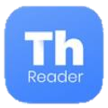
Blind Windows user
Thorium Reader
results with NVDA
results with JAWS
RedShelf with Firefox
results with NVDA
results with JAWS
Bookshelf Online with Firefox
results with NVDA
results with JAWS

Slide 21
Blind mobile user – Android and iOS
EasyReader
Android evaluation results
iOS evaluation results
Bookshelf
Android evaluation results
iOS evaluation results
RedShelf
Android evaluation results
iOS evaluation results

Slide 22
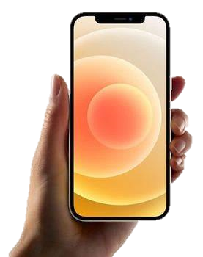
EasyReader
Library integration makes it easy to log in, search and download titles

Slide 23
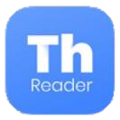
Blind macOS User
Bookshelf
results with VoiceOver
Thorium Reader
results with VoiceOver

Slide 24
Low vision user
Yay! Lots of choice:
Bookshare Reader
Bookshelf
Colibrio Reader
EasyReader
RedShelf
Thorium Reader
… and they all have read aloud

Slide 25
Students with neurodiversity
Bookshelf
results with Chrome
RedShelf
results with Chrome
Texthelp EPUB reader
results with Edge
K3000 for Mac
evaluation results

Slide 26
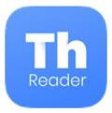
STEM student
Thorium Reader on Windows with NVDA
Bookshelf on macOS with Voiceover
Bookshelf Online via Firefox or Chrome on Windows using NVDA
RedShelf via Firefox on Windows with JAWS or NVDA
Bookshelf app on iOS with Voiceover

Slide 27
Bookshelf & Thorium for macOS: Math Accessibility

Slide 28
EasyReader for Windows– Visual Adjustments

Slide 29
RedShelf – Visual Adjustments

Slide 30
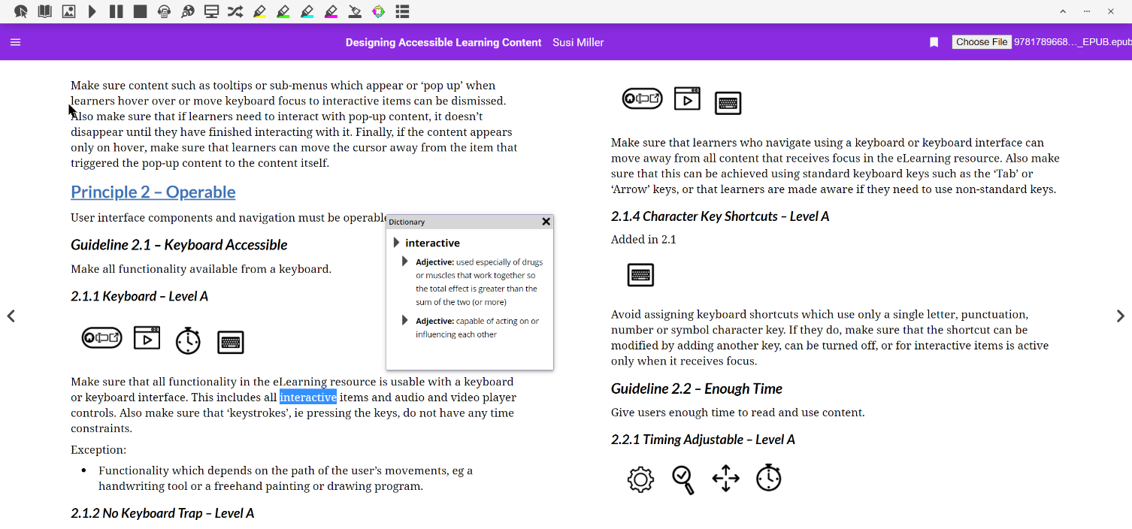
TextHelp EPUB Reader – Read Aloud

Slide 31
Sources of Education/Academic EPUBs
Buy Accessible
Bookshelf, RedShelf (detailed a11y info)
Kindle (some a11y info)
Kobo, Play Books, Apple Books
Borrow accessible
EBSCO ebooks
Journal articles
Bookshare
Access Text Network
Make your own

Slide 32
Resources
Reading apps roundup : inclusivepublishing.org
Detailed test results : epubtest.org
Getting started : daisy.org/help
Webinar videos : daisy.org/webinars
Community : daisy.org/epub-in-he
Make your own EPUB: daisy.org/wordtoepub

Slide 33
Questions
Notes:
Darrin

Slide 34
Conclusion
The EPUB format allows DSO professionals to create alternative media that covers most student content.
EPUB files are STEM friendly.
EPUB files can reduce the workload for DSO personell.

