Slide 1
Data Viz for Everyone: Live Accessibility Demos
Emilie Young
Gautam Gottipati
Mike Williamson
Marisha Lamont-Manfre
Addie Hugen
bit.ly/DataViz4All2023

Slide 2
Assistive Technology Overview
Assistive technology (AT) is any item, piece of equipment, software program, or product system that is used to increase, maintain, or improve the functional capabilities of persons with disabilities.
Screen reading applications (screen readers) are assistive technology
JAWS (Job Access with Speech) is a screen reader
Screen readers rely on synthesized speech, keyboard commands (computer), and gestures (mobile devices)
Notes:
Screen readers use synthesized speech to voice what happens on a computing system (computer, tablet, phone). A typical screen reader user cannot see the display and must rely on the auditory output of the screen reader to understand what is being presented.
To navigate around and interact within the system, users will rely on keyboard commands and/or gestures instead of mouse pointers and direct touch (touching a screen at a precise point). Screen readers provide a large amount of keyboard commands that allow a user to quickly navigate and interact with their environment (H for headings, P for paragraph, etc.). Additionally, screen readers have various tools that make it easier to deconstruct an interface and review different pieces at a time (links, buttons, forms, and headings lists).
In our demos, we will be using a screen reader to move around and interact. We will explain what we're doing and what's being said as things happen.

Slide 3
Demo
Historical Enrollment CU Dashboard - Tableau

Slide 4
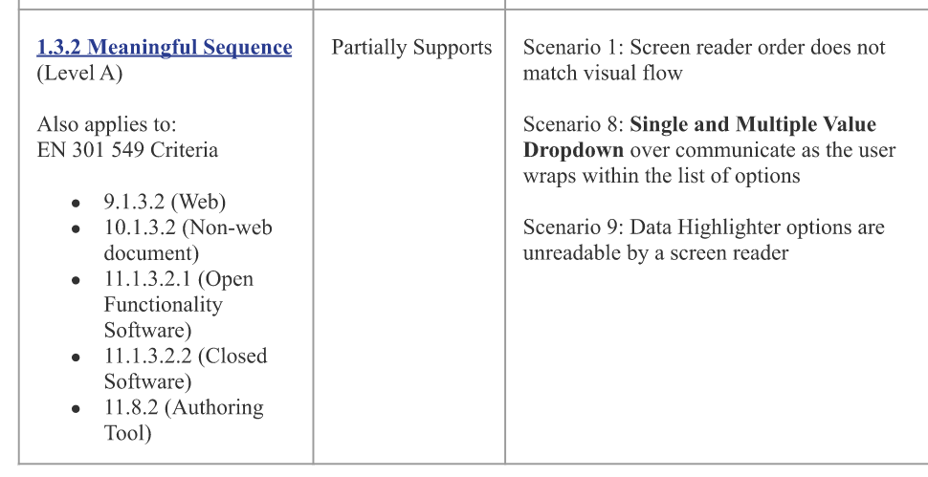
Tableau VPAT
We are focusing on Tableau today, but these problems aren't unique to Tableau.
VPAT provides information on accessibility but use with caution.
Screenshot from Tableau's 2022 VPAT
Notes:
Marisha – image/VPAT, purpose of our office and it's different from VPAT, from using tool in real world setting, and seeing the tool in a cherry-picked demo

Slide 5
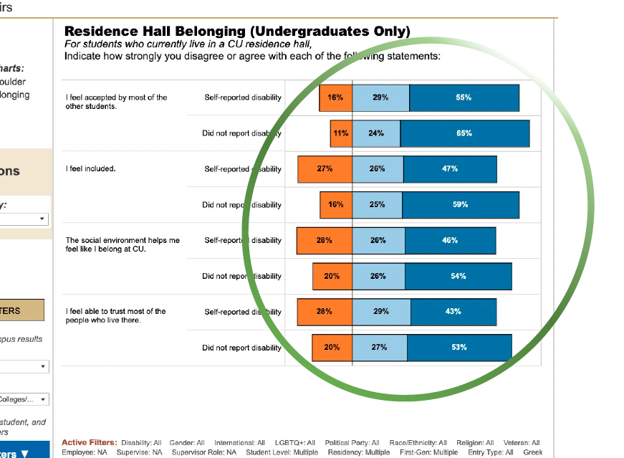
It's not just Tableau
Accessible data visualization is intrinsically hard.
None of the options we've tested have been fully accessible.
Tableau does some things well.
Screenshot of a Tableau bar chart
Notes:
Presenter: Marisha
Generates html table

Slide 6
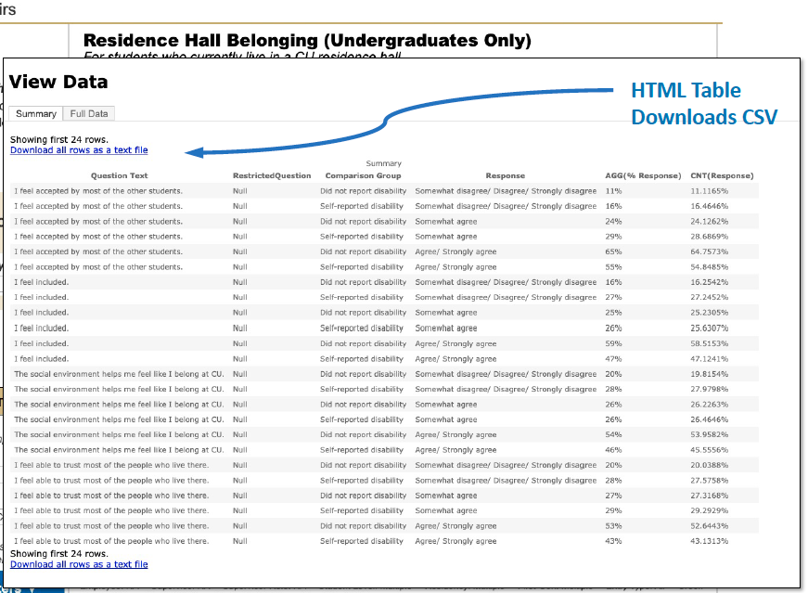
It's not just Tableau (cont.)
Accessible data visualization is intrinsically hard.
None of the options we've tested have been fully accessible.
Tableau does some things well.
Screenshot of a Tableau data table
Notes:
Presenter: Marisha
Tableau generates reasonable HTML tables of the data that is represented in the visual chart

Slide 7
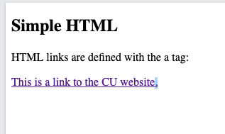
Semantic HTML – Example 1
<!DOCTYPE html>
<html>
<body>
<h2>Simple HTML</h2>
<p>HTML links are defined with the a tag:</p>
<a href="https://www.colorado.edu"> This is a link to the CU website.</a>
</body>
</html>
screenshot of the webpage created by the html
Notes:
Presenter Emilie:
Let’s talk about HTML. The code here is straightforward.

Slide 8
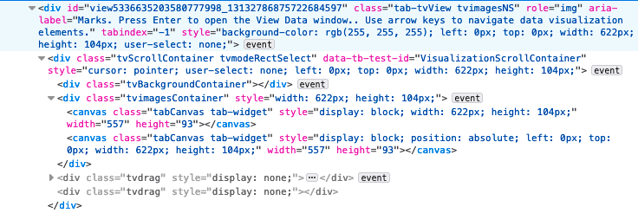
Semantic HTML - Example 2
What do you think this HTML is showing?
screenshot of the html generated by Tableau
Notes:
Presenter Emilie:
Who knows what HTML is?
HyperText Markup Language, around since the 70's.

Slide 9
Semantic HTML – Example 2 Button
screenshot of a webpage with a button titled “Central”
Notes:
Emilie:
All that was to produce this one button. And what you would hear if you were using AT is “You are on a visualization. Type command-enter to view data.” and there was no place in that HTML where the text ‘Central’ occurred.
This is an example of the HTML that gets produced with Tableau but it’s endemic to much modern web software. Assistive technology interprets the HTML in a browser and tries to make sense of it. It does a fairly amazing job with some convoluted HTML but there are limits to what it can do.

Slide 10
Semantic HTML – Example 2 (cont.)
<button class="btn btn-primary active">
Central
</button>
screenshot of the button created by the html code
Notes:
Presenter Emilie:
What we want to see is this.
Good reasons why modern software development has moved in this direction. Modern Software that produces websites have become much more complicated and need to perform complex tasks. But just because something looks like a button and behaves like a button, doesn’t mean it is an HTML button. This can be further complicated by the fact that different browsers will interpret the JavaScript differently and create different HTML. And there are multiple types of assistive tech. It was a revelation to me to hear DAO talk about the how some sites perform better and worse with different tech and browser combinations.

Slide 11
Semantic HTML
Use elements that clearly define content
<table> , <section>, <h1> … <h6>, <a>, <button>
Structure the page logically
Notes:
Emilie
So there has been a movement to making sure that your JavaScript creates semantic HTML as much as possible. This allows assistive technology to recognize elements and for users to navigate accordingly.
But there are ways to incorporate semantic HTML in your software and website design process.

Slide 12
Tableau API
“This VPAT report focuses on dashboards and views published to Tableau Server that are then embedded in an accessible web page.”
Screenshot of Tableau documentation
Notes:
Tableau’s solution is to have a well documented and robust Javascript API that allows you to embed visualizations in a webpage, getting around all the less accessible elementsThe data table that gets generated by Tableau is pretty good, it’s just all the other things around it. So could we use the API to eliminate the problems.
Where would this front–end live if not on the Tableau Server?

Slide 13
Why Drupal?
CU Boulder’s CMS
Semantic HTML and 10.0 commitment to accessibility
Open source and extensible with modules
Screenshot of CU Boulder Drupal website
Notes:
Emilie:
CU Boulder uses Drupal as its CMS. It does a good job of creating semantic HTML. I was impressed with the thought that went into Drupal 10 and Olivero (even if we don’t use Olivero
Our goal was to use the Tableau JavaScript API (application programming interface) to integrate the Tableau visualization into an accessible Drupal web page.

Slide 14
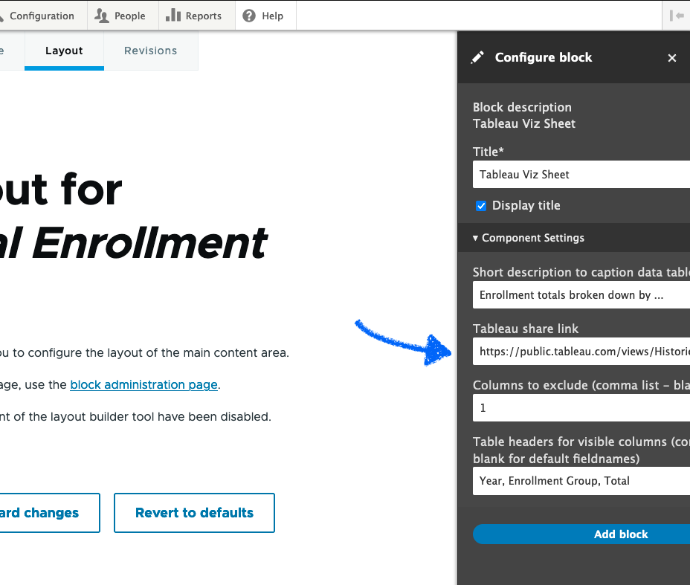
Tableau-Drupal Proof of Concept
We’ve created custom modules to embed Tableau data visualizations in Drupal pages.
screenshot of Drupal webpage
Notes:
I thought going into this that providing a way for screen readers to make sense of a graphical representation of data was going to be the hard part. When I learned from DAO that that part of the process worked fairly well, I wanted to see if we could write code that generated semantic HTML to solve all the surrounding issues. Our goal was to use the Tableau JavaScript API (application programming interface) to integrate the Tableau visualization into an accessible Drupal web page. So we wrote some very proof-of-concept modules that extend Drupal. If you have a visualization on a public Tableau server, like cu-public.cu.edu or public.tableau.com, you can create a Drupal content block and configure it with the URL of the the visualization and a few other pieces of information.

Slide 15
Drupal Demo
Historical Enrollment CU Boulder Drupal Page

Slide 16
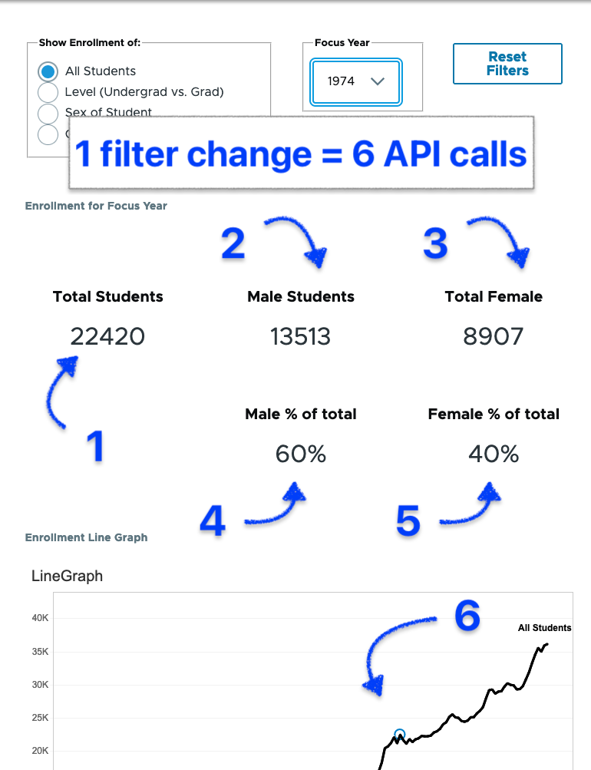
Proof of Concept - Next Steps
Address performance problems
Created standard Drupal PHP custom blocks
Create a central data repository and build a data pipeline reducing API calls.
Screenshot of a Tableau dashboard
Notes:
We’re in the process of contributing this module to the drupal open-source community.
We are also looking for collaborators and feedback.

Slide 17
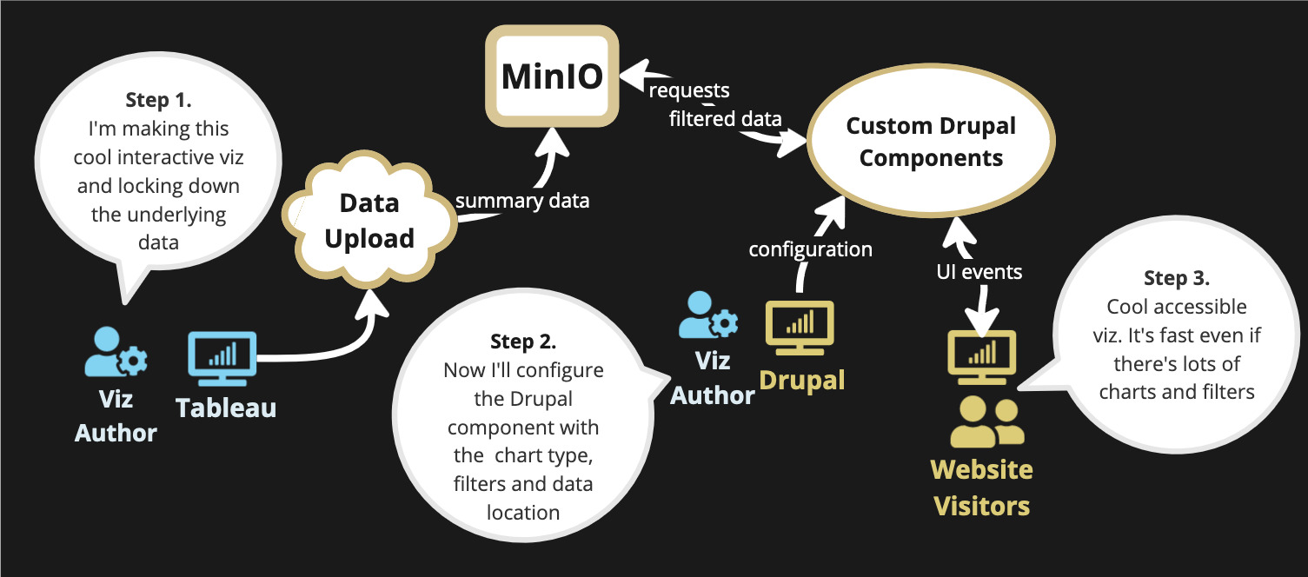
Next Steps – Data Repository
Diagram of the proposed data repository solution

Slide 18
Things that don't work in Tableau
Filters
"Buttons"
Alt text
Navigation & structure
Notes:
DAO

Slide 19
Things you can do instead
Simplify
Don't use filters
The "buttons" aren't programmatic buttons
Limit components that are presented
Notes:
DAO

Slide 20
Use detailed summaries
Best practice dictates concise and short alt text
Captions can provide information for more robust images/charts
Be cognizant of what you want people to get from the charts
Properly structured tables are easier to read
Notes:
DAO
Best practice dictates concise and short alt text
Captions can provide information for more robust images/charts
Be cognizant of what you want people to get from the charts – keep in mind data literacy
Properly structured tables (not the one in Tableau): look at the html Table in Tableau (not the table chart type)

Slide 21
Other accessibility tips
Style tips
Technical tips
Clear, simple data and content
Keep a consistent layout
Limit blank space
Do not use just video or image
Use appropriate color contrast (TPGi or WebAim have online checkers)
Use descriptive labels for links and buttons
Do not impose time limits to interact with content
Do not rely on documents for help information (or make them accessible)
Provide contact information (both phone and email)
Notes:
Presenter DAO: Marisha
What tools can you use? Color contrast, font size, Take content accessibility trainings on your campuses, keep data simple
https://github.com/UKHomeOffice/posters/blob/master/accessibility/dos-donts/posters_en-UK/accessibility-posters-set.pdf
Style content v Technical content
Tell people how you expect them to interact with the information
Emilie: add in a few technical tools

Slide 22
Resources
Knowledge Aquisition
Application
DAO LinkedIn
DAO Resources
DAO Newsletter
https://www.drupal.org/project/a11y_tableau
Notes:
Presenter DAO: Marisha
What tools can you use? Color contrast, font size, Take content accessibility trainings on your campuses, keep data simple
https://github.com/UKHomeOffice/posters/blob/master/accessibility/dos-donts/posters_en-UK/accessibility-posters-set.pdf

Slide 23
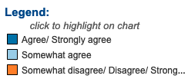
We* must do better.
* Content creators, developers, stakeholders and vendors
“Accessibility should be fundamental to any software project, not an afterthought.”
Notes:
When we create things that a group of people can’t use then we are leaving them out. We’re explicitly telling them they don’t belong. As content providers and web devs we need do our part to make our digital content accessible. It’s the right thing to do and the necessary thing to do. And my experience is that when software and content is designed from the beginning with accessibility in mind you end up with a product that’s cleaner and more robust and provides a better experience for everyone. Our stakeholders need to help set realistic priorities, and give us the time, resources and tools to ensure accessibility from the start. We also need to put pressure on the creators of third-party tools. And make them demonstrate accessibility with real examples that reflect real use cases, not cherry-picked demos.
As was mentioned before we are actively looking for collaborators and we would love to hear your thoughts and answer any questions you might have.

Slide 24
Support tools
All of the browsers have some great accessibility tools built in.
Get familiar with the using each browsers ‘Developer Tools’ or ‘Browser Tools’ so that you can see the HTML generated for your webpage.
Firefox has some particularly good tools that allow you to easily inspect common accessibility issues for individual elements as well as the entire page. It shows tab order and will simulate various forms of color deficiency (color blindness) and contrast issues. Firefox Resources

Slide 25
Questions?
Any questions?
Contact us:
Emilie Young: Emilie.Young@colorado.edu
Digital Accessibility Email: aul@colorado.edu

Slide 26
References
Dries Buytaert. (2023). Remembering Rachel Olivero. The Drop Times. https://www.thedroptimes.com/newsletter/remembering-rachel-olivero
Dries Buytaert. (n.d.) About. Drupal. https://www.drupal.org/about
Dries Buytaert. (n.d.). Strategic Initiagive: New Front-End Theme (Olivero). Drupal. https://www.drupal.org/about/core/strategic-initiatives/olivero
Salesforce. (2022). Salesforce accessibility Conformance Report International Edition. Accessibility Conformance Reports for 22.1 and 22.2. https://community.tableau.com/s/feed/0D58b0000A6cDlxCQE
UK Home office Digital, Data, and Technology. (n.d.). Accessibility Do's and Don'ts. CUNY Library Services. https://guides.cuny.edu/accessibility/a11ydodont
W3Schools. (n.d.). HTML Semantic Elements. W3Schools. https://www.w3schools.com/html/html5_semantic_elements.asp

