Slide 1
Creating, Remediating & Accessing Digitally Accessible STEM Based Course Content with Equatio
Rachel Kruzel
Louis Shanafelt
#AHG23

Slide 2
Hello, I’m Rachel.
Rachel Kruzel
Higher Education Specialist
Texthelp
@TH_RachelK
r.kruzel@texthelp.com

Slide 3
Hello, I’m Louis.
Louis Shanafelt
Product Manager
Texthelp
@LouisShanafelt
L.Shanafelt@texthelp.com

Slide 4
teaching and learning have changed a lot
#AHG23

Slide 5
Landscape
Online/hybrid class preference
Digital accessibility initiatives
Historical lack of attention paid to making STEM content accessible
Students with disabilities and disclosure
Available tools to create digital STEM content

Slide 6
Challenges with STEM Creation
Making it digital
Easy to create
Making it accessible
Omnipresent/ ubiquitous
Buy-in/use
Volume/amount
Content complexities
Professional experience level

Slide 7
Ability and Needs
Faculty or Staff:
Create content from inception
Remediate post-production materials
Share content with learners
Learner:
Engagement with materials
Creation of STEM content

Slide 8
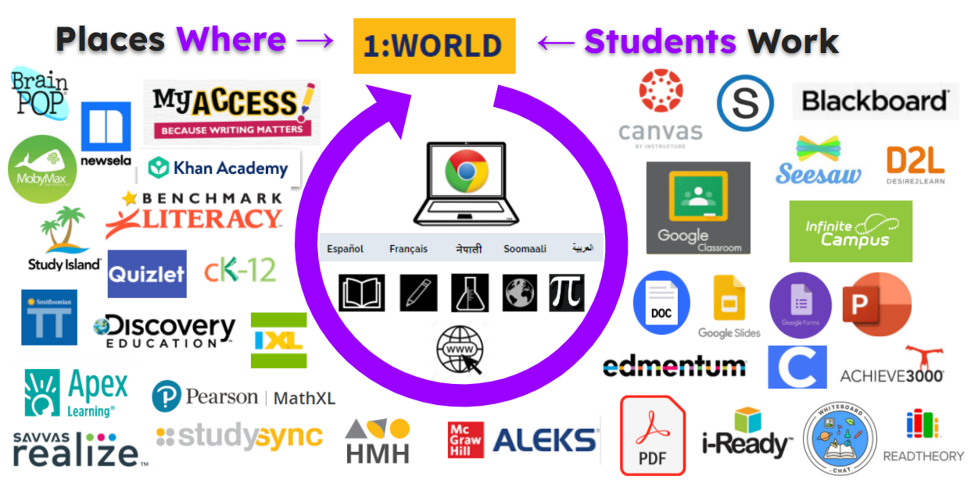
Integration in education is key
For education to truly be inclusive and equitable, tools should be available for all learners in all environments, no matter the place or assignment given.

Slide 9
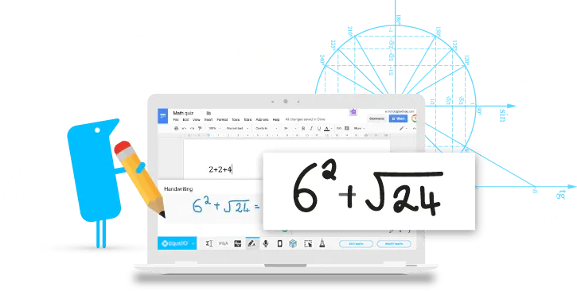
Equatio
Make math digital
Equatio allows you to create equations, formulas, and more, digitally. Helping to make math and STEM classes more accessible and engaging for every student.
#AHG23

Slide 10
Equatio can support faculty as they create new accessible STEM based content or remediate historical content.
Key Point
#AHG23

Slide 11
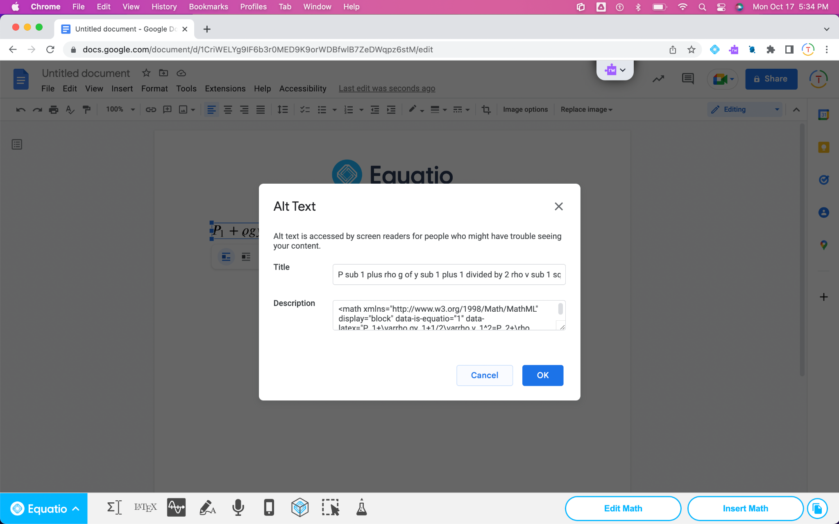
Create New Accessible STEM Based Content
Each math insert created by Equatio carries with it Alt Text & MathML.
Alt Text is supported by collaborative platforms such as Google & Microsoft.
Commonly used LMS providers also support Alt Text.
#AHG23

Slide 12
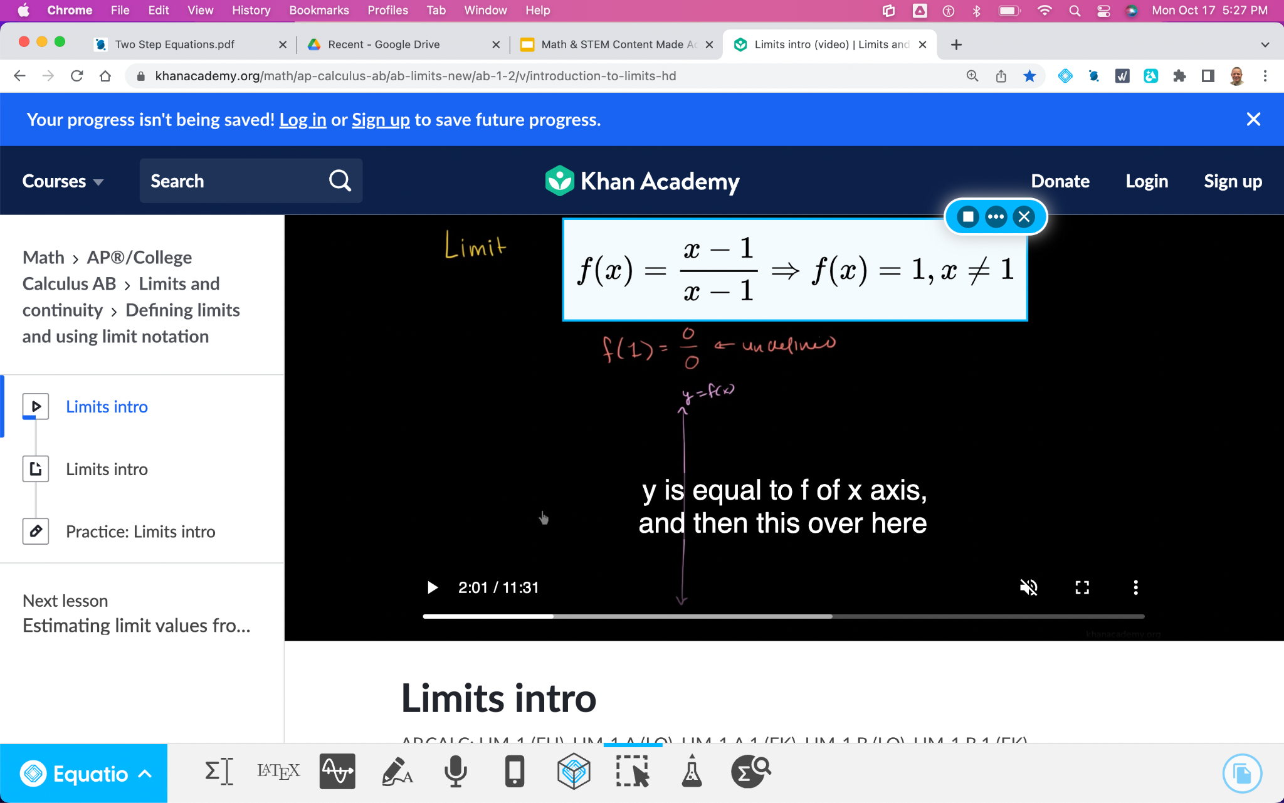
Remediate Historical Content
Use the Screenshot Reader to pull a box around math & STEM to hear the math played aloud.
Then copy the LaTex & bring it into Equatio to convert it into accessible math.
#AHG23

Slide 13
Equatio can support staff as they remediate STEM based course content and work toward accessibility.
Key Point
#AHG23

Slide 14
Support Staff As They Remediate STEM Based Course Content
Easy-to-use and time saving tool removes need for expertise when remediating historical content.
Removes need to re-create content from ground up.
Each math insert created by Equatio carries with it Alt Text & MathML.
#AHG23

Slide 15
Working Towards Accessibility
Digital accessibility is everyone’s responsibility on campus.
By equipping content creators across campus, everyone does their part to increase accessibility for either brand new content created or content needing remediation.
Move away from reactive remediation over time to proactive creation.
#AHG23

Slide 16
Students can access STEM based content more equitably given its accessible creation with Equatio.
Key Point
#AHG23

Slide 17
Learner Access to More Accessible STEM Content
Reads STEM based content, formulas and equations out loud.
Create STEM content digitally based on preference of creation method.
Increase in independence and through the reduction in need for peer proctors for testing.
#AHG23

Slide 18
Accessing STEM Based Content More Equitably
Access to innovative, easy-to-use STEM tool to reach and engage with STEM based content.
UDL voice and choice in method and ways students engage and create STEM content in response during assignments and assessments.
#AHG23

Slide 19
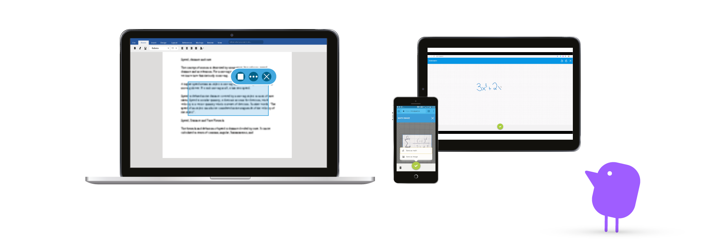
Demo Time
#AHG23

Slide 20
Feedback or questions?
#AHG23

Slide 21
Thank You!
Rachel Kruzel
Louis Shanafelt
Higher Education Specialist
Product Manager
Email: r.kruzel@texthelp.com
X: @TH_RachelK
Email: l.shanafelt@texthelp.com
X: @LouisShanafelt

