Slide 1
Coordinating Captioning Efforts on Campus - Three Perspectives
Annissa Stout, Accessible Content & Media Coordinator, UArizona
Rachel Levin, Digital Accessibility Services Manager, CU Boulder
Sarah Thompson, Accessibility Analyst, Indiana University

Slide 2
UArizona
Almost 47,000 students total
Over 3,700 students affiliated with Disability Services
85 students with captioning accommodations
Almost 300 course requests for Fall 2023
Captioning services coordinated by DRC alongside document conversion requests
Proactive captioning to be coordinated by individual departments

Slide 3
University of Colorado (CU) Boulder
Almost 37,000 students at the Boulder campus
Disability Services (DS) Office – student focused
ADA Office – employee and public focused
Digital Accessibility Office (DAO)
Less accommodations-focused, with the exception of post-production captioning
Procurement, Testing, Training, Captioning, and more

Slide 4
Indiana University
69,000+ degree-seeking undergraduate students
20,000+ students in graduate and professional programs
930+ academic programs university-wide
20,000+ classes offered each semester
Assistive Technology and Accessibility Center (ATAC)
Student accommodations and accessibility outreach

Slide 5
Group Background

Slide 6
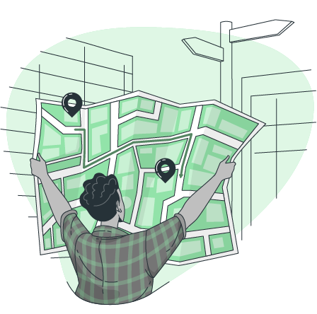
Campus Differences
Location of offices
Distribution of responsibility regarding accessibility
Roles

Slide 7
Intra-Institutional Collaboration
Gain understanding of different setups at other campuses
Tracking trends across several campuses
Share resources and ideas
Discuss vendor pain points and share advice

Slide 8
Common Findings Across Campuses
Large captioning volume
CU Boulder: 27,000 minutes
IU: 55,000 minutes
UArizona: 39,000 minutes
Lack of feedback from students
Partnerships with other departments is necessary
DEI, IT, and other disability and accessibility focused groups, including UDL practitioners
Fluctuation in accuracy from vendors

Slide 9
Vendor Accuracy Assessment

Slide 10
Assessment Goals
Assess accuracy across vendors
Expectations
Professional
Automatic (ASR)
Assess a wider range of vendors
Details available upon request

Slide 11
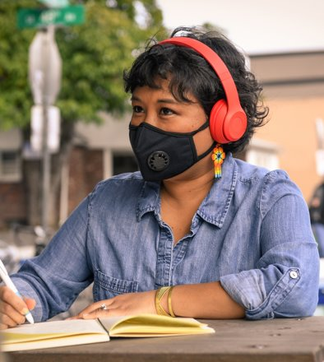
Assessment Methods
Consistent pool of videos submitted
Accuracy standards
Ideal transcript
Strict errors
Variety of videos used
Ideal sample
In-person lecture capture
Music
Poor audio quality
Speaker accents
STEM Content

Slide 12
Assessment Methods - Error Calculation
# | Text | Word Count | Exact Errors
1 | I: So out of the following sets these should be V: So are the following sets these should be ≠ ^ | 9 | 2
# | Text | Word Count | Exact Errors
10 | I: the postsynaptic receptor you look down to uh V: the postsynaptic receptor you look down to ^ | 8 | 1

Slide 13
Assessment Results - Example
File | Type | Word Count | Errors | Error %
Trigonometric integrals | STEM Content | 507 | 53 | 89.6%
WCCFL Plenary 2 | Poor Audio | 267 | 10 | 96.2%
In person | Lecture Capture | 398 | 49 | 87.7%
At home | Lecture Capture | 401 | 15 | 96.2%
What makes a ‘good college’ | Ideal Sample | 136 | 20 | 85.3%
Why is Joy a State of Mind – TED | Speaker accents | 418 | 36 | 91.4%
Full metal Jacket | Music | 79 | 12 | 84.8%
La Bamba trailer | Music | 203 | 59 | 71.0%

Slide 14
Professional/ASR Comparison
STEM Content
Poor Audio
Music
Lecture Capture In person
Lecture Capture ​ At home
Ideal Sample
Speaker accents
Music

Slide 15
Observations
Automatic
Music/sound effects
Large variability in accuracy
Professional
Music/sound effects
Math notation consistency
Speaker identification consistency

Slide 16
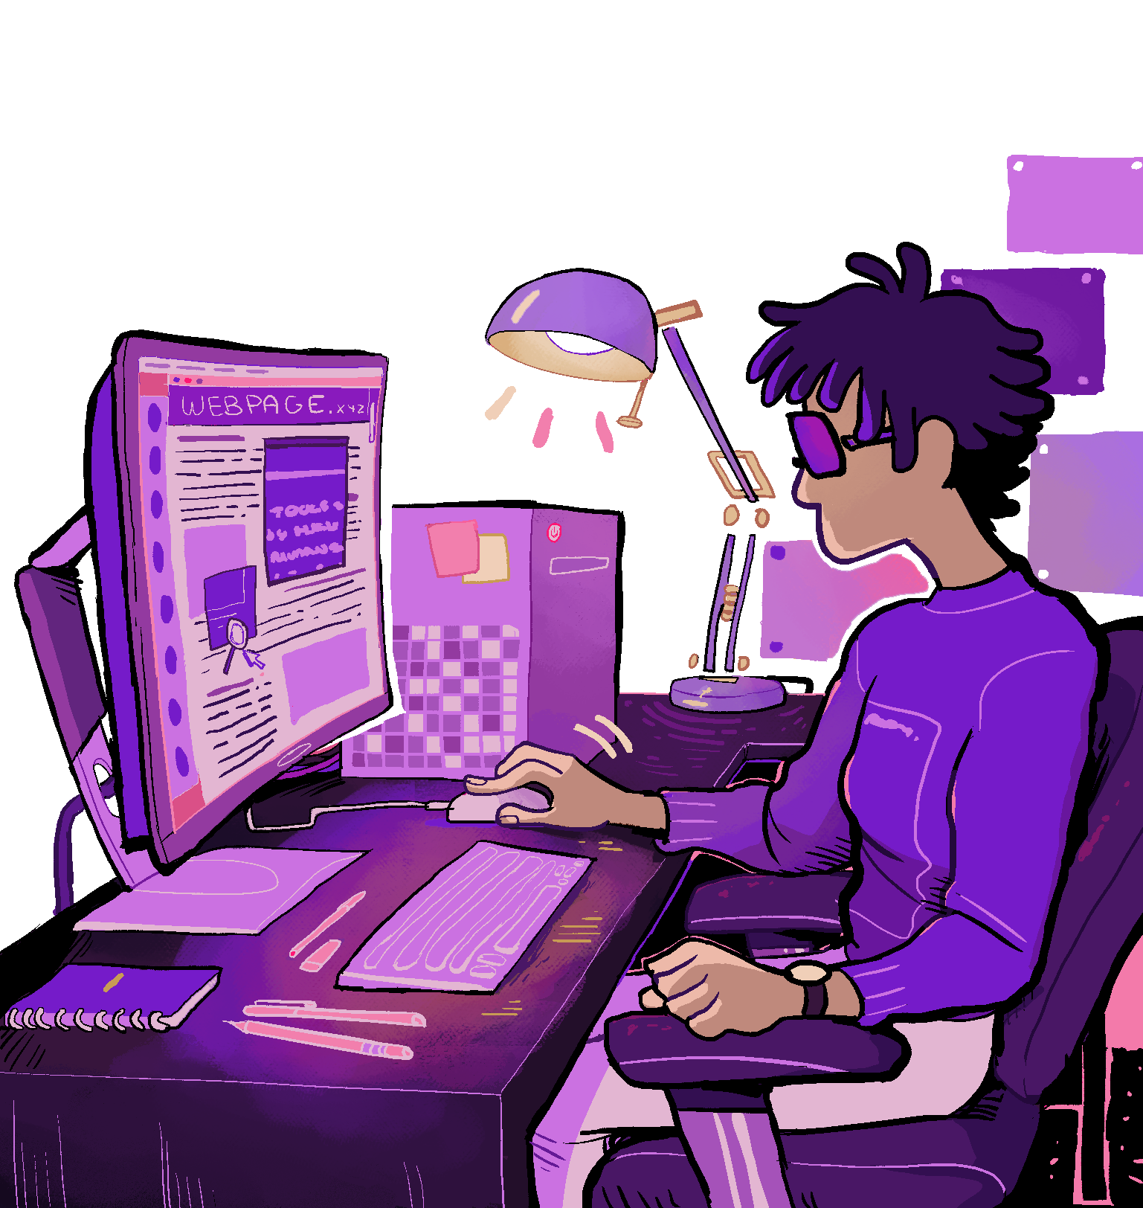
Other Considerations
Third party integrations
Kaltura, Teams, Zoom
Admin portal
Accessibility
Ease of scheduling
Metrics
Account hierarchy
Billing
Support structure
Point person

Slide 17
Next Steps

Slide 18
Strengths of our Collaboration
Smaller group with limited focus
Conversational, we all set the agenda
Meeting once a month rather than quarterly
Support system even outside of meetings

Slide 19
Broader Collaboration
Pooling resources
Sharing cost of research studies and assessments
Sharing expertise
Access to more vendors and tools
Leveraging the collective when giving feedback to vendors
Can work for other areas of focus

Slide 20
Future Assessment Ideas
"Chunking" of captioning
Live captioning or audio description (AD)
More vendors and computer-generated tools
Multiple service levels offered by vendors
Vendor workflows regarding AI and human involvement (how much and in what ways)
Control for fluctuating quality from vendors
Publish results

Slide 21
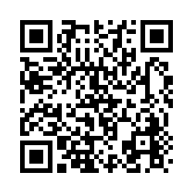
Have questions? Interested in joining us?
General Interest Form http://bit.ly/Captioning-AHG23 or scan QR code
Annissa Stout ACorsi@Arizona.EDU
Rachel Levin Rachel.D.Levin@Colorado.EDU
Sarah Thompson SAHerpst@IU.EDU
Notes:
Optional questions:
Is there anything you've found helpful that we didn't mention?
Any pain points that you'd like some guidance on?

Slide 22
Image Credits
2A2A6093-1. (n.d.). AllGo. https://canweallgo.com/plus-size-stock-photos/plus-size-stock-photos-home/
Chan, D. (n.d.). Dana Chan for Disabled And Here. Disabled and Here. https://affecttheverb.com/gallery/disabledandhere/videocall/
Henry, M. (n.d.). Women Working In Tech. Burst. https://www.shopify.com/stock-photos/photos/women-working-in-tech?q=team+work
Katigbak, J. (n.d.). dah-vogmask03. Disabled and Here. https://affecttheverb.com/gallery/disabledandhere/filtermasknotebook/
pch.vector. (n.d.). People using online apps set. Freepik. https://www.freepik.com/free-vector/people-using-online-apps-set_6974932.htm
Sherm. (n.d.). Sherm for Disabled And Here. Disabled and Here. https://www.freepik.com/free-vector/people-using-online-apps-set_6974932.htm
stories. (n.d.). Directions concept illustration. Freepik. https://www.freepik.com/free-vector/directions-concept-illustration_9319647.htm
The Gender Spectrum Collection. (2021). A trans person and a trans man working in a meeting. Vice. https://drive.google.com/file/d/1Dyw_Zt0YHwUfL7Kt9YHaV5QG4PRH6iZu/view

