Slide 1
Breaking Barriers Creating Accessible Online Assessments
Kristin Juhrs Kaylor, M.A.

Slide 2
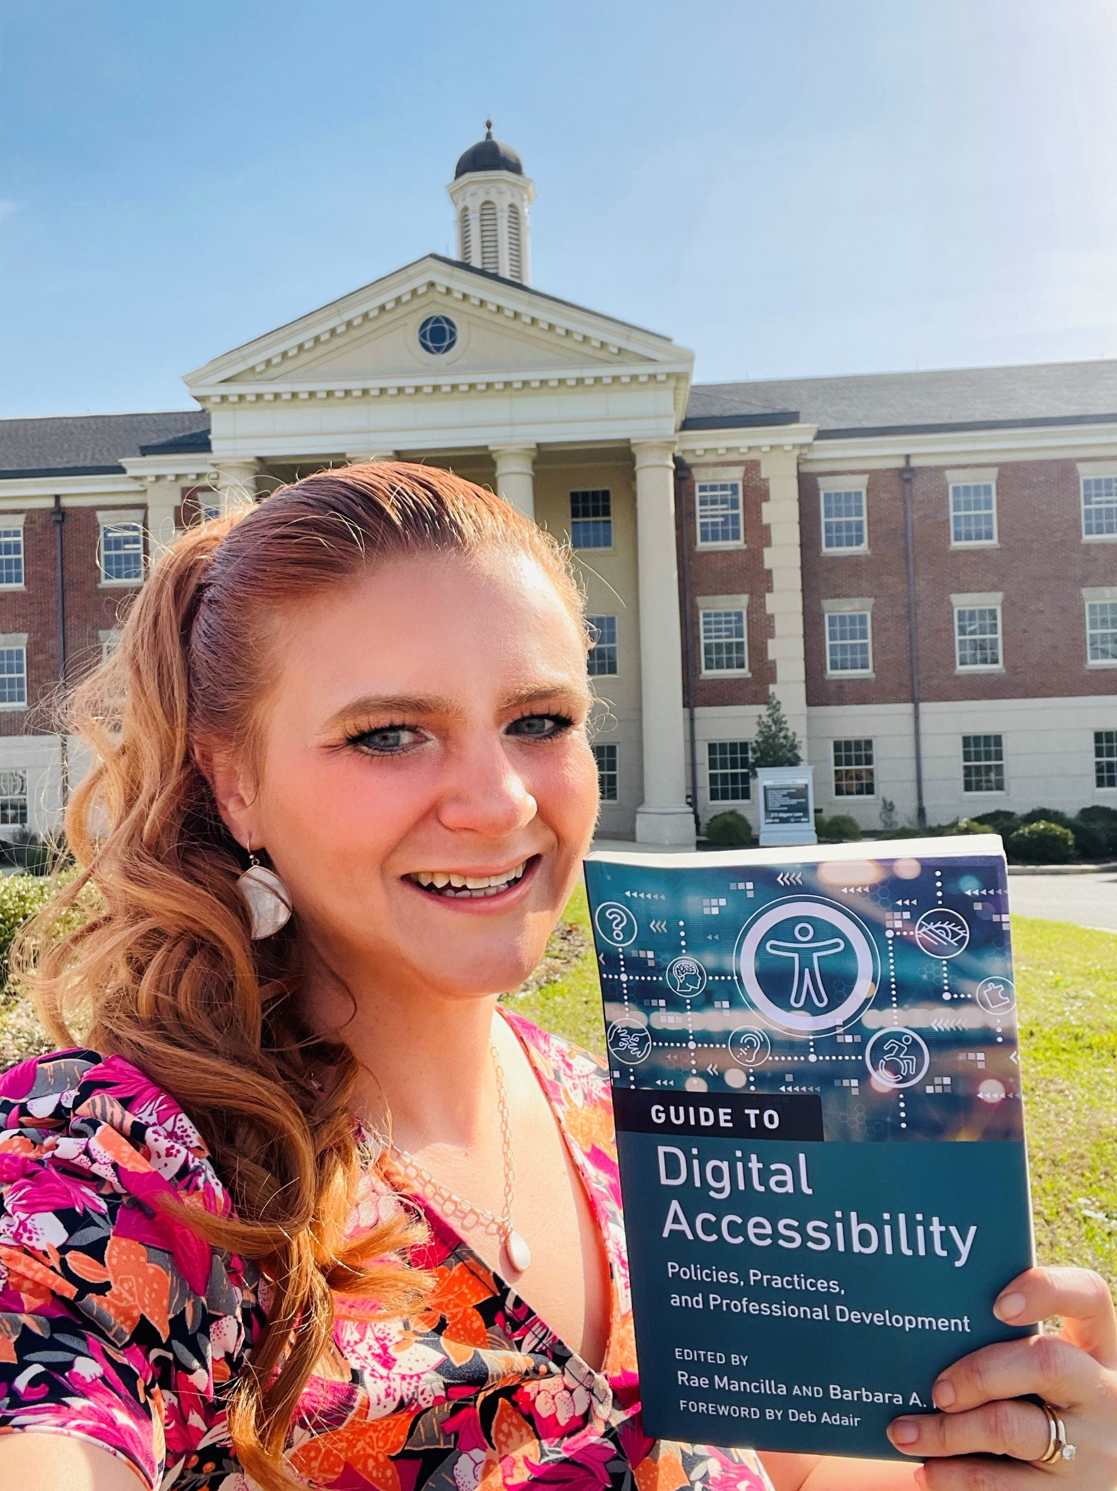
Speaker Biography
Kristin Juhrs Kaylor, M.A. is the Senior Accessibility Instructional Designer at The University of Alabama, College of Continuing Studies. She has over 23 years of experience in education accessibility, 15 years of experience as an educator (online learning, publications, and teaching), and 10 years of instructional design experience. For the past 4 years, she has led The University of Alabama Online’s course accessibility efforts, making UA is a national leader in online course accessibility.
She is a Certified Adobe PDF Accessibility Trainer. She holds Section 508 web standards and authoring accessible documents certificates through the Office of Accessible Systems & Technology, Department of Homeland Security.
She recently authored the chapter, “The University of Alabama Online’s Digital Accessibility Course Development Process, Practices, and Tools,” for the QM book, A Guide to Digital Accessibility: Policies, Practices, and Professional Development.
Kristin has presented/been selected to present on online course accessibility at Accessing Higher Ground, CSUN Assistive Technology Conference, and Alabama Instructional Design Network (AIDN) Conferences.

Slide 3
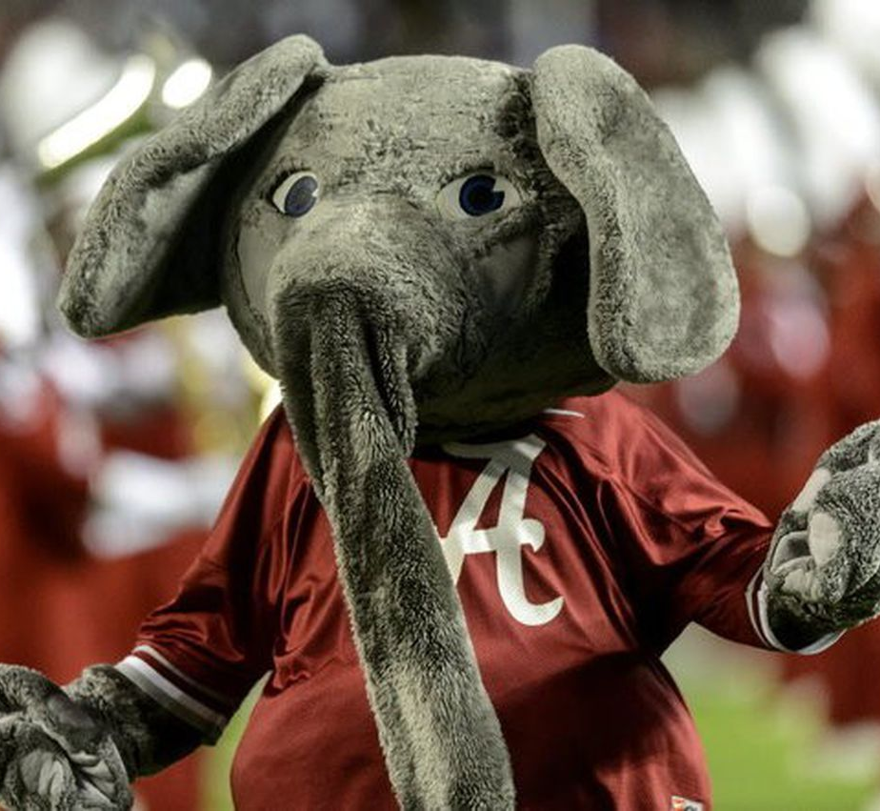
Questions
What types of assessments are used in your online courses?
How can they be as accessible as possible?

Slide 4
Assessments
Students are often assessed through:
Discussions
Blogs
Assignments
Field work
Quizzes, tests, and exams

Slide 5
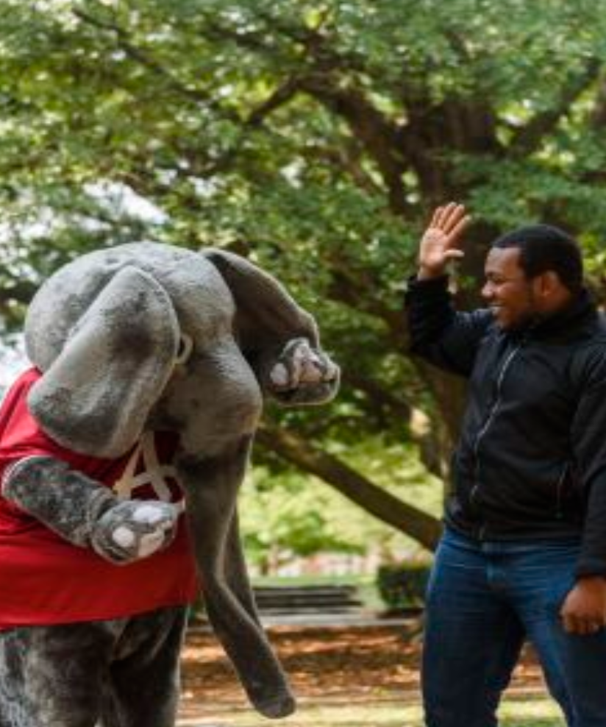
Discussions/ Blogs

Slide 6
Discussion Challenges
Beyond typing an answer, students are often asked to share
Websites
Articles
Images
Audio
Video

Slide 7
Discussion Accessibility Solution
Discussions are accessible when the instructions for students require accessibility.

Slide 8
Discussions/Blogs with Articles
Include the following in the prompt:
For articles and documents you share in a post, please share the HTML or Microsoft Office version (when available) so that everyone can enjoy your post. HTML and Microsoft Office (Word, PowerPoint, and Excel) are more accessible than PDFs for colleagues with disabilities.
If you require accommodations for text, you are required to contact the Office of Disability Services and your professor to coordinate accommodations prior to the discussion/blog.
This ensures students provide an accessible version of text for colleagues with disabilities.
A11y can help but manual remediation ensures full accessibility.

Slide 9
Discussions/Blogs with Images
Include the following in the prompt:
Provide a written description of the image you include, so that everyone can enjoy your post.
If you require accommodations for images, you are required to contact the Office of Disability Services and your professor to coordinate accommodations prior to the discussion/blog.
This requires students provide alt text for one another.

Slide 10
What is Easiest Way of Providing Alt Text?
Chat GPT 4 can author your alt text for you!
All you do is:
Upload the image with a standard prompt.
Copy/paste the results as the alt text for the image.

Slide 11
General At Text Prompt: Images, Infographics, Diagrams, Charts, and Figurative Images
Upload the Image and Paste the Chat GPT 4 Prompt: Create a textual description image with all of the information in it for a screen reader.
Select Send Message.
Copy and paste the output as the alt text.

Slide 12
Art Appreciation Prompt
Upload the Image and Paste the Chat GPT 4 Prompt: Identify the name of this piece of art, explain the art techniques and style used, and write a textual description image with all of the information in it for a screen reader.
Select Send Message.
Copy and paste the output as the alt text.

Slide 13
Tables, Scatter Plots, and Graphs Prompt
Upload the Image and Paste the Chat GPT 4 Prompt: Create a textual description image with all of the information in it in list paragrah format for a screen reader. Include all of the data points and numbers.
Select Send Message.
Copy and paste the output as the alt text.

Slide 14
Math Prompt
Upload the Image and Paste the Chat GPT 4 Prompt: Create textual description of the equation for a screen reader.
Select Send Message.
Copy and paste the output as the alt text.

Slide 15
CHAT GPT 4 Best Practices
Double check/spot check the results that are provided by CHAT GPT 4. Even AI makes mistakes.
If you get a processing error or CHAT GPT 4 stops working, you may need to start a new chat to get it to work again.

Slide 16
Discussions/Blogs with Audio
Include the following in the prompt:
For audio you share in a post, (when possible) select audio that is captioned. If you include anything your colleagues need to hear, make sure that you describe what they should be hearing.
If you require accommodations for audio, like closed captioning, you are required to contact the Office of Disability Services and your professor to coordinate closed captioning prior to the discussion/blog.
This provides:
Captioning for colleagues with disabilities
Information on how to get captioning
Captioning can be provided by a third-party provider and/or ASR.

Slide 17
Discussions/Blogs with All Media
Include the following in the prompt:
For articles and documents you share in a post, please share the HTML or Microsoft Office version (when available) so that everyone can enjoy your post. HTML and Microsoft Office (Word, PowerPoint, and Excel) are more accessible than PDFs for colleagues with disabilities.
Provide a written description of the image you include, so that everyone can enjoy your post.
For audio you share in a post, (when possible) select audio that is captioned.
If you include any images, charts, or anything someone would need to see in your video, describe it in detail out loud so that everyone can enjoy your video. If you include anything your colleagues need to hear, make sure that you describe what they should be hearing as well. You are required to avoid all flashing and flickering beyond 3 flashes/flickers per second of video as including this could cause seizures or migraines.
If you require accommodations for text, images, audio, or videos, you are required to contact the Office of Disability Services and your professor to coordinate accommodation prior to the discussion/blog.

Slide 18
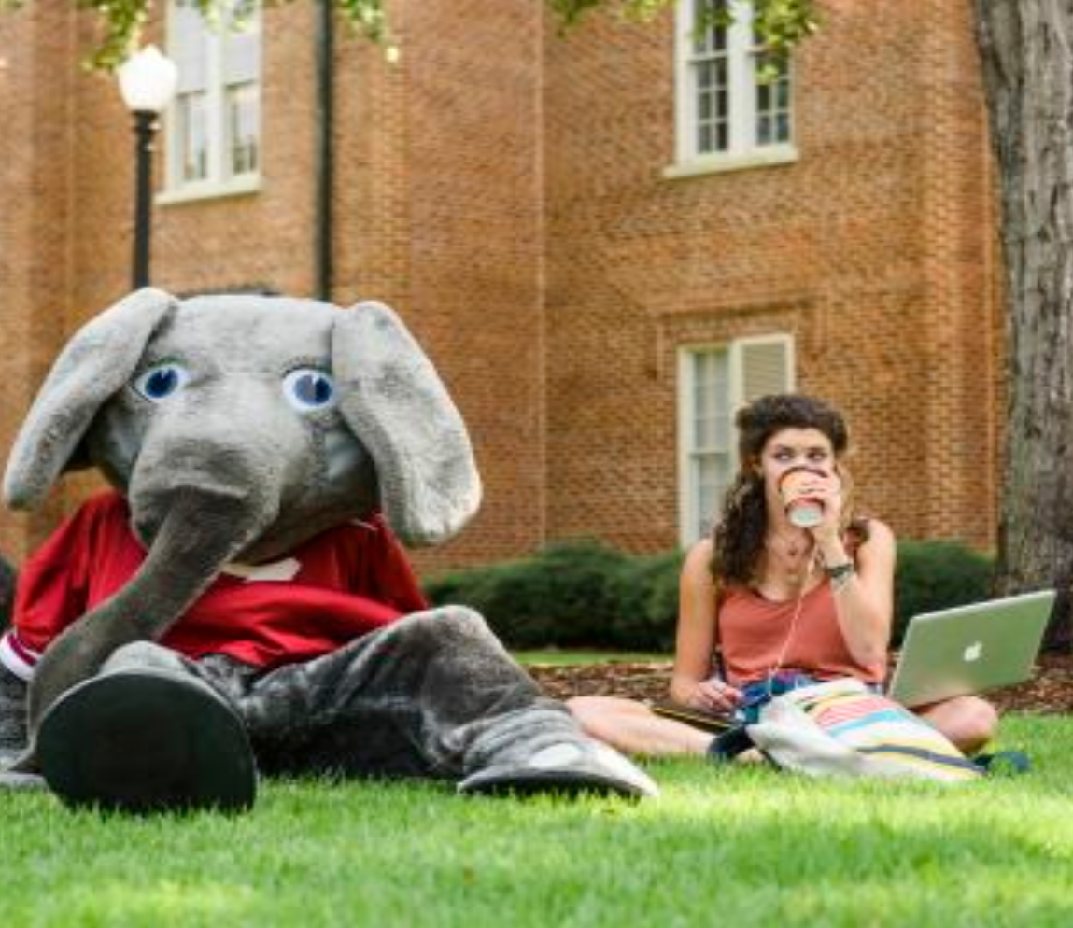
Blogs
Replace the word “Discussion” with “Blog” and include the applicable instructions.

Slide 19
Assignments and Field Work

Slide 20
Assignments and Field Work Considerations
Assignments and field work can take many forms. For all assignments, everything students interact with should be accessible. This includes, but is not limited to:
Tools/required software/online assessments
Handouts
Prompts and rubrics
Readings
Videos
Experiences
When tools, software, handouts, prompts, rubrics, readings, videos and experiences are not accessible, they must be remediated to become accessible.

Slide 21
Field Work
To ensure that students know what to do to request accommodation for field work, include the following in the prompt:
If you require accommodations for field work, you are required to contact the Office of Disability Services and your professor to coordinate them prior to beginning your field work.

Slide 22
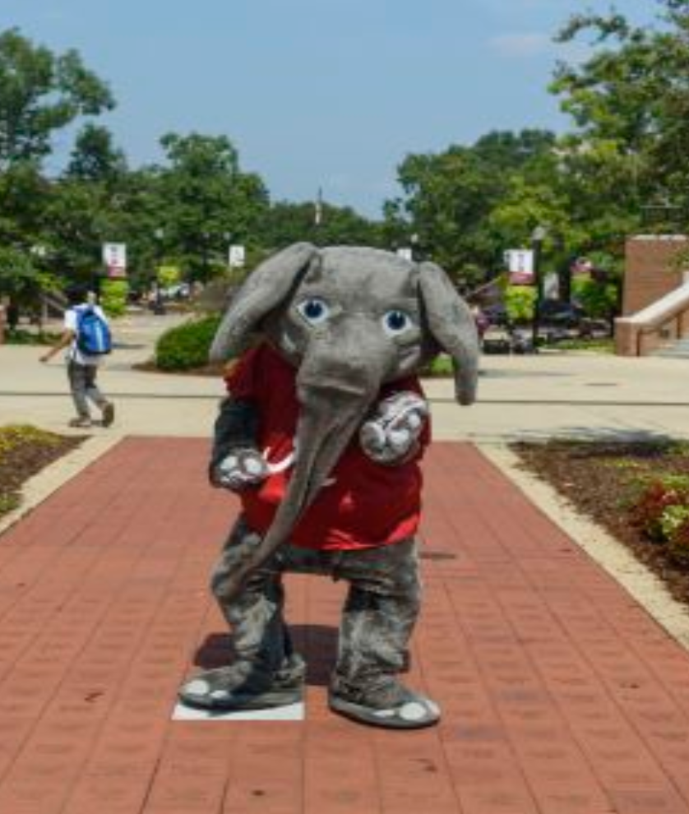
Quizzes, Tests, and Exams

Slide 23
Common Quiz, Test, and Exam Types
Multiple choice
True or false
Matching
Hot spot

Slide 24
Quiz, Test, and Exam Accessibility Challenges
Two types of questions can pose accessibility challenges:
Matching: If the matching is a drag and drop assignment, then it is not accessible because it is not keyboard accessible. This can be replaced by a matching assignment where students type the letter or number of the matching item.
Hot spot: This is not accessible because it requires that students be able to see the image and is not keyboard accessible. This can be replaced with a question asking students to describe in writing the location and/or appearance of something.

Slide 25
Fill in the Blank Questions
Fill in the blank questions often pose problems for screen readers because many screen readers do not read underscores or blanks aloud.
That means that students who use screen readers do not know where the blanks are in the question.
To fix this: Write blank instead of underscores for the blank.
Now, fill in the blank questions will read correctly for screen readers.

Slide 26
Quiz/Test/Exam Accommodations
Include the following with every link to the quiz, test, or exam so that students know how to request accommodation:
If you require accommodations for quizzes/tests/exams, you are required to contact the Office of Disability Services to coordinate the accommodations prior to taking the quiz/test/exam.
Reminding students every time is helpful for students with cognitive disabilities, neurodivergence, and learning disabilities. Also, reminding students every single time normalizes requesting accommodation.

Slide 27
Questions?

Slide 28
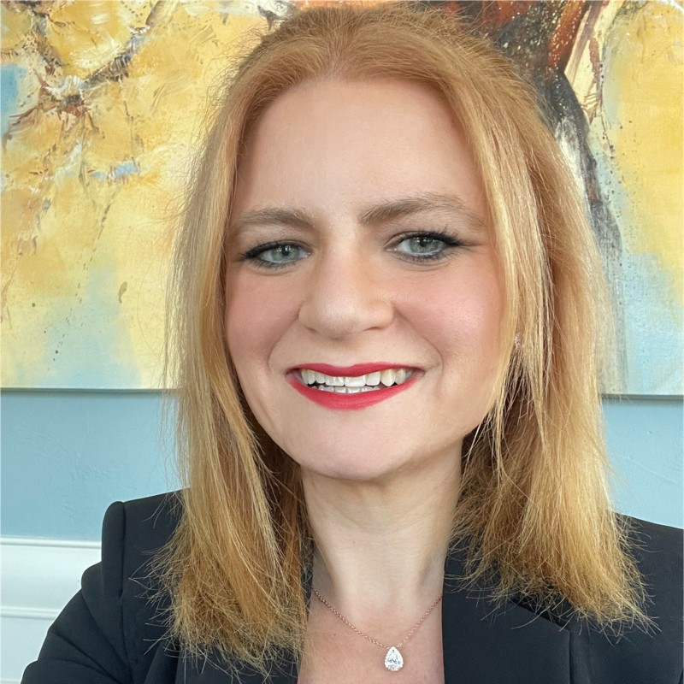
Contact
Kristin Juhrs Kaylor, MA
Senior Accessibility Instructional Designer
The University of Alabama
kjkaylor@ua.edu

Slide 29
The University of Alabama: Where Legends are Made

