Slide 1
Accessible Course Design Strategies For Rise and Storyline
By
Auston Stamm

Slide 2
About Me
I have mild cerebral palsy, ADHD and prosopagnosia
I benefitted from universal design and assignments that foster multiple means of engagement
I am working on a doctorate in educational technology from Boise State University
I am the Digital Accessibility Instructional Specialist for Stanford University

Slide 3
Presentation Goals
This presentation will provide strategies that can help you design more accessible Rise and Storyline courses
After this presentation you’ll be able to…
Identify inaccessible Rise and Storyline content
Implement accessible course design strategies
Use the provided Storyline and Rise checklists to identify accessible course content

Slide 4
Accessible Design
When designing Rise and Storyline courses consider a wide range of learners
Learners may use only the Keyboard
Learners may use screen reading software
Learners may use text to speech software
Being proactive reduces the need for accommodations

Slide 5
Agenda
Accessible Design
Course Introduction
Accessibility Features
Inaccessible Interactions
Focus Order and Elements
Audio/Video Content
Additional Resources

Slide 6
Course Design

Slide 7
Accessible Color
Before creating Rise and Storyline content it is important to ensure that there is sufficient contrast between the background color and foreground text
Use a color contrast checker:
WebAIM Color Contrast Checker
TPGI Colour Contrast Analyser (CCA)
Stanford Color Contrast Checker

Slide 8
Avoid Using Color Alone
Using color alone is inaccessible for people who are color blind and might be inaccessible for people using assistive technology
In Rise, the pie chart is an inaccessible block

Slide 9
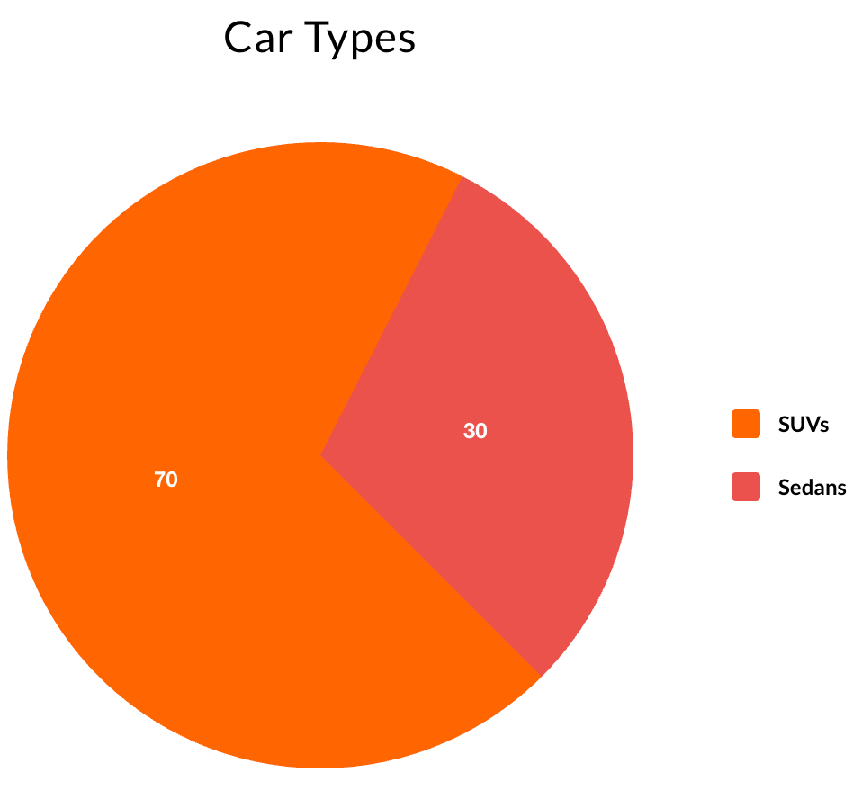
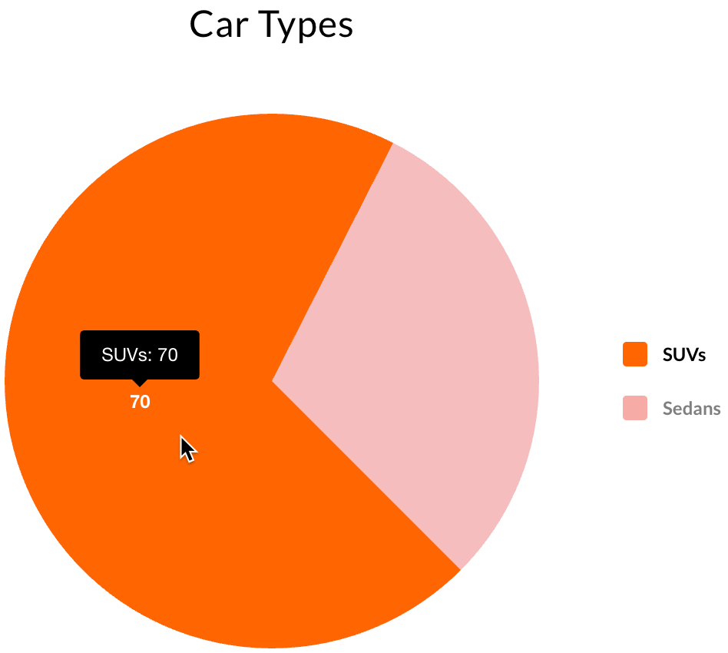
Rise Pie Chart Example

Slide 10
Pie Chart Example

Slide 11
Accessibility Tips
Avoid using images of text throughout the Rise or Storyline course
Use high quality images that do not pixelate when magnified to at least 200%
Use descriptive hyperlinks instead of URLs
Instead of www.applestore.com
Use Apple Store
Ensure any documents or external websites are accessible

Slide 12
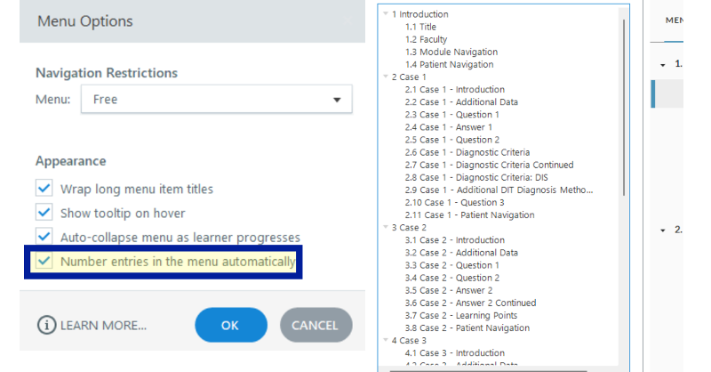
Storyline Unique Names
Each slide in Storyline slide should have a unique name
In the Player Properties menu option check “Number entries in the menu automatically”

Slide 13
Rise Unique Names
Each Rise page should have a unique name

Slide 14
Course Introduction

Slide 15
Designated Contact
If a leaner experiences an accessibility barrier there needs to be a person that they can contact to report the issue and get help
This person ideally should be familiar with the course and accessibility issues
Providing this information on the course sign up page or at the start of the course is recommended

Slide 16
Accessibility Info
Identify any known bugs or compatibility issues
Highlight the accessibility features available in the course

Slide 17
Accessibility Features

Slide 18
Storyline Accessibility Features
In Storyline use the modern player and turn on accessibility controls in the player properties menu
This turns on the following accessibility features:
Zoom to fit
Accessible text
Keyboard shortcuts
Background audio

Slide 19
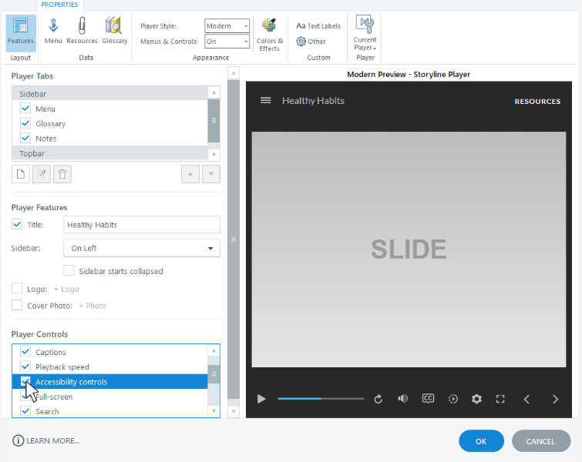
Accessibility Controls

Slide 20
Storyline Accessibility Demo
Inaccessible Storyline Course
Accessibility Controls are off
Accessible Storyline Course
Accessibility Controls are turned on

Slide 21
Rise Accessibility Features
All Rise courses support browser zoom
In the settings for a Rise course, it is possible to change the labels and screen reader announcements
This can be helpful if you want to change the default “click” to the more inclusive “select”

Slide 22
Rise Accessibility Settings

Slide 23
Inaccessible Interactions

Slide 24
Inaccessible Storyline Interactions
Avoid using hover states to convey meaningful information
Avoid drag and drop exercises or activities in Storyline because they are not keyboard accessible or compatible with screen reading software

Slide 25
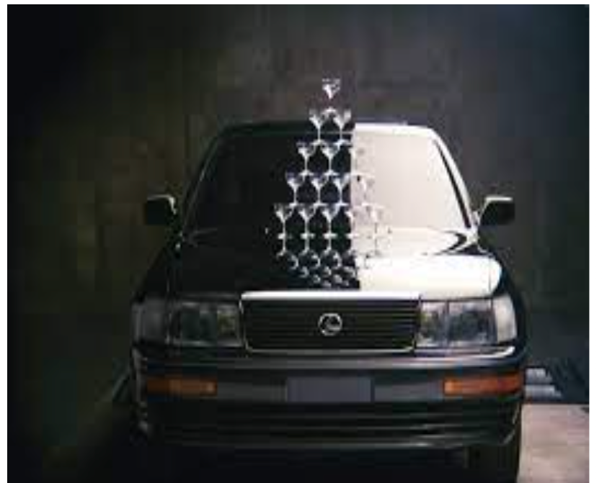
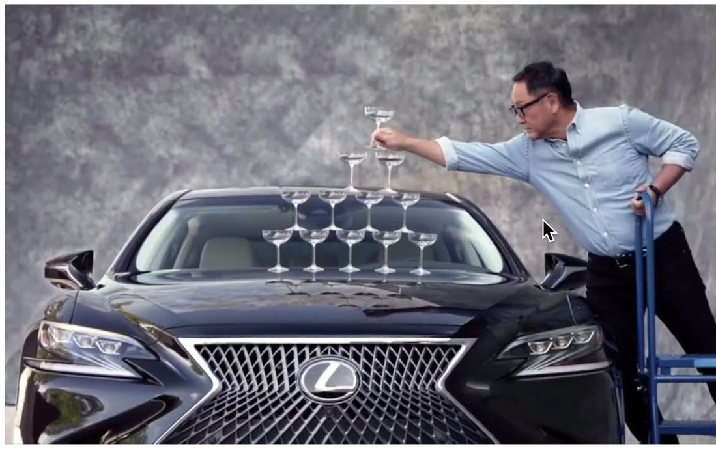
Hover State Example

Slide 26
Inaccessible Rise Interactions
The following Rise blocks are not accessible learners using only the keyboard or screen reading software
Rise blocks that use matching or sorting activities
The scenario Rise block
Quote and image carousels

Slide 27
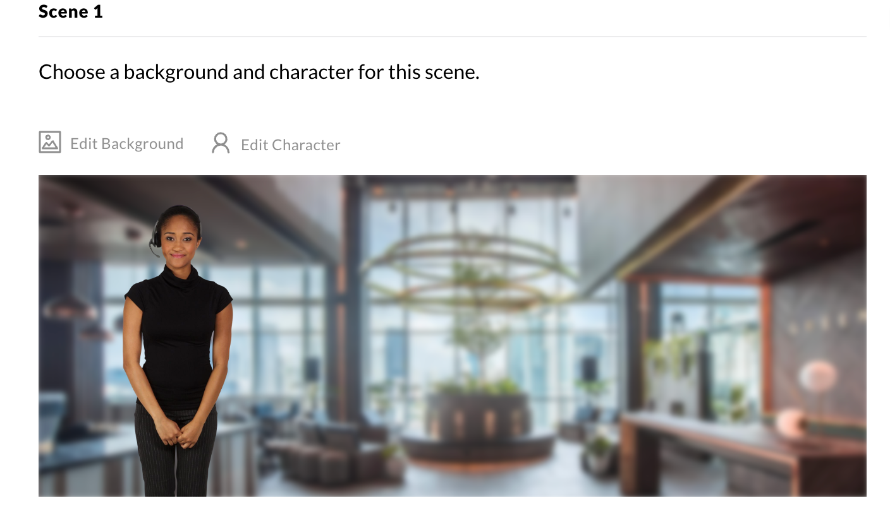
Scenario Example

Slide 28
Focus Order and Elements

Slide 29
Alt Text
Alt text describes what the image is
Alt text should be short 100-125 characters
Choose what information you want to convey
If more detail is needed use long description
Add the longer description below the image or create a separate layer

Slide 30
The Importance of a Logical Focus Order
The focus order should go from top to bottom in a logical order
Decorative image should be hidden, and meaningful images should be described
All meaningful items or interactive items should be in the focus order
Avoid having items from previous or next layers enter the focus order

Slide 31
Testing Content
Don’t rely on the preview this slide
Test content published to Articulate 360 Review or the LMS platform
Test the content by using only the keyboard to navigate
Does the focus adjust from one item to the next in a logical way?

Slide 32
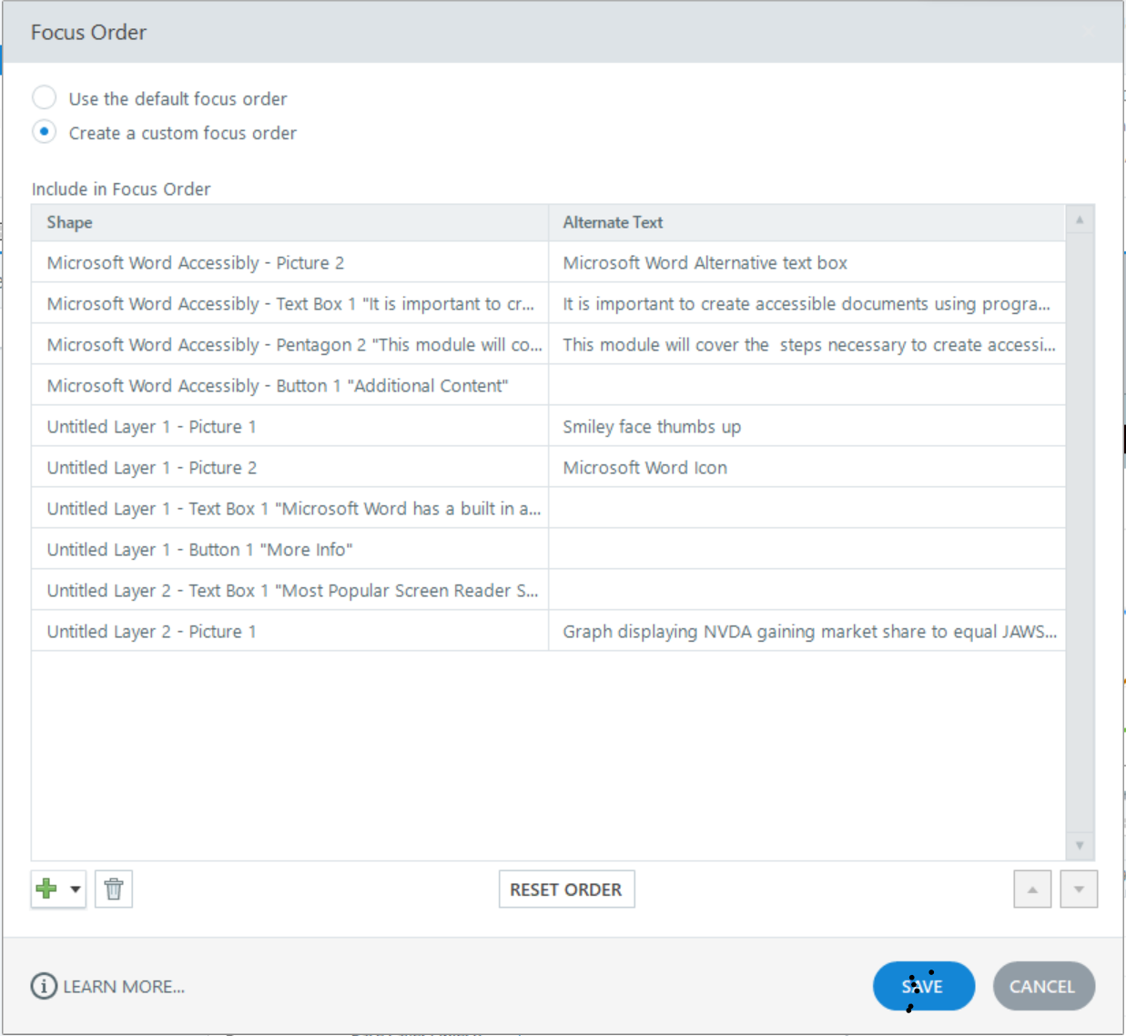
Storyline Focus Order Pane

Slide 33
Storyline Decorative Examples

Slide 34
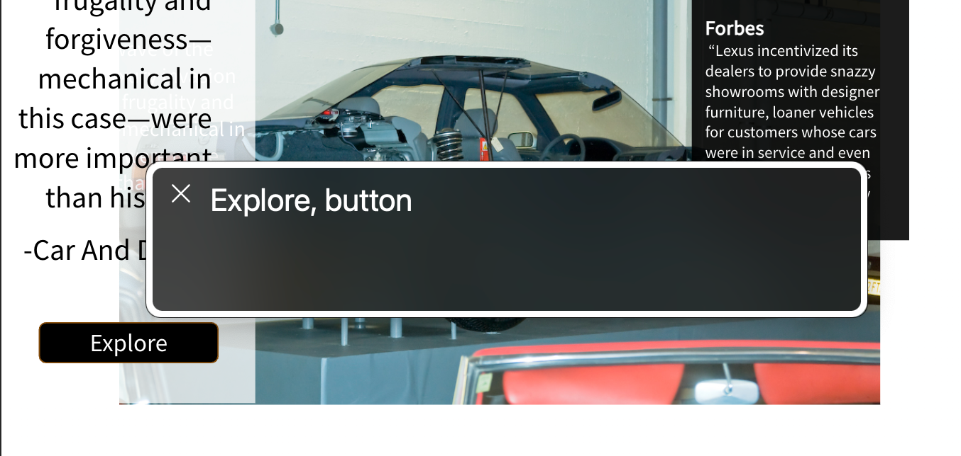
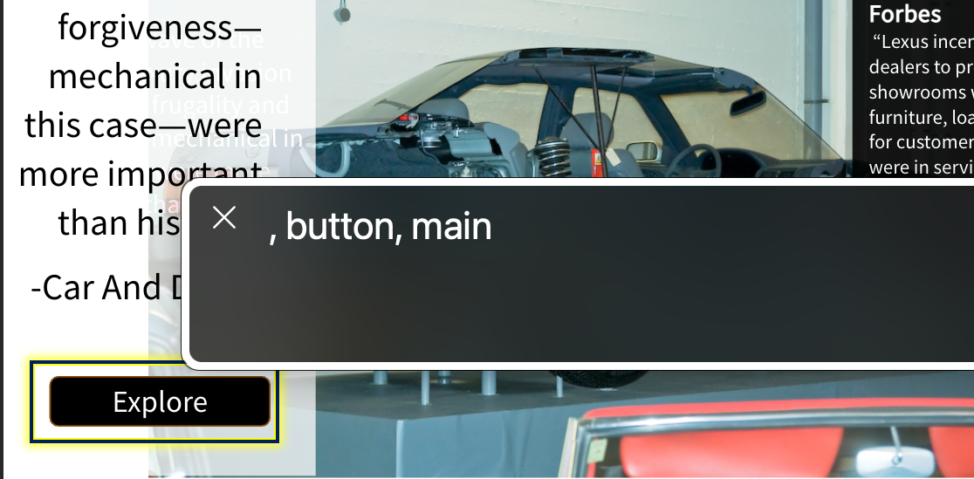
Storyline Button Examples

Slide 35
More Storyline Examples

Slide 36
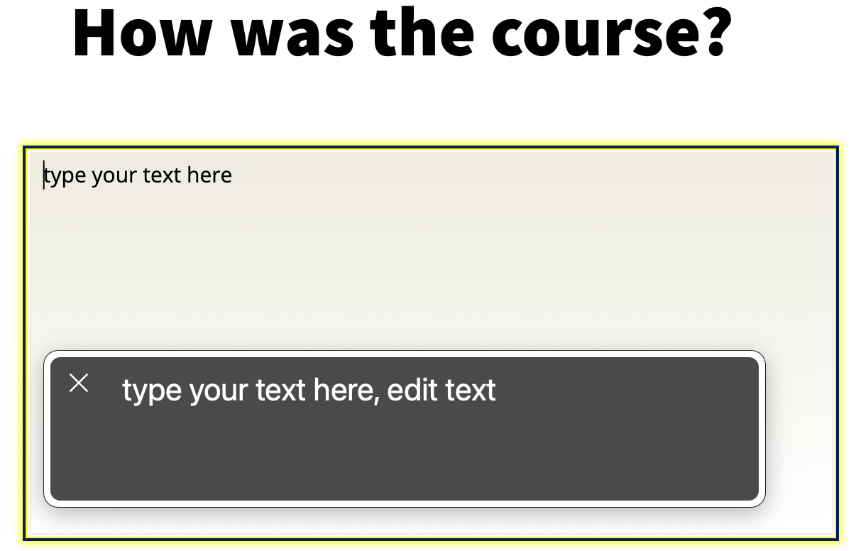
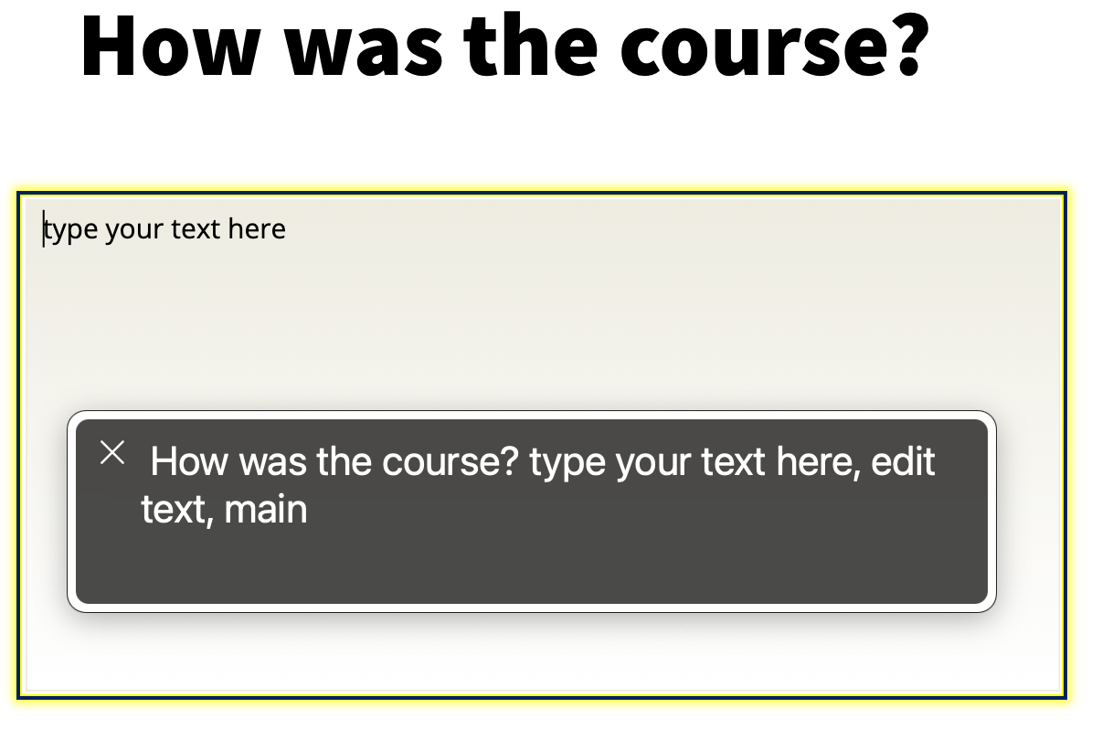
Text Entry Boxes
Include the full question as part of the name of the text entry box

Slide 37
Focus Order Pane Again

Slide 38
Storyline Multiple Layers
Slides with multiple layers need background layers hidden
When background layers are not hidden their interactive content can be accessed by using the keyboard
This may confuse learners who use only the keyboard or who use screen reading software

Slide 39
Multiple Layers Example

Slide 40
Rise Focus Order Tips
Use Rise headings and sub-headings on each page
Rise headings should be used to break up content
Accordion blocks also display as headings
Keep the content brief on each page to make it easier to navigate

Slide 41
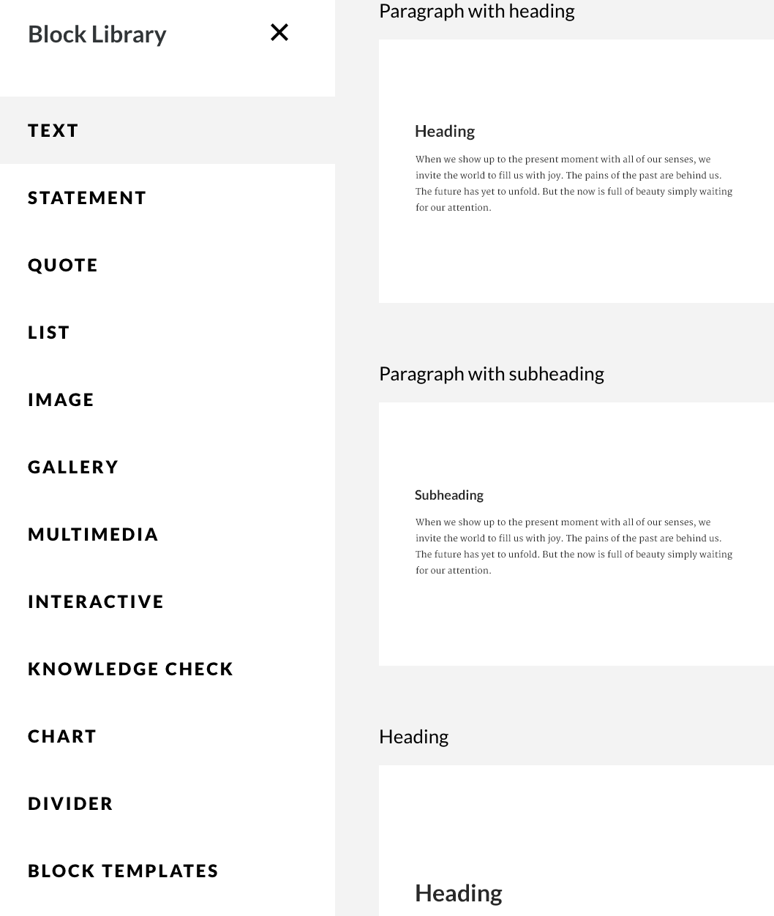
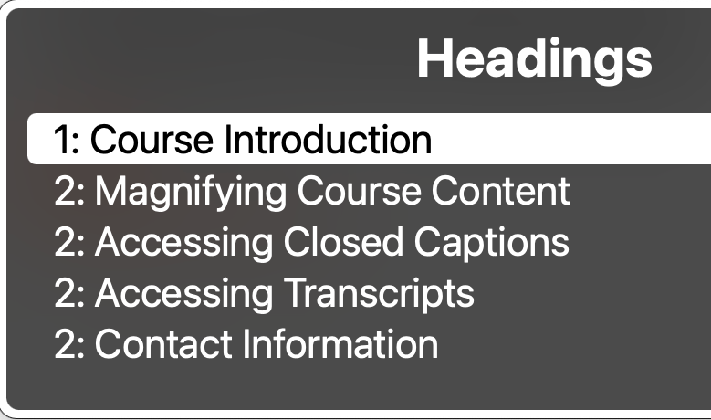
Rise Focus Order Examples

Slide 42
Audio/Video Content

Slide 43
Audio/Video Content Tips
Include a transcript for any video or audio materials
Include accurate subtitles for any video content that contains audio
Describe what is displayed on the screen when creating tutorial videos
Consider if you want your content to auto-play

Slide 44
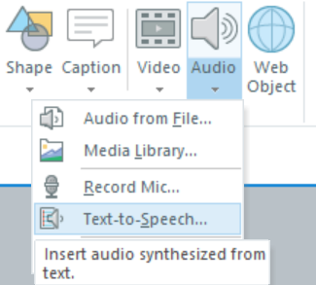
Storyline Non Video Content
When text pops in on a slide it is not announced to learners using screen reading software
Narration can make that text accessible

Slide 45
Additional Resources

Slide 46
Initiatives At Stanford
Requiring content authors to check their courses by using an accessibility checklist
Creating Storyline modules on how to make accessible Rise and Storyline
These modules will be available to the Stanford community and content authors will be encouraged to use the modules
Providing trainings and reviewing course content

Slide 47
Provided Resources
Drafts of the checklist standards are provided
Access to Course Introductions
Access to Storyline and Rise courses demoing accessible and inaccessible elements
Promoting Articulate accessibility resources

Slide 48
Questions

