Slide 1
Exploring Applications of Chat GPT and Similar Large Language Model AI to Promote Access
Chris Parthemos – Assistant Director, SAEO

Slide 2
About the Speaker
Chris Parthemos is the Assistant Director of Virginia Commonwealth University’s Student Accessibility and Educational Opportunity Office, where he oversees Case Management services, Assistive Technology, and Alternative Formatting.
Chris is also a doctoral candidate at VCU’s School of Education, where his research focuses include Artificial Intelligence, educational equity, and sense of belonging.

Slide 3
Session Agenda
What is Generative AI?
What are its risks and benefits?
How do/might our students use it?
What questions do we need to ask ourselves?

Slide 4
What is Large Language Model AI?
Chat GPT, Bard, etc.

Slide 5
In Summary
LLM AI uses an algorithm (Natural Language Processing) to generate language, word by word, in response to a prompt supplied by the user

Slide 6
In Summary
Tools like ChatGPT are a lot like AutoCorrect on a smart phone – they simply continue to guess until the ‘answer’ is complete

Slide 7
To Expand...
Artificial Intelligence is…
Generative AI…
A software or web-based tool that simulates human intelligence, generally by making independent decisions based on predetermined parameters
Generates content in a manner designed to simulate human intelligence, generally by answering questions or following prompts to produce strings of text (or images)

Slide 8
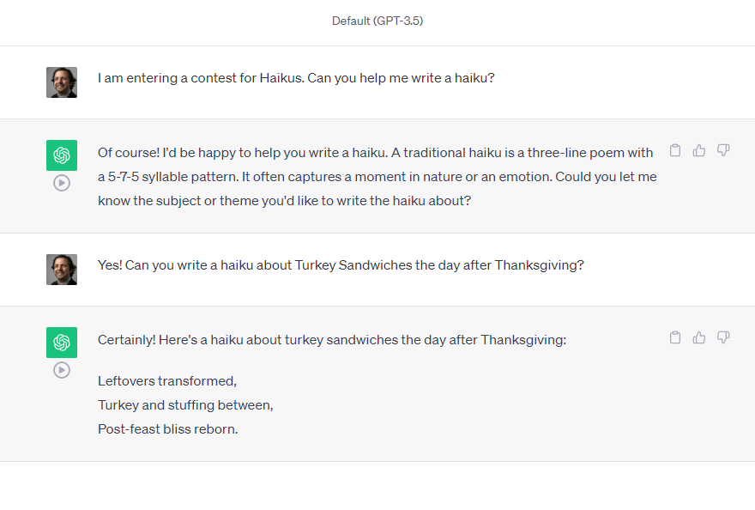
An Example...

Slide 9
What does this mean?
AI is designed to fulfill its user’s goal while seeming as independently intelligent as possible. In pursuit of this goal, AI is always learning from each interaction it has with us – about what we want, and about how we speak.

Slide 10
What are the Risks and Benefits of these tools?
Privacy vs. efficiency

Slide 11
In Summary
Much is unknown about how AI actually works – its algorithms are generally closely guarded secrets…

Slide 12
In Summary
While AI can rapidly produce content, it may do so inaccurately or with unintended bias… and it may take more than it gives

Slide 13
Some Benefits of AI
AI can rapidly produce content
AI can assess how well rules are followed
AI can provide a space for trial runs, brainstorming, etc.
AI can serve as a better internet search tool

Slide 14
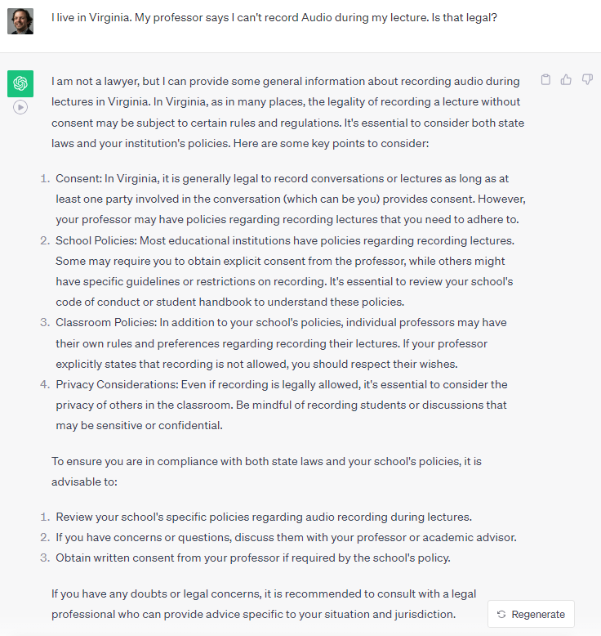
An Example...

Slide 15
Some Risks of AI
AI may make critical mistakes
AI may present information in a biased manner
AI does not protect the privacy of users
Reliance on AI may undermine learning objectives of some courses

Slide 16
An Example...
A List of Names Given by ChatGPT in “A Classic Love Story”
Damien & Audrey… Emily & Daniel… Amelia & Henry… Isabella & Luca…
Amanda & Francis… Robert & Sarah… Mark & Elizabeth… Tom & Mary…
What do we notice about these names?

Slide 17
How Do Students Use AI?
Advocacy, efficiency, & more

Slide 18
Possible Uses for Students...
AI as Advocate: Drafting Emails & Speeches
AI as Editor: Support with Spelling & More
AI as Tutor: Info dumps & Practice Quizzes
AI as Friend: Talk to Chat GPT about Anything
AI as Muse: Let Chat GPT get you started

Slide 19
AI as Advocate:
Dear Professor Shavathi,
I hope this email finds you well. I am writing to request a brief extension for the upcoming essay assignment in STAT 210.
I am currently facing a medical issue that has unexpectedly exacerbated, and I am struggling to manage it while meeting the original deadline. I am taking the necessary steps to address this issue promptly, but I am concerned that it may impact the quality of my work if I rush to complete the assignment under these circumstances…

Slide 20
AI as Advocate:
I am appreciative of your understanding and would be grateful if you could grant me a short extension of [mention the specific amount of extra time you need]. This extra time would allow me to produce the high-quality work that I strive for in your course.
I understand the importance of adhering to deadlines and will ensure that my essay is submitted promptly with this extension in mind. I would like to emphasize that I am fully committed to the course and am working diligently to manage this situation.
If you require any documentation or additional information, please do not hesitate to let me know, and I will provide it promptly.

Slide 21
AI as Tutor
What is the primary purpose of cellular mitosis?
To create genetically identical daughter cells
To introduce genetic diversity
To produce haploid cells
d) To repair damaged DNA

Slide 22
AI as Tutor
3. In a diploid organism with 2n=6, how many chromosomes are present in each daughter cell following mitosis?
3
6
12
2

Slide 23
AI as Friend
I'm really sorry to hear that you're going through such a tough time at college. It's not uncommon to feel overwhelmed and stressed, especially when you're struggling academically and feeling socially isolated. Here are some steps you can take to help manage these challenges:
Reach out to your professors
Seek academic support
Consider counseling services
Join Clubs or Organizations
Talk to your parents
Consider your options

Slide 24
AI as Friend
Remember that you're not alone, and many students face challenges in college. Seeking help and support from various resources on campus can make a significant difference in your experience. Don't hesitate to reach out to friends, family, or professional counselors if you need someone to talk to. Your college's staff and services are there to support you through this difficult period.

Slide 25
What Questions Do We Need to Ask Ourselves?
Is AI *really* going to change the world?

Slide 26
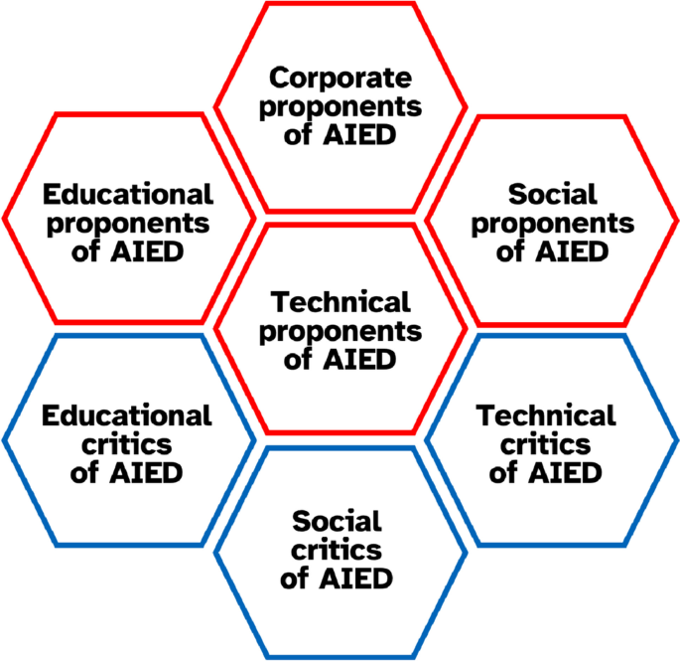
Where Do We Fit?
Should our students use AI?
Should we?
What is our institutional context?
What happens if we don’t let them use it?
Selwyn, N. Constructive Criticism? Working with (Rather than Against) the AIED Back-Lash. Int J Artif Intell Educ (2023).

Slide 27
Is AI a Tool for Access?
Are there any circumstances in which access to ChatGPT may be appropriate as an accommodation for a student?
Is the use of AI tools like ChatGPT, itself, accessible to our students?

Slide 28
Additional Reading
de Winter, J.C. Can ChatGPT Pass High School Exams on English Language Comprehension?. Int J Artif Intell Educ (2023).
Koedinger, K. Navigating Ethical Benefits and Risks as AIED Comes of Age. Int J Artif Intell Educ (2023). Selwyn, N. Constructive Criticism? Working with (Rather than Against) the AIED Back-Lash. Int J Artif Intell Educ (2023). Zhai, X. (2022). ChatGPT user experience: Implications for education. ResearchGate. https://www.researchgate.net/publication/366463233_ChatGPT_User_Experience_Implications_for_Education.

Slide 29
Q + A Time!

Slide 30
Thank You!

