Slide 1
Opportunities and barriers in implementing UDL for accessibility
- data from both students and faculty’s perspectives
Hongye Liu, Lawrence Angrave

Slide 2
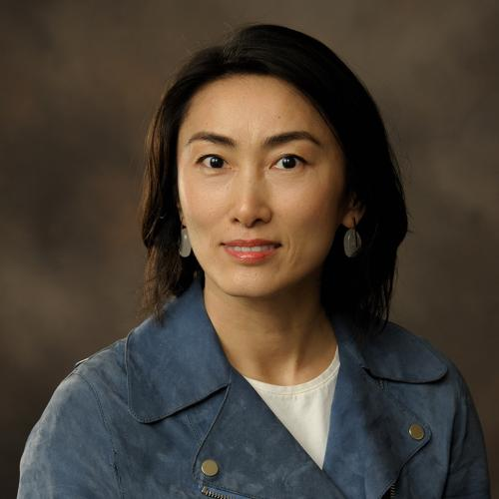
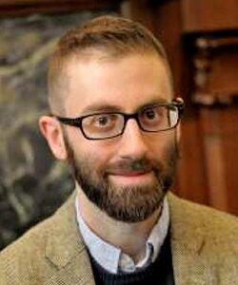
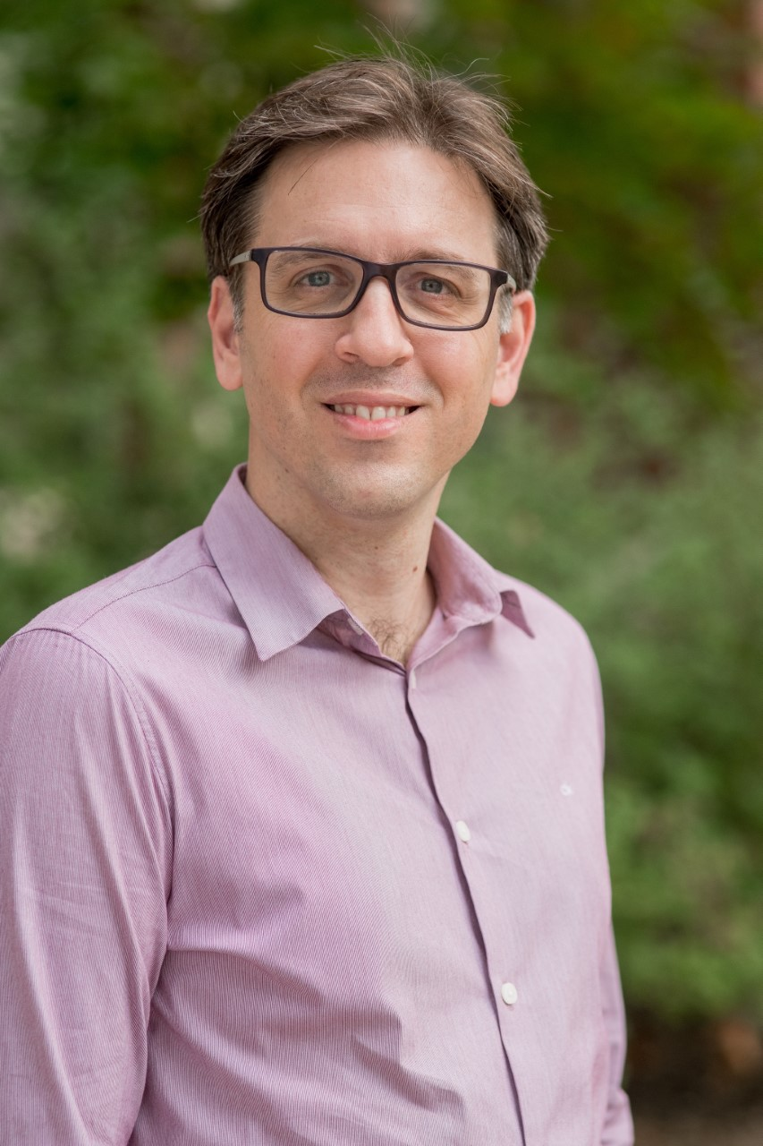
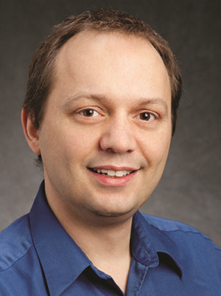
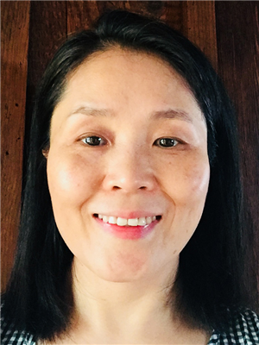

Team
Yun Huang
David Dalpiaz
Chrysafis Vogiatzis
Lawrence Angrave
Hongye Liu
Notes:
2 As, 1C, 2D, 1H

Slide 3
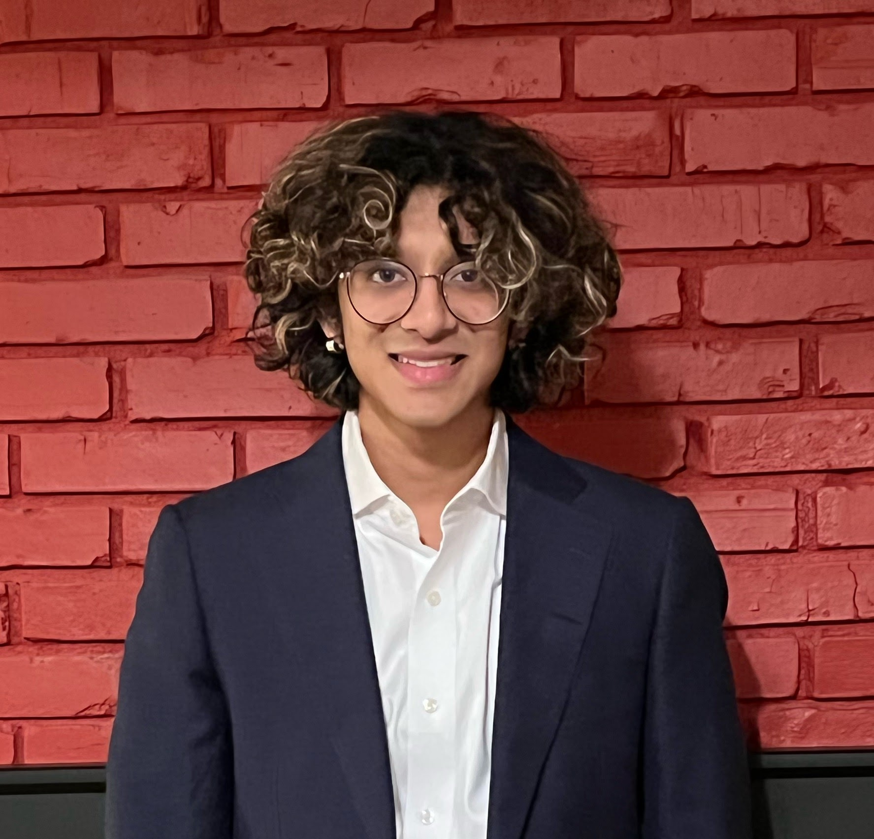
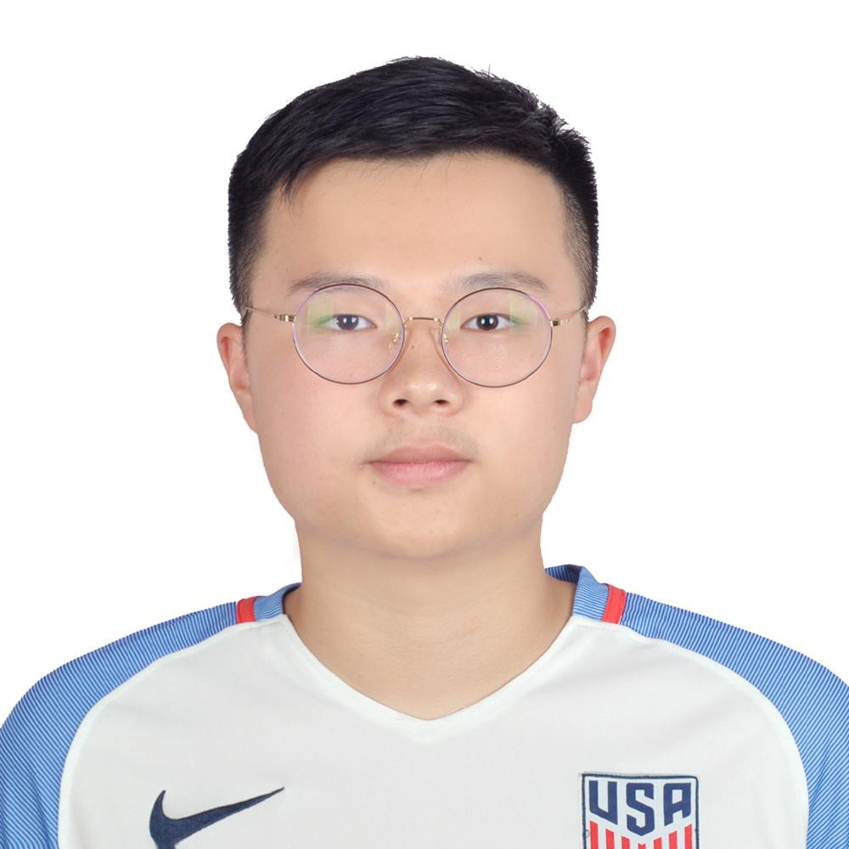
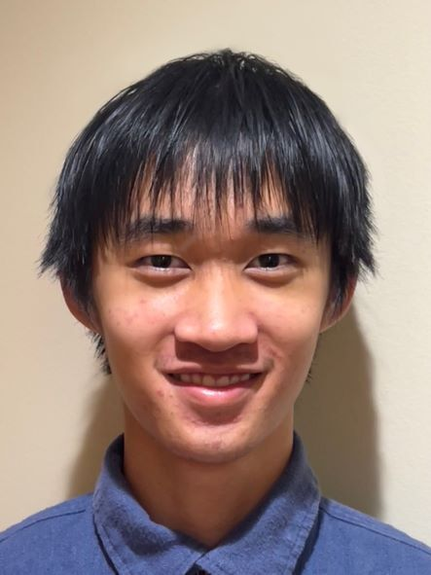
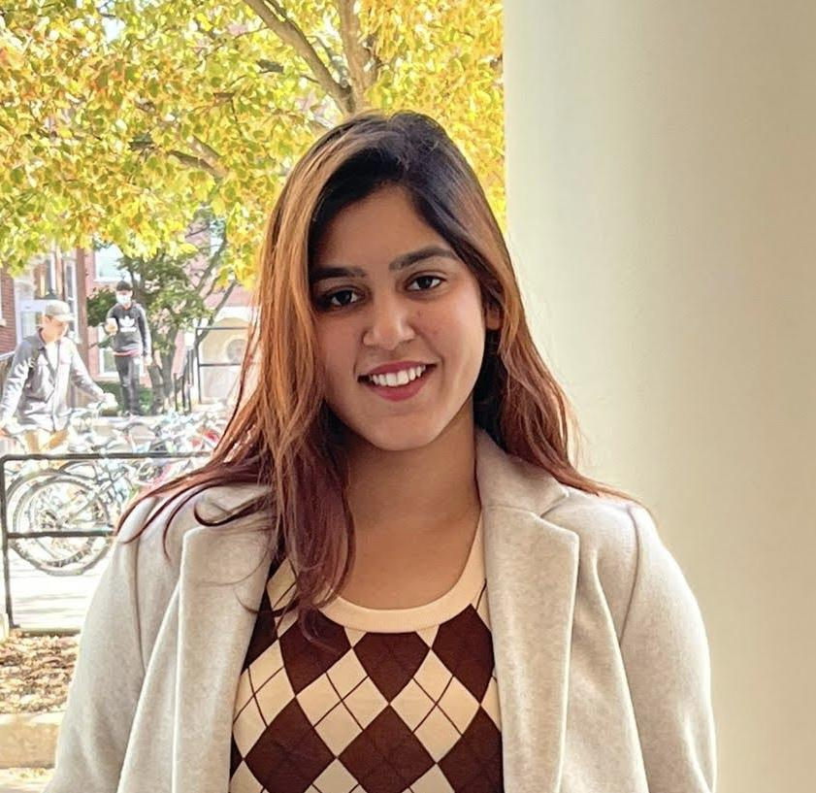
Team (conti.)
Sujit Varadhan
Xiuhao Ding
Ananya
Agarwal
Delu Zhao

Slide 4
Contents
Background
Research overview
Key findings
Future directions
Acknowledgment

Slide 5
Contents
Background
Research overview
Key findings
Future directions
Acknowledgement

Slide 6
Common Vocabulary
UDL: Universal Design for Learning
SWD: Students with Disabilities
SWOD: Students without Disabilities
SACAN: Students with Accessibility and Accommodation Needs

Slide 7
The needs of students with disabilities (SWD)
NSF and NCES report 19% 4-year undergrads have disabilities
Underreporting of SWD can be as high as 75%
Many SWD felt their needs are unmet
Notes:
What much of previous literature shows is that SWD are an underserved and relatively unacknowledged minority group

Slide 8
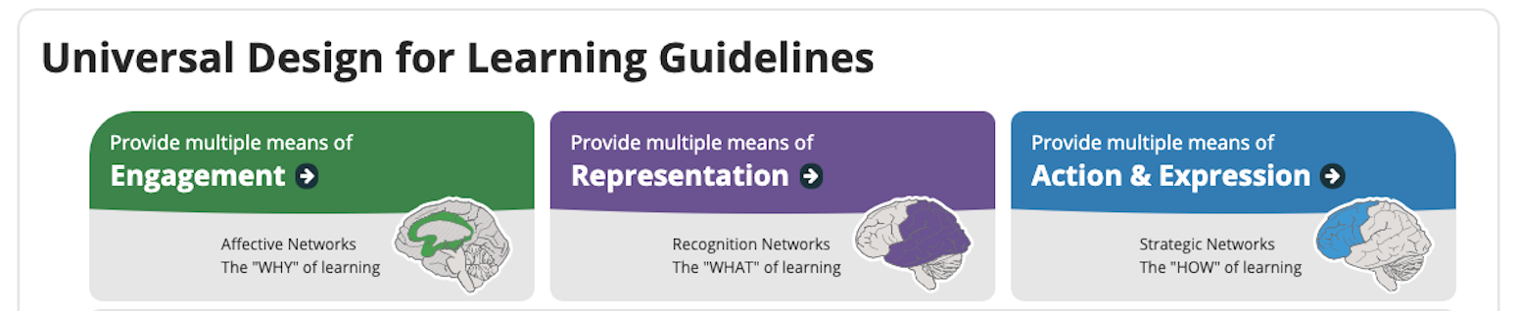
Universal design for learning (UDL)
Why? What? How?
Notes:
Universal Design for Learning (UDL) is an inclusive pedagogical framework and set of principles to improve learning for all students by emphasizing the importance of accommodating multiple modes of student learning, action, and engagement.
Engagement: discussion platforms, polls, providing learning obj
Representation: providing the same content in multiple forms: recorded lectures, slide decks, textbooks
AE: How students express their learning and knowledge: frequent low stakes quizzes, alternative assessments, auto grader

Slide 9
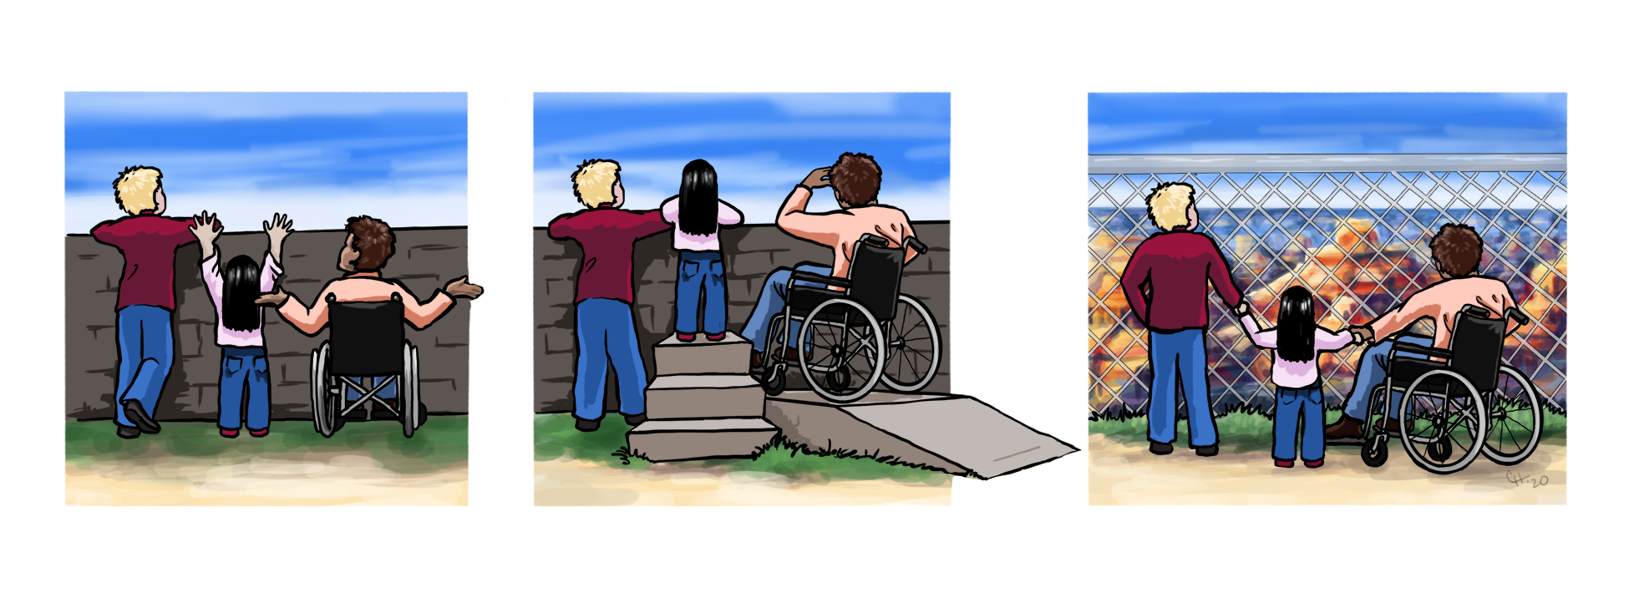
Universal design for learning
Slide credit to Keith Hays, 2021
Illustration by Cora Hays, 2021
INACCESSIBLE
ACCOMMODATION
ACCESSIBLE
EQUALITY
Everyone receives the same support, regardless of need.
EQUITY
Individuals given different support / accommodation to enable access.
INCLUSION
Everyone has access:
No need for support / accommodation

Slide 10
Contents
Background
Research overview
Key results

Slide 11
16 Representative UDL Features Surveyed
Engagement | Representation | Action-Expression | Accessibility
Official discussion platforms Provision of learning objectives or other motivational content On-boarding form for accessibility needs Alternative assessments Anonymous polls on course content Gamification (points systems, Kahoot!, etc.); Props/physical objects in teaching | Transcripts/captions on course-related videos Recorded lectures Alternative learning formats to lectures (textbook, slides, etc.), Alternative assessments Props/physical objects in teaching | Flexible assessment deadlines Auto-graders Frequent low-stake tests Alternative assessments Anonymous polls on course content Gamification (points systems, Kahoot!, etc.); | Accessibility checker for web pages Immersive Reader Text-to-speech On-boarding form for accessibility needs

Slide 12
Survey Design
Two Surveys About UDL practices
Student Survey to assess opinions and frequency of experience
Instructor Survey to assess knowledge and barriers and compare opinions about UDL features with students
Notes:
Instructors from across the college of engineering

Slide 13
Survey Demographics

Slide 14
Contents
Background
Research overview
Key findings

Slide 15
Top five useful UDL features ranked by students
1. Recorded lectures that students can search for content
2. Flexible assignment deadlines
3. Transcripts and captions on course related videos
4. Official discussion platform
5. Alternative learning formats to lectures (textbook, slides, etc.)
Notes:
Any Guesse?

Slide 16
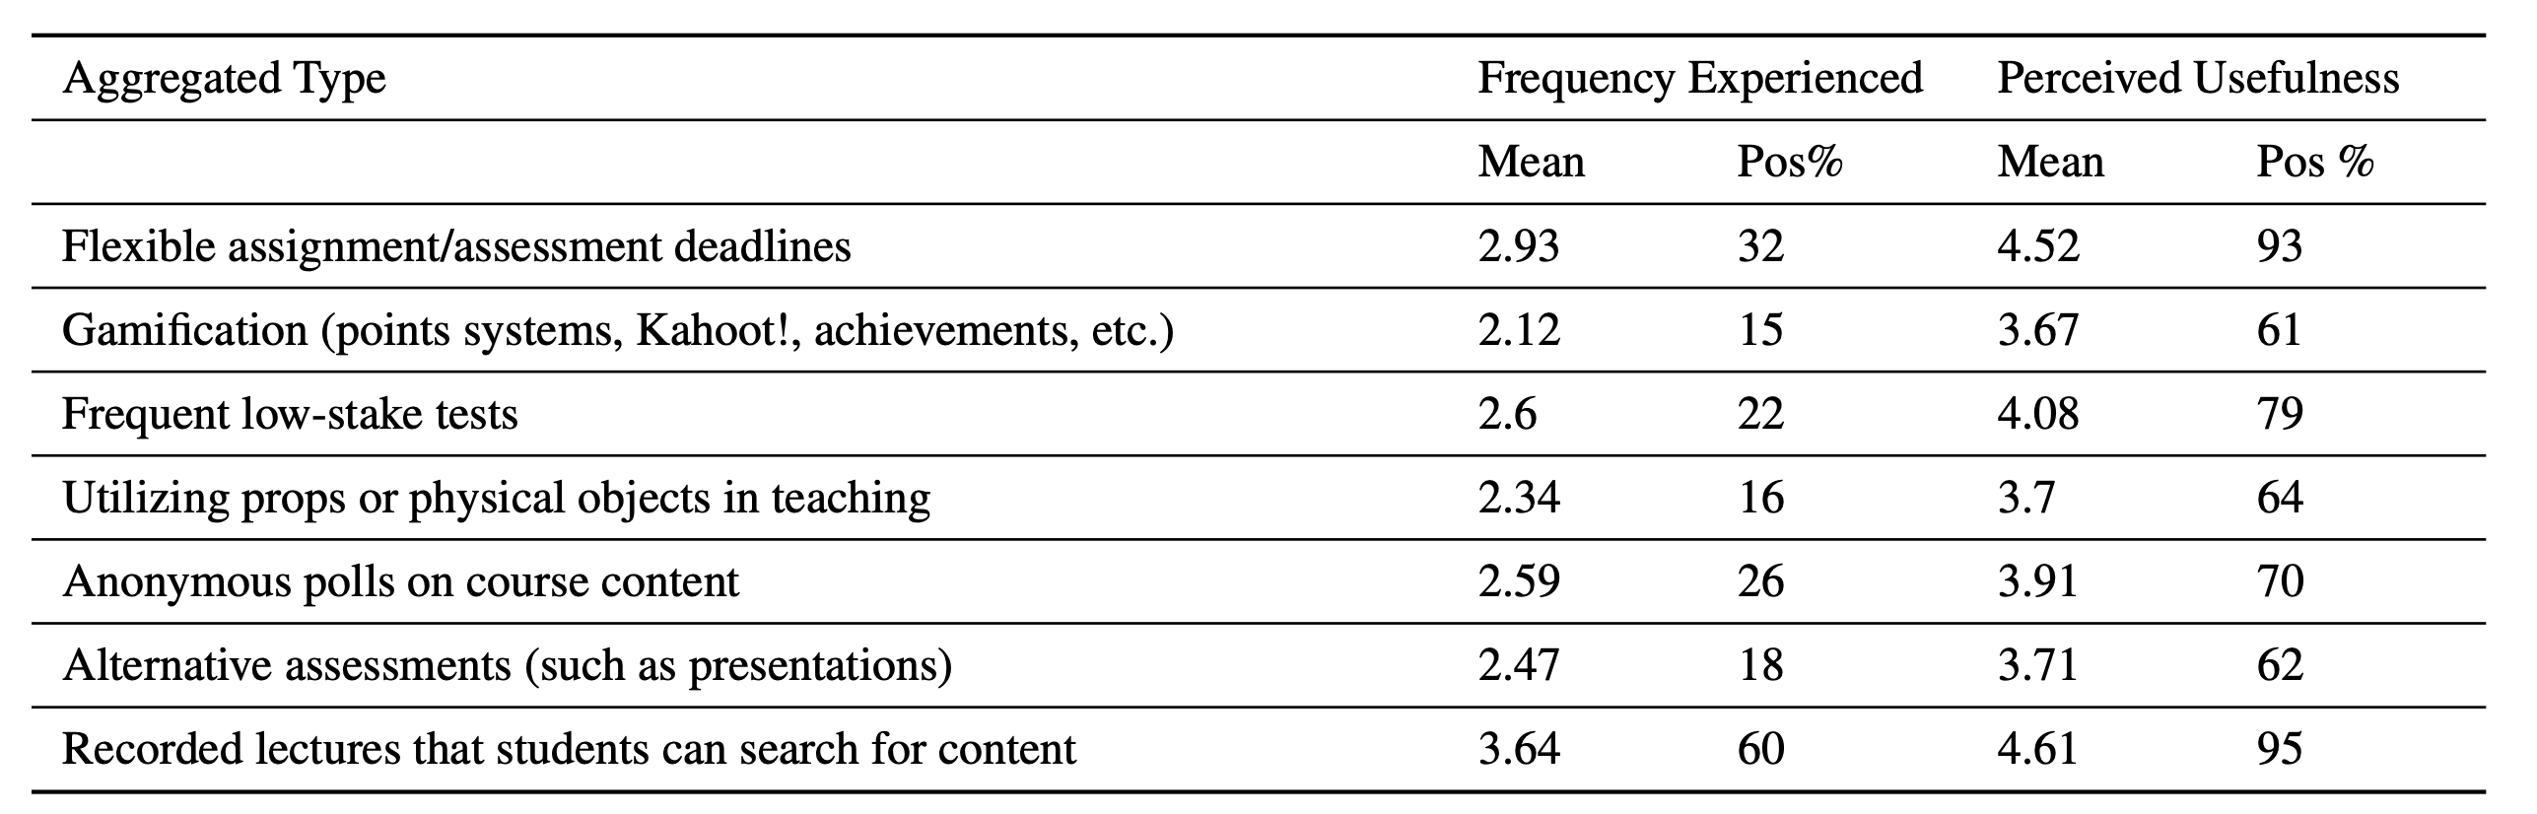
The gap between UDL practices frequency and their perceived usefulness
Notes:
In general, students do not experience UDL practices as much as their usefulness may suggest
The top useful practices such as “Recorded lecture with searchable content” and “flexible deadlines” were not experienced very frequently

Slide 17
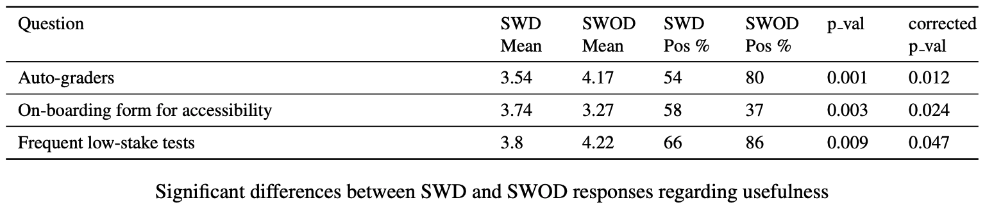
SWD ranks Accessibility higher
Notes:
The main barriers that instructors indicated were lack of training and lack of awareness of UDL and the issues solved by UDL. This presents the opportunity to provide faculty with concrete training and ways to easily implement UDL practices in the classroom.
Overall, SWD consider accessibility and engagement features more useful than SWOD
Instructors are least knowledgeable about accessibility and engagement features and indicated that accessibility features have the most barriers to implement
Caused by lack of training and awareness of the issues solved by UDL

Slide 18
Instructor knowledge about UDL practices
Notes:
Instructors are relatively knowledgeable about the top 5 desired UDL practices compared to the rest
ONE OF THE MOST INTERSTING THINGS WAS THAT WHEN WE SURVEYD INSTRCTORS ABOUT THESE TOP UDL PRACTICES, THE MAJORITY O THEM REPORTED FACING NO BARRIERS TO IMPLMENTTING THEM

Slide 19
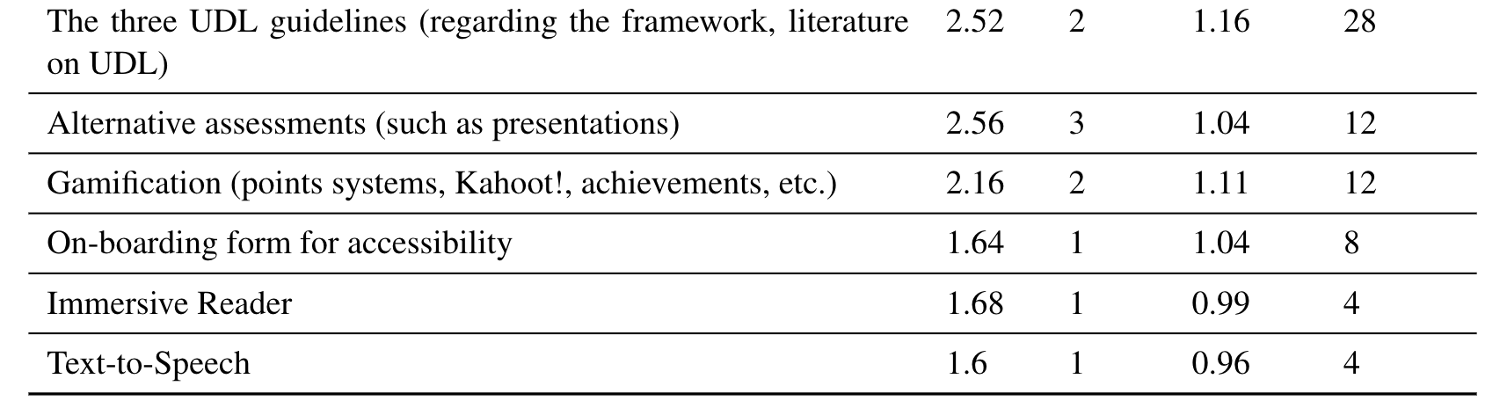
Instructor least knowledgeable about essential accessibility features
Notes:
Instructors are relatively knowledgeable about the top 5 desired UDL practices compared to the rest
ONE OF THE MOST INTERSTING THINGS WAS THAT WHEN WE SURVEYD INSTRCTORS ABOUT THESE TOP UDL PRACTICES, THE MAJORITY O THEM REPORTED FACING NO BARRIERS TO IMPLMENTTING THEM

Slide 20
Instructor barriers around top UDL practices
Notes:
Instructors are relatively knowledgeable about the top 5 desired UDL practices compared to the rest
ONE OF THE MOST INTERSTING THINGS WAS THAT WHEN WE SURVEYD INSTRCTORS ABOUT THESE TOP UDL PRACTICES, THE MAJORITY O THEM REPORTED FACING NO BARRIERS TO IMPLMENTTING THEM

Slide 21
Instructor knowledge and barriers around top UDL practices
Overall, instructors have the limited amount of time to implement top UDL features (recorded lectures, transcripts, flexible deadlines)
Reassuringly, “Do not believe in the effectiveness of
this practice” was the least prominent barrier
Most instructors reported that they learned about UDL by their own initiative
Notes:
A lack of time and need for instructor initiative can explain why the top UDL features are implemented very infrequently

Slide 22
Experiences of minority students in engineering
Overall, female students experienced UDL practices significantly less often than male students for 13 of the 16 practices
SWD experienced UDL significantly less often than SWOD for half of the UDL practices
Notes:
When analyzing the significant differences in experience between SWD and SWOD , we see the same pattern of SWD being underserved in practice; experiencing UDL practices significantly less frequently for half of the practices.

Slide 23
Opinions on Feedback Methods
1. Anonymous Google forms to gather course feedback (74%)
2. Instructors encouraging course feedback (51%)
3. Intermediary groups (49%)
4. Unofficial school wide forms to gather course feedback (45%)
Notes:
We asked all students if they felt comfortable bringing up curriculum issues and/or giving course
feedback to instructors and their rating of four potential feedback methods. Feedback is crucial
for underrepresented groups of students to present their needs of UDL practices in a comfortable
and timely fashion. Lack of such feedback would be a barrier for UDL implementations.

Slide 24
Opinions on Feedback Methods (II)
Female students and SWD are significantly more uncomfortable giving direct feedback to instructors
SWD and SACAN felt less comfortable about having intermediary
groups to transmit the feedback

Slide 25
Opinions on Class Format
1. Lecture-based classroom (76%)
2. Combinations of the rest (61%)
3. Flipped classroom (42%)
4. Fully asynchronous (34%)
5. Fully synchronous online classroom (33%)
Female students consider the usefulness of flipped classrooms lower than male students

Slide 26
Summary of students’ response
In general, students do not experience UDL practices as much as their usefulness may suggest.
The top useful practices such as “Recorded lecture with searchable content” and “flexible deadlines” were not experienced very frequently
Minority groups in engineering experience less of the UDL features, especially accessibility features.

Slide 27
Summary of instructors’ response
Instructors are least knowledgeable about accessibility features
Many however answered that they were not given training and were not aware of the issues
Instructors face no barriers to implementing the majority of UDL practices and learned about UDL practices by their own initiative

Slide 28
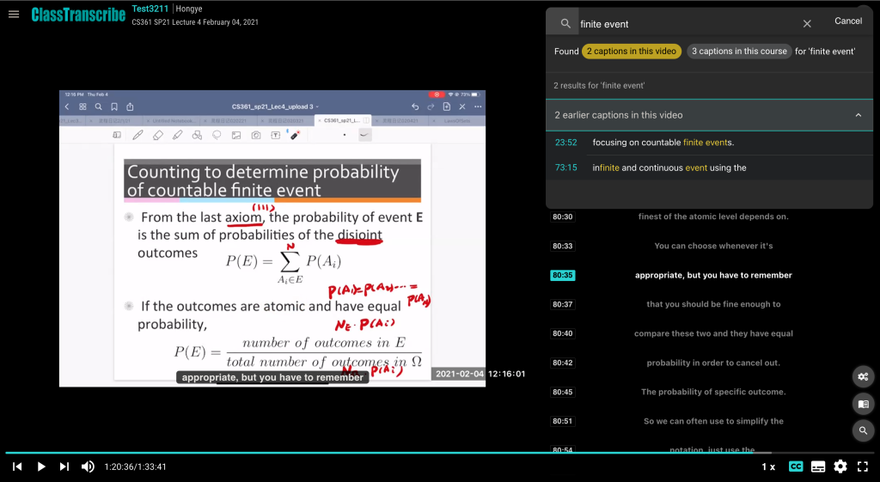
Recommendation 1: Utilizing recorded lectures with captions
Benefits low vision and deaf students
Benefits students with accessibility needs
Benefits all students since multiple modes of representation shown to be the most important UDL category
Notes:
Lecture recordings are an accessible way for students to learn and review course content. SWD can benefit from recorded lectures.
Low vision who cant see whiteboard can enlarge on their own screen and use screen readers
Deaf students can use accurate captioning to better understand
mobility can be an issue for students so they now have an alternative
ALL STUDENTS can review and go back to concepts they did not understand on first pass

Slide 29
Recommendation 2: Utilizing flexible deadlines and low stakes assessments
Middle ground of what students and instructors deem useful
Auto-graded quizzes/homework administered frequently (no manual grading!)
Rolling deadlines method
Notes:
Since grading is automatic, looser deadlines become more feasible
instructors can set a “100%” deadline and students will receive less credit for the assignment as time from the 100% deadline passes. This incentive encourages students to
finish assignments on time while also not overly-penalizing them for submitting slightly late
work. It also reduces the burden of dealing with late submissions for instructors because
submission deadlines are flexible and penalties for submitting late work are well defined.

Slide 30
Seven UDL approaches (I)
Giving flexible deadlines in students’ assignments or formative assessments (rolling deadline method)
Providing personalized prompt feedback to students
Guiding students in collaborative learning
Accommodating students to choose different formats to submit their assignments

Slide 31
Seven UDL approaches (II)
Providing students with multiple modalities of the same content in one place
Providing a unified calendar for all courses as deadline reminders
Allowing students to use discussion boards and group space for informal meetings.

Slide 32
General recommendations
Involve more students with disabilities in instruction and accommodation process
Be open minded and sympathetic with what students are going through
Encourage an open dialogue with students about their needs and support that they require to succeed

Slide 33
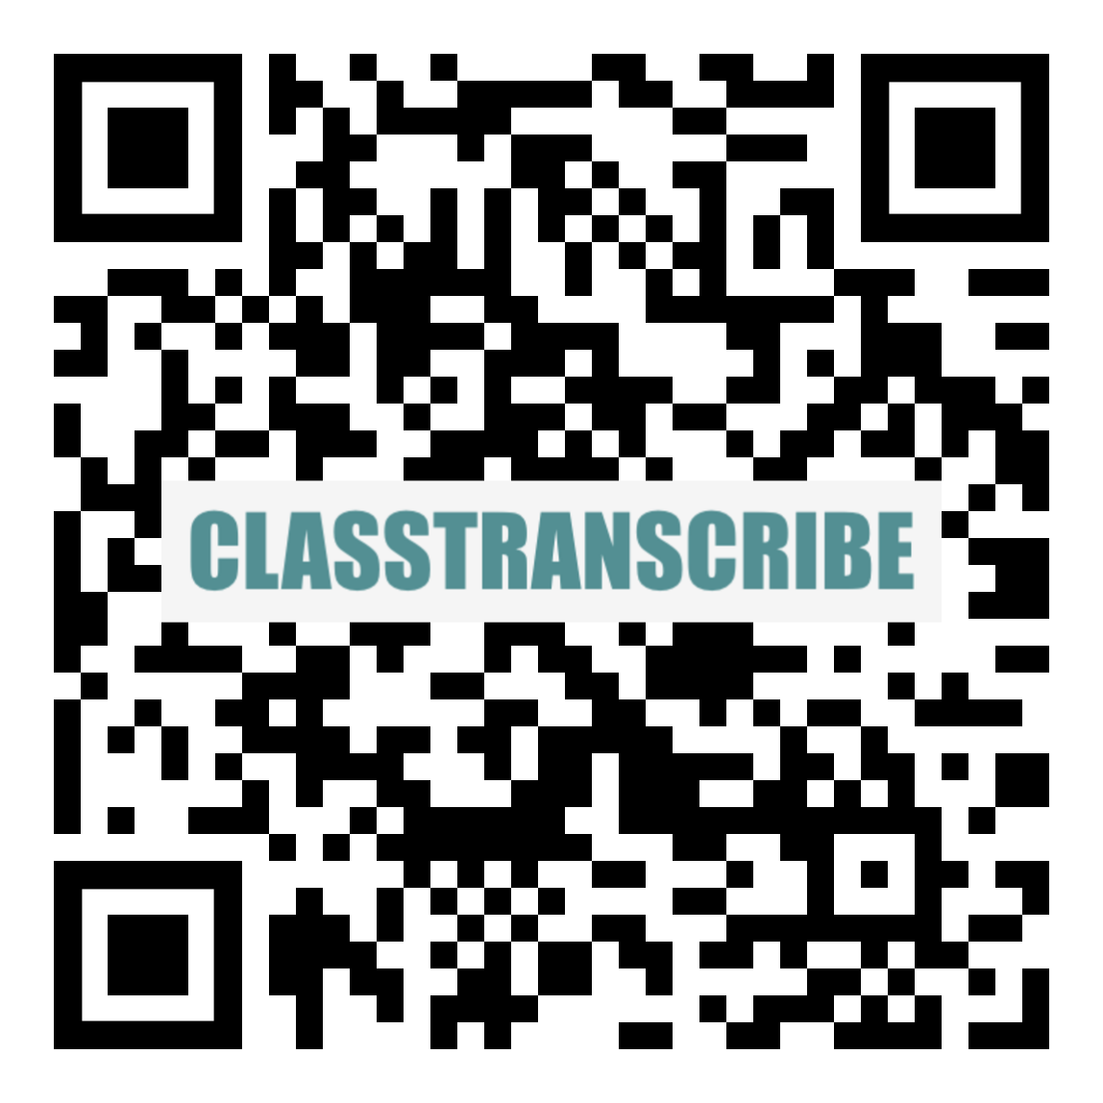
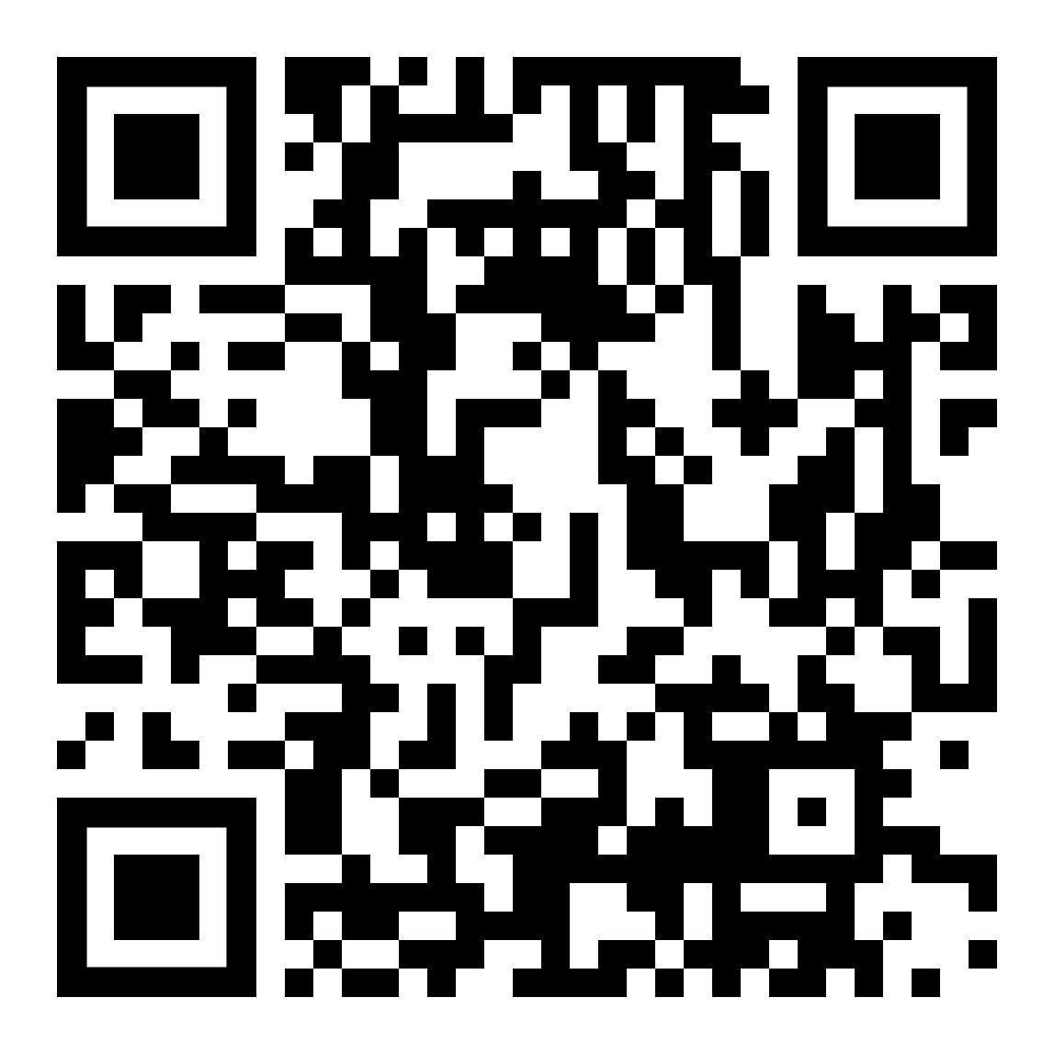
ClassTranscribe at UIUC
UIUC UDL and Accessibility Research Group
Features: video viewing with full automatic searchable transcripts, choice of speeds, start at previous stop, etc.
iNote (Digital notes editor).
https://publish.illinois.edu/udl-accessibility-group/
Notes:
Demo of the design practices in our project, on-boarding form, course frontpage, syllabus, accessibility checking, making pages, design of teamwork, worksheet, calendar, etc.

Slide 34
Thank You!

Slide 35
References
https://udlguidelines.cast.org/
SIIP Implementation project “UDL based best practices including utilizing Canvas for the needs of students with disability”
GIANT project “Applying a Theoretical Understanding of Text-Based Learning Modalities to Develop New Course Modalities That Meet the Needs of Student with Disabilities (Phase II)”

Slide 36
References
Boothe, K. A.el al (2018) Applying the Principles of Universal Design for Learning (UDL) in the College Classroom. JOSEA.
ASEE2020 paper “Improving student accessibility, equity, course performance, and lab skills: How introduction of ClassTranscribe is changing engineering education at the University of Illinois.”
ASEE2021 paper “A UDL-based large-scale study on the needs of students with disabilities in engineering courses”.

Slide 37
References
ASEE2022 paper “Understanding the needs of students with and without disabilities for inclusive UDL-based design of Engineering courses through learning management systems” (WIP)
ASEE2022 paper “A Digital Book Based Pedagogy to Improve Course Content Accessibility for Students with and without Disabilities in Engineering or other STEM courses” (WIP)
ASEE2023 paper “Opportunities and Barriers to UDL-based Course Designs for Inclusive Learning in Undergraduate Engineering and other STEM courses” accepted.

Slide 38
References
ASEE2023 paper “Evaluating the low-stakes assessment performance, student perceived accessibility, belongingness, and self-efficacy in connection to the use of digital notes in engineering and computing courses” accepted.

Slide 39
Acknowledgement
AE3 SIIP Implementation grant support at UIUC
GIANT grant support at UIUC
Microsoft grant support for UDL in STEM courses
AE3 Organizers – Jay Mann, Chris Migotsky
SIIP EIF fellow – Yuting Chen, Mariana Silva
Department of Computer Science, UIUC

