Slide 1

Ensuring Inclusion in Course Design with VR:
Lessons and Recommendations for Accessibility
By: RaLynn McGuire and Vanessa Garza

Slide 2
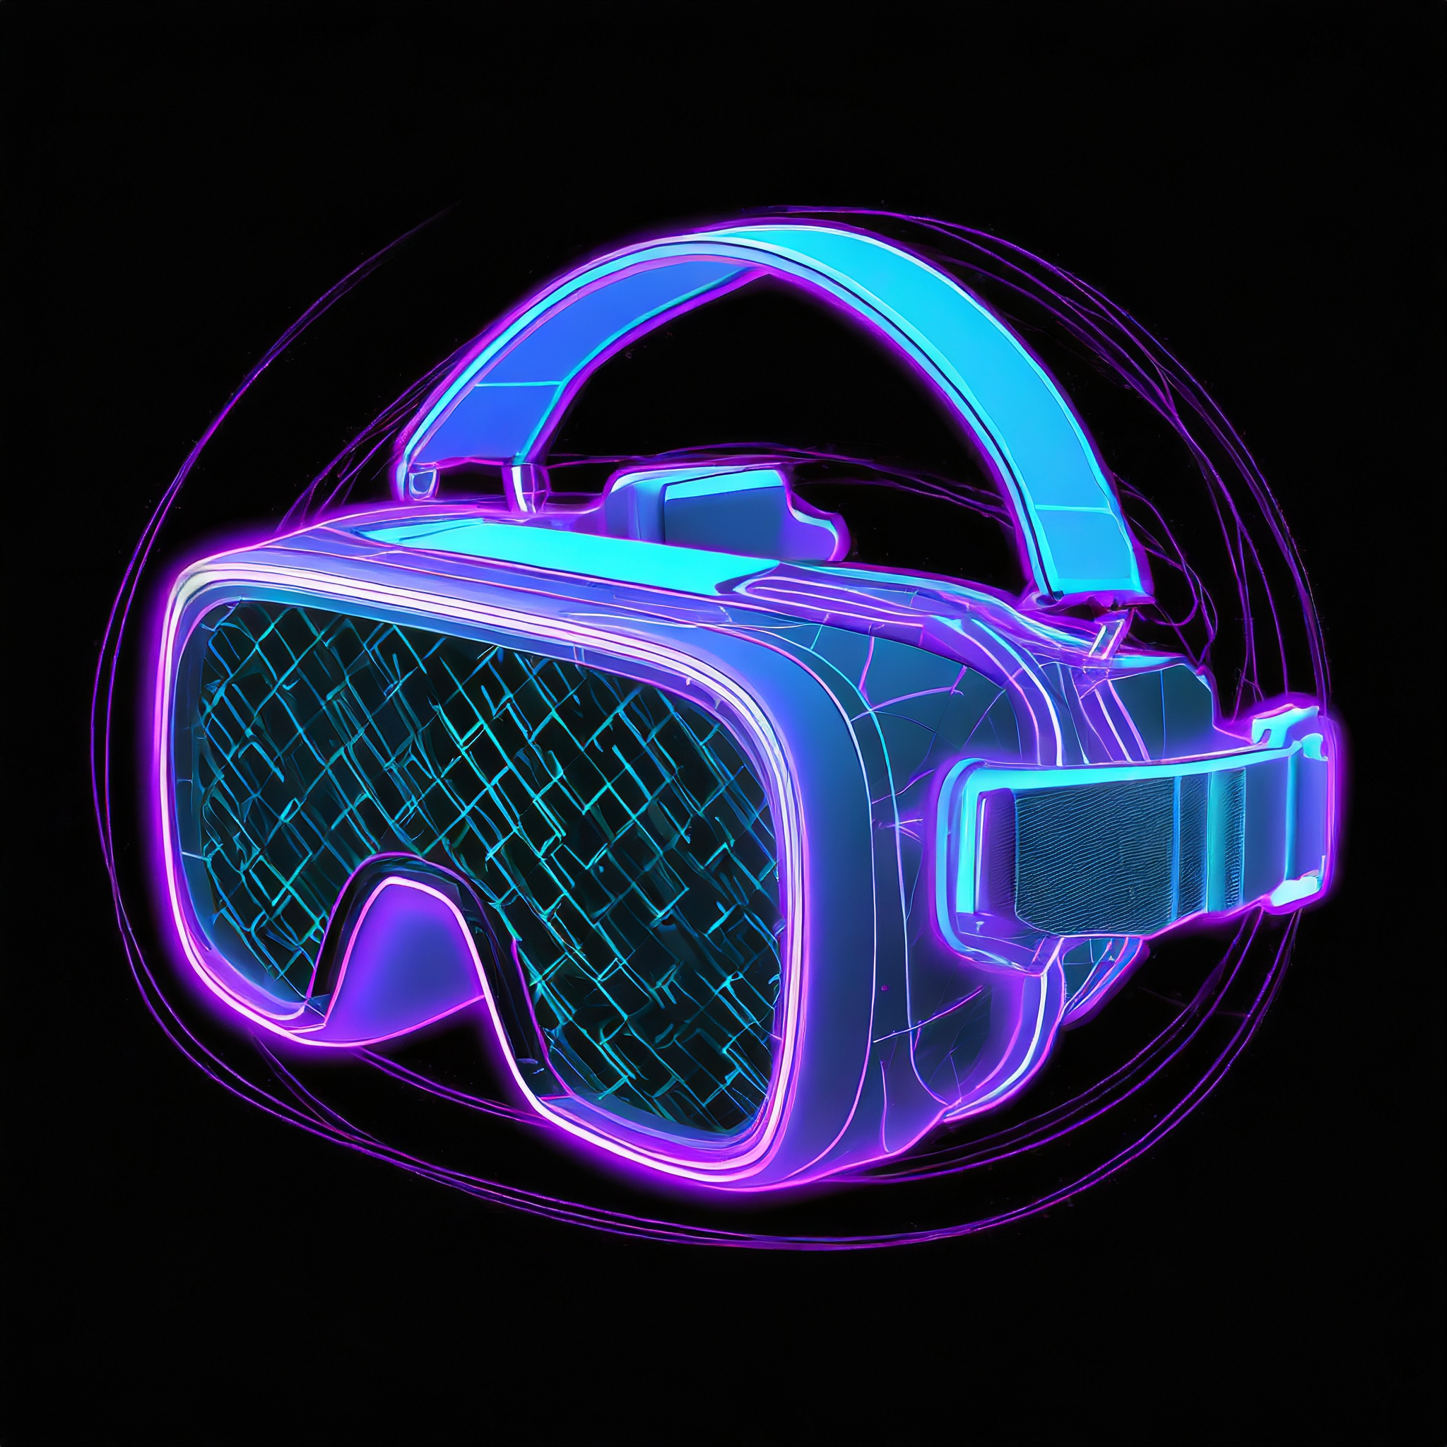

Agenda
Virtual Reality Need to Knows
The Problems with VR
Our Approach
Questions

Slide 3

Virtual Reality (VR) Need to Knows

Slide 4

What is Virtual Reality (VR)?
“Virtual reality technology seeks to create a realistic three-dimensional image or environment that a human can perceive as real, and even interact with in realistic ways.”
- DigitalTrends, What is VR?

Slide 5
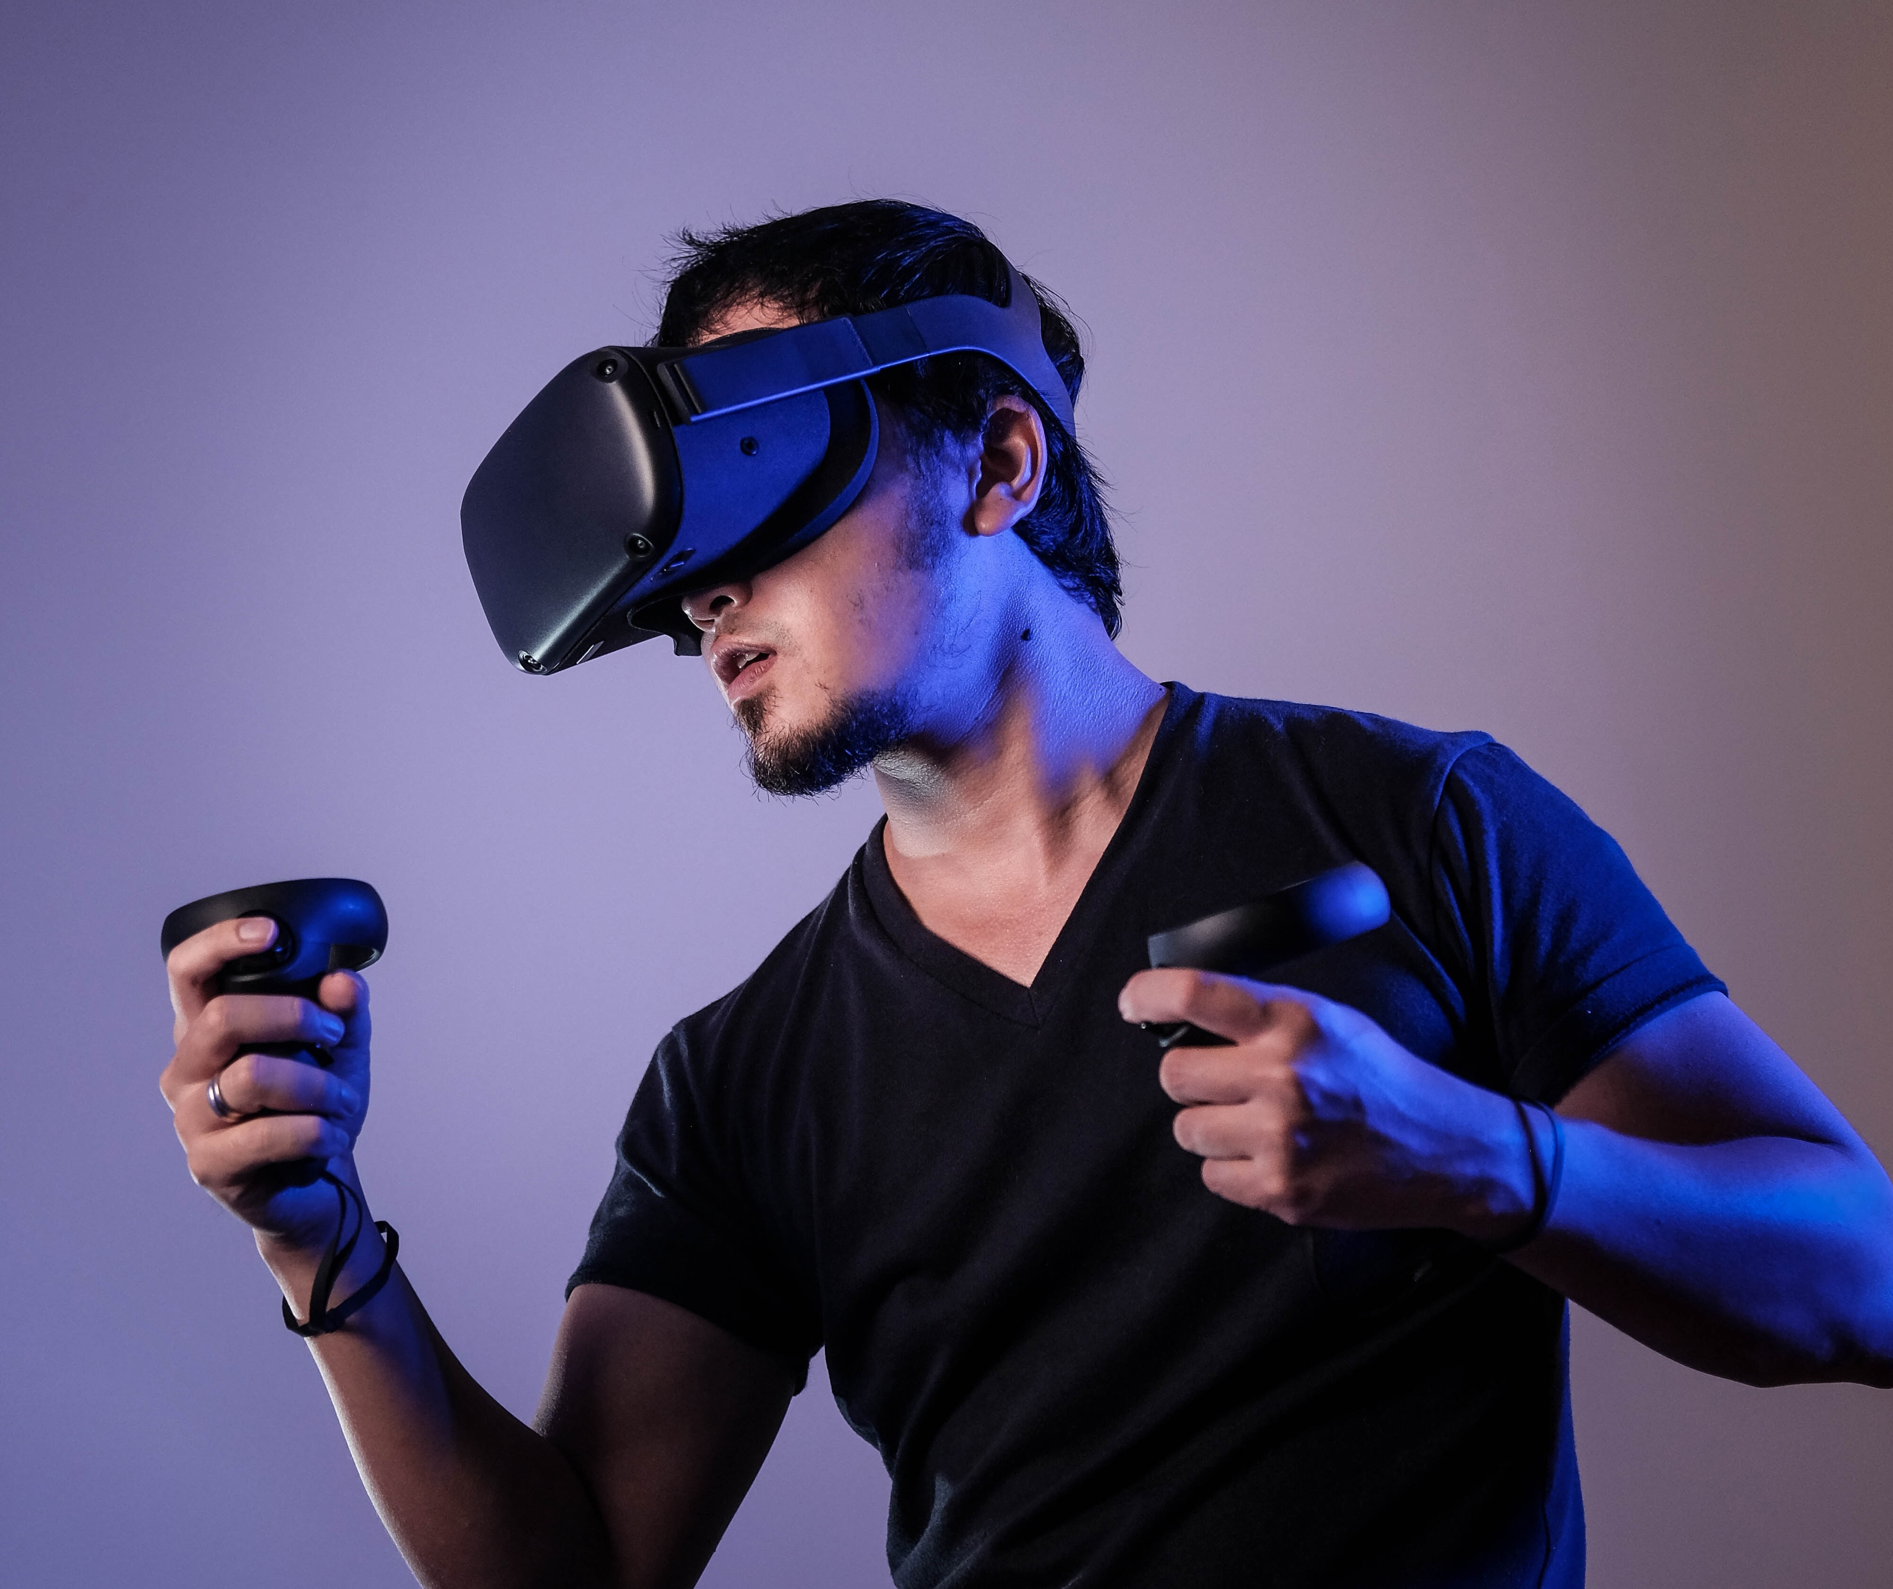

VR Equipment Options
The Headset Experience
  VR Goggles
  2 Controllers
  Space
The Computer Experience
Keyboard and/or Mouse

Slide 6
Types of VR (That We Are Discussing)
Prerecorded Immersive Environment
Live Immersive Environment
Prerecorded 360º VR Experience
  Primarily use a headset to interact or engage with an environment
  Real-time interaction with an environment using a headset
A video that can be accessed using a computer screen, but the intended experience is still through a headset

Slide 7
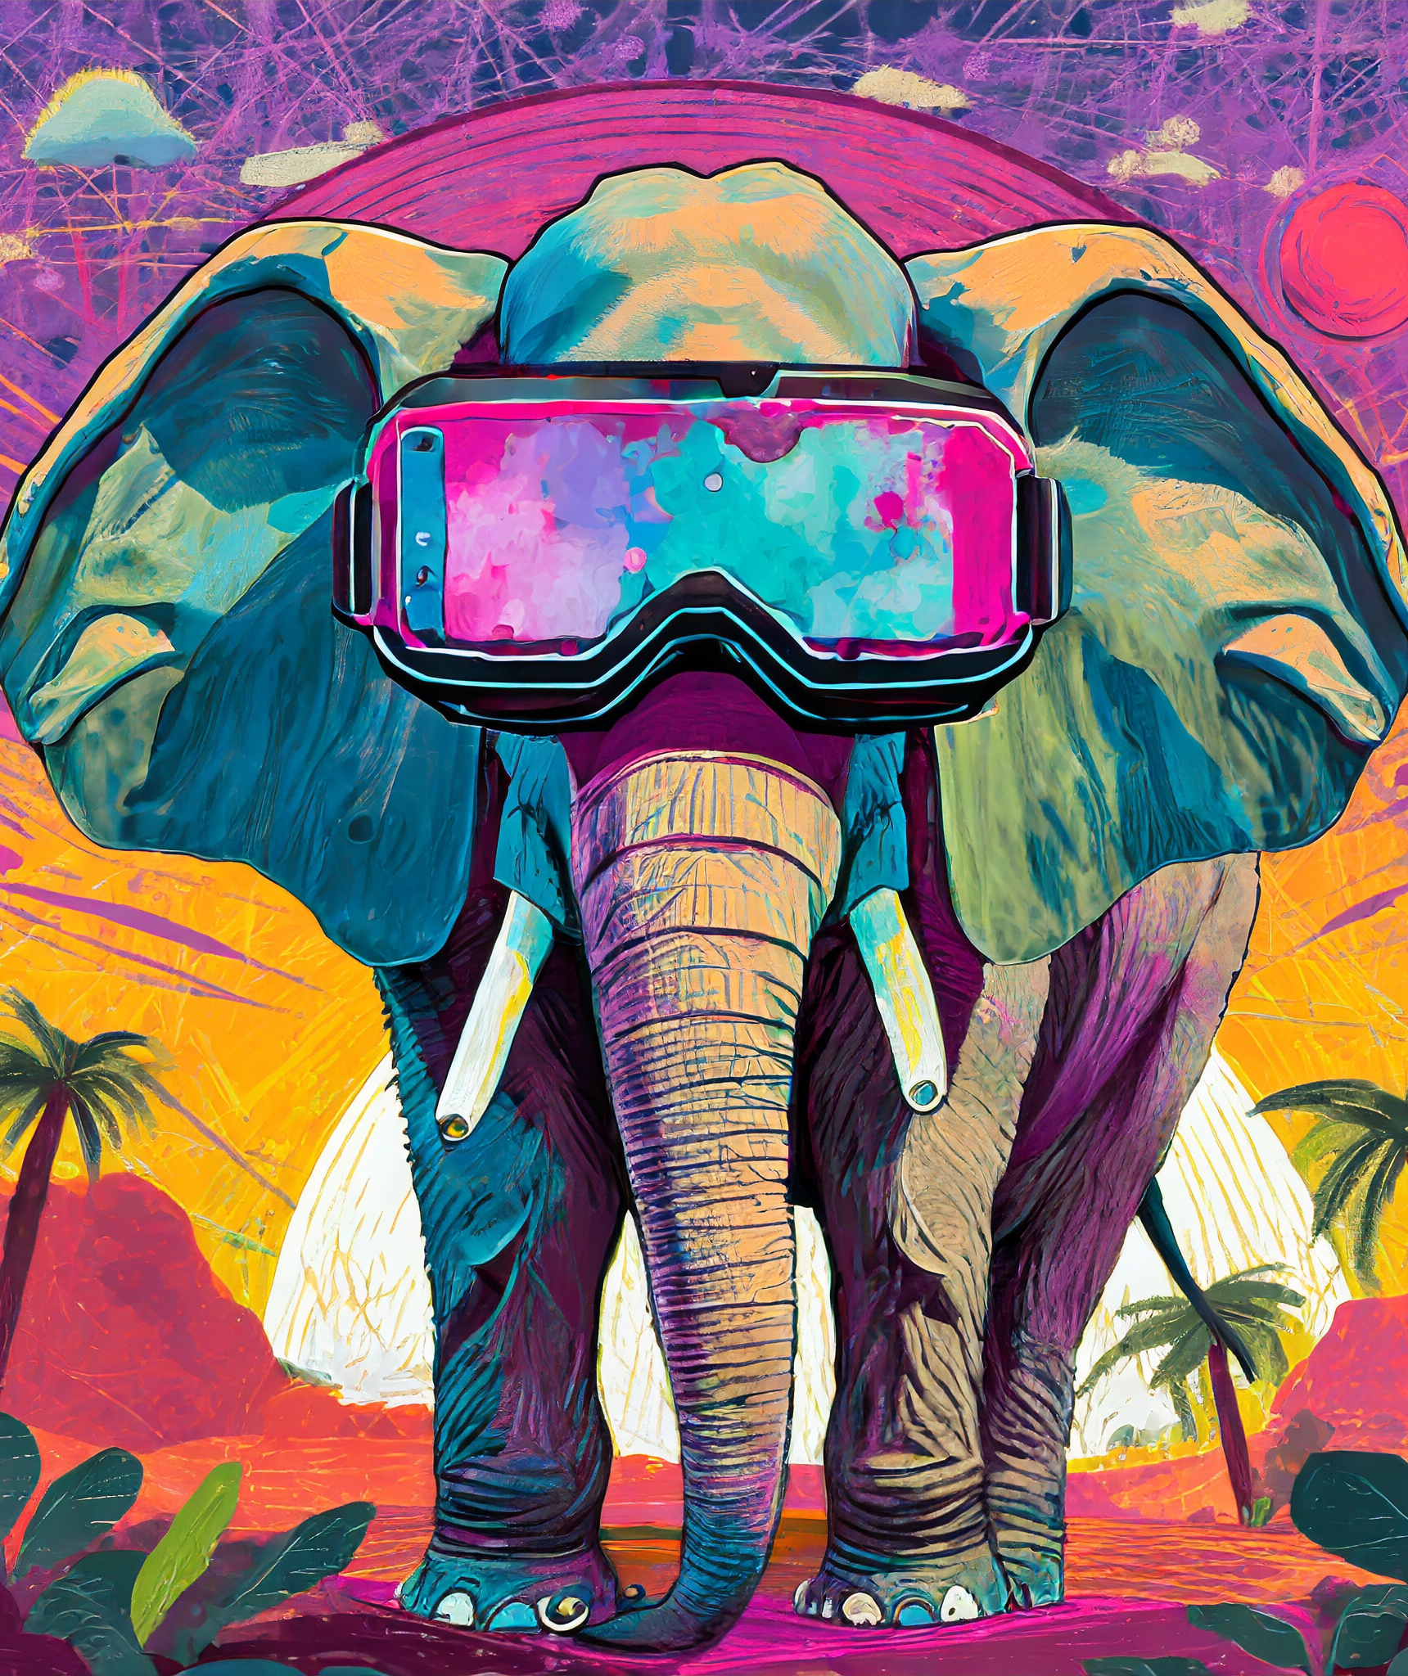
Addressing the Elephant

Slide 8

The Problems with VR

Slide 9
Accessibility Barriers
What are some accessibility barriers to using VR?

Slide 10
What are some accessibility barriers to using VR?
Visual
Auditory
Mobility
Cognitive

Slide 11
What makes VR accessibility so complicated?
Money
Buy-in
Slow progress of tech
Money

Slide 12

Our Approach

Slide 13
How We Approached VR
Setting the Scene
Our Solutions
History Course
Funded Course
5 VR Simulations
    1 simulation is only on the VR headset
    2 simulations are 360º videos on YouTube
    2 simulations are 360º videos on the
    New York Times site
Streamer-style recording
Captions
Audio Descriptions

Slide 14

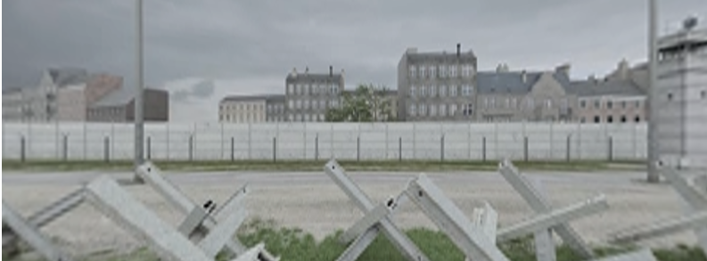
Video Examples
Anne Frank Full Simulation
The Fall of The Wall
Original Fall of the Wall Video

Slide 15
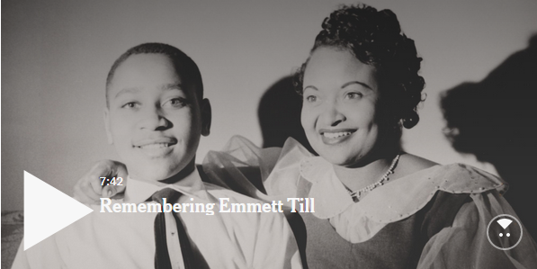
Audio Description Script Example
Remembering Emmett Till Video
Visual | Audio
Camera pans over the Mississippi Delta with a plethora of trees on both sides of it. Showcased across the water is an old rusty bridge. | On hot August night more than 63 years ago, Emmett Till was lynched here in the Mississippi Delta. His case was so horrific that he became an enduring symbol for racial hostility and injustice.
Many old photographs begin to appear across the screen creating a timeline effect, including a photo of Emmett. The phrase, “nation shocked, vow action in lynching of Chicago youth’ appears in large letters across the screen. A picture of a woman and a grocery store appear. | In 1955, Emmett, a 14-year-old black boy from Chicago, was kidnapped, brutally beaten and lynched in Mississippi after he was accused of whistling at a white woman at a grocery store. His body was thrown into a river and found days later.
The phrase, “Chicago boy found in river” appears. A news video clip begins of an older gentleman, his face filled with emotion. | “The body was so badly damaged that we couldn’t hardly just tell who he was, but he happened to have on a ring with his initials.”

Slide 16
Providing Access
A student shouldn’t have to ask for a more accessible version of content if you have one available.

Slide 17



Our Next Steps
Student feedback of accessible materials
Repository of accessible VR resources
Guide to create a descriptive transcript

Slide 18
Questions and
Thank You!
RaLynn McGuire & Vanessa Garza
DigitalAccessibility@utsa.edu

