Slide 1
Assistive Listening Systems
UVA's Decision to Prioritize Hearing Loop
Lori Kressin, Coordinator of Academic Accessibility
Kristin Roush, Ph.D., Audiologist/Coordinator of Deaf/Hard of Hearing and Accessible Media Services

Slide 2
Thank you OTOjOY for the hearing loop in this room!

Slide 3
Not everyone hears the same
Notes:
Today we are going to talk about assistive listening systems and why the University of Virginia is prioritizing hearing loop

Slide 4
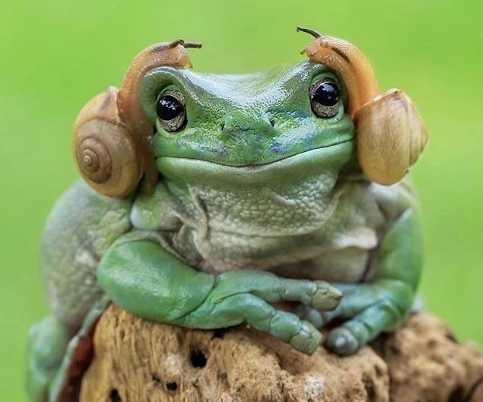
Objectives
Facts of Hearing Loss
Impact of Audibility
Assistive Listening Systems
UVA Hearing Loop
Notes:
We plan to review a few facts about hearing loss, impact of audibility and why assistive listenings systems are important and why they are required and then go into why at UVA we have decided to prioritize hearing loop.

Slide 5
FACTs
have what is termed an educationally significant hearing loss. ¹⁰
at risk of permanent hearing loss due to unsafe listening practices. ³
hard of hearing have a disability in addition to a hearing loss. ¹¹
30% of children who are
in the US have a hearing loss ¹⁰
have some degree of hearing loss ⁵
1 billion young adults
Over 1 million children
83 of 1000 children
with hearing loss use sign language. ⁶
13% of Americans
2% of people
Notes:
Assistive listening systems were developed to help those that have hearing loss. The need is there and study after study indicates this need. If the World Health Organization states that we have a billion young adults at risk for permanent hearing loss we must consider how this will impact With studies showing that 13-17% of americans have some degree of hearing loss and with hearing loss impacting

Slide 6
Impact of Hearing and Learning
Educational outcomes significantly reduced with more severe the degree of hearing loss and less interventions.¹²
Children with hearing loss scored significantly poorer than children with normal hearing in subtests on behavior, energy, stress, social support, and self-esteem.¹³
Normal hearing college students were asked about their reaction when the classroom was noisy, and their answers revealed difficulties in hearing the teacher, in concentrating and aggravation, and a high percentage reported that it was harmful to their learning or to their grades. all inadequate conditions for information processing and, consequently, for learning.¹⁴
Average college class size ranges between 35-125 students depending on University/College size, we will have noisy classrooms.¹⁵
Regardless of hearing loss, roughly 30% of the population are auditory learners.²
Notes:
The academic achievement of children with hearing loss has been a long-standing concern. Even normal hearing college students have negative reactions to noisy classrooms and it impacts their learning as well. Classroom sizes do vary depending on size of university or college but they are going to be noisy.

Slide 7
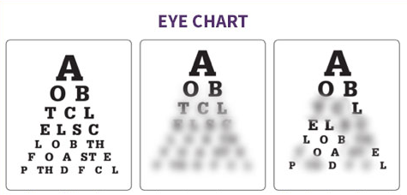
Image depicting normal hearing vs hearing loss
Normal Hearing
Vision Loss
Hearing Loss
Notes:
I like to use this chart when talking about hearing loss as many people try to relate it to vision loss and it is not quite the same. With hearing loss in general it is not that people cannot hear but that speech is not clear because they were unable to hear the whole message. Think of it like playing wheel of fortune. You heard some of the letters but the others were left blank. You have to use your visual cues and the context to glean the information.

Slide 8
improving audibility leadS to improved speech understanding
Studies which quantify audibility show that for a 10% improvement in audibility, we can expect a 20% improvement in speech understanding.
McCreery & Stelmachowicz, 2011; Souza, Boike, Witherell, & Tremblay, 2007
Notes:
So if we can improve audibility so they don't miss those letters or those letters don't get masked by back ground we can improve speech intelligibility and understanding. Studies show that for a 10% improvement in audibility we can expect a 20% improvement in speech understanding.
However, remember the benefit of any amplification is also a combination of the device itself and the listener’s auditory abilities.

Slide 9
So, how do we improve audibility?
Notes:
So… how do we improve audibility for both those with hearing loss and those without hearing loss.

Slide 10
Assistive Listening Systems (ALS)
any device that improves communication with or without amplification
Notes:
We use assistive listening systems. These are systems that improves communication

Slide 11
ADDRESS THESE LISTENING CHALLENGES
Volume
Background noise
Distance between the sound source and the listener
Poor acoustics
Notes:
I like to think of assistive listening systems as binoculars for the ears as regardless of type Assistive listening systems are trying to address listening challenges that we all face.
Show of hands, who has had trouble hearing in a restaurant before? Who has had trouble hearing over zoom before? Who has had trouble hearing in a lecture meeting room? Who has had trouble hearing over the phone before?
Essentially all hands in the room are raised. Now there are a number of variables that could account for these challenges but assistive listening systems can help to address these.

Slide 12
APPLICATION of Assistive listening systems
USED WITH
USED IN
normal hearing individuals
those with mild to profound hearing loss
hearing aid users
cochlear implant users
Places of entertainment
Education
Employment spaces
Home/personal use.
Notes:
The type of assistive listening system appropriate for a particular individual or application depends on the individual themselves, the characteristics of the setting, the nature of the program, and the intended audience.

Slide 13
Types of Assistive Listening Systems (ALS)
Large Area Systems
Personal Devices
Notes:
Assistive listening systems can be delineated into two types, personal devices and large area systems.

Slide 14
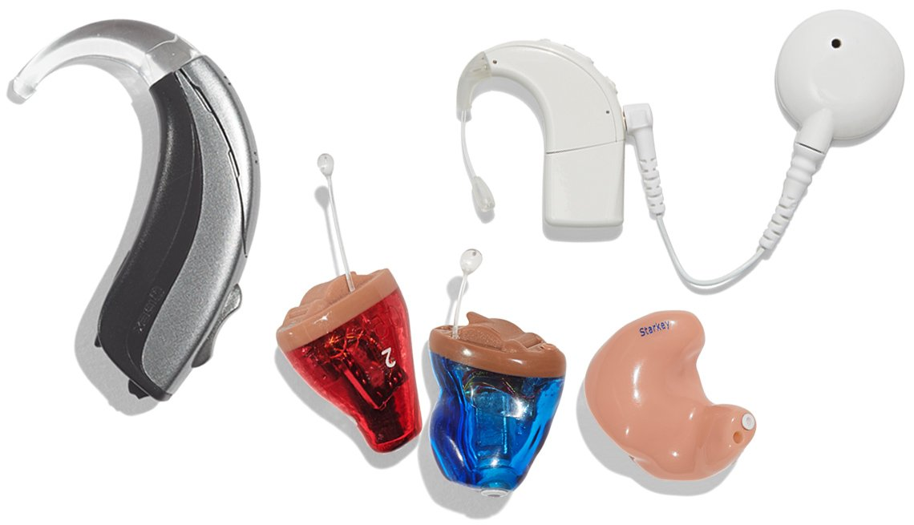
Personal assistive listening systems
Personal Systems
Hearing Aids
Cochlear Implants
TV Listening Systems
Phone Amplifiers
Etc
Notes:
Personal systems such as hearing aids or tv listening systems can be tailored to an individuals needs. They provide audibility through overall amplification of sound. They try to improve the signal to noise ratio and can even improve processing than can lead to better audiibilty and understanding

Slide 15
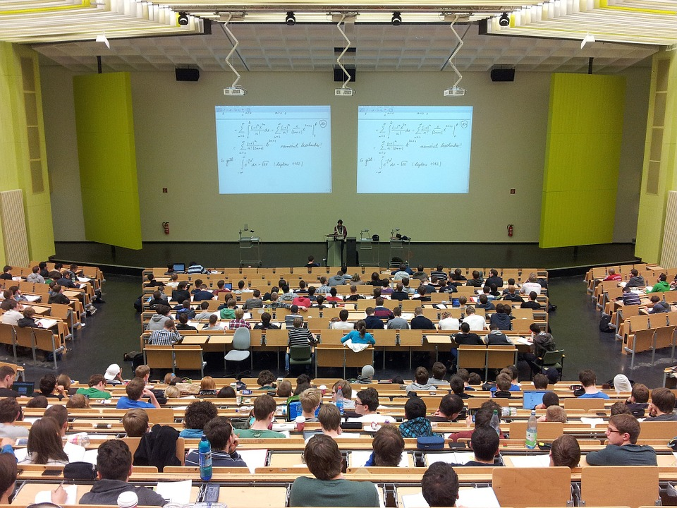
Large area systems
Large Area Systems
Infrared Systems (IR)
Frequency Modulation Systems (FM)
Hearing/Induction Loops (Telecoil)
Bluetooth
WiFi
Radio Frequency Systems (RF)
Notes:
I used to teach two whole semesters on hearing aids alone so we will not get into those specifices but we are going to focus on large area wireless assistive listening systems.
The signal is not individualized but readily available to all users with the appropriate receiver/coupling necessary

Slide 16
HOW Assistive listening systems WORK: The 3 Cs
CATCH
CARRY
COUPLE
Sound source is captured.
Carries the signal between the sound source and listener.
Couples the sound to the listener’s ear.
Notes:
Lori is going to discuss some of the pros and cons of theses systems but regardless of assistive listening system they ALL have three main components. Something to catch the source like a microphone, some form of transmission tehcnology that carries the signal from the source to the listener, and something that couples the sound to ear.
AT for Receptive Communication - Appendix D
Copyright 2005, Cynthia Compton Conley, Ph.D.
16

Slide 17
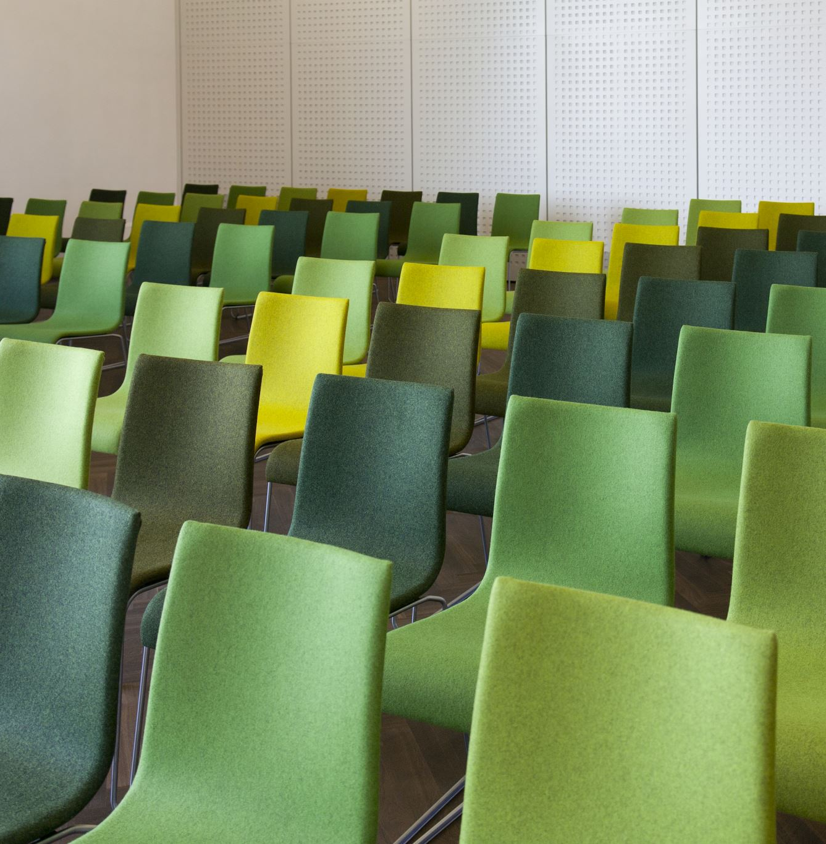
ALS requirements
Per the ADA, permanent installed systems are required when:
Audible communications are integral to the use of space (concert, lecture halls, playhouses, meeting rooms, movie theaters, etc.)
The venue can accommodate at least 50 persons
The venue has an audio-amplification system
The venue has fixed seating
The preference of the user must be considered

Slide 18
So, how do we chose?
Notes:
So… how do we choose? The type of assistive listening system appropriate for a particular application depends on the characteristics of the setting, the nature of the program, and the intended audience. There are pros and cons to all systems.

Slide 19
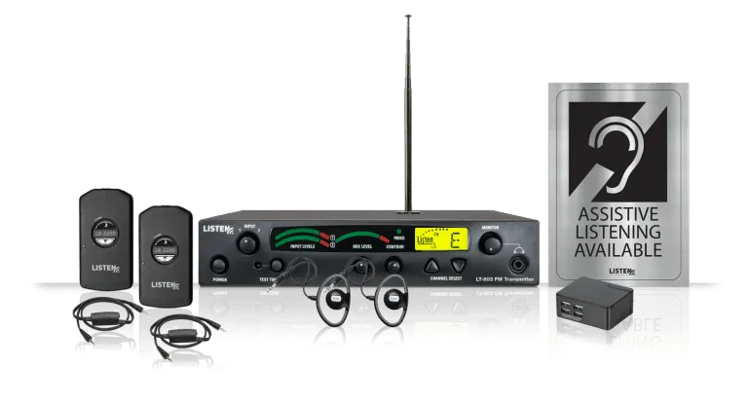
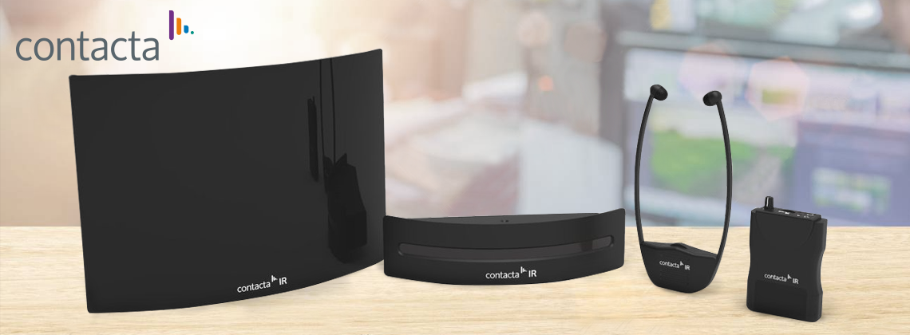
FM/RF/IR SYSTEMS
PROS | Lower upfront cost Variety of coupling methods can be used depending on need/device (universal) FM/RF can be used indoors/outdoors IR offers privacy Appropriate for areas where other solutions are not
CONS | Users must self-identify to get/request a receiver Management/administration is high. Has greatest distance​ but can have interference IR requires line of sight between the transmitter and receiver IR does not operate as effectively in sunlight/natural light
Notes:
An FM system works just like a commercial FM broadcast system (like your FM car radio). Overall the upfront

Slide 20
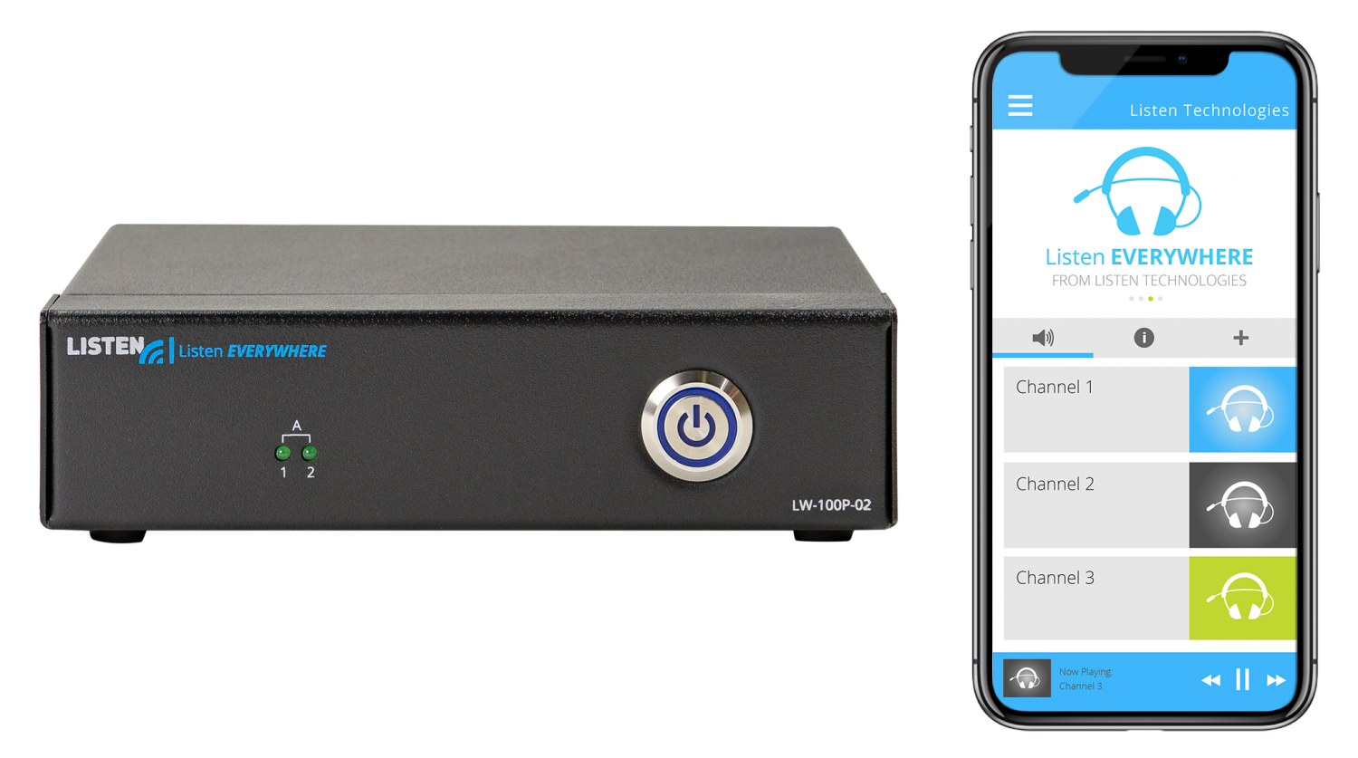
BLUETOOTH/WIFI SYSTEMS
PROS | Low cost Good for one-on-one situations Developing technology
CONS | Set up can be complicated for some Bluetooth signal not stable, expected interference due to wide use. Only one-to-one solution Requires their own device WiFi/Network security concerns Battery drain for both smart phone and hearing device

Slide 21
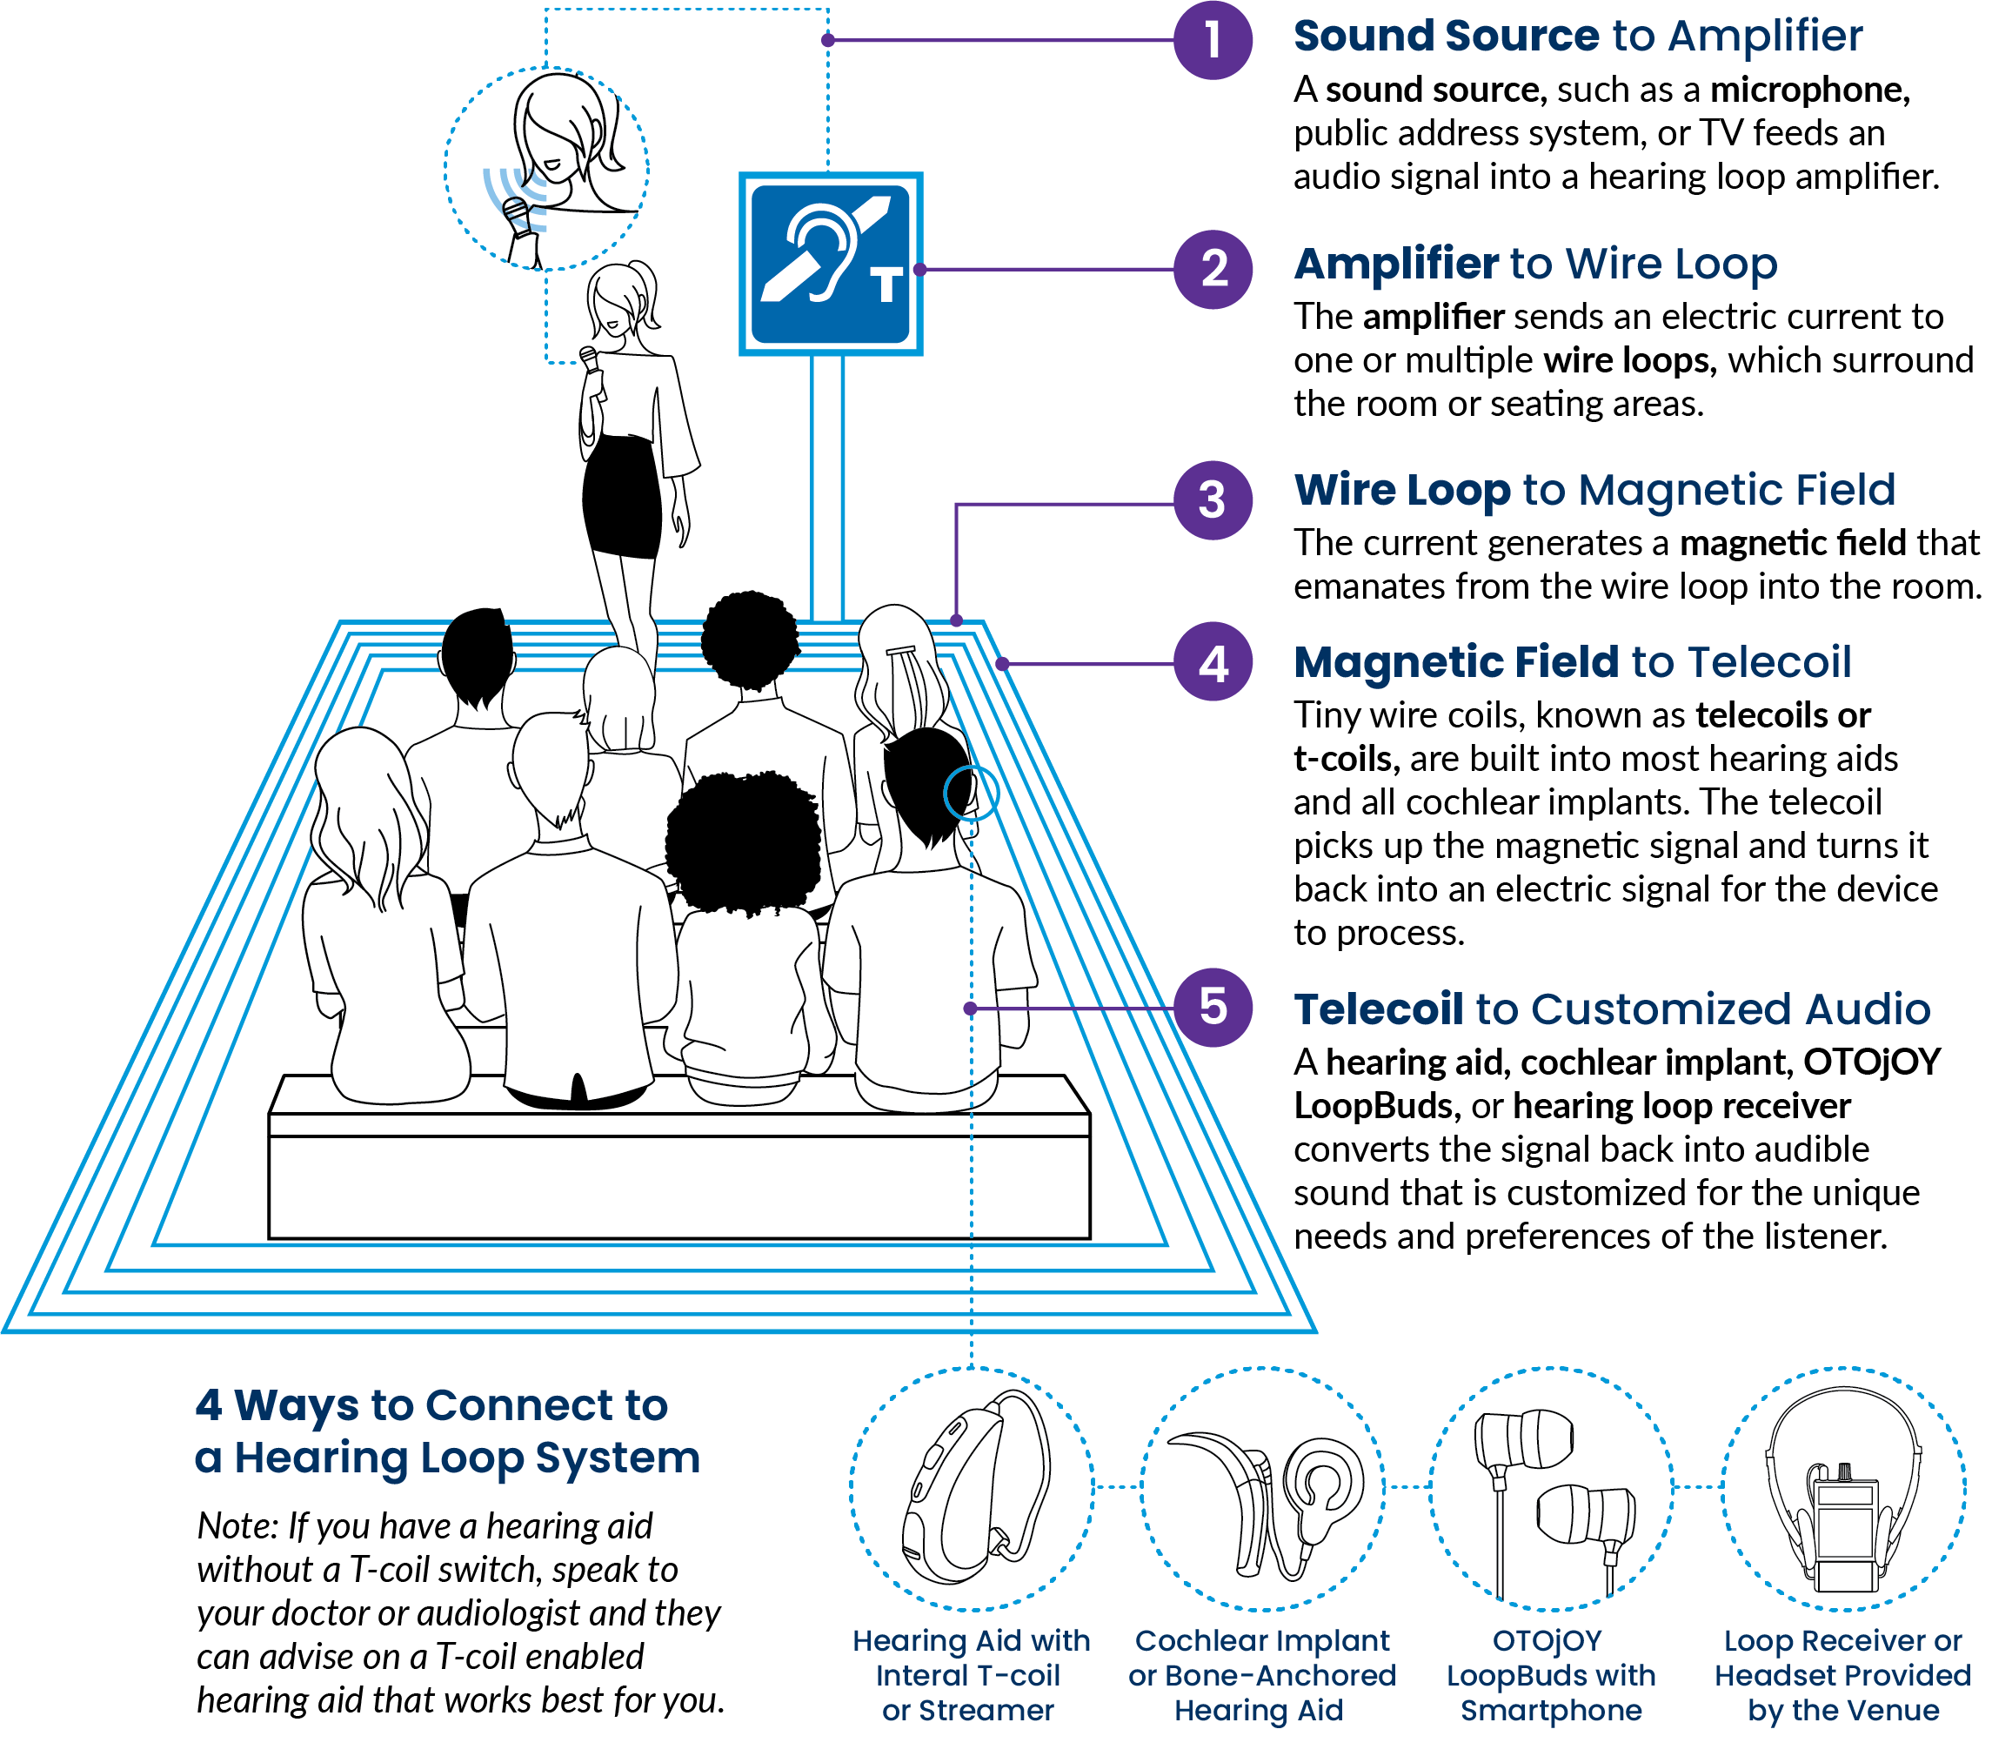
HEARING loop SYSTEMS
PROS | Inexpensive in comparison but can vary greatly Easy to use Availability Universal (as long as you have a T-coil or use a receiver) Can be used indoors and outdoors
CONS | Higher upfront cost Potential interference noise Must use qualified installers Must have t-coil in aid/CI or venues must have receivers available
Image Credit to OTOjOY

Slide 22
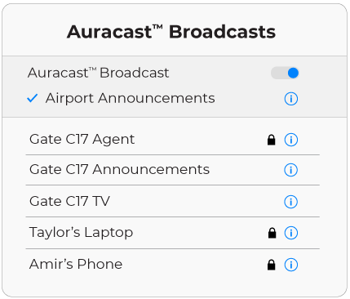
AURACAST
PROS | In development by the Bluetooth Technologies SIG Bluetooth 5.2 Allows for transmitters to send a signal to unlimited receivers
CONS | Not there yet! Both transmitters and receivers must be equipped with the new BT version
How it works!

Slide 23
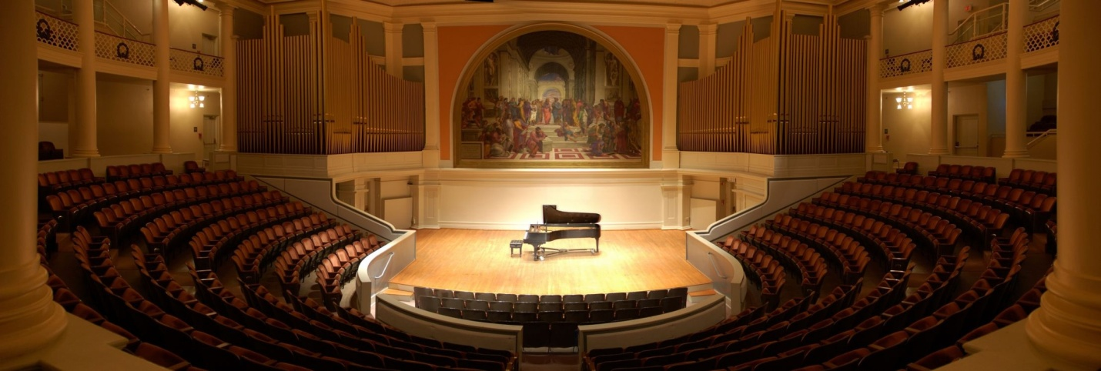
Additional considerations
Size of the venue
How will the venue be utilized
Is there a central administration location within the venue
What type of microphones will be used and where are they placed
Latency
Reliability of the chosen system

Slide 24
University of Virginia’s Direction

Slide 25
“While hearing loop may not be appropriate for all areas, we ask that it be given first consideration when an ALS is required”
Coordinator of Academic Accessibility
Director, Student Disability Access Center
Coordinator of Deaf/Hard of Hearing and Accessible Media

Slide 26
Hearing Loop – Recommended ALS
“While hearing loop may not be appropriate for all areas, we ask that it be given first consideration when an ALS is required”
Partners and buy-in
Logistics – thinking back to additional considerations
Preferred ALS by users of these systems
Informative website: Hearing Loop @ UVA

Slide 27
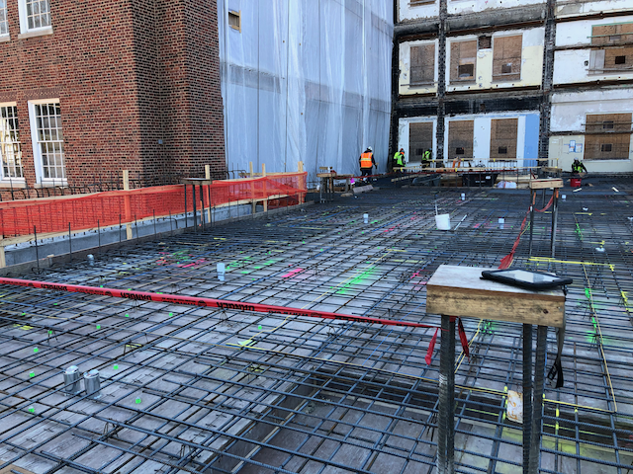
Challenges
Continuing to be confident in our decision
Working with construction/renovation project managers and vendors
Assuring qualified installers are hired
Assuring construction folks have a clue
Marketing

Slide 28
What makes it work!
Threshold of 60-person capacity for classrooms along with technical standards
Created an ALS workgroup
Identified classroom & non-classroom priorities
Identified current & future funding sources
Utilizing counter loops, room loops, and in the future portable loops
Awesome partnerships!

Slide 29
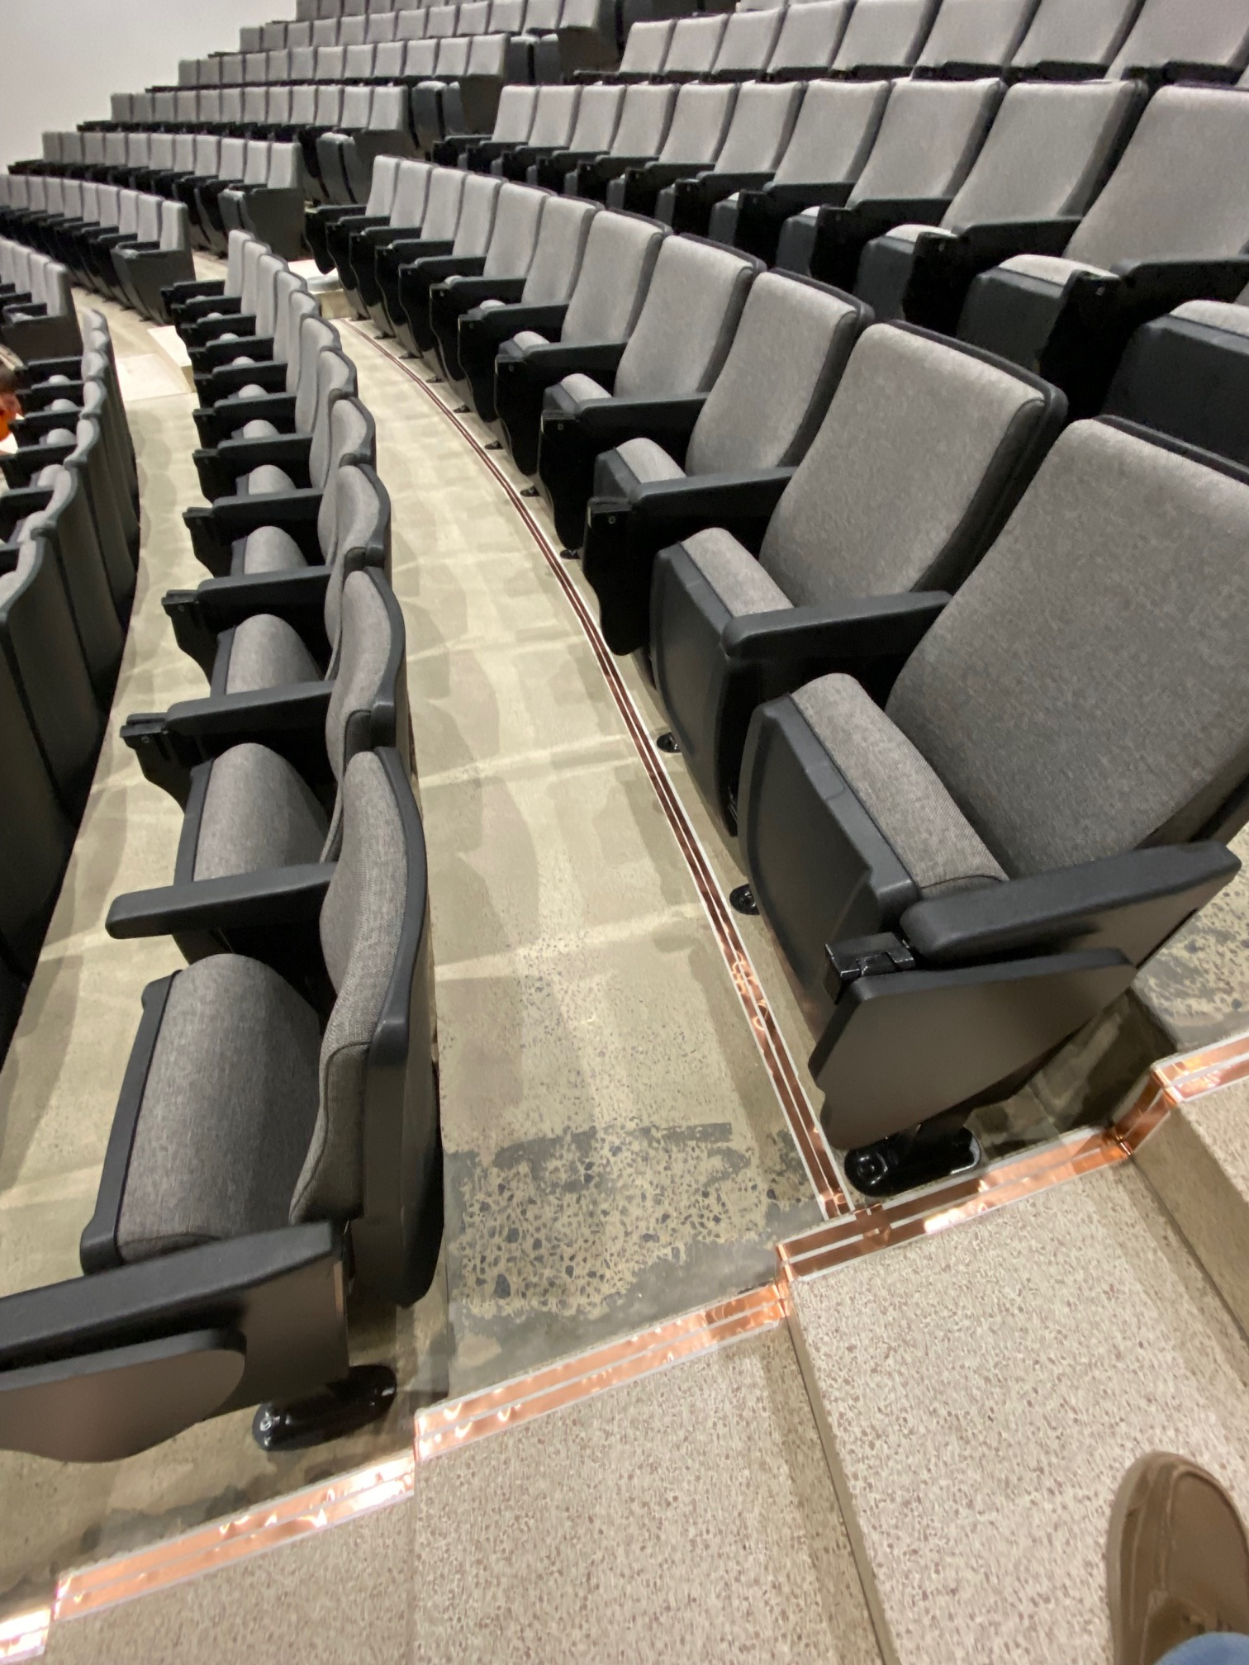
Current Status
28 Classrooms currently looped
8 Public areas currently looped
5 Counter loops in place
All new construction with classrooms > 60 and any public areas will be looped
Renovation of public areas will be looped
Funding becomes part of project budget

Slide 30
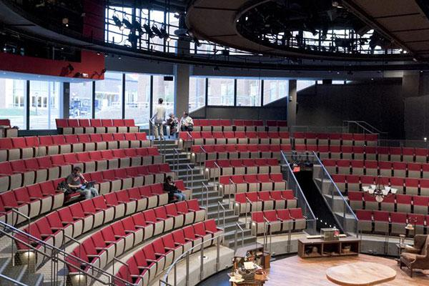
Looped Public Areas
Old Cabell Hall Auditorium
Miller Center Forum Room
Several locations within the Rotunda including the Dome Room
Three preforming arts theaters
Harrison-Small Auditorium
Newcomb Hall Theater

Slide 31
Contact Information:
Hearing Loop @ UVA Website: https://provost.virginia.edu/subsite/coaa/hearing-loop
Kristin Roush, Ph.D.: kcr9z@virginia.edu
Lori Kressin: coaa@virginia.edu

Slide 32
REFERENCES
Blank Slide With Rules – Hidden
Assistive listening systems and Devices. National Association of the Deaf. (2016, April 12). https://nad.org/issues/technology/assistive-listening/systems-and-devices
Buşan, A. M. (2014). Learning styles of medical students-implications in education. Current health sciences journal, 40(2), 104.
Deafness and hearing loss. World Health Organization (2023, February 27) February 2023. https://www.who.int/news-room/fact-sheets/detail/deafness-and-hearing-loss#:~:text=People%20who%20are%20hard%20of,use%20sign%20language%20for%20communication.
FM Systems. Hearing Link Services (2021, March) Retrieved April 12, 2016, https://www.hearinglink.org/technology/fm-systems/
Lin, F. R., Niparko, J. K., & Ferrucci, L. (2011). Hearing loss prevalence in the United States. Archives of internal medicine, 171(20), 1851-1853.
Mitchell, R. E., & Young, T. A. (2023). How Many People Use Sign Language? A National Health Survey-Based Estimate. Journal of Deaf Studies and Deaf Education, 28(1), 1-6.
Malta, M. (2014). Hearing Assistive Technology [PowerPoint Slides]. Retrieved from author via email communication.​
Souza, P. (2017). Improving audibility: The foundation of speech understanding. The Alexander Graham Bell Association for the Deaf and Hard of Hearing. Retrieved from https://www. agbell. org/ImprovingAudibility.

Slide 33
REFERENCES continued
Blank Slide With Rules – Hidden
Souza, P. E., Boike, K. T., Witherell, K., & Tremblay, K. (2007). Prediction of speech recognition from audibility in older listeners with hearing loss: effects of age, amplification, and background noise. Journal of the American Academy of Audiology, 18(01), 054-065.
US Department of Health and Human Services. Public Health Service.(1990) Healthy People 2000. National Health Promotion and Disease Prevention Objectives. DHHS Publication No. PHS, 9150212.
Wolff, A.B., & Harkins, J.E. (1986). Multi-handicapped students. In A.N. Schildroth and M.A. Karchmer (eds), Deaf children in America [pp. 55-82]. San Diego, CA: College Hill Press.
Tomblin, J. B., Oleson, J., Ambrose, S. E., Walker, E. A., McCreery, R. W., & Moeller, M. P. (2020). Aided hearing moderates the academic outcomes of children with mild to severe hearing loss. Ear and hearing, 41(4), 775.
Bess, F. H., Dodd-Murphy, J., & Parker, R. A. (1998). Children with minimal sensorineural hearing loss: prevalence, educational performance, and functional status. Ear and hearing, 19(5), 339-354.
Servilha, E. A. M., & Delatti, M. D. A. (2014). College students' perception of classroom noise and its consequences on learning quality. Audiology-Communication Research, 19, 138-144.
Understand College Campus and Student Body Size. Big Future Retrieved from https://bigfuture.collegeboard.org/plan-for-college/college-basics/types-of-colleges/understand-college-campus-student-body-size on 10/31/2023

Slide 34
Thank you!
End Subtitle

