Slide 1
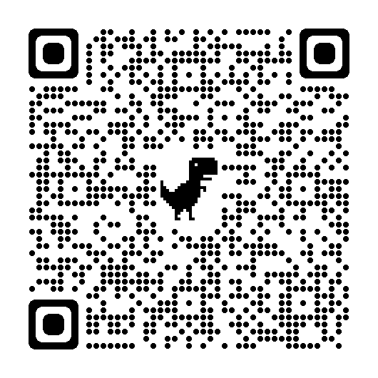
Evaluating Document Accessibility: Training Student Employees

Slide 2
Goals
Agenda
Explore a cost-effective scalable way for departments to address inaccessible files by investing in student employees
Briefly review how to evaluate different document formats for accessibility
Discuss lessons from a new approach to document remediation at a large public university
Notes:
Kate

Slide 3
Accessible Course Materials
California State University, Northridge (CSUN) implemented Ally (by Anthology) in 2018
Accessibility training series offered every semester
Not seeing the gains in instructional materials that we’ve seen in other areas
Time to try something new
CSUN takes a “teach them to fish” approach
Limits: faculty workload, participation, etc.
In 2017, offered our first accessibility service for faculty
Centralized and funded captioning for instructional videos
Notes:
Kate - Challenge

Slide 4
Student Employees
Benefits for CSUN:
Efficiency
Scale: over 800,000 files in Fall 2023
Cost vs. remediation vendors
Students are closer to subject material than accessibility staff or vendors
Prioritization: set by department
Benefits for student employees:
Marketable skill
2 certificates
Awareness of accessibility as an aspect of diversity, equity, inclusion
Notes:
Kate - Opportunity and benefits

Slide 5
WebAIM Accessible Documents Training
We wrapped this Canvas course
Five 90-minute live training sessions spread over five weeks
Scheduled around the Canvas course
4 modules (with a 5th bonus module)
Quizzes and Exams
Canvas course for independent study
https://webaim.org/training/docs/
Notes:
Stacy – Our training included asynchronous modules and 5 weekly 90-min. live training sessions; We combined our live sessions with this Canvas course and were available in between weekly meetings to offer support to SE. Also, student's employers were aware of the time commitment and this training accounted for their department job hours/duties. There were 4 modules within the Canvas course and participants were required to receive 100% on quizzes (which they had unlimited retake options) and they needed to pass the exam at the end of each module with a score of 80% or better (one retake).
Year 1: California State University (CSU) Chancellor’s Office licensed training for all CSU staff, faculty and student employees
Year 2+: CSUN licensed training for student employee participants ($125 per license)
A few students did WebAIM training only and one or two returned to complete the course
WebAIM Online Accessible Documents
https://webaim.org/training/docs/

Slide 6
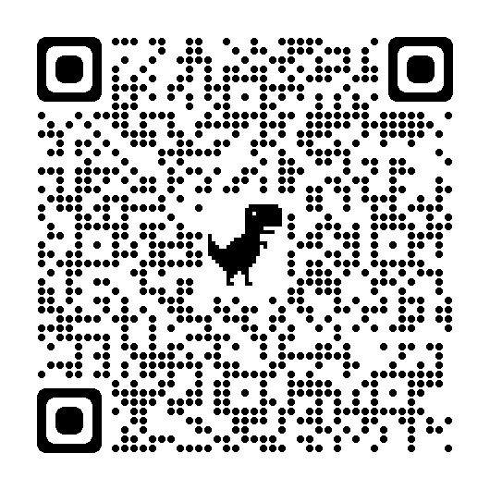
Structure (weeks/modules)
Week | Topic | WebAIM Module | Assessment
1 | Introduction | 1. Document Content
2 | Descriptive Text | 2. Document Structure
3 | Evaluating Documents (Word) | 3. Evaluating Accessibility & Creating PDFs | Evaluating a document
4 | Evaluating Documents (PDF) | 4. Optimizing PDFs in Acrobat | Evaluating a document or PDF
5 | Conclusion |  | Evaluating a PDF
Notes:
Stacy

Slide 7
Software and Tools
Required
Available for Windows and Mac
Microsoft Office: Word and PowerPoint
Adobe Creative Cloud: Adobe Acrobat Professional DC
Colour Contrast Analyser
Browser plug-ins (Chrome preferred):
WAVE-Web Accessibility Evaluation Tool
Image Alt Text
Screen Readers
Windows NVDA User Guide
Mac VoiceOver User Guide
Computers
Provided laptops for training sessions with all software installed
Notified supervisors to have all required software installed on work stations
Recommended
CommonLook Validator for PDFs (Windows only)
Available for Windows and Mac
Browser plug-ins (Chrome preferred):
Grayscale the Web or Penguinium
Web Developer
Notes:
Stacy – Explain the required software and how this would assist SE with the Document Evlauation.

Slide 8
But First, Evaluation
Before student employees can fix a file, they need to know
which files need work and
what to fix
Notes:
Kate

Slide 9
Eight-Point Evaluation
Is it legible?
Is it searchable and selectable?
Can you zoom to 400%?
Does it have a good title?
Is link text descriptive?
Color
Is there enough contrast between text and background color?
Does color convey meaning?
Are videos captioned?
Can you navigate entirely via keyboard (no mouse)?
Notes:
Kate

Slide 10
Eight Point Evaluation
Is it legible?
Is it searchable and selectable?
Can you zoom to 400%?
Does it have a good title?
Is link text descriptive?
Color
Is there enough contrast between text and background color?
Does color convey meaning?
Are videos captioned?
Can you navigate entirely via keyboard (no mouse)?
Notes:
Kate - This slides passes all automated/software checks.

Slide 11
Microsoft Word (Office) Evaluations
Review: Check Accessibility
Home: paragraph
Show/hide paragraph
Visual indicators of whitespace
View: check Navigation Page box
Show heading structure
Notes:
Stacy – MS Office have built-in "Check Accessibility" features that check for accessibility structure. We showed the student employees where to locate this feature and shared some additional tips to improve accessibility structure by using the paragraph fuction to reveal the excess empty/blank space which screen readers will announce.

Slide 12
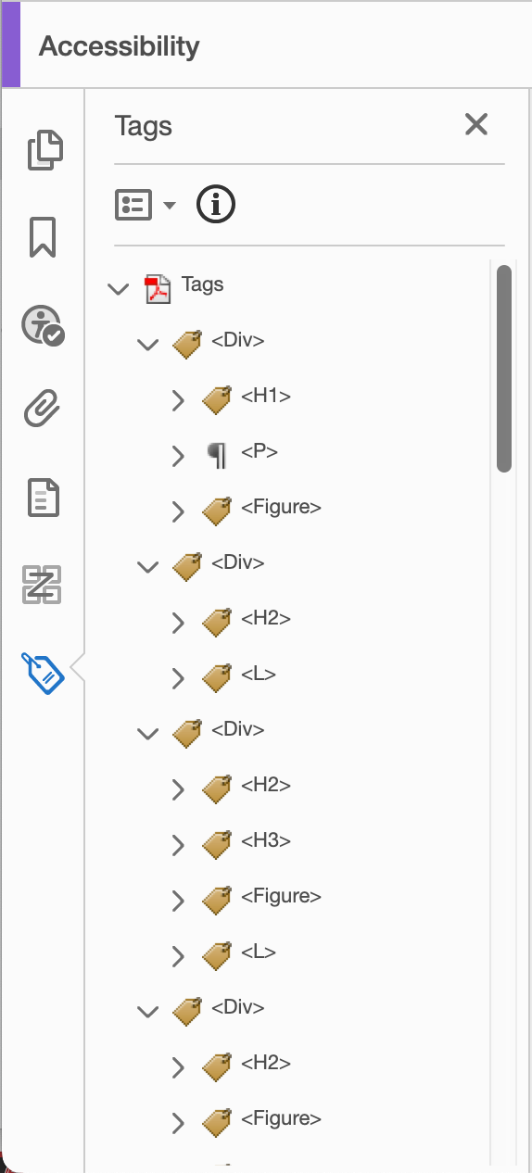
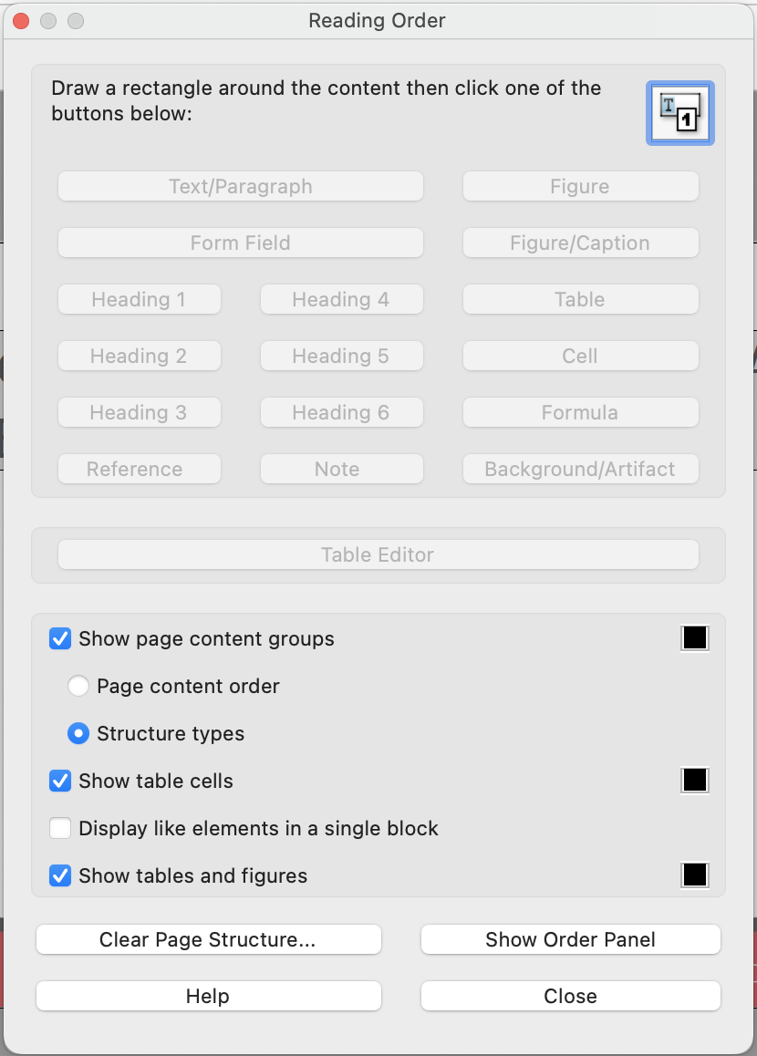
PDF Evaluations: Adobe Acrobat DC Pro
Accessibility Tools
Full Check
Tags
Reading Order
Reading Order tool
Notes:
Stacy – Showed students how to apply what they learned in the weekly modules to real life examples (e.g. scanned PDFs, how to OCR a PDF, tags, reading order, accessibility check).

Slide 13
Don’t Fix Scanned PDFs (if you can possibly avoid it)
Make a new copy
Find a better digital version
Make a new scan of a physical version
Contact the University Library
CSUN has Subject Specialists and other library staff who might be able to help
3. Use Ally and other tools
Download Ally OCRed version
Download Ally HTML version
May produce a file that is easier to fix than original PDF
4. Contact CSUN accessibility team
Fixing a scanned PDF is a last resort
Notes:
Stacy

Slide 14
Evaluation Assessment
Gave students a Word file first
The next week, the same content in PDF
They conducted an 8-point evaluation and used the software tools to check
Submitted their evaluations by email
Notes:
Kate

Slide 15
Wrap-Up (Final Week)
Screen readers
Introduced in week 1
In week 5, offered a more thorough demonstration and discussion
Tables
In Word and PDF
Notes:
Stacy – Provided an in-depth screen reader demo and showing SE keyboard shortcuts (Header menu or link menu); discussed how to create an accessible tables (header row, avoid merging table cells, etc). Additionally, the UDC team opened it up for Q&A on topics that were covered throughout the 5-week training. Finally, we concluded with a wrap up activity using a Kahoot game to reflect and test their knowledge on the topics covered from WebAIM, and celebration for the student employee's final week of training.

Slide 16
Iterations
Semester 1: pilot group drawn from known non-academic departments
Semester 2: marketing and communications focus
Year 2: academic departments
Year 3: not enough enrollment
Summer session
Each semester after the first we had “returning customers”
Solicited feedback from participants
More engagement
Kahoot!
Intended to be in-person
First in-person sessions year 2
Notes:
Kate

Slide 17
Next Steps
Seeking new audiences of student employees
Grant funding to pay dedicated pool of student employees
Emphasis on STEM materials
Notes:
Kate

Slide 18
Questions

Slide 19
Presenters
Kate Tipton
Program Manager
Universal Design Center
kathryn.sharron@csun.edu
818-677-3065
Stacy Jones
Accessibility Analyst
Universal Design Center
stacy.jones@csun.edu
818-677-6230

