Slide 1
Microsoft vs Google: Accessibility of Docs & Slides
Gaby de Jongh Document Accessibility Specialist gabyd@uw.edu
Terrill Thompson Manager, IT Accessibility Team tft@uw.edu

Slide 2
Agenda
Part 1: Top Ten Accessibility Techniques
Part 2: Test Results & Conclusions

Slide 3
Part 1: Top Ten Accessibility Techniques

Slide 4
Technique #1 Alt Text

Slide 5
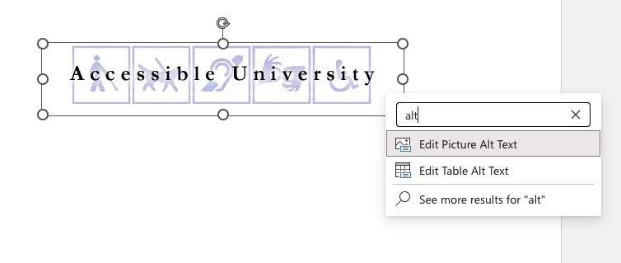
Alt Text in Microsoft Word & PowerPoint
Right click image
Select “Edit Alt text” or “View Alt text” from the context menu
If there is no menu item, type “alt” into the search field

Slide 6
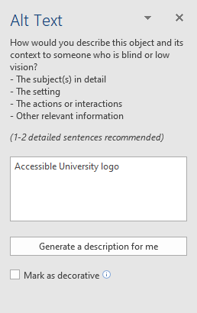
Alt Text Panel (Word desktop, PPT desktop & web)
Images that are purely decorative, select “Mark as decorative” checkbox
Just for fun, try “Generate a description for me”

Slide 7
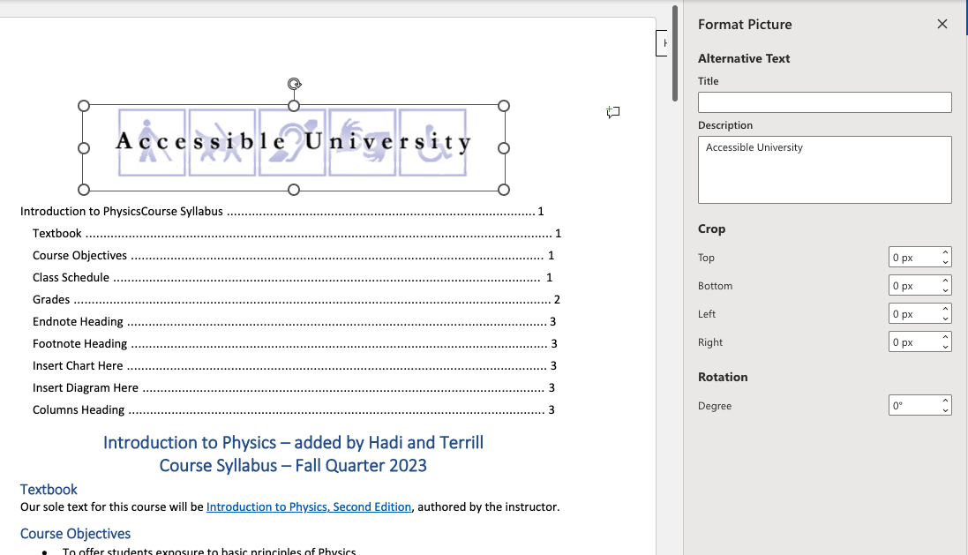
Format Picture Panel (Word for the Web)
Add Alt text in "Description" field
Optionally, add “Title” but:
Know that “Title” will not survive if document is exported to PDF
Can’t mark images as decorative

Slide 8
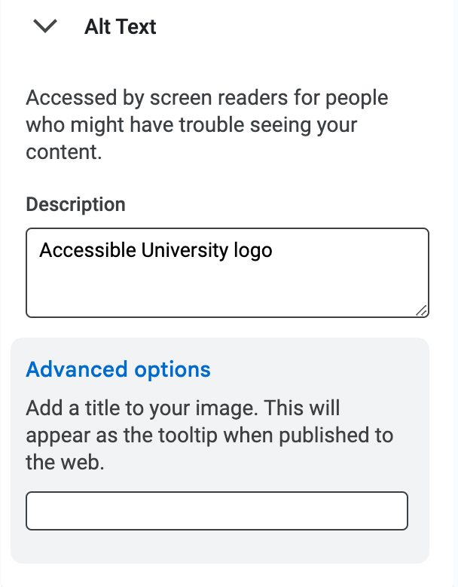
Alt Text in Google Docs & Google Slides
Right click image
Select “Alt text” from the context menu
Add Alt text in "Description" field
Optionally, add “Title” but:
Know that “Title” will not survive if document is exported to Word, PPT, PDF
Can’t mark images as decorative

Slide 9
Background images on Master Slide in PowerPoint Desktop only
Select the "View" tab, choose "Slide Master"
Select image, right click > Alt text
Check "Mark as decorative" checkbox
JAWS and Narrator read images from Master Slide if they have alt text; NVDA and VoiceOver do not
Images you want to be read should not be on the Master Slide

Slide 10
Background images on Master Slide (Theme) in Google Slides
There is no option to mark an image as decorative in Google products
Every image will be announced.
So, they must have Alt text!

Slide 11
Technique #2 Complex Images + Alt Text

Slide 12
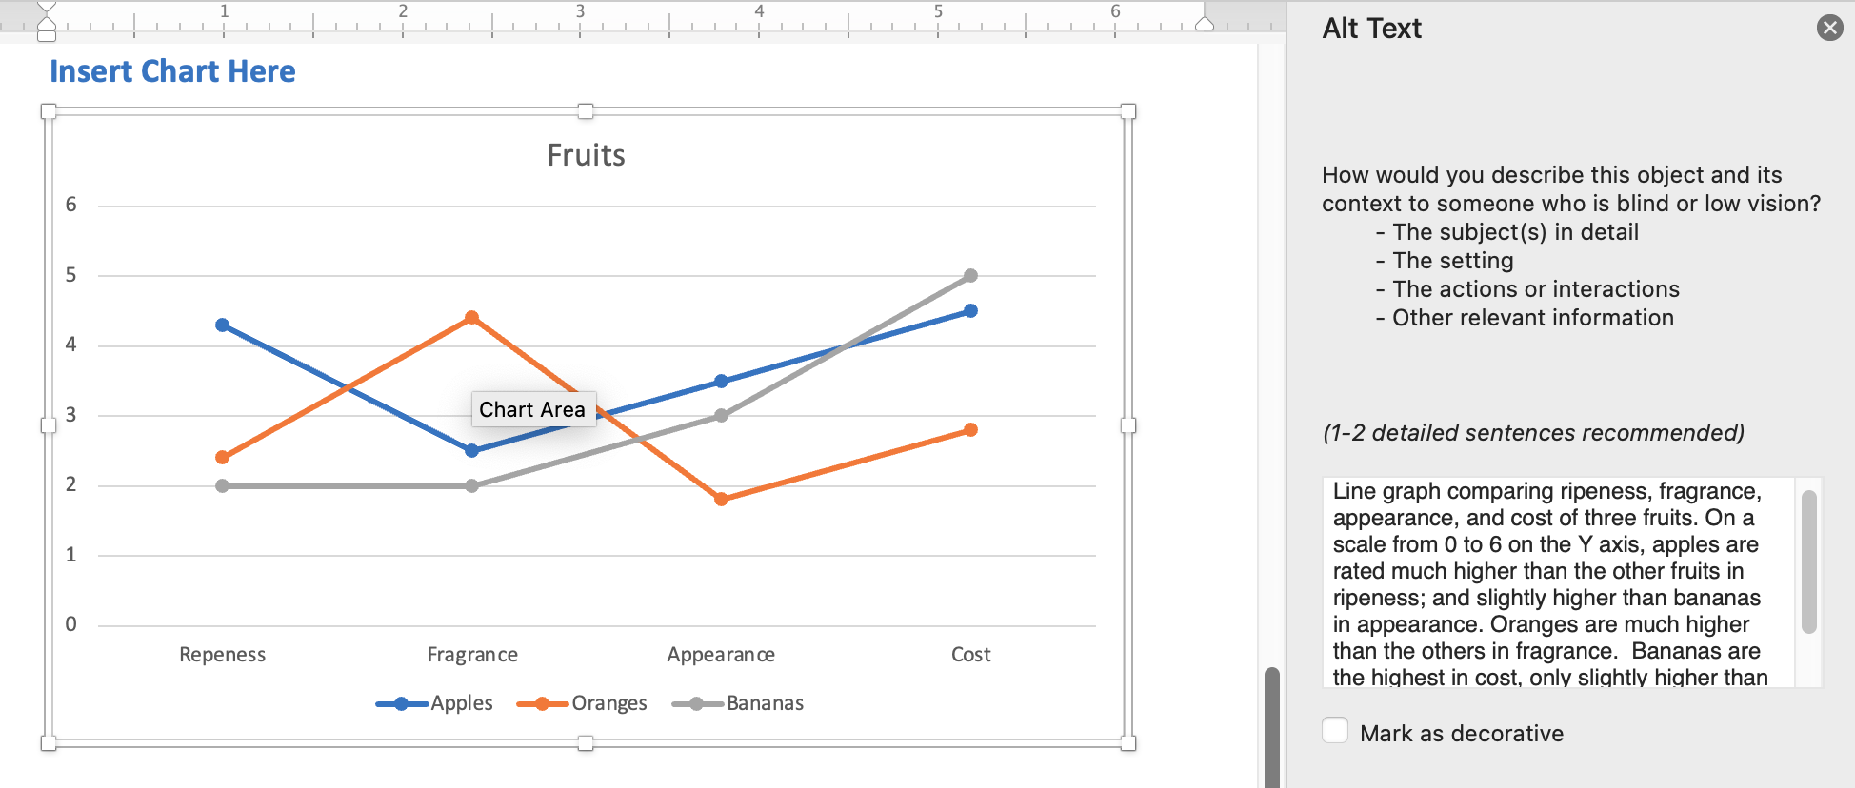
Complex images in Word & PowerPoint – Charts and Graphs
Select object ensuring entire diagram (not individual components) is outlined
Word & PowerPoint desktop:
Right click, select "View Alt text" from context menu
Word & PowerPoint for the Web:
Adding charts or graphs is not supported

Slide 13
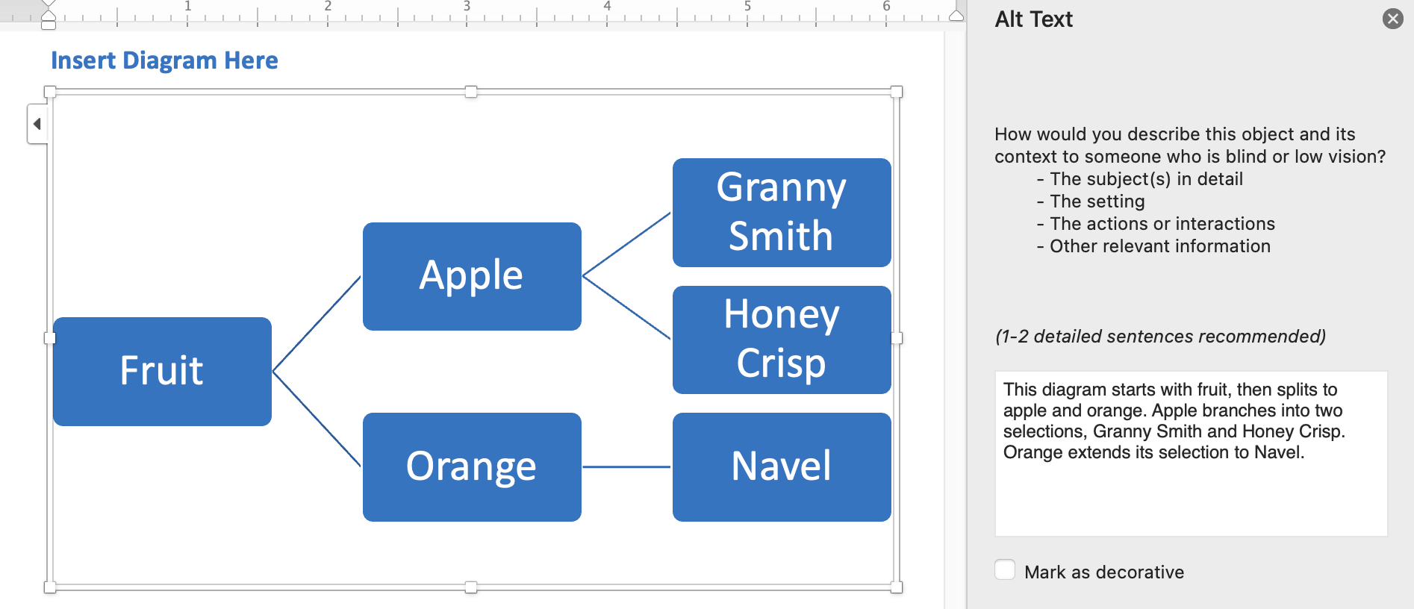
Complex images in Word & PowerPoint – Smart Art Diagrams
Select object ensuring entire diagram (not individual components) is outlined
Word desktop:
Right click, select "View Alt text" from context menu
Word for the Web – can't easily add Alt text
PowerPoint Desktop & Web:
Right click, select "View Alt text" from context menu

Slide 14
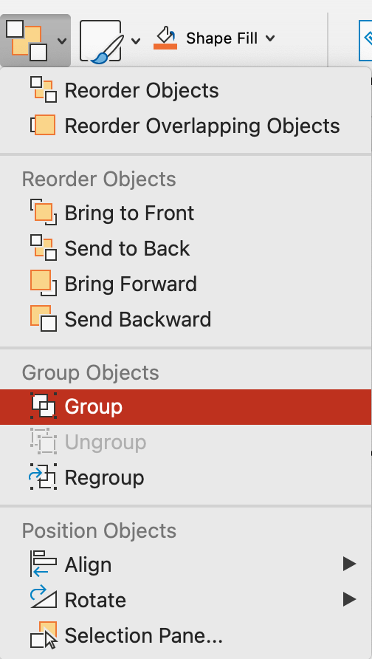
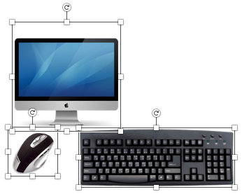
Complex images in PowerPoint - Grouping
First, mark each image as decorative
Select all images in the group
From the Home ribbon choose "Arrange" drop down and choose "Group"
Then provide alt text for the Group

Slide 15
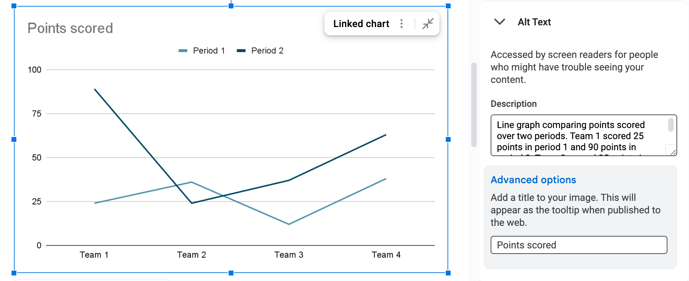
Complex images in Google – Charts and Graphs
Select object ensuring entire diagram is outlined
Add Alt Text in "Description" filed (Title is optional)
Google Docs & Slides:
Right click, select "Alt text" from context menu

Slide 16
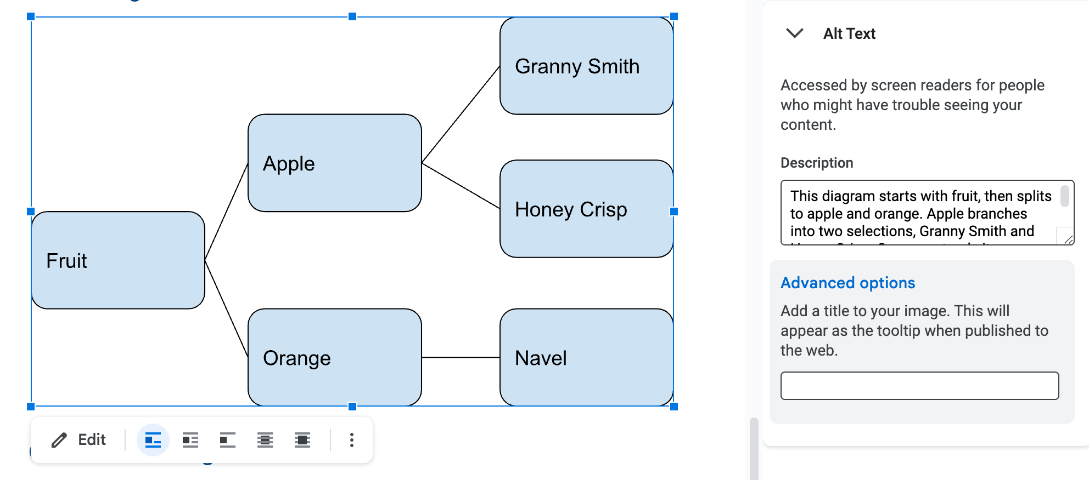
Complex images in Google – Drawings
Select object ensuring entire diagram is outlined
Add Alt Text in "Description" field (Title is optional)
Google Docs:
Select object, then "Image options" from menu bar > Alt text
Right click context menu does not include "Alt text," no search
IMPORTANT! Google Slides – not possible to add / edit Alt text to drawings

Slide 17
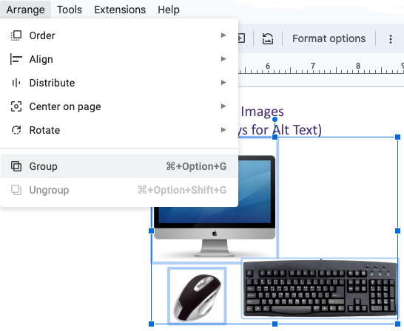
Complex images in Google Slides – Grouping
Select all images in the group
Choose "Arrange" from the menu and choose "Group"
IMPORTANT! It is not possible to add Alt text to a group in Google

Slide 18
Technique #3 Headings & Slide Titles

Slide 19
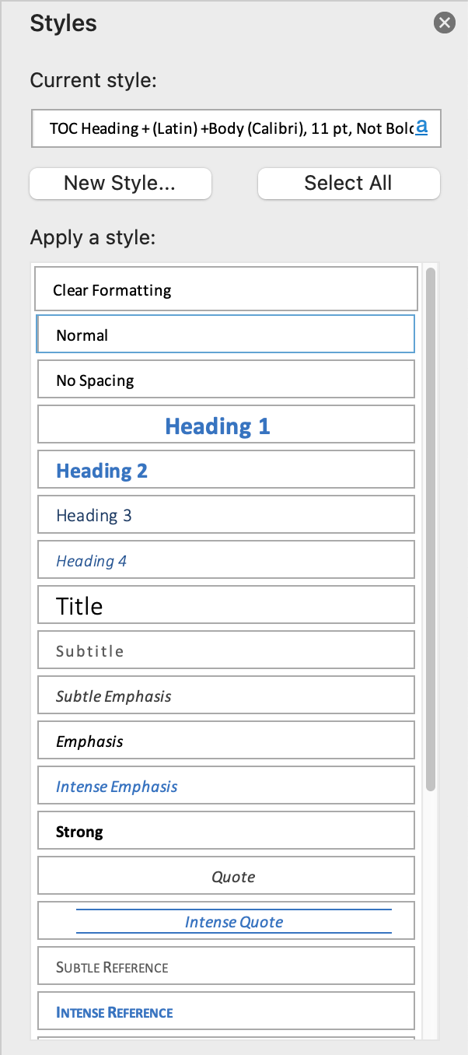
Headings in Word
Use Heading Styles from Home ribbon
Making text big and bold does not make it a heading
Table of Contents

Slide 20
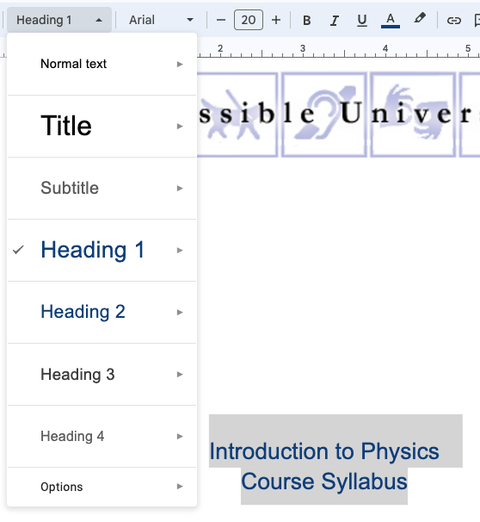
Headings in Google Docs
From the menu bar
Select the proper Style from the Rich Text Editor drop down

Slide 21
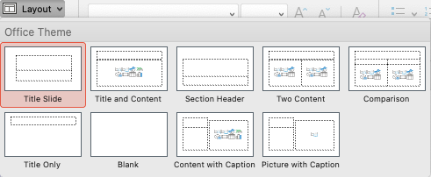
Slide Titles in PowerPoint & Google Slides
Slide titles act as headings
Every slide must have a unique slide title
Use Templates and built-in Layouts

Slide 22
Technique #4 Lists

Slide 23
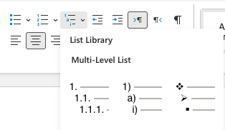
Lists in Word & PowerPoint
From the Home ribbon, choose Bulleted, Numbered, or Multilevel

Slide 24
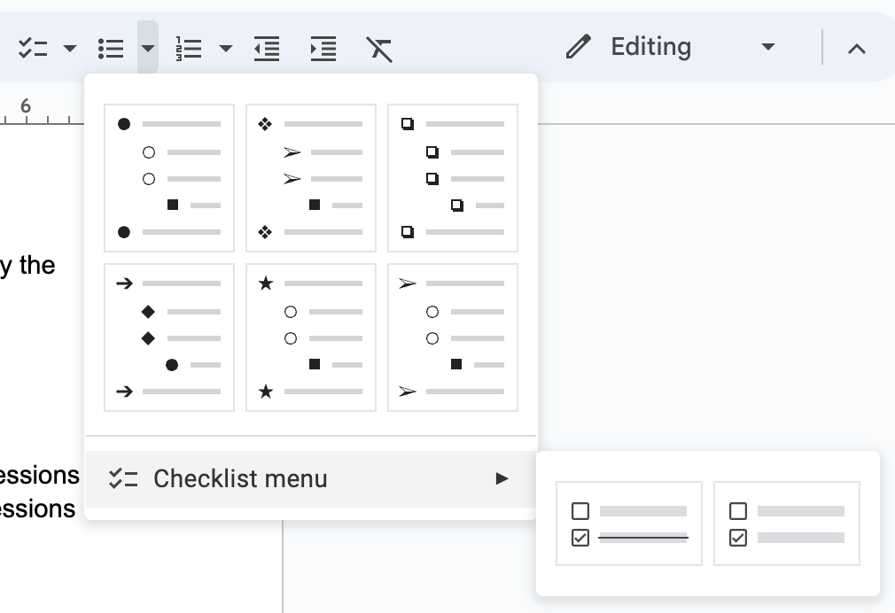
Lists in Google Docs & Slides
From the menu bar select
checklist
bulleted list
numbered list

Slide 25
Technique #5 Tables

Slide 26
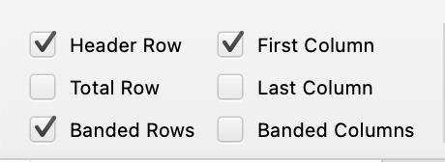
Tables in Word & PowerPoint
Simple tables can be made accessible by defining the table header(s)
Table Design tab, select the proper row/column option(s)
Check “Header Row” for column headers
Check “First Column” for row headers
“Last Column” is not supported by any screen readers
Complex tables should be simplified for clarity

Slide 27
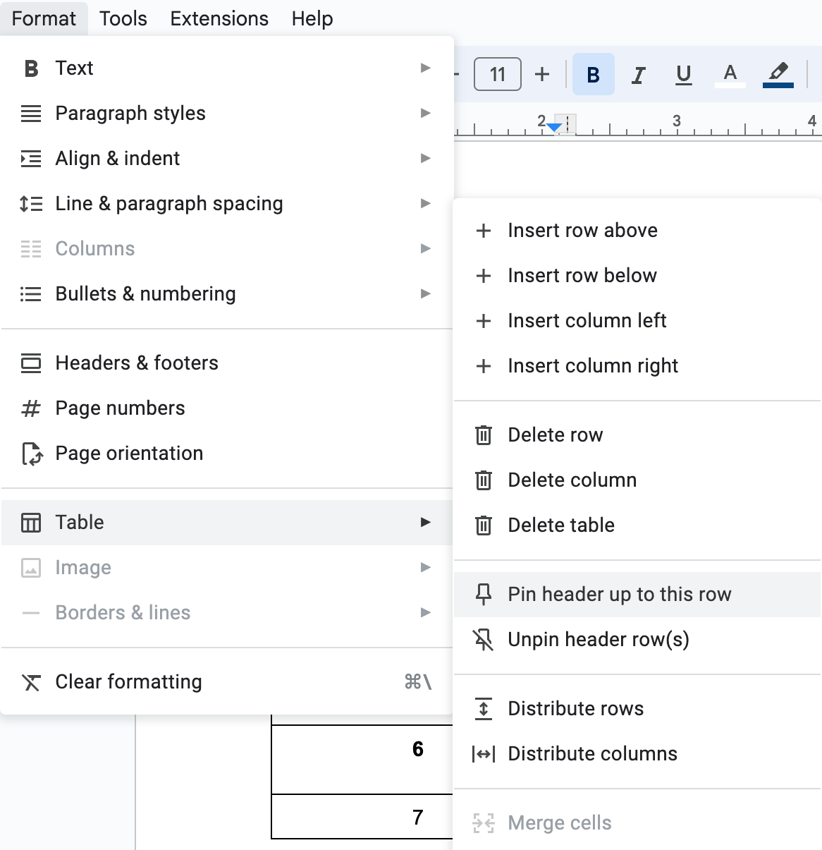
Tables in Google Docs
Select top row of table
From the menu choose "Format," then "Table" > Pin header up to this row
In Google Slides it is not possible to pin a header row in a table

Slide 28
Technique #6 Links

Slide 29
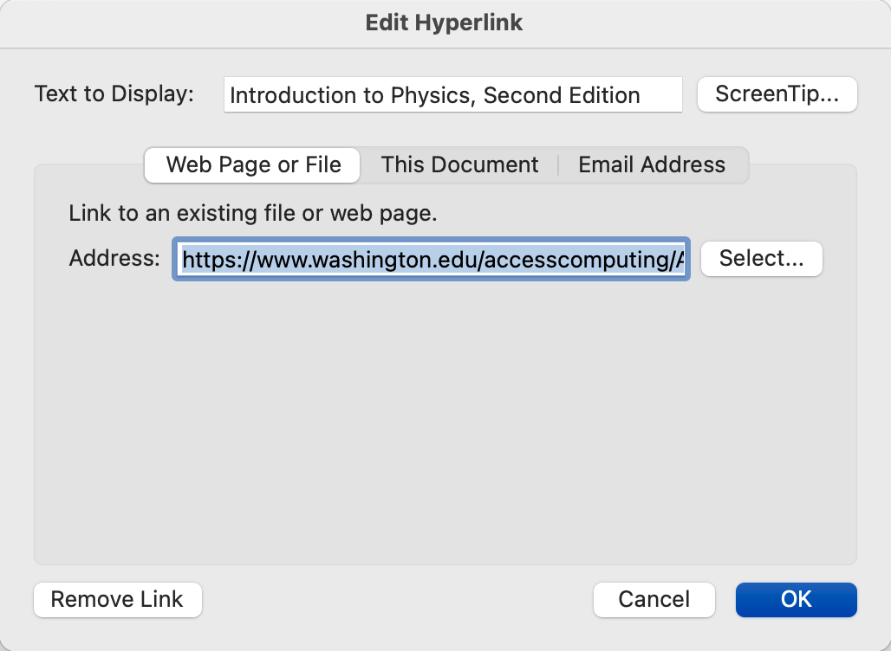
Links in Word & PowerPoint
Select text, then right click and select “Hyperlink” from context menu
Enter URL in Address field

Slide 30
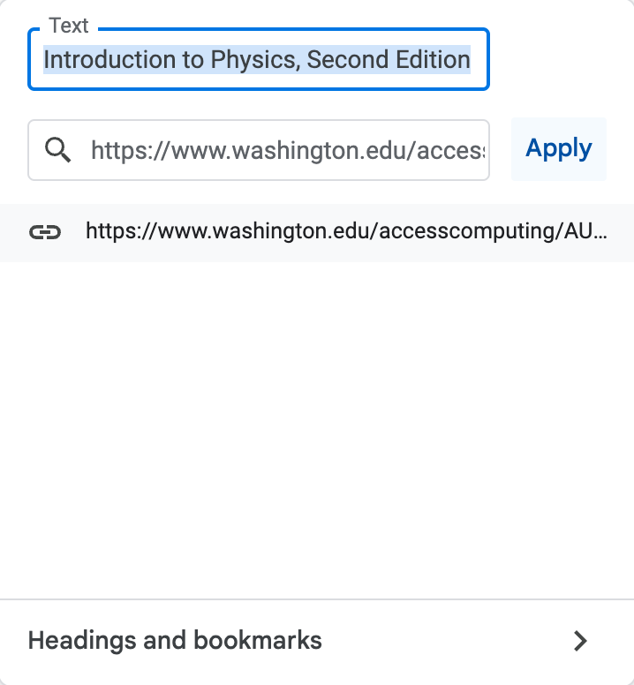
Links in Google Docs & Slides
Select text, then right click and select “Hyperlink” from context menu
Enter URL in Address field

Slide 31
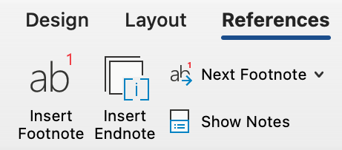
Footnotes and Endnotes in Word
From the Reference tab
Select “Insert Footnote” or “Insert Endnote,” depending upon the preferred citation style

Slide 32
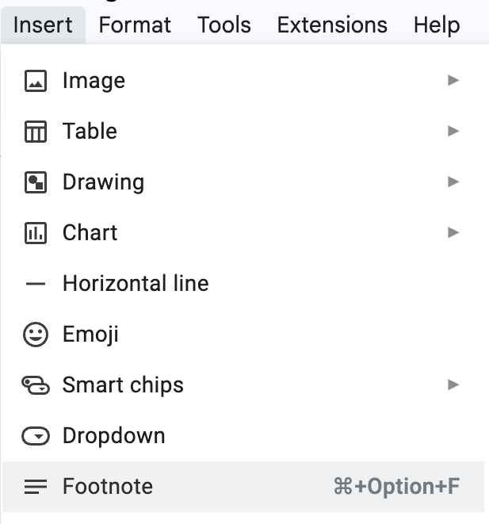
Footnotes in Google Docs
Select ”Insert,” then choose “Footnote” from the list of options
Endnotes not supported in Google Docs

Slide 33
Technique #7 Document Title

Slide 34
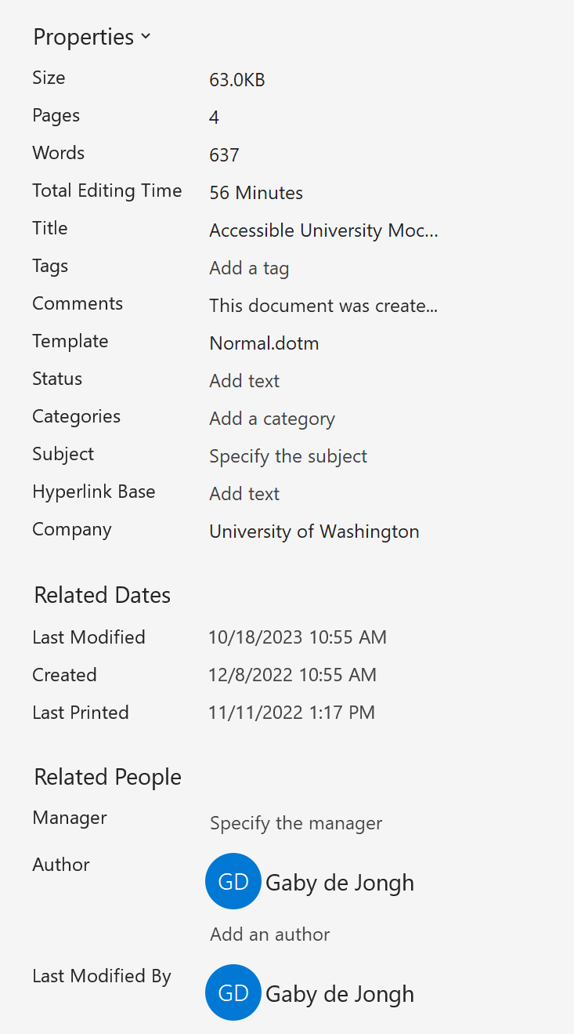
Document Title in Word & PowerPoint Desktop only
Windows
File > Info > Show All Properties
MacOS
File > Properties > Summary tab
Not possible to add document properties in Word & PowerPoint for the Web
Title style is not the same as Document Title
Title styles are just paragraphs <P> when exported to PDF

Slide 35
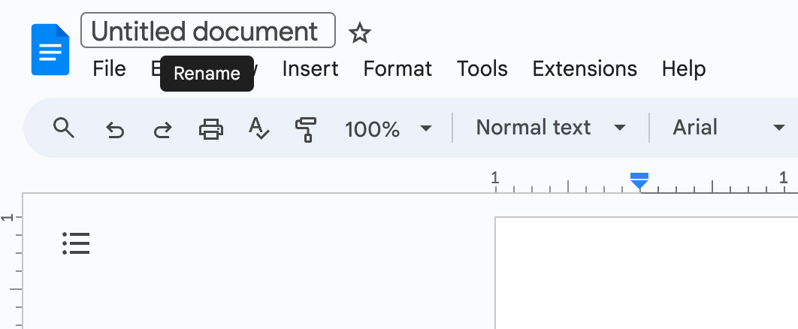
Document title in Google Docs & Slides
Add Document Title In the upper left text field

Slide 36
Technique #8 Language

Slide 37
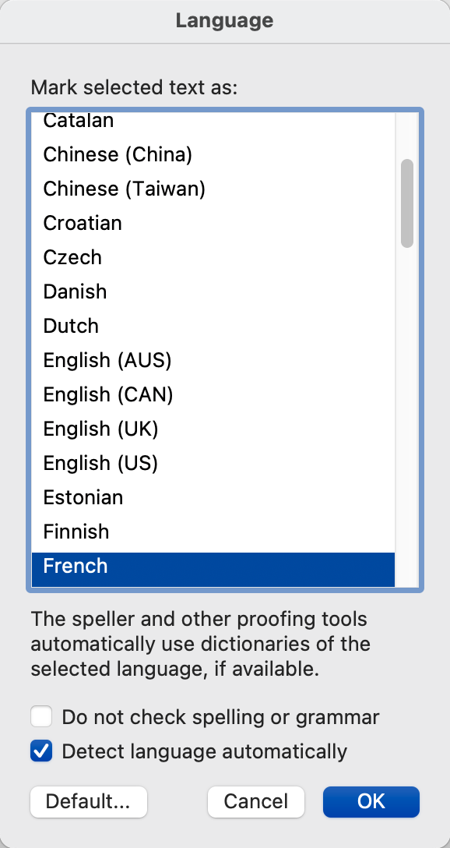
Language in Word
Set the document language
From the Review tab select “Language”
Choose proper language from the list
Set foreign language content within document
Select the foreign language text
Repeat the above process
It is not possible to assign language in PowerPoint

Slide 38
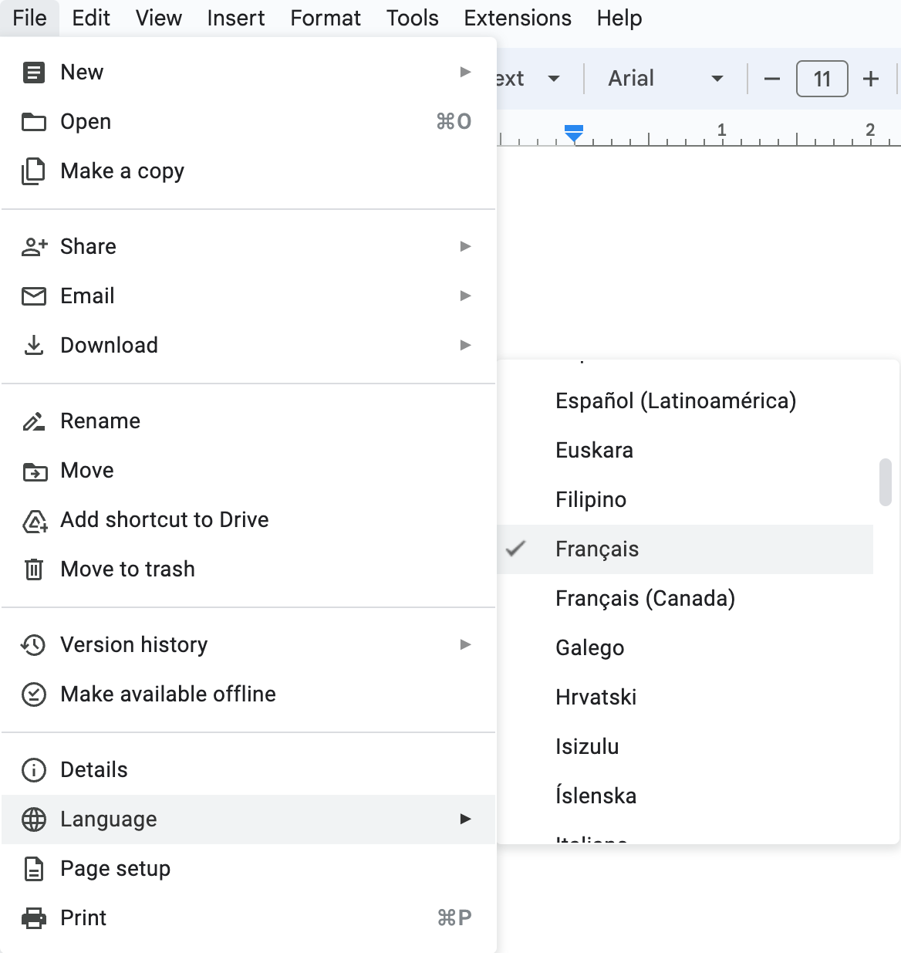
Language in Google Docs & Slides
From the File menu choose "Language”
It is not possible to set a different language for foreign language parts within a document

Slide 39
Technique #9 Read Order

Slide 40
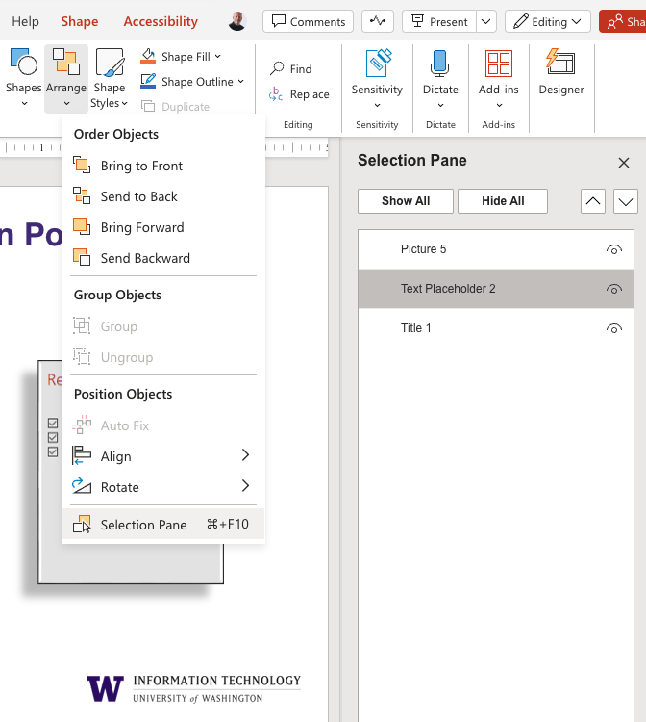
Selection Pane in PowerPoint
Arranged in reverse order, bottom to top
From the Home ribbon
Select the “Arrange” drop down then “Selection Pane”

Slide 41
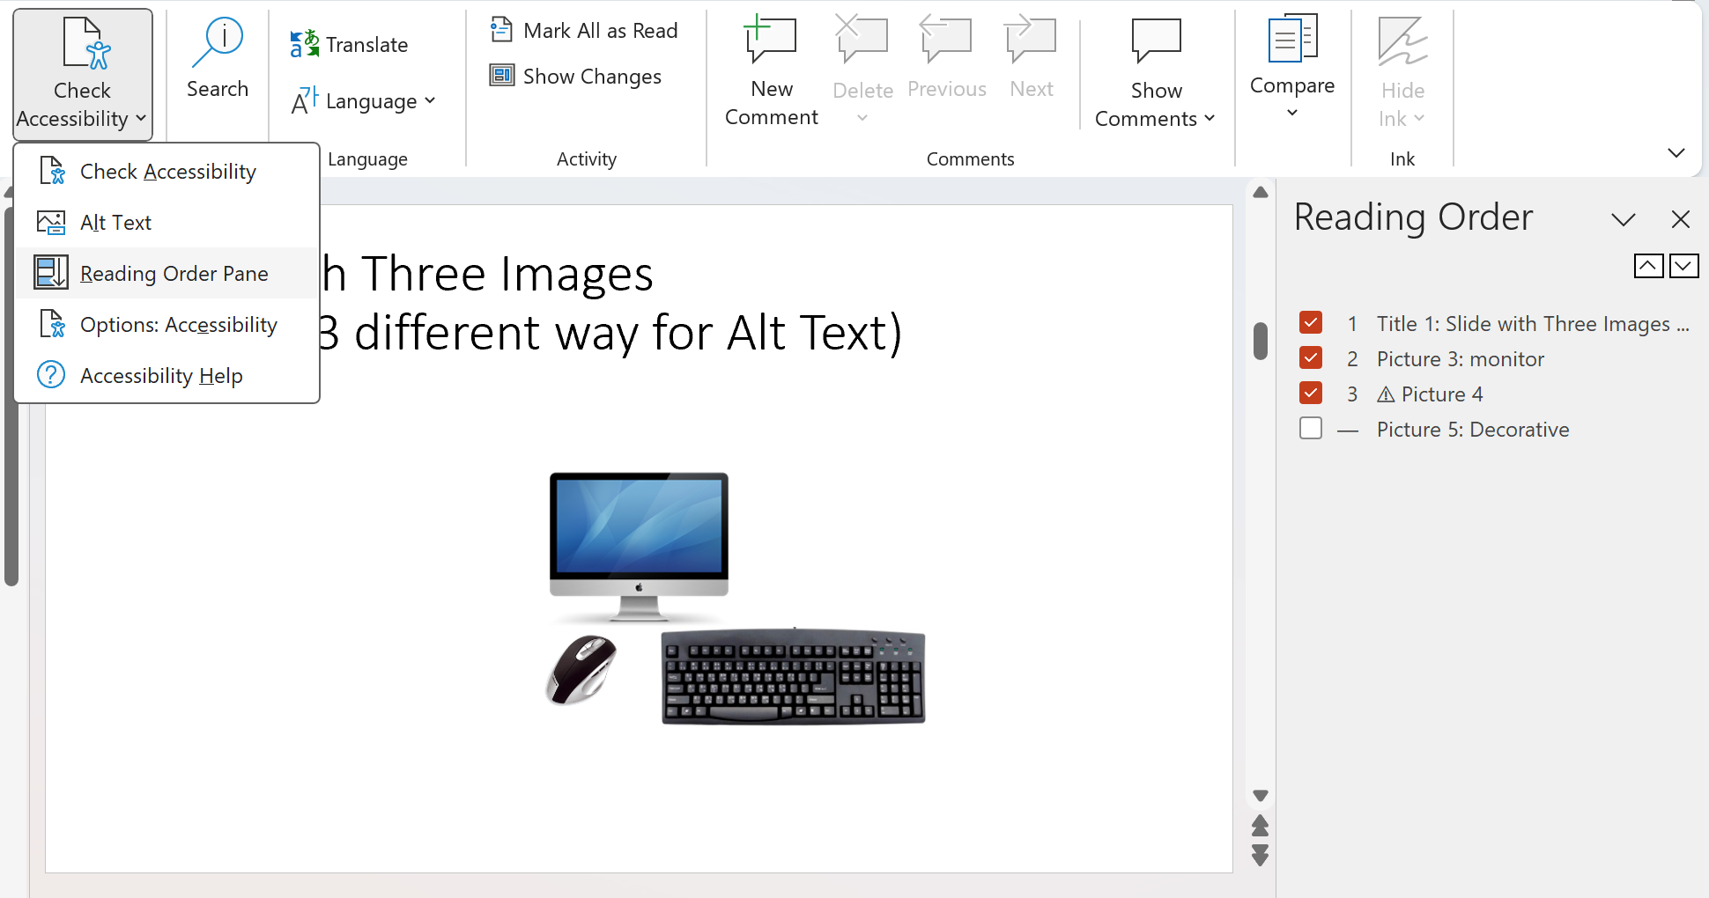
Reading Order Pane in PowerPoint (Windows desktop only)
Arranged top to bottom
From the Review tab
Select ”Check Accessibility” then “Reading Order Pane”

Slide 42
Controlling read order in Google Slides
Not possible!

Slide 43
Technique #10 Accessibility Checker

Slide 44
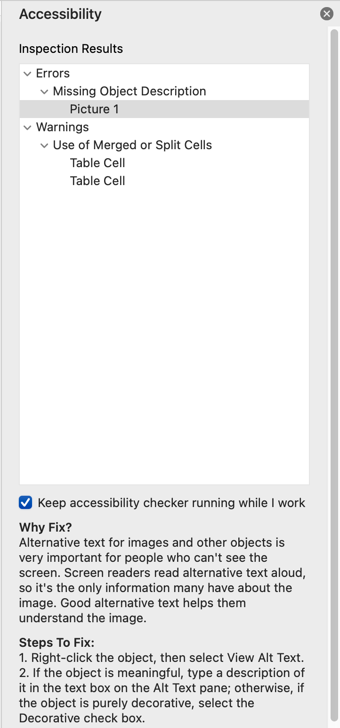
Checking accessibility in Word and PowerPoint
From the Review tab
Select "Accessibility" from the ribbon
Explanations and Steps to Fix are provided

Slide 45
Checking accessibility in Google Docs & Slides
Not possible! There is no accessibility checker
Grackle Docs fills this gap (more on that later)

Slide 46
Part 2: Test Results

Slide 47
Test Methods
Tested documents authored in:
Word & PowerPoint Desktop
Word & PowerPoint for the Web
Google Docs & Google Slides
Screen readers used to test:
NVDA, JAWS, Narrator, VoiceOver (iOS & macOS)
Tested output when converting from accessible original sources:
Word Save As / Export to PDF
PowerPoint Save As / Export to PDF
Google Docs Download to Word
Google Slides Download to PowerPoint
Google Docs/Slides Download to PDF (Grackle)

Slide 48
Disclaimer
It's possible our results were due to lack of knowledge on our part. Maybe there's a way to make something work and we couldn't figure out how to do it.
However, that alone is good data. We're three accessibility professionals with nearly a century of experience between us, including one full-time screen reader user, and if we can't figure it out, how many other users can?

Slide 49
User Experience

Slide 50
Word Desktop
Most users are highly familiar with this environment.
Most accessibility features are supported by screen readers.
Limitations:
No screen readers read alt text on charts
NVDA does not read alt text on smart art diagrams (all other screen readers do); NVDA reads components instead
JAWS is the only screen reader that has good support for footnotes and endnotes (Alt + Shift + E reads the note when the superscript identifier has focus; user does not lose their place in the document)

Slide 51
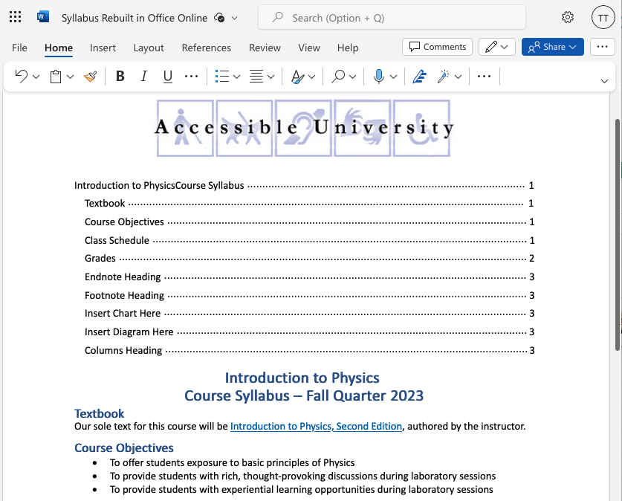
Word for the Web (Edit Mode)

Slide 52
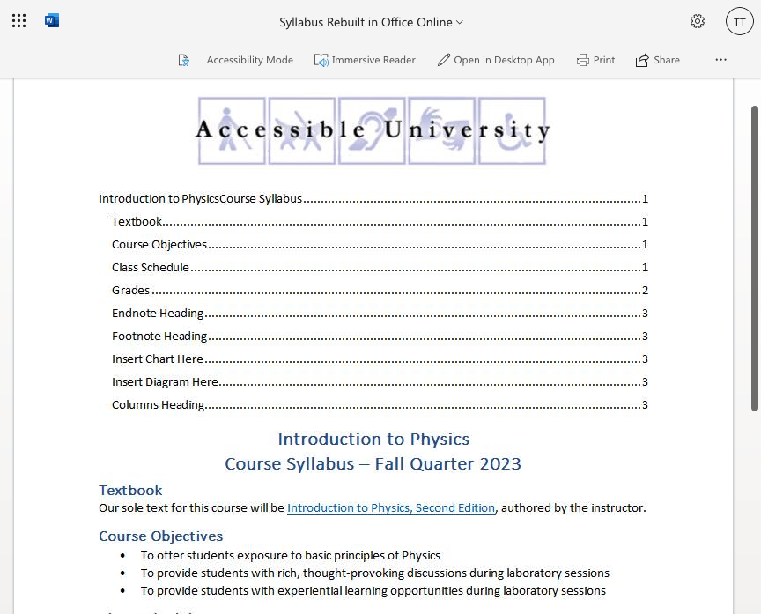
Word for the Web (View-only)

Slide 53
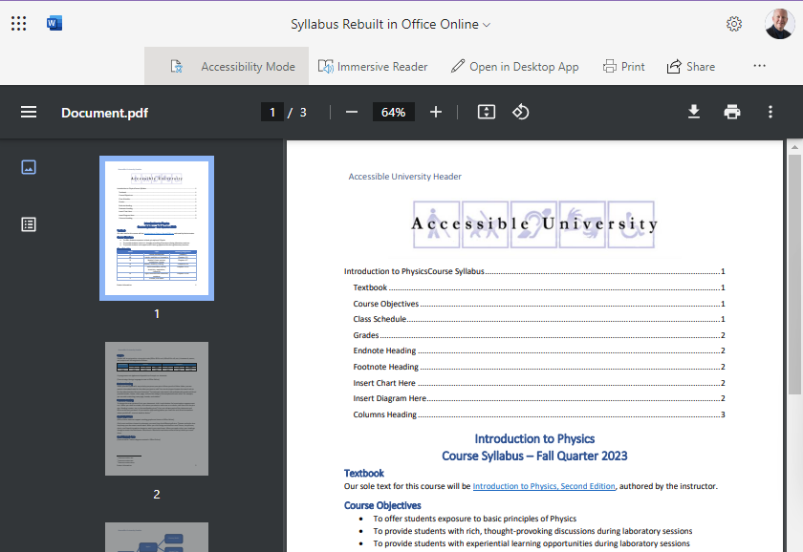
Word for the Web (View-only, “Accessibility Mode”)

Slide 54
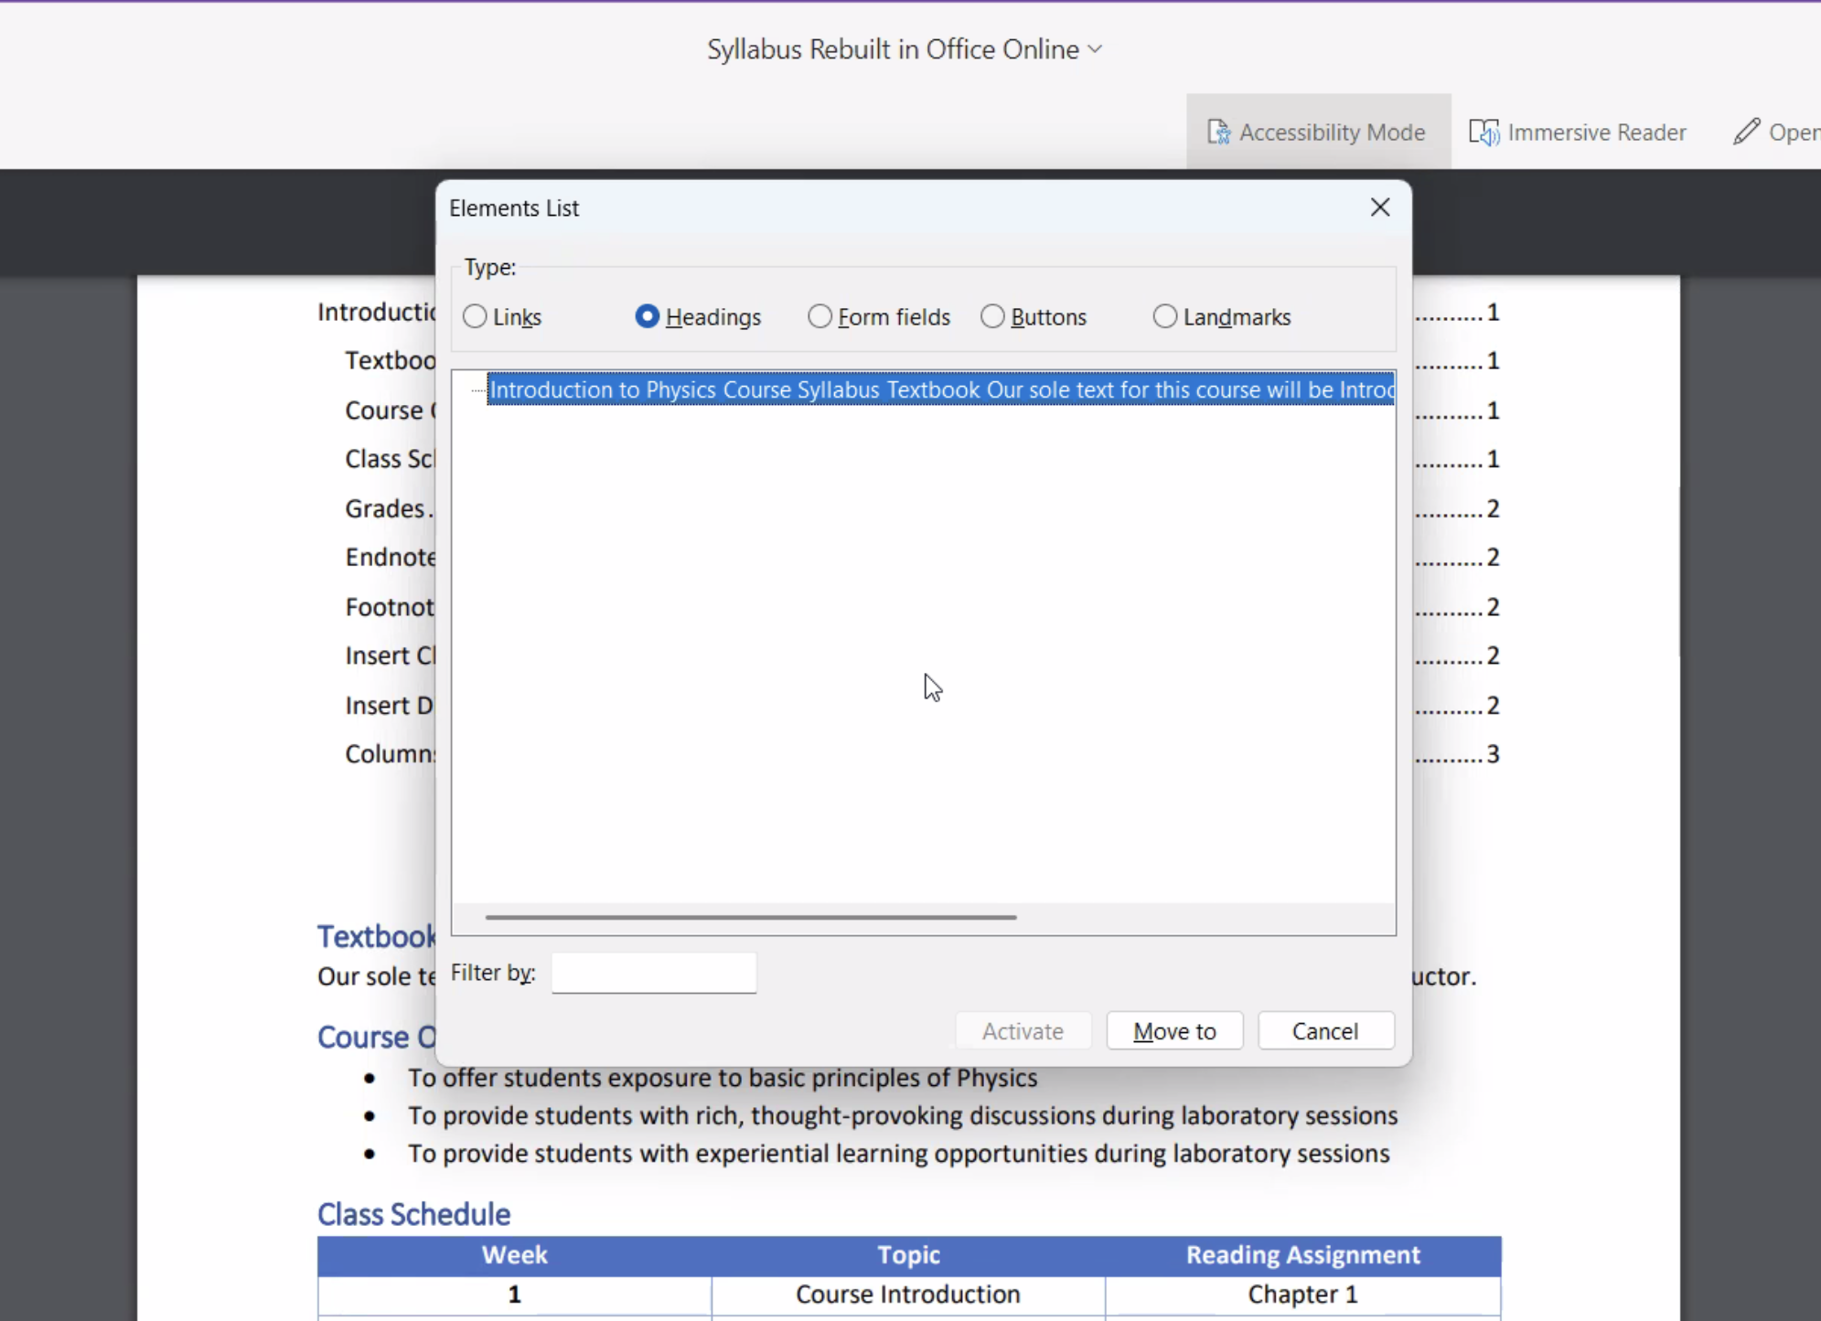
“Accessibility Mode” has accessibility bugs

Slide 55
Word for the Web: Summary
If document is shared in “Edit mode”, user can:
Access the document through the online interface
It’s not bad, but the application chrome is part of the same web page; this can interfere if the user just wants to read the document.
Open the document in the Word desktop app
Accessibility is good. Most users are highly familiar with this tool
Should only use ”Edit mode” if you want the user to be able to edit. They can easily edit accidentally without realizing it.
If document is shared in “View mode”:
The default online viewer is completely inaccessible
“Accessibility mode” converts the document to PDF (see later slide for quality of PDF export) but the online PDF viewer introduces accessibility problems.
The user can open in Word desktop app.

Slide 56
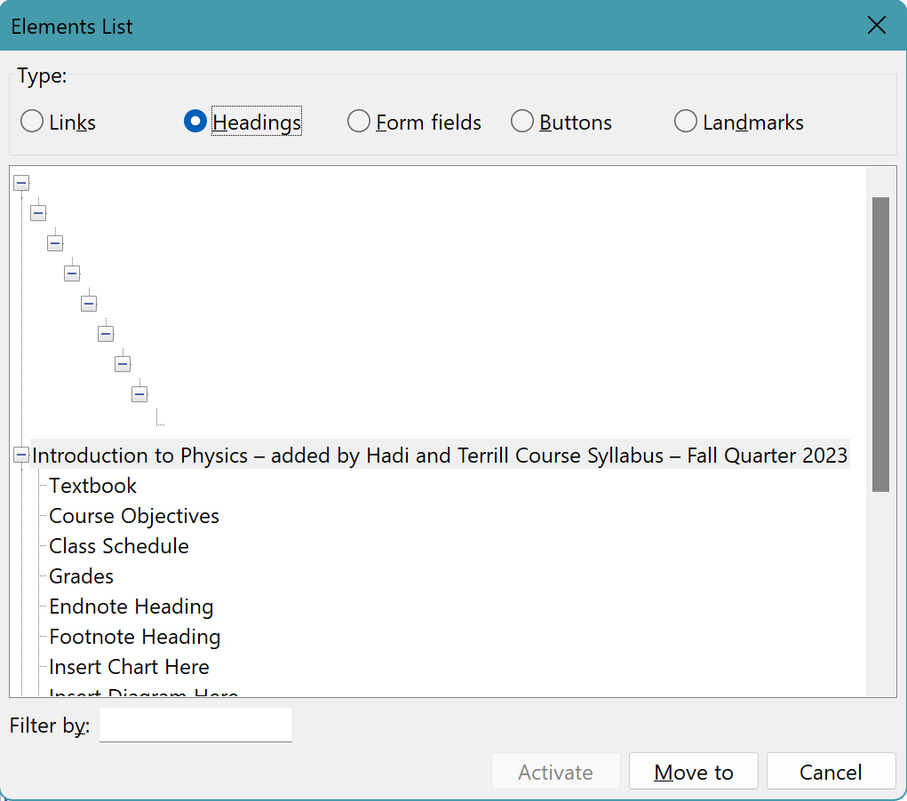
Weird heading bug in Word for the Web
Every document created in Word for Web has 18 hidden headings by default
The headings are visibly hidden (positioned offscreen)
These headings have no text content and JAWS ignores them, but NVDA does not.
Notes:
Feel free to move stuff around here so it looks better.

Slide 57
Bonus Geek Content: Weird heading bug
The following two elements are repeated 9 times in every new document
Each repeated element increments the id and aria-level by 1 (the result = heading levels 1-9)
<div
id="PreviousHiddenHeadingElementIdLevel1"
class="HiddenElementForScreenReaderNav"
aria-label="Loading additional document content"
tabindex="-1" role="heading" aria-level="1">
</div>
<div
id="NextHiddenHeadingElementIdLevel1"
class="HiddenElementForScreenReaderNav"
aria-label="Loading additional document content"
tabindex="-1" role="heading" aria-level="1">
</div>

Slide 58
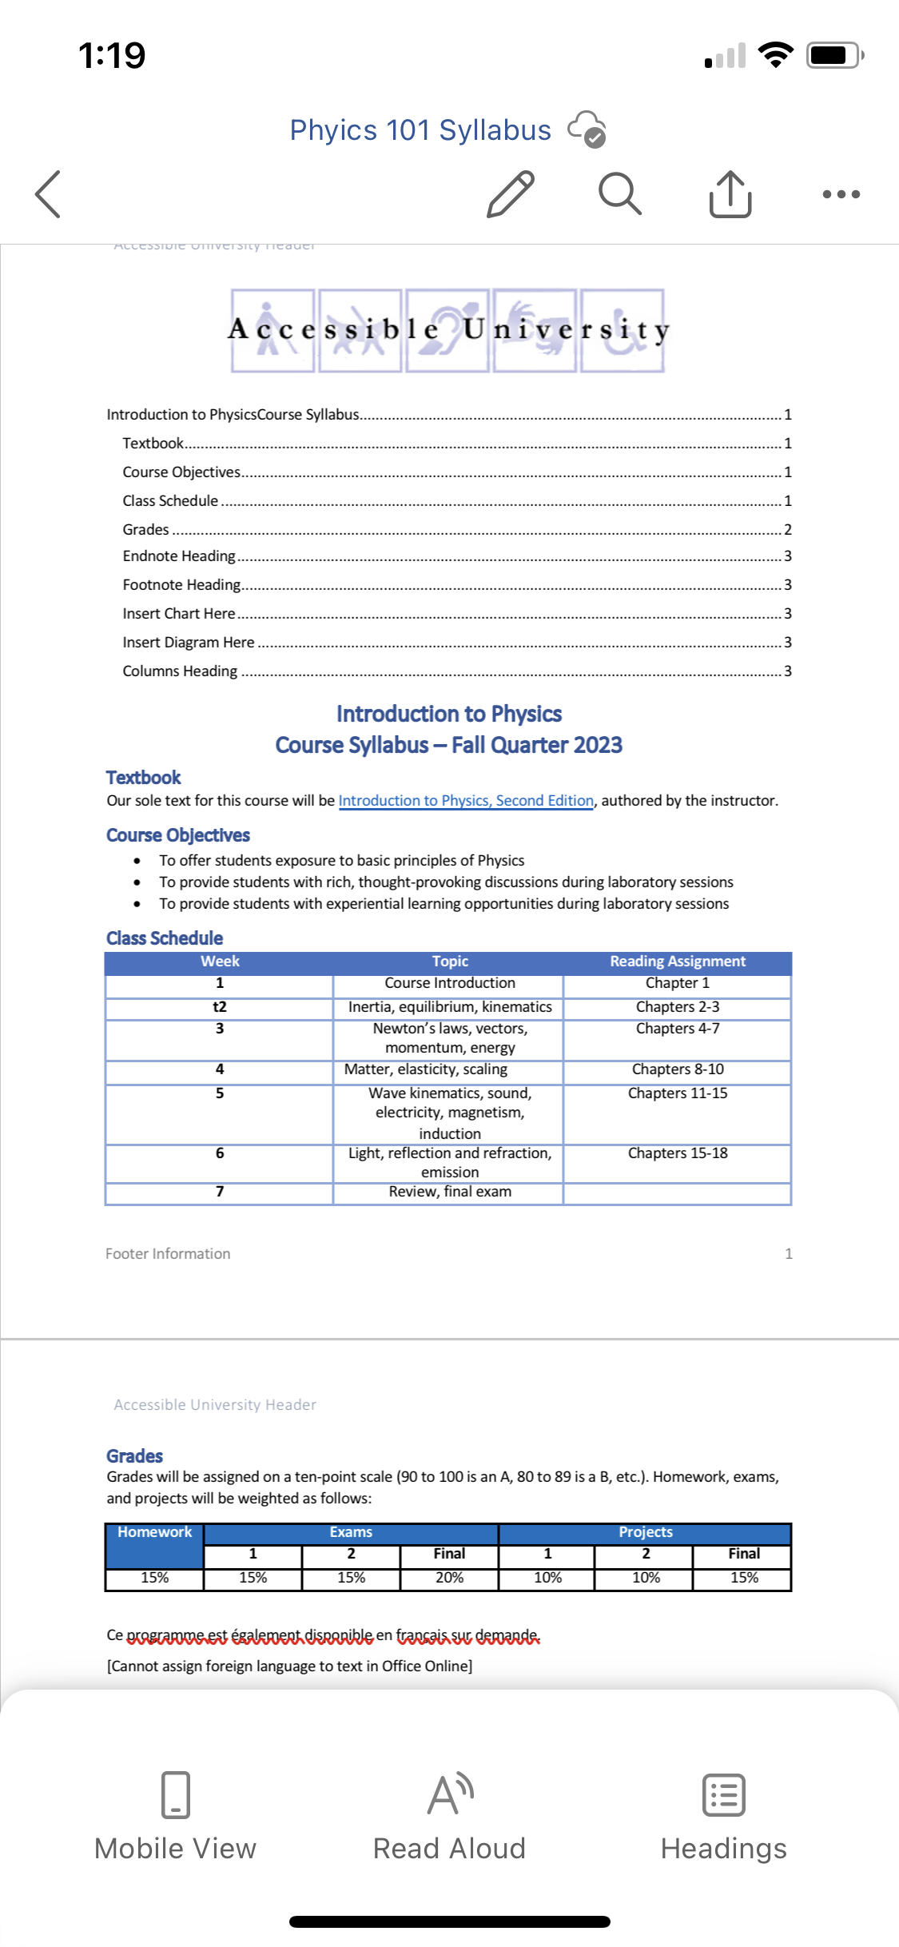
Word Mobile App (iPhone)
VoiceOver can read all content linearly.
Swipe right or left moves through pages, then reads the page that has focus.
It is difficult, if not impossible, to navigate between elements of the page.
“Read Aloud” feature is a plus.
“Headings” feature facilitates navigation, but isn’t designed for VoiceOver users (they can use the Rotor to move between headings)

Slide 59
Google Docs
Screen reader keystrokes listed in Google’s online help docs don’t work. For correct keystrokes, turn on Accessibility via Tools menu, then consult Accessibility menu in Google Docs.
Keystrokes are long and cumbersome, but somewhat intuitive. For example:
Ctrl + Alt + N, Ctrl + Alt + G = Next graphic
Ctrl + Alt + N, Ctrl + Alt + H = Next heading
Ctrl + Alt + P, Ctrl + Alt + H = Previous heading
Ctrl + Alt + N, Ctrl + Alt + O = Next list
Some keystrokes may conflict with keystrokes used for other purposes (e.g., Ctrl + Alt + N = launch NVDA)

Slide 60
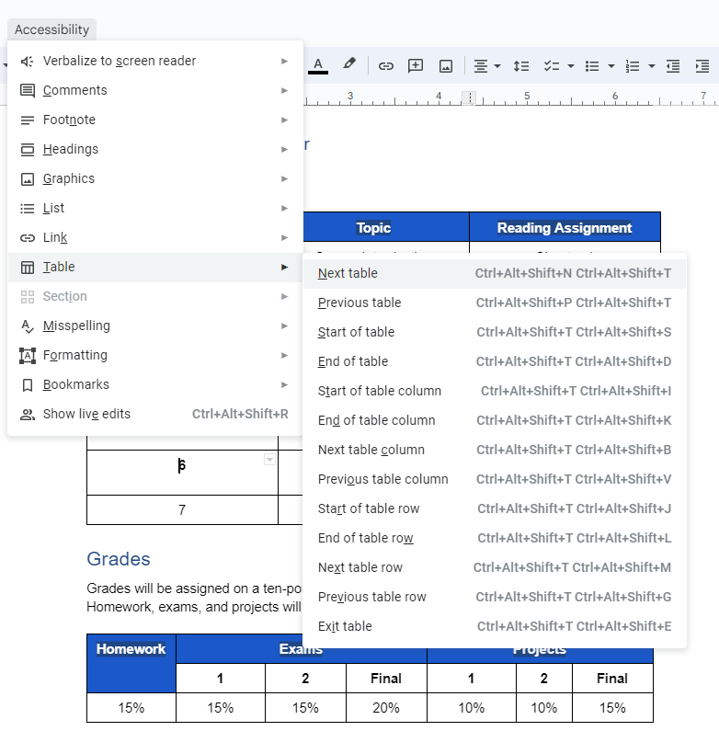
Google Docs Keystroke Example: Table Navigation

Slide 61
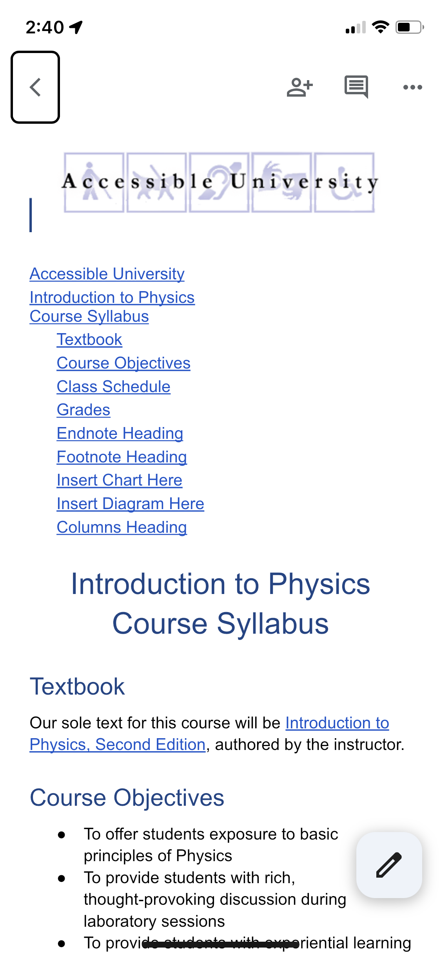
Google Docs Mobile App (iPhone)
VoiceOver can read the entire document from top to bottom, but users can’t interact with individual elements.
The VoiceOver Rotor doesn’t recognize critical features within the document, such as headings.
These same issues persist if users double-tap to enter Edit mode.

Slide 62
PowerPoint Desktop: Screen Reader Inconsistencies
JAWS and Narrator read images from Master Slide if they have alt text; NVDA and VoiceOver do not
NVDA does not announce links as “link” when reading the entire slide. Users can tab to the link, but NVDA does not announce the link text when it receives focus (This second issue is true in VoiceOver too).
All screen readers read alt text on a diagram, but JAWS and Narrator also read the individual components, even if they’re marked decorative.
NVDA does not recognize tables. (It reads their content as text, but table navigation keys do not work)

Slide 63
PowerPoint for the Web
Screen readers are more consistent than they are with PowerPoint desktop, but there are bugs:
For all Windows screen readers, links and link text are separate objects. NVDA List of Links shows links as “Unlabeled” links; JAWS List of Links shows nothing.
All screen readers handle tables as expected if they have a header row. However…
Tables without header rows are not recognized as tables at all. This is true for all screen readers.

Slide 64
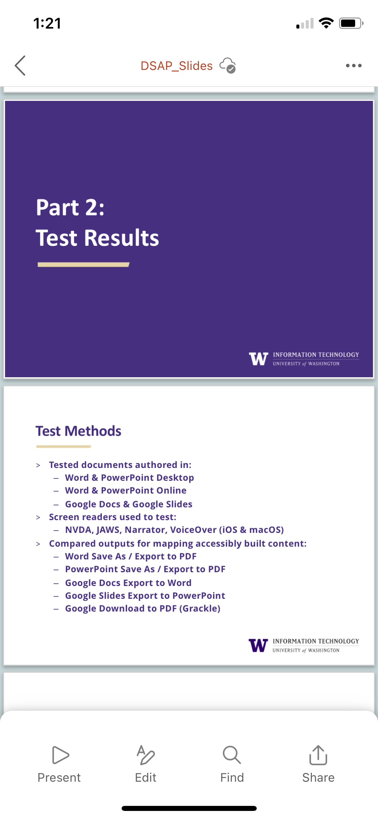
PowerPoint Mobile App (iPhone)
User swipes right to move between slides. Each slide is identified by number and title.
Double tap to enter a slide, then swipe right to move from object to object.
Some objects (e.g., table) require additional action to enter and read their content.
Overall, a very clean and easy-to-use interface.

Slide 65
Google Slides
Unlike PowerPoint, slides are not readable in Presentation Mode (see next slide for a demo)
In Standard Mode:
Alt + Ctrl + Shift + C moves to Canvas
Alt + Ctrl + Shift + F moves to Filmstrip
Alt + Ctrl + Shift + S moves to Speaker notes
In Canvas, press Tab to move between objects.
Press Enter to edit the content of the current object.
Do not use arrow keys when an object has focus! That will nudge the position of the object.

Slide 66
Google Slides in Presentation View

Slide 67
Bonus Geek Slide: Google in Presentation Mode
The entire slide is an <svg> element.
Below is the “Terrill Thompson” line:
<g>
<g class="sketchy-text-background" visibility="visible"></g>
<g></g>
<g class="sketchy-text-content" visibility="visible">
<g class="sketchy-text-content-text" transform="translate(0 30.72)">
<text text-rendering="geometricPrecision">Terrill</text>
<text text-rendering="geometricPrecision">Thompson</text>
</g>
</g>
</g>

Slide 68
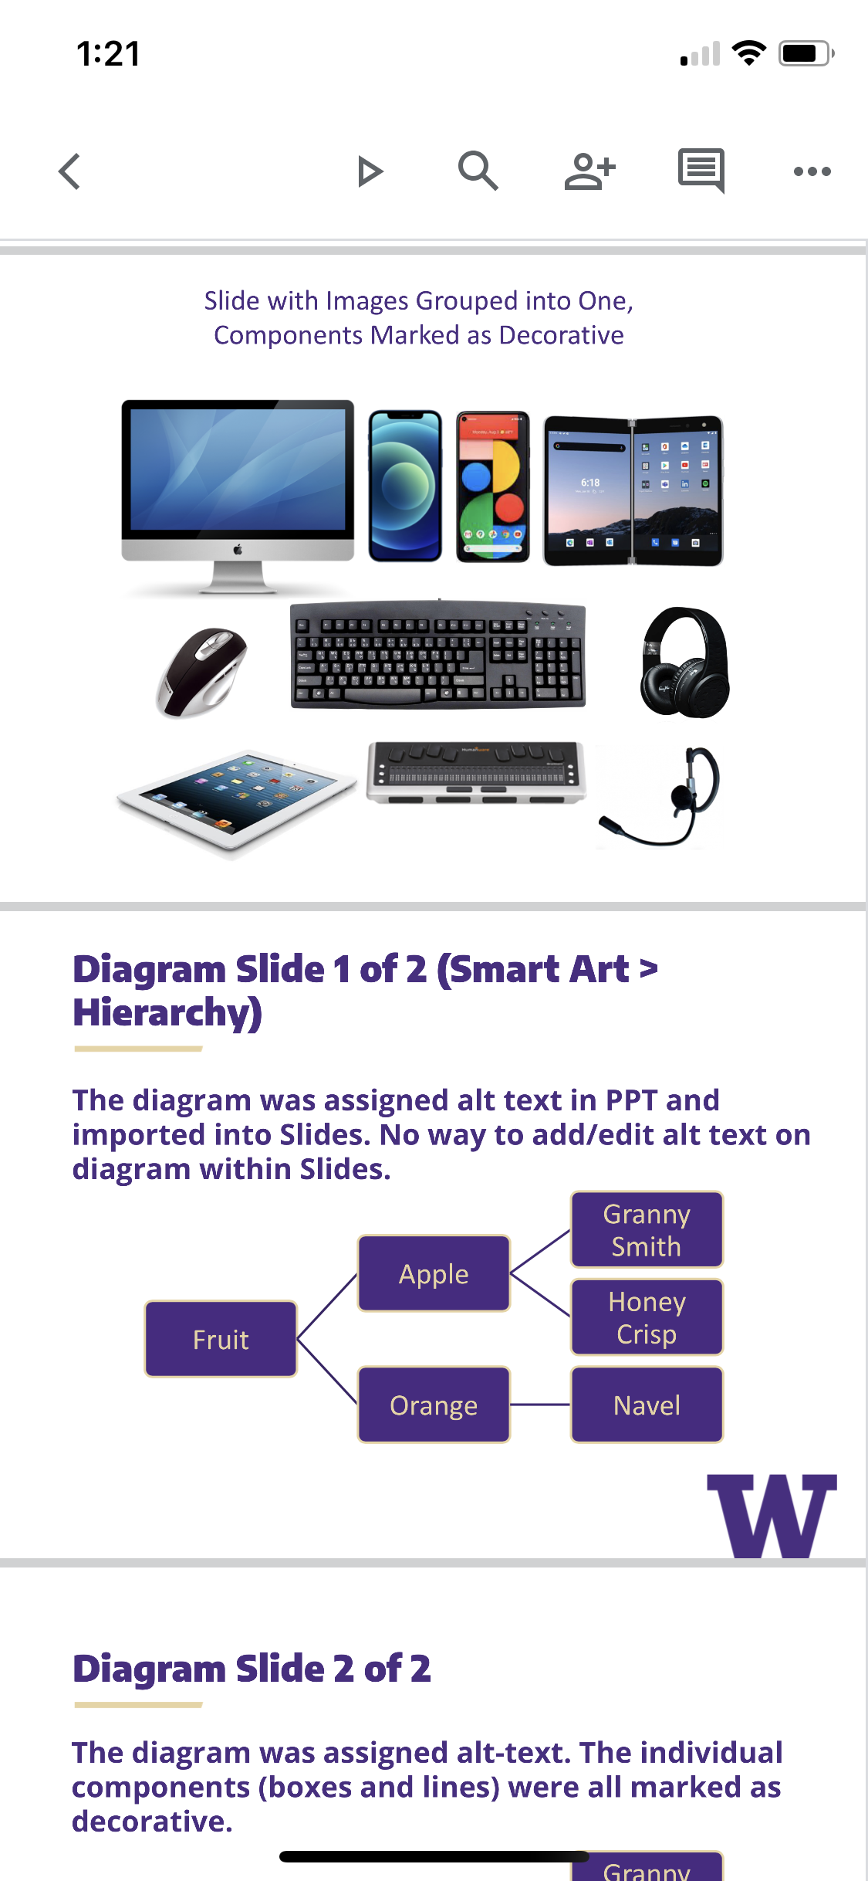
Google Slides Mobile App (iPhone)
User swipes right to move between slides.
If the user doesn't swipe again, all content of the slide that currently has focus is read.
Double tap brings up a pop-up menu. One of the options is "Edit mode", but reading content in Edit mode is not easy (plus it's risky).

Slide 69
Summary: Documents & Slides

Slide 70
Comparison of Document & Slide Tools (1 of 3)
Feature | Word & PowerPoint (Desktop) | Word & PowerPoint (Web) | Google Docs & Slides
Add alt text to individual images | Right click image. Select “Alt Text”. | Same as desktop | Right click image. Select “Alt Text”. Enter alt text into “Description” field, not “Title” field.
Add alt text to grouped images, designs, charts, etc. | Right click group. Select “Alt text”. | Right click group. Select “Alt text”. If not an option, search for "Alt". | Not supported
Mark images as decorative | Same as above. Click “Mark as decorative” checkbox. | Same as above. Click “Mark as decorative” checkbox. | Not supported

Slide 71
Comparison of Document & Slide Tools (2 of 3)
Feature | Word & PowerPoint (Desktop) | Word & PowerPoint (Web) | Google Docs & Slides
Lists | Select proper list function from Home ribbon | Same as desktop | Select proper list function from menu bar
Document title | Mac: File, Properties, Summary tab Win: File, Info, Show All Properties | Not supported, open in desktop to include | Add title in upper left field
Language | Review tab, choose language (can set language of the entire document or selected text) | Not supported, open in desktop to include | File, choose language to set document language. Can not set a separate language for selected text.

Slide 72
Comparison of Document & Slide Tools (3 of 3)
Feature | Word & PowerPoint (Desktop) | Word & PowerPoint (Web) | Google Docs & Slides
Mark column and/or row headers in table | Select table. In Ribbon, click “Table Design”. Check “Header Row” and/or “First Column” checkboxes. | Select table. In Ribbon, click "Table". Click "Style Options" and select "Header Row” and/or “First Column” | Not supported
Run an automated accessible check | In the Ribbon, click “Review”, then “Check accessibility”. | Same as desktop | Not supported (available with third party extension Grackle Slides).

Slide 73
Comparison of Document Tools
Feature | Word (Desktop) | Word (Web) | Google Docs
Headings | Select appropriate heading from Styles pane, right click to modify or update style. | Same as Word desktop | Select appropriate heading from Styles dropdown on menu bar

Slide 74
Comparison of Slide Tools
Feature | PowerPoint (Desktop) | PowerPoint (Web) | Google Slides
Slide titles | Use Template, Select proper Layout | Same as desktop | Same as PowerPoint
Read Order | Win: Review tab, Check Accessibility, Read Order Mac: Arrange drop down from ribbon, Selection Pane | Arrange drop down from ribbon, Selection Pane | Not possible

Slide 75
Summary: Exporting from Docs to Word

Slide 76
Comparison of Word Downloaded from Google (1 of 2)
Feature | Google Docs (Native) Download to DOCX | DOCX, uploaded to Google, Download back to DOCX (no edits)
Headings are intact and cascading properly | Yes | Yes
Links work (TOC, Footnotes, Endnotes) | TOC: Yes Footnotes/Endnotes: No | TOC & Endnotes: Yes Footnotes: No
Language assignment survives | No (language of document and parts is lost) | No
Notes:
Gaby, Is the second column needed? Why would anybody do that?

Slide 77
Comparison of Word Downloaded from Google (2 of 2)
Feature | Google Docs (Native) Download to DOCX | DOCX, uploaded to Google, Download back to DOCX (no edits)
Images, charts, diagrams have alt text | Yes | Yes
Lists are tagged as lists | Yes | Yes
Table has column and/or or row readers | No (Not supported) | Yes (although Google does not support this, it doesn’t remove it from the original)

Slide 78
If you download from Google Docs to Word, follow these additional steps
Ensure proper language assignment
Check tables for headers
Add alt text to grouped images, charts, diagrams
Mark decorative images as decorative
If footnotes are included, add or fix as needed
Run Accessibility Checker

Slide 79
Summary: Exporting from Slides to PowerPoint

Slide 80
Comparison of Downloaded PowerPoint from Google (1 of 2)
Feature | Google Slides (Native) Download to PPTX | PPTX, uploaded to Google, Download back to PPTX (no edits)
Slide titles properly mapped | Maybe (see Additional Steps slide) | Yes
Lists are tagged as lists | Yes | Yes
Links work | Yes | Yes
Table has “Header Row” and “First Column” selected | Yes | Yes

Slide 81
Comparison of Downloaded PowerPoint from Google (2 of 2)
Feature | Google Slides (Native) Download to PPTX | PPTX, uploaded to Google, Download back to PPTX (no edits)
Images have alt text | Yes | Yes
Grouped images are grouped, with alt text | No (Not supported) | Yes
Diagram has Alt text | No (Not supported) | Yes
Bar chart has Alt text | Yes | Yes
Reading Order is maintained | Maybe (see Additional Steps slide) | Yes

Slide 82
Additional Steps for making PowerPoint accessible
Review Alt text for grouped images and diagrams
Review Slide elements and Reading Order
Google Slide elements mapped as Google Shapes in PPT

Slide 83
Summary: Exporting Documents to PDF

Slide 84
How to Export to PDF
Don’t use Google (unless you have Grackle)
For PowerPoint slides, use the Windows desktop app or PowerPoint Web (Mac does not support “tagged PDF”)
“Save as PDF” and “Export to PDF” both work.
“Export to PDF” includes options.
In Options, be sure “Document structure tags for accessibility” is checked.
If you chose “Minimize size”, that will uncheck the above checkbox. Be sure to check it back on.

Slide 85
NOTE: Do not use Adobe PDF Maker (for now)
If you install Adobe Acrobat on a computer that has Office installed, PDF Maker is added to Office.
This will show up as a new option “Save as Adobe PDF”, or can be accessed from an “Acrobat” menu within Office.
Adobe’s September 2023 update introduced a major bug: Images (i.e., <Figure> tags) are misplaced in the tag tree, scattered randomly throughout the document.

Slide 86
Comparison of Exported Document to PDF (1 of 2)
Feature | Word (Desktop) | Word (Web) | Google Docs | Google Docs + Grackle
Export to “Tagged PDF” | Yes | Yes | No | Yes
Headings are tagged | Yes | Yes | No | Yes
Bookmarks are added | Win: No Mac: Yes | Yes | No | No
Lists are tagged as lists | Yes | Yes | No | Yes

Slide 87
Comparison of Exported Document to PDF (2 of 2)
Feature | Word (Desktop) | Word (Web) | Google Docs | Google Docs + Grackle
Images have alt text | Yes | Yes | No | Yes
Complex images have alt text | Chart: Yes Diagram: No | No | No | Chart: Yes Diagram: No
Links work (TOC, Footnotes) | TOC: Yes Footnotes: No | TOC: Yes Footnotes: No | TOC links work but not tagged Footnotes: No | Yes
Tables with headers | All cells are <TH> (true if “Header Row” is checked, regardless of any other boxes) | Yes | No | Yes
Document properties | No | No | No | Yes

Slide 88
Summary: Exporting Slides to PDF

Slide 89
Comparison of Exported Slide Deck to PDF (1 of 2)
Feature | PowerPoint (Desktop) | PowerPoint (Web) | Google Slides | Google Slides + Grackle
Export to “Tagged PDF” | Yes (in Windows) No (in Mac) | Yes | No | Yes
Slide titles are tagged as headings | Yes | Yes | No | Yes
Bookmarks for each slide | Yes | Yes | No | Yes
Lists are tagged as lists | Yes | Yes | No | Yes

Slide 90
Comparison of Exported Slide Deck to PDF (2 of 2)
Feature | PowerPoint (Desktop) | PowerPoint (Web) | Google Slides | Google Slides + Grackle
Images have alt text | Yes | Yes | No | Yes
Grouped images are grouped, with alt text | Yes | Yes (with some exceptions, e.g., diagrams) | No | No
Decorative images are hidden from screen readers | Yes | Yes | No | Yes
Tables with headers | Yes | Yes | No | No

Slide 91
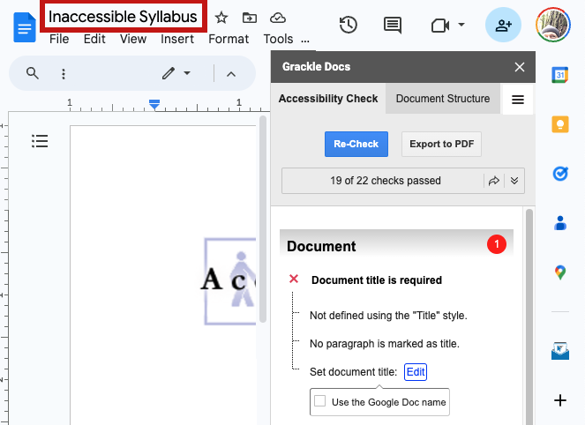
Does Grackle Docs help?
Grackle Docs (grackledocs.com) enhances Google Workspace with:
An accessibility checker
Ability to export to tagged PDF

Slide 92
Conclusions

Slide 93
Things to Know about the UI
Google Docs requires memorizing long, complex keyboard shortcuts. Some users find this overwhelming.
In Google Slides Presenter View, everything is a graphic.
Microsoft Word for the Web has many choices
From Office on the web, users can ”Download to the Desktop App”
The PowerPoint iPhone app is excellent for reading slides

Slide 94
Documents & Slides
Google does not support tagged PDF.
If content will ultimately be saved to PDF, use Microsoft.
Grackle fixes this Google limitation, but the UW does not have a license.
Google does not include an accessibility checker.
This is a major limitation. Use Microsoft instead.
Grackle fixes this too, but how helpful is its help?

Slide 95
Slides
Google does not support alt text on grouped content.
For most slides, this is a major limitation. Grackle does not fix it. Use PowerPoint instead.
PowerPoint does not support tagged PDF on a Mac (if a PDF is needed, use Windows or Web versions of PowerPoint to export).

Slide 96
Authoring in Google, Saving as Microsoft
If you author in Google and download to Microsoft:
Run the Accessibility Checker!
You may need to remediate:
Table headers
Language
Footnotes or endnotes
Alt text on grouped images
In PowerPoint: Ensure proper read order (made difficult because all objects are unintuitively named as Google Shapes)

Slide 97
Converting to PDF
Google does not support tagged PDF.
Grackle fixes this, if you have a license.
PowerPoint for Mac does not support tagged PDF.
“Save as PDF” and “Export to PDF” both work.
“Export to PDF” includes options.
In Options, be sure “Document structure tags for accessibility” is checked.
If you chose “Minimize size”, that will uncheck the above checkbox. Be sure to check it back on.
Avoid Adobe PDF Maker as of September 2023.
Major bug with misplacement of <Figure> tags

Slide 98
Resources
Accessible documents: uw.edu/accesstech/documents
Accessible PowerPoint presentations: uw.edu/accesstech/documents/powerpoint
The 2-hour version of this presentation: https://uw.edu/accesstech/webinars/liaisons20231024

