Slide 1
Accessibility of Digital Information and Technology for People with Intellectual and Developmental Disabilities (IDD)

Slide 2
Presenters and Authors
Presenters
Authors
^{Carolyn Elias}
Program Evaluation Coordinator at Surrey Place
Barry Isaacs
Lisa Cohen
Peter Coppin
Judy Verseghy
^{Sandra Law, PhD}
Athabasca University/OCAD University

Slide 3
Acknowledgements
The researchers are grateful for the generous support of Accessibility Standards Canada who funded this work through an Advancing Accessibility Standards Research Grant.

Slide 4
Recommendations
Current WCAG guidelines need to specifically consider the needs of people with IDD
Promote and support research using UX and Co-design approaches to address gaps in accessibility solutions when it comes to barriers people with IDD face in accessing ICT and digital information
Development of guidelines on development and updating of hardware and software technology
Notes:
We developed a decision tree and recommendations to address the barriers that people with intellectual and developmental disabilities experience when using ICT
Today we will explain how we developed this decision tree and recommendations.

Slide 5
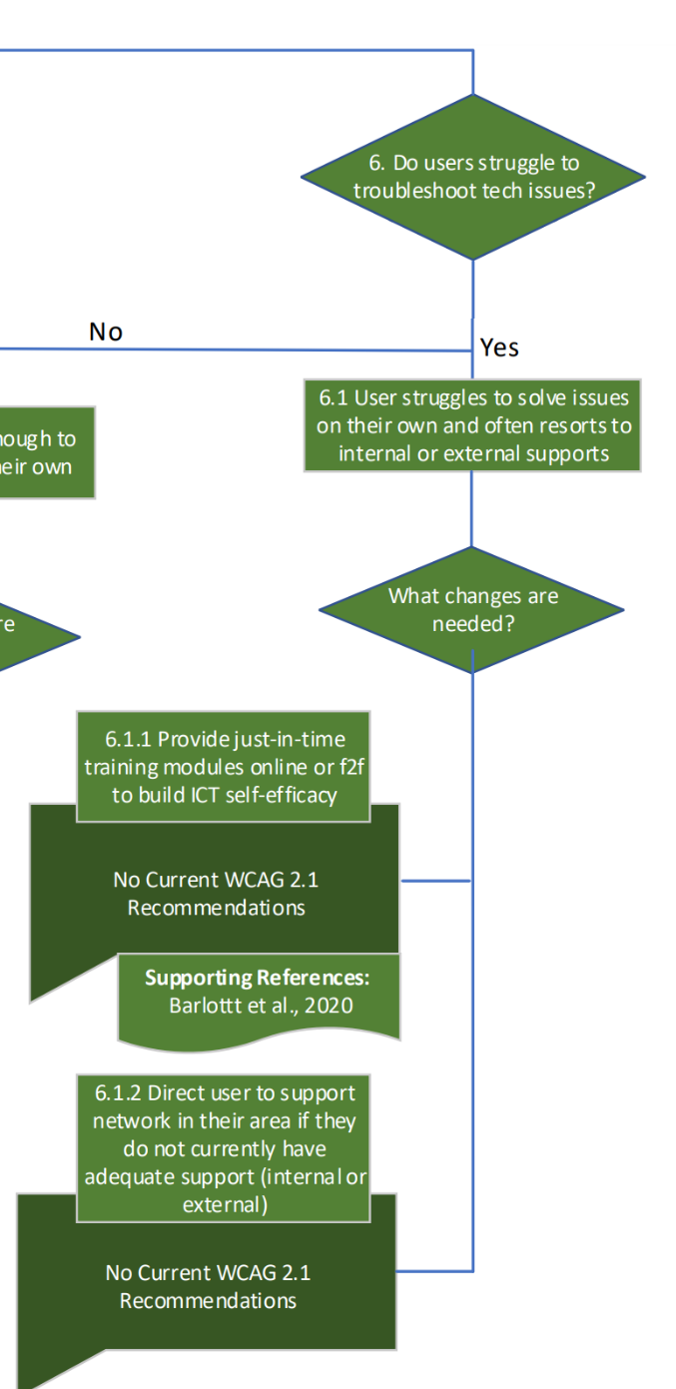
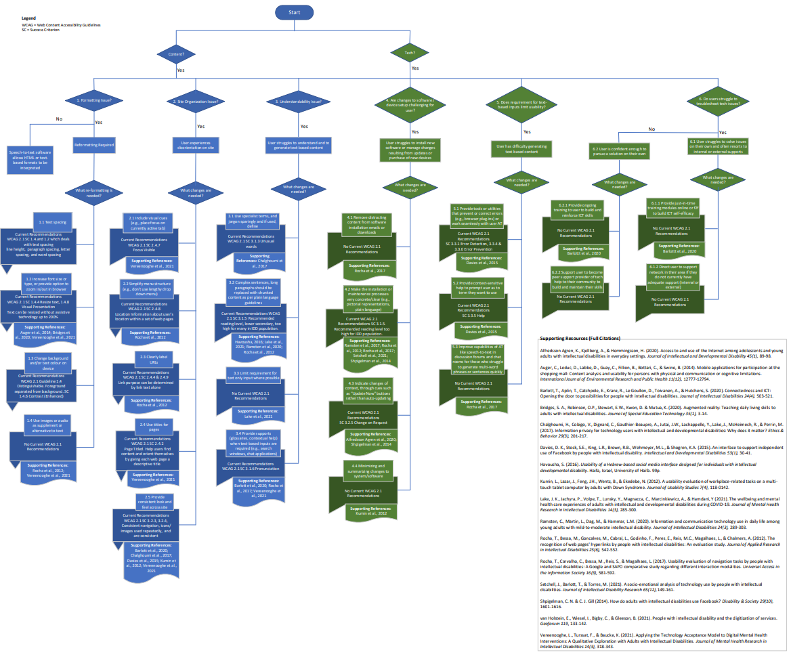
Decision Tree

Slide 6
Project Purpose
While the 2019 Accessible Canada Act lays out steps to remove barriers to access for Canadians living with disabilities, little consideration has been given to the specific usability needs of people with intellectual and developmental disabilities (IDD).
This gap remains unaddressed and results in inequities for people with IDD.
Current standards and guideline for information and communication technology (ICT) are inadequate to guide developers of IT.
Usability barriers prevent access and participating freely in the “digital world”.
Notes:
While the 2019 Accessible Canada Act lays out steps to remove barriers to access for Canadians living with disabilities, little consideration has been given to the specific usability needs of people with intellectual and developmental disabilities (IDD).
In the case of digital information and information technology, this gap remains unaddressed and results in a variety of inequities for people with IDD, furthering the exclusion of a portion of the disability population.
While there are examples of information and communication technology (ICT) that attempt to address accessibility needs for people with IDD, current standards and guideline are inadequate to guide developers of information technology and information that is shared through such technology.
As a result, usability barriers prevent this population from accessing and participating freely in what is increasingly becoming the “digital world”.
Studying usability as a barrier for this population is a key piece of the narrative that has been missing from accessibility discussions.

Slide 7
Project Objectives
1
Scoping review to examine the current research.
2
Consultations with advisors with IDD and supporters to explore their experiences with ICT and the barriers identified in the review.
3
Develop recommendations and decision tree to guide research and development in overcoming the barriers that people with IDD experience.
Notes:
In an effort to inform accessibility standards in IT the objectives of this project are to:
1. Conduct a scoping review to examine accessibility to IT for individuals with intellectual and developmental disabilities (IDD).
2. Consult with people with IDD to discuss their experiences and gain their perspectives on accessibility to IT and the aides available to the to overcome barriers
3. Develop a decision tree to guide research and development in overcoming the barriers that people with IDD experience

Slide 8
What is an Intellectual & Developmental Disability (IDD)?
ID can be characterized by differences in both cognitive functioning (i.e., IQ below 70) and adaptative behaviour.​
IDD is used to describe when an intellectual disability and other chronic disabilities are present¹
IDD includes:
Intellectual disability
Autism spectrum disorder (ASD)
Fetal alcohol spectrum disorder (FASD)
Down Syndrome
Fragile X syndrome^{1,2}
¹ Office of Communications, 2021
² Lunsky & Lake, 2019
Notes:
Lunsky, Y. & Lake, J. (2019). Intellectual & developmental disabilities. CAMH. Retrieved from https://www.camh.ca/en/professionals/treating-conditions-and-disorders/intellectual-and-developmental-disabilities
Office of Communication. (2021). About intellectual and developmental disabilities (IDDs). NIH. Retrieved from https://www.nichd.nih.gov/health/topics/idds/conditioninfo#f2

Slide 9
First Objective
^{Scoping Review}

Slide 10
Scoping Review: Purpose
A review of the current literature.
Three areas of focus for this review:
What kind of technology that people with IDD use.
What are barriers experienced and how they are supported.
Identifying gaps within the literature.

Slide 11
Scoping Review: Inclusion Criteria
Directly referenced the experience of individuals with:
Intellectual Disability (ID)
Developmental Disability (DD)
The combined category of IDD
Directly addressed technological or content-related barriers
Or difficulties comprehending content that users with IDD encountered.
Work was published between 2007 and 2022

Slide 12
Scoping Review: Results Overview
24 Studies Included
7 Barriers Identified
Published after 2007
Focused primarily on people with IDD
Technological, interaction and content-based barrier
Methodology Included:
Usability Study
Co-design
Qualitative
Quantitative
Mixed Methods
Reliance on text-based content
Complex security features
Complexity of information
Unfamiliar technology (hardware/software)
Need for manual dexterity to operate hardware
Lack of training and technical supports
Task complexity

Slide 13
Scoping Review: Barriers 1 and 2
Barrier 1: Reliance on Text-Based Content
Many individuals with ID struggle with reading and writing.
Reliance on text-based leads to inability to fully access online content or interact with interfaces
Barrier 2: Complex Security Features
Retain/recall information outside of the individual’s home
Captcha technology

Slide 14
Scoping Review: Barriers 3 and 4
Barrier 3: Complexity of Information
Complexity of content displayed on websites and other platforms.
E.g., social media, educational, banking websites or applications.
Term complexity often referred to text-based content content
Barrier 4: Unfamiliar Hardware/Software
This problem is enhanced when:
Having to familiarize themselves with new technologies
Recently updated software that may have changed substantively

Slide 15
Scoping Review: Barrier 5
Barrier 5: Need for Manual Dexterity to Operate Hardware
Difficulties with augmented reality application.
Difficulty holding up a tablet on for video playback.
Mobile applications for real-world shopping aids.
iPad’s touch features.
A preference for virtual keyboards or other input options over devices.

Slide 16
Scoping Review: Barriers 6 and 7
Barrier 6: Lack of Training & Technical Supports
Inadequate support during pandemic (online learning).
Informal support provided by family.
Barrier 7: Task Complexity
Struggle to locate the controls on a device.
Controls that had more than one function.
Tasks that required too many steps leads to accessibility issues.

Slide 17
Second Objective
^{Consultations}

Slide 18
Consultations: Recruitment
Ethical approval from the Research Ethics Board at Surrey Place.
Recruited from three organizations in Toronto Ontario:
Surrey Place
The Centre for Addiction and Mental Health (CAMH)
Community Living Toronto (CLT)
One national organization:
Inclusion Canada

Slide 19
Consultations: Participants
12 - 64
AGE RANGE OF
ADVISORS WITH IDD
1
1
Notes:
A total of eight (8) people acted as advisors to this project. Six of the advisors have IDD and two (2) do not.
Five of the advisors with IDD were from Ontario and one was from Newfoundland.
The advisors with IDD ages ranged from 12-64 years.
All advisors with IDD functioned in the mild range of disability.
Both advisors without IDD lived in Ontario.
One was the father of an advisor with IDD and the other the husband of another advisor with IDD.
In other words, two of the advisors with IDD have support people participating in the project along with them and those support people are also acting as project advisors. All project advisors were provided an honorarium for their work on this project.

Slide 20
Consultations: Study Design
3 sets of meetings from December 2022 to April of 2023:
Individually
Advisors with IDD and their support person together
Focus group format and independent interviews.
Semi-structured interviews and ICT related tasks.
Honorarium provided for advisor's participation.
Notes:
To date we have had 3 sets of meetings with each advisor with and without IDD.
On most occasions we met with advisors with IDD who did not have a support person involved in the project individually.
If an advisor with IDD had a supporter (advisory without IDD) taking part in the project, we usually met with them both together.
On one occasion we used a focus group format to meet with advisors with some project advisors.
Meetings consisted of semi-structured interviews and ICT related tasks

Slide 21
Consultations: Meeting Structure
Meeting 1:
Nature of ICT Use and barriers
Meeting 2:
Detailed exploration of barriers
Meeting 3:
Website navigation
Testing existing accessibility features
Discussion of solutions

Slide 22
Consultations: Data Analysis
All meetings were recorded, with the consent of advisors, and then transcribed.
The transcripts were inputted onto Dedoose© where data was analyzed using thematic analysis.
The analysis began with broader codes (referred to as parent codes) then became more specific (referred to as child codes).
Notes:
All meetings were recorded, with the consent of advisors, and then transcribed.
The transcripts were inputted onto Dedoose© where data was analyzed using thematic analysis.
The analysis began with broader codes (referred to as parent codes) then became more specific (referred to as child codes).
Microsoft Excel and Word were used to organize the codes and excerpts, in which the excerpts substantiate the codes.

Slide 23
Consultations: First Phase Results
The first phase focused on:
How advisors used ICT and the barriers they have encountered.
The most common devices owned:
Tablet
Phone
Laptop
Notes:
The first round of interviews focused on how advisors used ICT and the barriers they have encountered.
The most common devices owned and used by advisors were smartphones, laptops, and tablets.

Slide 24
Consultations: First Phase Results 1
Advisors with IDD activities included:
Banking
Communication
Education
Work
Information Seeking
Ordering Prepared Food
Shopping
Navigating Online
Virtual Appointments
Several challenges identified with online banking and shopping.
Assistive technology used:
Large keyboards
Screen readers
Voice-controlled devices
Word predicting software

Slide 25
Consultations: First Phase Results 2
Many advisors acknowledged:
The need to engage with others for support
A degree of digital autonomy & aspects of ICT they do well:
Independently logging into or entering passwords
Composing emails or writing letters in Word Doc or Google Docs
Switching from one software to another on a familiar device.
Notes:
Many advisors acknowledged the need to engage with others for support. This support could come from a family member, friends or a professional they rely on for general support such as a developmental support worker or teacher.
Despite these challenges, most advisors described some degree of digital autonomy and there are aspects of using ICT that they do well:
Logging into or entering passwords independently to access accounts e.g., E-mail).
Composing emails or writing letters in Word Doc or Google Docs.
Switching from one software to another on a familiar device (e.g., phone call to text to email).

Slide 26
Consultations: Second Phase Results
The second phase of interviews aimed to:
Further explore challenges and barriers to accessing ICT experienced.
Most prevalent barriers/challenges:
Searching for information
Changes to software/hardware
Being afraid to make a mistake
Too much information, usually in text content
Challenges with multiple tabs and drop down-menus
Updating software, and inability to update due to technical issues

Slide 27
Most Prevalent Barriers 1 & 2:
1. Searching for Information
Difficulty conducting searches using online tools.
Causes:
Difficulty identifying the proper search terms.
Difficulty inputting search terms correctly
2. Changes to Software/Hardware
Changing from the type of hardware or software to another
Useful interfaces were changed.
Transferring information from an old device to a new one was complex.

Slide 28
Most Prevalent Barriers 3 & 4:
3. Being Afraid to Make a Mistake
Lack of comfort or confidence with certain online activities:
Fear of making a mistake.
Security concerns (e.g., fraud).
Causes:
Previous negative experiences.
Concerns about being victimized.
Difficulty understanding certain functions online.
4. Too much Information, Usually in Text Content
Many websites challenging because of reliance on text.
Causes:
Reading level of most people with IDD is at an elementary school level.

Slide 29
Most Prevalent Barriers 5 & 6:
5. Challenges with Multiple Tabs and Drop Down-menus
Layout of different websites (e.g., multiple tabs or drop-down menus)
Difficulties processing complex information, memory and performing complex tasks.
Difficulties reading.
6. Updating Software and Inability to Update
Sudden appearance of a message to update.
Prefer auto updates over the manual updates.
Not able to update their devices because their device or software was out of date, or an error code appeared on their screen.
Causes:
Difficulties processing new information.

Slide 30
Consultations: Third Phase Results
The third phase of interviews we:
Observe some challenges identified by advisors in accessing ICT.
Observed how advisors use accessibility aids.
Asked to provide feedback on experiences with accessibility aids.
Notes:
The third phase of interviews we:
Attempted to observe some of the challenges identified by advisors in accessing ICT and digital information by watching them interact with specific websites, such as Surrey Place’s website and job searching websites, and perform an internet search.
Observed how advisors use accessibility aids, to understand information, navigate websites and perform searches.
We also asked advisors to give us feedback on the experiences with accessibility aids.

Slide 31
Consultations: Third Phase Results 1
Observation on website interactions:
Surrey Place website:
Found the homepage helpful.
Used alternative way to find information.
Tab headings too abstract.
Job search websites. Difficulties with:
Understanding certain terminology.
Layout or the search option on the homepage.
Relying on manual entry to search.
Understanding icons provided.
Suggested improvements:
Less text
Pages less dense
Plain language
Definition of certain words

Slide 32
Consultations: Third Phase Results 2
Accessibility Aids used:
Voice recognition software
Challenges: Mispronunciation
Suggestion: Consider how people with IDD speak.
Specialized keyboard
Screen readers
Online writing assistant
Text-to-speech

Slide 33
Consultations: Third Phase Results 3
Beneficial features on Surrey Place:
Dictionary
Contrast
Text resizing
Hide images
Screen reader
Suggested areas of improvement:
Plain language
Accessibility features more available.
Site maps
Web Searching
The majority were able to complete a search successfully.
Voice-controlled device utilized when spelt words incorrectly.

Slide 34
Discussion
Their use of ICT and the benefits they experience are hampered by accessibility issues.
Characteristics of ICT that contributed to accessibility barriers for people with IDD:
The reliance on text-based content.
The need to perform complex functions.
Complex layouts.
Changes in hardware or software.
Need for manual dexterity
Current accessibility tools are not always helpful in overcoming barriers.

Slide 35
Third Objective
Recommendations and Decision Tree

Slide 36
Recommendations Overview
Current WCAG guidelines need to specifically consider the needs of people with IDD
Promote and support research using UX and Co-design approaches to address gaps in accessibility solutions when it comes to barriers people with IDD face in accessing ICT and digital information
Development of guidelines on development and updating of hardware and software technology

Slide 37
Recommendation 1
Assess the current guidelines and success criteria address the needs of people with IDD.
Include people with IDD and those who support them on technical committees.
Consider the way standards can address the issue of intersectionality where people have multiple disabilities.
Create accessible versions of guidelines and standards.
Notes:
Current WCAG guidelines need to specifically consider the needs of people with IDD
Current WCAG guidelines are designed to address barriers faced by people with cognitive disabilities. Cognitive disability, however, is a broad category and the unique and specific needs of people with IDD remain unaddressed in guidelines. Current guidelines do not clearly address the fact that people with IDD often have multiple disabilities, nor are they written in a way that is accessible to people IDD.
Assess the degree to which current guidelines and success criteria address the needs of people with IDD. Give priority to guidelines listed in Appendix A that align with barriers faced by people with IDD.
Include people with IDD and those who support them on technical committees. When doing so ensure they are supported such that their participation is meaningful. Consult with experts in IDD when trying to accommodate people with IDD and promote their meaningful participation.
Consider the way standards can address the issue of intersectionality where people have multiple disabilities.
Create accessible versions of guidelines and standards so people with IDD can be more involved in the process of development and evaluation.

Slide 38
Recommendation 2
WCAG guidelines do not address barriers created by hardware and software.
Develop guidelines on the development of hardware and software updates.
Notes:
Development of guidelines on development and updating of hardware and software technology
WCAG guidelines focus on building accessible web content, but do not address barriers created by hardware and software. Features such as hard to locate or use on/off switches, complex or difficult to use keyboards, major changes in interfaces when hardware or software are updated.
Develop guidelines on the development of hardware, including smartphones, tablets, laptops, desktops, printers and scanners that address barriers to their use by people with IDD.
Develop guides on software updates to address user issues created through major changes in user interface. For example, develop guidelines for entities to incorporate accessible sitemaps and user instruction utilizing simple language, paired visuals and structured task analysis lists to support learning related to ongoing updates and changes.

Slide 39
Recommendation 3
Identify needs and priorities by:
Reviewing the list of solutions and gaps identified with individuals with IDD and supporters.
Funding large scale needs assessments.
Promote and support research that test the effectiveness of existing solutions using UX approaches.
Promote and support development of new solutions using co-design.
Notes:
Promote and support research using UX and Co-design approaches to address gaps in accessibility solutions when it comes to barriers people with IDD face in accessing ICT and digital information
Many solutions exist to help people with IDD overcome the barriers to using ICT and accessing digital information. Many existing solutions, however, are not developed with the specific needs of people with IDD in mind and are difficult for them to use and/or are ineffective. For some barriers no solutions exist. A major contributor to this problem is that research on accessibility to ICT and digital information for people with IDD is lacking both in quantity and quality. In what little research exists, co-design and UX approaches are rarely employed.
Identify needs and priorities by:
Reviewing the list of solutions and gaps identified
Funding large scale needs assessments that include and is guided by people with IDD (including those with multiple disabilities) as equals in the research process.
Promote and support research that test the effectiveness of existing solutions with people with IDD (including those with multiple disabilities) using UX approaches.
Promote and support development of new solutions using Co-design.

Slide 40
Decision Tree Overview
Results of consultation and scoping review used to identify common ICT barriers
WCAG 2.1 guidelines reviewed to determine which ones offered support for people with IDD
Gaps between needs of people with IDD accessing ICTs and existing guidelines were identified
Prototype of decision tree was developed looking at specific challenges around ICT use identified by advisors
Two-part decision tree developed: content-related barriers and technology-related barriers.
Notes:
Gaps included missing guidelines, that is, a need that was not addressed by any guideline or a need that did not fully address the needs of many users of ICTs with IDD. For example, the Reading level success criterion that is listed under the Understandable guideline. The reading level proposed may be too advanced for many individuals with IDD, so the guideline did not fully address the barrier.

Slide 41
Part 1: Content-Related Barriers
Notes:
Three different criteria emerged from a comparison of results of consultations and scoping review and a review of existing web design guidelines (WCAG 2.1). These are: formatting related, site organization, and understandability of content.

Slide 42
Formatting Issues
Text-spacing
Font size or options for adjusting size
User control of background and text colour
Formats in addition to text, e.g., audio, images
Notes:
Four main issues were identified from the analysis of the findings in the consultations, the scoping review and process of determining whether existing guidelines provided remedies to the barriers that were identified. These were: text-spacing, font size or availability of options for adjusting font size, user control of the colour of the background and the text on a page, and whether images and/or audio were used to supplement textual content or there were easy options for converting text to audio (e.g., user had text-speech software, and content was formatted in such a way that no barriers existed (e.g., placing text in tables or frames) to easy conversion of text to audio.

Slide 43
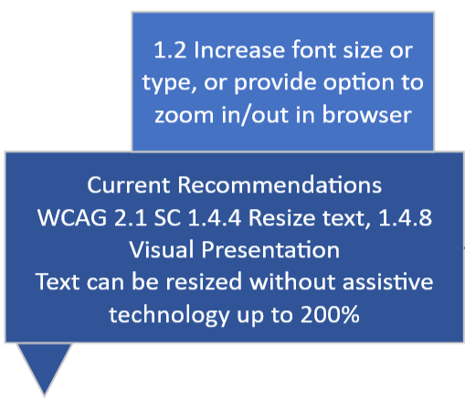
Formatting Issues: Text Spacing & Font Size
1.1 Text Spacing
Too much text, too little white space
Can lead to reduced understandability
1.2 Font Size
Text resizable without assistive technology up to 200%
User able to use consumer software rather than assistive technologies

Slide 44
Formatting Issues: Control Text/BG Colour & Other Formats
1.3 Change Background/Text Color
One advisor indicated adjustments to text and background increased readability:
E.g., white text on black background
1.4 Other Formats
Scoping review and the consultations found users preferred content to be delivered in multiple in addition to (and not to exclusion of) text-based ones.
Notes:
Important of user control over how text is displayed onscreen was a finding of both the scoping review and the consultations. In this case control over the contrast between foreground (text) and background.
One advisor indicated that she sometimes used different background and text colours to increase readability (e.g., white text on black background)

Slide 45
Site Organization Issues
Visual Cues
Menu Structure
Clearly Labeled URLs
Title Pages
Consistent Look and Feel Across Site

Slide 46
Site Organization Issues: Visual Cues & Menu Structure
2.1 Include Visual Cues
Orient users on page or in application
Users struggled to return to main page or navigate to other forms in application
2.2 Menu Structure
Multiple users experienced disorientation on websites
Notes:
Help orient users on page or in application
Active tab or text field receives focus (e.g., flashing cursor, other emphasis)
One example, income tax completion software, with multiple tabs/pages.
User can struggle to return to main page or navigate to other forms in application.
WCAG 2.1 SC 2.4.7 deals specifically with focus.

Slide 47
Site Organization Issues: Clear Links & Title Pages
2.3 Clearly label URLs
Addresses some barriers, but still relies on text-based information
Issues with multi-page or tab websites or applications
2.4 Page titles
Another technique that helps users orient themselves on a website
Relies on textual information but plain language guidelines can improve understandability
Notes:
SC 2.4.4 suggests using a textual link to indicate the purpose of the link, however this approach still relies on text. Using other guidelines, such as, plain language guidelines when creating textual links would be good practice. Should help users avoid content they are not interested in, and the associated navigation.
WCAG 2.1 SC 2.4.4 suggests that the purpose of the link be clearly indicated by the text.
This addresses some barriers, but still relies on text-based information.
WCAG 2.1 SC 2.4.9 addresses issues around navigating a multi-page websites or applications.
Concerns user disorientation on site (e.g., income tax software).
Examples: icon and text in same link.

Slide 48
Site Organization Issues: Consistency
2.5 Provide consistent look and feel across site
Many advisors expressed their preference for familiar websites and navigation schemes.
WCAG 2.1 SC 3.2.3 recommends consistent navigation and layout on a site.
Preference in IDD user population is consistency across applications/sites.
WCAG 2.1 SC 3.2.4 recommends consistency in functionality across an application, e.g., navigation
Notes:
WCAG 2.1 SC 3.2.3 points out the importance of providing clarity in how to navigate a website, online application. Which is another technique that a designer can use to help someone with IDD orient him or herself on a website or within an application. The preference, as expressed in consultations, by almost all advisors, was for familiarity, across all the services and applications they accessed. Not just within an application. They often self-curated and would only access sites with which they had become familiar. Out of necessity they might have to navigate to unfamiliar sites, such as the web-based income tax software.

Slide 49
Understandability Issue
Specialist Terms
Complex Sentences
Allow Additional Input Types
Provide Pronunciation Supports

Slide 50
Understandability Issue: Jargon & Complex Sentences
3.1 Limit Use of Jargon
Multiple users had difficulty understanding technical jargon
Wanted help to understand terms and pronounce words
3.2 Complex Sentence
The reading level recommended by WCAG 2.1 is lower secondary
Too advanced for many people with IDD
Chunk long sentences and paragraphs as per plain language guidelines
Notes:
The definitions could be provided at the bottom of a webpage, or the term on a webpage could be linked to term’s entry in an online glossary, Or a link could be made to an online dictionary. Or an inline definition of the word could be provided on its first use on a site. If users prefer audio then providing a voice-enabled dictionary search could help them find the word they need additional information on.

Slide 51
Understandability Issue: Input Types & Pronunciation Support
3.3 Reduce Text Inputs
Many sites are text-heavy
Provide additional formats like audio, images, or video
3.4 Provide Supports
Advisors indicated they used virtual assistants/other applications to help in searches and with pronunciation
Addresses limitations of text-to-speech software around pronunciation, when knowing correct pronunciation helps with meaning
Provide sound files with correct pronunciation or include those files in online glossary
Notes:
Other guidelines such as those provided by CAST and its Universal Design for Learning principles provide some help to designers and others as to the approaches they should take to improve the understandability of content on websites, social media, and other applications (e.g. gaming, government services, healthcare services). Again, the idea is to provide format in other ways, as a supplement to text-based content, not instead of text-based content.

Slide 52
Part 2: Technology-Related Barriers
Notes:
Software Updates
Heavy Reliance on Text Inputs
Troubleshooting Challenges

Slide 53
Software Updates & Device Setup Challenges
Distracting Content
Clarity of Language
Notifications
Provide Summary of Changes

Slide 54
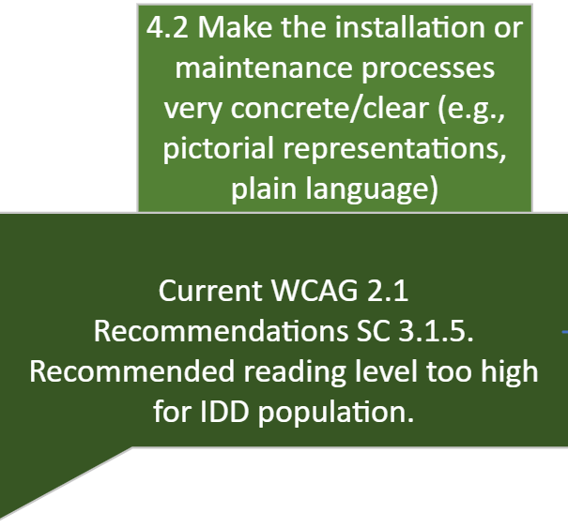
Software Updates: Distracting Content & Clarity of Language
4.1 Remove Distracting Content
Installing new software or updating existing can be barrier to use
Barrier relates to visual clutter on site or in email that distracts from task
4.2 Clarity of Language
Reading level recommended by WCAG 2.1 may be too high
Use of plain language guidelines recommended
Provide additional formats
E.g., images, audio
Notes:
More information is not necessarily better for this population. Especially when the information provided is not directly relevant to the task that the user needs to complete. Such as downloading and installing software. There was preference on the part of most of the advisors for having systems auto-update software as long as notification of a change was given. Although some struggled with new versions of software if there were too many changes to functionality and how information was laid out on a website or in an application.

Slide 55
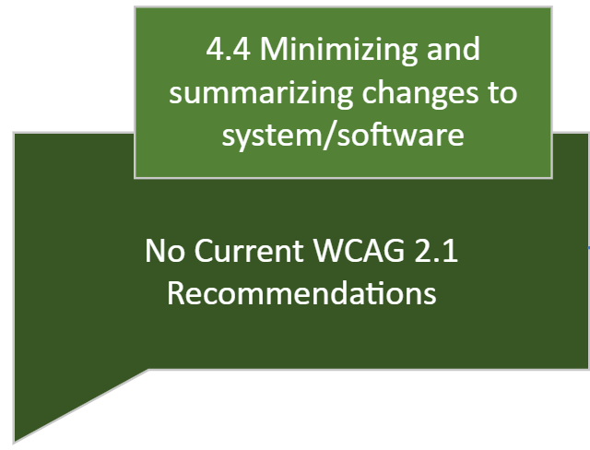
Software Updates: Notifications & Summaries
4.3 Indicate Change to Software
Provide notifications of updates
Most advisors preferred auto-updates with notification
4.4 Minimizing/Summarizing Changes to OS and Software
Summarizing changes to system by:
Listing changes
Providing notifications when updates occur
Advisors indicated they delayed updates or waited until new versions are fully tested.

Slide 56
Text Based Input Challenges
Provide Support to Prevent and Correct Errors
Provide Context-Sensitive Help
Provide Help in Generating Multi-Word Phrases

Slide 57
Text Inputs: Error Prevention Support & Context-Sensitive Help
5.1 Provide Tools or Utilities for Errors
Many sites and functions on Internet require text-based inputs
Notify users of potential errors and provide multiple opportunities for error correction, including final review (e.g., sensitive info)
5.2 Context-Sensitive Help
Helps users to avoid mistakes and maintain focus on immediate task
Notes:
Many sites and functions on Internet require text-based inputs.
WCAG 2.1 SC 3.3.1, 3.3.4, 3.3.6 deal with error detection and prevention.
Providing user with notification of potential errors and multiple opportunities for error correction can build confidence in completing online tasks.
Provide opportunity to review final submission of sensitive information (e.g., tax, legal, banking).

Slide 58
Text Inputs: Multi-Word Phrases
5.3 Improve Capabilities of AT
Integrate speech-to-text applications in text-based discussion forums and chat rooms.
Alternatively provide integrations with AI like ChatGPT that simplify process of generating such phrases, allowing user to review them before submitting.
Notes:
There are many ways to approach the issue of platforms that currently only allow text-based inputs or have a bias towards text-based inputs. Allowing users to use speech-to-text (and increasing the accuracy in the translation through improved Natural Language models that are better able to cope with users who struggle with pronunciation, have a speech impediment, or rapid speech pattern) or even ChatGPT (which can generate phrases for the user) are two such options for improving the IDD users ability to interact with others online especially in synchronous communications where there is some expectation of rapid, and immediate response.

Slide 59
Troubleshooting: Different Approaches
Independent Users:
Skill Improvement & Role in Peer Support
Less Independent Users:
Training

Slide 60
Troubleshooting: Less Independence
6.1.1 Online Training and 6.1.2 Direct User to Support
Less independent users may seek help from support persons when first encountering a problem.
Provide support options for users if they don’t currently have adequate support
E.g., no family, no external service
Training is often overlooked for people with IDD and could increase ICT self-efficacy.

Slide 61
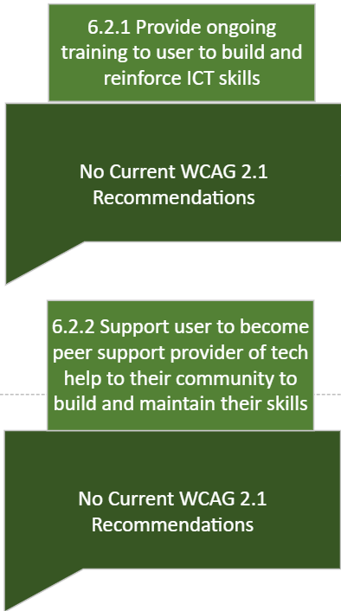
Troubleshooting: Independent Users
6.2.1 Training and 6.2.2 Peer Support Provider
Some users more technically savvy than others
E.g., looking for error codes on software websites.
Lack of training for ICT.
No explicit guidelines exist in WCAG 2.1 guidelines training for any population.
Users who are more independent need support in developing skills and can support peers as well.

Slide 62
Decision Tree: Next Steps
Test decision tree efficacy through use cases
Revise tree as needed
Provide more detailed breakdown of the recommendations in each node of the tree by conducting co-design activities with people with IDD

Slide 63
Summary
The needs of individuals with IDD are often overlooked by designers of ICTs
These needs are unique and complex and are not adequately addressed by current WCAG guidelines
Many daily functions moved online during the pandemic revealing the barriers that many with IDD face
To enable people with IDD to operate with greater independence it is important to consider their needs in the design of all content and ICTs

Slide 64
Questions?

Slide 65
References
Lunsky, Y. & Lake, J. (2019). Intellectual & developmental disabilities. CAMH. Retrieved
from https://www.camh.ca/en/professionals/treating-conditions-and
disorders/intellectual-and-developmental-disabilities
Office of Communication. (2021). About intellectual and developmental disabilities
(IDDs). NIH. Retrieved from https://www.nichd.nih.gov/health/topics/idds/conditioninfo#f2

Slide 66
Thank You!
@SurreyPlaceON

