Slide 1
Web Accessibility for Speech Recognition Users – A Pragmatic Approach
Accessing Higher Ground November 2023
By:
Shashank Kapur IAAP CPACC
Director – Strategy & Growth

Slide 2
About BarrierBreak
EXPERIENCE
GLOBAL CUSTOMERS
19+ Years of leading the conversation on accessibility in the offshore markets
Servicing Technology, Edtech, Fintech, Retail & government customers in 20+ countries
280+ TEAM
INCLUSIVE
Experienced team passionate about accessibility
People First Approach - Having people with disabilities part of the process & solution
LOCATION
AT LAB
Based out of Mumbai and structured to deliver on the remote working model
State of the Art Assistive Technology Lab

Slide 3
Session Objectives
Speech Recognition Overview
Learn how users access web content
Interaction patterns
Expected behavior
Identify access challenges
Learn techniques for accessible implementation
Practices to avoid & follow

Slide 4
Speech Recognition Overview
Software that helps to control the device with voice
Available for:
Computer, tablet, mobile phone, television …
Users can dictate text as well as give voice commands
Mouse and keyboard navigation is also supported but a user can navigate using voice only
Train the software to recognize your voice and get started, its as simple as that!
Helps people with:
Mobility disabilities – CP, quadriplegic, RSI, limited hand movements …
Temporary disabilities – injured arm, fingers
Situational disabilities – mother is busy holding her baby
Multi-tasking! – cooking, too tired after a long day so opted to give voice commands

Slide 5
Speech Recognition Overview – Continued
Speech input is widely used today to:
Perform tasks via by Smart assistants
Perform voice search
Dictate text
Send voice messages
Voice recognition is available for different operating systems:
In-built & third-party software/apps

Slide 6
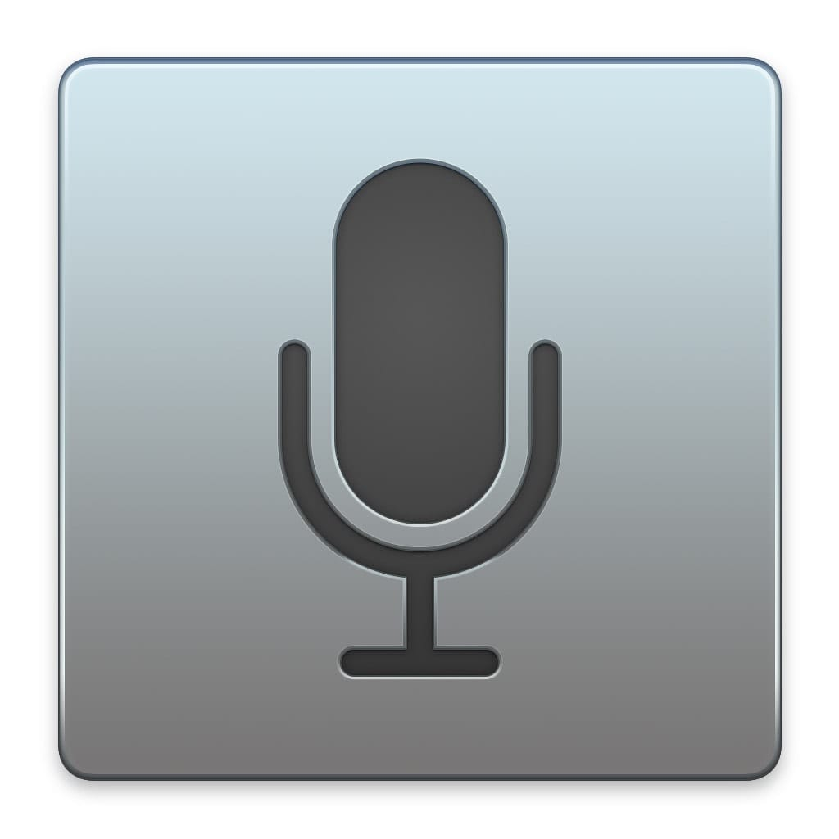
Speech Recognition – What are the options?
Speech Recognition | Operating System | In-built/Third-party
Dragon Naturally Speaking | Windows | Third-party
Speech Recognition | Windows | In-built
Voice Control | Mac OS | In-built
Voice Control | iOS | In-built
Voice Access | Android | In-built
Notes:
Dragon Anywhere—professional-grade mobile dictation app Dragon Anywhere professional‑grade mobile dictation makes it easy to create documents of any length and edit, format and share them directly from your mobile device—whether visiting clients, a job site or your local coffee shop.
Voice navigate through fields of a report template, and apply common formatting like underline and bold.

Slide 7
Smart Assistants – What are the options?
Alexa
Siri
Google Assistant
Cortana
Too many of them!
Smart Assistants help to perform different tasks:
Make phone calls
Set up reminders
Book a cab
Control other devices
Answer questions
Play music
Tell stories & jokes …
But I can’t fill up online forms or activate links on a web page with these smart assistants
So, let’s focus on Speech Recognition!

Slide 8
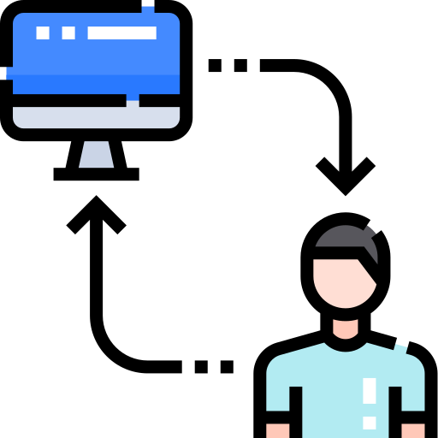
Interaction Patterns
What is the method used for interaction?
Dictation commands
Voice command: “Click Submit”, “Click First Name”
Users say “Show Numbers”:
Number gets assigned to each interactive element
Users can then say, “Click 5” or just “5”!
Show Labels or Names:
Helps to interact with images or icons
Also, helpful when visual label is missing, i.e., Search input field
Mouse Grids are used for controls that lack keyboard support:
Require users to say a series of commands in order to activate a control
Often takes longer to complete an action
Not a preferred method of interaction
Notes:
Dictation Commands – Like!
New Line | New Paragraph. Undo That | Redo That.
Select Previous | Next. ...
Select | Unselect <text> ...
Correct <text> through <text> ...
Cap <text> (to start the next word you dictate with a capital letter) ...
Spacebar. ...
Press Backspace, Backspace 2. ...
Microphone off | Stop Listening.

Slide 9
Interaction Patterns – Continued
Users can carry out keyboard commands, control the mouse & carry out gestures too!
Press Tab, Shift Tab, Press Tab 5 times
Click , Double-click, Right-click
Scroll Up, Down, Left or Right
Move Up, Down, Left or Right in case of sliders
Tap, Long press, swipe Left, Right, Up or Down …
Notes:
Press Tab, Shift Tab, Press Tab 5 times … Navigating a page
Click , Double-click, Right-click … Interacting with an element
Scroll Up, Down, Left or Right …. Mouse Scroll
Move Up, Down, Left or Right in case of sliders ….
Tap, Long press, swipe Left, Right, Up or Down … Gestures

Slide 10
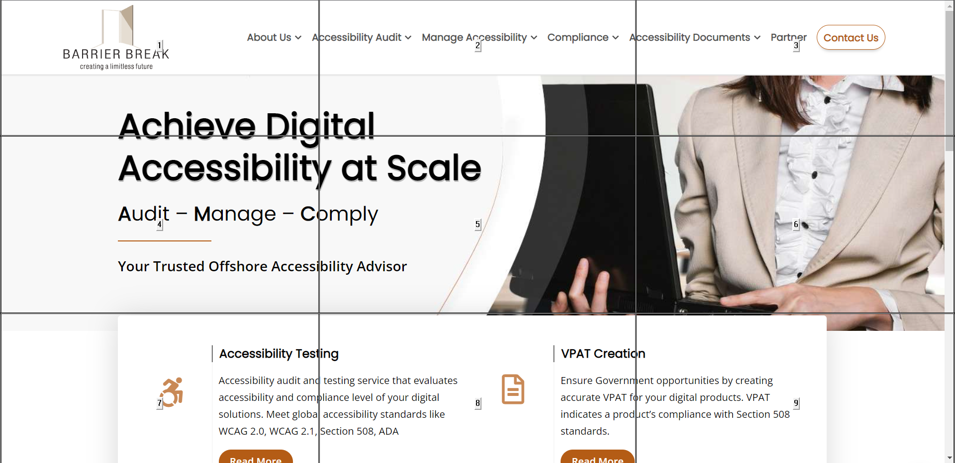
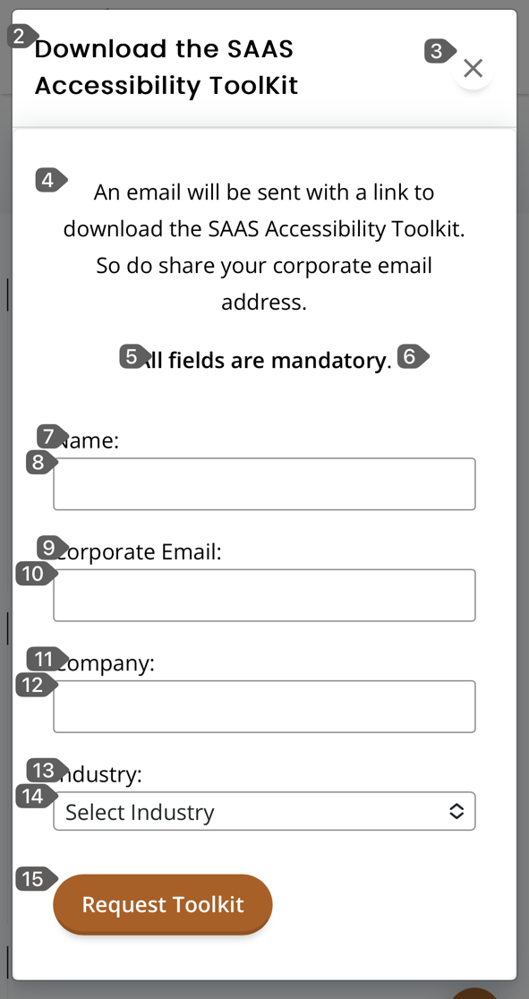
Expected Behavior
Voice command:
Action is performed as expected – “Click About Us” Opens the About Us page.
Unexpected control does not get activated – “Click Submit” does not activate the Search button.
Dictation Command:
Users are able to dictate text in form fields, such as input fields, text area and so on.
In case of custom input fields dictation commands might not work as expected
Show Numbers:
Saying the number should activate the respective user interface control
If the control does not get activated, users have to rely on mouse grid commands
Show labels:
Saying the label should activate the respective control
If the control does not get activated, users have to rely on mouse grid commands
Mouse Grid:
Generally, users make use of this method as a last resort
Users will use the command click or tap on a grid interaction and it should activate the respective control

Slide 11
Accessibility Challenges
Lack of keyboard focus indicator makes it difficult to identify which control currently has focus
Users generally say Tab while filling up forms
If focus is not visible, they loose track of their position on the page
Textual description for image links and buttons don’t match with the visual text on the image
User will give command to click “Subscribe”
Action is not carried out as the alternate text is specified as “Submit”
Links with identical text:
Click here, Learn more, Read more … are quite common on the web
Users say, “Click Learn More” and a number is assigned to all the links with the matching text
Users need to give additional command, “Click 4” to carry out the action!
Not a critical issue but needs additional step on the part of users
Lack of textual descriptions for image based controls:
Users can’t give voice commands to directly activate the control
Show labels might not work as intended
Requires users to rely on generic commands, such as “Show Numbers” or “Click” and perform additional step to activate the control

Slide 12
Accessibility Challenges – Continued
Content available only on mouse hover, drop-down menus, tooltips
Users need to make use of mouse grid or grid overlay to access the content
Time consuming method of interaction
Users find it difficult to access as they have to precisely move the pointer on the area that will trigger additional content
Clickable area is too small
Makes it difficult to click on the tiny drop-down arrow if label is not clickable as well
Custom radio buttons and checkboxes require users to click on tiny controls
Accessible name for user interface controls doesn’t match with their visual labels
Accessible name for a link is “Click here to learn about Our Services”
Visual label for the link is “Learn More”
Link can’t be activated with the voice command
Other challenges:
Control looks like a button but is coded as a link
Lack of keyboard support for drag and drop functionality
Custom controls lack semantics
Focus is not managed correctly - modal dialogs
Content is not visible – sticky headers
Controls are not identified consistently – Search/Find or Save and Close/ Save Changes

Slide 13
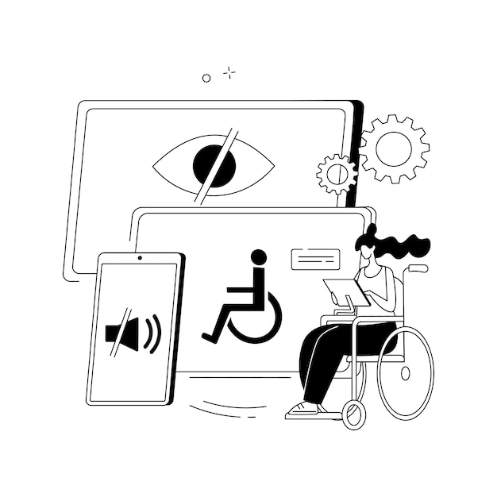
Techniques for Accessible Implementation
Use unique & descriptive text labels for all user interface controls
Make sure focus is clearly visible for all controls
Use native HTML controls to ensure controls are identified correctly
Include visible label at the start of accessible name of controls
Specify label for form controls
Explicitly associate labels for each form control

Slide 14
Techniques for Accessible Implementation – Continued
Include text labels for images & icons
Redundant textual links for product images actually helps!
Combine both image and text in a single link
Specify alternate text for image links and buttons
Use alt or title attribute if text can’t be added for images
Use value, alt or title attribute in case of textual and image buttons
Make sure all the functionality is keyboard operable
Make sure drag and drop functionality can be accessed through alternative ways
Make sure content available on hover is also focusable
Consistently identify controls across the set of web pages

Slide 15
Few Best practices
Use unique and descriptive label for user interface controls:
Avoid unpronounceable labels for user interface controls:
Acronyms, Abbreviations – makes it hard to give voice commands
Avoid spacing between words of user interface controls
Makes it difficult to recognize as a phrase
Define textual description for icons that users can easily guess:
Search –
Add to cart –
Add to wish list –
Avoid using multiple frames in a web page as scrolling becomes difficult

Slide 16
To sum things up …
Code for keyboard operability
Add descriptive labels for controls
Use native HTML elements
Add semantics for custom controls, role, name, state …
Accessible names should include visual labels at the start
Add clearly visible focus indicator for controls
What to Test?
Test key tasks of a website or application
Test different components
Test forms and navigation
Test for ARIA implementation
Test different templates

Slide 17
Thank you!
Give us a shout at:
LinkedIn
Shashank Kapur – https://www.linkedin.com/in/shashank-kapur-cpacc/
Shoot me an email at: shashank@barrierbreak.com

