Slide 1
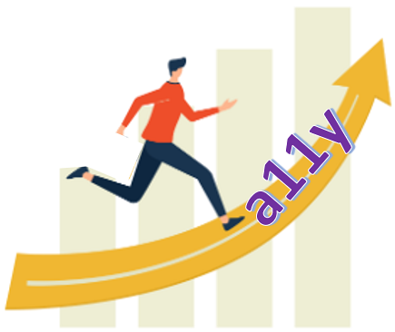
Replacing an Accessible Website: Ensuring a Better New Site

Slide 2
Presenters
Kate Tipton
Program Manager
15+ years user experience developer, then software development manager
6 years full-time accessible technology
Alen Davoudian
Sr. Information Systems Analyst
8+ years web, application and database management systems
12 years of full-time web accessibility

Slide 3
Disclaimer and Status
Most of the CSU Northridge web presence is still hosted on the previous web platform.
The home page and a small number of pages have been migrated.
More content will migrate in phases this year.
The new CSU Northridge web platform is not guaranteed to be 100% compliant (WCAG 2.0 AA).
Neither is the old platform.
We are working an active issues list.
We have procedures in place to test new content as it is migrated.
Notes:
Kate

Slide 4
Starting Over
CSU Northridge put years of effort into the accessibility of our previous web platform.
In 2020, we started over with a completely new web platform:
New templates
New design features
Drupal 9
Notes:
Alen

Slide 5
The Team
University Relations & Advancement (URA)
Marketing and communications, branding
Information Technology (IT)
Web development and platform management
Plus
2 vendors
University technology governance
Universal Design Center
Accessible Technology Initiative (ATI)
4 staff, 2 student employees
Notes:
Kate

Slide 6
University Commitment
"It is the policy of the CSU to make information technology resources and services accessible to all CSU students, faculty, staff and the general public regardless of disability.”
- ati.calstate.edu
"On a video call - Dana Chan for Disabled And Here" by Dana Chan for Disabled And Here is licensed under CC BY 4.0.
Notes:
Kate
Interviewing potential vendors – accessibility compliance and experience

Slide 7
Executive Sponsorship
CIO and VP, Information Technology
ATI Executive Sponsor
URA leadership in transition
"Let's connect 37" by DSaroyan (WMF) is licensed under CC BY-SA 4.0.
Notes:
Kate

Slide 8
Follow Through
“Nevertheless, she persisted.”
– Sen. McConnell
We asked for:
Meeting invitations
Committee/working group assignments
Agenda items
Previews of designs
Early access to the platform
And we kept asking
Notes:
Kate

Slide 9
Testing
Testing the new website, from designs to pre-production pages.
Testing steps, reports and remediation
Provided feedback on early designs
Tested prototypes
Tested pre-production pages
Suggested potential fixes
Re-tested remediated modules and pages
Notes:
Alen

Slide 10
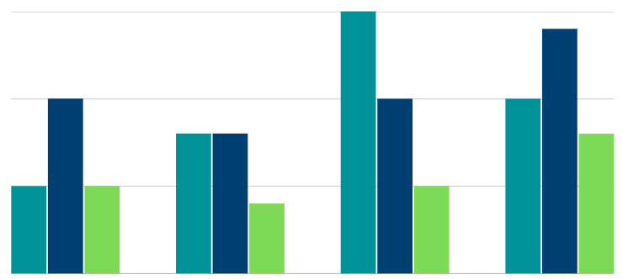
Reports and Remediation
Page/module
Issue description
Recommendation
Screenshots and code snippets
Impact
WCAG referenced criteria
Resolution
Notes:
Alen

Slide 11
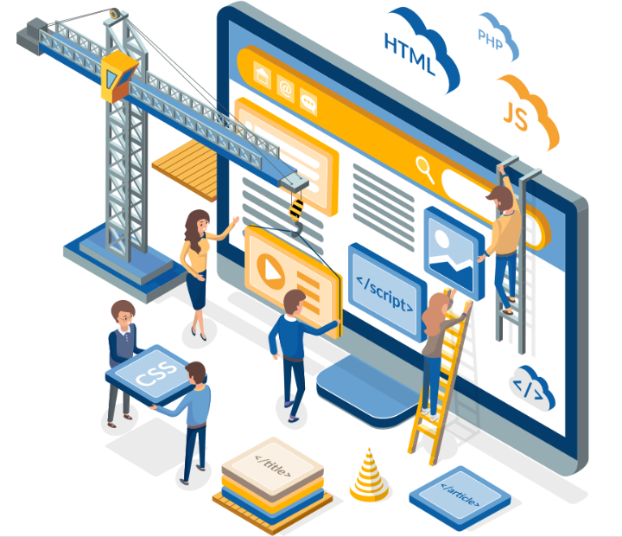
Interactive Modules
Areas requiring attention and heavy testing.
Mega menus
Tab structures
Side panels
Carousels and moving content
Data tables
Notes:
Alen

Slide 12
Mega Menus
Notes:
Alen

Slide 13
Tab Structure
Notes:
Alen

Slide 14
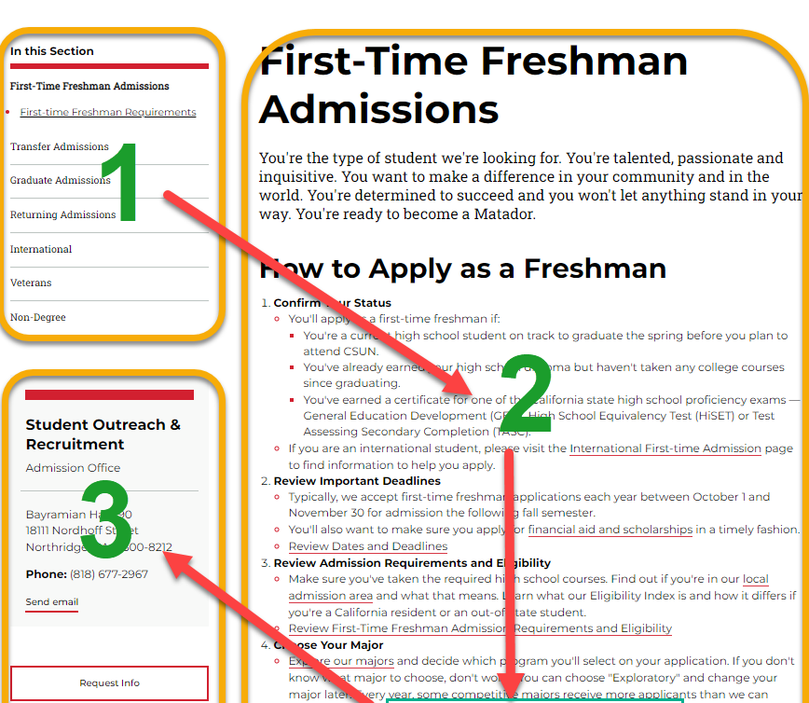
Side Panel
Notes:
Alen

Slide 15
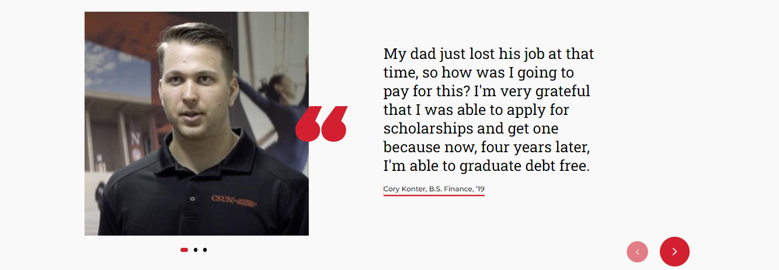
Carousels and Moving Content
Notes:
Alen

Slide 16
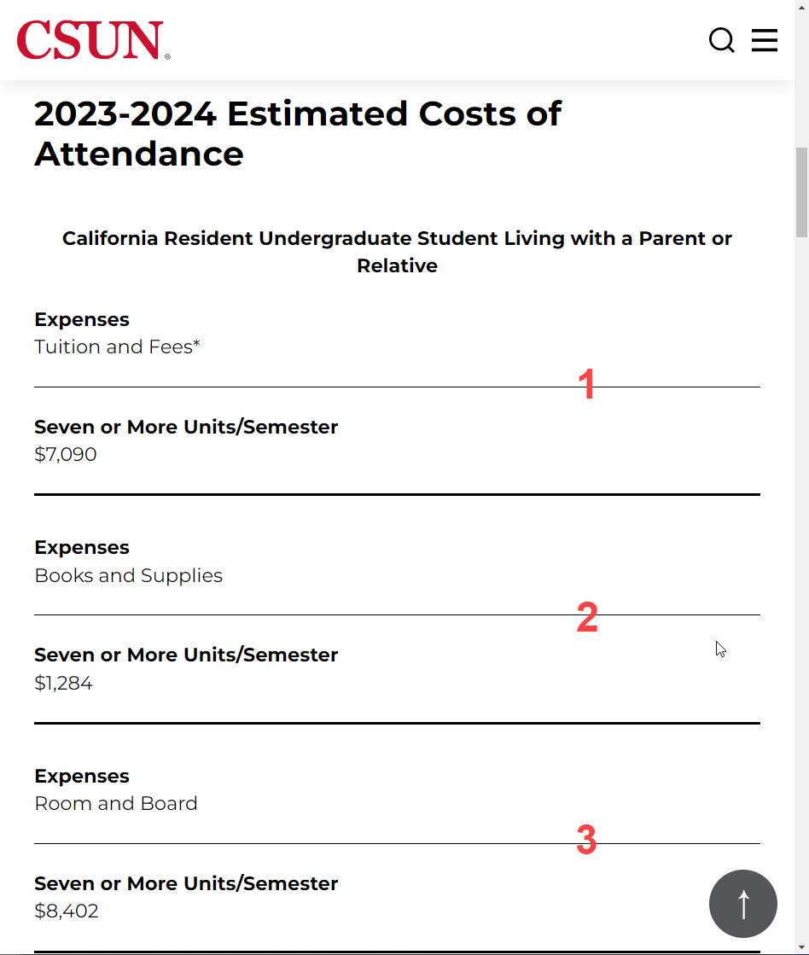
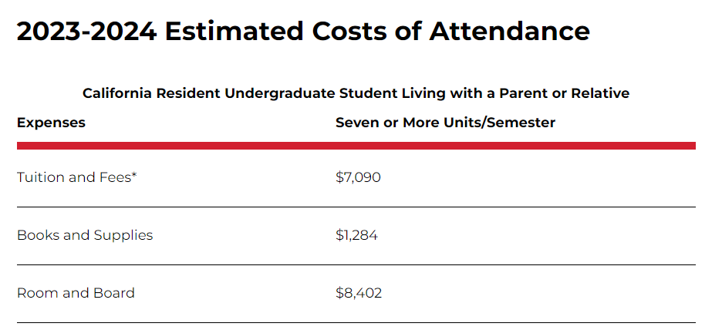
Data Tables
Notes:
Alen

Slide 17
Lessons and Take-aways
Project Management
We did not have a project manager.
Contracts and Details
The contract stated that the vendor would provide training on the new platform.
The contract did not elaborate.
While accessibility was included in the vendor’s training, key steps came up short.
Issue Tracking
Related to lessons 1 and 2, we don’t have comprehensive, shared issue tracking for this project.
Status and responsibility for accessibility issues aren’t always clear.
Usability for Content Creators
We planned to emphasize the user experience (UX) of the people managing websites and entering content.
An improved UX could help creators add more accessible content.
For example, accessibility validation.
Notes:
Both

Slide 18
Questions?
csun.edu/udc
Notes:
Both

Slide 19
Thank You
Kate Tipton
Program Manager,
Universal Design Center
kathryn.sharron@csun.edu
818-677-3065
Alen Davoudian
Sr. Information Systems Analyst,
Universal Design Center
alen.davoudian@csun.edu
818-677-5290
Notes:
Both

