Slide 1
Making Inclusive Digital Campus Maps Brandon Biggs CEO, XR Navigation

Slide 2
Importance of Full Inclusion
3,300
Digital Accessibility Lawsuits in 2022
DOJ/OCR
are focusing on digital accessibility
44%
Of blind customers who switch from businesses lacking digital accessibility

Slide 3
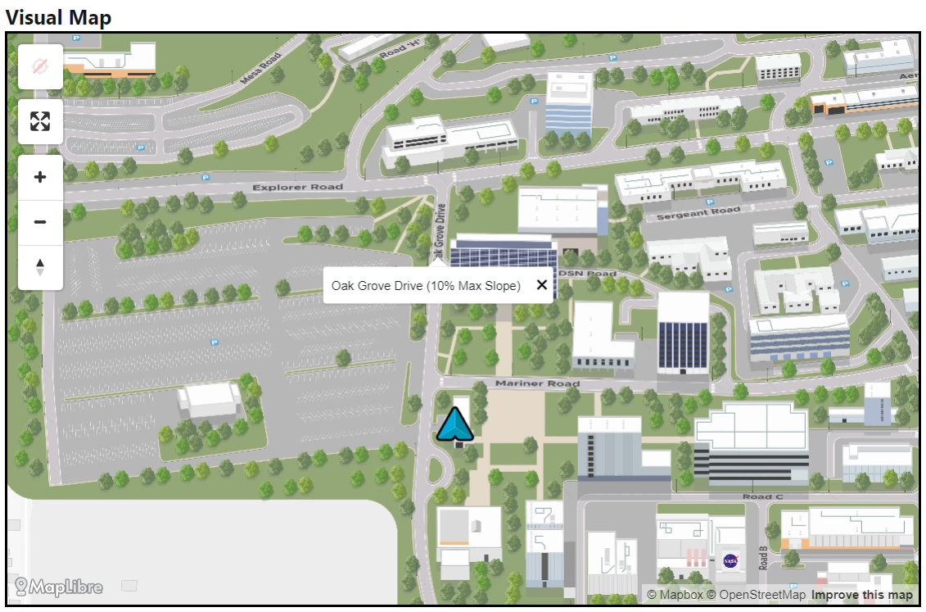
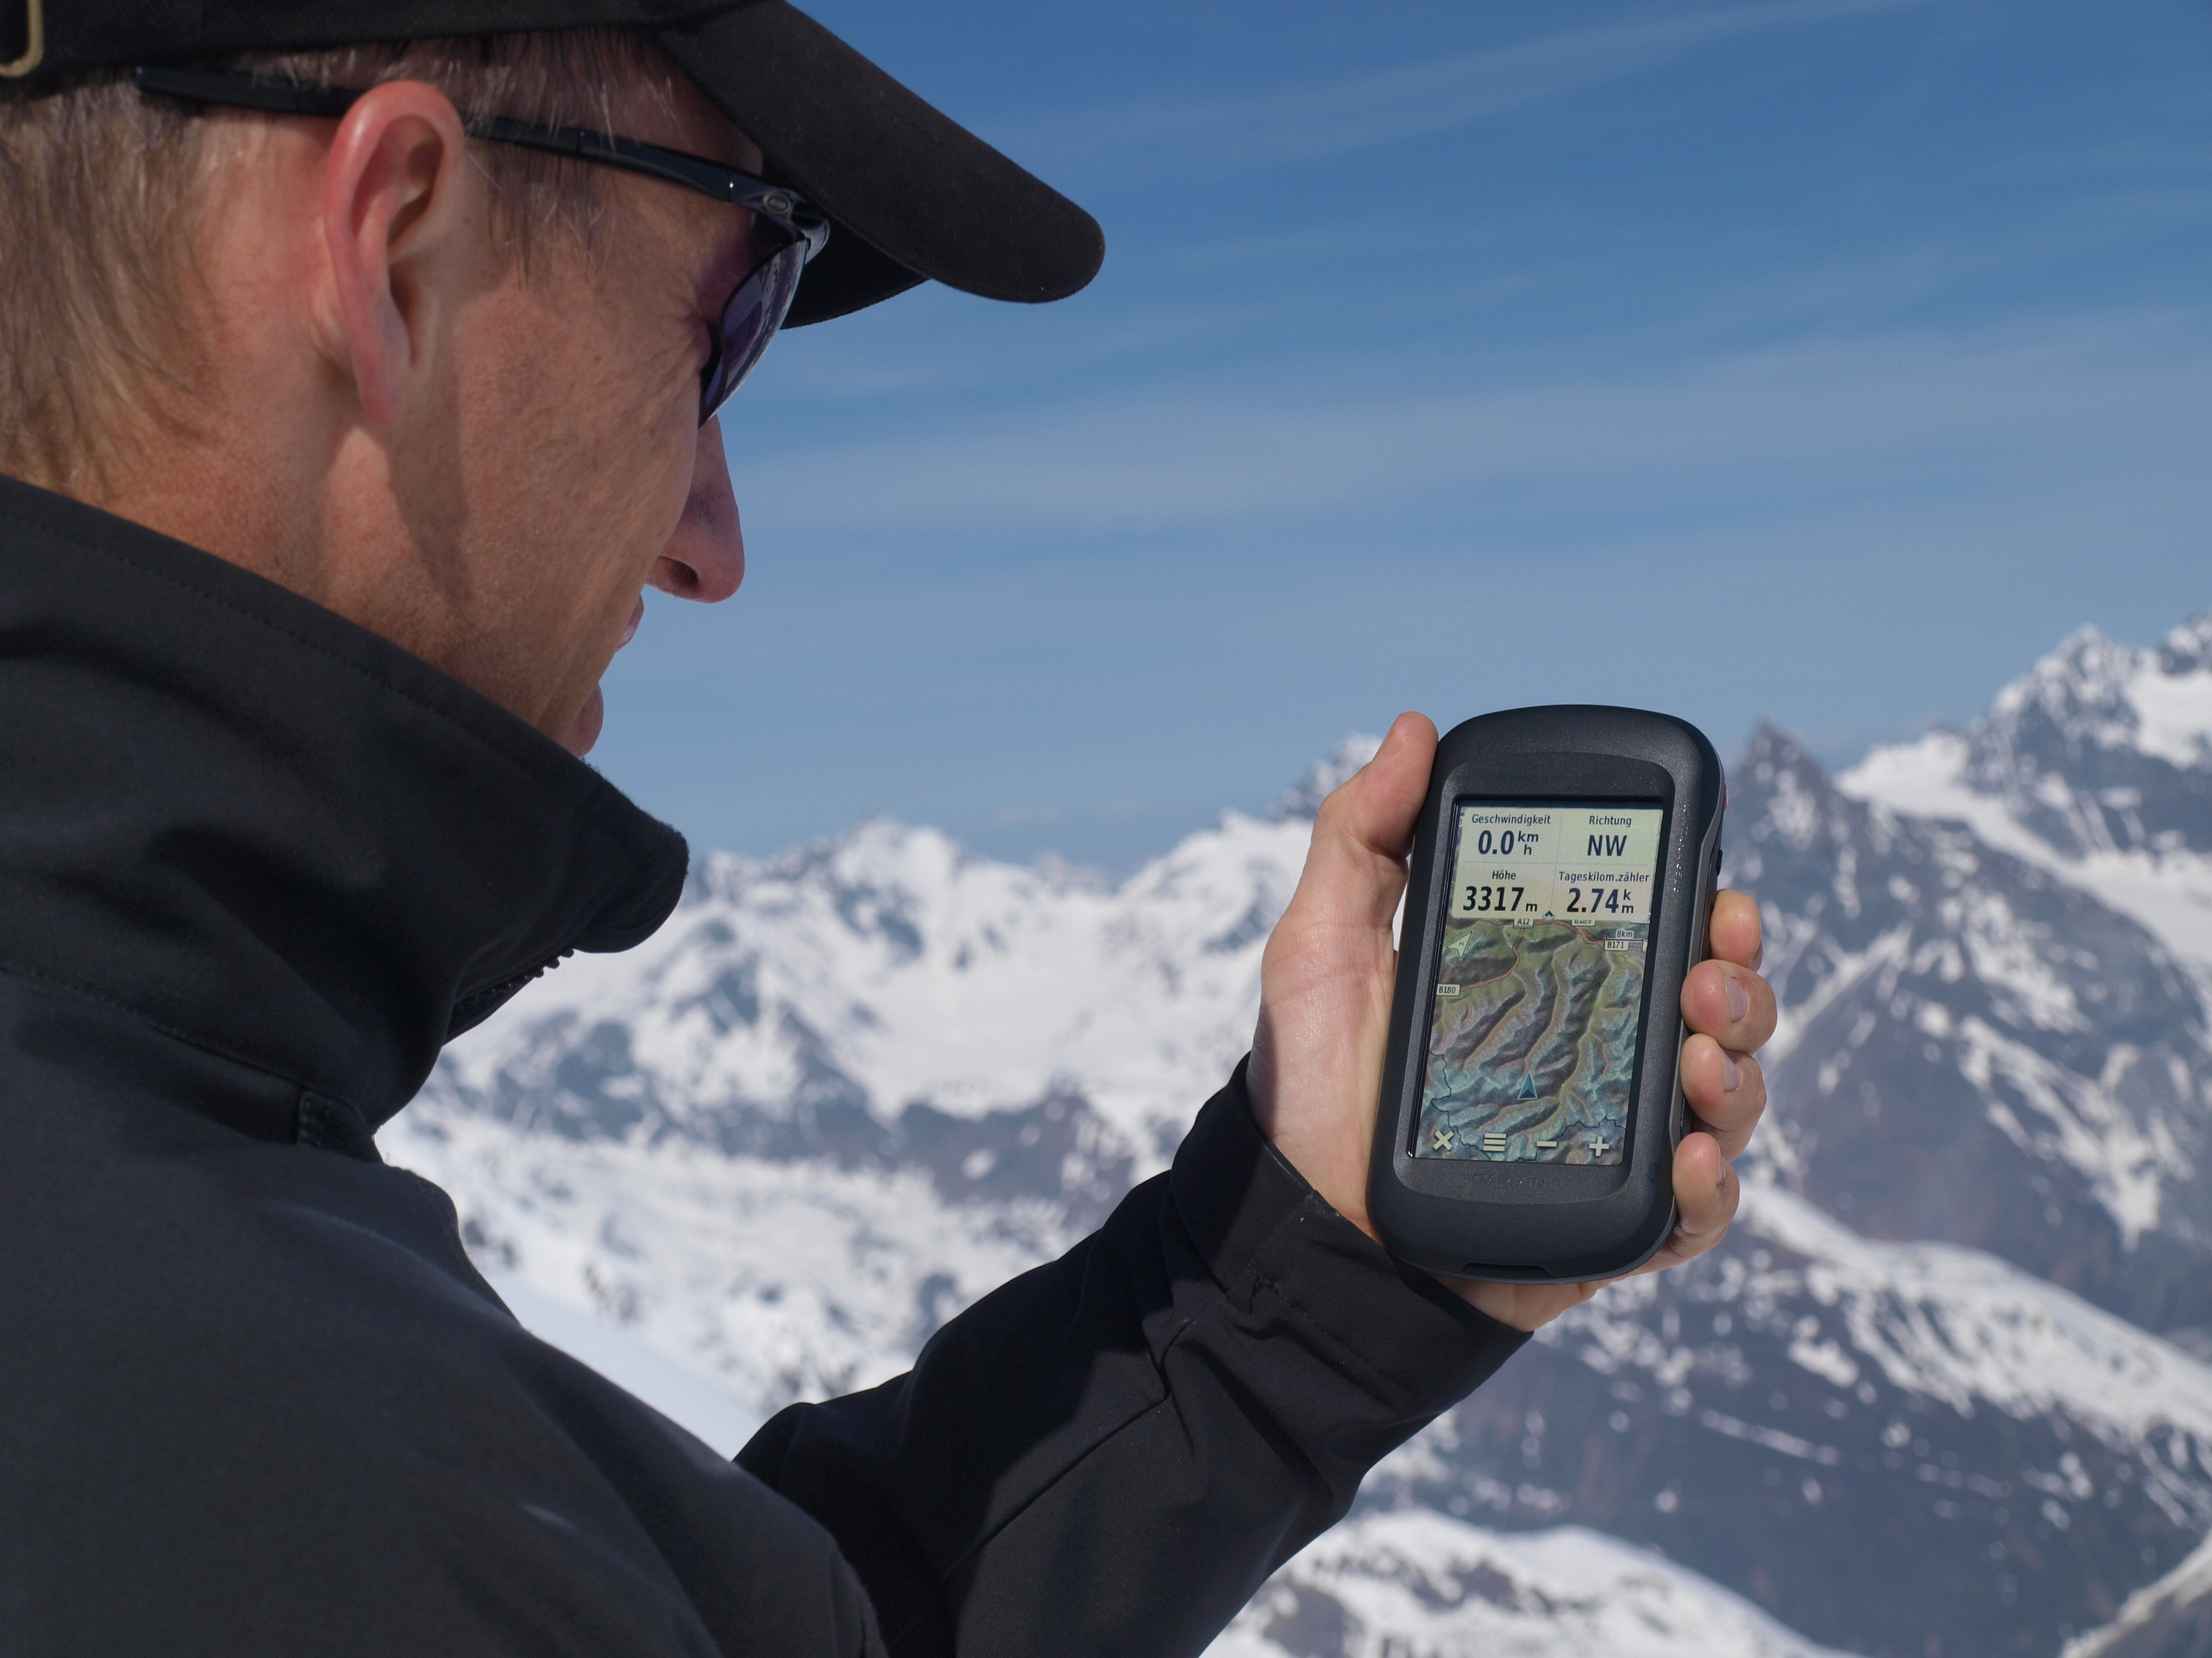
Elements to an Inclusive Digital Campus Map
Data
Viewer
Router
3

Slide 4
Indoor/Outdoor Vector Data With Accessible Elements
4

Slide 5
How to Get Data: Facilities, Croud, Scan
5

Slide 6
Return on Investment for Inclusive Maps
Less use of para transit
Increased value of data for urban planning
Increased usage of accessible features by bikers and scooter riders

Slide 7
Accessible Viewer: When, Where, Why, and How

Slide 8
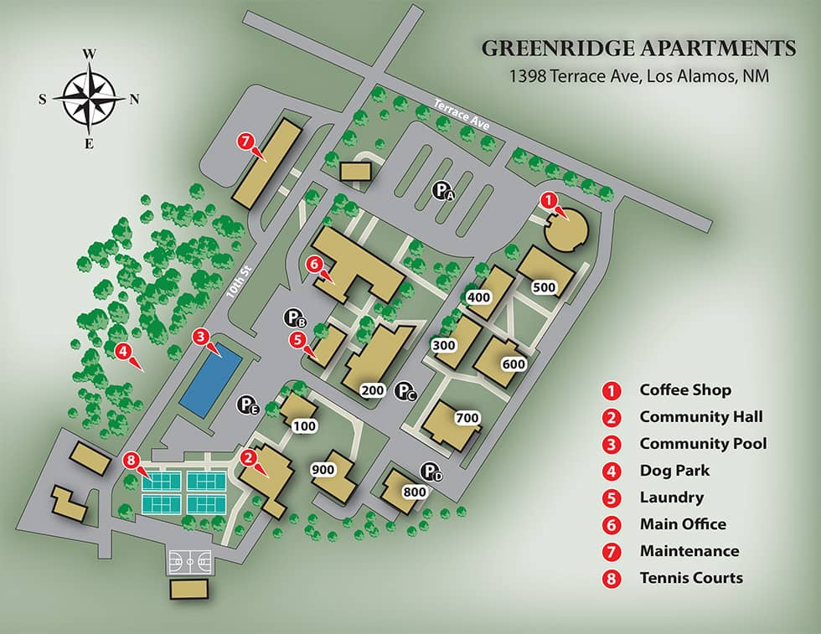
What a sighted person can see
Maps Are Inaccessible
What a screen reader will say

Slide 9
Accessibility Conformance Report for Mapping Libraries
Web map tool | Total |  | Level A |  | Level AA |  | Level AAA
 | Failed | Applicable | Failed | Applicable | Failed | Applicable | Failed | Applicable
Google Maps embed | 11 | 13 | 6 | 8 | 3 | 3 | 2 | 2
Google Maps Platform API | 10 | 13 | 6 | 8 | 2 | 3 | 2 | 2
Bing Maps embed | 5 | 14 | 2 | 9 | 1 | 3 | 2 | 2
Bing Maps Control API | 7 | 13 | 3 | 8 | 2 | 3 | 2 | 2
MapKit JS (Apple Maps) API | 8 | 12 | 4 | 7 | 2 | 3 | 2 | 2
Leaflet JS API | 6 | 13 | 2 | 8 | 3 | 3 | 1 | 2
OpenStreetMap embed | 8 | 14 | 3 | 9 | 3 | 3 | 2 | 2
OpenLayers API | 8 | 13 | 4 | 8 | 2 | 3 | 2 | 2
MapBox Studio embed | 6 | 14 | 3 | 9 | 1 | 3 | 2 | 2
MapBox GL JS API | 7 | 13 | 3 | 8 | 2 | 3 | 2 | 2
TomTom Maps SDK for Web | 9 | 13 | 5 | 8 | 3 | 3 | 1 | 2
Audiom | 0 | 14 | 0 | 9 | 0 | 3 | 0 | 2

Slide 10
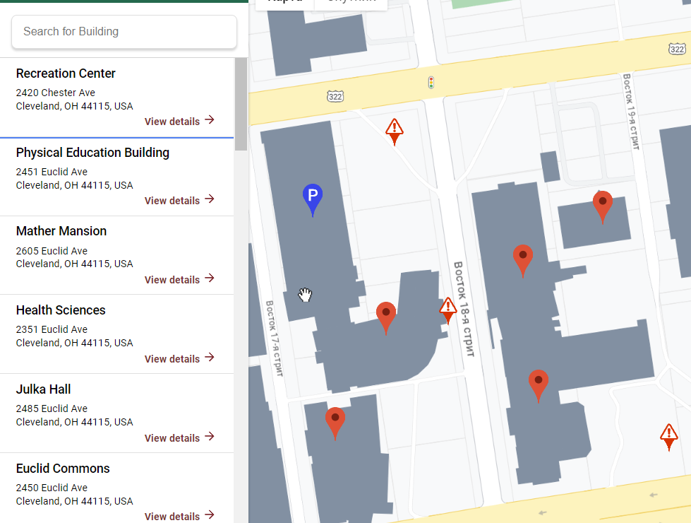
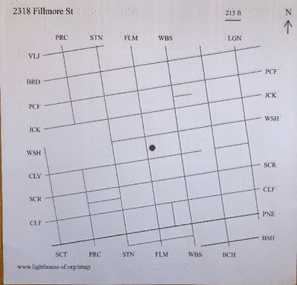
Current Options: List, Describe, Tactile
10

Slide 11
AUDIOM
The world's most inclusive visual, auditory, and tactile digital map viewer and editor.

Slide 12
How It Works
Users Can Easily…
Zoom in and out
Leverage spatial audio
Use Interactive Alt-Text

Slide 13
Audiom Campus Map Example
13

Slide 14
Audiom Studies
Table vs Audiom (N=40)
Spatial knowledge evaluation (N=14)
Co-Design 2 (N=6)
Co-Design 1 (N=10)
Table vs Audiom (N=40): (Being written)
Spatial knowledge evaluation (N=14):
Biggs, B., Toth, C., Stockman, T., Coughlan, J., & Walker, B. (2022). "Evaluation of a Non-Visual Auditory Choropleth and Travel Map Viewer." Retrieved from https://icad2022.icad.org/wp-content/uploads/2022/06/ICAD2022_27.pdf. Published in the International Conference on Auditory Display, 2022. PMCID: PMC10010675. Available at https://www.ncbi.nlm.nih.gov/pmc/articles/PMC10010675.
Co-Design 2 (N=6):
Biggs, B., Agbaroji, H., Toth, C., Stockman, T., Coughlan, J., & Walker, B. (2023). "Co-designing auditory navigation solutions for traveling as a blind individual during the COVID-19 pandemic." Journal of Blindness Innovation and Research. (In Press).
Co-Design 1 (N=10):
Biggs, B., Coughlan, J., Coppin, P. (2019). "Design And Evaluation Of An Audio Game-Inspired Auditory Map Interface." Retrieved from https://icad2019.icad.org/wp-content/uploads/2019/06/ICAD_2019_paper_51.pdf. Published in the International Conference on Auditory Display, 2019.
14

Slide 15
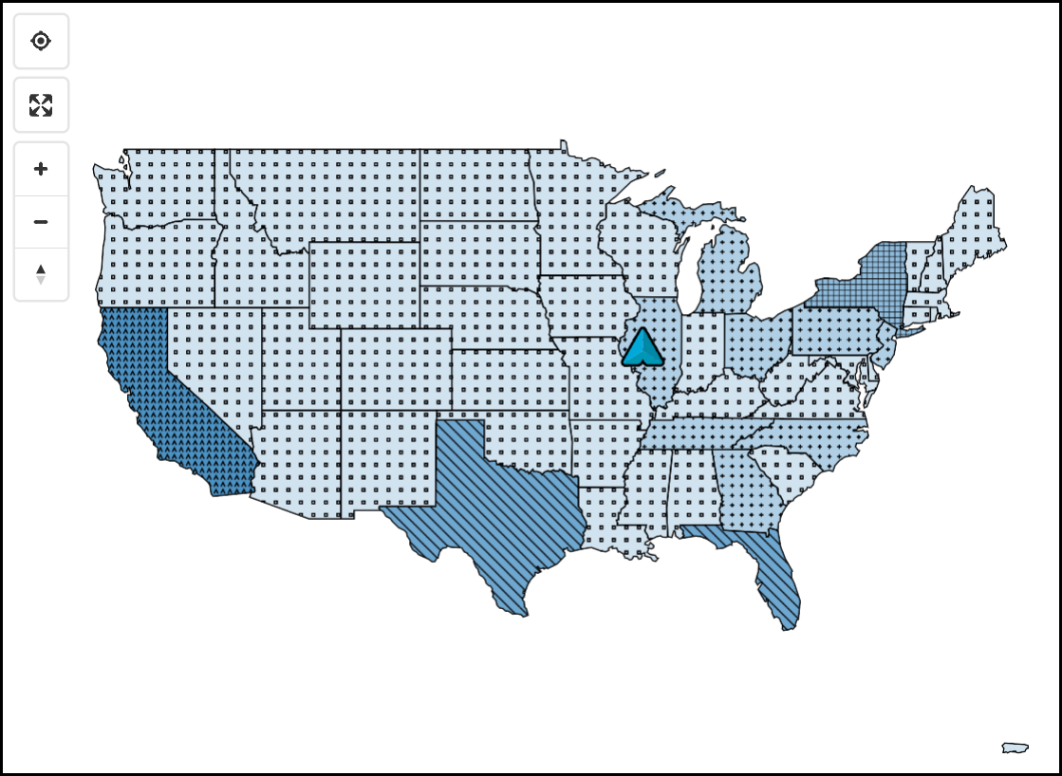
Web Content Accessibility Guidelines AAA Compliance
Screenshot of an Audiom street map
Screenshot of an Audiom COVID map
15

Slide 16
Current Clients
We have contracts with Enterprise customers, but we are built for long-term scale
16

Slide 17
Process
We learn what data you have
We send you a quote
We process the data
We give you an embed code
You embed the map next to or replacing your existing map
17

Slide 18
Return on Investment for an Inclusive Viewer
Decreased risk due to noncompliance
Increased academic performance and campus participation by people with disabilities
Increased attractiveness for potential students with disabilities

Slide 19
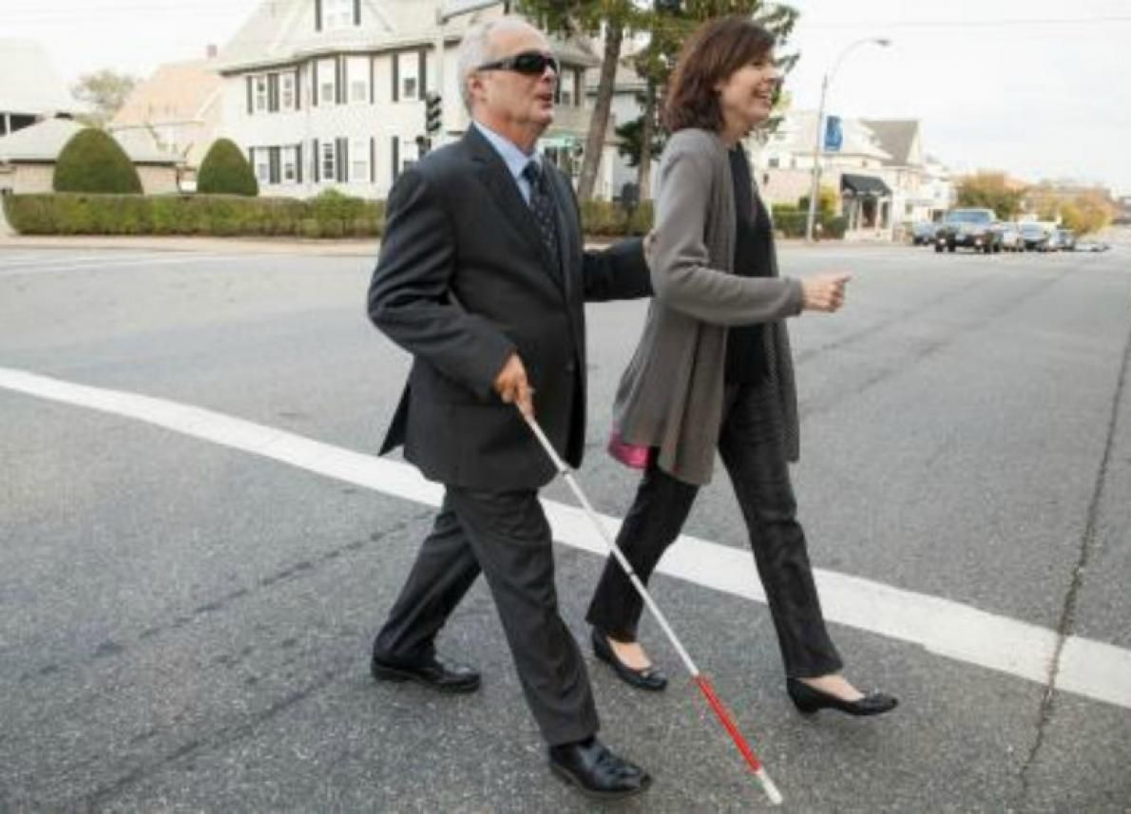
Routing: Accessible, Accurate Indoor/Outdoor Turn-By-Turn Directions

Slide 20
Indoor/Outdoor Navigation
Goodmaps
Mapsted
Lazarillo
20

Slide 21
Return on Investment for an Inclusive Routing Solution
Decreesed student stress and anxiety
Increased data on student navigation behavior
Better on-campus user experience
21

Slide 22
We envision a world where anyone can access a digital map

Slide 23
Resources
Map evaluation tool
Croud Map data collection guide
Audiom
Goodmaps
23

Slide 24
Invest in Inclusion Today
Website:
xrnavigation.io
Email:
Brandon.biggs@xrnavigation.io
Phone:
650.833.9394
24

