Slide 1
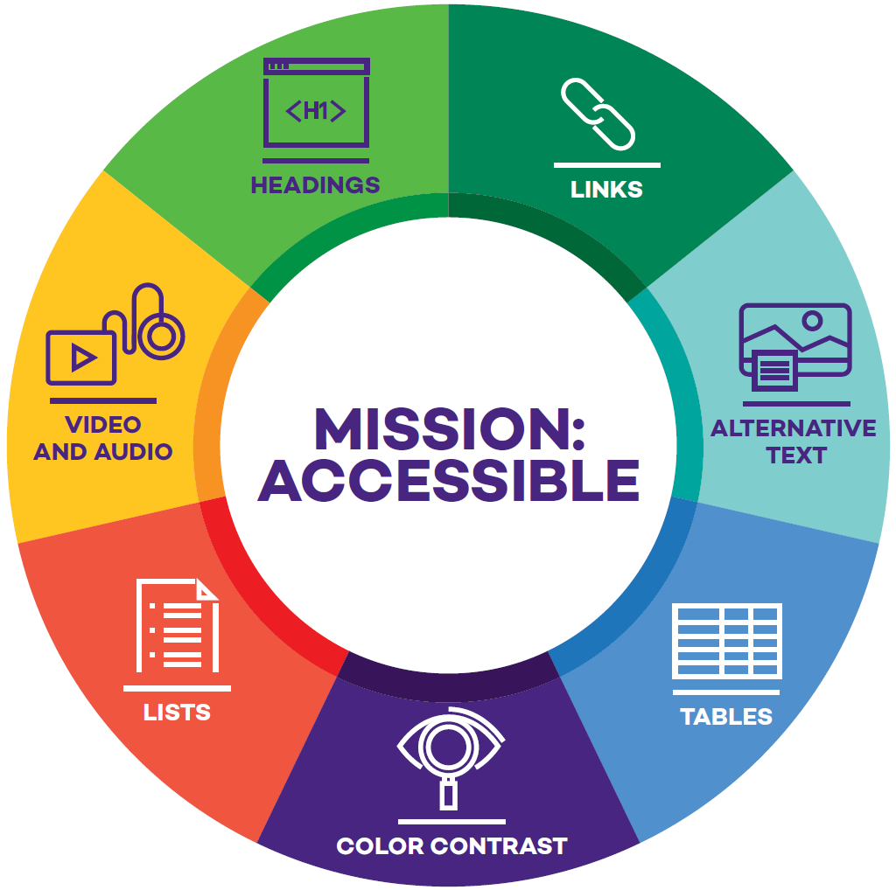
Mission: Accessible – Challenging Instructors to Create Accessible Canvas Content
Jim Stachowiak
Accessible Technology
Strategy and Operations Lead
Northwestern University

Slide 2
Digital Accessibility Efforts
Digital Accessibility at NU
Digital Accessibility Policy
Siteimprove & Website Monitoring
Accessible Purchasing Process
Digital Accessibility Liaisons
Course Sites

Slide 3
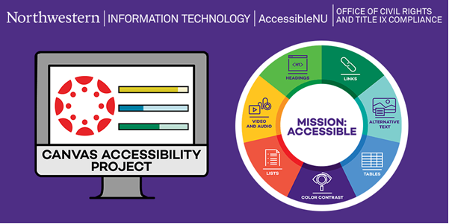
2

Slide 4
Approach
Start with Canvas content
Focus on easy, high impact issues
Don’t overwhelm
Educate
Build something sustainable

Slide 5
Mission: Accessible Components
Training
Challenge
Support
Seven Core Skills website
Workshops and trainings
Videos
Visual Brand
Comms Plan
Tracking and Follow-up system
Gamification
Recognition
Data Tracking
Brains Trust
Consultations
Accessible Templates

Slide 6
Brains Trust
Barbara Butts
Theater Instructor
Judy Franks
IMC Instructor
Desi Hanford
Journalism Instructor
Frank Sweis
Library Staff
David Noffs
SPS Instructor
Ilya Mikelson
Engineering Instructor
Janice Mejia
Engineering Instructor
Veronica Berns
Chemistry Instructor
Matt Carlson
Med School Staff
James Harrington
Econ Coordinator
Denise Drane
Med School Instructor
Christine Scherer
SPS Accessibility
Robin Stark
Chem Coordinator
Chelsea Watson
Chem Coordinator
Dave Zohfeld
Procurement

Slide 7
Seven Core Accessibility Skills
Headings
Links
Alternative Text
Color Contrast
Lists
Tables
Video and Audio

Slide 8
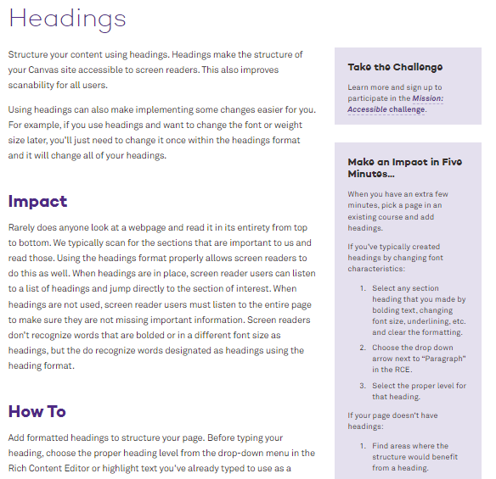
Seven Core Skills Website
Impact
How To
Things to Avoid
Going Forward
Make an Impact in Five Minutes
www.northwestern.edu/accessibility/digital-accessibility/seven-core-skills/

Slide 9
Workshops
Beginner Workshop
(Offered monthly)
Advanced Accessibility Workshops
(Offered twice a year)
Make Your Canvas Content More Accessible in 7 Simple Steps
Using Available Automated Checkers in Canvas
Using Assistive Technology to Navigate a Canvas Site
Stylish and Accessible: Using Divs to Format Your Canvas Site
Writing Alt Text for Complex Images
Creating Accessible Documents
Using Accessible Canvas Templates

Slide 10
Visual Brand
Developed by NUIT Communications
Reminder of the seven core skills
Used in messaging
Used on laptop stickers
Helped make the project feel official

Slide 11
Communications Plan
Developed a partnership for communication between NUIT, AccessibleNU and the Office of Civil Rights and Title IX Compliance
Emails:
Seven core skills intro emails
Direct email invitation from NUIT to all instructors with a Canvas Course
Follow up from ANU to all instructors with students with accommodations
Other:
Canvas announcement
Digital displays throughout the library and other buildings on campus

Slide 12
Tracking
Instructor signs up their class for the challenge
Every two weeks they receive an email with a link asking them to update their progress
When all seven skills are addressed, their site is reviewed and approved or sent back to fix errors
Initial tracking system was used a programmed Smartsheet

Slide 13
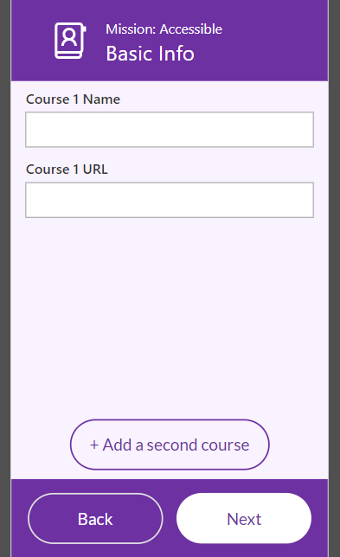
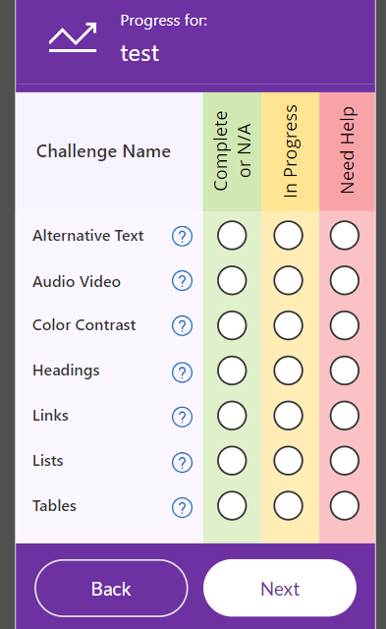
Tracking - PowerApp
Better interface
Individualized email timeline
Easier tracking for instructor
Easier tracking for project staff

Slide 14
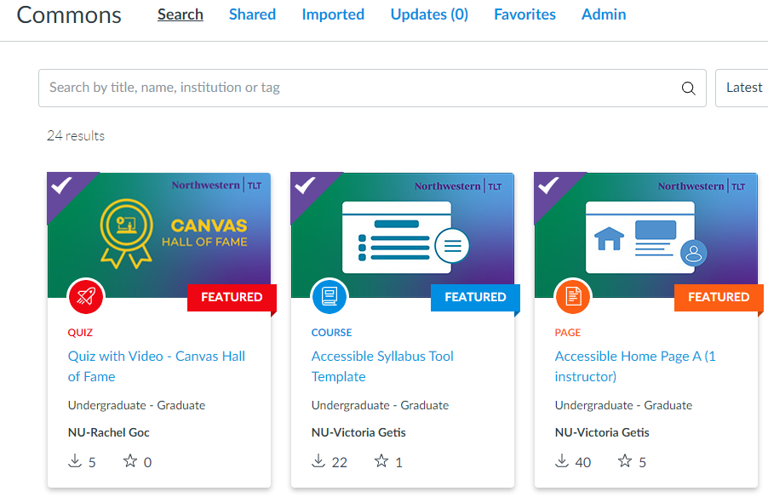
Templates
Developed several accessible course templates
Full course
Syllabus page
Assignment
Template with explanations
Made available via Canvas Commons

Slide 15
Consultations
23 consultations
“I need help” option on tracker triggered outreach
Various TLT team members handled consultations
For larger issues, grad students helped fix issues
TLT took over HTML-based issues

Slide 16
Recognition
Course listed on the Mission: Accessible Wall of Fame
Certificate of completion
Email to Dean, Associate Dean, & Dept. Chair
Language to use on syllabus
Mission: Accessible laptop sticker

Slide 17
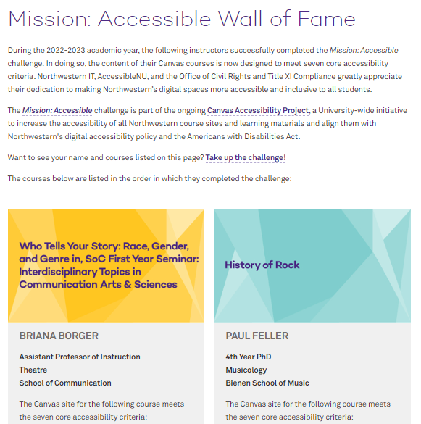
Wall of Fame

Slide 18
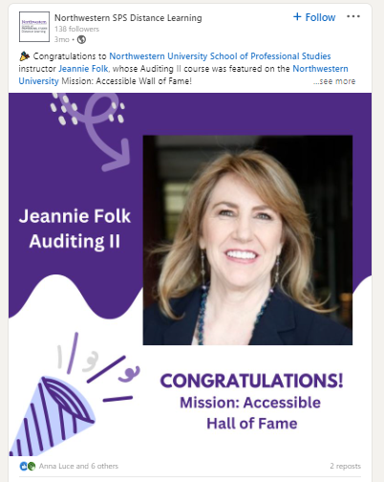
17

Slide 19
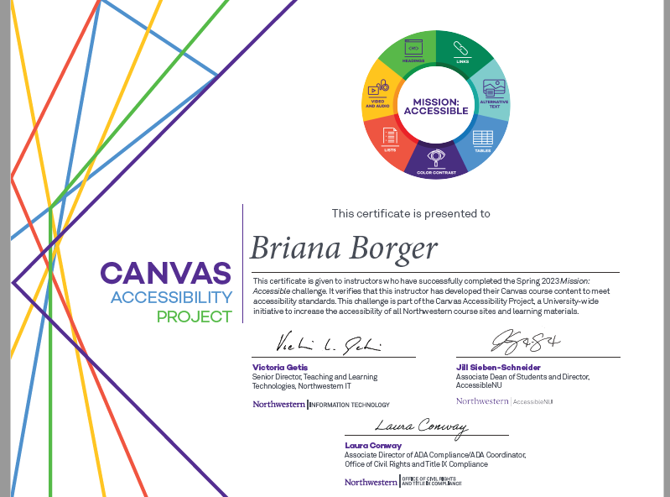
18

Slide 20
Instructor Responses
“Thank you so much for this. It was great to have guidance to make the course a bit more accessible.”
“Thank you! I really learned a lot and would definitely do it again!”
“Thank you very much, Jim! I appreciated the guidelines for completing this work and would like to mention that Abby Rosensweig was very helpful in walking me through the process (especially some of the technical questions I was unsure about). “
“Overall I found the checklist really helpful when I did it for the first time last spring. I have used the accessibility tools and they’ve helped me find things that I had missed, so I appreciated that. I’m really glad NU is putting resources and expertise into this.”

Slide 21
Responses from Deans
“Thanks very much for sharing this list. It is wonderful to recognize faculty members who are making a difference in this important area.”
- Dean, Weinberg College of Arts and Sciences
“Thank you for your email, which is very heartening to hear. With Anna’s permission, we will be sure to include this on the website where we describe our current classes and in our upcoming departmental newsletters.”
- Chair, German Department
“Many thanks for sharing this with me! I am so grateful to Dr. Pila-Leiderman for her incredible commitment to access and inclusivity! Well done!! We’ll share this with our weekly newsletter also!”
- Chair, Department of Medical Social Sciences
“What great recognition for the work of these fine colleagues.”
- Dean, Medill School of Journalism

Slide 22
Syllabus Language
This course site is verified by the Canvas Accessibility Project team as having completed the Mission: Accessible challenge. The Canvas-based components of the site meet current digital accessibility standards.

Slide 23
Mission: Accessible Year 1 Stats
90 instructors registered courses for the challenge
9 of 11 Northwestern schools were represented in the challenge
63 classes successfully completed the challenge

Slide 24
Mission: Accessible’s Impact
Error | Percent Improvement: Errors per Page
Headings not structured | 17%
Page has no headings | 14%
Image without Alt text | 25%
No data cell attached to table header | 6%
Color contrast not sufficient | 14%
Do these links point to the same URL | 19%

Slide 25
What Worked Well
Visual Branding
ANU follow up message
Instructor encouragement
Consultations
Offering grad student support
Email recognition

Slide 26
What Wasn’t as Effective as Expected
VIP Treatment
Digital Signage
Office Hours
Siteimprove metrics

Slide 27
Next Steps
Implement Pope Tech Accessibility Dashboard and Accessibility Guide
Increase participation in Mission: Accessible 2023-2024
Begin Phase 2: Document Conversion

Slide 28
Phase 2 - Funding
Pope Tech Accessibility Dashboard & Accessibility Guide
WebAIM Accessibility Training
Document remediation tools
Term staff for document remediation
Student accessibility tools

Slide 29
Using Pope Tech Dashboard
Track improvements
Share school data
Address courses with most errors
Create school partnerships

Slide 30
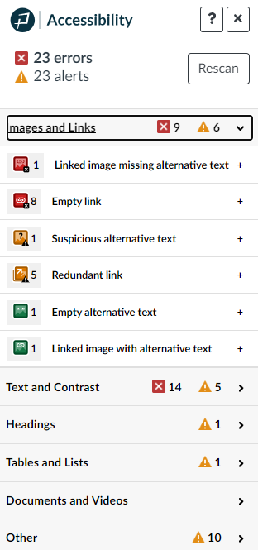
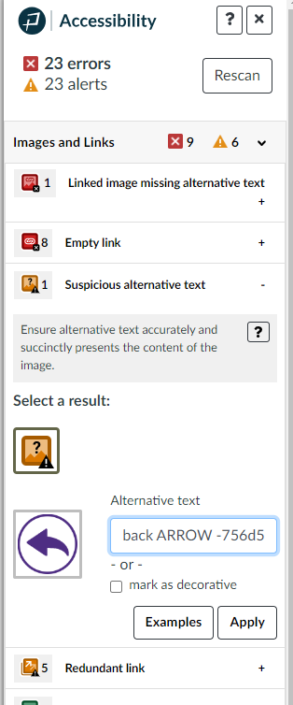
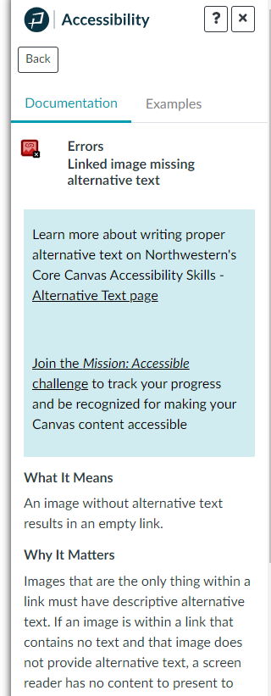
Pope Tech Accessibility Guide

Slide 31
Medill School of Journalism Partnership
Goal
Work with Medill associate deans, instructors, and librarians to make Medill a model school for digital accessibility in the learning environment.
Fall 2023
Winter 2024
Spring-Fall 2024
Begin partnership
Provide Medill-specific workshops
Enroll instructors in Mission: Accessible – add announcement to all new Canvas pages
Identify Medill support person(s)
Establish remediation procedure with librarians
Develop accessible templates for Medill
Continue Medill-specific accessibility workshops
Roll out document remediation process for those who’ve completed Mission: Accessible
Begin specifically addressing courses with high error rates
Continue Mission: Accessible enrollment for courses
Continue document remediation
Review Medill Pope Tech data for year
Highlight this partnership across campus to entice similar opportunities in other schools

Slide 32
Document Remediation, Training, & Student Tools
Fall 2023
Winter 2024
Spring-Fall 2024
Document Remediation
Develop JD for and hire term remediation position
Provide accessible docs workshop
Initiate library partnership
Training
TLT team participates in WebAIM Accessibility training
Provide feedback
Determine process for inviting others to next round
Document Remediation
Purchase codemantra and Equidox licenses
Develop process with library
Pilot remediation service with M:A finishers
Training
WebAIM training – Round 2 for CANDUITS
Student tools
Connect with other Glean institutions
Share Glean with LTAC and Associate Deans
Create structure for Glean Pioneer Program
Document Remediation
Expand efforts beyond M:A finishers
Focus on courses with most docs & highest enrollment
Training
WebAIM training – Rounds 3 & 4
Continue accessible docs workshops
Student tools
Begin Glean Pioneer Program
Offer student trainings

Slide 33
Questions? Email: james.stachowiak@northwestern.edu

