Slide 1
Certified Accessible eBook Ecosystem From Vendor to Publisher to Student

Slide 2
Panel
Charles LaPierre
Will Awad
Rachel Comerford
Blake Perdue
Notes:
CL

Slide 3
Overview
Benetech’s GCA Program Overview
EPUB Vendor’s Perspective
EPUB Publisher’s Perspective
EPUB Retailer’s Perspective
Future of Accessible Books
New: Accessible Tools Certification
Useful Links
Notes:
CL

Slide 4
Global Certified Accessible (GCA) Overview
Launched June 22, 2018
Macmillan Learning was our first publisher certified
Newgen was our first conversion vendor certified
Have close to 80 publishers certified
With over 70% Canadian publishers certified
Have close to a dozen vendors certified
GCA fully accessible bookstore thanks to VitalSource

Slide 5
GCA Overview Continued
Helping publishers and conversion vendors produce fully accessible and compliant EPUBs
Requires three passing EPUBs to be certified
Annual spot-checks required to maintain certification
Access to DAISY’s SMART tool
Quarterly GCA technical bulletins
Access to industry accessible EPUB experts

Slide 6
Global Certified Accessible Stamp

Slide 7
GCA Certified Publishers
https://bornaccessible.org/certified-publishers/

Slide 8
GCA Certified Conversion Vendors
https://bornaccessible.org/certified-vendors/

Slide 9
A Vendor’s Perspective

Slide 10
Newgen’s History

Slide 11
Newgen’s Partners

Slide 12
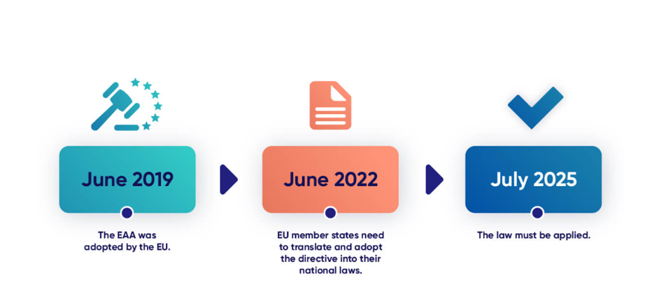
EEA Important Dates

Slide 13
Accessible EPUB
Our data-conversion team are experts in creating accessible EPUBs according to the WCAG 2.1 AA standard following the EPUB Accessibility 1.1 Specification

Slide 14
A Publisher’s Perspective

Slide 15
A (very) Brief Publisher’s e-book History
2016: PDF ebook
2017: ePUB + lots of feedback on how to do it better
2018: ePUB + slightly less feedback on how to do it better
2019: ePUB Global Certified Accessible + hundreds of backlist titles updated

Slide 16
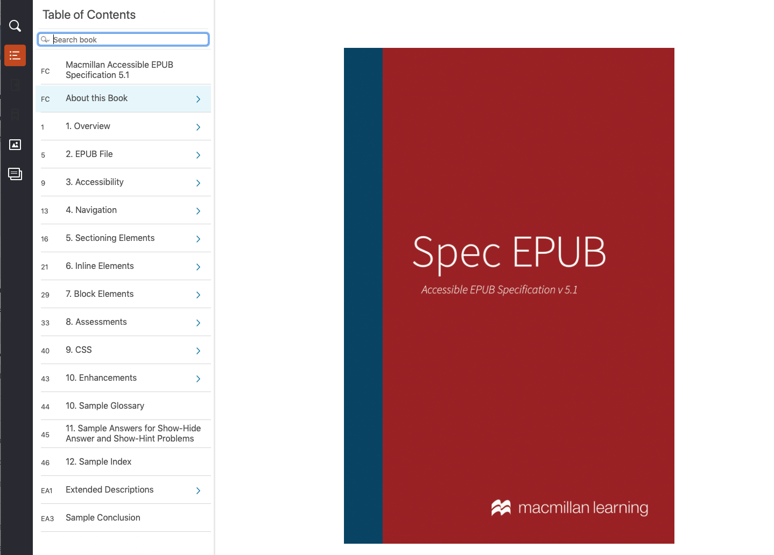
2020-2023 Improvements - Guide
Internal guideline document in EPUB format with detailed descriptions of how to accessibly create all elements of our eBooks.

Slide 17
2020-2023 Improvements - Validate
ePUBCheck
Custom Code
xHTML/HTML Validator
Internal EPUB validator consisting of a stack on the ePUBcheck validator, DAISY’s Ace Validator; and custom rules based on our guidelines
CSS 3 Validator
JavaScript: JSLint Validator
Link Checker: Perl Module
ACE

Slide 18
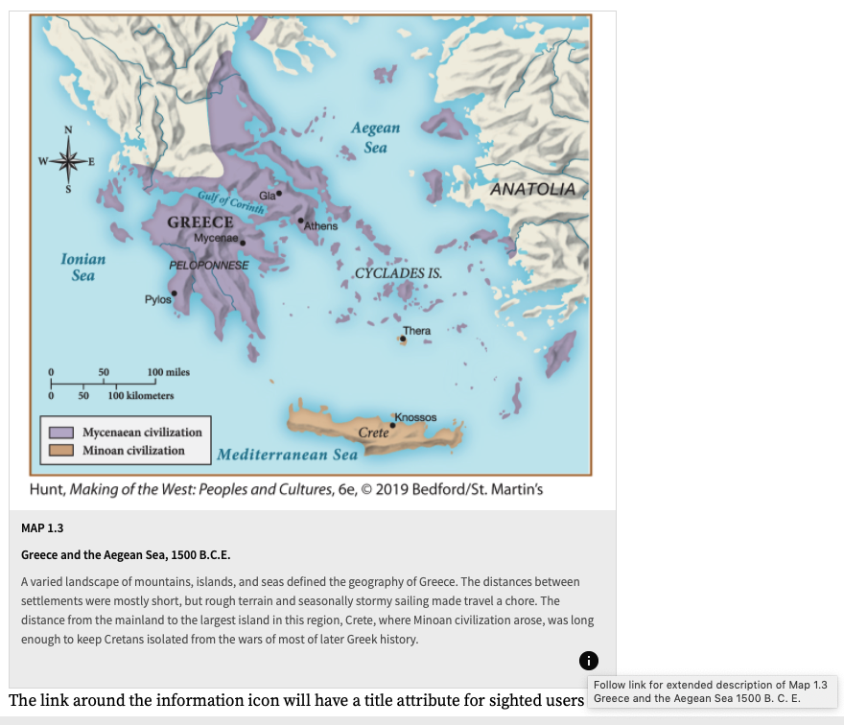
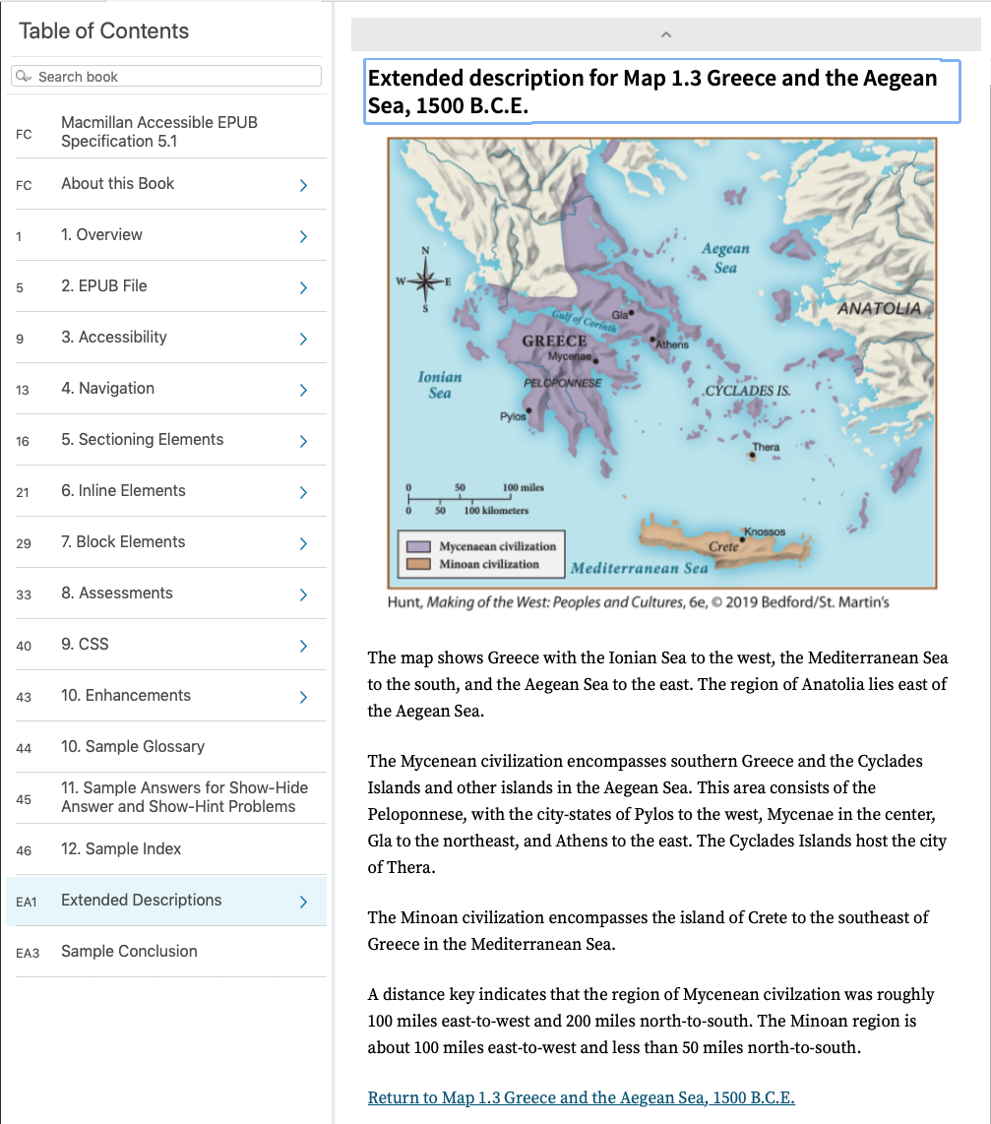
2020-2023 Improvements - Improve

Slide 19
2020-2023 Improvements - Communicate
Accessibility Summary:
This publication meets the EPUB Accessibility requirements, and it also meets the Web Content Accessibility Guidelines (WCAG) at the double “AA” level. It is screen-reader friendly and is accessible to persons with disabilities. The publication was designed to be as accessible as possible to all persons with disabilities. It is compatible with the wide range of Assistive Technology on the market today. Extensive navigation is provided to make it easy to use via a table of contents and page numbers. All non-decorative images have alt text or captions or are described in the surrounding text. Math was created with and is represented by MathML. Long descriptions are present for complex images and graphs that are necessary for understanding content.

Slide 20
A Retailer’s Perspective
We’ve seen a growing market demand for accessible platforms
Institutional review and approval processes have put increased pressure on educational products
This extends not just to EPUB but also PDF content
Student pull gives us leverage
Certification programs helped us establish trust

Slide 21
Importance of Metadata
The importance of metadata cannot be overstated
VitalSource has prioritized ingesting, cataloging and surfacing accessibility metadata
We continue to see a lack of participation in quality metadata
Solving the metadata problem through ingestion tools
New learner capabilities powered by metadata

Slide 22
Interactive Content
Interactive content needs standardization via specs and frameworks
The eTextbook engagement challenge is driving content enhancements
We’ve seen a spectrum of interactivity solutions across publishers, each with their own accessibility challenges
The growth of development frameworks and kits on the web is a shining example of how publishers can rise to these challenges

Slide 23
The Future of Accessible Books
Have you seen a behavior change in the publisher requests for creating accessible EPUBs?
What about changes to requests students make of publishers?
What are the challenges that publishers are facing right now in creating accessible ebooks?
Do you think AI will replace human authoring of alt text writing for publishers?
What implication will the EAA have on publishers in the next 1.5 years?
What is the importance of having the metadata in the accessible eBooks?

Slide 24
Benetech Approved Tools

Slide 25
Resources: GCA and Accessibility Tools
GCA website https://bornaccessible.org/global-certified-accessible/
Benetech's Accessible VitalSource Bookstore https://benetechaccessiblebooks.vitalsource.com
DAISY’s Accessible Checker for EPUB (Ace) https://github.com/daisy/ace-gui/releases
DAISY's SMART Tool https://smart.daisy.org

Slide 26
Panelist Company Websites
Benetech: https://www.benetech.org
GCA Bookstore: https://benetechaccessiblebooks.vitalsource.com
Newgen: https://www.newgen.co
Macmillan: https://www.macmillanlearning.com
Vital Source: https://www.vitalsource.com

