Slide 1
7 Ways to Make Content Digitally Accessible

Slide 2
Agenda
Company Background
What is…
Examples
Relevance to Diversity and Inclusion
Legal Compliance

Slide 3
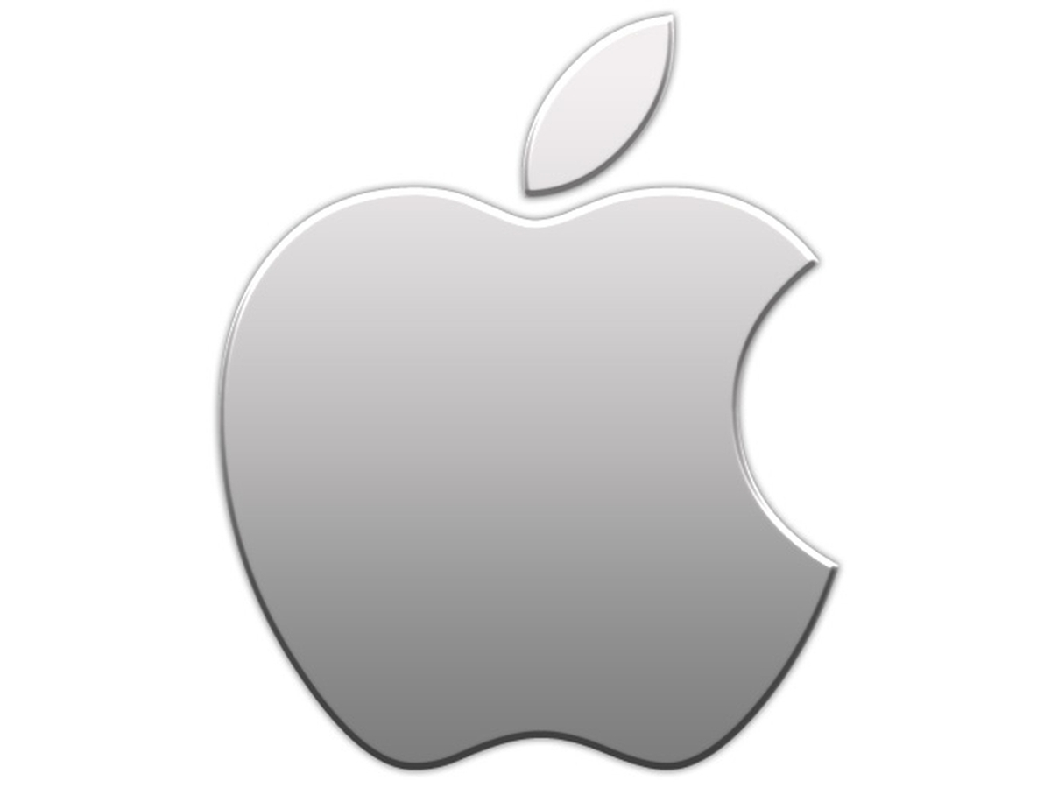
Company Background

Slide 4
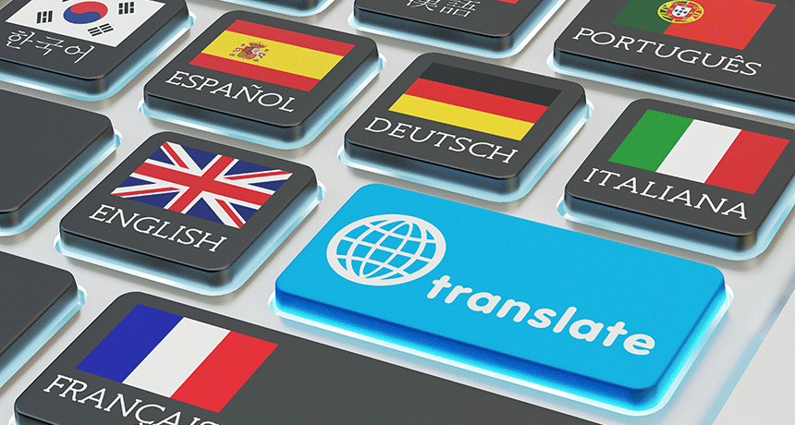
Written Translation
The written translation of information from any SOURCE language to any TARGET language

Slide 5
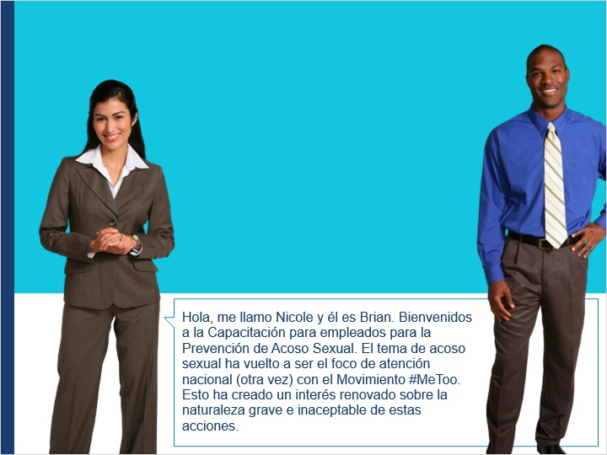
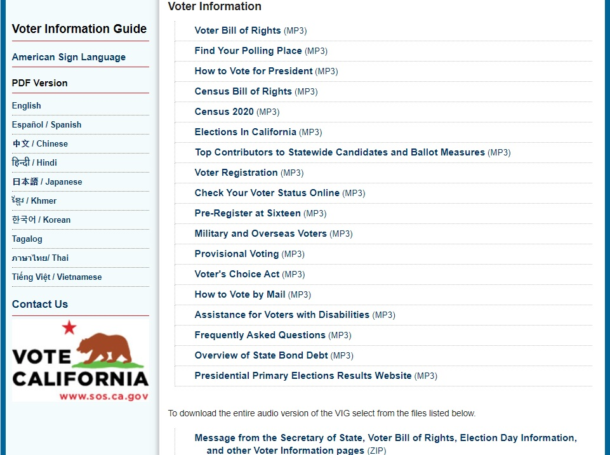
Examples of Written Translations
Training Courses
Brochures

Slide 6
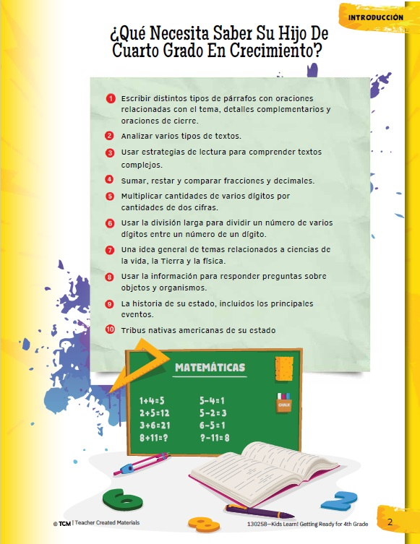
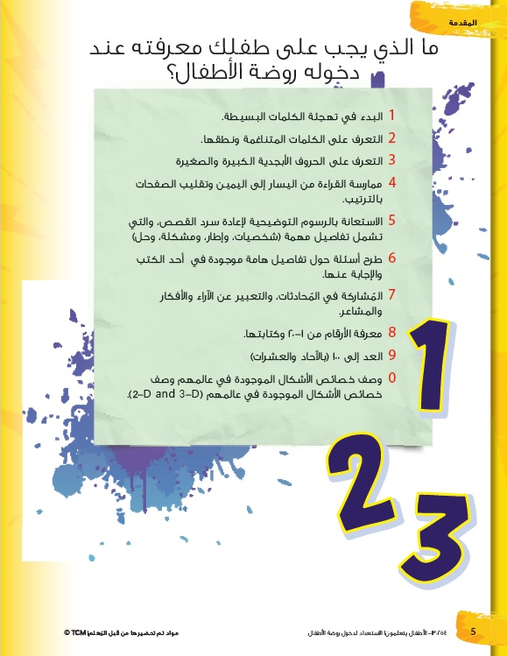
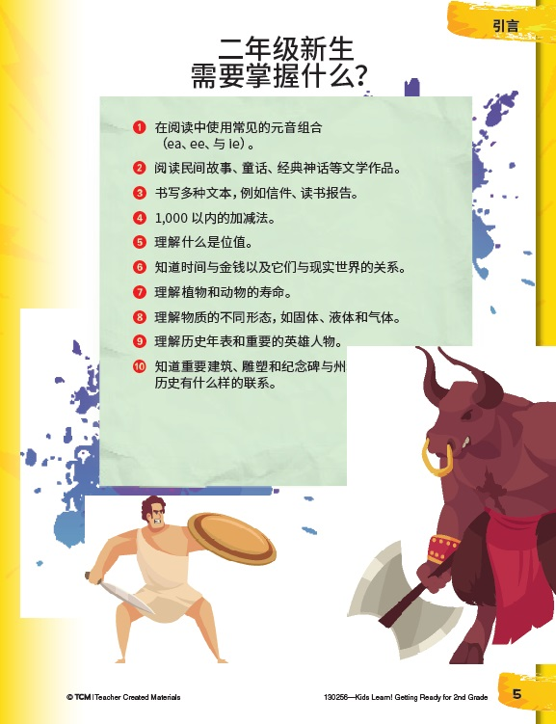
Examples of Written Translations
Educational Brochures for Parents and Students

Slide 7
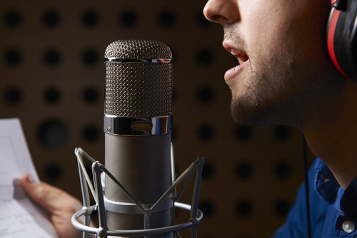
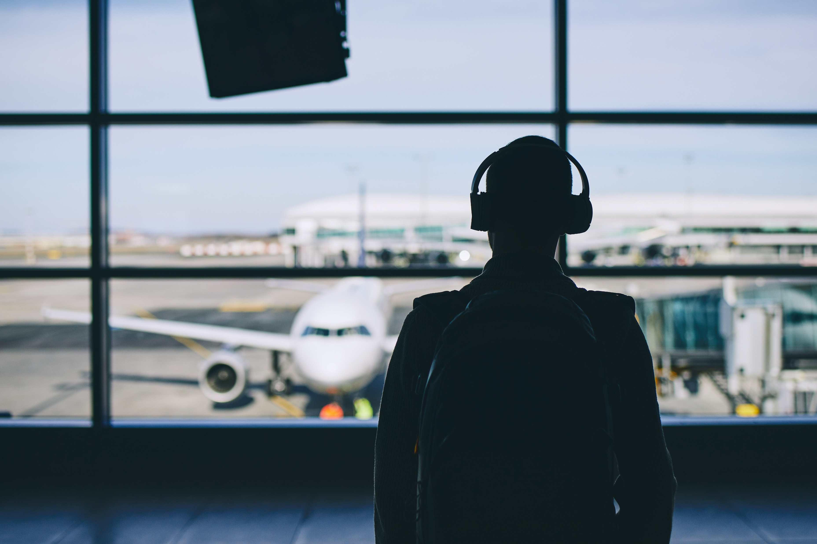
Voiceover
The audio recording of a script or text which can then be listened to

Slide 8
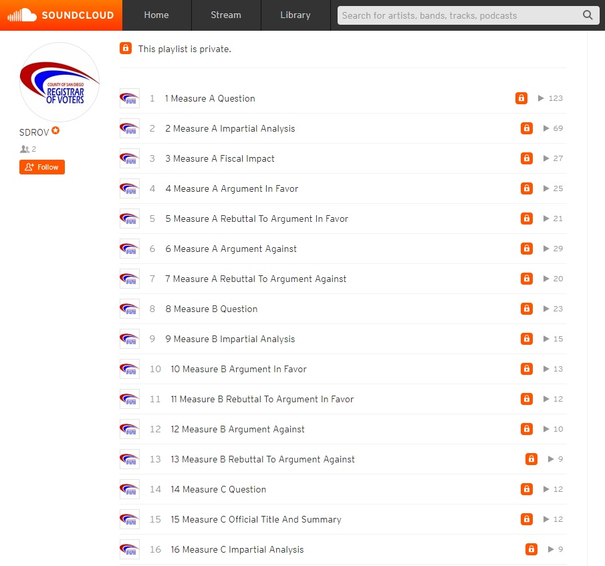
Examples of Voiceovers
Training Courses
Audio Ballots for Voters

Slide 9
How do Voiceovers Promote Inclusion and Diversity?
Blind or Visually Impaired

Slide 10
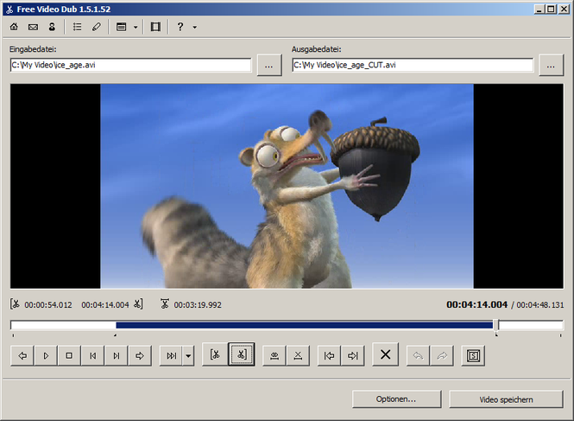
Video Dubbing
Video narration or character dialogue in the language of your target audience

Slide 11
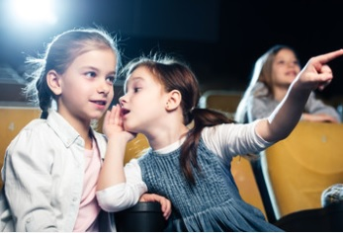
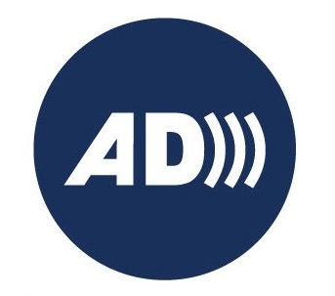
Audio Description
An additional audio track containing narration that describes what is happening on-screen, including physical actions, facial expressions, costumes, settings and scene changes

Slide 12
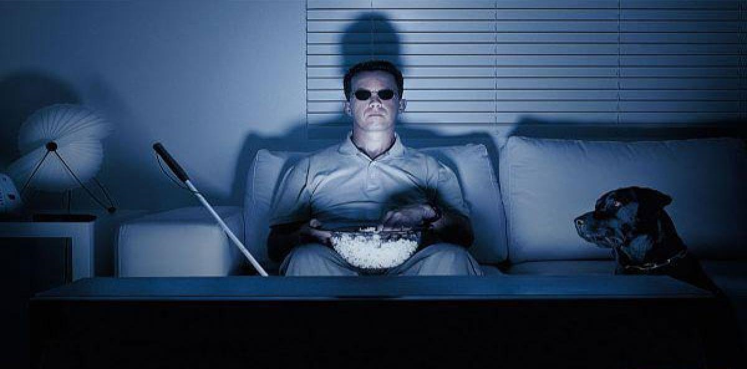
How do Audio Descriptions Promote Inclusion and Diversity?
Blind or Visually Impaired Viewers

Slide 13
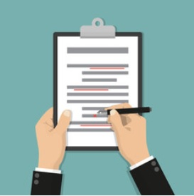
Transcription
Conversion of audible information into written text that can be read

Slide 14
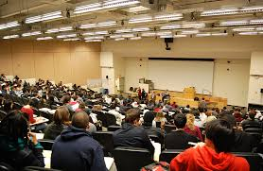
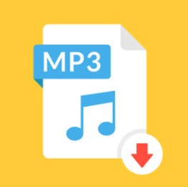
Examples of Transcriptions
Lectures
Audio Recordings

Slide 15
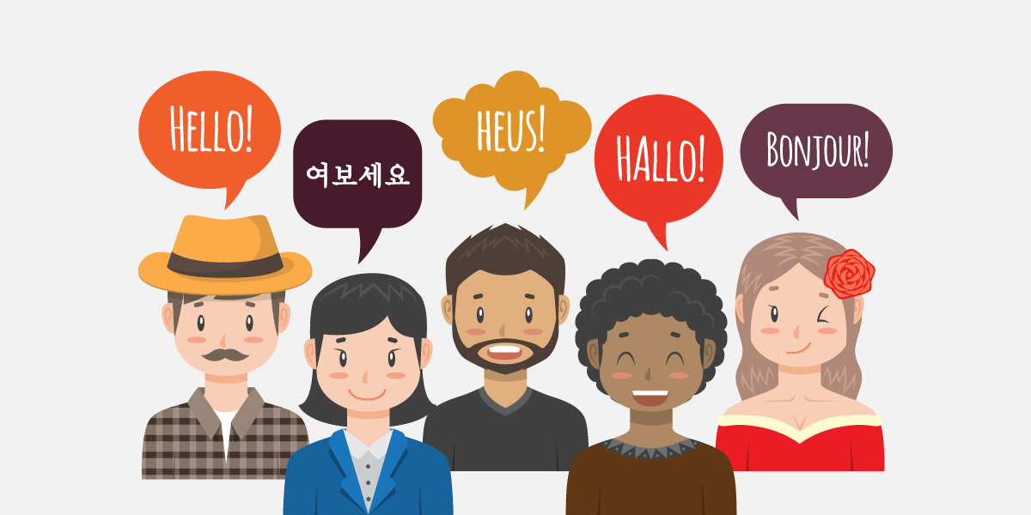
How do Transcriptions Promote Inclusion and Diversity?
Deaf or Hard of Hearing
Non-Native English Speakers

Slide 16
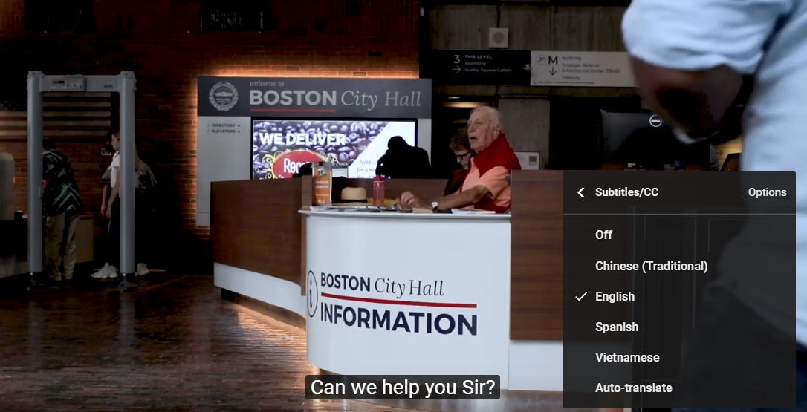
What is the difference between Captions and Subtitles?
Captions: Text displays in the original language being spoken
Subtitles: Translated text displays of what’s being spoken

Slide 17
How do Captions and Subtitles Promote Inclusion and Diversity?
Deaf Viewers
Non-Native English Viewers

Slide 18
Video Sample of Making a Video Accessible

Slide 19
Video Sample of ASL

Slide 20
Video Sample of Audio Description

Slide 21
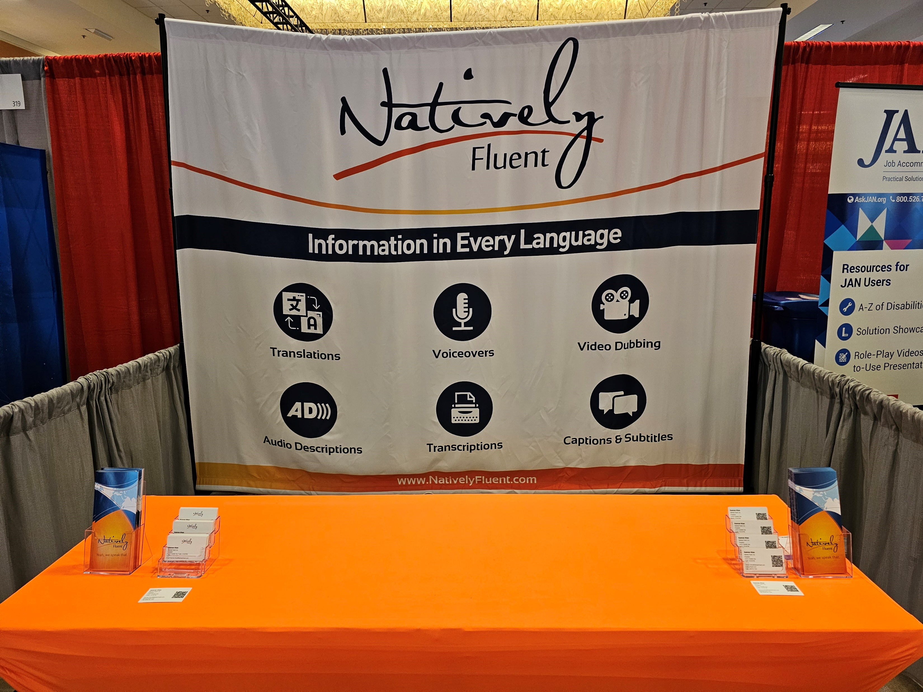
Come Visit Us at Booth 317

Slide 22
Text Questions to (949) 735 - 7522

Slide 23
Contact Us
Info@NativelyFluent.com
(888) 345-FLUENT
NativelyFluent.com

