Slide 1
Creating a Sustainable Decentralized Model for Accessibility
Noelle Bareswilt, Program Director, IT@UC Accessibility
Heidi Pettyjohn, Executive Director Accessibility

Slide 2
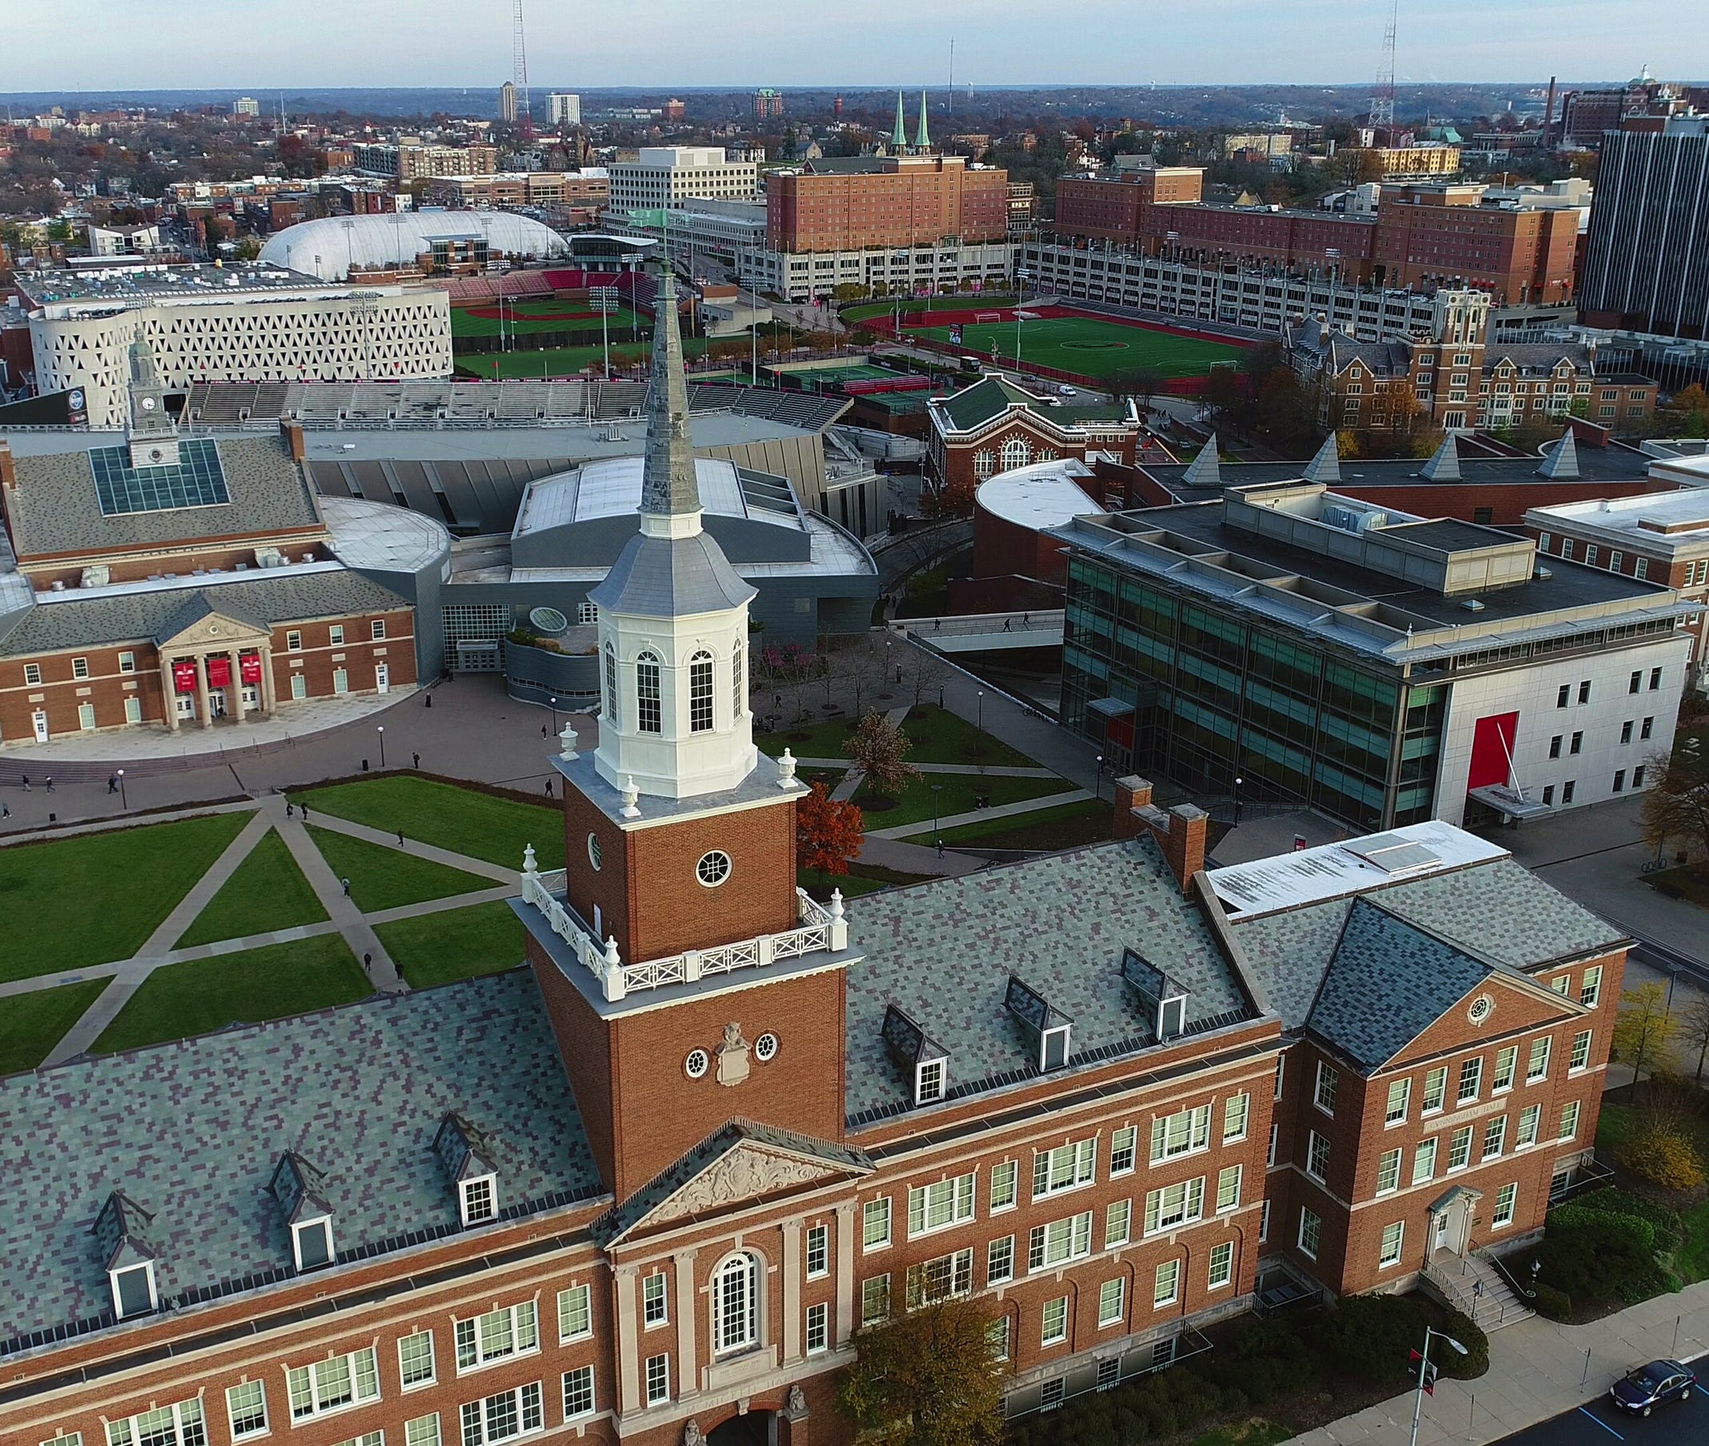
The University of Cincinnati
Urban Research 1 university founded in 1819
50,921 total students in fall of 2023; ~8,000 in online programs
4,500 faculty and 4,900 staff
Over 350 undergraduate programs and 340 graduate degree and certificate programs
14 colleges including 3 professional schools (Medicine, Law and Pharmacy) and 2 regional colleges
US News and World Report’s top tier ranking for national universities and Niche #45 among top public universities in the country
Invented cooperative education and currently ranked #4 in the nation, and top public university, in cooperative education

Slide 3
Today’s Takeaways
Decentralization leads to shared responsibility
Resistance is part of the process.
Focus on the “yes” people.
Notes:
Why are we talking about our journey and our

Slide 4
Accessibility Network at UC
The Accessibility Network increases the university’s capacity for electronic accessibility through education, resources, and direct support.

Slide 5
The Accessibility Network at UC
UC President
Student Affairs – Accessibility Resources
Exec. VP/AVP Marketing
VP and Chief Digital Officer
Exe. VP and Provost
CET&L
Communications
MarComm/Digital Team
IT Accessibility
CEEL/e-Learning
Application Development and UI/UX
Director Digital Access; 2 Accessible Media Specialists
Associate Director
Web Communication Manager
Asst. Director, WebStrategist, Communications
IT Accessibility Program Director, 2 Quality Assurance Analysts
Sr. Instructional Technologist; Computer Info Analyst; Support Specialist
Software Applications Developer Lead, Software Applications Developer 2
Notes:
Introduction of presenters

Slide 6
Accessibility Network Committees
Steering Committee: DTS; Student Affairs; Undergraduate Academic Affairs; Human Resources; Central Purchasing; Digital Marketing and Communications; Student Affairs; Provost Finance; Faculty
Executive Sponsors: Exec Vice President for Academic Affairs and Provost; Sr. Vice President for Administration and Finance and CFO; VP for Equity, Inclusion and Community Impact and Chief Diversity Officer
Accessibility Liaisons: Representatives from each college as well as UC Libraries, UC Online, and the Graduate School

Slide 7
Accessibility Network Phases
Phase 1: Compliance
Office for Civil Rights response
Phase 2: Commitment
Sustainable models for accessibility and incorporation of best practices
Phase 3: Culture
Personal and departmental ownership of accessibility
Notes:
Heidi – (interactive, focus on barriers, faculty role)
student experience is a huge area of focus. How do we ensure that students don’t have to jump through the same hoops on each campus, or at each college?

Slide 8
Standards of Accessibility
Web Accessibility
All content on public facing websites must be independently accessible
Third Party Accessibility
All software procured must provide full, equal and independent access. If this is not possible due to academic constraints, there must be a plan in place to create accessibility through an accommodation process.
Academic Accessibility
All online instructional materials must be accessible and allow students to engage in the same interactions with their classmates and instructional materials, at the same time

Slide 9
Creating Partnerships
- Why: Cast a vision
- How: Determine a model
- What: Define the Work
- Who: Invite others to do the work
Notes:
Noelle

Slide 10
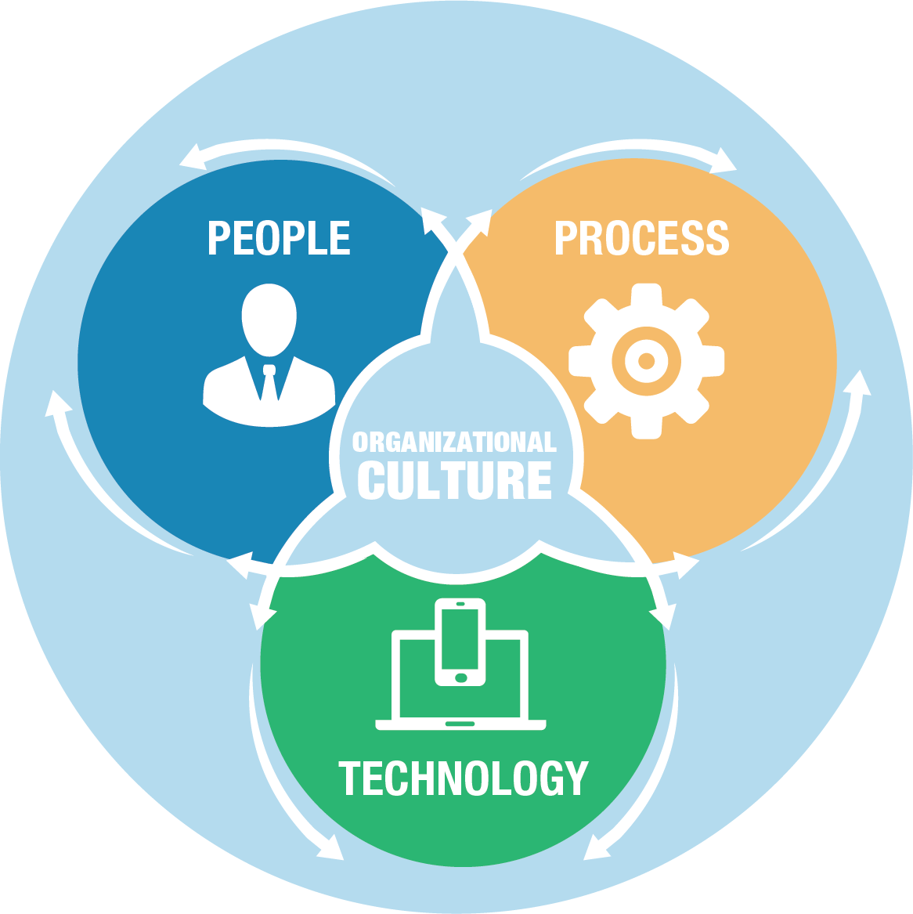
People, Process, and Tools: Questions
People
Who is going to champion this effort?
Who is going to lead this strategy?
Who is going to do the work?
Who is this for?
Process
Where should this work fit in?
Are there upcoming opportunities to incorporate this work?
How does this impact the process?
Tools
How accessible is your website/content/social media/eLearning?
How can you deliver training?
How can you communicate?
Notes:
Noelle

Slide 11
People, Processes, and Tools
Process + People (no tools) = Effort wasted due to lack of data or tools
Process + Tools (no people) = Effort wasted due to wrong audience/target
People + Tools/technology (no process) = Effort wasted due to lack of ownership
Notes:
Noelle

Slide 12
Process: Accessibility as agile process
Cross-functional team with diverse skillsets
Work in phases with deliverables along the way
Continuous planning, collaboration, and improvement
Benefits
Reduced Risk
Increased Transparency
Continuous collaboration
Flexibility
Quick delivery
Notes:
Noelle

Slide 13
What is the “the work” of accessibility?

Slide 14
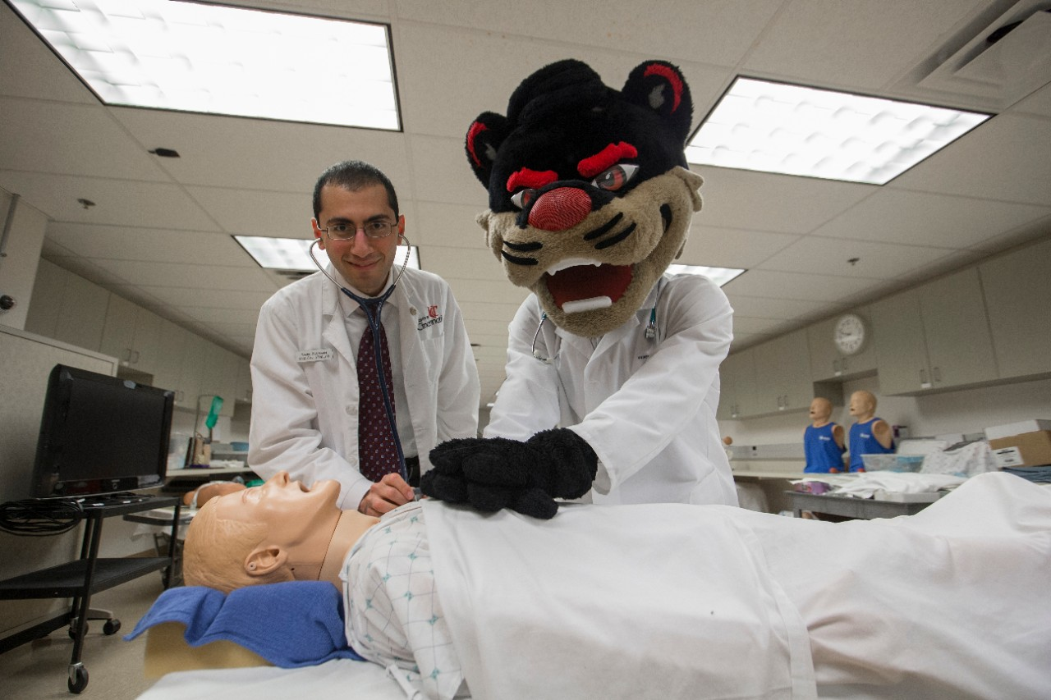
“The Work” at University of Cincinnati
Advocacy
Student accommodations
Employee accommodations
Creating accessible things
Making things accessible (remediation)
System management
Training/ Building resources
Policy and compliance requirements
Notes:
Heidi

Slide 15
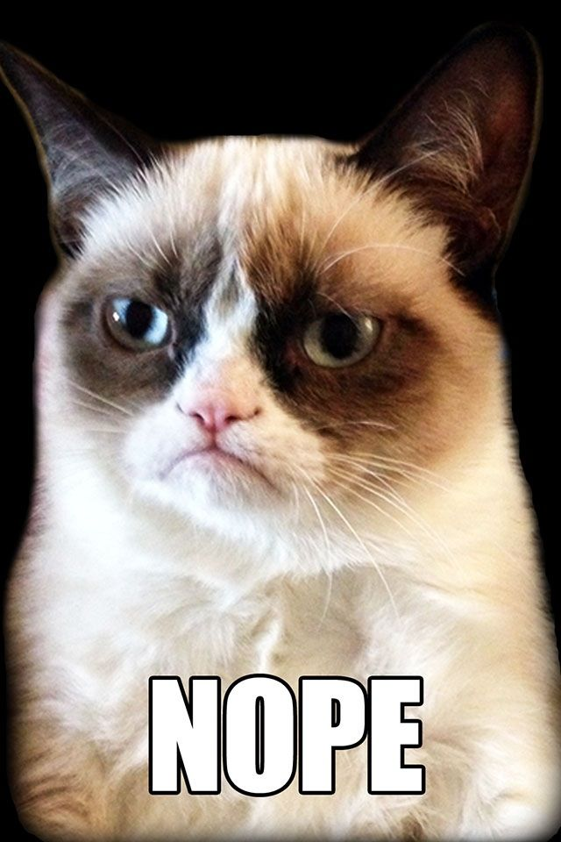
Resistance

Slide 16
Strategies for Resistance
Stay focused on people
Enthusiasm
Continued awareness
Technical solutions (templates and reusable components)
Offering education
Relating accessibility to their work
Involving leadership in development
Ignoring the resisters

Slide 17
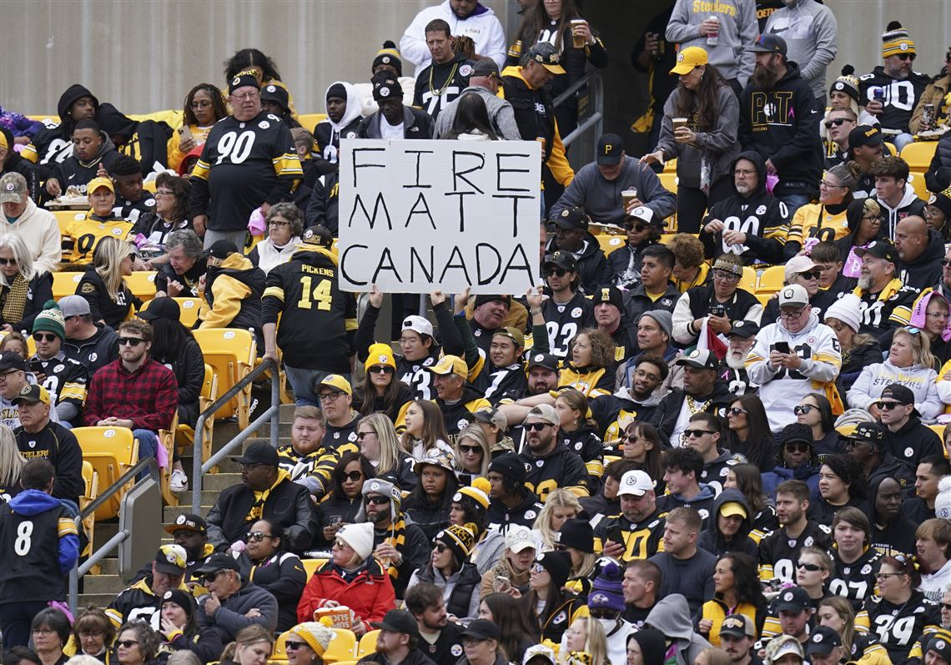
Choose your audience. . .

Slide 18
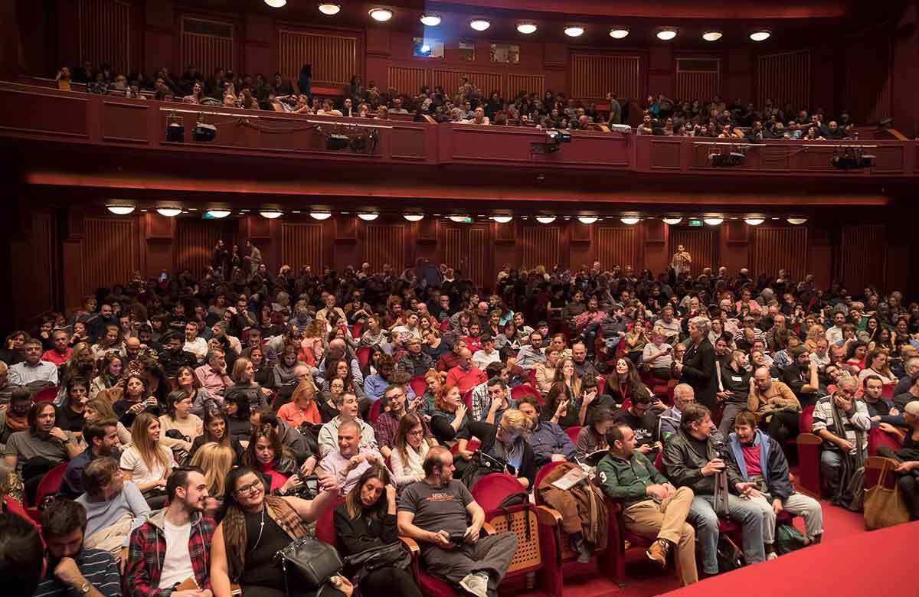
To reach this audience

Slide 19
Invest in the Best

Slide 20
Invest in the Most Likely to Say Yes
50% of your time and resources go to the “Stars”
On board and already doing the work
Bought in and wanting to learn more
Personal connections to the work
These are your ambassadors
25% of your time resources to new staff and faculty
On-boarding resources
Training for access
Introduction to philosophy, culture and tools
15% of your time to the “maybes”
Are not saying no but have questions and concerns
Connect with the Stars
10% resisters
Those out of compliance or making waves

Slide 21
The Change is Happening
Where is Noelle to ask her accessibility question?
Getting quick side messages during meetings from other functional team members saying "psst! Is that even accessible???"
Starting to see things become pro-active. Instead of reaching out to test something, people come to us first.
Seeing accessibility incorporated into technical tool training
The data! How long it is taking to QA sites, how many product reviews are coming in
Accessibility incorporated into central processes (Project gating, Procurement)
Notes:
We all know it is hard when you're in something day in and day out to step back and see the difference we're making – these are some of my favorite times that helped me step back and notice

Slide 22
What does a "Yes" approach look like?
For beginners
"Start Here" Campaign
Microsoft Word and PowerPoint workshops
Disability identity basics and universal design concepts
For advancing interests
PDF workshops
Closed captioning
Blackboard Ally tools
For technical staff
WCAG, ARIA
Accessible design
Field specific training

Slide 23
In Closing
Don't let perfect be the enemy of good
IF YOU WANT TO GO FAST, GO ALONE. IF YOU WANT TO GO FAR, GO TOGETHER

