Slide 1
Maximize the Impact: Strategies to Increase Knowledge & Use of Available AT Tools Across Campus
Accessing Higher Ground 2023

Slide 2
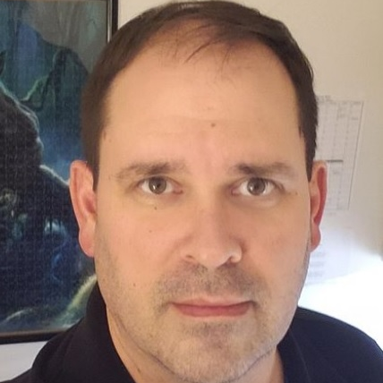
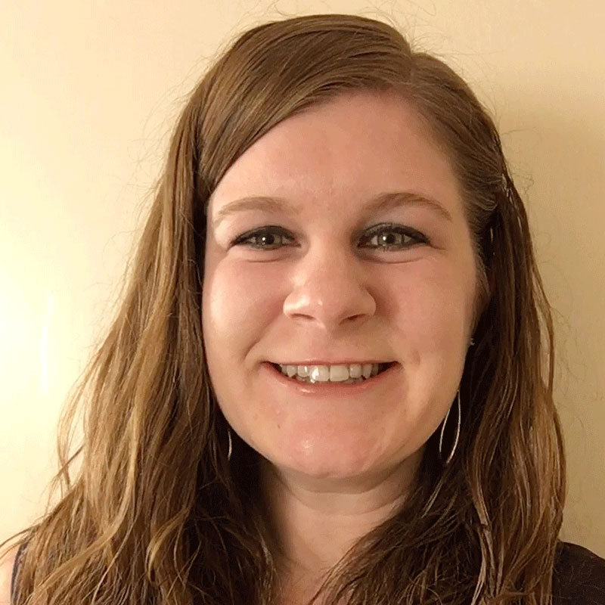
Hello!
Scott Bryden
Rachel Kruzel
Assistant Director of Accommodated Services
Higher Education Specialist
Texthelp
Email: r.kruzel@texthelp.com
Phone: 651-245-3128
X: @TH_RachelK
Case Western Reserve University
Email: scott.bryden@case.edu
Phone: 216-368-2132

Slide 3
Today’s Agenda
Our College Students Today
Awareness Building
Questions and Discussion
Campuswide adoption of AT tools
Building Partnerships

Slide 4
Our College Students Today

Slide 5
Students of today
Students with disabilities
Connected and not connected with DS
Un and underdiagnosed students
Finances, stigma, documentation, disclosure, awareness of disability or resources
Struggling learners, academic preparedness, skill preparedness, executive functioning, literacy, variability

Slide 6
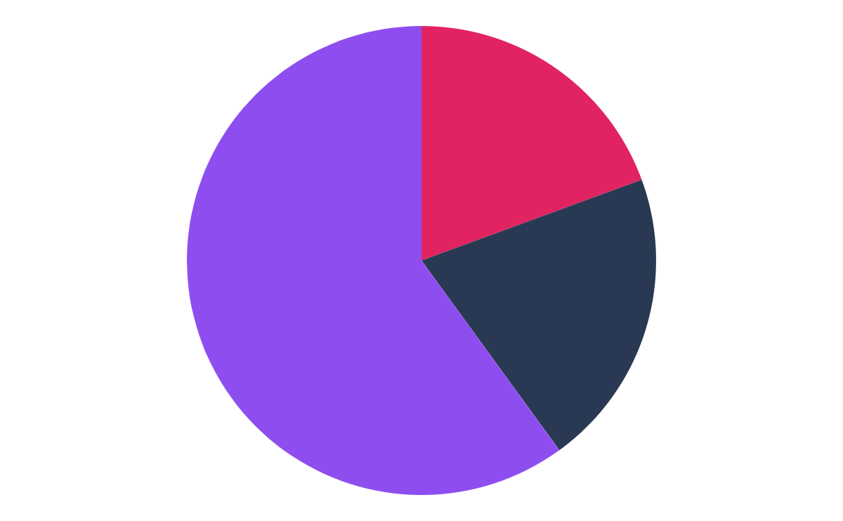
Disability and neurodiversity
19.4% of college students report having a disability ¹
37% of students with disabilities informed their college ²
Between 12-13% of students informed their college of their disability ²
Projected that 25% is a more accurate percentage of students with disabilities
Between 11-30% of college students are neurodiverse ³
More than 60% of college students meet the criteria for at least one mental health condition ⁴

Slide 7
Students reporting disability stats
Department of Education research found that only 37% of students with a disability reported their disability to their college. Additionally, a Mental Health America survey of 471 college students with mental health disabilities found that 70% didn’t register for accommodations from their school.
Department of Education, 2023

Slide 8
Weis, R., Waters, E.A. Evidence-Based Accommodations for Postsecondary Students with Disabilities: Beware the Base Rate Fallacy. Psychol. Inj. and Law 16, 213–226 (2023). https://doi.org/10.1007/s12207-023-09471-7
“A large, diverse sample of of undergraduates with and without disabilities rated their academic functioning across multiple domains… Overall, 95.5% of students with disabilities and 90.0% of students without disabilities reported at least one substantial limitation in academic functioning.”

Slide 9
Academic preparedness - reading
Reading too slowly - 11.1% (17.7%)
Understanding what I read - 16.1% (25.9%)
Need to re-read to get to the main point - 31.3% (43.6%)

Slide 10
Academic preparedness - notetaking
Taking organized notes that make sense - 11.3% (24.2%)
Talking good notes that prepare me for tests - 13.1% (25.6%)
Listening to a lecture/taking notes at the same time - 15.6% (32.2%)

Slide 11
Academic preparedness - overall
Needing to spend more effort on academic tasks than other people to perform well - 16.6% (31.6%)
Needing to spend more time on academic tasks than other people to perform well - 17.5% (34.5%)
Any academic limitation - 90% (95.5%)

Slide 12
Faculty and staff of today
Faculty and staff with disabilities
Faculty and staff without disabilities
Faculty focused on students with disabilities, UDL, inclusive learning strategies and practices

Slide 13
Campuswide Adoption of AT Tools

Slide 14
Rationale for campuswide adoption
Campus adoption of AT tools
Belief in the bigger impact it can make - inclusion
Evolution of our mindset and evolution of support
Students with disabilities connected to our offices versus the wider student population
Collaboration and all students are “our students”

Slide 15
Realities of implementation and awareness building
Used primarily by students connected to DS Offices
Direct contradiction for their wider purchase
Lack of awareness and knowledge by students
With disability connected to DS Office
With or without a disability not connected to the DS Office

Slide 16
Realities of adoption
Budgets, funding
Funding is availability; advocacy is necessary
Competing priorities
Justification - data, use, impact, scope of reach
Embrace the “why” of adoption and support it can provide

Slide 17
Importance of increasing AT knowledge
AT available to unregistered students with disabilities
Increase awareness of advantages that AT can bring to all
AT supports core functions and competencies
Universal license availability versus impact: 10% student; less than 5% faculty & staff
Access and use of AT increases student retention

Slide 18
Access to AT for student who don’t register
Student still feel stigmatized despite the benefits
Resources and AT help students gain equal access
Lowers stress, anxiety, increases focus, confidence and performance, better acclimation to university
Show university support learners with disabilities

Slide 19
Benefits of AT to students without disabilities
Dual modality for reading digital content aloud - benefit and preference
Annotate digital content (highlighters, text, shapes etc.)
UDL: multiple means of engagement: multiple learning methods to comprehend content in a method of preference

Slide 20
Benefits of AT to students without disabilities cont.
Organization, study habits, preparedness
Lower stress, reduce anxiety, and allow students to focus on a more positive study experience

Slide 21
Benefits of AT to faculty & staff without disabilities
Incorporate AT into course design to support students understanding and master of course content - leads to better grades
Quickly show complex equations in real time and share accessible files with students online for STEM course content

Slide 22
Benefits of AT to faculty & staff without disabilities cont.
Increase accessibility for all students with literacy tools
Streamline reports, smoother, more efficient for staff
Multi-tasking and report management for staff

Slide 23
Awareness Building

Slide 24
Common institutional priorities
Diversity, Equity, and Inclusion
Digital Accessibility
Retention, Student Success, Graduation Rates
Financial sustainability
UDL
Mental Health/Well-being
Enrollment
Sustainability
Assessment

Slide 25
Action items for strategic priorities
Rooted in theory; focused on education and training
Tangible actionable steps forward
Timeframe for seeing results is long - measured in years not semesters or weeks
Senior leaders are always looking for new, fresh ideas to implement to support this work

Slide 26
Priorities as a catalyst for change
Due to resources and attention…
How do you more closely align your office work to these priorities?
How do you make this work more visible to campus leaders and your line managers to help allocate and advocate resources?
How can tying these together create buy-in for your priorities and work?

Slide 27
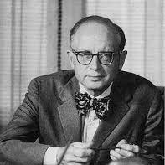
Education quote
“Education is learning what you didn’t even know you didn’t know.”
Daniel J. Boorstin
12th Librarian of Congress/Historian
University of Chicago

Slide 28
Letting It Happen versus Making It Happen
When actively working on implementation, using research backed strategies, you can expect up to an 80% outcome of what you’re seeking in three years.
If you don’t use implementation science strategies, you will only see 14% of the desired outcomes and it can take you up to 17 years to get to your desired outcomes.
This is why things start, stop, and fizzle out and why we don’t get lasting impact.

Slide 29
Domain AT your institution could have
Read&Write (includes Read&Write for Google Chrome)
Equatio
OrbitNote
JAWS
NaturalReader
Kurzweil
MathType
Speechify
Otter.ai

Slide 30
Technology of the student
What tools are students using and have been exposed to prior to coming to our institutions?
What types of tools and platforms have students used before?
Are you meeting students where they are at or giving them tools familiar and comfortable to us as professionals?

Slide 31
Getting students on board using AT
Present to incoming students during orientation. Build study skills and awareness on how these tools support these skills.
Awareness building with first year students on AT available and the benefits.
On-demand videos or demos to show the hands-on applications of the AT.
Partner with vendors to collaborate on presentations.

Slide 32
Action planning
Choose 2-5 action items
Set goals, expectations and leader
Determine timeline
Once achieve, repeat
Resource: Ways to Get the Word Out on Campus About Texthelp Tools

Slide 33
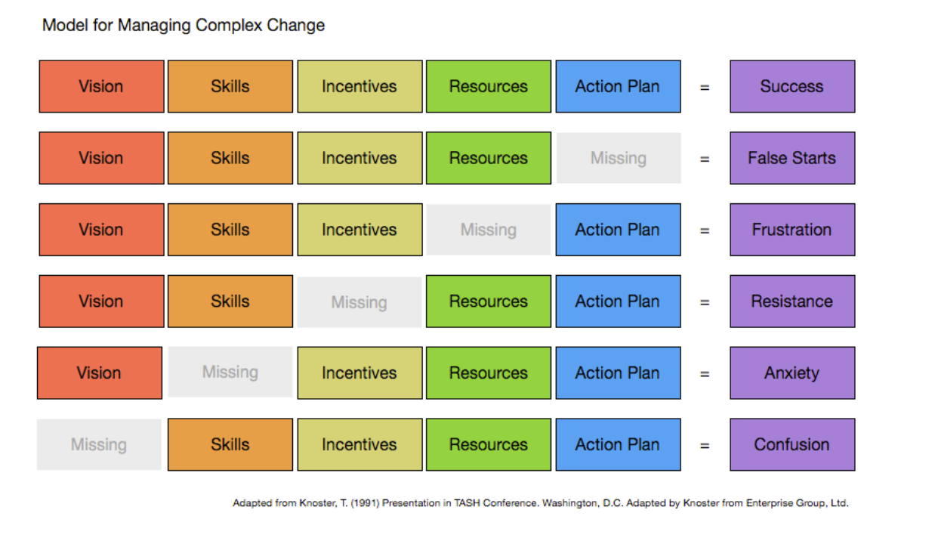
Model for Managing Complex Change

Slide 34
Building Partnerships

Slide 35
Importance of collaboration
“Alone we can do so little; together we can do so much.”
Helen Keller

Slide 36
Key partnerships
Instructional Design
Retention, Student Success & Student Support
CEO & CIO (Experience and Innovation)
Faculty?
Intentionality of connection is key

Slide 37
The Six Principles of Persuasion
Reciprocity - return favors, payback
Scarcity - innovation and short supply to get buy-in
Liking - the more you’re liked, the more you’ll persuade
Authority - influencers, titles, leaders are followed
Social Proof - what are your peers doing? competition?
Commitment/Consistency - alignment of beliefs and values

Slide 38
The Yes Ladder
Getting to the final yes is like a ladder - one step at a time
Steps (from The Scientifically Proven Method For Getting People to Say Yes)
What is your big ask?
Work backwards
Play your first ‘yes’
Encourages trust

Slide 39
Shared collaboration
The number - effective and efficient
What skills and strengths do I need?
Who brings which ones?
What is lacking?
Who is an influencer?
Voices, leadership, segments of institution

Slide 40
Questions & Discussion

Slide 41
Let’s Connect!
Scott Bryden
Rachel Kruzel
Assistant Director of Accommodated Services
Higher Education Specialist
Texthelp
Email: r.kruzel@texthelp.com
Phone: 651-245-3128
X: @TH_RachelK
Case Western Reserve University
Email: scott.bryden@case.edu
Phone: 216-368-2132

