Slide 1
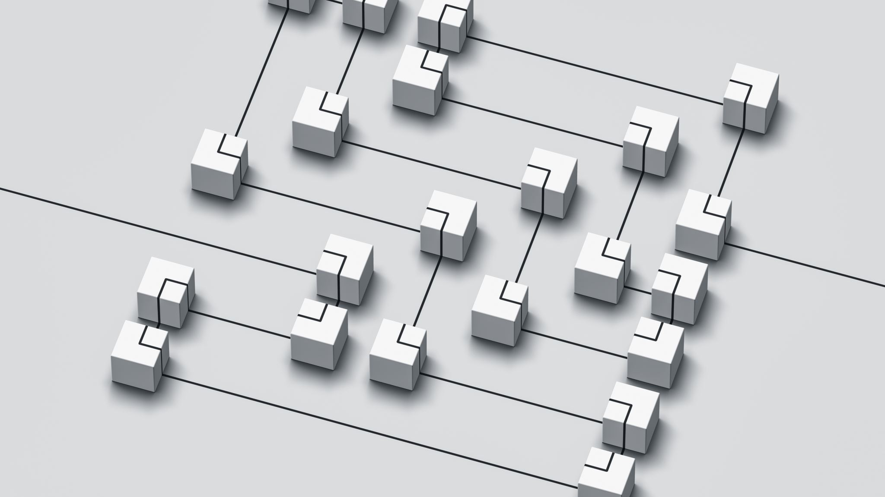
Building the Digital Accessibility Gateway: A data-driven model for Accessibility
Noelle Bareswilt, Program Director, UC Digital Technology Solutions
Heidi Pettyjohn, Executive Director Accessibility at UC

Slide 2
Key Points
Leadership support and engagement relies on communicating the right data in the right way
Developing a comprehensive data collecting/reporting strategy is critical
It is important to understand which data matter most in communicating accessibility needs to leadership
Notes:
Noelle

Slide 3
Data-driven Model
A data-driven model relies on the collection and use of data to shape the information we present and the story we tell.
Notes:
When you google "data-driven model" you are going to get a lot of very technical results talking about computational models, statistical models, machine learning, and database design. While we may be utilizing some of those concepts, we're going to keep it high level. --Noelle

Slide 4
Why use a data-driven model?
Helps to prioritize
Helps to demonstrate why this is a big problem that needs a big solution
Highlights underlying issues that impact accessibility
Notes:
--Noelle

Slide 5
Question
What data do people in the room currently have about accessibility?
Notes:
-Noelle

Slide 6
Inherent Challenges
Different levels of data maturity across the institution
Multiple sources of data
Need for specialized tools
Large amounts of data
Being data-driven but staying people focused
Notes:
-Noelle

Slide 7
Digital Accessibility Gateway Demo
Notes:
What does leadership do with this? What does this tell them about accessibility at UC? What are some stories we're still hoping to tell? What were some of the challenges we had along the way?

Slide 8
Standards of Accessibility
Web Accessibility
All content on public facing websites must be independently accessible
Third Party Accessibility
All software procured must provide full, equal and independent access. If this is not possible due to academic constraints, there must be a plan in place to create accessibility through an accommodation process.
Academic Accessibility
All online instructional materials must be accessible and allow students to engage in the same interactions with their classmates and instructional materials, at the same time
Notes:
Heidi

Slide 9
Two Types of Data
Foundational data: The data you gather in different areas that creates the foundation for evaluating the accessibility of your institution.
Accessibility data: How accessible is your content?
Notes:
Heidi

Slide 10
Web Accessibility Data
Accessibility data
Foundational data
Accurate alt text on every image
Correct and consistent heading structures
Captions on videos
Correct Color contrast
Web forms
PDFS
Etc.
Number of websites and pages
Number of PDFs, videos, web forms
Number of people who can change the accessibility of your website and who are they?
Number of content management systems
Analytics
Notes:
Noelle

Slide 11
Academic Accessibility
Accessibility data
Foundational data
Accurate alt text on every image
Correct and consistent heading structures
Captions on videos
Correct Color contrast
PDFs
Created content accessibility
Third party usage (videos, articles, etc.)
Number of courses
Number of faculty with live courses
Who are the faculty and staff creating courses and content?
Number of students with disabilities; number of courses with SWD enrolled; number of faculty with SWD in their class
Time to completion for digital/communication access accommodations and requests
Notes:
Heidi

Slide 12
Third-Party Accessibility
Accessibility data
Foundational data
Accurate alt text on every image
Correct and consistent heading structures
Captions on videos
Correct Color contrast
Web forms
PDFS
Vendor documentation
Roadmap documentation
Potential for inherent inaccessibility
Adherence to internal compliance requirements
Functionality of the software/hardware.
Purpose of software/hardware in course and program of study
Number of people who can use it/will use it
Time to integration and use?
Is it an authoring tool?
How customizable is it?
Who is going to implement it?
Notes:
Noelle

Slide 13
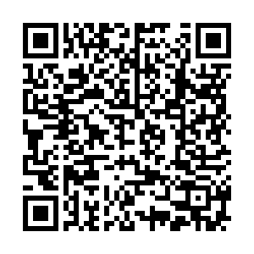
Activity
Choose a worksheet and fill out the answers to the questions – two minutes
Share your results/reactions with a group – five minutes

Slide 14
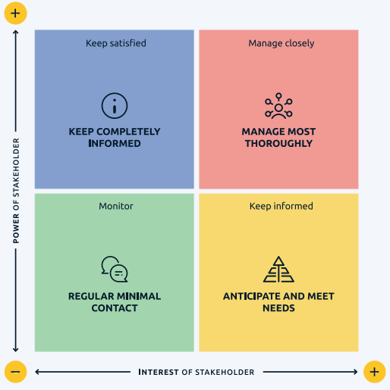
Stakeholder Mapping

Slide 15
Stakeholder Matrix Text
Stakeholders with low power and low interest: Monitor with regular, minimal contact
Stakeholders with low power and high interest: Keep informed and anticipate and meet their needs
Stakeholders with high power and low interest: Keep satisfied and completely informed
Stakeholders with high power and high interest: Manage closely, and most thoroughly

Slide 16
Stakeholder Matrix Example: Blackboard Ally Implementation
Low power and low interest: Monitor with regular, minimal contact: Students
Low power and high interest: Keep informed and anticipate and meet their needs: Instructional design and IT staff in colleges; Accessibility Resources staff; Faculty
Stakeholders with high power and low interest: Keep satisfied and completely informed: Deans; Executive Sponsors (Provost, CIO, CDO)
Stakeholders with high power and high interest: Manage closely, and most thoroughly: Accessibility Network staff; IT Staff managing the system; Faculty leaders; Assistant Deans

Slide 17
Communication Ideas
Low power and low interest: Monitor with regular, minimal contact
Example: Emails, newsletters, passive communication
Low power and high interest: Keep informed and anticipate and meet their needs
Examples: Attend standing meetings; give background information; understand their questions and concerns; develop resources for support; advocate for their concerns
Stakeholders with high power and low interest: Keep satisfied and completely informed
Examples: Layout the issue in one paragraph or a few bullets; stay focused on the problems that they are actively trying to solve at the institution (compliance, finance, impact); don’t let them be surprised
Stakeholders with high power and high interest: Manage closely, and most thoroughly
Examples: bring into the process; solicit feedback; respond to concerns and questions; adapt to meet needs of their other priorities; don’t catch off-guard

Slide 18
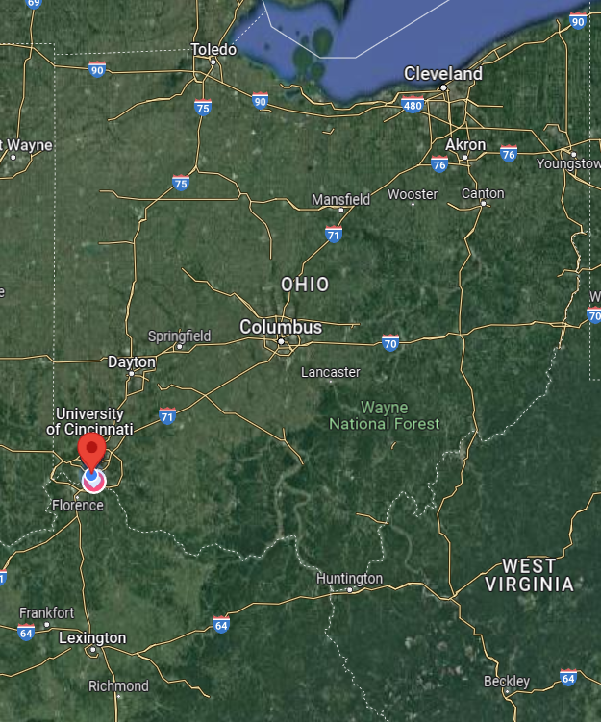
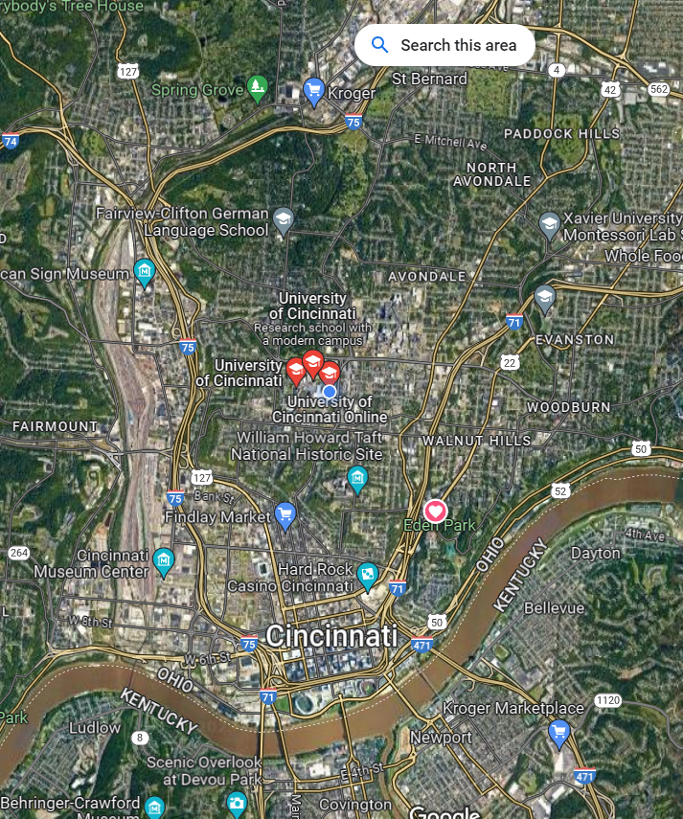
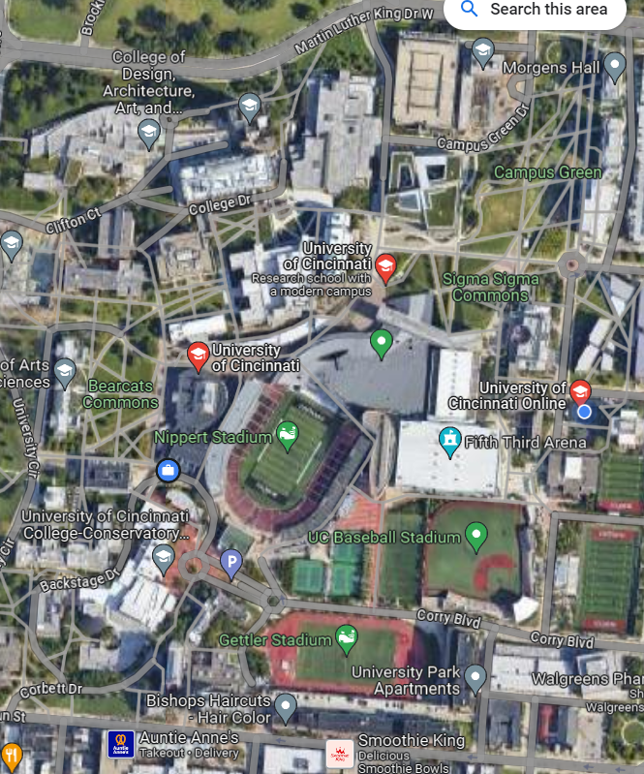
“Zoom Out” In Communication

Slide 19
A Data Story
Notes:
Noelle

Slide 20
Questions and Thank you

