Slide 1
Automated and Manual Accessibility Testing
Mike Williamson
Marisha Lamont-Manfre
Addison Hugen
CU Boulder DigitalAccessibility Office
https://bit.ly/ManualTestingAHG23

Slide 2
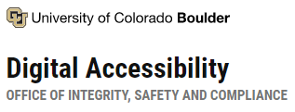
Who we are
Assessment & Usability team
We are involved in other processes in addition to testing:
Procurement
Consultations with vendors
Requests for document review
Special projects:
Data Visualizations
Student Portal
Digital tools study
Notes:
Mike

Slide 3
Learning Objectives
Understand that automated testing alone does not provide a complete picture
Understand why digital accessibility is about user experience
Learn best practices and resources to help implement digital accessibility into workflow
Notes:
Mike

Slide 4
We're Not All at the Same Place... And That's Okay
Learning/understanding is a process
You may be at different places than others
Resources differ
Not all processes will look the same
Notes:
Mike

Slide 5
Questions to the audience:
What is Accessibility? What is Usability?
Notes:
Ask the question and for volunteer examples (3 for each)
Take a moment – 2 minutes – 5 minutes max
Our definitions on the following two slides
We define accessibility as the idea that all people should have access to the same information, interactions, and services as everyone else.
Mike

Slide 6
What is accessibility and usability?
We define accessibility as that all people having access to the same information, interactions, and services as everyone else.
Usability is when the technology is:
Functional
Convenient
Consistent
Comfortable
We care about both.
Accessibility standards can be met while the product is still unusable or difficult to use.
Notes:
Mike

Slide 7
How can we measure accessibility?
There are many ways to measure, assess, and explain accessibility. The two you may have heard of are:
Web Content Accessibility Guidelines (WCAG) developed by the World Wide Web Consortium (W3C)
VPAT (Voluntary Product Accessibility Templates) that vendors will often create and provide with their product
To fill out a VPAT or to check for WCAG compliance, someone may conduct an accessibility test on a product. While there are different ways of testing, two common approaches are automated and manual testing.
Notes:
Marisha

Slide 8
Digital Accessibility in Higher Education
Digital accessibility is found in all areas of life, but below is a list of examples of where we should consider digital accessibility in higher education:
Video content
3rd party ed-tech tools
Websites
Library databases
Learning management modules
Procurement
OIT software
Notes:
Marisha

Slide 9
Digital Accessibility Testing
Accessibility testing is "a subset of usability testing where the users under consideration have disabilities that affect how they use the web." (W3C, 2019).
Usability testing evaluates "how usable a product is for people with disability" (Deque, 2014)
The goal is for accessible and usable sites and software that all users can utilize. ​
Notes:
Marisha

Slide 10
Automated Testing
Automated testing relies on digital tools that "enable you to audit thousands of documents, web pages, or even multiple websites simultaneously." (Siteimprove, 2022)
Notes:
Marisha
Pro - Quantifiable?
Con – Accuracy
https://beaccessible.com/post/why-using-automated-tools-for-testing-accessibility-is-not-enough/
https://www.boia.org/a11yreports/
https://www.section508.gov/test/testing-overview/
https://alphagov.github.io/accessibility-tool-audit/

Slide 11
Automated Testing Pros
Pros:
Requires less time and resources (Siteimprove, 2022)
Can be free or low cost (essential Accessibility, 2018)
Results are immediate (essential Accessibility, 2018)
Quantify how accessible a product is
Notes:
Marisha

Slide 12
Automated Testing Cons
Cons:
There can be false positives or false negatives (essential Accessibility, 2018)
Gives yes/no ratings and not available to provide nuance of issues like alternative text.
Reports indicate low accuracy rates
Notes:
Marisha

Slide 13
Manual testing
Manual accessibility testing uses humans to navigate the website or platform using assistive technology to look for errors.
Testers note where there are accessibility issues.
Issues can be:
Areas not screen reader compatible (Siteimprove, 2022)
Cannot be accessed by keyboard
Navigation or readability issues
Lack of alternative text or labels
Notes:
Marisha

Slide 14
Manual Testing Pros
Pros:
More nuanced
Allows for true AT users (or people with disabilities) who have lived experiences to assess content
Notes:
Marisha

Slide 15
Manual Testing Cons
Cons:
Time – manual testing takes time to go through each page
Cost – there are testers that need to be paid for their time

Slide 16
Mental Maps
How someone makes sense of their digital environment:
Document Structure
Naming conventions (calling something what it is)
Contextual queues
Consistent operations
Notes:
Mike

Slide 17
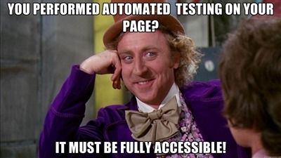
How Automated Testing Falls Short
Notes:
Marisha

Slide 18
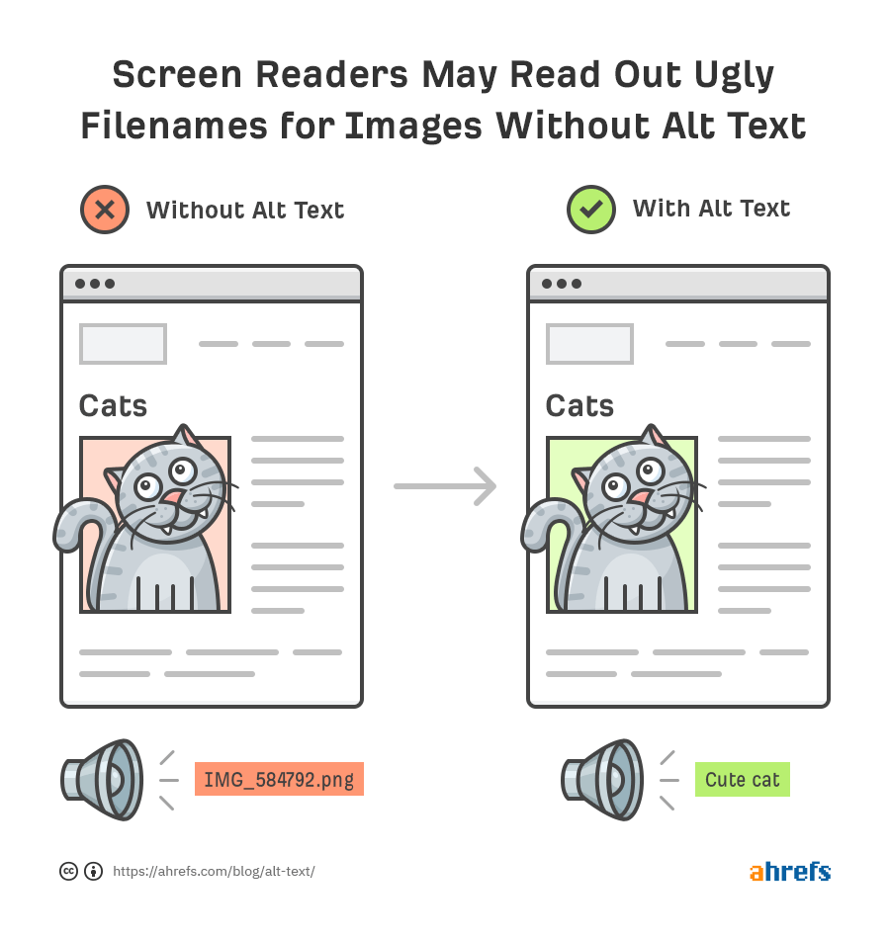
Limitations
Automated testing alone cannot catch all accessibility or usability issues.
Studies have shown that automated testing tools only "find 20 to 30% of accessibility issues" (Bunch, 2021).
Demo
Notes:
Demo – PDF – Short PDF paragraph with an image.
Show automated tools (checker)
Check we're using our own computers - NVDA
Marisha

Slide 19
Screen Reader Demo
Using: Two examples of the same PDF (good and bad)
Key takeaways: what you see is not always what you get
Notes:
Marisha will talk, Mike will drive SR

Slide 20
Manual Testing at CU Boulder
The way that we test has worked for our office and program. While this may not be the best course for other institutions, there are lessons we want to share.
Notes:
Marisha
Check the inventor

Slide 21
CU Manually Tests
CU Boulder's Assessment & Usability team manually tests digital products. We have developed a methodology that works for our office.
Learn about the product
Write task list (or testing script)
Test the product using the testing script.
Validate testing notes & compile report.
Report is reviewed & sent to the customer
Notes:
Marisha

Slide 22
CU Manually Tests (part 2)
We test with a focus on usability. Products can be technically accessible by WCAG standards but may not be usable.
The report uses four categories:
Severe – the issue breaks the program
Significant – the issue is difficult to navigate or "violates" WCAG
Minor – the issue impedes usability with slight difficulties that's easily overcome
Usability – issue affects all users
Notes:
Marisha

Slide 23
Screen Readers – Our Foundational Tool
Why do we use screen readers?
Screen reader accessibility captures more than just issues that will impact users who are blind or have low vision.
Since screen readers read the code, issues impacting all users can be found.
For example, if a button is not a programmatic button, then that will also disrupt speech-to-text use.
Notes:
Mike

Slide 24
Experience of True AT Users
Importance of true AT users (or users with disabilities)
The W3C mentions that there are two groups that should conduct testing: experts and users (2019).
They note: "No amount of developer inspection and screening can substitute for the raw clash between a user and a website."
True AT users can uncover more technical issues and experience the "subtle interactions between web content and assistive technology" (W3C, 2019).
Notes:
Marisha

Slide 25
Other Considerations
Keep these in mind:
Color Contrast
We use the Colour Contrast Analyser by TPGi to test for color contrast.
Closed Captions
Captions need to have a 99% accuracy. Auto captions on YouTube and other sites are generally 80% accurate (3Play Media, 2022).
Notes:
Marisha

Slide 26
What can you do?
“The power of the Web is in its universality. Access by everyone regardless of disability is an essential aspect.”
Tim Berners-Lee, director of W3C
Notes:
Marisha

Slide 27
Nurturing Digital Accessibility Proficiency And Cultural Competence From An Organizational Perspective
Accessibility is not a “feature”
Understanding there is nuance (“it depends”)
Digital Accessibility Policy
Training
Talk about it!
Let others see you doing it!
Notes:
Mike & Marisha
Accessibility is not a “feature”
Understanding there is nuance (“it depends”)
Digital Accessibility Policy
If you don't have one create it! Testing is a learned skill, so be sure to have people who know accessibility.
Hire people who use AT and have disabilities
Training
Talk about it!
"Nothing about us without us"
Let others see you doing it!

Slide 28
Nurturing Digital Accessibility Proficiency And Cultural Competence From A Human Perspective
Disability is an important part of the diversity and inclusion conversation
Awareness of lived experiences and identities
Buy-in to human condition
Experiences vary, they are individual
Notes:
Mike

Slide 29
Ask Questions!
Whether working with vendors, the institutions, or using digital tools in the classroom, here are questions you can ask:
Vendors:
How was the product tested?
If it was just automated, call it out!
Do they have a VPAT or a Roadmap?
Do not take VPATs for their word. Ask about roadmaps and if they're willing to work with you to address accessibility issues/concerns
Notes:
Mike

Slide 30
Ask Questions! (part 2)
Institution:
What are the digital accessibility policies?
How is the institution testing for accessibility?
Are there processes for reviewing products?
Who should be contacted for accessibility questions/support?
Online Digital Tools:
Am I asking students to engage in activities or use tools that will exclude them?
Do I know how accessible this tool is?
What accessibility information is online?
Who can you contact (vendor or institution) if there is an accessibility issue?
Notes:
Mike

Slide 31
Resources
General
WebAIM
W3C Digital Accessibility Foundations Course (free!)
LinkedIn Learning has accessibility trainings
Not all trainings are created equally
CU Boulder Accessibility Support
Newsletter
Resource pages
Notes:
Marisha

Slide 32
Questions?

Slide 33
Thank you!
AUL@colorado.edu

Slide 34
References
Bunch, W. (2021, March 15). Why Automated Accessibility Testing Tools Are Not Enough. Zoonou. https://zoonou.com/resources/blog/why-automated-accessibility-testing-tools-are-not-enough/#:~:text=Limited%20coverage%3A%20automated%20tools%20cannot,%2D30%25%20of%20accessibility%20issues
Deque Systems. (2014, November 18). How to Incorporate Users with Disabilities in UX Testing. Deque. https://www.deque.com/blog/incorporate-users-disabilities-ux-testing/#:~:text=While%20usability%20testing%20can%20evaluate,are%20also%20like%20other%20users
eSSENTIAL Accessibility. (2018, March 2). Web Accessibility Toolbars: 7 Pros, 8 Cons of Automated Testing Tools. eSSENTIAL Accessibility. https://www.essentialaccessibility.com/blog/web-accessibility-toolbars
Gevorkian, D. (2019, September 30). Why Using Automated Tools for Testing Web Accessibility Is Not Enough. Be Accessible. https://beaccessible.com/post/why-using-automated-tools-for-testing-accessibility-is-not-enough/
Gibson, B. (2019, December 08). Accessibility Testing by People with Disabilities. 24Accessibility. https://www.24a11y.com/2019/accessibility-testing-by-people-with-disabilities/
McErlean, E. (2022, May 06). Make Space For All: Digital Accessibility Benefits Everyone. Forbes. https://www.forbes.com/sites/servicenow/2022/05/06/make-space-for-all-digital-accessibility-benefits-everyone/?sh=2939124564ae
Shenton, A.K. (2004). Strategies for ensuring trustworthiness in qualitative research projects. Education for Information 22.
Siteimprove. (2022). Manual Accessibility Testing. Siteimprove. https://www.siteimprove.com/glossary/manual-accessibility-testing/
Siteimprove (2022). Automated accessibiltiy testing. Siteimprove. https://www.siteimprove.com/glossary/automated-accessibility-testing/
Stahl, N. A. & King, J. R. (2020). Expanding Approaches for Research: Understanding and Using Trustworthiness in Qualitative Research. Journal of Developmental Education, 44(1).
W3C. (2018, June 05). Web Content Accessibility Guidelines (WCAG) 2.1. W3C Recommendations. https://www.w3.org/TR/WCAG21/.
W3C. (2019, May 20). Accessibility testing. W3C Wiki. https://www.w3.org/wiki/Accessibility_testing
3PlayMedia. (n.d.). The Ultimate Guide to Closed Captioning. 3PlayMedia. https://www.3playmedia.com/learn/popular-topics/closed-captioning/#

