Slide 1
Promoting and enhancing Audio Description practice within Higher Education
Ann Fredricksen (DRES) and Bob Dignan (CITL)
Disability Resources and Educational Services and Center for Innovation in Teaching and Learning
1

Slide 2
Outline
Past: History of AD at University of Illinois
  Some Accessibility-related landscape
Present: In Progress AD Activities
Future: AD Aspirations
Disability Resources and Educational Services and Center for Innovation in Teaching and Learning
2

Slide 3
Key Takeaways
Tips for promoting audio description teaching practices to instructors and campus.
Outsourcing audio description can be financially and mentally challenging to disability service offices.
Higher Ed institutions have all the skills and knowledge required to strategically create AD in house.
Disability Resources and Educational Services and Center for Innovation in Teaching and Learning
3

Slide 4
History of AD at UIUC (1 of 3)
Tim Nugent and legacy of DRES 1948
2007—IITAA 1.0
  "All video and multimedia productions that contain essential visual information shall be audio described when provided to the public and/or required to be viewed by employees."
2010—Development of media player with rich accessibility functionality
  Addressed challenges of AD in education. Came to AHG in 2012!
  Timed XML for descriptions: player pauses should extended description be needed
2011—2-day AD training by Joel Snyder, Audio Description Associates LLC
  Sponsored by Provost and Library IT fund
  20 in attendance (recording available to UIUC)
  Subset of 5 trainees continued practice via informal, occasional meetings
Disability Resources and Educational Services and Center for Innovation in Teaching and Learning
4
Notes:
DRES- Disability Resources and Educational Services
IITAA- Illinois Information Technology Accessibility Act

Slide 5
History of AD at UIUC (2 of 3)
2013—Campus Administrative Manual Policy (FO-43)
  Multimedia Accessibility: “The University of Illinois relies on administrators, faculty, and staff to provide equal access to all programs and activities for individuals with disabilities. The most effective means of providing equal access to media is through the use of products with open or closed-captioning, subtitles, and descriptive audio. It is the responsibility of all units/departments, administrators, faculty, and staff to utilize media products in adherence with IITAA.”
2017—Exemption Under 17 U.S.C. § 1201 (Final Rule and Long Comment)
  Allowed for Disability Service offices to make multimedia accessible without getting permission from the copyright owners.
Disability Resources and Educational Services and Center for Innovation in Teaching and Learning
5

Slide 6
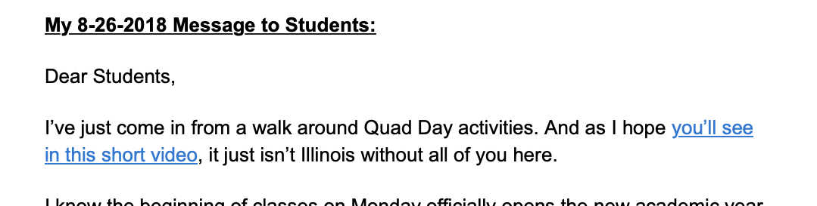
History of AD at UIUC (3 of 3)
2018—IITAA 2.0 "IL-WEB-8.5 Provide audio descriptions for multimedia containing essential visual information."
  Digital Accessibility Policy (HR-86)
    OVCDEI, ADA IT Coordinator, ITAL
Chancellor Videos—Increasingly visual productions from Public Affairs (Dec 2017, Aug 2018)
Disability Resources and Educational Services and Center for Innovation in Teaching and Learning
6
Notes:
OCVDEI- Office of the Vice Chancellor for Diversity, Equity & Inclusion
ITAL- IT Accessibility Liaisons

Slide 7
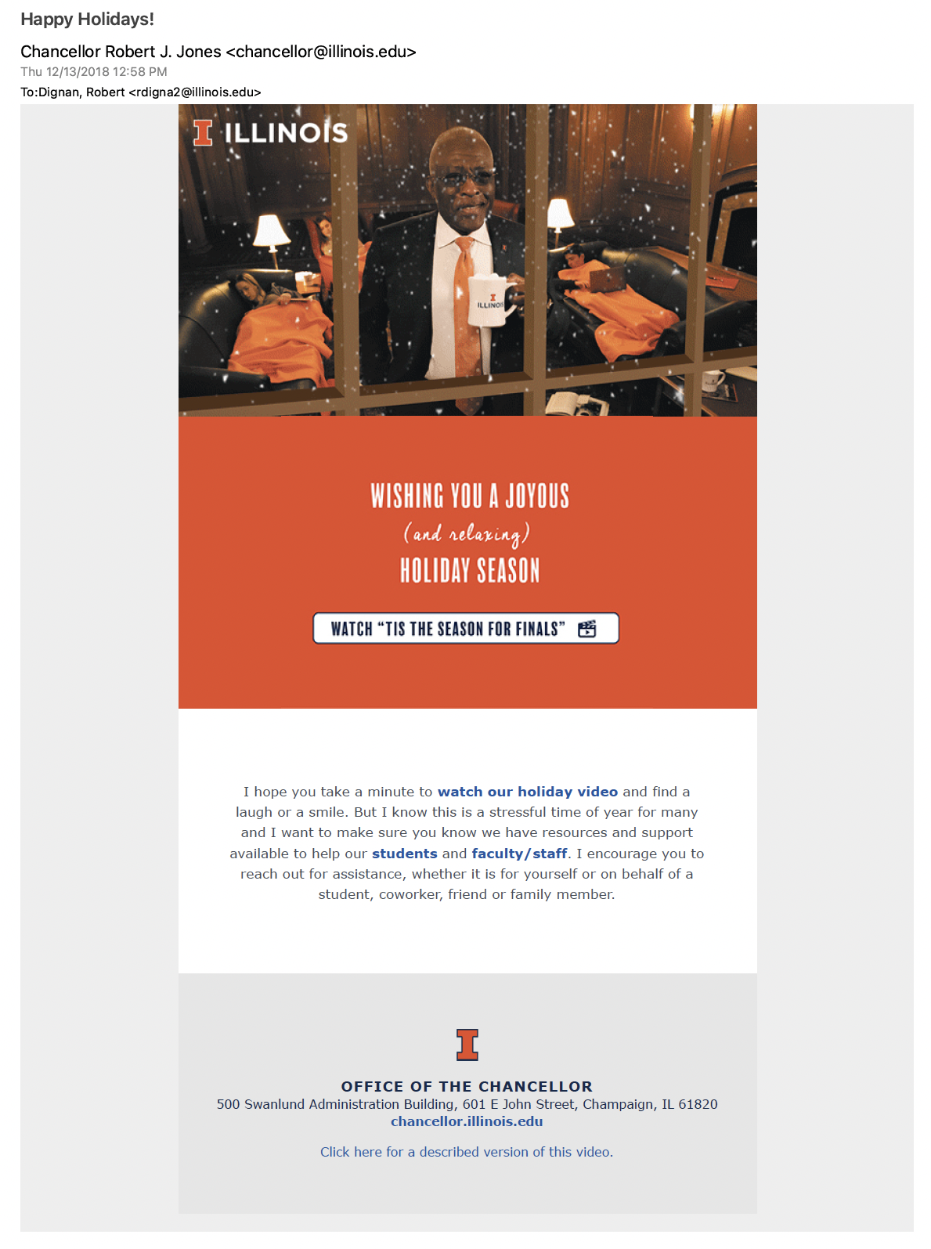
Examples of AD (1 of 2)
Dec 2018: "'Tis the Season for Finals"
  Got script (production notes)
  2 weeks prior to launch
  48-hours between seeing edit and deadline
  Included in Massmail
Disability Resources and Educational Services and Center for Innovation in Teaching and Learning
7

Slide 8
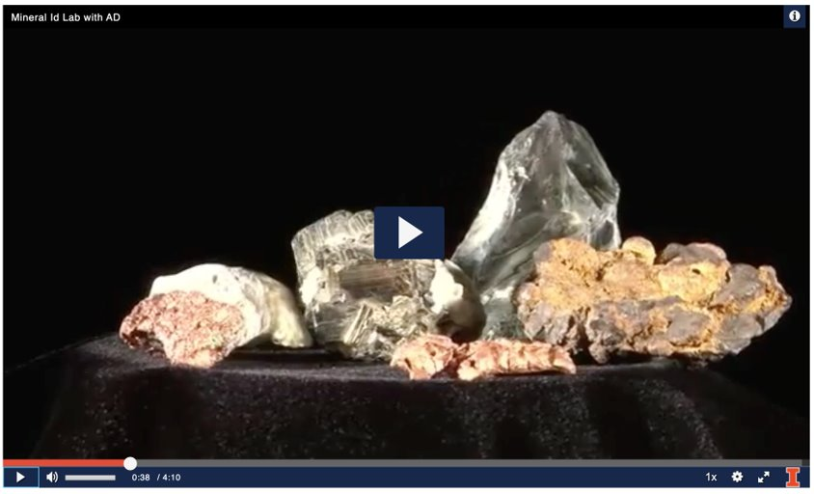
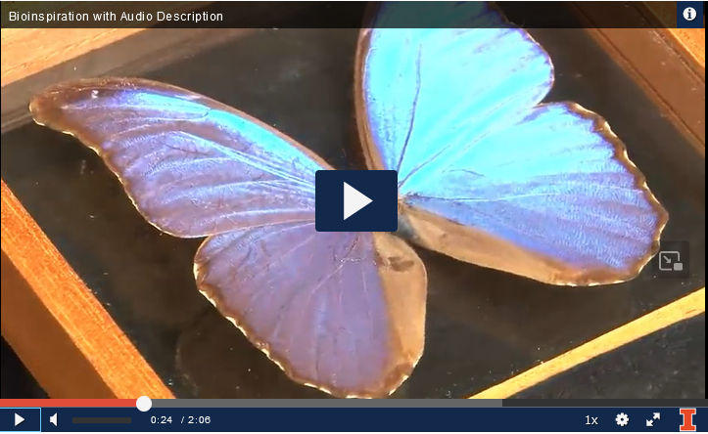
Examples of AD (2 of 2)
Fall 2017-DRES practices creating AD in house.
  Introductory Geology:
  Mineral Identification Lab
  Bioinspiration:
  Butterfly and photonic crystals
Disability Resources and Educational Services and Center for Innovation in Teaching and Learning
8

Slide 9
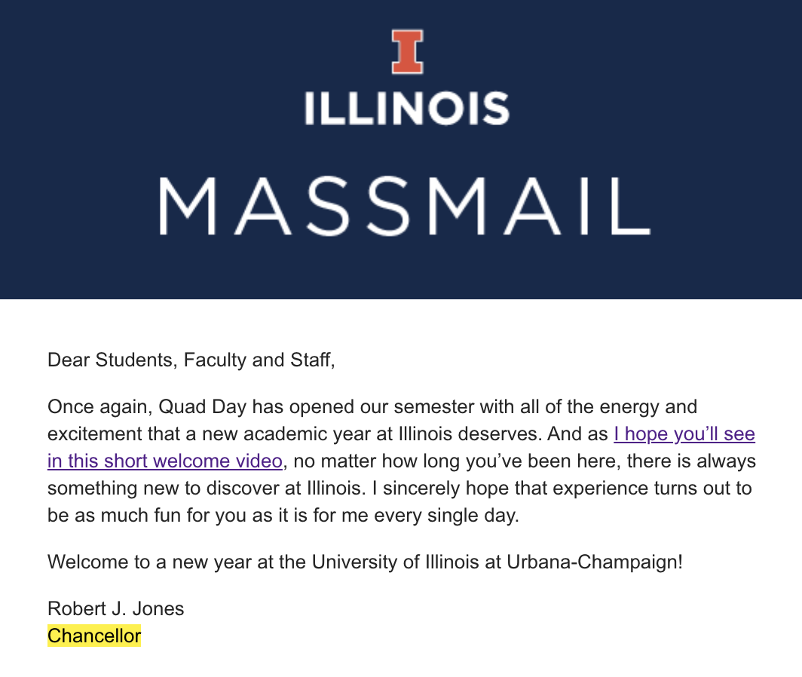
Thumbnail of Many Years
Aug 2019
Led TARC Launch Event (2019) with
story of "'Tis the Season for Finals"
Hit and miss for "fun" videos
Certain, high-profile academic programs needing AD
on all materials. Utilized vendor to keep pace.
ITAL and Faculty-facing presentations re: AD
New energy around accessible media for education. Computer Science prof using OCR and Scene detection to turn video into ePub
Disability Resources and Educational Services and Center for Innovation in Teaching and Learning
9

Slide 10
Audio Description Requests by Students
Pre-2017, AMS had asked blind/low vision students if they needed/wanted AD—all basically said the visual material in media was so low priority that they were not concerned.
  Note pre-2017 media not as heavily used as it is today.
2017—Hired an hourly worker to test training/creation of AD in house feasibility.
  This was a result of a student taking Coursera Course/degree program that was inaccessible.
Students on descriptions within transcripts:
  2021-2023: 1 student, 4 courses, 81.09 hours
  2022-2023: 2 students, 5 courses, 28.25 hours
Disability Resources and Educational Services and Center for Innovation in Teaching and Learning
10
Notes:
AMS-Accessible Media Services

Slide 11
Outsourcing concerns with Vendors
Outsourcing of content can be pricey.
Vendors are not necessarily content experts.
  Neither are DSOs.
  Should/can you trust a vendor or DSO staff to decide what was described accurately in the audio track?
  Was there alternative text in the ancillary material?
Educational material is typically audio rich content.
  There isn’t a lot of room to add description—do I need to pay more to create extended described video content?
Disability Resources and Educational Services and Center for Innovation in Teaching and Learning
11

Slide 12
Present: In Progress AD Activities
Training and Re-training from Joel Snyder
  1 hour, online, faculty-facing | 1 hour, online, IT accessibility
  3 day intensive across University System (30 attendees)
Creation of badging module for higher education contexts
  Canvas LMS with digital credential (modeled after Captioning 101)
  Integration of desperate AD and accessibility resources like The Visual Made Verbal, The Diagram Center, UDL concepts, technology options/solutions.
Community of Practice
  Microsoft Teams and Monthly meetings for project sharing and momentum
Disability Resources and Educational Services and Center for Innovation in Teaching and Learning
12

Slide 13
Future of AD at UIUC
Staffing and technology to support students
  DOJ ADA Title II Proposed Rulemaking
  Campus media player doesn't yet support secondary audio track.
    Vendor capability through Kaltura Reach creates second copy of video and can only be “ordered” through one vendor through Reach system.
  UDL and A11Y first training and culture
Academic course on AD (cross listing welcome!)
More (any?) AD for campus life and community offerings: performing arts, museums, campus app, media/TV
Engaging researchers how they think – grants
Disability Resources and Educational Services and Center for Innovation in Teaching and Learning
13

Slide 14
Tips for promoting AD on your campus (1 of 2)
Positive culture around accessibility is more powerful than policing compliance.
  Reject "unfunded mandate" woes with empathy
  Help people critically examine a phrase like "as you can see..."
Some faculty like control. Let them "take control" and self-describe visuals in-line with teaching.
  Often, the most expert voice on the visual is that faculty
  Alleviates technical systems if AD is in primary audio
Disability Resources and Educational Services and Center for Innovation in Teaching and Learning
14

Slide 15
Tips for promoting AD on your campus (2 of 2)
AD is a transferable skill! Faculty can increase their digital and media literacies for journal/book publications, conferences, self-promotion, etc.
Enter hearts through the arts
Connect to research enterprise with faculty and students
  Microsoft's Accessibility Lighthouse Program
  Beckman Institute's (dis)Ability Design Studio
Disability Resources and Educational Services and Center for Innovation in Teaching and Learning
15

Slide 16
What are your options?
Teach faculty and staff to describe will lecturing/content creation
YouTube-YouDescribe
  Second version of video.
Video production software-All used at University of Illinois
  Camtasia
  Audacity
  Adobe
  FramIO
  Descript
Outsourcing to Vendors
Disability Resources and Educational Services and Center for Innovation in Teaching and Learning
16

Slide 17
Lessons Learned
Several DEI initiatives, but need to get down to details such as funding structure, labor, policy, administration, etc.
  Note: Currently for now, until 2024, AMS can work for departments for free!
Mass communications for "all", but notice disparities
AD for education is nuanced and complicated. Must be done!
Disability Resources and Educational Services and Center for Innovation in Teaching and Learning
17

Slide 18
Thank you! Feel free to contact us.
Bob Dignan
  Associate Director for Instructional Media Resources
  Center for Innovation in Teaching and Learning
  rdigna2@illinois.edu
Ann Fredricksen
  Coordinator of Accessible Media Services
  Disability Resources and Educational Services
  ajfredr1@illinois.edu
  https://DRES.Illinois.edu
Disability Resources and Educational Services and Center for Innovation in Teaching and Learning
18

Slide 19

Conclusion slide: wordmark
19

