Slide 1
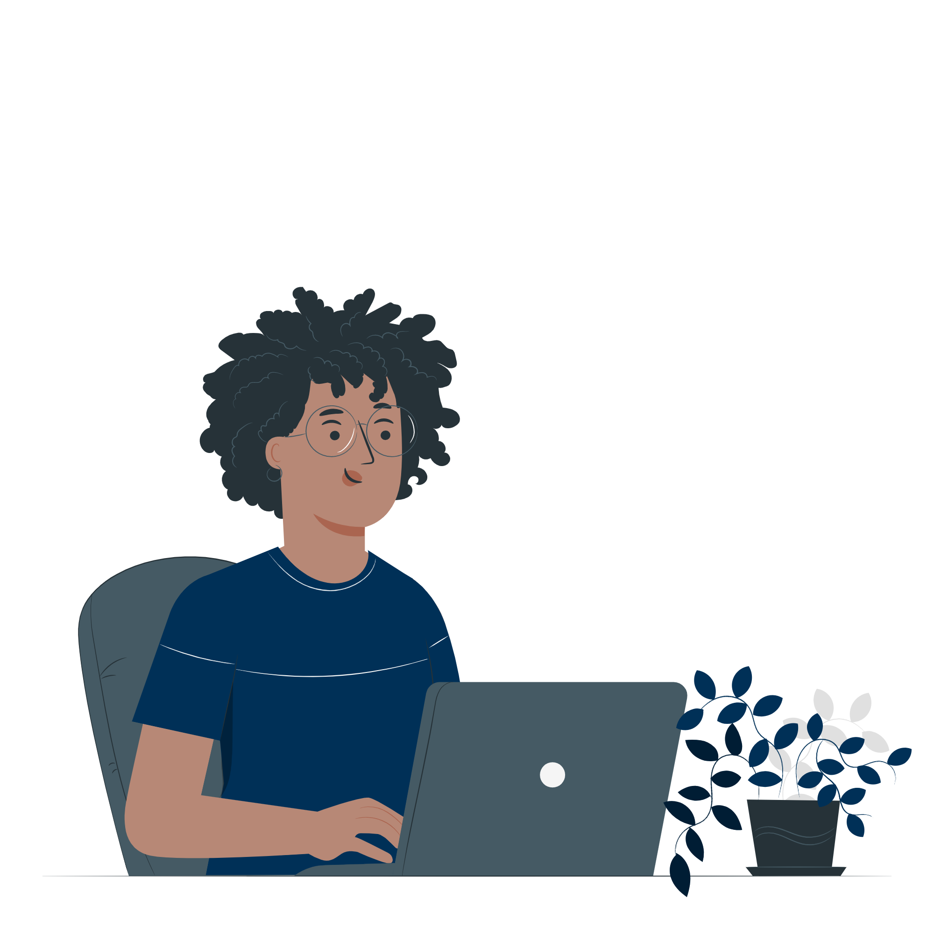
Welcome
Building Self-Paced Professional Development Opportunities for Faculty

Slide 2
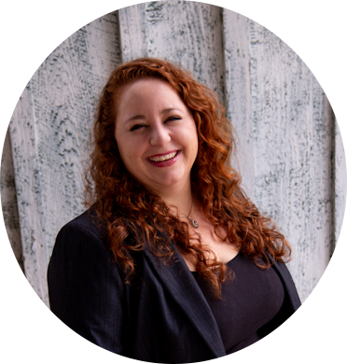
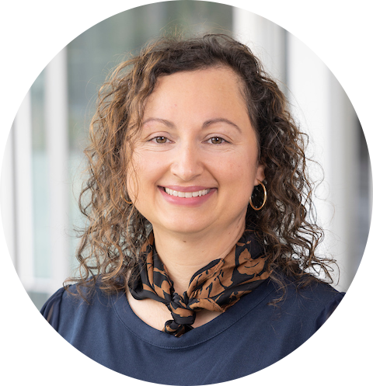
Introductions
Laura Otero, Ph.D.
Instructional Designer, Faculty
Luz Española, M.S.
Accessibility Specialist, Faculty

Slide 3
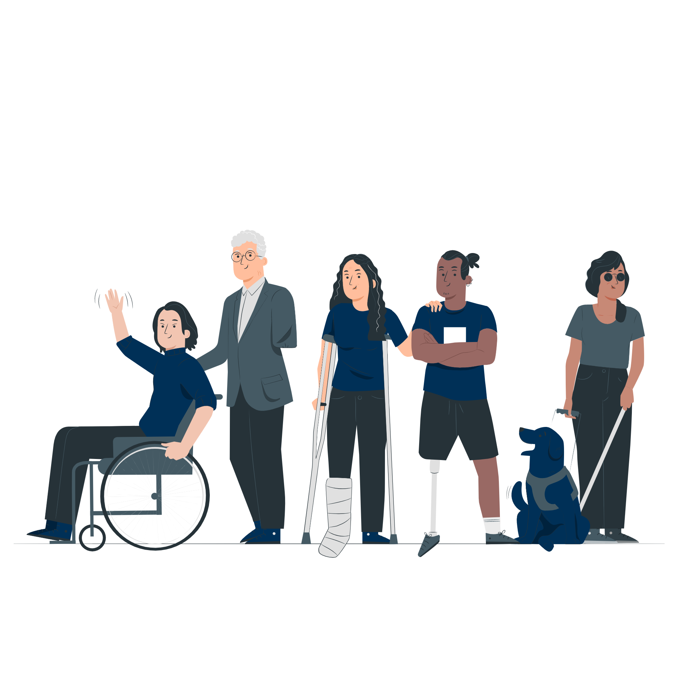
Background

Slide 4
Course Tracks 2022
Track #1 Clearing the path for accessibility
Track #2 Demystifying Accessibility

Slide 5
Success Metrics 2022
67 participants (majority faculty)
86% course completion rate
Incentive: stipend upon successful completion

Slide 6
Course Tracks 2023
Track #1 Accessibility and UDL
Track #2 Create Accessible Digital Content

Slide 7
Success Metrics 2023
42 participants (majority faculty)
100% course completion rate
Incentive: stipend upon successful completion

Slide 8
Post Feedback #1
Notes:
“It was very hands-on and the tutorials gave us actionable information. The fact that I got to practice fixing issues in my course was of real benefit, as I knew loosely about these items, but never had a direct opportunity to practice using the accessibility checkers before.”

Slide 9
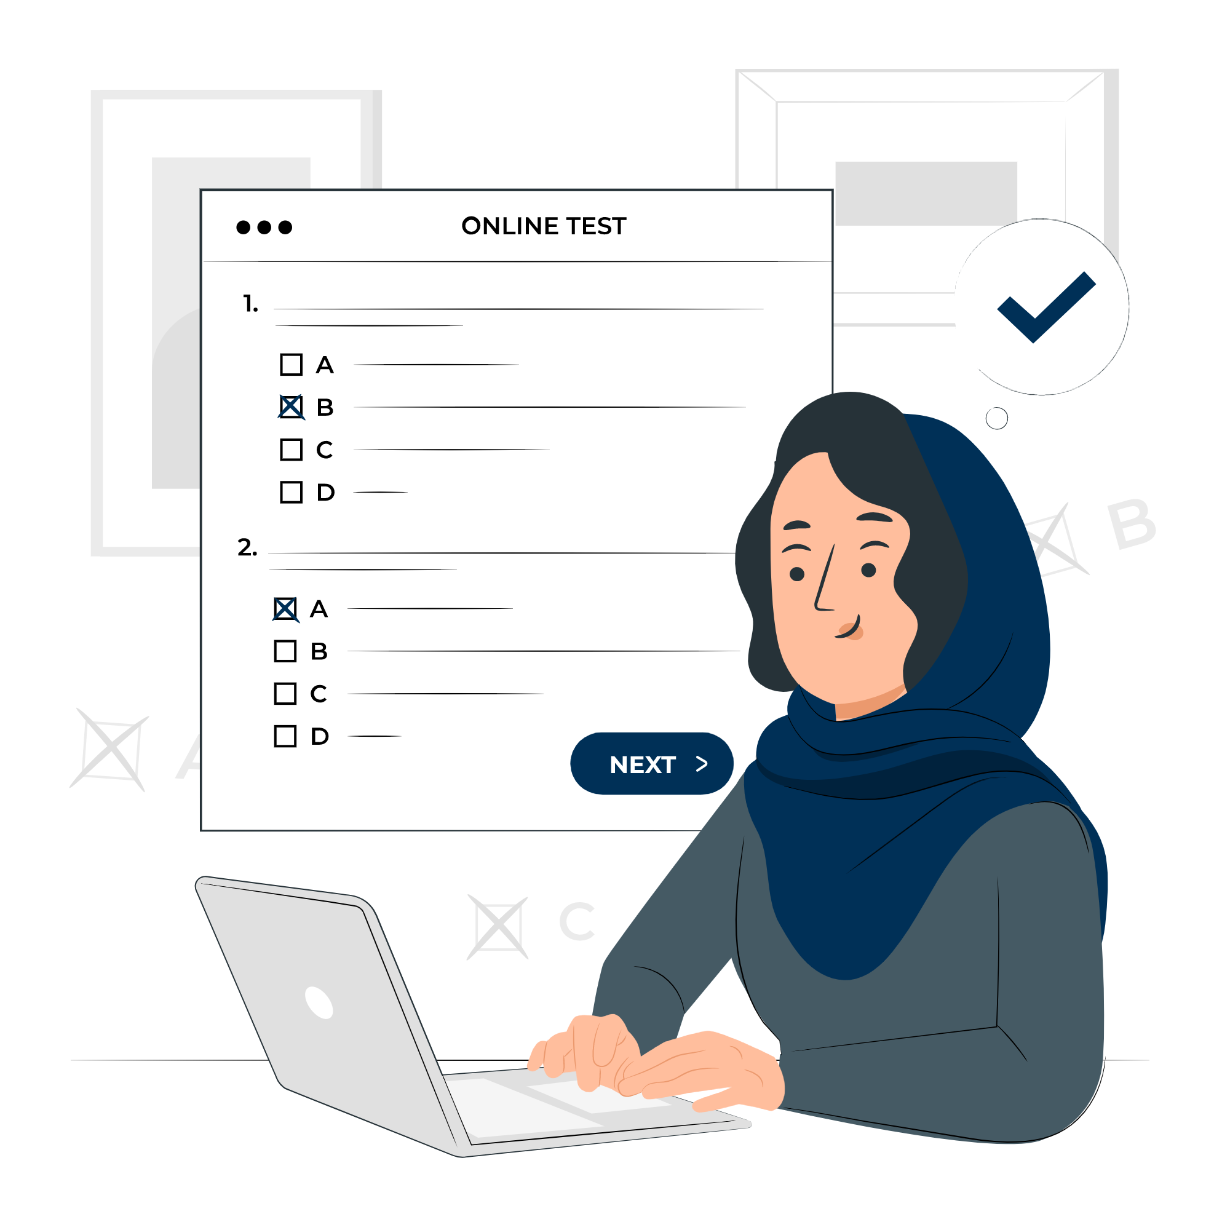
Post Feedback #2
Notes:
“The assignments were at just about the right level... challenging enough that we were learning things, but not so difficult that I wanted to give up!”

Slide 10
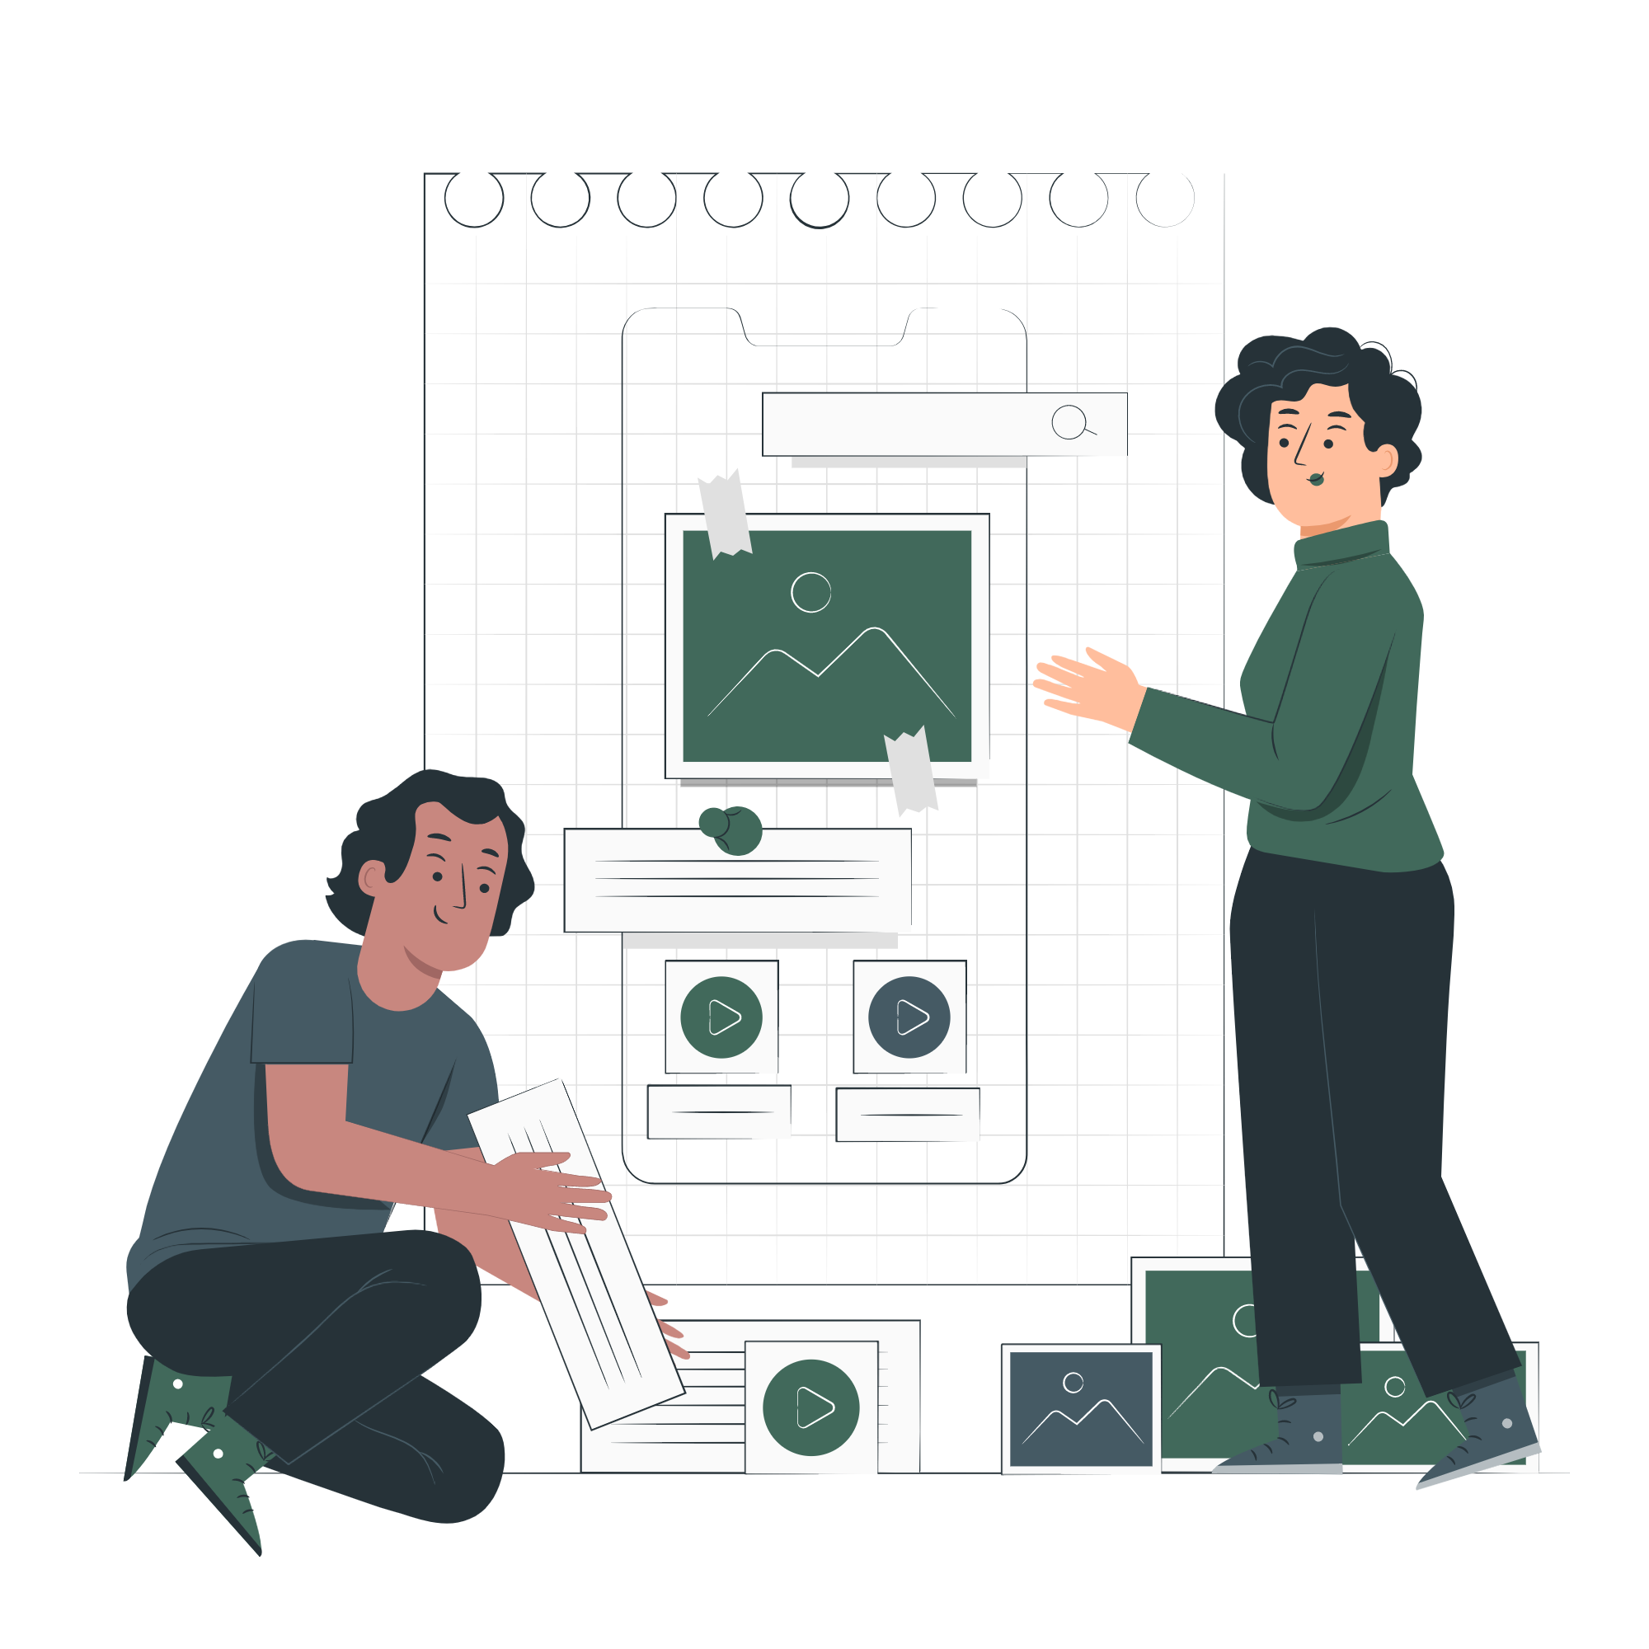
Post Feedback #3
Notes:
“I loved the fact that every day I really learned something that will add value to my teaching going forward. Every minute was well spent(...) Enjoyed seeing the problems the other faculty were solving.”

Slide 11
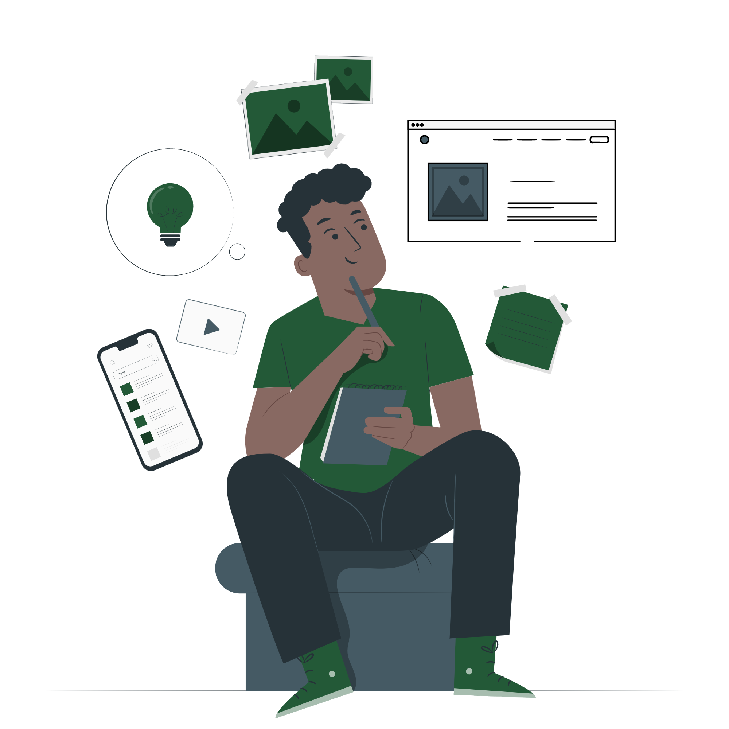
Our continued journey
Open the course year round
Continue stipend incentives
Open to students fill the gap of accessibility knowledge in curriculum

Slide 12
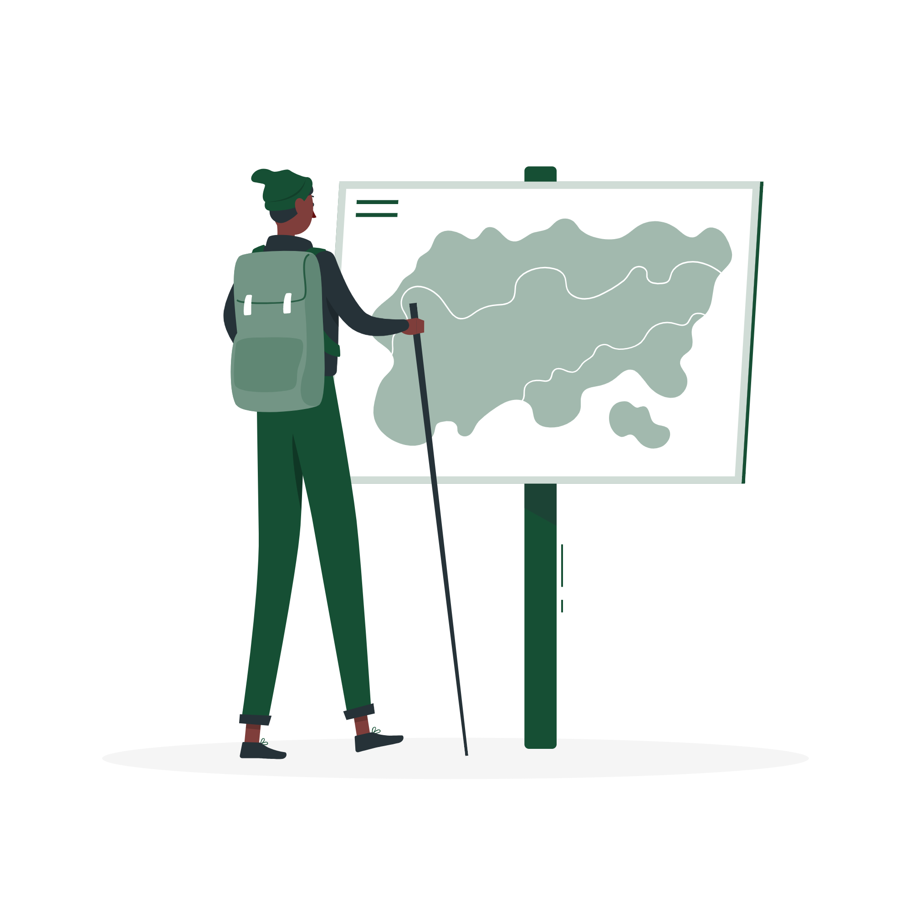
Course Map
ACE100 Course map review

Slide 13
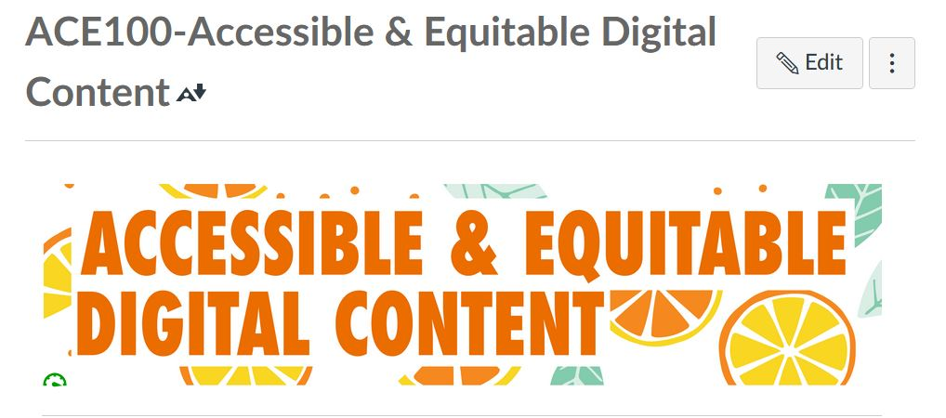
Course Review

Slide 14
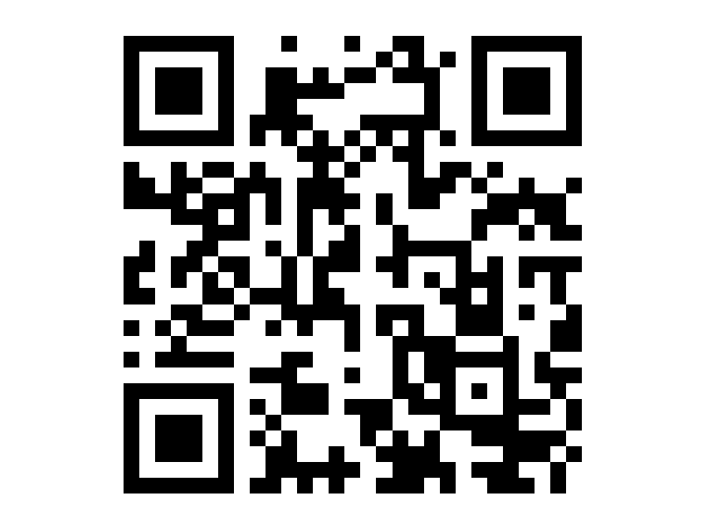
Course Request Form
Visit bit.ly/ACE100atCSUMB
Or use QR Code

Slide 15
Thank You
Laura Otero
lotero@csumb.edu
linkedin.com/in/lauralarkotero
Luz Española
luzespanola@csumb.edu
linkedin.com/in/luzespanola
Course Request Form

Slide 16
Questions

