Slide 1
Website Liability Legal Update
Ken Nakata
Converge Accessibility LLC

Slide 2
Who Am I?
Ken Nakata
Principal, Converge Accessibility LLC
12 years as a Senior Trial Attorney with the U.S. Department of Justice
Helped shape the government’s policies for the Americans with Disabilities Act and Section 508 of the Rehabilitation Act
Helps organizations manage the change towards accessibility in all aspects
Crafts policies, develops stakeholder ownership, and forges awareness and commitment to the legal and business case supporting accessibility

Slide 3
Why Should We Care About Web Accessibility Litigation?

Slide 4
Number of Federal Lawsuits
2015: 57 lawsuits
2016: 262 lawsuits
2017: 814 lawsuits
2018: 2,314 lawsuits
2019: 2,890 lawsuits
2020: 3,503 lawsuits
2021: 4,011 lawsuits
2022: 4,455 lawsuits (projected)

Slide 5
Total Number of Complaints
Reasonable Estimate: About 50,000 complaints for 2022

Slide 6
Overview of Laws Involved in Web Accessibility Litigation

Slide 7
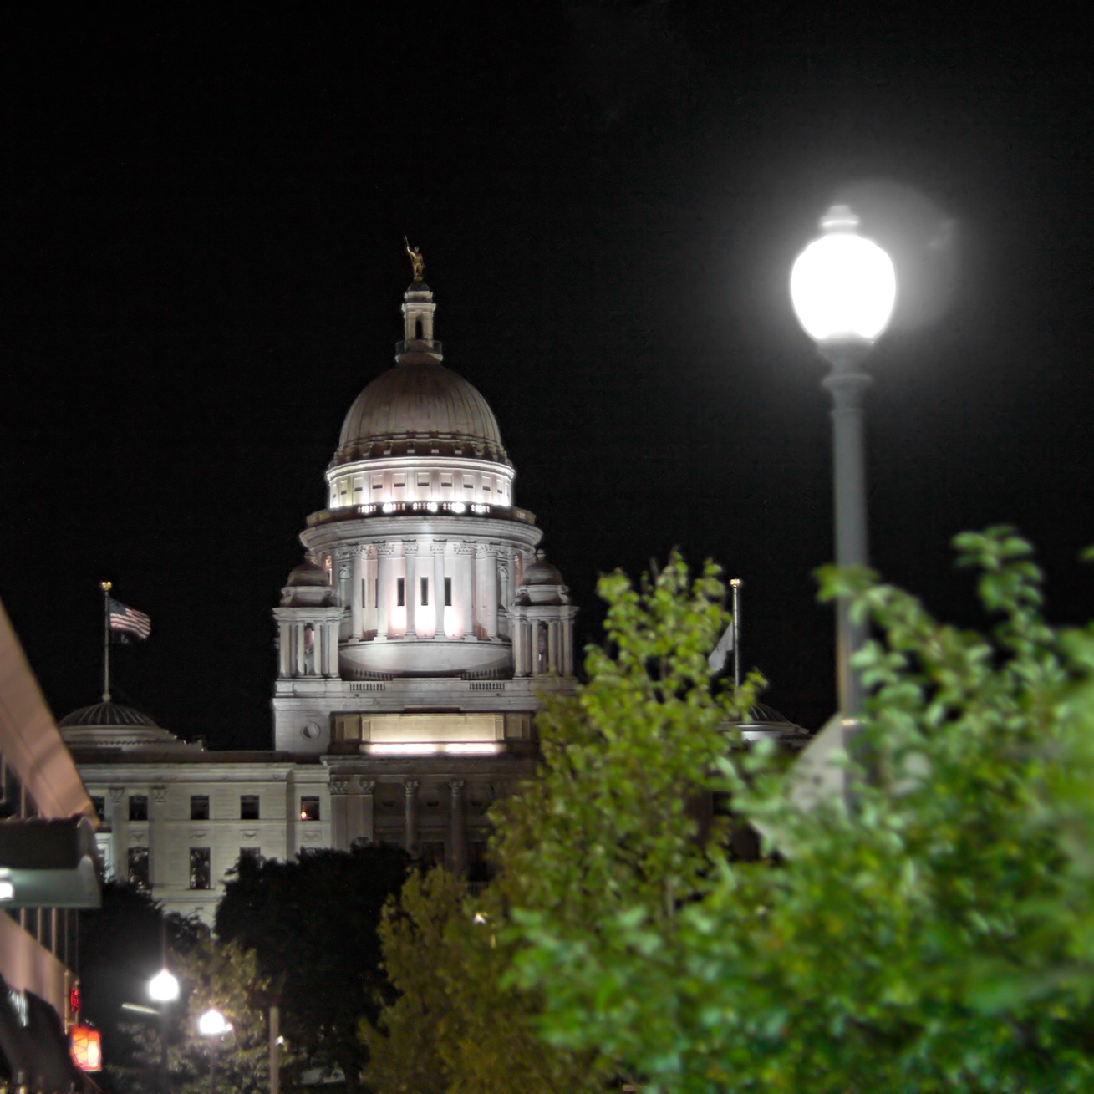
Americans with Disabilities Act (ADA)
Title II
Title III

Slide 8
Americans with Disabilities Act (ADA)
Fewer lawsuits in courts but more complaints in Federal agencies
Key Concept: “Program Access” (e.g. Martin v. MARTA)
Title II is almost identical to Section 504 (Federal agencies and Federal funding)
Title II

Slide 9
Americans with Disabilities Act (ADA)
Title II
Title III

Slide 10
Americans with Disabilities Act (ADA)
Whether a private company can be sued because of their website depends on where the lawsuit is brought.
Also, greater potential liability in California because of separate Unruh Act (discussed later)
Title III

Slide 11
Location, Location, Location!!!
ADA Title III language prohibits discrimination by a “place of public accommodation”
Where is the “place” when it comes to websites? Courts answer this question differently

Slide 12
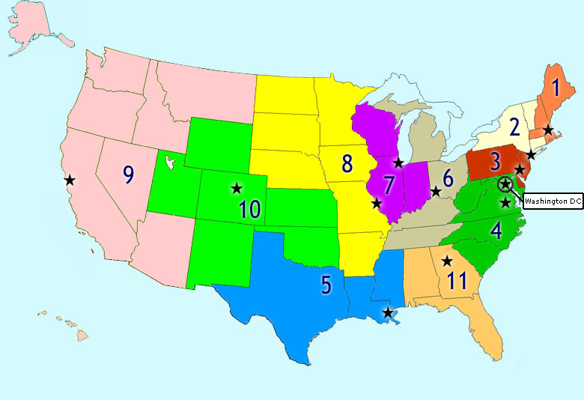
ADA Title III– Where Your Lawsuit Starts Matters
Whether a website is a ”place” of public accommodation has created a “split in the circuits”
12

Slide 13
“Place Doesn’t Matter” Approach
Physical Place not Relevant
First Circuit and Seventh Circuit
Possibly Fourth Circuit
Here, place doesn’t matter. Even purely online companies can be sued.
13

Slide 14
Nexus Approach
Probably the most popular approach
Third Circuit
Sixth Circuit
Ninth Circuit
Eleventh Circuit
Need to show some connection or “nexus” between the website and a business with a physical place.
14

Slide 15
Second Circuit Approach
Generally quite liberal but really depends on the judge.
Contrast:
Jaquez v. Dermpoint, Inc., 021 U.S. Dist. LEXIS 96067 (S.D.N.Y. 2021)(allowing lawsuit against purely online company)
Winegard v. Newsday LLC, 2021 U.S. Dist. LEXIS 153995 (E.D.N.Y. 2021)(following approach in Winn-Dixie)
15

Slide 16
Unruh and Disabled Persons Act (California)
Compared to ADA…
Broader Coverage (all business establishments)
No nexus requirement but intent required to sue online-only companies
ADA violations are automatically Unruh violations
Much bigger damages Remember NFB v. Target Corporation and $6 million settlement.
16

Slide 17
Real-Life Scenarios and Legal Defenses

Slide 18
Defense #1 Can’t We Just Post Our Customer Service Number Instead of Making Our Website Accessible?

Slide 19
Defense #2 I Don’t Control the Content So Why am I Being Sued? (aka “Lack of Ownership or Control”)
No es mi problema…

Slide 20
Defense #3 The Plaintiff Isn’t Interesting in My Business Anyways (aka “Standing to Sue Part 1”)

Slide 21
Defense #4 No Harm, No Foul (aka “Standing to Sue Part 2”)

Slide 22
Defense #5 I Just Settled a Similar Case and Now I’m Being Sued Again? (aka “Mootness and Res Judicata”)

Slide 23
Defense #6 I’m Being Sued in a Court That’s Thousands of Miles Away?!?! (aka “Personal Jurisdiction”)

Slide 24
Quick Legislative Update

Slide 25
Legislative Update #1: Colorado HB 21-1110
Passed on June 30, 2021.
Requires Colorado public entities to make their web and digital technologies comply with WCAG 2.1 A/AA by July 2024 or face private litigation with $3,500 per violation.

Slide 26
Legislative Update #2: California AB 1757
AB 1757 would apply to private sector.
For the first time, AB 1757 also applies to developers of websites and applications at heart of problem.
Reintroduced 2024 and quite likely to pass.

Slide 27
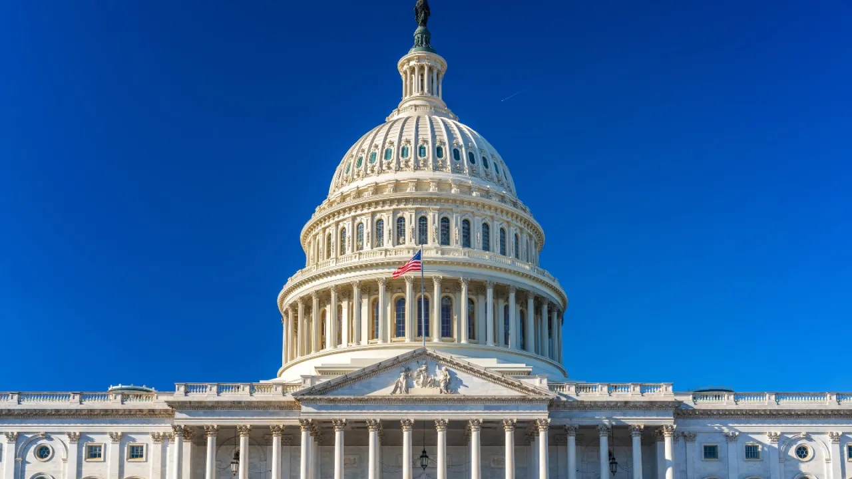
Other Legislative Developments…
Websites and Software Applications Accessibility Act (S. 2984)
Communications, Video, and Technology Accessibility Act (S. 2494)

Slide 28
Thank You!!
Ken Nakata
ken.nakata@convergeaccessibility.com
www.convergeaccessibility.com

