Slide 1
Creating an online course accessibility database at a large institution
Tania Heap, University of North Texas
Audon Archibald, University of North Texas

Slide 2
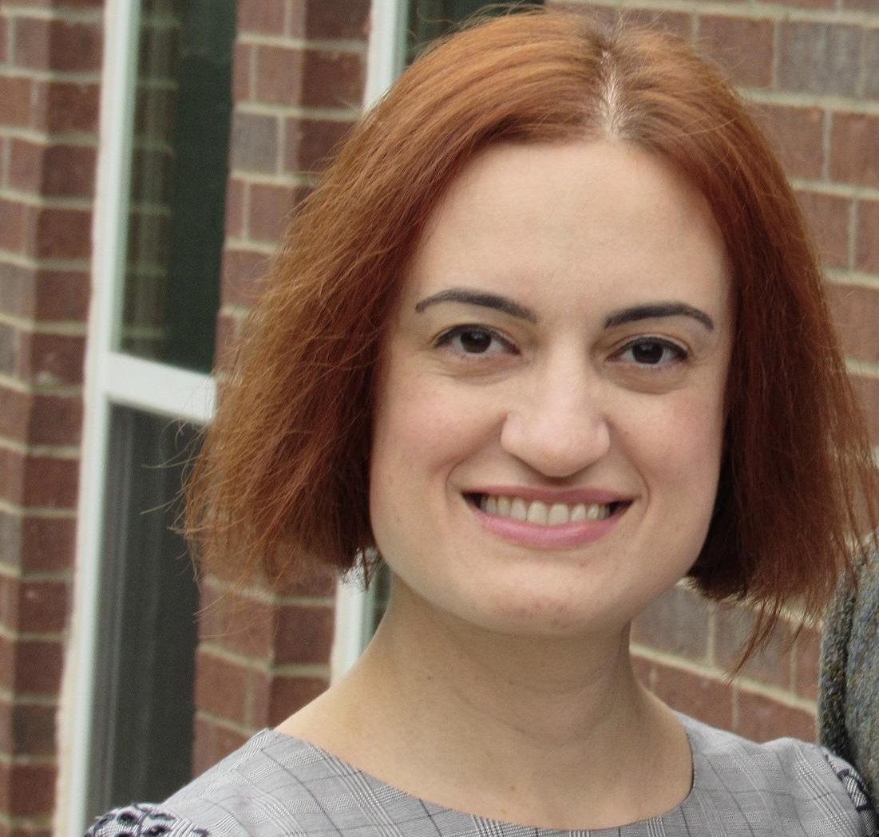
Who We Are and What We Do
Audon Archibald, PhD
Data Analyst, DSI
University of North Texas
Tania Heap, EdD
Director, Learning Research & Accessibility, DSI
University of North Texas

Slide 3
Overview
Introduction and problem
Online course accessibility at UNT
Our study
Methods
Results
Policy implications and next steps
Adobe Stock 534355260

Slide 4
Introduction and problem
Hybrid teaching and working is gaining popularity post-pandemic, raising digital accessibility concerns (Rice & Dunn, 2022).
Most literature focuses on practitioner-oriented perspectives; lacks University system examples (e.g., Lomellini et al., 2022).
Approximately one-third of U.S. disabled population resides in the South (Kelly & Wilson, 2023).
How is a Southwestern University handling it?

Slide 5
Online course accessibility at UNT
Our process

Slide 6
Our process
Campus teaching and learning center's accessibility and copyright team.
Native assistive technology users; compliance officer/lawyer.
Team reviews all courses with 50% or more online content.
Faculty submit course content for provisional accessibility reviews (first 2 weeks of content), then make necessary modifications.
Final accessibility reviews (16 weeks of content) are conducted before course goes live.
12 major checkpoints, based on WCAG 2.1 and Quality Matters 8.

Slide 7
Our checkpoints
Keyboard navigation
Headings, lists, tables
Text and links
Responsive design
Color contrast
Graphics
Captions/transcripts
Auto-play
Electronic documents (Word, PPT, PDF, XL)
Existing conformance report for third-party

Slide 8
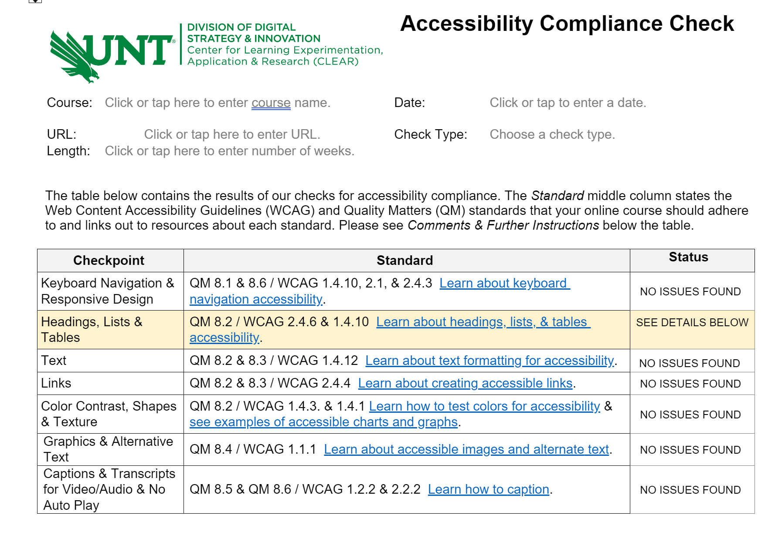
Our reports

Slide 9
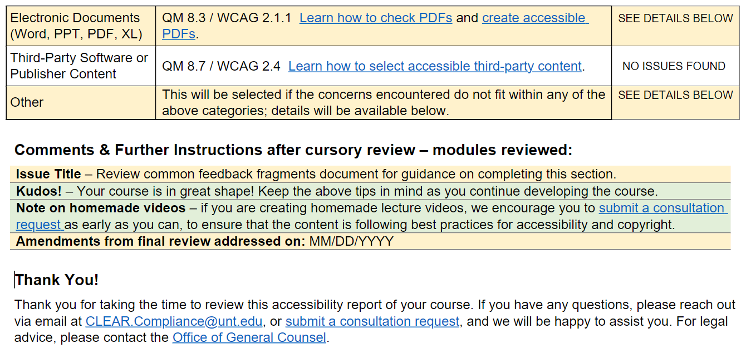
Our report (continued)

Slide 10
Our study
What did we do, find, and learn from it

Slide 11
Research questions (RQs)
Most common accessibility issues across online courses at our institution?
Differences in issue frequency depending on subject discipline?
... depending on course level (e.g., high-enrollment undergraduate vs. low-enrollment graduate)?
Impact of early feedback to faculty on a subsample of course content?
Differences in number of issues identified between faculty who had gone through the online course development process at least once before vs. novices?

Slide 12
Methods
374 accessibility reports analyzed, completed between March 2022 and January 2023.
Quantitatively assessed the 12 checkpoints (met vs. unmet). Didn’t look at qualitative feedback, yet.
Categorical factors i.e., faculty status, course level, and review type (provisional vs. final), were used to analyze accessibility checkpoint compliance.

Slide 13
Results (RQ 1)
Half checkpoint types (6) unmet more than 10% of the time.
Electronic documents and links most frequently unmet, followed by text, headings, lists & tables, graphics, and captions & transcripts.
Others unmet 4% of the time at most.
'Electronic documents': graduate courses more likely to meet standards.
'Graphics': lower met rates in the Arts; 'electronic documents': higher met rates in Business

Slide 14
Results (RQ 2)
Type of review (final vs. provisional) significantly influenced pass rates for various checkpoints.
Final reviews likely to have more checkpoints met, except for captions/transcripts.
Much more media later; faculty over relying on auto-captions?
For 'graphics', final reviews nearly 3x as likely to meet standard, compared to the provisional assessments.

Slide 15
Results (RQ 3)
‘Veteran’ faculty:
Twice as likely to meet accessibility requirements for electronic documents.
About 1.5 times more likely to create accessible links.
Adobe Stock 522112353

Slide 16
So what? And what's next?
Implications and next steps

Slide 17
Implications & recommendations
Findings suggests need for support, training, and early guidance for faculty:
Provide early feedback
Promote early interventions
Focus on specific challenges (electronic documents; link formatting; captions)
Allocate limited resources wisely

Slide 18
Limitations
Provisional reviews may miss later issues (new: midpoint check-ins.)
Some issues overlap categories (new: edited checkpoints.)
Issue frequency and magnitude in a course not explored.
Focus on course development, not teaching.
Qualitative feedback and conversations during course development not included, yet.

Slide 19
Next steps
Edited reports and checkpoints to measure anecdotal trends we are seeing (e.g., third-party materials not a checkpoint before but seems a frequent issue.)
Offering targeted training (e.g., PDF accessibility) based on study results and website analytics.
Working on an online course accessibility database/data warehouse to be available to internal staff, faculty, chairs, and deans.

Slide 20
References
Briggs, M., Archibald, A., Heap, T., Thompson, R., and Liss, A. (under review) Identifying one university’s prevailing online course accessibility issues, Educational Technology & Society.
Kelly, D., & Wilson, K. I. (2023, April 3). A New Disabled South. Ford Foundation. https://www.fordfoundation.org/news-and-stories/stories/a-new-disabled-south/
Lomellini, L., Lowenthal, P. R., Snelson, C., & Trespalacios, J. H. (2022). Higher education leaders’ perspectives of accessible and inclusive online learning. Distance Education, 43(4), 574-595. doi: 10.1080/01587919.2022.2141608
Rice, M. F. & Dunn, M. (2022). Inclusive online and distance education for learners with dis/abilities. Distance Education, 43(4), doi:10.1080/01587919.2022.2145936

Slide 21
Thank you!
Tania.Heap@unt.edu
DSI.Research@unt.edu
CLEAR.Compliance@unt.edu

