Slide 1
Driving Accessibility Improvements in IT Products
Leon McNaught
Director, Digital Accessibility
California State University, Los Angeles
lmcnaug@calstatela.edu
Jeff Singleton
Principal
Converge Accessibility
jeffrey.singleton@convergeaccessibility.com

Slide 2
Accessible Procurement Overview
Procurement Process: Determine Impact
Accessibility Requirements
Minimum requirements: VPAT/ACR
Vendor Buy-In
High Impact Requirements
Culture of Inclusivity
Annual Follow Up
3rd Party Consultation

Slide 3
Important Considerations
Designate staff to do accessibility reviews
Understand accessibility and have some IT skills
Review documents, conduct product demos, and connect with vendor
Procurement department staff usually do not have the skills or time
Map out a process
https://ati.calstate.edu/procurement/process
Provide clear accessibility requirements for vendors to follow
https://ati.calstate.edu/procurement/vendor-requirements

Slide 4
Process Overview
Purchaser
Reviewer
Procurement
Vendor
IT & Disability Services Staff

Slide 5
Process Steps
Step 1 – Gather Information
Step 2 – Review Information
Step 3 – Review Accessibility
Step 4 – Complete the Procurement

Slide 6
Process Steps – Step 1
Step 1 – Gather Information
Step 2 – Review Information
Step 3 – Review Accessibility
Step 4 – Complete the Procurement

Slide 7
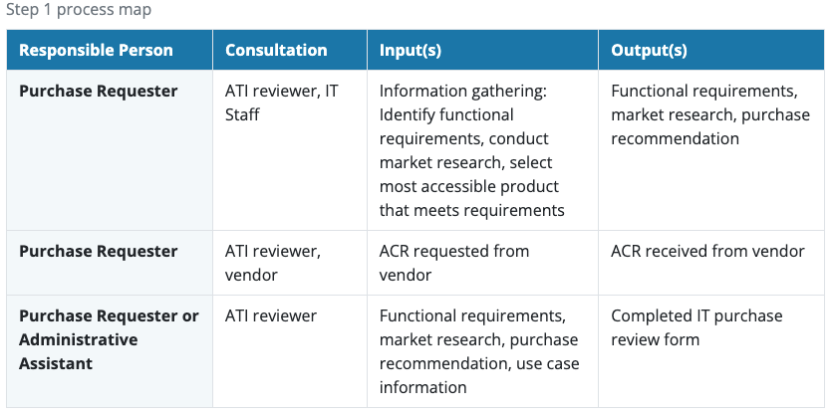
Step 1 – Roles & Responsibilities

Slide 8
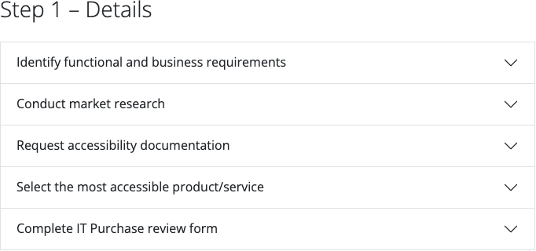
Step 1 – Details

Slide 9
Process Steps – Step 2
Step 1 – Gather Information
Step 2 – Review Information
Step 3 – Review Accessibility
Step 4 – Complete the Procurement

Slide 10
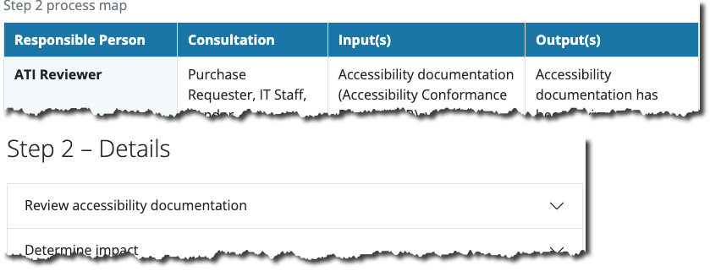
Step 2 – Review Information

Slide 11
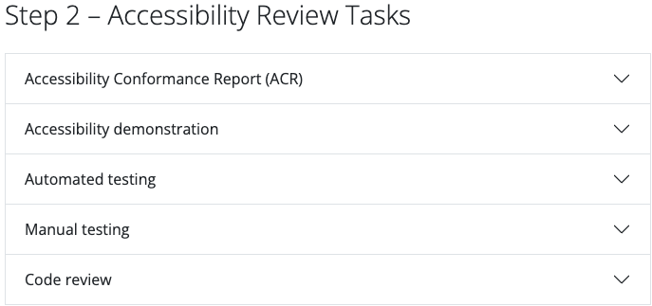
Step 2 – Review Information

Slide 12
Step 2 – Review Information

Slide 13
Step 2 – Review Information

Slide 14
Step 2 – Review Information

Slide 15
Process Steps – Step 3
Step 1 – Gather Information
Step 2 – Review Information
Step 3 – Review Accessibility
Step 4 – Complete the Procurement

Slide 16
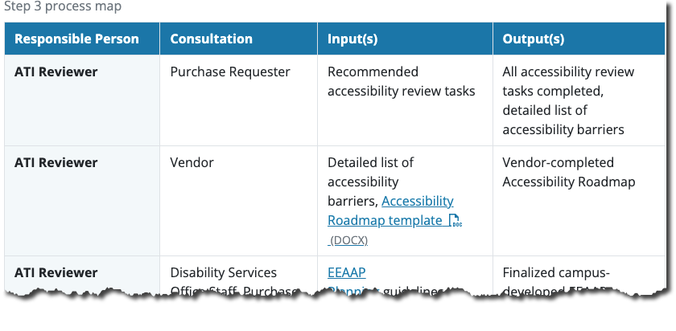
Step 3 – Review Accessibility

Slide 17
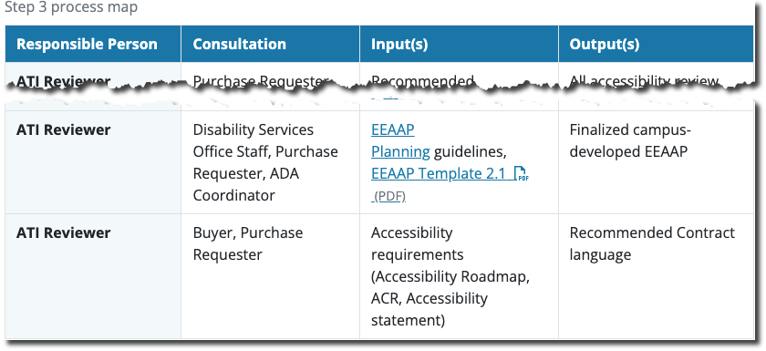
Step 3 – Review Accessibility

Slide 18
Step 3 – Review Accessibility

Slide 19
Process Steps – Step 4
Step 1 – Gather Information
Step 2 – Review Information
Step 3 – Review Accessibility
Step 4 – Complete the Procurement

Slide 20
Step 2 – Review Information

Slide 21
Vendor Requirements
Step 1 – Gather Information
Step 2 – Review Information
Step 3 – Review Accessibility
Step 4 – Complete the Procurement
Vendor Requirements

Slide 22
Information from Vendor

Slide 23
Information from Vendor

Slide 24
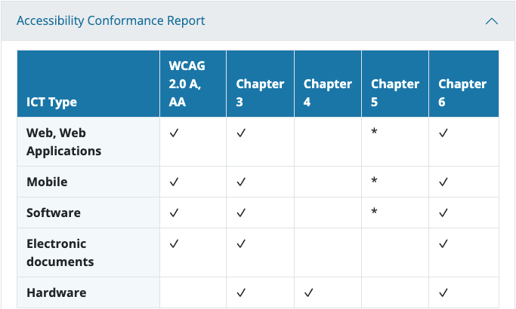
Vendor ACR

Slide 25
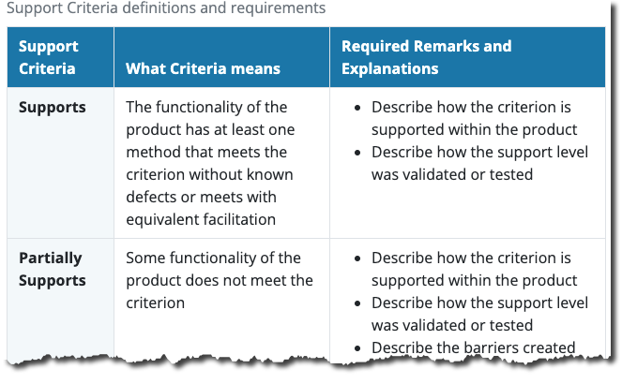
Vendor ACR Support Criteria

Slide 26
Vendor ACR Remarks & Explanations

Slide 27
Vendor ACR Conformance Level Support

Slide 28
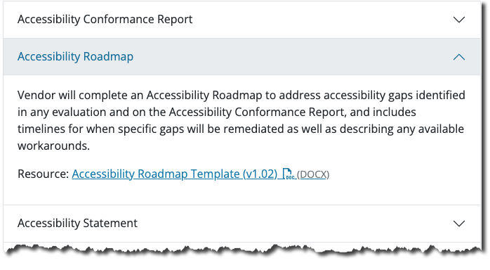
Vendor Accessibility Roadmap

Slide 29
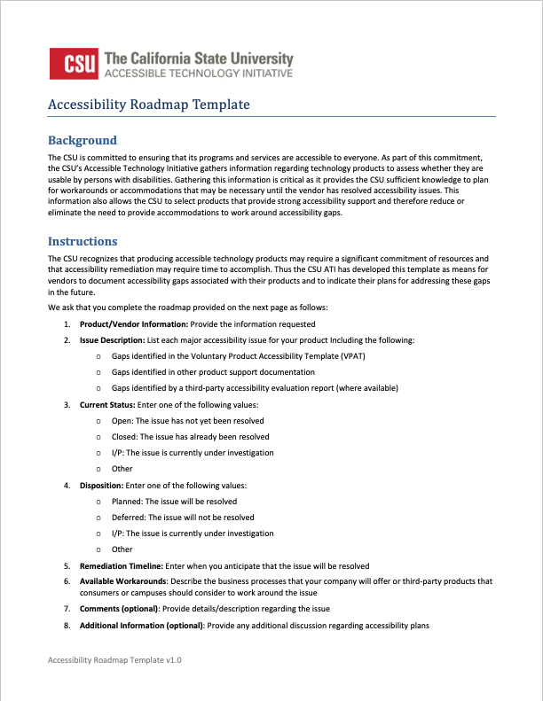
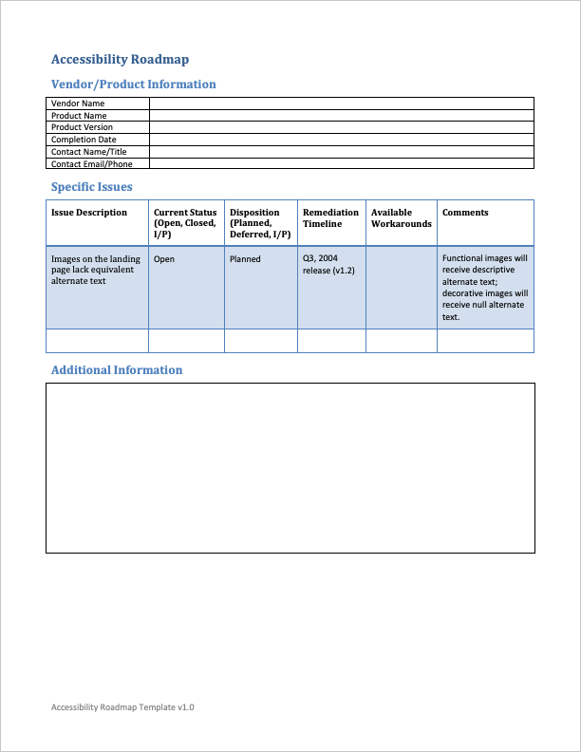
CSU’s Vendor Accessibility Roadmap Template

Slide 30
Roadmap: Vendor/Product Information

Slide 31
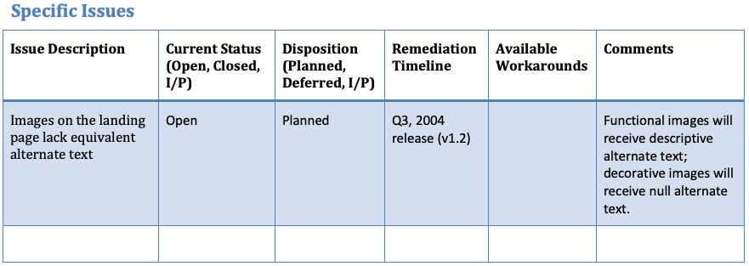
Roadmap: Specific Issues

Slide 32
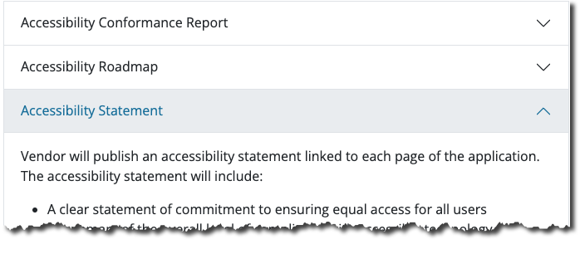
Vendor Accessibility Statement

Slide 33
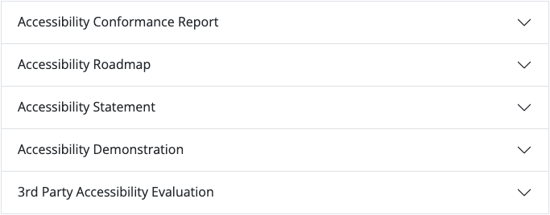
Vendor Accessibility Demonstration

Slide 34
Part 1 – Vendor Questions
How is accessibility integrated into your development process?
Does your company have an accessibility training program for product developers?
What specific tools are used for accessibility testing during product development?

Slide 35
Part 2 – Hands On Demonstration
WAVE Toolbar
Keyboard Only
Contrast
Text Resize
Accessing Accessibility Statement
Screen Reader

Slide 36
Vendor 3rd Party Evaluation

Slide 37
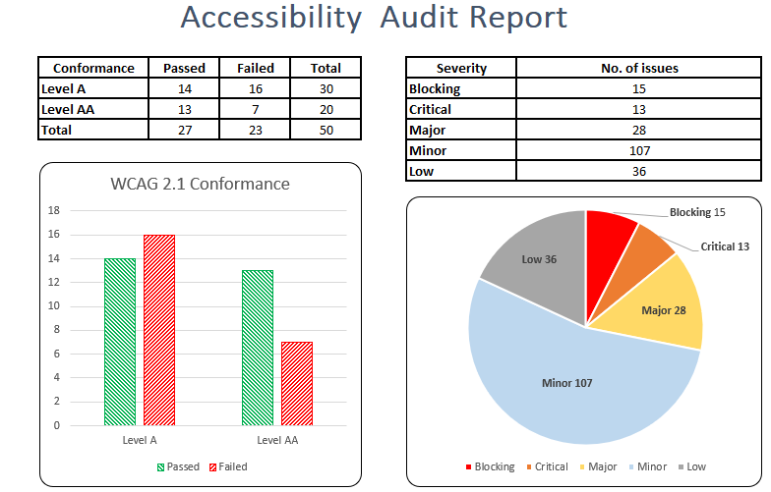
Third Party Evaluation Process
WCAG 2.2 Level A/AA
Screens/Pages to Review
Critical User-based Tasks
Accessibility audit reports:
Issue details
Where issue is found
WCAG Criterion in question
Recommendation
Impacted Group
Severity
Executive Summary
VPAT/ACR
Be clear on what ACR is required (Section 508, WCAG only, etc.)

Slide 38
Thank you!
https://ati.calstate.edu/procurement/process
https://ati.calstate.edu/procurement/vendor-requirements
Leon McNaught
ATI Program Manager
California State University, Los Angeles
lmcnaug@calstatela.edu
Jeff Singleton
Principal
Converge Accessibility
jeffrey.singleton@convergeaccessibility.com

