Slide 1
STEM accessibility: Beyond simply making things accessible
What can we do to prepare students for life post-college?

Slide 2
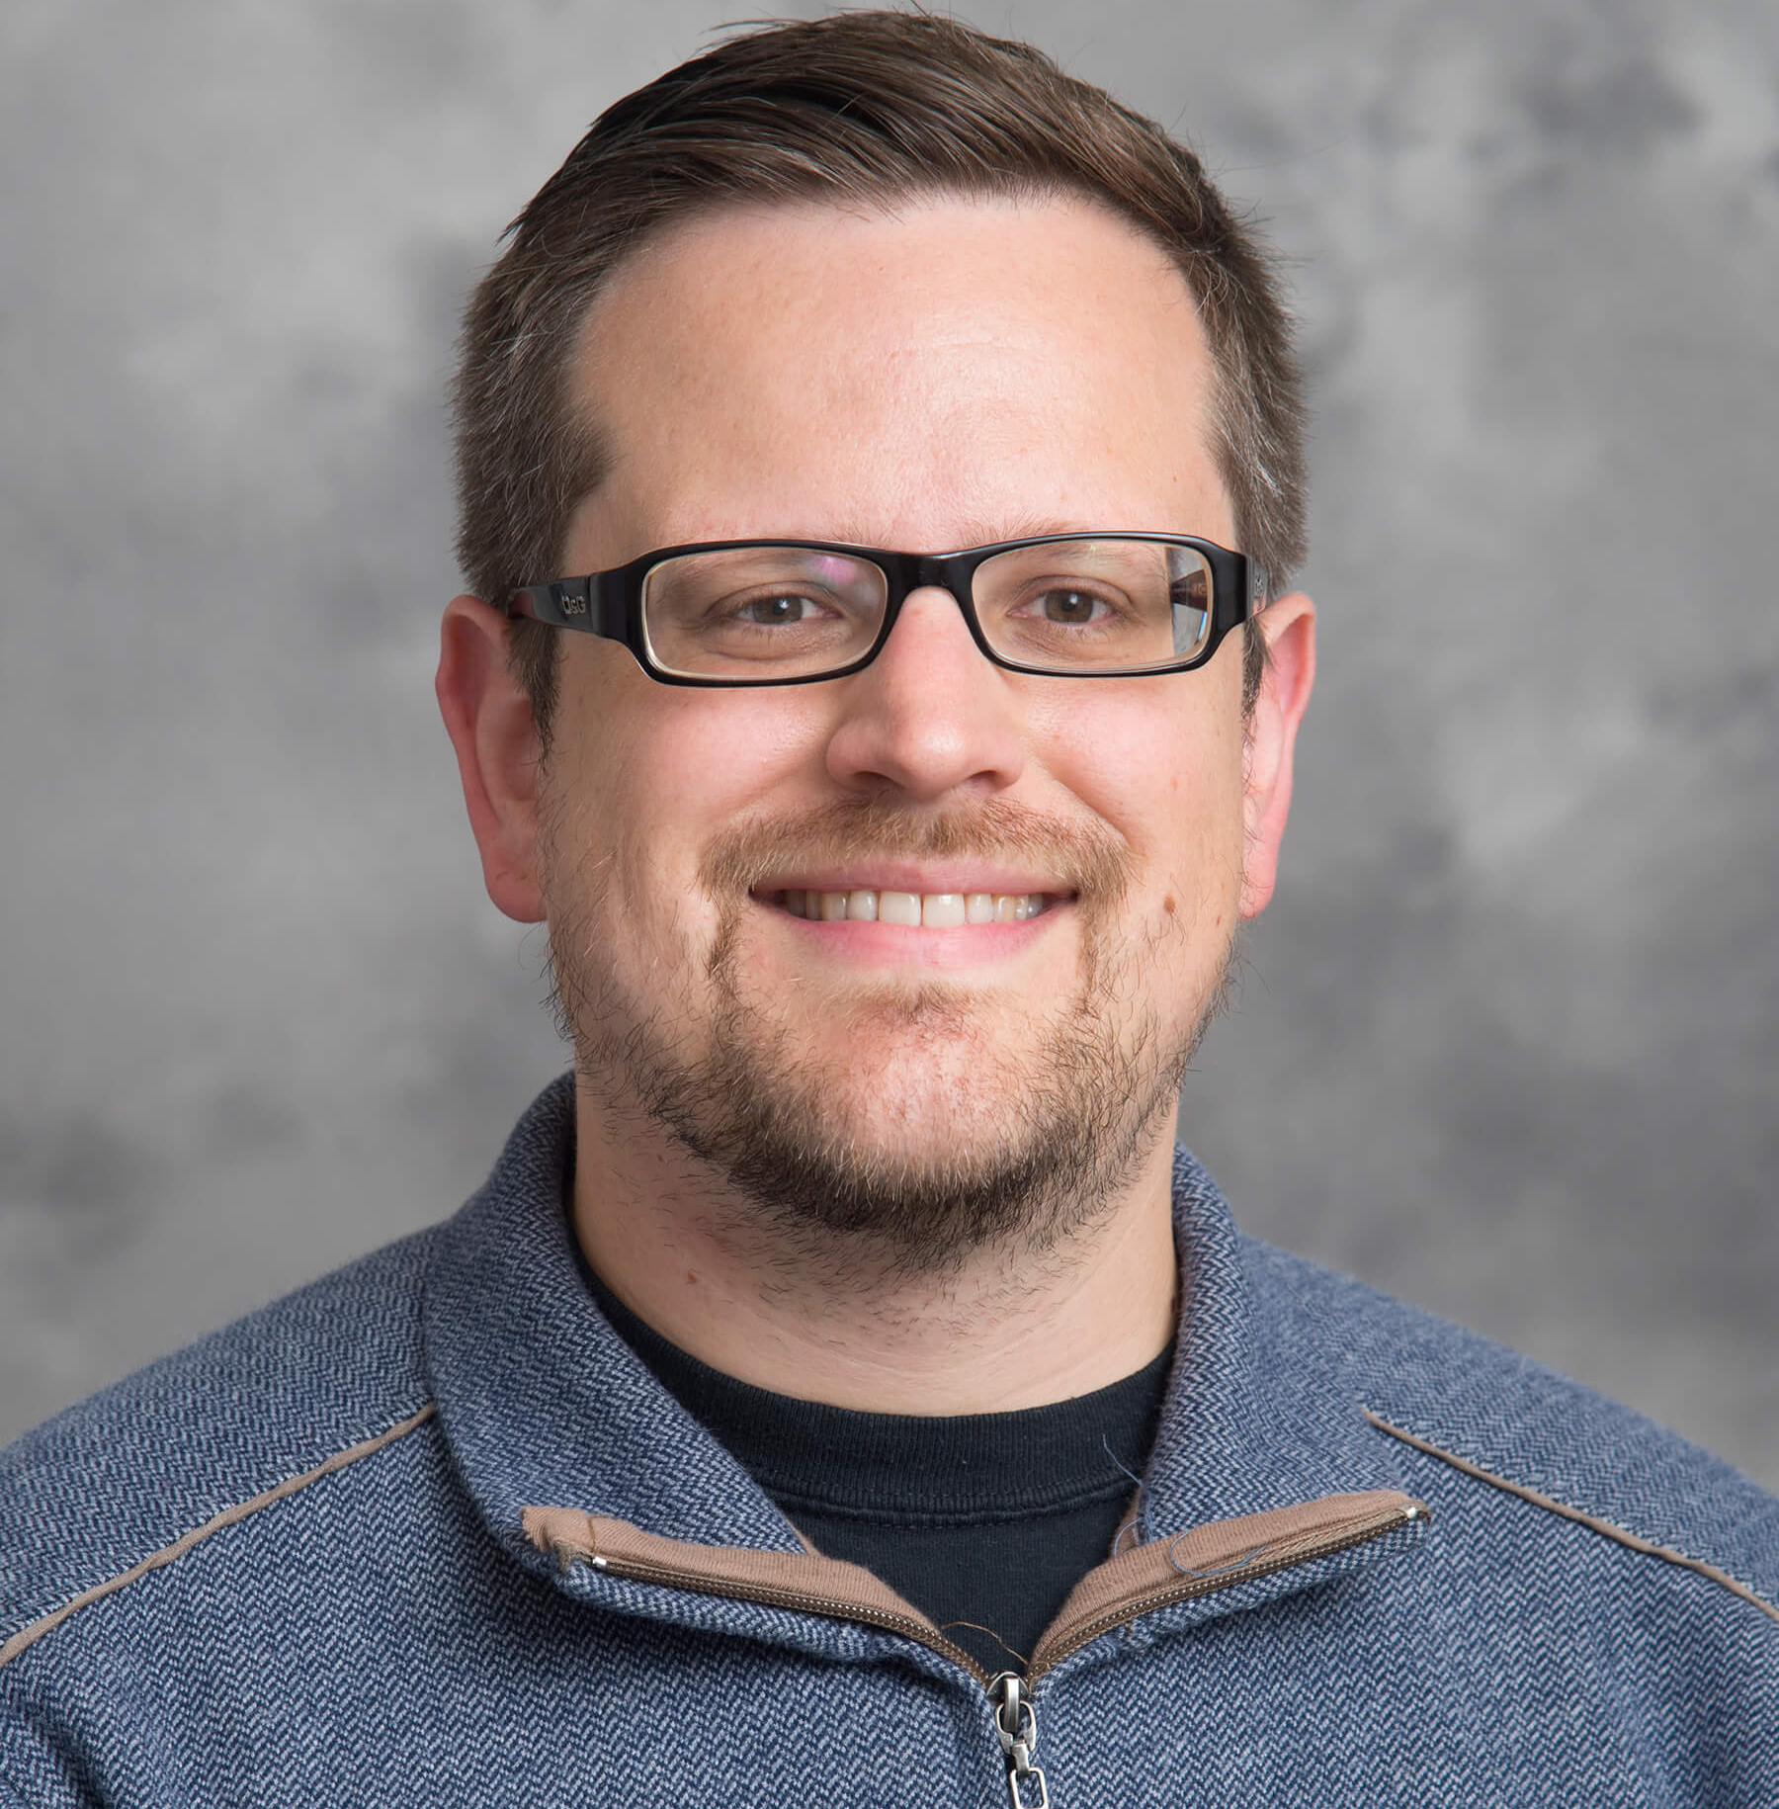
Who Are We?
David Schwarte
Assistive Technology Specialist
Alex Mason
Assistive Technology Specialist

Slide 3
Who Are We? (2)
Where do we fit in at Purdue University?
Consulting & Training Team
Support Brightspace
Support Globally-Supported Integrations
Workshops, Consultations, etc.
Unique position between DRC and TLT

Slide 4
Why Are We Here?
Our Agenda:
How does a student in STEM engage and interact with materials?
Why is it important for a student to have independence when working with STEM materials?
How was this done with one particular student and how can this be replicated for future use?

Slide 5
Engaging with Materials
After making materials accessible, we can’t just stop there!
There is no one-size-fits-all solution in every circumstance
Accessibility related to math and engineering
Graphical representations of information

Slide 6
Having Independence With Materials
Accommodation logistics, etc.
Importance of human readers/scribes in STEM
Potential barriers with human readers/scribes
Not effective, long-term solution
There is no one-size-fits-all solution in every circumstance

Slide 7
Interaction and Replication
How did the student show their work?
How did the student explain their “engineering judgement” used in solving the problem?

Slide 8
ChattyInfty Demo
ChattyInfty Demo

Slide 9
Interaction and Replication (2)
How did the student graph and chart lab information?

Slide 10
Tactile Graph Example
Tactile Graph Example

Slide 11
Interaction and Replication (3)
How did the student interact with technical drawings?

Slide 12
CAD Drawing Example
CAD Drawing Example

Slide 13
Discussion / Q&A

Slide 14
Thank you!

Slide 15
Contact Us!
David Schwarte
Assistive Technology Specialist
schwarte@purdue.edu
Alex Mason
Assistive Technology Specialist
mason3@purdue.edu

