Slide 1
Colorado HB 21-1110 How to Meet it and is Your State Next?
Ken Nakata and Laura Ruby
Converge Accessibility LLC

Slide 2
Who We Are
Ken Nakata
Principal, Converge Accessibility LLC
12 years as a Senior Trial Attorney with the U.S. Department of Justice
Helped shape the government’s policies for the Americans with Disabilities Act and Section 508 of the Rehabilitation Act
Helps organizations manage the change towards accessibility in all aspects
Crafts policies, develops stakeholder ownership, and forges awareness and commitment to the legal and business case supporting accessibility

Slide 3
Overview
Colorado 21-1110. What is it? How is it different from the ADA? What is the current status? How does it affect me?
How Should You Prepare for It? How do I address my current technologies? What can I do to avoid creating new problems? What lessons learned can you share?
What Are Other States Doing? What is California AB 1757?

Slide 4
Who We Are
Laura Ruby
Director and Sr. Consultant, Converge Accessibility LLC
22 years at Microsoft leading Worldwide Accessibility Policy and Standards
Developed technology regulatory policy and industry-wide standards that ensure accessible technology for people with disabilities around the globe
Supports public and private sector with developing compliance programs, partners with governments around the world to develop laws, regulations, and policies that promote digital accessibility, and collaborates with national and international disability organizations and industry associations
Specializes in helping organizations integrate accessibility into procurement policies and digital transformations

Slide 5
Colorado HB 21-1110
Passed on June 30, 2021.
Requires Colorado public entities to make their web and digital technologies comply with WCAG 2.1 A/AA by July 2024 or face private litigation with $3,500 per violation.

Slide 6
HB 21-1110 versus ADA Title II
 | HB 21-1110 | ADA Title II
Coverage | Only Colorado public entities | Nationwide. All U.S. public entities
Damages | $3,500 per violation | None
Web Access Standard | WCAG 2.1 AA | Unknown (part of current NPRM)

Slide 7
Latest Developments
HB 21-1110 | ADA Title II
HB 21-1110 amended by SB 23-244, which requires Colorado OIT to create new regulations for public entity accessibility. | DOJ issued NPRM for web accessibility for public entities. NPRM requires WCAG 2.1 A/AA compliance with several large exemptions

Slide 8
What Are the Challenges with 21-1110?
Public entities use web applications and CMSs that have a number of fundamental WCAG violations and their vendors don’t understand basic accessibility requirements.
Don’t assume vendors assurances or VPATs are correct
By contrast, relatively few errors are created by content creators.

Slide 9
How to Prepare for 21-1110
Assess all high-impact technologies
Identify workarounds and create a plan
Fix the technology or replace it
Tighten up your procurement process

Slide 10
Assess all high-impact technologies
Identify basic accessibility problems using basic use cases.
Request VPATs and ACRs but do not rely on them!

Slide 11
2. Identify workarounds and create a plan
If there are technological barriers, identify non-technological workarounds.
Make sure these workarounds are understood both internally and externally.

Slide 12
3. Fix the technology or replace it
Provide your accessibility assessments to your vendors and, if they can’t commit to fixing the problems, replace them!
Hint: Consider moving to a newer version of the product where the issue has been fixed.

Slide 13
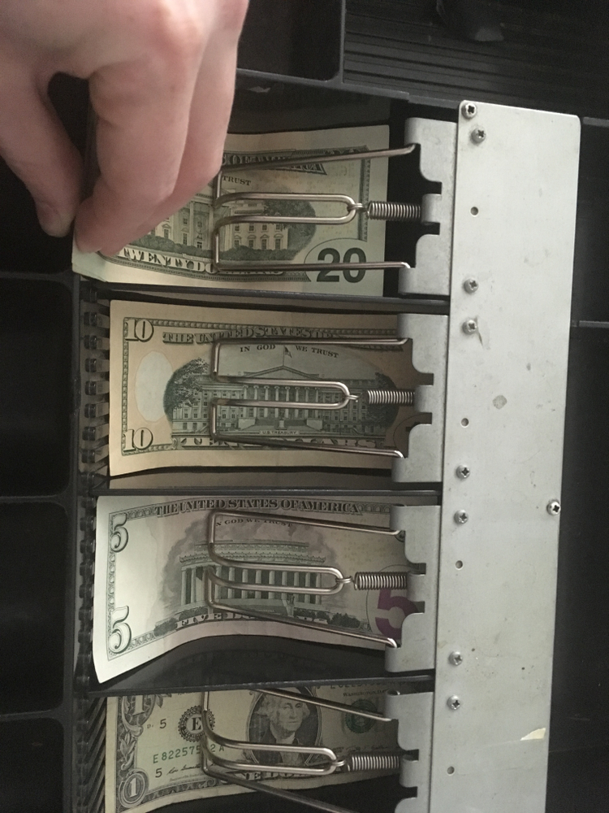
4. Tighten up your procurement process
Ensure your organization has a strong procurement policy and process specific to accessibility
Hint: pointing to a regulation and a standard is not enough

Slide 14
Be specific and communicate clearly
Develop or advocate for a dedicated accessibility procurement policy and process (for ideas, review the World Economic Forum model policy for ICT accessibility)
Define and assign implementation roles and responsibilities
Document guidance for unique situations and exceptions
Develop and implement required training across organization
Require verification of conformance in RFPs and communicate expectations with vendors (after that it's a dialogue)
Review/adjust policy if needed

Slide 15
What About Other States?
AB 1757 would apply to private sector.
For the first time, AB 1757 also applies to developers of websites and applications at heart of problem.

Slide 16
Thank You!
ken.nakata@convergeaccessibility.com
laura.ruby@convergeaccessibility.com
Follow our blog at www.convergeaccessibility.com

Slide 17
Thank You!!
Ken Nakata
ken.nakata@convergeaccessibility.com
www.convergeaccessibility.com

