Slide 1
How Faculty, IT Staff & Others Can Contribute to Making Courses Accessible to All Students
Sheryl Burgstahler
sherylb@uw.edu

Slide 2

2 Units in Accessible Technology Services
        IT Accessibility Team
          1984–
          Funded by UW
          DO-IT Center
          USA, 1992–
          Supported with federal, state,
          corporate, private funds
          DO-IT Japan, 2007–
          Center on UD in Education,
          1999–
Disabilities
Opportunities
Internetworking
Technology
NSF #CNS-2137312

Slide 3
Individual-Centered Community Building Model
Key stakeholders who may erect barriers or contribute to the success of people with disabilities
Success of People with Disabilities in College & Careers
Person with disability
Family members
Peers, near peers, mentors, allies
Postsecondary administrators, faculty, staff
Technology vendors
Professional organizations
Service providers
Legislators, policy makers
Funding agencies
Who might not be doing their share?

Slide 4
Topics
        Paradigm shift
        Access approaches: Accommodations & universal design
        Principles, guidelines for UDHE
        Examples of practices
        Roles of stakeholders
        Resources
All content in Google doc tinyurl.com/3wctr67z
Notes:
We’ll share a bit about how we’ve been thinking about the things that we wish these stakeholders – who are largely not familiar with disability -- were familiar with.

Slide 5
We need a paradigm shift
from “ableism” to celebration of all forms of diversity, including disability
from deficit view of disability to social justice
from reactive reliance on accommodations alone to proactive, sustainable UD design of courses, services, physical spaces, & IT
from design for the “average” to design for everyone
…and we already did this

Slide 6
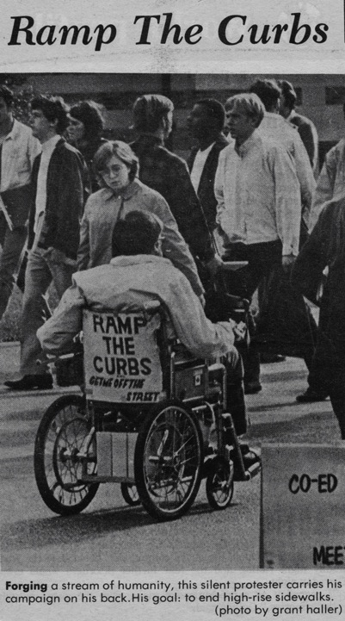
UD of physical spaces
“The Daily” @UW
1970

Slide 7
Common IT accommodations for online learning
Making inaccessible documents accessible, mainly those in PDF format
Captioning &
re-captioning
videos

Slide 8
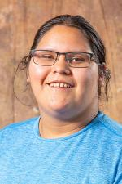



Note
Races/ethnicities, gender identities, disabilities, other characteristics may not be obvious
Fewer than 1/3 of students with disabilities report them to the disability services office
Campuses primarily offer accommodations to individuals after inaccessibility is discovered
Its important to consider intersectionality

Slide 9
Universal Design in Higher Education (UDHE) Framework
Scope
Definition
Principles
Guidelines
Process
Practices

Slide 10
Scope: Online learning occurs in:
  Fully on-site courses
  Fully online courses
  Hybrid courses

Slide 11
Universal Design (UD) =
“the design of products & environments to be usable by all people, to the greatest extent possible, without the need for adaptation or specialized design.”
The Center for Universal Design
www.design.ncsu.edu/cud

Slide 12
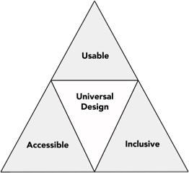
Applying
UD makes any product or environment

Slide 13
3 sets of principles underpin a UDHE framework for all applications in higher education
UD
UDL
WCAG
7 Universal Design
4 Web Content Accessibility
Guidelines
3 Universal Design for Learning

Slide 14
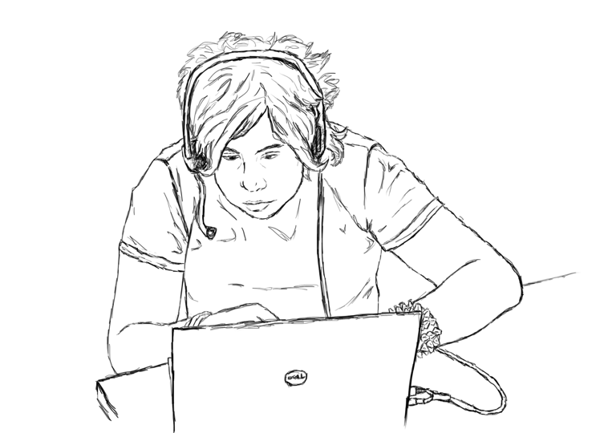
Principles for UDL
Multiple means of
representation
Multiple means of
engagement
Multiple means of action & expression
- Center for Applied Special Technology (CAST)

Slide 15
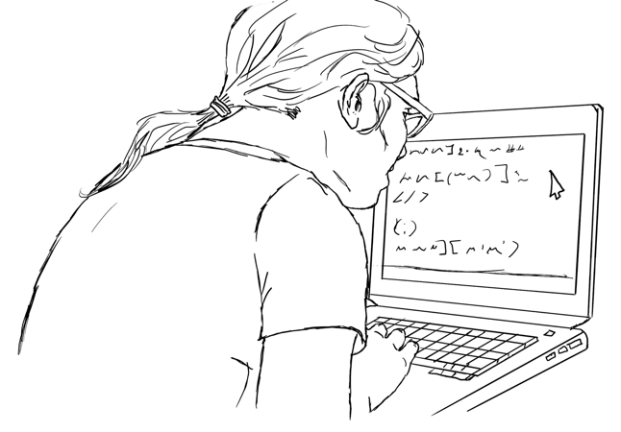
Principles for UD of IT
Underpinning of Web Content Accessibility Guidelines to ensure that digital tools/content is
Perceivable
Operable
Understandable
Robust
- Web Accessibility Initiative (W3C)

Slide 16
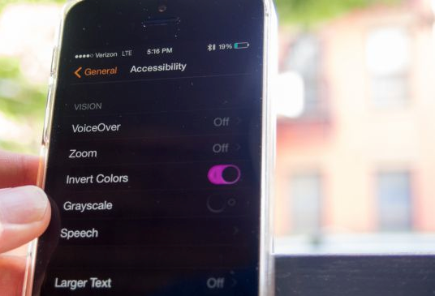
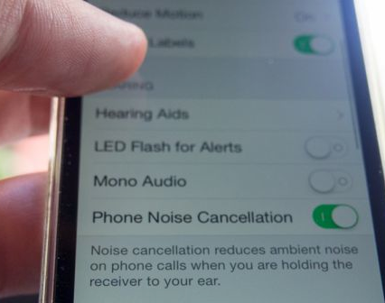
UD of technology
builds in
accessibility
features
ensures compatibility with assistive technology

Slide 17

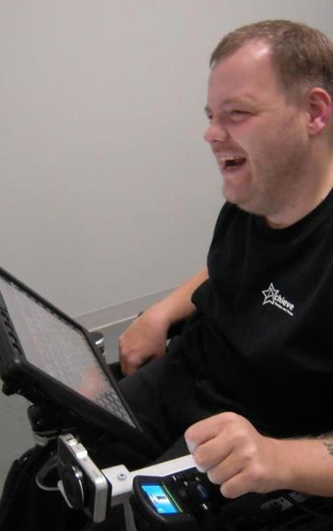
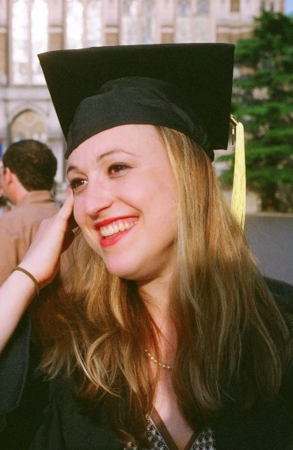
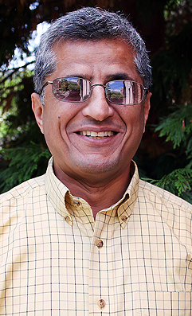
students
When applying UDHE to online learning consider characteristics of students who might be in a course & the assistive technologies they might be using.
Zayn
Anthony
Jesse
Hadi

Slide 18
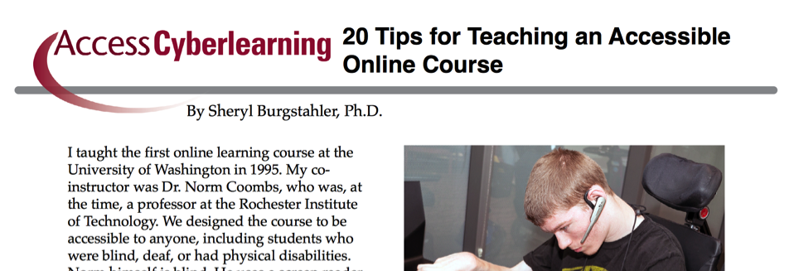
20 tips for teaching an accessible online course
        uw.edu/doit/20-tips-teaching-accessible-online-course
        Tips for documents, images, videos, instructional methods
        With references

Slide 19
Examples of tips, 1/2
Give students multiple, accessibly designed ways to learn
Give students multiple, accessibly designed ways to demonstrate learning
Give students multiple, accessibly designed ways to engage
Caption videos
Minimize number of attached documents; alternatively deliver in HTML on content pages

Slide 20
Examples of tips, 2/2
For content pages & digital documents:
  Avoid PDFs (esp. scanned images)
  Use text format
  Structure headings, lists, tables
  Make descriptive link text descriptive; describe content in images
  Use large sans serif fonts with high contrast to plain backgrounds with no reliance on color alone; well organized, uncluttered content
Design assignments that integrate UDL with UD of IT tools & products

Slide 21
If you understand basic accessibility issues,
you can better understand & use the accessibility checkers in
Microsoft Word & PowerPoint,
Learning Management Systems (eg., Ally),
other products

Slide 22
UDHE
Framework
Scope
Definition
Principles
Guidelines
Process
Practices

Slide 23
An attitude; a goal, process—UD:
Values diversity, equity, & inclusion
Promotes best practices
Does not lower standards
Is proactive
Can be implemented incrementally
Is for the benefit of everyone
Minimizes the need for accommodations

Slide 24
Examples of UW’s ATS support
Host Accessible Technology website
Offer routine trainings
Offer individual/group consultation
Lead IT Accessibility Task Force
Support IT Accessibility Liaisons
Offer limited ‘free” captioning
Offer limited “free” document remediation
Collaborate with Teaching & Learning Center, disability services units, department IT units, …

Slide 25
Describe your ideal state for:
Stakeholder | Roles
Students Instructors Central support Disability services IT services Teaching & learning center Library ADA compliance office + ??? Departmental support IT services Teaching & learning support + ??? | Accommodations, UDE advocacy
TINYURL.COM/3WCTR67Z

Slide 26
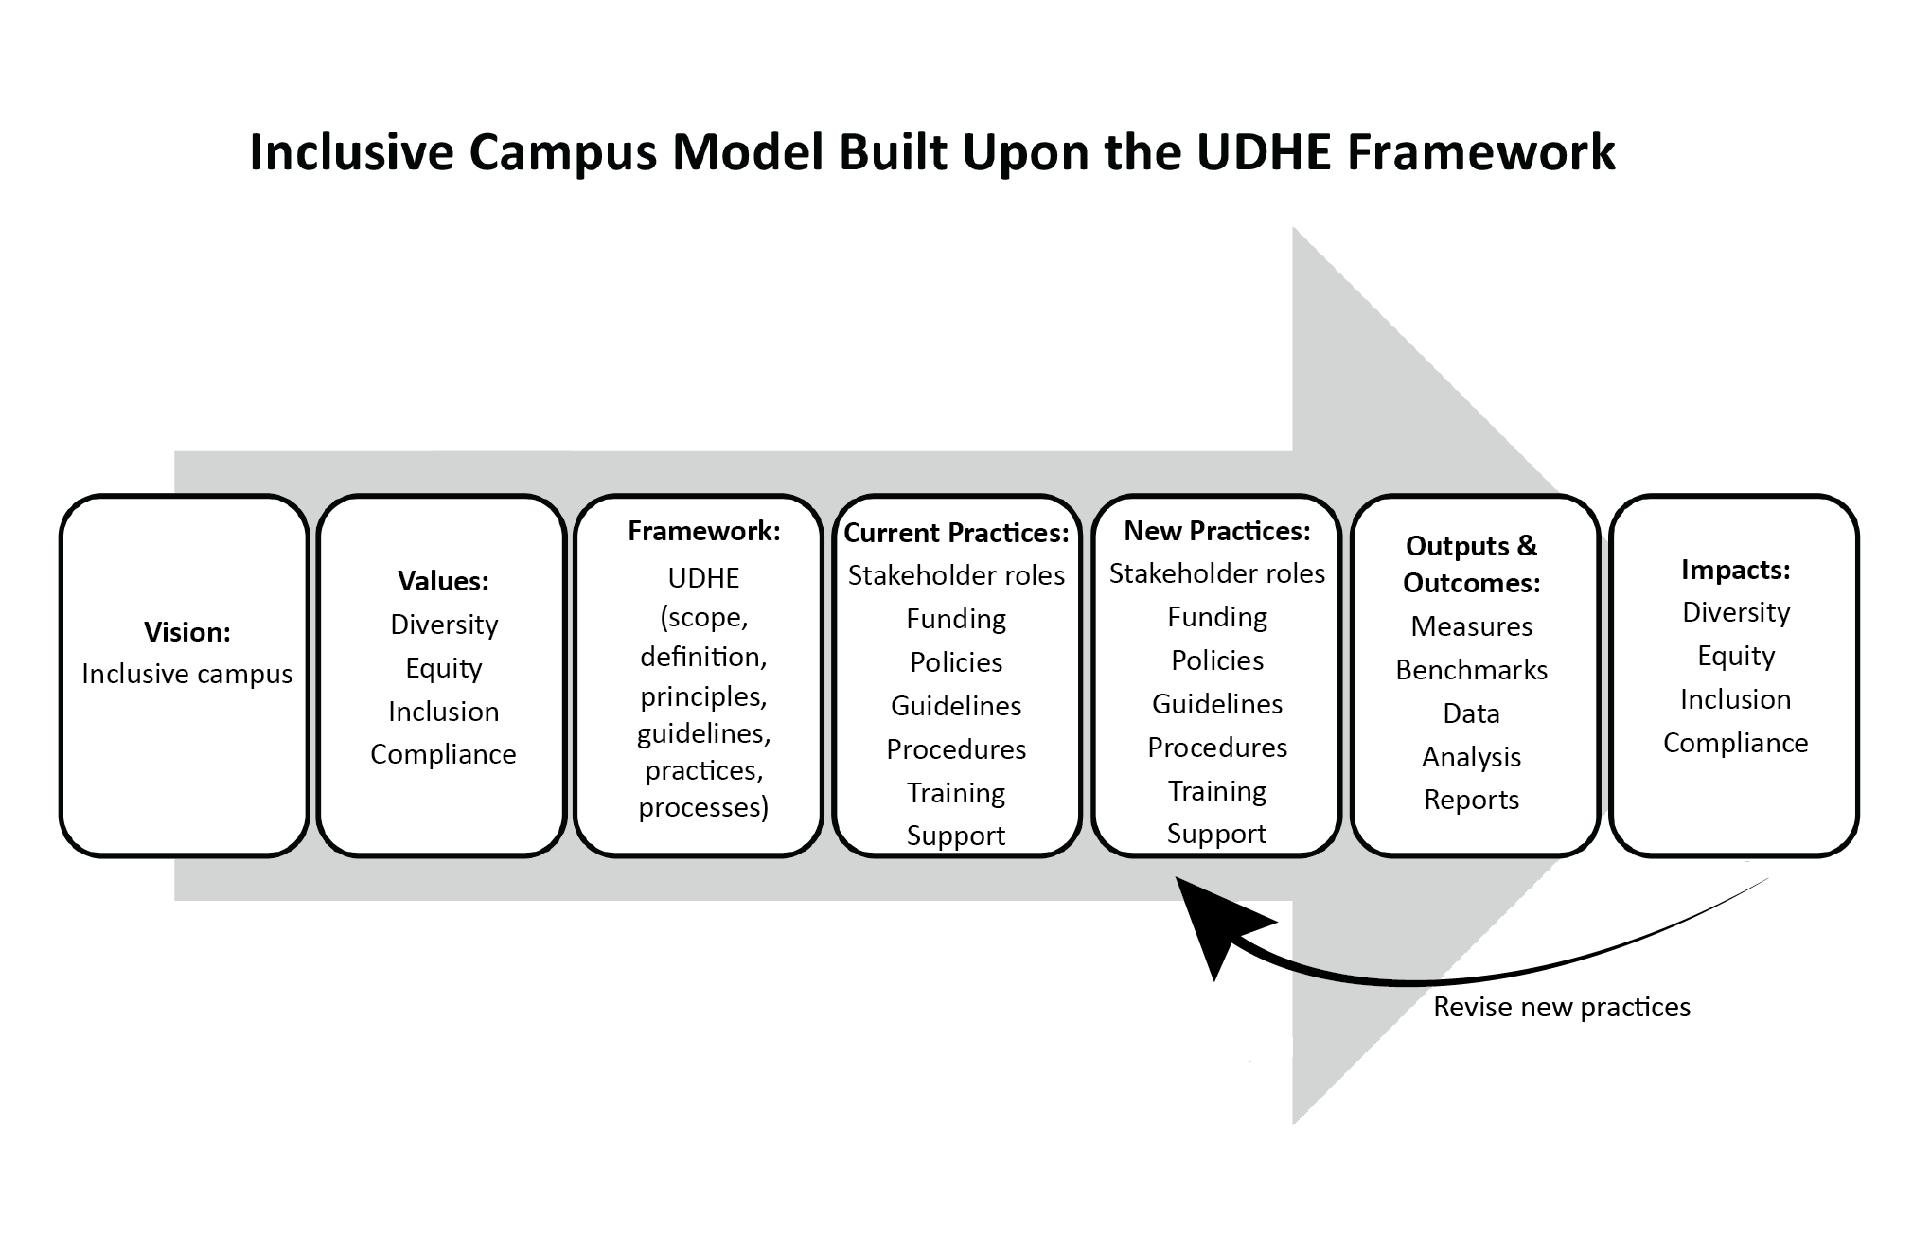
Systemic change model for online learning underpinned by UDHE Framework

Slide 27
Resources
Our Google doc
tinyurl.com/3wctr67z
UW’s Accessible Technology
uw.edu/accessibility
DO-IT’s Center for UD in
Education uw.edu/doit/cude
  UDHE Knowledge Base
  UD as a Framework for DEI in Higher Education
  Equal Access: Universal Design of Instruction
  20 Tips for Teaching an Accessible Online Course
  Published Books & Articles About Universal Design in Higher Education (UDHE)
Sheryl Burgstahler sherylb@uw.edu

