Slide 1
Leveraging Trusted Tester for Web For Windows
Exploring the relationship between web accessibility training and compliance
GMU Assistive Technology Initiative
Accessing Higher Ground 2022
November 16, 2022
Notes:
Korey

Slide 2
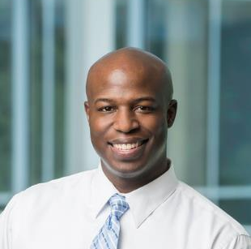
Today’s Presenters
Kristine Neuber, Ph.D. & Grady
IT Accessibility Coordinator, ATI
Korey Singleton, Ph.D. ATP RET
Manager, ATI
Notes:
Korey

Slide 3
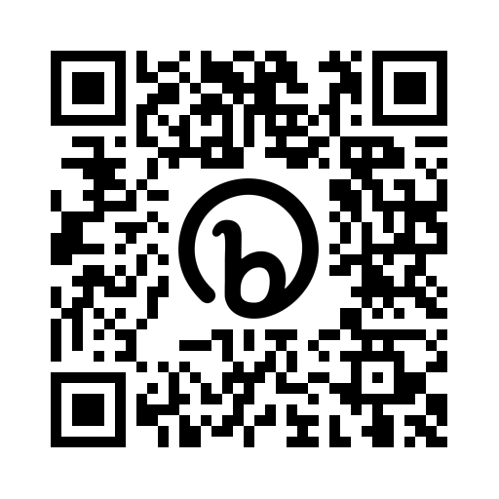
Today’s Agenda
Link to presentation:
https://bit.ly/AHG2022-TrustedTester
QR Code:
Introductions
Existing Web Accessibility Efforts @Mason
Fall 2021 Digital Accessibility Meetings with Strategic Partners
Trusted Tester for Web Fundamentals Pilot Cohort (Why, Course Timeline, Structure, Results)
Next Steps
Q&A
Notes:
Korey

Slide 4
Introductions
GMU’s Assistive Technology Initiative
Notes:
Korey

Slide 5
George Mason University
R1 Public Institution (largest in Virginia)
39k+ students from 130+ countries
Heavy investment in online instruction
1500+ Instructional and Research Faculty
10 colleges and schools, 4 locations
Centralized AT and Digital Accessibility approach
Notes:
Korey
George Mason University is the largest public R1 institution in the Commonwealth of Virginia. We have approximately 39,000 students from over 130 different countries. Situated in Fairfax, Virginia, just 20 miles west of Washington, DC, Mason consistently ranks as one of the most diverse campuses in the country. Our assistive technology and digital accessibility services and supports are centralized out of the Assistive Technology Initiative Office (or ATI for short). The ATI reports directly to the ADA Coordinator and is housed under the Office for Diversity, Equity, and Inclusion (DEI). The Chief Diversity Officer and VP for DEI reports directly to the University President.

Slide 6
Accessibility@Mason: A Collaborative Partnership
Notes:
Korey
The Accessibility at Mason Collaborative is a partnership between the ATI Office, Disability Services (DS), and the Office for Diversity, Equity, and Inclusion (DEI). The ATI reports directly to the Associate VP for DEI/ADA & Title IX Coordinator who oversees accommodations for employees with disabilities. DS oversees accommodations for students with disabilities. The ATI is tasked with developing and implementing the university’s digital accessibility response.

Slide 7
ATI’s Role...
In addition to the provision of assistive technology resources, the ATI works to ensures equivalent access to ICT resources for individuals with different learning styles and abilities in the Mason community through video captioning, web and document accessibility, alternate formats (i.e., textbooks, quizzes, tests), and AT/ICT accessibility related raining.
Notes:
Korey

Slide 8
Existing Web Accessibility Efforts @Mason:
DubBOT, ASRB, Classroom
Notes:
Kristine

Slide 9
DubBOT (Web Governance Solution)
Implemented in Sum/Fall 2020
Performs following compliance checks:
Web Accessibility
Broken Links
Web Governance
Spelling & Readability
Benefits
Automated reviews
Customizable
Integrates web accessibility into university’s web governance process
Photo taken from Dubbot.com
Notes:
Kristine

Slide 10
Architecture Standards Review Board (Purchasing & Procurement)
The Architecture Standards Review Board (ASRB) is under the Architecture Standards Committee and is responsible for reviewing IT purchases prior to implementation.
The ASRB includes representatives from Security, Enterprise Integration, Server Management, ATI (Accessibility), and Purchasing.
ASRB
Security
Integration
Server Management
Accessibility
Purchasing
Notes:
Kristine

Slide 11
Web Accessibility Reviews (by request)
Service involves:
Review of third-party websites or applications (e.g., Piazza, MATLAB, Pearson, etc.) for instructional faculty.
It also involves occasional consultation and guidance to screen reader users.
Review Process:
Manual reviews using JAWS/NVDA, ANDI, and/or CCA
Notes:
Kristine

Slide 12
Fall 2021: Meetings with our strategic partners
Issues, Feedback from Debriefs
Notes:
Korey

Slide 13
Existing Issues, Feedback, and Next Steps
A. Issues with Existing Strategies
B. Feedback from Strategic Partners
C. Next Steps
Short-staffed
Increasing demands on accessibility (Documents, ASRB)
Cannot catch everything
Strategic partners would like to feel more empowered to address accessibility questions/concerns
Strategic partners desire to learn how to identify and remediate digital accessibility issues, when appropriate, on their own.
Provide more document (Word, PPT, PDF) and web accessibility-related training (E.g., how to use web accessibility testing tools)
More targeted training for strategic partners
Research existing options
Secure funding/support from upper admin
Create a community around web accessibility
Notes:
Korey
While many commented that ATI services (i.e., captioning and transcription, document remediation, web accessibility) and resources (ATI websites, training) have been well received, few understand how or have the confidence to address digital accessibility-related concerns on their own.

Slide 14
Trusted Tester for Web Fundamentals pilot
Participants, Course Structure/Details, Communications
Notes:
Kristine

Slide 15
Why we settled on Trusted Tester…
Cost savings
Industry-recognized
Comprehensive
Self-paced
Targeted training approach
Photo taken from DHS Trusted Tester
Notes:
Kristine

Slide 16
DHS Trusted Tester for Web Certification Course Structure
DHS Description:
Participants learned about the Section 508 Standards applicable to the web, how to install and use web accessibility test tools, and how to apply the Trusted Tester process for testing web sites and web applications for conformance to the revised Section 508 standards, released in January 2017.
Resources:
Trusted Tester Course Descriptions
DHS Course modules (~55 hours):
What is Section 508 and Why is it important?
Section 508 Standards for Web
Introduction to Trusted Tester Tools (ANDI & TPGI’s CCA)
Trusted Tester Training for Web on Windows (Incremental Exams)
Trusted Tester – Practice Exam for Web on Windows (~10 hours)
If applicable, Certification Exam for Web on Windows (~10 hours)
NOTE: DHS course completion is expected within 90-days.
Notes:
Kristine

Slide 17
GMU’s TTW Fundamentals Cohort Course Structure
GMU Goal:
Provide participants with a foundational understanding of the legal standards outlined in Section 508 of the Rehab Act of 1973 and WCAG 2.x Level A and AA.
Provide guidance on how to independently identify and report issues related to inaccessible web content (e.g., structure, color contrast, forms, alternative text descriptions for images, etc.
Cohort Structure/Requirements:
Complete Demographic Survey
Attend TTW Cohort Orientation
Attend at least 2 of the 6 Check-in Sessions
Successful completion of the Trusted Tester for Web for Windows Certification Course through Module 4 (i.e., incremental exams)
Attend TTW Closing Session
Complete Exit Survey
Added a study component…
Notes:
Kristine

Slide 18
Participants
Participants:
25 Mason web developers and web content authors agreed to participate in the cohort (20 participated in the study).
Individuals represented 14 critically strategic areas on campus. For example, HR, University Branding (i.e., Drupal), ITS Web Admin (i.e., WordPress), University Libraries, as well as developers from some of the main colleges/schools (e.g., CEHD, CHSS, etc.).
Notes:
Kristine

Slide 19
Pilot Timeline
Invitation to Participate
Orientation
Check-In Sessions
Expectation/Timeline Adjustment
March 10
Acceptance Letters
March 23
March 30 – April 1
April 8 – June 10
July 15
Closing Session
August 5
Notes:
Kristine

Slide 20
GMU’s TTW Fundamentals Cohort Course (Study Component)
IRB# 1878973-2
Research Questions:
Does participation lead to improvements in the university’s conformance with Section 508 and the WCAG 2.1 Level A and AA guidelines?
After completing the cohort, what perspectives do participants have about their ability to ensure university websites comply with Section 508 and WCAG?
Study Components:
Pre/Post survey data
Drop-In Session transcripts
Pre/Post automated reviews of websites (DubBOT)
Pre/Post manual reviews of websites (ANDI/CCA)
Participate in semi-structured exit interviews (allow use of transcript)
Notes:
Kristine

Slide 21
Drop-In Sessions (via MS Teams)
Synchronous drop-in sessions were held (via MS Teams) every other week, covering the following topics:
Color Contrast
Keyboard Accessibility
DUBBOT Training and Q&A
Using Screen Reading Technology
Top 10 Accessibility Checks with ANDI
Testing Form Elements
This Photo by Unknown Author is licensed under CC BY-SA
Notes:
Kristine

Slide 22
Open Discussion (via MS Teams)
Asynchronous chat (via MS Teams) was open as well. There were no pre-scheduled topics. Participants could post about anything they had a question or comment about.
This Photo by Unknown Author is licensed under CC BY-SA
Notes:
Kristine

Slide 23
TTW Cohort Incentives
Incentives:
Created a TTW Fundamentals Badge
$250 HR Impact Award (funded by DEI)
NOTE: Participation in study was not required to participate in the training cohort or to receive compensation.
Notes:
Kristine

Slide 24
Pilot Results – RQ#1
RQ #1: Does targeted training lead to Improvements in conformance with Section 508 and WCAG?
Notes:
Korey
Full question: Does participation by web developers and web content authors in a university-sponsored web accessibility certification training program lead to improvements in the university’s conformance with Section 508 and the WCAG 2.1 Level A and AA guidelines?

Slide 25
Total Websites Reviewed
Participants submitted 127 sites during the TTW Cohort application process
10 identified as low priority (i.e., sites still under construction, content not directed toward Mason community, etc.)
17 were duplicates
12 were not listed in DubBOT (i.e., automated reviews)
As a result, 89 websites were used as a part of the pre- and post- automated and manual accessibility reviews!
Notes:
Korey

Slide 26
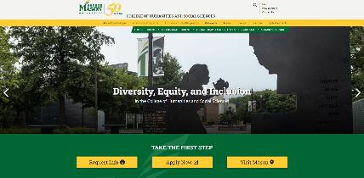
What sites were reviewed…
18 templates identified
The MAIN and CHSS templates (42 and 21 sites, respectively) make up ~71% of all sites reviewed
16 standalone sites/templates (e.g., HR, ITS, LEADS, Library, etc.)
Notes:
Korey

Slide 27
Automated and Manual Website Audits
Researchers reviewed the home pages of all websites against several WCAG Level A & AA checkpoints:
Images
Color contrast
Hyperlinks
keyboard access & Navigation
Forms
Tables
Media content
Documents
Why just the home pages?
Image taken from W3C Blog.
Notes:
Korey

Slide 28
Automated accessibility Audit Highlights
Notes:
Kristine

Slide 29
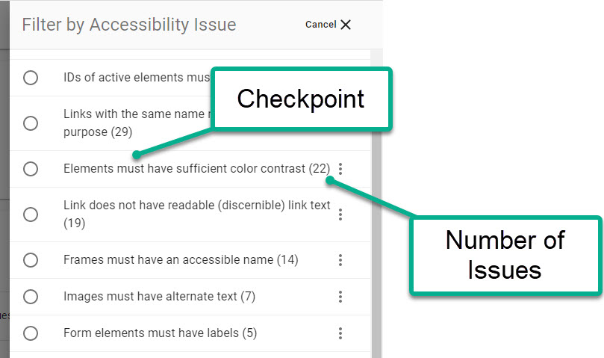
Automated Accessibility Audit (DUBBOT)
62 accessibility checkpoints were reviewed over 89 home pages
Perceivable (20 A, 5 AA) – 25
E.g., images, color contrast
Operable (10 A, 1 AA, 2 AAA) – 13
E.g., keyboard navigation, hyperlinks
Understandable (4 A, 1 AA,1 AAA) – 6
E.g., page language, form labels and instructions
Robust (18 A) – 18
E.g., frames, ARIA, ID Attributes
26 Best Practices Techniques
E.g., Use of Landmarks, Headings
Notes:
Kristine
Example of best practices:

Slide 30
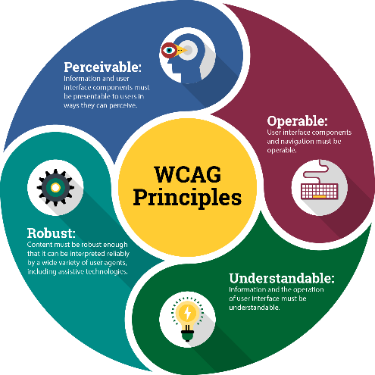
Summary of Issues Flagged
Perceivable
Color Contrast
Missing alt-text for Images
Text spacing
Operable
Missing page title
Links do not have readable link text
Links not descriptive
Understandable
Missing language attribute
Form Labels
Robust
Frames must have accessible name
ARIA related issues
Id attribute issues
Notes:
Kristine

Slide 31
Pre-/Post- Automated Accessibility Reviews (Improvement)
POUR | Checkpoints | # of Issues Flagged May | # of Issues Flagged Nov | Reduction in Issues (%)
Perceivable | 3 | 246 | 198 | -19.9
Operable | 3 | 160 | 118 | -26.3
Understandable | 2 | 9 | 6 | -33.3
Robust | 10 | 334 | 284 | -15.0
Total Issue Reduction | 18 | 749 | 606 | -19.1
Notes:
Kristine

Slide 32
Highlights from Automated Review
POUR | # of Issues Flagged May | # of Issues Flagged Nov | Reduction in Issues (%)
Color Contrast | 191 | 153 | -19.9
Images missing Alt Text | 53 | 43 | -18.9
Links Readable | 87 | 77 | -11.5
Links Descriptive | 71 | 41 | -42.3
Elements must only use allowed ARIA Attributes | 64 | 8 | -87.5
Id Attribute value must be unique | 183 | 200 | 9.3
Notes:
Kristine

Slide 33
Manual accessibility Audit Highlights
Error Reduction Rates(%), Common Issues Identified
Notes:
Korey

Slide 34
POUR Checkpoints
Breaking down the 34 checkpoints (25 Level A, 9 Level AA) by principle:
Perceivable (9 A, 2 AA) – 11
E.g., images, captions, color contrast
Operable (13 A, 5 AA) – 18
E.g., keyboard navigation, hyperlinks, headings, landmarks, page title
Understandable (1 A, 2 AA) – 3
E.g., page language, form labels and instructions
Robust (2 A) – 2
E.g., iframes
Notes:
Korey

Slide 35
Pre-/Post- Manual Accessibility Reviews (Improvement)
# of home pages with improved overall accessibility scores | # of home pages whose overall accessibility scores remained the same | # of home pages with worse accessibility scores
57 | 9 | 23
Notes:
Korey

Slide 36
Pre-/Post- Manual Accessibility Reviews (Overall Error Reduction)
69 of the 89 home pages reviewed saw a reduction in the number of errors reported post-training. The MAIN and CHSS templates are highlighted as they comprise the largest number of sites reviewed.
Template | # of sites | Avg. # of Errors – May 2022 | Avg. # of Errors – Nov 2022 | Avg. Reduction in Errors (%)
HR | 1 | 7 | 3 | -57.14
CHSS | 21 | 7 | 4.1 | -41.22
CEHD | 2 | 4 | 3 | -25
MUSIC | 1 | 14 | 11 | -21.43
MAIN (DRUPAL) | 42 | 5.4 | 4.4 | -17.8
TTAC | 2 | 3 | 2.5 | -16.67
Notes:
Korey

Slide 37
Pre-/Post- Manual Accessibility Reviews (Perceivable)
76 of the 89 home pages reviewed saw a reduction in the number of errors reported under the Perceivable guideline (11 checkpoints) post-training. These errors are consistent with issues related to, for example, missing alternative text descriptions, poor color contrast, and videos with no or inaccurate captions.
Template | # of sites | Avg. # of Errors – May 2022 | Avg. # of Errors – Nov 2022 | Avg. Reduction in Errors (%)
HR | 1 | 1.0 | 0.00 | -100.00
COS | 2 | 0.5 | 0.00 | -100.00
Library | 2 | 0.5 | 0.00 | -100.00
CHSS | 21 | 2.8 | 0.70 | -75.86
CEHD | 2 | 2.0 | 1.00 | -50.00
MAIN (DRUPAL) | 42 | 1.6 | 1.0 | -34.33
MUSIC | 1 | 4.0 | 4.0 | -25.00
OLD | 5 | 1.6 | 1.4 | -12.50
Notes:
Korey
The MAIN and CHSS templates are highlighted as they comprise the largest number of sites reviewed. They show reductions of approximately 34% and 76%, respectively.

Slide 38
Pre-/Post- Manual Accessibility Reviews (Operable)
Template | # of sites | Avg. # of Errors – May 2022 | Avg. # of Errors – Nov 2022 | Avg. Reduction in Errors (%)
OSCAR | 1 | 3.0 | 1.0 | -66.67
UL | 1 | 4.0 | 2.00 | -50.00
MUSIC | 1 | 2.0 | 1.0 | -50.00
Library | 2 | 3.0 | 1.5 | -50.00
MAIN (DRUPAL) | 42 | 2.8 | 1.9 | -33.61
HR | 1 | 3.0 | 2.0 | -33.33
OLD | 5 | 3.6 | 2.60 | -27.78
CDC | 2 | 2.5 | 2.00 | -20.00
CEHD | 2 | 3.0 | 2.50 | -16.67
CHSS | 21 | 4.0 | 3.3 | -16.67
ITS WEB | 2 | 3.5 | 3.0 | -14.29
80 of the 89 home pages reviewed saw a reduction in the number of errors reported under the Operable guideline (18 checkpoints) post-training. These errors are consistent with issues related to, for example, keyboard navigation (e.g., focus cursor, buttons, video controls, etc.), heading structure, and meaningful hyperlinks.
Notes:
Korey
The MAIN and CHSS templates are highlighted as they comprise the largest number of sites reviewed. They show reductions of approximately 34% and 17%, respectively.

Slide 39
Pre-/Post- Manual Accessibility Reviews (Understandable)
83 of 89 home pages reviewed reported zero errors under the Understandable (3 checkpoints) guideline both before and after training. These errors are consistent with issues related to, for example, missing language attributes, missing form labels, and form labels lacking adequate instructions.
Notes:
Korey

Slide 40
Pre-/Post- Manual Accessibility Reviews (Robust)
69 of the 89 home pages reviewed saw a reduction in the number of errors reported under the Robust guideline (2 checkpoints) post-training. In our checklist, these errors are consistent with issues related to the frames, specifically iframes (i.e., YouTube videos, calendar widgets), that lack accessible names.
Template | # of sites | Avg. # of Errors – May 2022 | Avg. # of Errors – Nov 2022 | Avg. Reduction in Errors (%)
MUSIC | 1 | 2.0 | 0.00 | -100.00
OLD | 5 | 0.4 | 0.00 | -100.00
CHSS | 21 | 0.1 | 0.00 | -100.00
MAIN (DRUPAL) | 42 | 0.8 | 0.4 | -48.57
Notes:
Korey
Please Note: These reductions can be explained in one of 2 ways: (1) the videos or widgets were removed from the web page or (2) the developers changed the iFrame titles when embedding the videos.
The MAIN and CHSS templates are highlighted as they comprise the largest number of sites reviewed. They show reductions of approximately 48% and 100%, respectively.

Slide 41
Common Issues Identified
Unable to pause/stop slider widget
Skip navigation links missing
Form fields structured with table element (missing role attribute)
Issues with color contrast (e.g., slider widgets, Mason Alert, breadcrumbs)
Keyboard focus indicator missing (e.g., slide widgets, block widgets, expand/collapse control, etc.)
Videos with inaccurate captions
Ambiguous hyperlink text
Color contrast issues (i.e., slider widgets)
Notes:
Korey

Slide 42
#1 – Unable to pause/stop slider widget
Website Examples: CHSS
Notes:
Korey

Slide 43
#2 – Skip Navigation Links Missing
Website Examples: CHSS
Notes:
Korey

Slide 44
#3 – Improperly Identified Table Elements
Website Examples: CHSS
Notes:
Korey

Slide 45
#4 – Color Contrast Issues (Breadcrumbs)
Website Examples: Graduate Admissions
Notes:
Korey

Slide 46
#5 – Keyboard Focus Issues (slide carousel, block widgets, tab control widgets)
Website Examples: Business, Diversity
Notes:
Korey

Slide 47
#6 – Videos with inaccurate captions
Website Examples: Science
Notes:
Korey

Slide 48
#7 – Ambiguous hyperlink text
Website Examples: CHHS
Notes:
Korey

Slide 49
#8 – Color contrast issues related to slider widgets
Website Examples: CHHS
Notes:
Korey

Slide 50
Pilot Results – RQ#2
RQ #2: Participants’ Perspectives about their ability to ensure university websites comply?
Notes:
Korey
Full question: What perspectives do web developers and web content authors at the university have about their ability to ensure university websites comply with Section 508 and WCAG 2.1 Level A and AA before and after participating in the web accessibility certification training program?

Slide 51
Themes from Qualitative Feedback
#1 – Common Training-Related Challenges
#2 – Positive Takeaways
#3 – Growing the “new” web accessibility community
Structure of TTW training was “back-loaded
Incremental exams were frustrating, both in how questions were asked and in how the testing mechanism was implemented (i.e., exam quirks)
Several participants experienced a feeling of being overwhelmed
Heightened awareness about web accessibility and its impact on individuals with disabilities (i.e., color contrast, alt text)
Learning how to use tools and apply findings
Sense of community (e.g., shared frustrations)
Concerns about successfully implementing what was learned
Strong desire for the work started in the TTW to continue (i.e., more targeted training initiatives – e.g., screen readers)
Suggestions to support future TTW participants (i.e., Pacing, Pacing, Pacing)
Notes:
Korey

Slide 52
Ensuring success in Future Cohorts
Suggestions from the 2022 Trusted Testers
Notes:
Korey & Kristine

Slide 53
Snapshot of suggestions and considerations from the 2022 Trusted Testers
Invite 2022 participants who did not finish
Pacing is important!
Use the TTW resources
Create Mason examples that mirror the incremental exams
Already have a head start
Consider support structures
ATI, Supervisor, Colleagues, etc.
Avoid procrastination
Videos, participant forums, etc.
Use real life examples
Provide more structure deadlines/times
Can you complete during work hours?
Meet GMU’s 2022 Trusted Testers!
Notes:
Korey & Kristine

Slide 54
Questions?
This Photo by Unknown Author is licensed under CC BY

Slide 55
Contact Information
Kristine Neuber, IT Accessibility Coordinator
Email: kneuber@gmu.edu
Phone: 703-993-9815
Korey Singleton, ATI Manager
Email: ksinglet@gmu.edu
Phone: 703-993-2143

