Slide 1
Shifting Students from Peer Notetaking to Technology Based Solutions
Accessing Higher Ground 2022, November 16, 2022
Gwynette Hall, MS
Accessible Learning Technology Manager
McBurney Disability Resource Center, University of Wisconsin – Madison

Slide 2
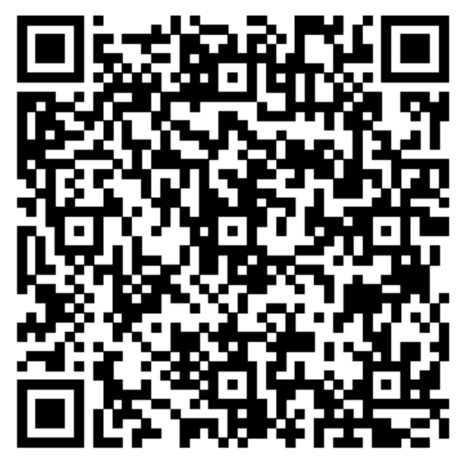
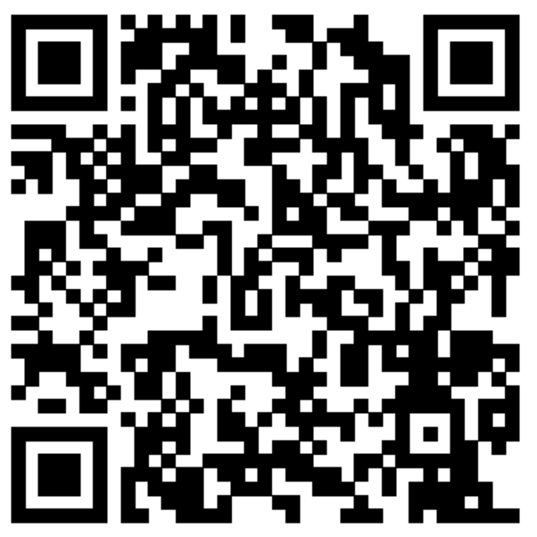
Shifting Students from Peer Notetaking to Technology Based Solutions
Presentation slides:
Link: https://go.wisc.edu/f215jf
Google Doc
Link: https://go.wisc.edu/eisw64

Slide 3
Group Norms for Today
Make yourself comfortable
Ask questions (get my attention, Google Doc, or note cards located up front and in the back of the room)
Who is in the audience? Take a minute to enter what you do and where you are from in the Google Doc
Presentation Materials: https://go.wisc.edu/f215jf
Google Doc: https://go.wisc.edu/eisw64

Slide 4
Overview
UW-Madison Notetaking Accommodations History
New Notetaking Accommodation Recourses and Toolkit
Notetaking Technology and Student feedback
Cost Comparison
Current Notetaking Trends and Stats

Slide 5
Notetaking Accommodation History
Peer Notetaker
Student and faculty recruit the notetaker
Paid notetaker
Most common
Echo Smartpen
Loaned device
Provided notebooks and ink

Slide 6
Implemented Database Software (AIM)
Peer notetaking trends
48% growth in first academic year after move to new process
Students not viewing notes
Students using notes for absences
151% growth by 2019-2020 academic year
Echo Smartpen trends
Rise in Mac users as main device leading to more tech issues
40% of the students approved were not using accommodation

Slide 7
Notetaking Work Group
Questions asked:
How are notetaking accommodations determined?
What are the most common barriers experienced?
What questions are being asked around notetaking during initial meeting?
Are we providing the most appropriate accommodation?
How is the need for skills development vs. a barrier assessed?

Slide 8
Findings from Work Group
Difficultly determining barriers vs. skills
Unsure of what would be the most appropriate accommodation
Unsure of notetaking technology itself and how it works
Mac users got frustrated with Echo Smartpen and Echo Desktop
Most common barriers: mobility, processing, focus, anxiety, tracking, executive functioning, chronic health, visual, and hearing
Current options create more barriers for students
Neither current option the most appropriate accommodation

Slide 9
Conclusion from Work Group
Need for other technology-based options
Access Consults needed support around
What questions to ask around notetaking?
How to determine skills vs. barrier?
Understanding the different notetaking software, hardware, and apps
Create resources for skills development

Slide 10
Two Pathways for Resources
Barriers caused by disability
Offer notetaking accommodation consults
Provide Access consultants with resource materials to help them determine barriers vs. skills
Provide consultations to Access Consults around notetaking technology and barriers
Barriers caused by lack of skills
Offer skills consults
Provide resources for incoming freshman at orientation
Offer notetaking workshops
Notes:
Implemented notetaking apps Fall 2020 and iPad pilot in Fall 2021

Slide 11
Notetaking Toolkit
Microsoft OneNote
Glean
Echo Smartpen
Notability
Advanced Access to Presentation Slides
Peer Notetaking
Notetaking Skills Consults

Slide 12
Microsoft OneNote - Features
Features:
Sync notes with audio
Import PPT, PDFs, videos
Great organization
Search notes
Create to-do lists
Color coding
Compatibility:
Windows Desktop
Mac Desktop
Chromebook

Slide 13
Microsoft OneNote – Points of Access
Barriers Removed:
Processing
Focus
Tracking
Executive Functioning
Anxiety
Preferences considered:
Typed notes
Take notes on slides
Keep notes in one place
Cloud based storage of notes

Slide 14
Microsoft OneNote - Student Feedback
Pros:
Helps with organization
Can use beyond High Ed
Take notes on slides/next to
Import additional materials
Makes studying easier
Color coding notes
Searchable notes
Easy to learn, familiar software
Relisten to only missed information
Notetaking skills have improved
Cons:
Sometimes can hear typing
Sometimes confusion around where notebooks are saved
Sometimes difficultly locating notebooks

Slide 15
Glean - Features
Features:
Sync notes with audio
Generate transcript of audio
Import PPT
Some organization
Quick keys
Compatibility:
Chrome browser

Slide 16
Glean – Points of Access
Barriers Removed:
Mobility
Chronic Health
Hearing
Processing
Focus
Tracking
Anxiety
Preferences Considered:
Typed notes
Take notes along side of slides
Cloud based storage for notes

Slide 17
Glean - Student Feedback
Pros:
Visual audio
Transcript conversion
Track audio along with slides
Quick keys/tags
Notetaking skills are improving
Cloud storage
Easy to use
Cons:
Too busy, causes distractions
Sometimes can hear typing
Lacking organizing features

Slide 18
Echo Smartpen - Features
Features:
Sync notes with audio
Pen and paper
Convert to electronic notes
Compatibility:
Windows and Mac Desktop

Slide 19
Echo Smartpen – Points of Access
Barriers Removed:
Processing
Focus
Hearing
Chronic Health
Anxiety
Preferences Considered:
Pen and paper
Handwriting notes

Slide 20
Echo Smartpen - Student Feedback
Pros:
Review only what was missed
Reduces anxiety to allow more focus
Allows for movement/restroom use
Cons:
Forget notebooks
Forget to charge pen
Uninstalling/reinstalling Echo Desktop on Macs
No organizational supports

Slide 21
Notability - Features
Features:
Sync notes with audio
Type notes and handwrite notes
Import PPT and PDFs
Great organization
Built-in templates
Color coding
Searchable notes
Easy to use
Compatibility:
Apple iPad

Slide 22
Notability – Points of Access
Barriers Removed:
Processing
Focus
Tracking
Executive Function
Hearing
Chronic Health
Anxiety
Preferences Considered:
Handwriting or typed notes
Take notes on slides

Slide 23
Notability Student Feedback
Pros:
“It’s a game changer”
Organization
Everything in one place
Take notes on slides
Import additional materials
Searchable notes
Improves notetaking skills
Review only details missed
Cons:
Sometimes can hear writing/typing

Slide 24
Cost Comparison 2022
Cost per student for 4 year (4 classes per semester)
Notability (iPad with keyboard) = $563
Notability (iPad with stylus) = $543
Glean = $439
Smartpen = $395
OneNote = free with Microsoft Office Suite
Peer Notetaking = $4000

Slide 25
Current Notetaking Trends
Students purchasing personal device (iPad)
Opting to switch to notetaking technology over peer notes
Coming in with the knowledge of Notability
Preference for cloud storage
Prefer ownership of their own notes
Developing notetaking and studying skills with notetaking technology

Slide 26
Current Notetaking Stats
Fall 2022 Notetaking Accommodations
35% of students using a notetaking app or software
48% of students use OneNote
33% of students use Notability
19% of students use Glean
13% of students use Echo Smartpen with 70% checking out Smartpen
25% of students using peer notetaking
27% of students use advanced access to slides
Notes:
43% decrease in peer notetaking accommodations since Fall 2020

Slide 27
Key Takeaways
Students want autonomy
Fitting the notetaking accommodation to the student
Allows student autonomy
Allows student to developing skills
Reduces barriers

Slide 28
Thank you. Questions?
Contact information:
Gwynette Hall, gwynette.hall@wisc.edu

