Slide 1
Building an accessible campus experience: Tools to remove obstacles and reduce friction

Slide 2
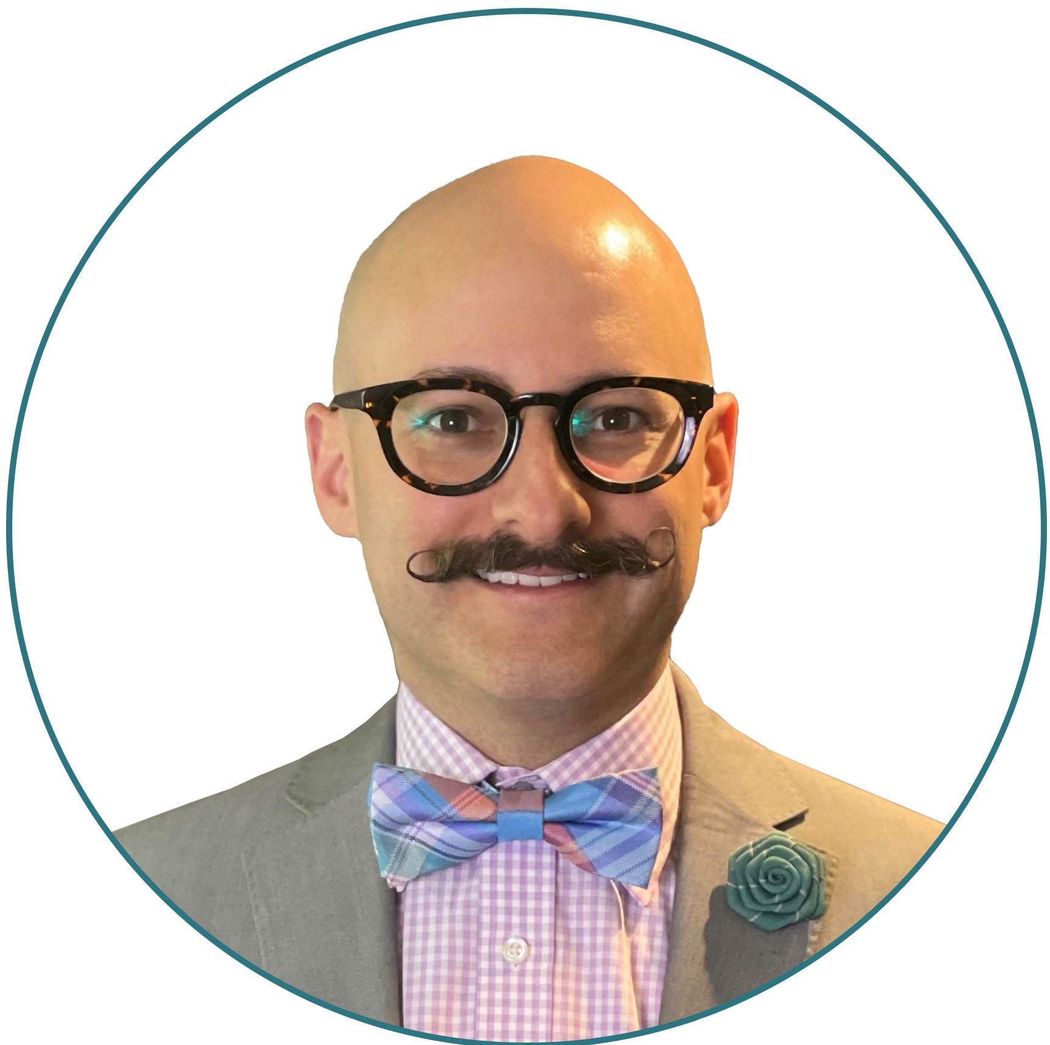
Michael Wood
Strategic Accounts Manager - Education
MWood@vispero.com

Slide 3
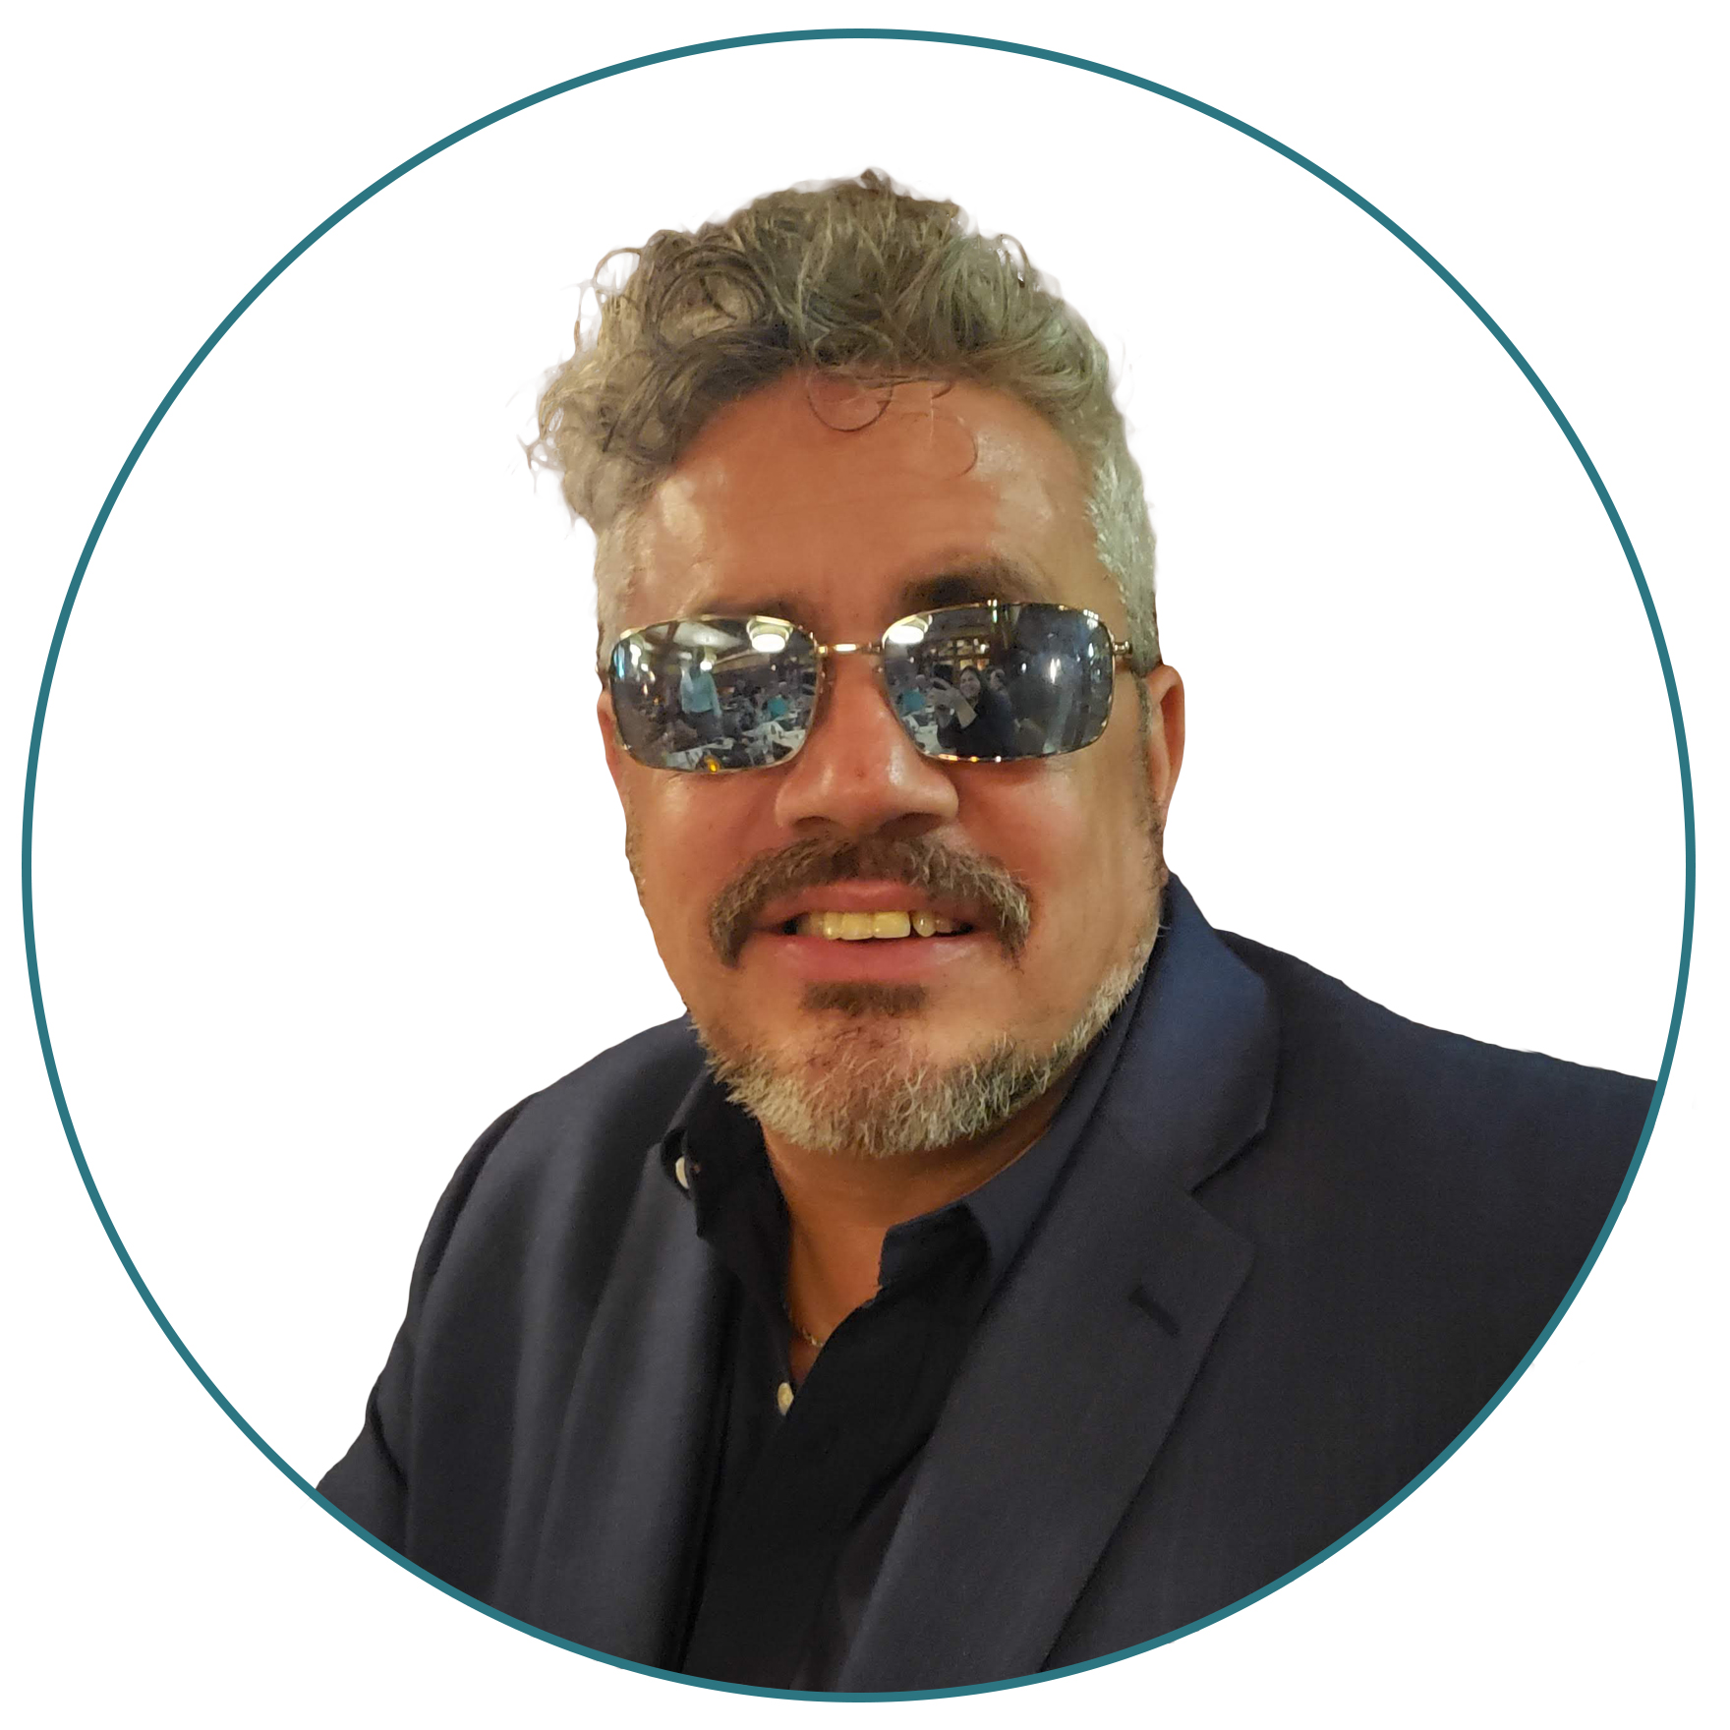
Douglas Gerry
National Director of Software Sales
DGerry@vispero.com

Slide 4
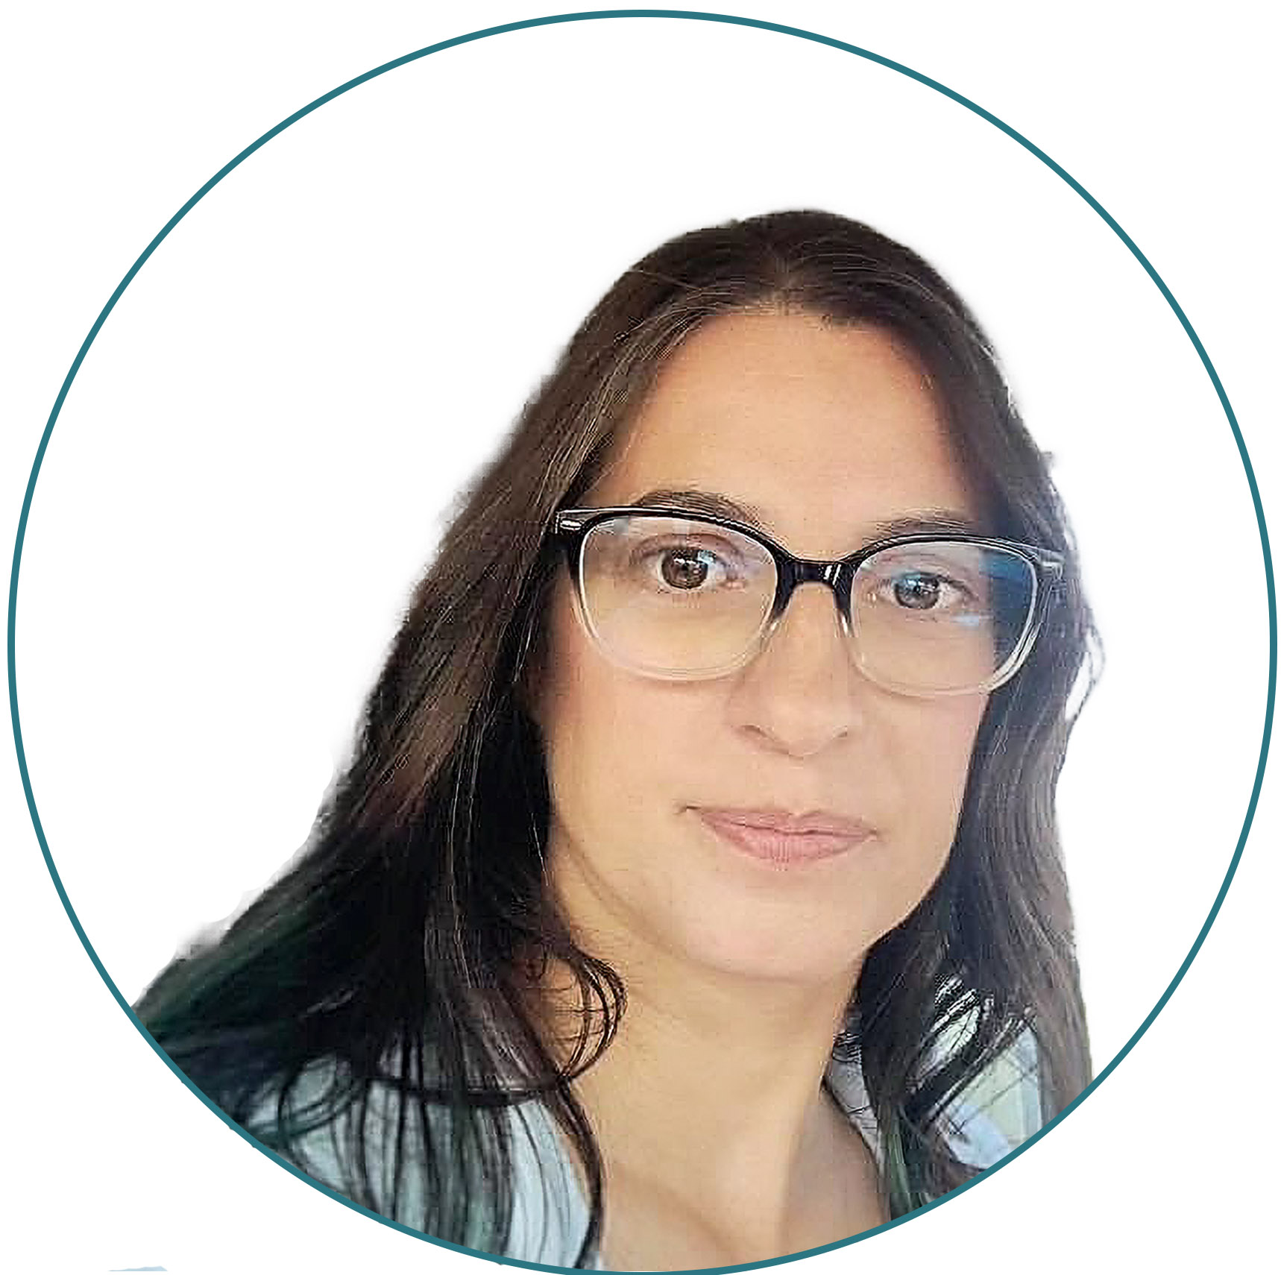
Laura Boniello Miller
Director of Business Development
LMiller@vispero.com

Slide 5
Who is Vispero?
VISIO ₊ SPERO ₌
(Latin for “VISION”) (Latin for "HOPE") ("TO SEE HOPE")
Vispero develops products – both hardware and software – in cooperation with end-users. Innovation is important to us and we always strive for the best solution.
Our team has extensive knowledge and years of experience in the field of assistive technology. With our solutions, we enable users to gain an education, obtain employment, succeed in professional careers, and live independently throughout their lives.
Our products are represented in more than 70 countries

Slide 6
Some signs of low vision even with corrective lenses
Difficulty reading a book, newspaper or magazine?
Recognizing the faces of family and friends?
Cooking, sewing, or fixing things around the house?
Selecting and matching the color of your clothes?
Feeling like your lights are dimmer than normal?
Reading traffic signs or the names of stores?

Slide 7
Some Causes for Low vision & Blindness
Low vision is usually caused by eye diseases or health conditions. Some of these include:
age-related macular degeneration (AMD)
cataract
diabetes
glaucoma
Eye injuries and birth defects are some other causes
Whatever the cause, lost vision cannot be restored. It can, however, be managed with proper treatment and vision rehabilitation.

Slide 8
What could help?
Software
ZoomText
Fusion
JAWS
Hardware
Optical Magnifiers
Lighting and Filtering Lenses
Electronic Magnifiers
Portable Video Magnifiers
Braille Displays

Slide 9
Problem worth solving:
Books, in person presentations, not perceivable by someone with low vision.
Solution:
Tools to make books and physical content accessible

Slide 10
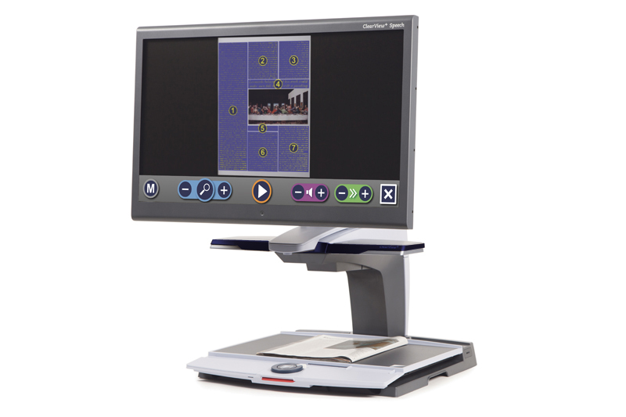
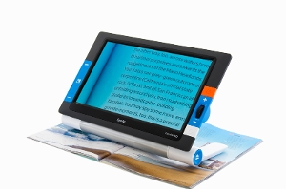
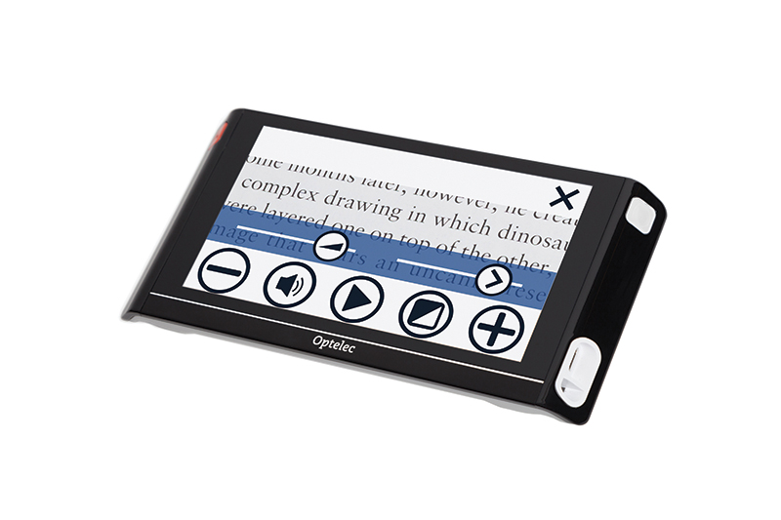
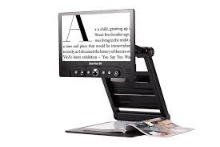
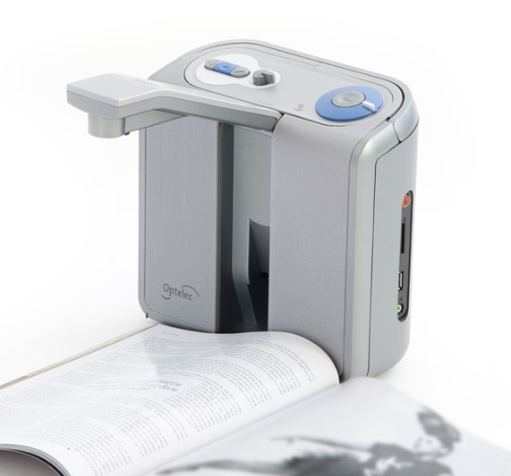
Notes:
Optelec
ClearView + 24" Full HD Speech
Optelec Compact 6 HD Speech
Optelec ClearView Go 15" (and 17" not shown)
Optelec ClearReader +
ClearView C Full HD Speech
Optelec Traveler HD

Slide 11
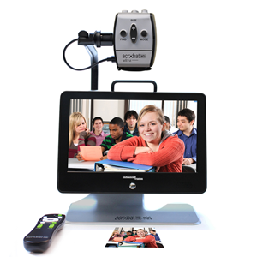
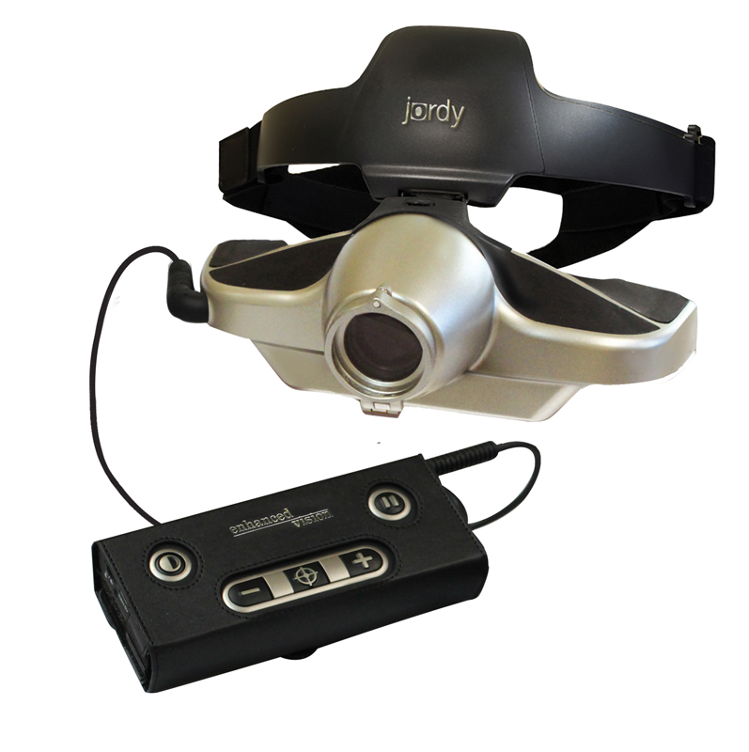
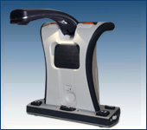
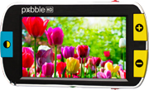
Notes:
Enhanced Vision
Merlin Mini: Portable, Foldable Desktop Video Magnifier
Acrobat HD Mini Ultra: Portable Battery Operated Electronic Magnifier
Jordy
Pebble HD
Smart Reader HD
Transformer HD

Slide 12
Problem worth solving:
Digital content not perceivable by someone with low vision.
Solution:
Software to read digital content & applications

Slide 13
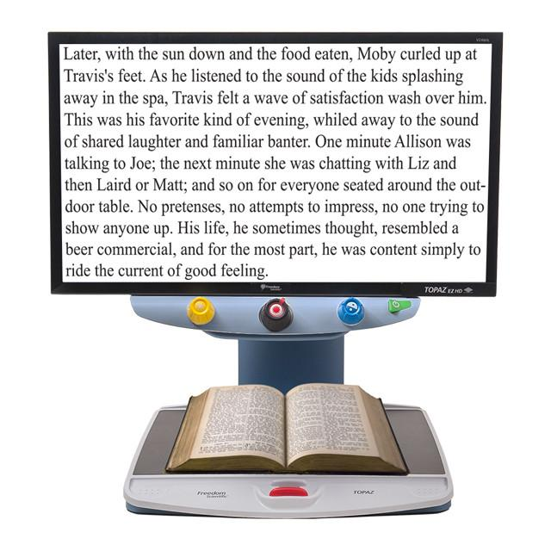
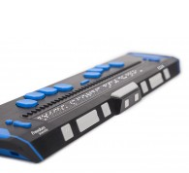
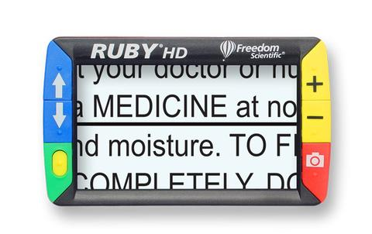
Notes:
Freedom Scientific.
Left to right:
Topaz EZ HD
Focus 40, Focus 80
Ruby HD by Freedom Scientific
ZoomText
Fusion
JAWS

Slide 14
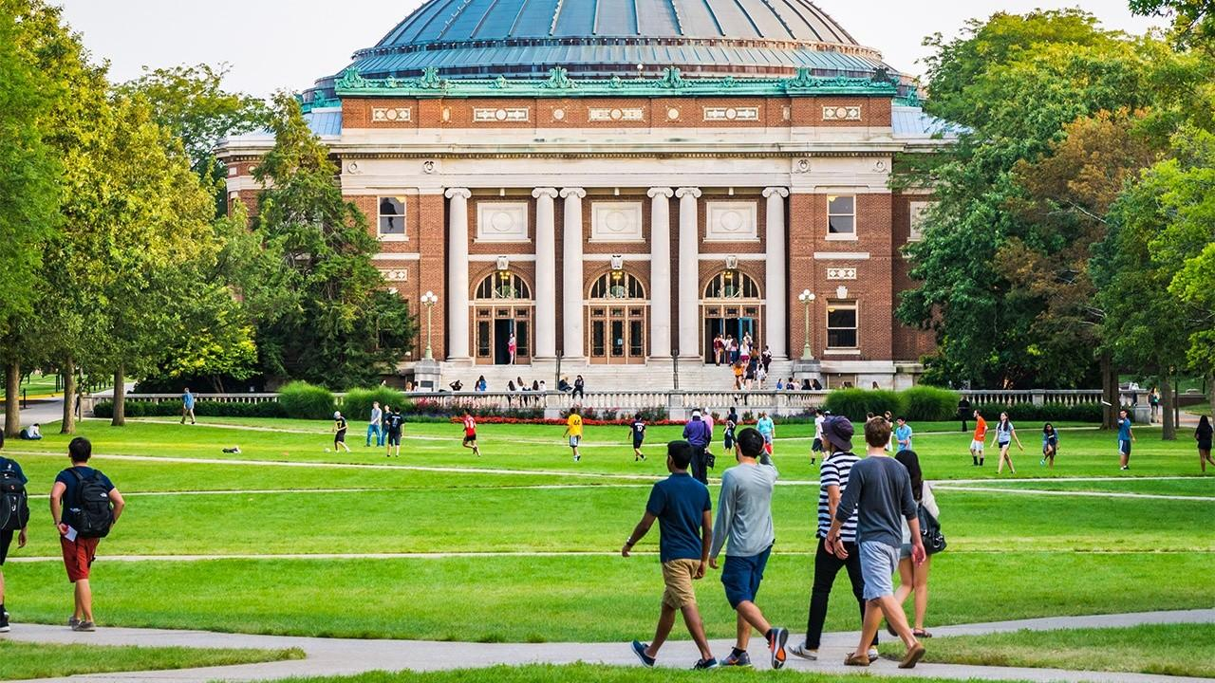
Campus Wide License
CUNY
UT Dallas
Over 400 Universities
State Wide License
Florida

Slide 15
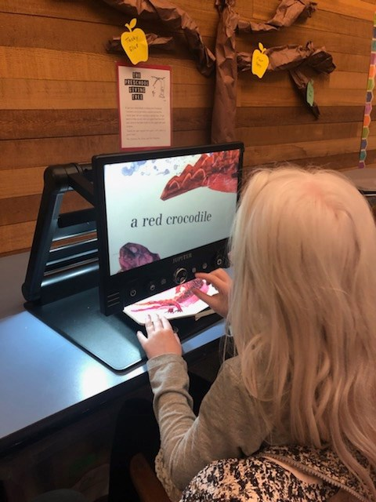
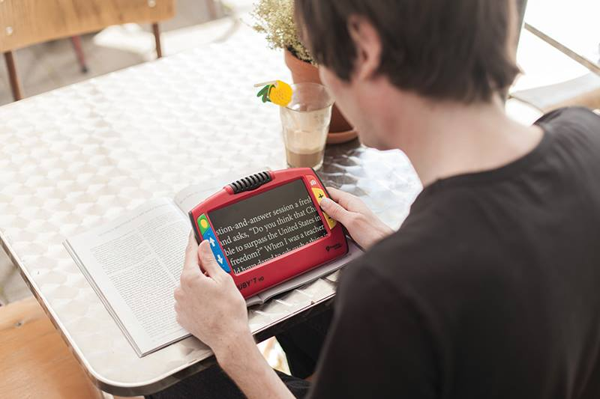
Advantages
Ease of use with the portal
Schools often have licenses at school
Home access for students

Slide 16
Problem worth solving: Even with the correct tools, websites, apps not accessible
Solution:
Services to help make websites, college/university apps accessible

Slide 17
Monitoring &
Training
VPAT
Assistance
JAWS Scripting
Accessibility Review
Notes:
The Paciello Group
ARC
Accessibility Review
VPAT Assistance
Training
JAWS Scripting
JAWS Inspect

Slide 18
Problem worth solving:
Physical transaction machines are inaccessible
Solution:
Software & services to help make kiosks & other closed systems accessible

Slide 19
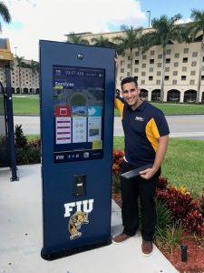
Wayfinding, Interactive Information Kiosks
Notes:
https://intermediatouch.com/portfolio-posts/florida-international-university-installs-outdoor-interactive-kiosks-with-a-custom-wayfinding-solution-to-guide-and-inform-their-students-and-faculty-members/

Slide 20
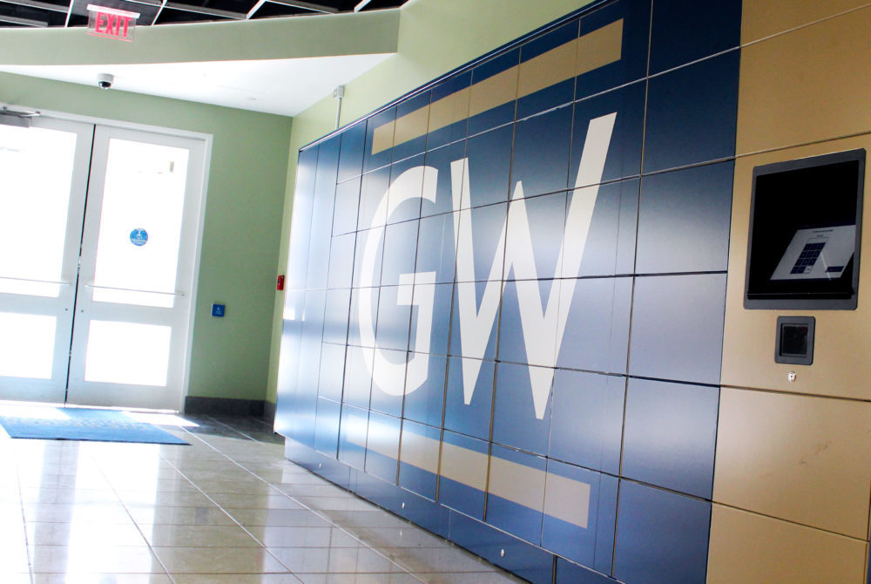
Locker Kiosks

Slide 21
Dining services kiosks
Notes:
Virginia tech food services touch screen kiosk

Slide 22
Assistive Technology such as (JAWS) Screen reader, Headphone Jack, Tactile input device.

Slide 23
The Built Environment
A piece of hardware may be fully accessible in the showroom but moved to a site may be:
too big for the space
inaccessible to wheelchair access due to the placement of ramps
have too much glare for viewing the screen

Slide 24
What makes a closed system accessible?
Standards
Usability/Accessibility
Hardware/Enclosure
Kiosk Application/Software
Input Devices (Card Reader, Tactile Input)
Auxiliary Aids (Screen Reader)
Braille

Slide 25
Questions?

Slide 26
Connect with Us
Twitter: @freedomsci
Facebook: FreedomScientificInc
Instagram: @FreedomScientific
YouTube: FreedomScientificTraining
Podcast: FreedomScientific.com/training/podcasts
Blog: blog.freedomscientific.com
Email us: training@vispero.com
TikTok: tiktok.com/@freedomscientific
Clubhouse

Slide 27
Thank you & Contact Information
Laura Miller
Director of Business Development
LMiller@Vispero.com
Michael Wood
Strategic Accounts Manager – Education
MWood@Vispero.com
Douglas Gerry
National Director of Software Sales
DGerry@Vispero.com

