Slide 1
I’m Drowning in Resumes!
Finding & Hooking the Right A11y Fish
Presenters:
Naveesha Maharaj, CPWAS & DHS TT Certified
Heidi Kelly-Gibson, PMP, CPACC
Notes:
Speaker’s Notes:
Heidi:
If you’re here today, you might be drowning in a pile of resumes and are wishing someone would cast you a line and help you determine if the school of fish in your pool are experienced enough A11y fish you can use to build your team and accelerate your accessibility momentum. Or maybe you are embarking on a new high seas adventure and you are wondering how you can best present your accessibility skills to a potential employer. You came to the right place!
Naveesha:
Whether you are a recruiter, hiring manager or applicant this is your life preserve! Buckle up your life vest, grab your gear and let’s dive into what you need to know to obtain or to be that one in a million subject matter expert. This is bound to be a nautical experience (ad nauseum perhaps) for all of us and we can’t wait to set sail!

Slide 2
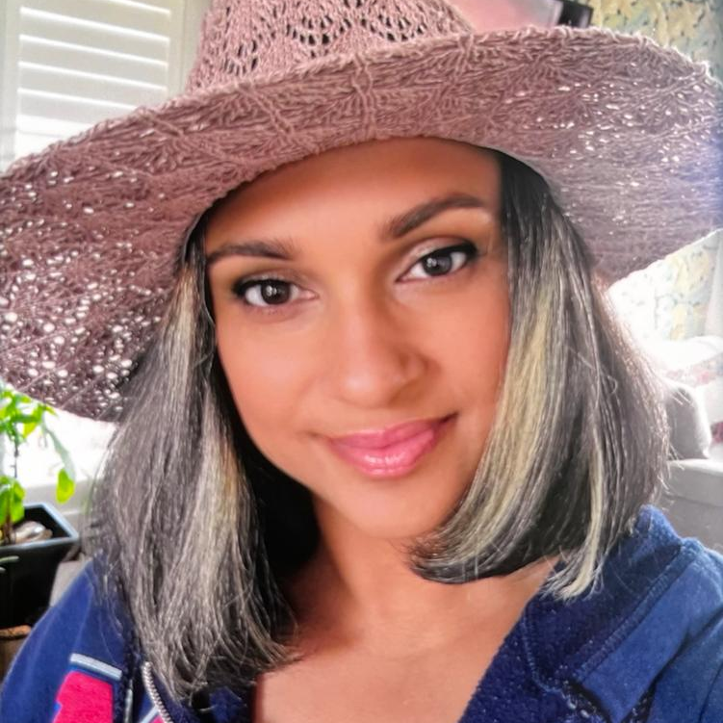
Presenters
Naveesha Maharaj
Accessibility Manager - TMS
CPWA & DHS TT Certified
Heidi Kelly-Gibson
Strategic Acct. Director - A11y Program Manager - Deque, PMP, CPACC
Notes:
Naveesha:
Been in the A11y field since 2008 starting from CNIB working my way through many organizations until becoming a certified A11y consultant in both US and Canada for just over 9 years, some of those 9 years were spent with Heidi at Deque fortunately. After some deep considerations, Ive finally decided to settle down with one organization to implement process, train, hire, add some A11y vendors for testing and build a resource center for all of TMS digital staff to refer to for their everyday a11y needs. I know what you're thinking, does she live and breath accessibility?! almost! outside of all this fun, I spend the rest of my energy on my 3 beautiful huskies and my ally hubby Oscar, so you can imagine what are dinner conversations are like.
Heidi:
Heidi Kelly-Gibson, PMP, CPACC - Customer Success - Strategic Account Director & Program Manager - Deque
Heidi made an entry into working in the accessibility field by joining Deque in 2018. As a mom, wife and daughter, accessibility has touched her family in many ways over her lifetime. This includes dyslexia, ADHD, autism, macular degeneration, depression, anxiety and by having aging parents.
Heidi has two decades of experience in project and program management as well as organizational change across many industries including financial, healthcare, ecommerce, security, and payroll. She is certified as a Project Management Professional and holds the Certified Accessibility Core Competencies certification. Heidi co-wrote Deque's "Change Management in Accessibility" which is a 5-part blog series. Most recently she is focused on her customer's accessibility journeys and supporting them through the development and execution of their accessibility programs.
Heidi is seldom without her faithful furry companions: her rescues, the beloved English Bulldog, Louie, and her sweet Labradoodle Rottweiler Mix, Luna. One is good for cuddles and the other is good for jogging the Minnesota hiking trails. Guess which is which!
LinkedIn
Conferences previously presented at:
AxeCon 2022
AccessU Knowbility 2022
Why we are trusted experts on this topic
We are living the dream of working in the rewarding field of making digital accessibility a reality
We have experience establishing successful accessibility programs
We have been the interviewer and the interviewee
Naveesha:
Does anyone know the difference between accessibility and a11y? A + 11 characters + Y = accessibility

Slide 3
Swim Schedule
Introduction
Types of roles to hire for
What to look for on a resume
What to ask in an interview
What to say in an interview
Wrap Up
Q&A
Notes:
Heidi:
The hiring pond for accessibility is huge, murky, and you just started training for this swim event so how do you know who you want in your medley relay? In other words, how do you know you are talking to the right candidates for the accessibility team you want to build? How do you know you have the necessary and desired skills to set yourself leagues in front of the others?! I ran a search on Indeed.com for accessibility jobs and it returned over 95k results. There were a variety of job titles including Accessibility Coordinator, Advisor, Senior SME, Program Manager, Director, Analyst, Specialist, Tester, SCRUM Master, Coach, Consultant, Software Developer, and Product Manager just to name a few. Many of these are posted by leading companies like Google, Adobe, and Amazon, but there are hundreds of other companies leading and growing their accessibility prowess in the world.
Today we are going to take two perspectives. The hiring manager and the candidate.
Naveesha:
With our combined roles we are able to share some of our expertises by coaching all of you through some positions to consider adding as part of your team when looking to incorporate accessibility. Your team can be made up of many talents and organized in many different ways, but we want to help you know where to begin. What we really don't want to do is to run a catch and release program! As a candidate, you should understand how your skills can fit into the roles that companies are hiring for and where you can upskill to make yourself that long standing trophy fish.
Without giving too much away, we will spend a little time going over what you should look for and include in a resume so be prepared for some role playing with great questions and really useful responses that will set you up with key skills to find that specific A11y talent
We’ll leave time at the end for a wrap up and Q&A. If you haven't figured it out yet, we will be inviting a few of you to participate in the interviews so get ready to dive in! Don’t worry, we won’t put you on the spot! We have a script for you. AND! just so you know, no fish were harmed in making this presentation

Slide 4
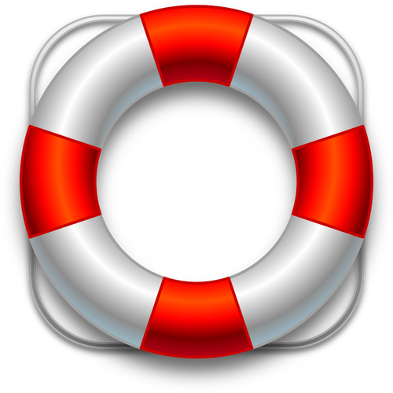
Program? Team?
I just need to be accessible!
Don’t Panic!
Notes:
Heidi:
Don’t go off the deep end! This might be your maiden voyage or you might have been working with digital accessibility for a long time. There are a lot of different ways to go about achieving good digital accessibility practices and processes and that includes determining what your needs are now and in the future for how you structure the talent you bring on board. Let’s talk about what kind of a11y structure companies are building so you can decide what fits your organization or your skillset best.
Program: An accessibility program is made up of many facets of your organization and aligning them with the accessibility goals you have is a key to the success of the program. These facets include policy, governance, support, developer lifecycle and training, just to name a few. A program usually makes the most sense in medium to large sized companies who have structured organizational change processes.
Accessibility teams: These are an essential part of your success in rolling out accessibility in your organization. There are teams dedicated to accessibility and then there is the integration of accessibility into your already established teams and processes. Dedicated teams can be formed in a Centralized way or a Decentralized way and each have their own benefits.
Integrated A11y Talent: Bringing people into your teams who have experience designing, developing, and testing for accessibility.
What the fish want:
Employees are looking for companies that are diverse and inclusive of all types of people. This ranked as the 6th most important thing employees were looking for in their next job in a study done by Gallup. Think about this when you are hiring. You are being interviewed just as much as doing the interview.

Slide 5
What roles do you need to consider?
Actually...each role has a built-in responsibility to incorporate A11y
Accessibility Training
Concept Review
Project Kickoff
Wireframe
Accessibility Review
UX Design
Accessibility Review
Site Build/QA Site
Accessibility Audit/QA
QA Site Review
Accessibility Validation
QA Site Review
Accessibility Validation
Deployment/Go Live
Accessibility Smoke Test
Notes:
Naveesha:
With all the titles representing accessibility talent being hired, who do you actually need to hire and where do your skills as a candidate fit into an organization? could be anywhere within the process, starting with training!
So the good thing about A11y , as you can see, is that it fits into all digital roles, so whether you're a
Copy or Content Writer who adds meaningful alt text for images that require an alt​ or maybe adding page titles that accurately reflect the page content​ or even a
UX/UI Designer that has to ensure text against its background meets the contrast requirements​ or Colour alone is not used to convey important information​ or maybe selecting the best type of elements to provide that awesome user experience.
If you’re a Front End Developer, you’re definitely not left out, before anything moves into QA, you’d be responsible for running screens through automated testing tools such as aXe extension, after ensuring actionable elements can be accessed using keyboard and not only mouse​, headings are accurately marked up or validating your html markup and so on, only then can you move your product to QA.
QA peeps! even though the asset may have been run through many checks. you still want to make sure you run it through automated checks in addition to your regular checks of ensuring, there is meaningful sequence, accurate alts, all actionable items are keyboard accessible and so on.
There are a lot of areas as you can see where accessibility fits in and because of this high demand, we need to figure out what to look for on the stack of resumes HR has just handed us

Slide 6
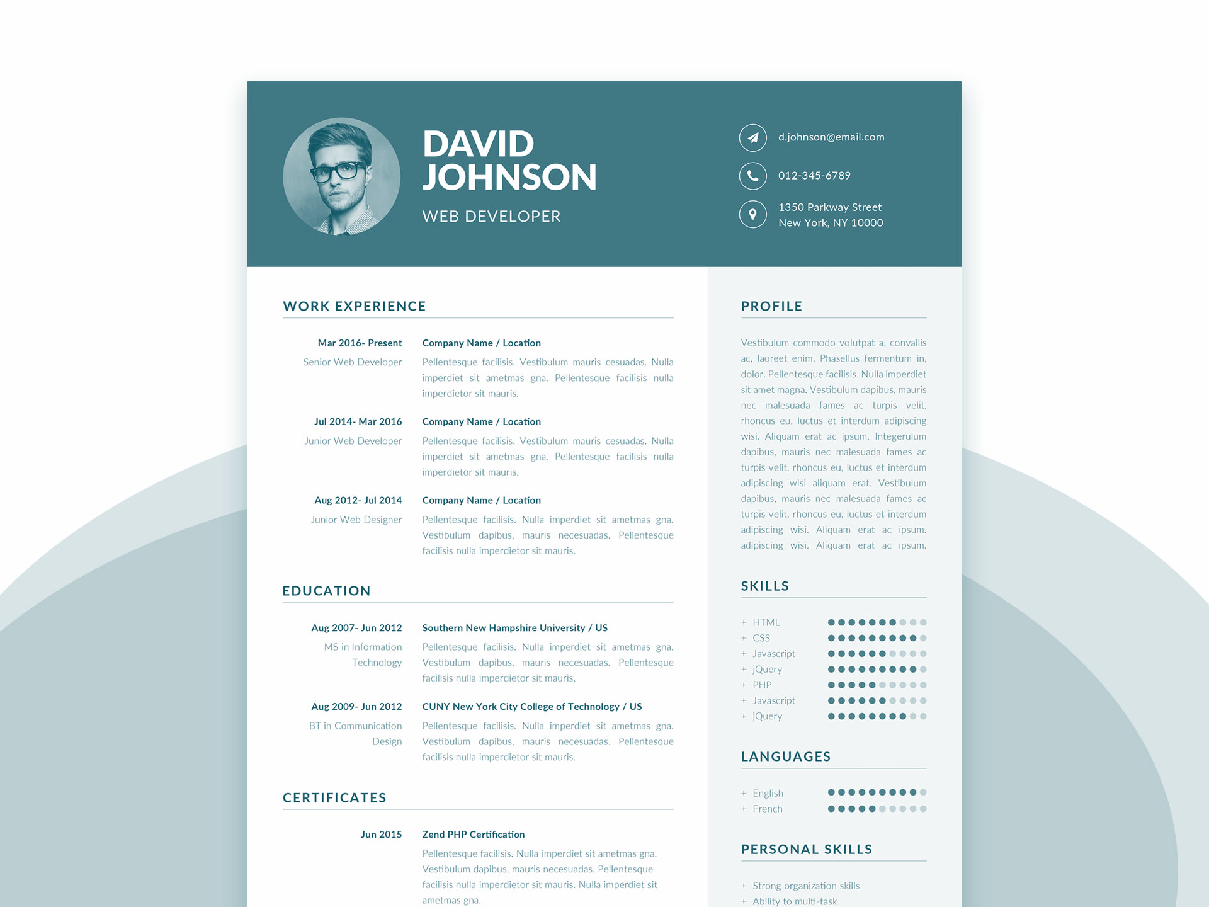
Fishing around for accessibility talent
Fishing around for accessibility talent
SME on WCAG
Implementation of universal and Inclusive design
Adapt to internal A11y
Review concepts, wires, designs, copy, etc
Comprehensive reports
Work towards implementation
Audit interpretation
Vendor liaison
Notes:
Heidi:
Alright, you have a stack of resumes, what do you look for? Are there key words, education, or experience you want to make sure you have in your company?
Or you are getting ready to write the job posting, what do you ask candidates to have so you can find the right skills to get you quickly moving forward?
Or you are creating your resume, what do you want to highlight about yourself or what additional learning, training, or certification should you seek out to make sure you stand out?
Naveesha:
As an accessibility manager, Im going to tell you the bare minimum…
Must be a subject matter expert in Web Content Accessibility Guidelines (WCAG) and knowledgeable in legal requirements and liability/fines across markets
Become fully versed in a client(s) Accessibility toolkit(s) or process if they have one, so willing to adapt
Work with internal teams on accessibility review of concepts, wireframes, designs and copy
Work closely with Accessibility Manager on company-wide accessibility implementation
Liaison to any supporting external accessibility vendors for the bulk of accessibility application testing
Digital content could range from an email or website to a native app or AR/VR experience
Help teams understand and manage Accessibility Audits received from accessibility vendors and clients
Produce reports highlighting issues around accessibility and impacts
Guide teams on how to implement the principles of Universal Design for Learning and Inclusive Design into digital applications/campaigns globally
If you have all of the above, then we can think about the nice to haves or the bonus features. Determine what level of accessibility knowledge is necessary for a job position and be explicit in the listing.
Consider listing IAAP Accessibility Certification as a stated requirement or preference for candidates.
Recruit applicants with disabilities as they have extensive first-hand knowledge of using assistive technologies such as screen readers.
Consider if current employees have the interest and aptitude to become accessibility professionals.
REMEMBER: Ensure that your job posting and application are accessible.

Slide 7
What are we casting for?
CPWA
Usability
Experience!
Experience!
Experience!
A11y QA
Global Standards and Laws
WCAG 2.0
WCAG 2.1
Governance
Assistive Technology
Process Implementation
Automated Testing Tools
Notes:
Navesha:
What are we casting for? lets throw the line a bit farther and see what we catch!
Heidi:
Keep in mind, you can cast a large net and get a lot of candidates, but digital accessibility is relatively new (the WCAG guidelines were first established in 1999) and you will find a wide range of skill sets and experience in the market.
Certifications
IAAP (International Association of Accessibility Professionals) is made up of accessibility professionals from around the world who come together to define, promote, and improve accessibility professions through certification, education and networking. They offer a few different certifications that you might consider adding to your job descriptions, depending on the role you are hiring for such as:
Certified Professional in Accessibility Core Competencies (CPACC)
Web Accessibility Specialist (WAS)
Certified Professional in Accessible Built Environments (CPABE)
Accessible Document Specialist (ADS)
Certified Professional in Web Accessibility (CPWA) Designation
There is also the DHS Trusted Tester certification (for the US). This certifies that the person doing testing is following a manual test approach that aligns with the ICT (Information and Communication Technology) Testing Baseline and provides repeatable and reliable conformance test results.
Naveesha and I have some of these certifications so if you’d like to know more about any of them, please feel free to ask in the Q&A.
Knowledge
Some key things you want to point out that you have a deep knowledge about or call out that you want candidates to have a deep knowledge about:
The W3C (World Wide Web Consortium) is the main international standards organization for the World Wide Web. One of the standards developed from W3C is called WCAG (Web Content Accessibility Guidelines). The latest version is WCAG 2.1 (which includes WCAG 2.0). WCAG 2.1 is currently considered globally to be the best strategy to increase your international accessibility compliance.
WCAG 2.2 is expected to come out in the coming months and will build on 2.1.
Assistive technology knowledge will be important. Assistive technology can range from no tech solutions to high tech ones and they are available for many different user types. They include, but are not limited to magnifiers, screen readers, Braille displays, amplified telephones, vibrating alarm clocks, speech output software, audio books, wheelchairs, and switch devices.
Testing tools exist out there that will find accessibility issues using automated methods. Anyone you hire should be familiar with these products and know the pros and cons of them.
Accessibility reaches across an entire organization. Having knowledgeable employees who understand accessibility and how it pertains to policy, governance, and change management will make a big difference.
There is a difference between an accessible experience and a usable experience. While making an accessible experience should make a more usable experience, new hires should understand the difference between these and how to balance between them.
Experience
Of course, experience is key! You don’t get good at incorporating accessibility into your job if you don’t do it! Look for candidates with experience!
However, finding motivated, passionate, champions can go a long way too. You’ll find that a lot of people applying for jobs relating to accessibility have a passion for it and are willing to learn. Keep this in mind.
You likely are up against an organizational change, so looking for individuals with experience in change management who are flexible, willing to learn, and strategic will go a long way.

Slide 8
The swim lanes are set up..ready..set…
UX Designer and Content Writer
A11y Manager/Lead
Developer and QA
Notes:
Naveesha:
Time for some fun! Lets get some volunteers!
The company, T-shirts for Huskies and Bulldogs has been around for thirty years, outfitting the large, fluffy and odd shaped breed and has been doing really well the last five years financially. They have had an online platform for twenty years and the web traffic is increasing substantially. They also have developed a hybrid app for even easier ordering. About eight months ago, a legal complaint was filed against them because their app and website was not accessible. They have resolved this complaint, but now have awareness of their inclusivity oversight and they want to make their digital platforms accessible to everyone. They know they have a lot of gaps to fill regarding the talent on their teams and the organizational and process changes needed to sustain accessibility.
Heidi:
They have decided they need:
A11y Manager/Lead
They need someone to organize accessibility within the company, be a knowledge resource, create best practices and process to follow. Potentially build a team to support these goals, but consider integrating this within the development teams as well.
Developer and QA
Some companies have QA testers and some developers QA their own work. THB (T-shirts for Huskies and Bulldogs) is growing but their developers do the testing right now. You need a leader so you are looking for someone who knows about accessibility and can lead a team towards THB’s accessibility goals.
UX Designer and Content Writer
Accessibility starts here. Great job looking for innovators who can design and create content that is accessible.

Slide 9
The right bait to hook the right A11y Manager!
How was a11y handled in a multi project environment with minimal compliance expertise?
How have you maintained and kept a11y consistent?
How have you taken accessibility to the next level?
A11y Director
How have you handled challenges and turned them into a success?
How have you maintained a11y knowledge to be reliable?
Notes:
Naveesha
A11y Director interviewing an A11y Manager or Lead with an under experienced/skilled candidate
The interview is already in progress and the A11y Director has some really key accessibility related questions they want to hear the candidate respond to.
Heidi - Question 1: I see on your resume you have over 5 years of accessibility experience, Please tell me more about how you’ve taken accessibility to the next level in your previous organization.
Audience participation
Naveesha - DON’T just throw key words at the interviewer. Be ready to highlight specific scenarios!
Heidi – Question 2: When has implementing or sustaining the accessibility process within your previous organization become a challenge and how were you able to set that back on a successful path?
Audience participation
Naveesha - DON’T blame others. Accessibility is hard and it takes time, but own the challenge and talk about the positive steps forward you were part of!
Heidi - Question 3: What process or technique have you used to maintain accessibility knowledge and consistency within your previous organization?
Audience participation
Naveesha - DON’T underestimate this question. Providing the knowledge is a key foundational piece of building a sustainable program.
Heidi - Question 4: In a high volume organization, such as ours, how would you handle compliance across multiple simultaneous projects with minimal accessibility expertise?
Audience participation
Naveesha - DON’T lose your focus on this question. You are being asked how you’d manage compliance across many areas. Any experience with change management in the past will aid in answering this question.
Heidi - Question 5: How do you maintain your level of accessibility knowledge to ensure the organization you work for can consider you 100% reliable for recommendations?
Audience participation
Naveesha - DON’T say you know everything, always. The WCAG Guidelines are intentionally vague so that they can be applied to many digital situations. There are gray areas, interpretations, and things change with technology quickly. Have a plan to stay on top of the changes over saying you know everything.

Slide 10
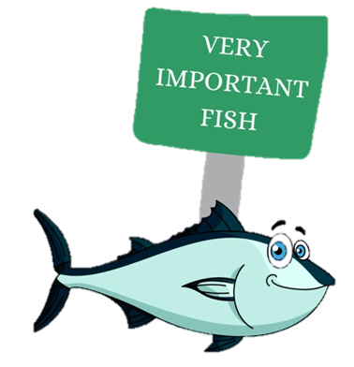
How to be the catch of the day!
Dedicated role training and process implementation
Establish Buy-in through benefits of more than just a11y
Frequently updated A11y Resource Hub
Vendor approval and/or automated tools
Conferences, webinars, courses and more!
Notes:
Naveesha
A11y Director interviewing an A11y Manager or Lead with an adequate experienced/skilled candidate
Heidi - Question 1: I see on your resume you have over 5 years of accessibility experience, Please tell us more about how you’ve taken accessibility to the next level in your previous organization
Naveesha - Response 1: Using the knowledge I’ve obtained through different roles, I’ve been able to implement training that applied to each applicable role within my organization prior to rolling out a process which made each role accountable for accessibility within their area
Heidi - Question 2: When has implementing or sustaining the a11y process within your previous organization become a challenge and how were you able to reset that back to a successful path?
Naveesha - Response 2: In a few environments, buy-in is normally the root of the issue until legalities come into play. Normally that puts everything into perspective but when that’s not the case, trying to help others see the benefits from not just an a11y standpoint but through SEO and ROI. Being able to analyze these benefits through the organizations past, current and future results generally resets interpretations and builds buy-in to encourage that successful journey
Heidi - Question 3: What process or technique have you used to maintain accessibility knowledge and consistency within your previous organization
Naveesha - Response 3: Using the software available, I was able to build a Resource hub where other teams were able to search for a11y testing tools, upcoming webinars, training material and pretty much any a11y tips and tricks that could assist in their roles. I frequently kept this hub updated with the latest in the a11y realm
Heidi - Question 4: In a high volume organization, such as ours, how would you handle compliance across multiple simultaneous projects with minimal accessibility expertise?
Naveesha - Response 4: With that buy-in that I was able to establish, I was also able to receive approved budget to bring in vendor assistance. This allowed our teams to provide the vendor with dev sites for quick assessments where issues were logged directly into our ticketing system for our a11y developers to remediate. Now sometimes obtaining that budget is difficult, in which case making each role responsible for at least the automated testing portion of a11y prior to requesting my help definitely contributed to a smoother journey. Devs used tools such as the aXe extension, designers used tools such at the CCA (Color Contrast Analyser) and so on to ease the load of a11y issues occurring and issues being logged
Heidi - Question 5: How do you maintain your level of accessibility knowledge to ensure the organization you work for can consider you 100% reliable for recommendations
Naveesha - Response 5: Well coming to conferences like AHG (unpaid pitch..wink wink), registering for webinars provided by reliable sources and just overall being apart of the accessibility community definitely contributes to a lot of my current knowledge in addition to taking a few courses here and there such as the ones offered by Deque

Slide 11
The right bait to hook the right Lead Developer!
Enough a11y experience?
Process sustenance?
IT Manager
Quality assurance?
SLDC updates?
Knowledge transfer?
Notes:
Heidi
IT Manager interviewing a Lead Developer with an under experienced/skilled candidate
Our next interview is going well and is also in progress. Let’s drop in as some accessibility questions are asked.
Naveesha - Question 1: It sounds like you have a lot of experience leading a development team. Can you tell me how you’d integrate accessibility testing into an already established process?
Audience Participation
Heidi - DON’T provide processes for other scenarios or other roles, A11y is a very specific need across environments and roles
Naveesha - Question 2: How would you ensure that an accessible experience is being developed within the team?
Audience Participation
Heidi - DON’T make assumptions or respond with ego, consider an a11y process that might have been implemented
Naveesha - Question 3: What kind of checks have you put in place in the past to assure your team was not introducing new issues into production?
Audience Participation
Heidi - DON’T confuse other role requirements and combine them to provide an a11y response. A11y checks are unique and require constant validation
Naveesha - Question 4: Where would you make changes in the SDLC to incorporate accessibility best practices?
Audience Participation
Heidi - DON’T think this is the time to share your opinion and trash talk the SDLC, this is where you fill the gaps to incorporate A11y
Naveesha - Question 5: If you had someone on your team who was not skilled in accessibility coding best practices, what would you do?
Audience Participation
Heidi - DON’T release the bias! This is not the time for you to remove the employee you dont get along with or dont want to work with. Consider how to fill knowledge gaps

Slide 12
How to be the catch of the day!
Provide training and tools
Change implementation
A11y in critical flows
A11y bugs are bugs
Meet them where they’re at
Notes:
Heidi
IT Manager interviewing a Developer with an adequately experienced/skilled candidate
Naveesha - Question 1: It sounds like you have a lot of experience leading a development team. Can you tell me how you’d integrate accessibility into an already established team?
Heidi - Response 1: Providing training and tools is really important when you are introducing a new idea into an established process. I would be sure that approved tools were available to the team and I would challenge them to grow their knowledge about accessibility and help us build a knowledge base. It’s important to guide people towards the change. This means providing them resources to learn what is needed and expected from them and then tools to do the job being asked of them. You also have to establish metrics that you are recording to show your progress over time. Finally, it is important to keep providing ongoing support as they learn and move forward. That’s the foundation. I would look for places that automation could be used to do the testing to lighten the load on the development and qa team.
Naveesha - Question 2: How would you ensure that an accessible experience is being developed within the team?
Heidi - Response 2: I would implement changes that would insert accessibility checks early and often to stop issues from getting very far in the SDLC. This includes accessible design reviews, linting and automation testing as parts of the earliest accessibility interactions. I would collaborate with designers to establish processes for communicating accessible experiences in mock ups and designs to achieve standards, best practices and SOPs as appropriate. Collaborating with Design so that clear success criteria is passed on to developers is a must.
Naveesha - Question 3: What kind of checks have you put in place in the past to assure your team was not introducing new issues into production?
Heidi - Response 3: We created quality gates based on the policy guidelines of the company. We started out by not committing code unless all critical issues found in automated testing were resolved. We expanded that over time as the accessibility knowledge and maturity of our team increased to include serious issues. Meanwhile, we encouraged accessibility learning so issues that can’t be found using automated tools were programmed correctly to begin with. Regression can be prevented by having good coverage, snapshot tests, accessibility tests in components and accessible integration tests that simulate users going through critical flows.
Naveesha - Question 4: Where in the SDLC would you incorporate accessibility best practices?
Heidi - Response 4: One of the main things would be to no longer treat accessibility bugs any differently than any other bug. Developers need to own the testing of the application as much as QA. That is part of the craft and code quality (which includes accessibility) and it starts with the developer.
Naveesha - Question 5: If you had someone on your team who was not skilled in accessibility coding best practices, what would you do?
Heidi - Response 5: Meet them where they are at. Programming for accessibility is a skill that can be learned, but it does require changing habits and old ways of thinking. I would work to understand the learning styles of the individual and based on that, some ideas would be to create a repository of learning materials (some of which lives inside tooling they can be using to do their testing!), share meaningful articles and webinars, and provide the time in their workload to do some of the learning. This would become a goal we’d discuss and make sure their feelings and challenges are heard. Then we would design a path of learning for them.

Slide 13
The right bait to hook the right UX Designer!
Inclusive Personas
Tactics for A11y requirements?
Marketing Manager
Design considerations for media?
Struggles with heavy copy?
Enabling support with A11y change?
Notes:
Naveesha
Marketing Manager interviewing a UX Designer and Content Creator with an under experienced/skilled candidate
Our final interview is going well and they have just gotten to a series of accessibility questions.
Heidi - Question 1: What inclusive personas have you primarily designed for?
Audience participation
Naveesha - DON’T talk about disabilities and how you think you can help, consider inclusive design
Heidi - Question 2: What tactics do you incorporate and communicate to developers for a11y requirements?
Audience participation
Naveesha - DON’T reinvent the wheel! Reach out to other SMEs for input and build on what they have already done or experienced!
Heidi - Question 3: What are your primary design considerations when it comes to media?
Audience participation
Naveesha - DON’T just create your own design. Utilize SMEs and tools that are already out there.
Heidi - Question 4: What are your struggles when it comes to designing with heavy copy?
Audience participation
Naveesha - DON’T use this as an opportunity to bash your colleagues. Consider highlighting situations that allowed you to create a positive experience.
Heidi - Question 5: How do you enable and support consistent a11y organizational change within your surrounding team?
Audience participation
Naveesha - DON’T forget about the people! Organizational change takes process changes AND people changes. There is no I in TEAM.

Slide 14
How to be the catch of the day!
Participate and gather a wide spectrum of human experience
Suggestions for searchability and usability
Consistent navigation to avoid clutter
Consolidate content
Component, checklist or resource library!
Notes:
Naveesha
Marketing Manager interviewing a UX Designer and Content Creator with an under experienced/skilled candidate
Audience Participant 1 - Question 1: What inclusive personas have you primarily designed for?
Audience Participant 2 - Response 1: A design that enables as many people as possible to use the product. When a diverse set of users with multiple perspectives come across a product/service, the reactions are naturally different and individualistic. My goal is to allow people to participate and gather a wide spectrum of human experiences. In order to achieve this, I include different communities, groups, and minorities that should be considered in identifying points of exclusion and explore possible solutions.
Audience Participant 1 - Question 2: What tactics do you incorporate and communicate to developers for a11y requirements?
Audience Participant 2 - Response 2: Offering suggestions of what can better make our site searchable and usable, such as using plain text with high contrast or using fonts that are legible and responsive to fit within any device are some key tactics
Audience Participant 1 - Question 3: What are your primary design considerations when it comes to media?
Audience Participant 2 - Response 3: Logical order and placement, avoid clutter , provide room for transcripts when needed and ensure placement of navigation elements are consistent
Audience Participant 1 - Question 4: What are your struggles when it comes to designing with heavy copy?
Audience Participant 2 - Response 4: Using the correct elements to preserve real estate
Audience Participant 1 - Question 5: How do you enable and support consistent a11y organizational change within your surrounding team?
Audience Participant 2 - Response 5: Produce an accessible component library to assist with plug and play, Have checklist made available to help users verify and take personal ownership over their assets

Slide 15
Wrap Up
“You can more consistently approach accessibility by creating a network of champions that work across all functions.”
“Decentralizing accessibility throughout the team is one of the most sustainable and impactful ways to increase accessibility in your digital products.”
“If you want to be able to hire people with disabilities, you really don’t want the job application process to be a barrier.”
Notes:
Naveesha
(Flip through and read quotes)
You can more consistently approach accessibility by creating a network of champions that work across all functions
Decentralizing accessibility throughout the team is one of the most sustainable and impactful ways to increase accessibility in your digital products.
If you want to be able to hire people with disabilities, you really don’t want the job application process to be a barrier.
There are many ways to increase your team’s capacity for accessibility and it’s less important where you start than it is that you do start. Accessibility must be a permanent program within organizations, much like security. You wouldn’t just do one round of security testing and consider it taken care of.
Heidi
Remember, accessibility is an ongoing journey. It is about progress over time, but it is never done. However, it has many rewards! You will have a more diverse and creative team, more robust digital products, more market share, and more meaningful work for everyone involved.
By this time, you should be able to clearly SEA what will set candidates apart from the rest and how to BE or HIRE a Star-FISH. You could even be eligible for a PROMOCEAN!
Naveesha
We’ll leave you with some KRILLER jokes so you can say “Island so much information in this presentation!”
I’m going through so many emoceans wrapping this up
Heidi
Okay, this is getting out of sand.
Let minnow if you have any questions!

Slide 16
Dish out your questions!
Naveesha Maharaj:
https://www.linkedin.com/in/naveesha-maharaj-282b0510
Heidi Kelly-Gibson: linkedin.com/in/heidi-kelly-gibson-pmp-cpacc-4b922515

Slide 17
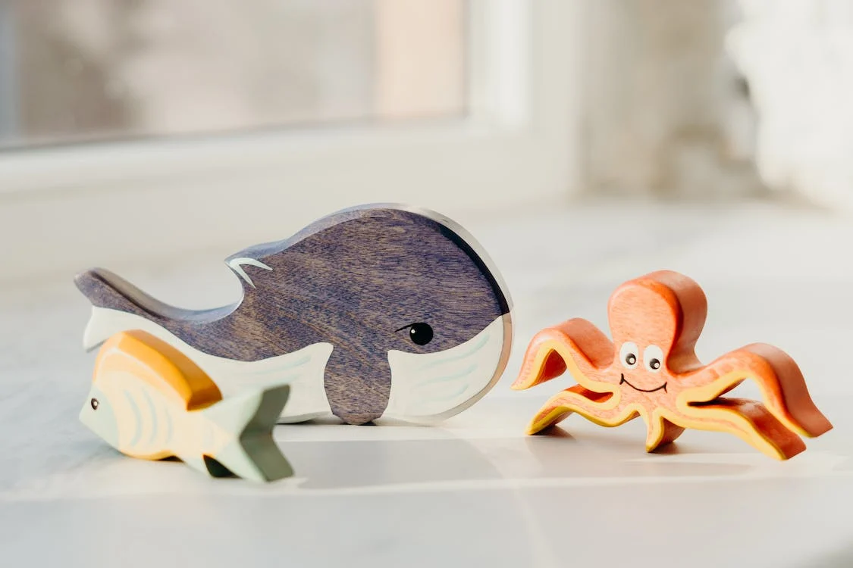
Resources
More Companies Are Looking to Hire Accessibility Specialists - WSJ
Indeed search returning 95k accessibility related jobs
WCAG Guidelines
World Wide Web Consortium (W3C)
The Top 6 Things Employees Want in Their Next Job
Where Accessibility Fits in an Organization - Decentralized vs Centralized Model
IAAP (International Association for Accessibility Professionals
DHS Trusted Tester
What a11y standards do I follow from a global perspective?
Assistive Technology Types
How to Hire Digital Accessibility Roles

