Slide 1
Going Further with EPUB
Accessing Higher Ground
Accessible Media, Web and Technology Conference
November 14-18, 2022

Slide 2
Summary
EPUB is the file format used globally in digital ebook publishing. It has been rapidly adopted for academic publications, not least for its extensive accessibility features and flexibility to support universal design for learning. This workshop will show library, faculty, and DSO colleagues how EPUBs are built on familiar web technologies. We will learn how to create, edit and check the accessibility of EPUB files.

Slide 3
Abstract
The EPUB format has many universal design and accessibility advantages, and there are millions of titles available from publishers. In this session, we will look inside EPUB files to demystify and understand the anatomy of the format. Attendees will learn how to create beautiful and accessible EPUBs using free tools, how to edit EPUBs, and how to check they are valid and accessible.
You will leave feeling confident about making your own EPUB files from your own or faculty content, and how to check whether a digital publication in the EPUB format is suitable for your learners.
Attendees that are new to EPUB might like to also consider registering for the companion session “Getting Started with EPUB”.

Slide 4
Keypoints
EPUB is the modern format for digital publishing with accessibility features that can benefit all learners.
Anyone can create beautiful and accessible EPUB publications that learners will love.
There are helpful tools to edit EPUB files, and check they are valid and accessible. And the tools are free.

Slide 5
Your Panel
Betsy Granger, Macmillan Learning
Charles LaPierre, Benetech
George Kerscher, DAISY Consortium
Richard Orme, DAISY Consortium

Slide 6
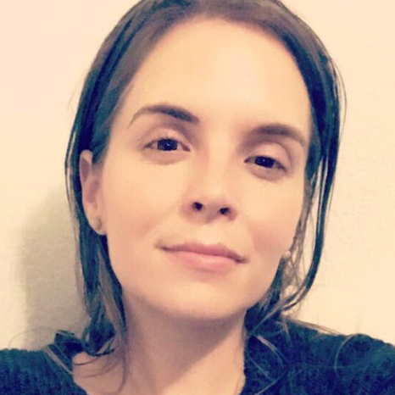
Introductions - Betsy
Betsy Grainger
Associate Director Content Standards
Macmillan Learning

Slide 7
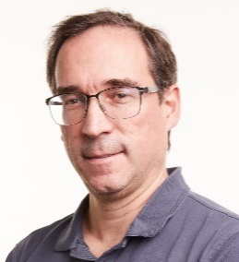
Introductions - Charles
Charles LaPierre
Technical Lead, Born Accessible Benetech

Slide 8
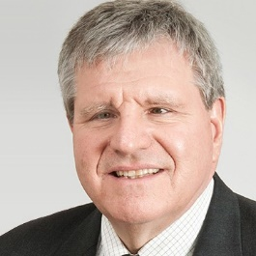
Introductions - George
George Kerscher
Chief Innovations Officer
DAISY Consortium

Slide 9
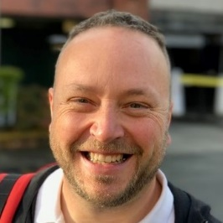
Introductions - Richard
Richard Orme
Chief Executive
DAISY Consortium

Slide 10
Overview
Inside EPUB
Editing EPUB
Validation and conformance checking
Make your own EPUB

Slide 11
Inside EPUB
Built from familiar modern web technologies, e.g.
HTML for content (using the XML syntax)
GIF, PNG, JPG, WebP for images
CSS for styling
MP3 for audio
Handily packaged in a zip container

Slide 12
Hands on #1
Browse to an EPUB on the local drive
Make a copy of the file
Ensure “File name extensions” is checked in the View tab
Rename the extension to .ZIP
Look inside and discover the different files
Select an XHTML file to view in the browser

Slide 13
Editing EPUB
More free software!
Cross platform, open-source editor for EPUB
Under active development
Some really useful plugins available
Not entirely accessible

Slide 14
Hands on #2
Browse to an EPUB on the local drive
Make a copy of the file
Open the file in Sigil

Slide 15
Validation and conformance checking
EPUBCheck – because for any format, an accessible file is a valid file
Ace – analogous to the Accessibility Checker in Word, plus extras
SMART – to guide manual checking
Human review – in reading apps

Slide 16
Hands on #3
Open EPUB-Checker
Select Open (ctrl + O) and browse to an EPUB on the local drive
Review the results

Slide 17
Make your own EPUB
Create accessible EPUBs using free tools:
Simplest – from word processor to EPUB
Cloud services – Hederis, Pressbooks
Advanced – InDesign EPUB export
Notes:
Pressbooks is based on WordPress. It has a free trial tier, then other tiers starting at $120 per annum
Hederis is a web based production system. The first project is free. After that, projects are $119 for EPUB or $199 for full typesetting. Volume discounts are available.

Slide 18
Hands on #5
Open Word
Open the demo file “Sinking of the Titanic”
Use the WordToEPUB tool to make an EPUB
Review the EPUB in a reading app

Slide 19
Contact information
www.daisy.org
www.inclusivepublishing.org
Betsy Granger- betsy.granger@macmillan.com
Charles LaPierre- charlesl@benetech.org
George Kerscher- gkerscher@daisy.org
Richard Orme – rorme@daisy.org

