Slide 1
Are we there yet? The developing state of mobile access equity
Salimah LaForce & Dara Bright
Salimah@cacp.gatech.edu
Center for Advanced Communications Policy
November 16, 2022

Slide 2
Research
Policy
Development
CACP is an R&D policy center at the Georgia Institute of Technology. We uphold our mission to study the interaction between people, policies and technology to assist in the development of equitable communications through inclusive design and applied policy research.
Our process:
Research • Accessible Product Development • Neutral Authority to Inform Policy

Slide 3
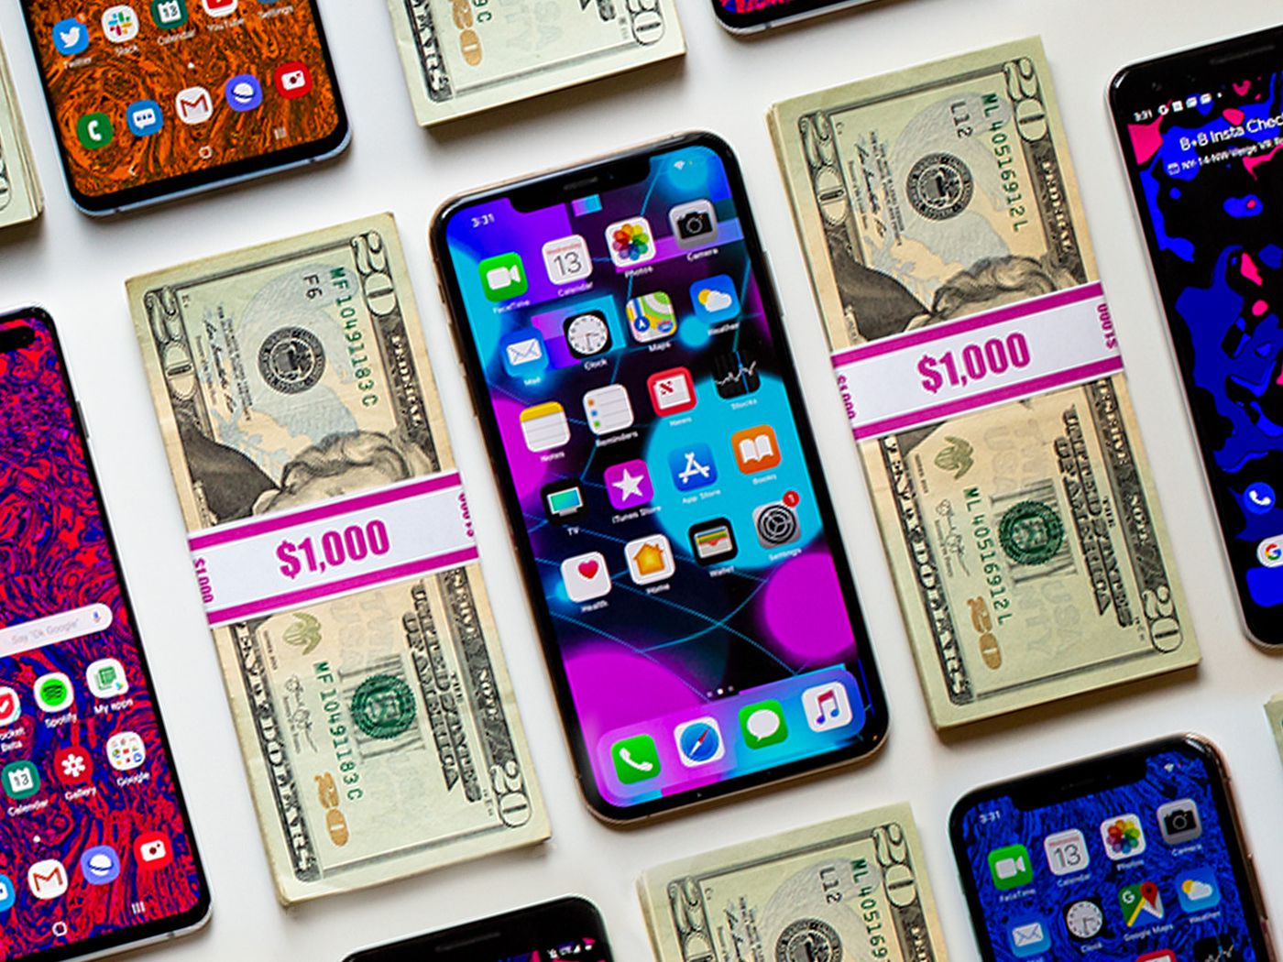
Introduction
25% of the U.S. Population is comprised of people with disabilities (Okoro et al., 2018)
With 511 USD Billion dollars in purchasing power (Shaewitz et al., 2018)
One in four person with disabilities is a potential customer
Consumers w/disabilities expect equitable choices when making purchases

Slide 4
Introduction
Enabling & Using Accessibility Features Can Be Challenging
Design
Touchscreen
Buttonless Devices
Light or Sound indicators
Accessibility
Limited functionality for persons with multiple disabilities
Usability
Impeding independent setup of devices
Inadequate support for maintaining access after upgrades
Inadequate support for interoperability with external AT
Impeding informed choices - inadequate information about device accessibility

Slide 5
Sociopolitical Context & the Role of Perception & Bias
Attitudinal Barriers
Assigning value to what issues are important
Determine who should be included
Mobile Tech Industry
Low representation of PwDs in design and engineering fields
=
Low levels of usability and utility for PwDs
Regulatory Response
Inclusion of PwDs in product research and development phases
=
Industry practice of built-in accessibility features at the front-end
Nothing About Us, Without Us

Slide 6
21st Century Communications & Video Accessibility Act
Codified Technology Access Rights for Persons with Disabilities
Biennial Assessment of Industry Compliance
Input, control, and mechanical functions should be locatable, identifiable, and operable:
Without:
Vision
Hearing
Speech
or Color perception
With limited:
Vision
Hearing
Color perception
Manual dexterity, reach and strength
Cognitive skills
With:
prosthetic devices” (FCC, 2020).

Slide 7
The Study
Inform the public policy and business practice concerning accessible advanced communications.
What is the current state of mobile phone accessibility?
Where has there been growth?
Where do gaps remain?
Methods – Biennial Reviews of Mobile Phone Accessibility
Top four carriers, One pre-paid carrier, Five Lifeline carriers
Sample sizes range from 141 – 215 mobile phones
54 features that impact accessibility assessed
Coded as either 1 = "yes," 0 = "no," or 2 = "information not available."
Sources
Mobile Manufacturers Forum Global Accessibility Reporting Initiative (GARI) database
User Manuals
Phonescoop.com

Slide 8
Study Limitations
Information Unavailable
For many of the features, information about whether it was included in the phone could not be found using three consumer-facing sources.
Sampling Method
Sample of Lifeline phones was predicated on publicly available information, instead of random selection

Slide 9
Results & Implications: Current State and Past Comparisons by Feature and Disability Type
Questions? Comments?

Slide 10
Accessibility Features A (90-100) | % | Accessibility Features B (80-89) | % | Accessibility Features C (70-79) | % | Accessibility Features D (60-69) | % | Accessibility Features F (<59) | %
Headphone Jack | 99% | Touch input | 89% | Biometric Log-in | 79% | FM radio | 61% | Flashlight Notification | 59%
Bluetooth | 99% | Battery Saver or Adaptive Battery Settings | 87% | Closed-captioning Support | 76% |  |  | Near Field Communications | 58%
Speaker-phone capable | 98% | Speech-to-text/Dictation | 87% | Configurable Audio | 76% |  |  | Voice Notes | 57%
GPS Capability | 97% | Supports Accessibility APIs | 87% | Mirror Link | 76% |  |  | Automatic Redial | 56%
Adjust Font | 96% | Text-to-speech | 87% | Real-time text | 75% |  |  | Automatic Answer or Any Key Answer | 51%
Alternative Biometrics | 96% | Dedicated/clearly distinguishable lock screen key | 86% | External Keyboard Support | 75% |  |  | Switch Control | 48%
USB | 95% | Dedicated/clearly distinguishable volume keys | 86% | Assistive Touch | 73% |  |  | Haptic Feedback | 42%
Speed Dial | 95% | Predictive Text Input | 86% | Hand Movement | 73% |  |  | Visual Indicators on Display | 41%
No Screen Timeout | 93% | Accessibility Menu | 85% | Screen reader | 72% |  |  | Easy Battery Placement | 39%
WEA-capable | 92% | Visual Indicators on Display | 85% | Two-way video | 71% |  |  | Anti-slip Features | 37%
Screen magnifier | 90% | Intelligent Personal (Digital) Assistant | 84% | External Switch / Pointer Support | 70% |  |  | Eye Tracking | 33%
 |  | Adjustable Vibration | 84% |  |  |  |  | Audible Cues | 31%
 |  | Emergency Services/Location | 83% |  |  |  |  | Braille Display Support | 25%
 |  | Simple Display | 83% |  |  |  |  | Physical keyboard/number pad | 15%
 |  | Gesture Based Navigation | 83%
 |  | Contrast Adjustment | 82%
 |  | Stylus/Prosthetic Device support | 82%

Slide 11
Longitudinal Comparison of Mobile Phone Accessibility (2015 – 2022)
Accessibility Features | 2015 | 2017 | 2019/20 | 2022
2 Way Video | 40% | 80% (↑40%) | 63% (↓17%) | 71% (↑ 8%)
Adjust Font | 70% | 95% (↑25%) | 95% | 96% (↑ 1%)
Braille Access | 27% | 44% (↑17%) | 36% (↓8%) | 25% (↓ 11%)
Built-in TTS | 75% | 89% (↑14%) | 82% (↓7%) | 87% (↑ 5%)
Contrast Adjustment | 35% | 83% (↑48%) | 72% (↓11%) | 82% (↑10%)
Full access screen reader | 3% | 53% (↑50%) | 62% (↑9%) | 72% (↑10%)
Physical # Keypad | 12% | 12% | 13% (↑1%) | 15% (↑2%)
Physical QWERTY | 26% | 3% (↓23%) | 6% (↑3%) | 15% (↑9%)
Procure TTS | 13% | 1% (↓12%) | 15% (↑14%) | ---
Simple Display | 47% | 63% (↑16%) | 40% (↓23%) | 83% (↑43%)
Touch Input | 81% | 88% (↑7%) | 93% (↑5%) | 89% (↓4%)
Vibration Adjustment | 40% | 53% (↑13%) | 75% (↑22%) | 84% (↑9%)
Voice Features | 90% | 93% (↑3%) | 93% | 87% (↓6%)

Slide 12
Comparison of Assistive Technology Connections (2019-2020) and 2022

Slide 13
Implications of Phone Feature Results
No, we are not there yet.
The ideal state has not been achieved.
Half to less than of the accessibility features were present on mobile devices.
Certain phone features are a requisite for effective use.
Having more than one disability makes identifying an appropriate mobile device more complex.
For the individual
For the organization providing such devices for use

Slide 14
Accessibility Features for Visual Disabilities (2022)

Slide 15
Changes in Accessibility Features Supporting Visual Disabilities

Slide 16
Implications of Visual Disability Feature Results
These results indicate that people who utilize braille readers have limited options when selecting a mobile phone.
Differential access based on disability type is the antithesis of equitable access.
Within the visual disability community there is a wide range of access needs.

Slide 17
Accessibility Features for Hearing Disabilities

Slide 18
Differential of Accessibility Features for Hearing Disabilities between 2019-2020 and 2022

Slide 19
Hearing Aid Compatibility

Slide 20
Comparison of Smartphone and Non-Smartphone HAC Ratings

Slide 21
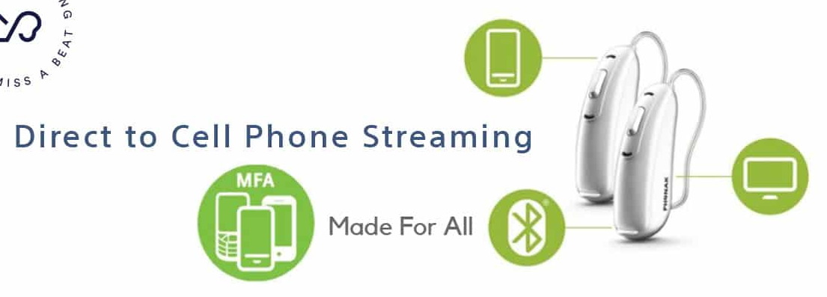
Implications of Hearing Disability Feature Results
The HAC ratings are likely impacted by advances in the hearing aid industry.

Slide 22
Accessibility Features for Cognitive Disabilities (2022)

Slide 23
Differentials of Accessibility Features for Cognitive Disabilities between 2019-2020 and 2022
Accessibility Features Supporting People with Cognitive Disabilities | Percent Increase Since 2019-2020
Simple display | 49
Intelligent Personal Assistant | 21
Contrast Adjustment | 18
Screen reader | 15
Built-in TTS | 11
Adjust Font | 7
Accessibility Menu | 6
Accessibility Features Supporting People with Cognitive Disabilities | Percent Decreases/No Change Since 2019-2020
Speech-to-text/Dictation | 0
Biometric Log-In | -1

Slide 24
Implications of Cognitive Disability Feature Results
Availability of features are on the rise for
Ease of call taking/making (auto answer/ any key answer, speed dial, and auto redial)
Ease of navigation (distinguishable home button)
Shorter word counts per line (adjust font)
Auditory information processing (TTS and screen reader)
Removal of distracting stimuli (simple display)
Readability (contrast adjustment)
Limiting dependence on typing (voice input, digital assistants, predictive text)
Limiting dependency on memory (biometric log-in).

Slide 25
Accessibility Features for Mobility Disabilities (2022)

Slide 26
Differential Accessibility Features for Mobility Disabilities between 2019-2020 and 2022

Slide 27
Implications of Mobility Disability Feature Results
Manufacturers should be encouraged to “up their game” when it comes to more complex access needs.
People should not have to sacrifice one feature for another when both are needed and wanted.

Slide 28
Results & Implications: Current State and Past Comparisons by Phone Type and Provider Type
Questions? Comments?

Slide 29
Provider Type: Tier 1 Phones and Lifeline Phones

Slide 30
Phone Type: Smartphones Compared to Non-smartphones
Steepest Point Differential between Smartphone and Non-Smartphone Features (2022)
Features | Percentage Point Differential
Simple display | 80 points
Stylus or Prosthetic Device support | 79 points
Speech-to-text/Dictation | 78 points
Text-to-speech | 78 points
Visual Indicators on Display (other notifications) | 76 points
Adjustable Vibration | 74 points
Mirror Link | 73 points
External Keyboard Support | 71 points
screen magnifier | 68 points
Emergency Services & Location | 60 points
External Switch / Pointer Support | 59 points
Intelligent Personal Assistant | 55 points
GPS Capability | 29 points
Speed Dial | 27 points

Slide 31
Implications of Provider and Phone Type Results
Lower levels of accessibility features in Lifeline provided phones affects individuals with disabilities from economically disadvantaged backgrounds.
The 2022 trend of advanced non-smartphone capabilities improves access for persons who desire or require more durable tactile features.

Slide 32
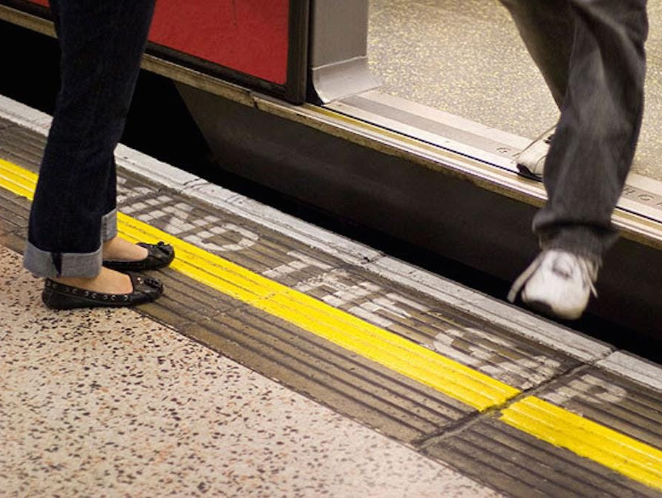
Conclusion
We are on the way to mobile access equity!
But mind the gaps.
Especially when integrating mobile technology into the classroom or workplace.
The GARI Database - https://www.gari.info/

Slide 33
Contact & Connect
Technology Access, Equity, and Inclusion
Salimah LaForce
salimah@cacp.gatech.edu
Dara Bright
Dara@cacp.gatech.edu
Center for Advanced Communications Policy
https://cacp.gatech.edu/
@CACPGT_Access
TechAccessEquity
Accessible Technology Policy Group

